Slide 1
EOG Review: Similar Figures
Warm Up: IXL (1-10)
Review Lesson: Similar Figures
  Practice Problems: Similar Figures(11-15)\
  Indirect Measurement (16-19)
Showdown Cards (20-30)
Assessment- Quia Quiz

Slide 2
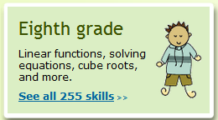
Warm-Up IXL #1-10
Go to IXL Complete 10 Problems H.6
Practice >> Eighth grade >> Ratios and proportions: Do the ratios form a proportion?
Write the Problems and answers in boxes 1-10.

Slide 3
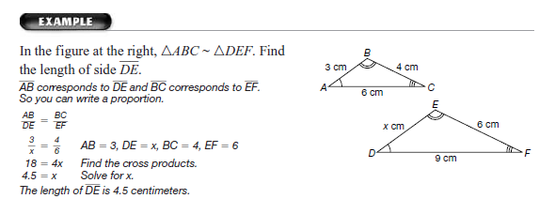

Slide 4
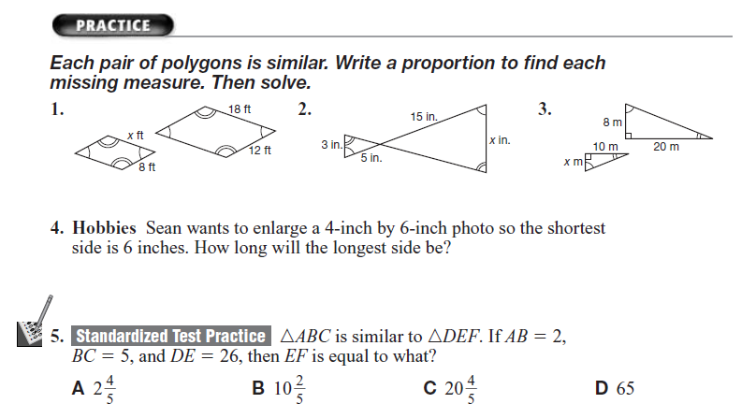
Practice – Boxes 11-15
11
12
13
14
15

Slide 5

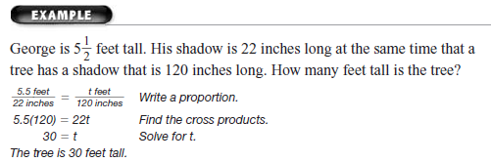
Indirect Measurement

Slide 6
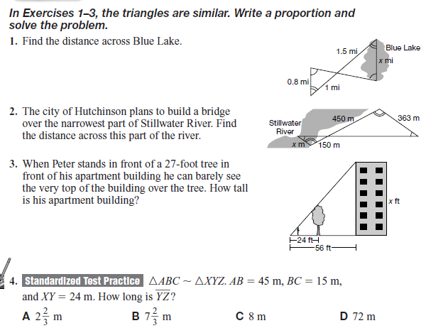
16
17
18
19

Slide 7
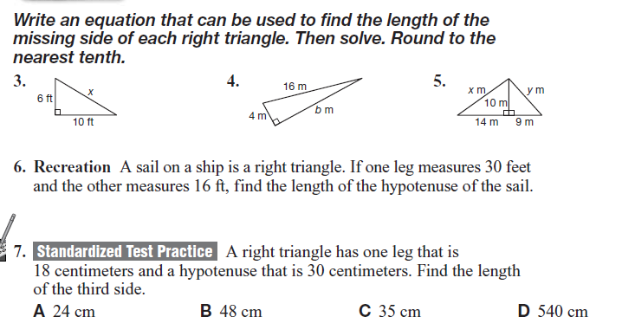
Mixed Review BIG Ideas (19-23) Pythagorean
21
22
20
23
24

Slide 8
Showdown Cards-
Stack the cards facing up in the center of the team(answers on the back).
The leader reads the first question.
Without talking every including the leader writes the answer to the question on dry erase board.
Place boards face down when finished.
The leader says :showdown
Flip over the board and show the answers. The leader turns the task card over to check. Discuss answers that are different and celebrate correct answers.
If everyone had the correct answer, remove the card for the deck. If not, place it at the bottom to repeat later.
Rotate Leaders in clockwise fashion for each round. Repeat as time allows.

Slide 9

Assessment
Firstlastname572
Math
Please Log on to your QUIA Page
Complete the Quiz For
Goal 2:
Similar Figures
Make Sure You Complete Quiz with 80% Accuracy

