Slide 1
Exponential Growth and Decay
Lesson 8.8
Lesson Objectives
Model exponential growth
Model exponential decay

Slide 2

Another Exponential Function Story

Slide 3
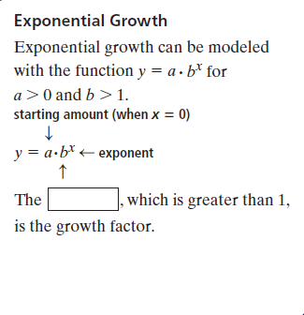
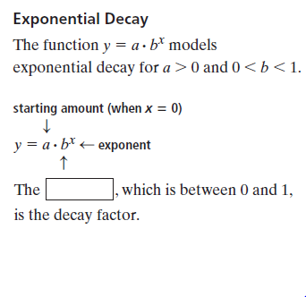
Exponential Growth and Decay
Exponential Growth
Exponential Decay

Slide 4
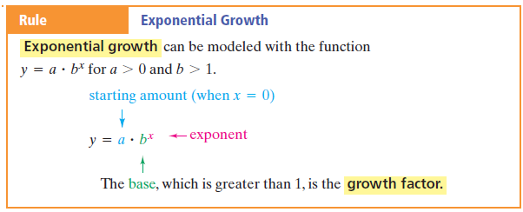

Slide 5
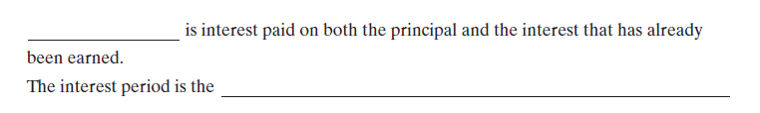
Exponential Growth: Compound Interest

Slide 6
Compounding Interest
What is Compound Interest?
Compound Interest

Slide 7
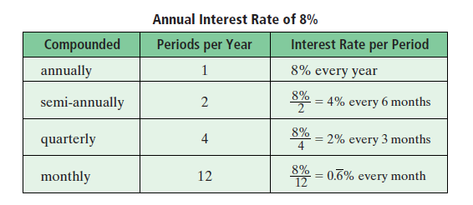

Slide 8
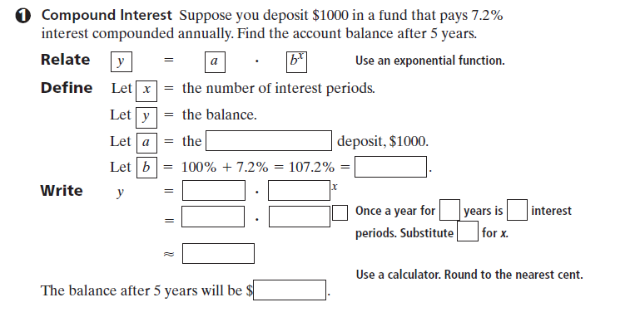
Exponential Growth: Compound Interest

Slide 9
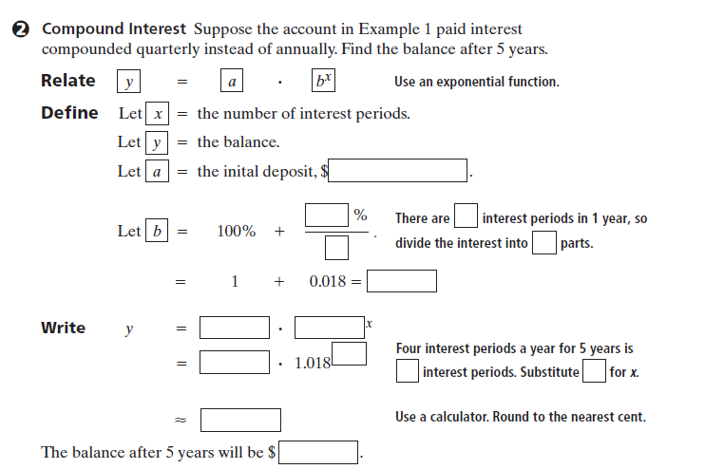
Compound Interest

Slide 10
Guided Practice
Population Growth
Since 1990, the population of Virginia has grown at
an average annual rate of about 1%. In 1990, the population was about
6,284,000.
a. Write an equation to model the population growth in Virginia since 1990.
b. Suppose this rate of growth continues. Predict Virginia’s population in 2010.
8-8 • Guided Problem Solving
GPS Student Page 481, Exercise 47

Slide 11
Read and Understand
Since 1990, the population of Virginia has grown at
an average annual rate of about 1%. In 1990, the population was about
6,284,000
1. What is the annual growth rate of Virginia’s population?
2. What was the population in 1990?
3. What are you asked to find?

Slide 12
Plan and Solve
Since 1990, the population of Virginia has grown at
an average annual rate of about 1%. In 1990, the population was about
6,284,000
4. In the equation y a bx modeling the situation, what is a, the starting amount?
5. What is b, the growth factor? (Hint: It is not 0.01.)
6. Write the equation that models the situation.What does x represent?
7. What is x in 2010?
8. Use the equation to predict the population of Virginia in 2010.

Slide 13
Look Back and Check
Since 1990, the population of Virginia has grown at
an average annual rate of about 1%. In 1990, the population was about
6,284,000
9. Does the population increase over 20 years seem reasonable?

Slide 14
Exponential Decay
Car depreciates in value
An endangered species is disappearing

Slide 15
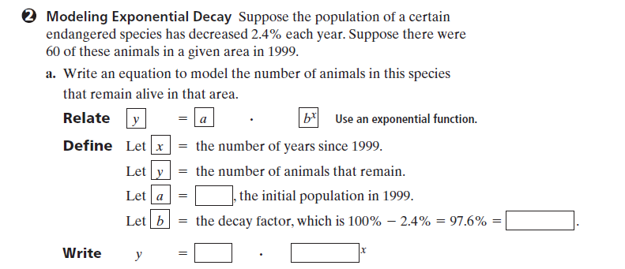
EXPONENTIAL DECAY
Notes:
Definitions
Exponential Decay: An original amount is reduced by a consistent rate over a period of time.
Original Amount: The amount before the decay occurs.
Formula: y = a(1 -b)^{x}
y: Final amount remaining after the decay over a period of time
a: The original amount
b: The decay factor
x: Time

Slide 16
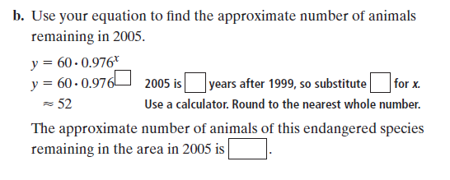
Exponential Decay

Slide 17
HW: Practice Page 8.8
Practice 8-8 Exponential Growth and Decay
Write an exponential function to model each situation. Find each amount after the specified time.
1. Suppose one of your ancestors invested $500 in 1800 in an account
paying 4% interest compounded annually. Find the account balance in
each of the following years.
1850 b. 1900 c. 2000 d. 2100
2. Suppose you invest $1500 in an account paying 4.75% annual interest.
Find the account balance after 25 yr with the interest compounded the
following ways.
annually b. semiannually c. quarterly d. monthly

Slide 18
HW: Practice Page 8.8
3. The starting salary for a new employee is $25,000.The salary for this
employee increases by 8% per year.What is the salary after each of the
following?
a. 1 yr b. 3 yr c. 5 yr d. 15 yr
4. Carbon-14 has a half-life of 5,700 years. Scientists use this fact to
determine the age of things made of organic material. Suppose the
average page of a book containing approximately 0.5 mg of carbon-14 is
put into a time capsule. How much carbon-14 will each page contain
after each of the following numbers of years?
a. 5700 b. 11,400 c. 22,800 d. 34,200
5. The tax revenue that a small city receives increases by 3.5% per year. In
1990, the city received $250,000 in tax revenue. Determine the tax
revenue in each of the following years.
a. 1995 b. 1998 c. 2000 d. 2006

Slide 19
6. Suppose the acreage of forest is decreasing by 2% per year because of
development. If there are currently 4,500,000 acres of forest, determine
the amount of forest land after each of the following.
a. 3 yr b. 5 yr c. 10 yr d. 20 yr
7. A $10,500 investment has a 15% loss each year. Determine the value of
the investment after each of the following.
1 yr b. 2 yr c. 4 yr d. 10 yr
8. A city of 2,950,000 people has a 2.5% annual decrease in population.
Determine the city’s population after each of the following.
a. 1 yr b. 5 yr c. 15 yr d. 25 yr
9. A $25,000 purchase decreases 12% in value per year. Determine the
value of the purchase after each of the following.
a. 1 yr b. 3 yr c. 5 yr d. 7 yr

Slide 20
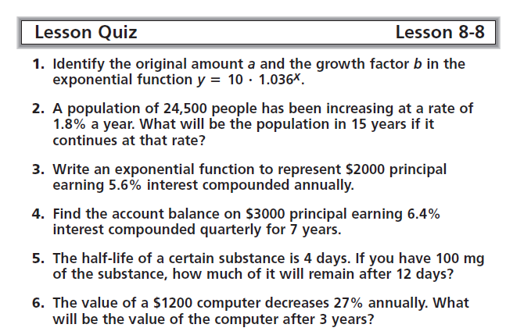
8.8 Quiz

