Slide 1
Indirect measurement Problems
Use a mixed Practice Answer sheet.
Write a proportion and solve for the missing side

Slide 2
PROBLEM SOLVING SKILLS: INDIRECT MEASUREMENT
An indirect measurement is one in which a measure is calculated using other measures.
This is useful when it is difficult to make the necessary measurement.
Properties of similar triangles can be used to calculate
some indirect measurements.

Slide 3
Definitions
Using proportions to find a measurement is called indirect measurement.
Using Indirect Measurement
  Use the corresponding parts of similar triangles to write a proportion.
  Solve the proportion to find the missing measurement.

Slide 4

Lesson Example
George is 5 1/2 feet tall. His shadow is 22 inches long at the same time that a
tree has a shadow that is 120 inches long. How many feet tall is the tree?
Write a proportion. Small
5.5 feet 22 inches
Big
Divide
=
Tree Height
120 inches
Cross Multiply
5.5 * 120=22*T

Slide 5

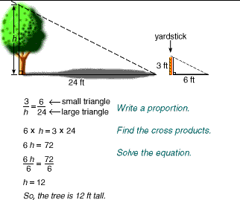
Lesson Review and Practice
Practice Exercises
http://youtu.be/LhEe0kB4QIs
Start the Practice Problems
Video lesson

Slide 6

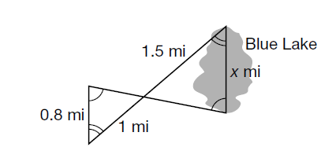
1. Write a proportion and solve for the missing measurement.

Slide 7
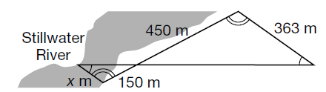
2. Write a proportion and solve for the missing measurement
The city of Hutchinson plans to build a bridge
over the narrowest part of Stillwater River. Find
the distance across this part of the river.

Slide 8
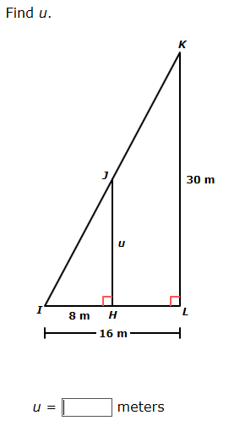
3. Write a proportion and solve for the missing side

Slide 9
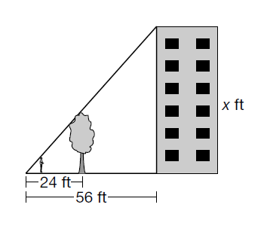
4. Write a proportion and solve for the missing side
When Peter stands in front of a 27-foot tree in
front of his apartment building he can barely see
the very top of the building over the tree. How tall
is his apartment building?

Slide 10
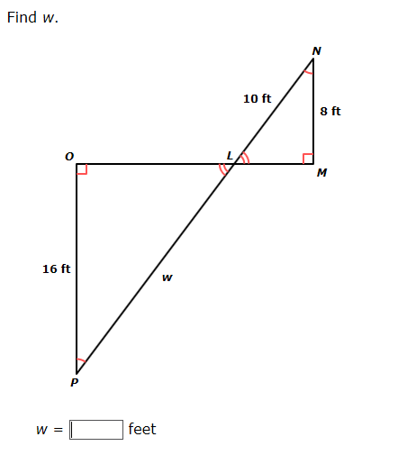
5. Write a proportion and solve for the missing side

Slide 11
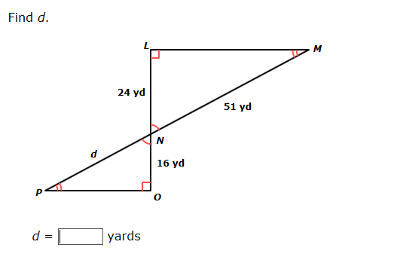
6. Write a proportion and solve for the missing side

Slide 12
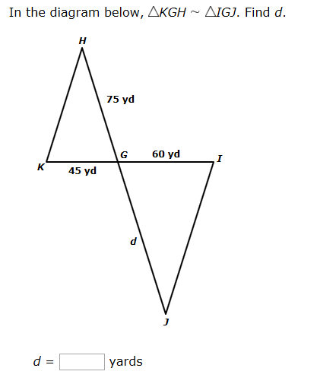
7. Write a proportion and solve for the missing side

Slide 13
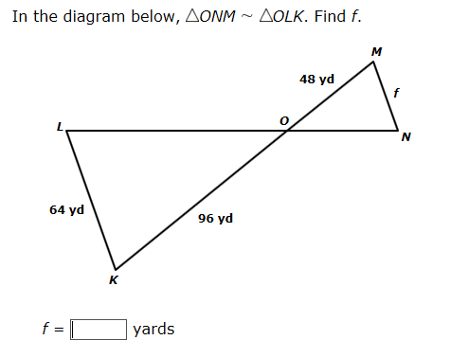
8. Write a proportion and solve for the missing side

Slide 14
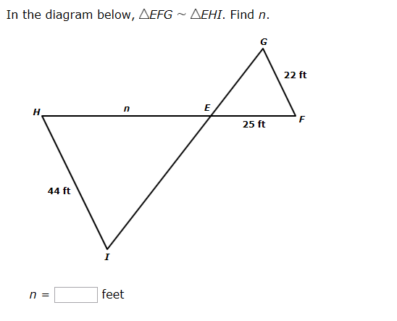
9. Write a proportion and solve for the missing side

Slide 15
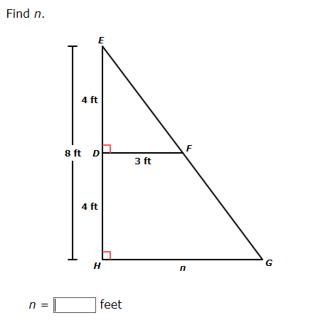
10. Write a proportion and solve for the missing side

Slide 16
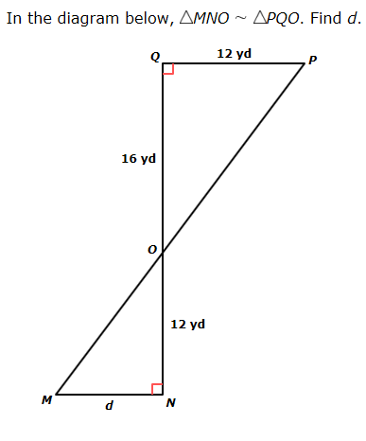
11. Write a proportion and solve for the missing side

Slide 17
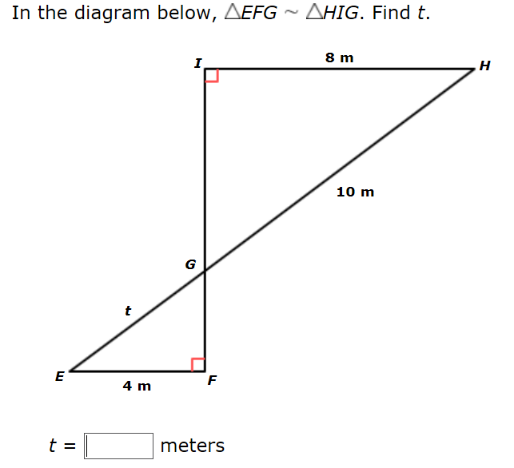
12. Write a proportion and solve for the missing side

Slide 18
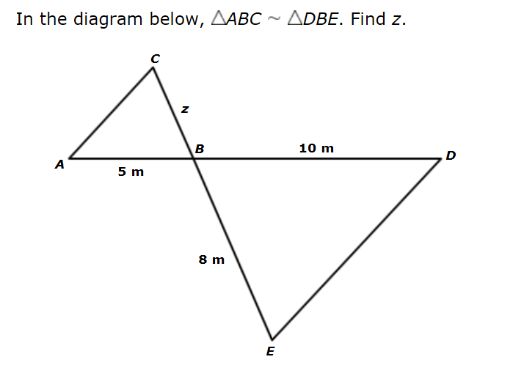
13. Write a proportion and solve for the missing side

Slide 19
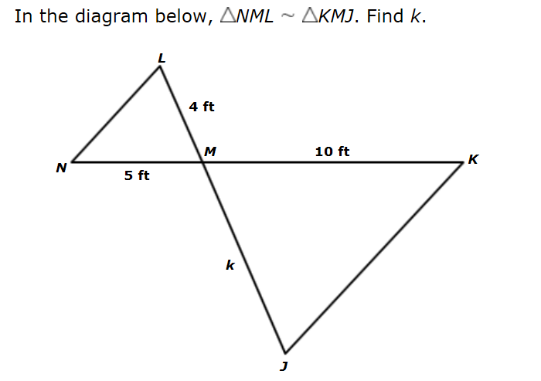
14. Write a proportion and solve for the missing side

Slide 20
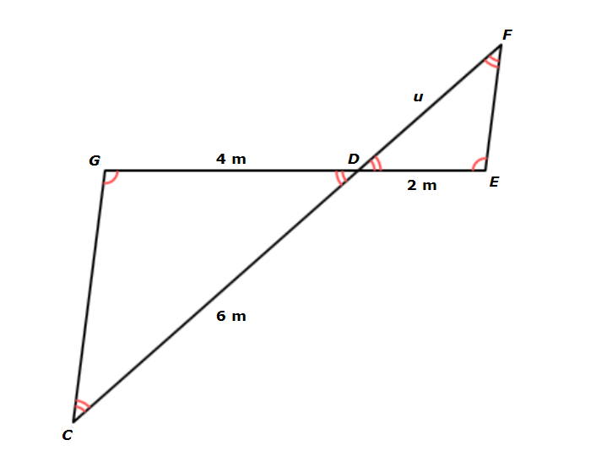
15. Write a proportion and solve for the missing side

Slide 21
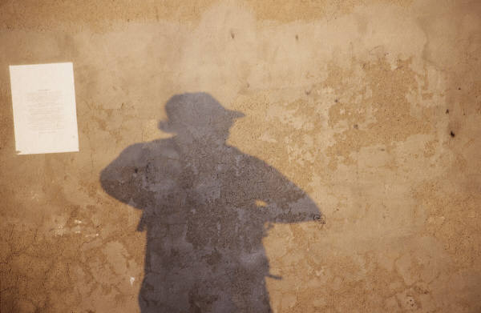
16. Write a proportion and solve for the missing measurement
HEIGHT
Paco is 6 feet tall and casts a
12-foot shadow. At the same time,
Diane casts an 11-foot shadow. How tall
is Diane?

Slide 22
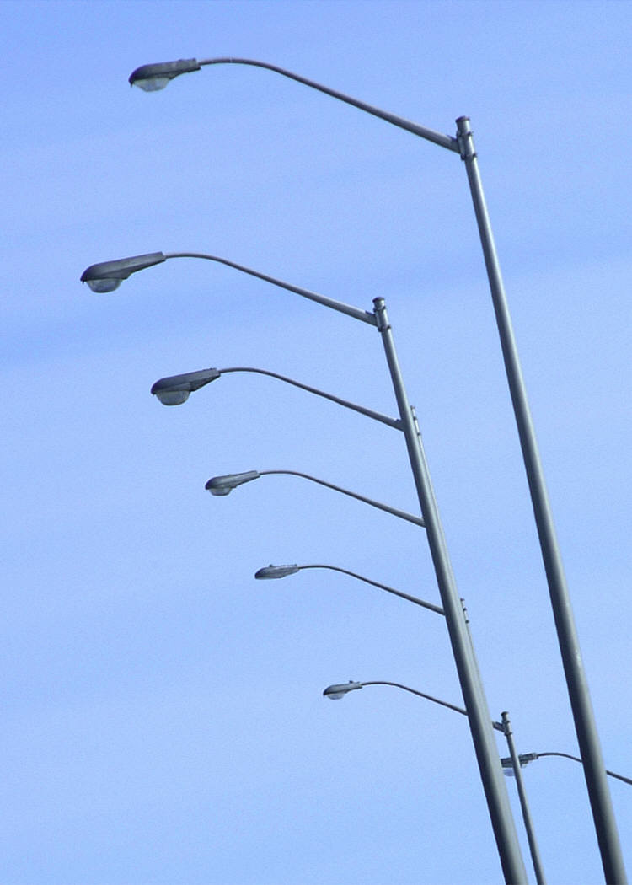
17. Write a proportion and solve for the missing measurement
LIGHTING
If a 25-foot-tall house casts a
75-foot shadow at the same time that a
streetlight casts a 60-foot shadow, how
tall is the streetlight?

Slide 23

18. Write a proportion and solve for the missing measurement
FLAGPOLE
Lena is 5 ½ feet tall and casts
an 8-foot shadow. At the same time, a
flagpole casts a 48-foot shadow. How
tall is the flagpole?

Slide 24
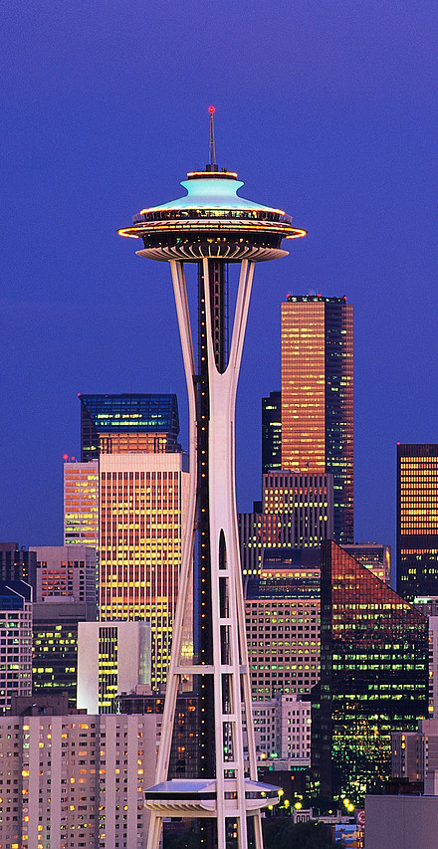
19. Write a proportion and solve for the missing measurement
LANDMARKS
A woman who is 5 feet
5 inches tall is standing near the
Space Needle in Seattle, Washington.
She casts a 13-inch shadow at the same
time that the Space Needle casts a
121-foot shadow. How tall is the Space
Needle?

Slide 25
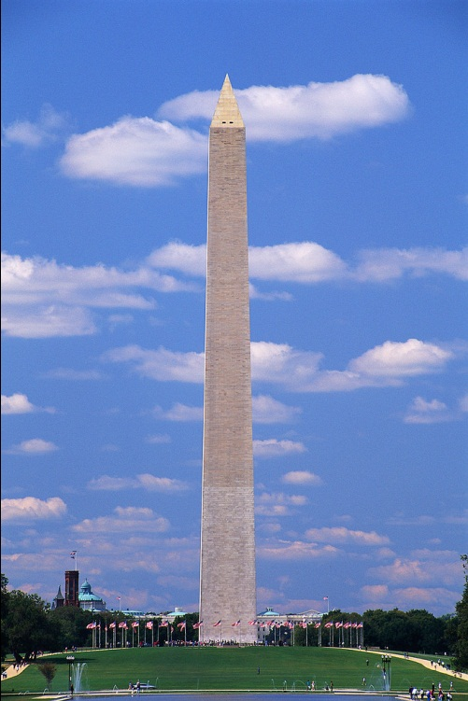
20.
NATIONAL MONUMENTS
A 42-foot flagpole near the Washington
Monument casts a shadow that is
14 feet long. At the same time, the
Washington Monument casts a shadow
that is 185 feet long. How tall is the
Washington Monument?

Slide 26
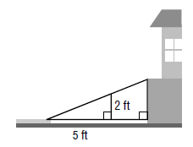
21.
ACCESSIBILITY
A ramp slopes upward
from the sidewalk to the entrance of a
building at a constant incline. If the
ramp is 2 feet high when it is 5 feet
from the sidewalk, how high is the
ramp when it is 7 feet from the
sidewalk?

Slide 27
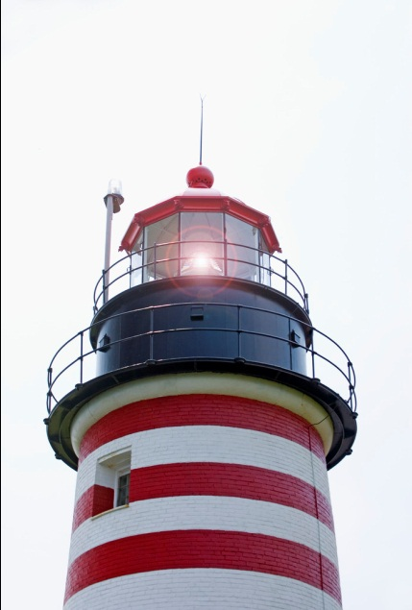
22.
A lighthouse casts a shadow 25 ft long. A 5-ft person standing next to the building
casts a 2-ft shadow. How tall is the lighthouse?

Slide 28

23.
A 200-cm clothesline pole casts a 300-cm shadow. A garbage can next to the
clothesline casts a 105-cm shadow. How tall is the garbage can?

Slide 29
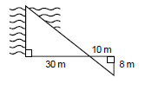
24.
Find the width of the river.

Slide 30
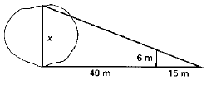
25.
Find the width of the lake

Slide 31
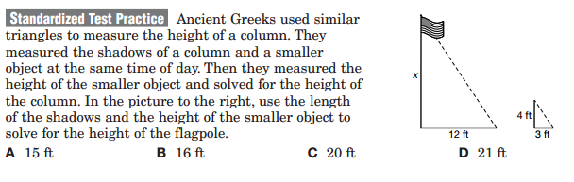
26.

Slide 32
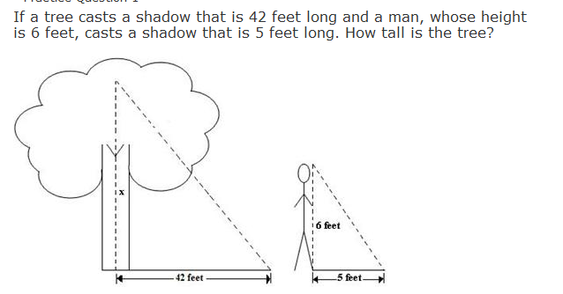
27.

Slide 33
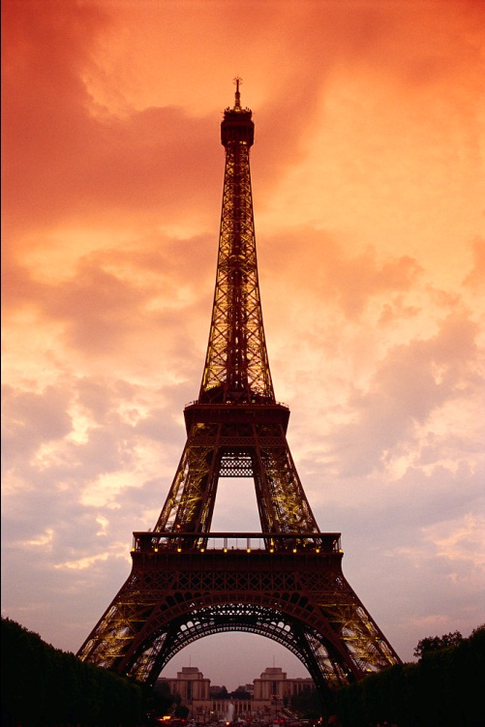
28.
If a 6 foot tall man stands next to the Eiffel Tower and casts a 2 foot shadow, what would the height of the Tower be if its shadow is 328 feet?

Slide 34

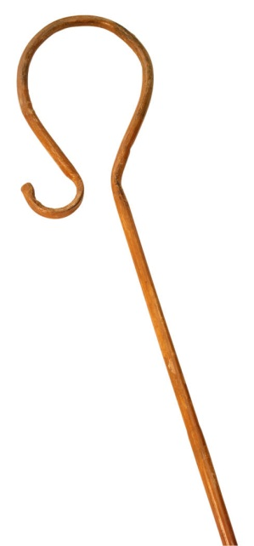
29.
A staff's shadow is 8 feet and a tree's shadow is 16 feet. If the staff is 9 feet tall, how tall is the tree?

Slide 35
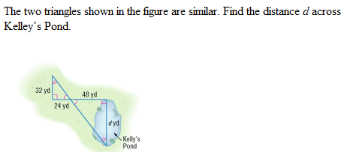
30.

Slide 36


