Slide 1
Factoring Trinomials of the Type x² + bx + c
Use this lesson and activities to factoring!
Chapter 9. Lesson 5

Slide 2
Lesson Goals
What You'll Learn
To factor trinomials
… And Why
To factor trinomials like h² − 4hk − 77k²

Slide 3

Notice that the coefficient of the middle term 8x is the sum of 3 and 5. Also the constant term 15 is the product of 3 and 5.
To factor a trinomial of the form x² + bx + c, you must find two numbers that have a sum of b and a product of c.

Slide 4
Take a Closer Look:
Factoring x² + bx + c
Factor x² + 7x + 12.
Find the factors of 12. Identify the pair that has a sum of 7.
Factors of 12 | Sum of Factors
 | 13
 | 8
 | 7
1 and 12
2 and 6
3 and 4
Answer:
x² + 7x + 12 = (x + 3)(x + 4).

Slide 5
Check for Understanding
1a. Factor g ² + 7g + 10.
a. | (g + 1)(g + 10)
b. | (g + 7)(g + 1)
c. | (g + 7)(g + 10)
d. | (g + 2)(g + 5)

Slide 6
Factor v ² + 21v + 20.
a. | (v + 4)(v + 5)
b. | (v + 20)(v + 1)
c. | (v + 2)(v + 10)
d. | (v + 21)(v + 1)

Slide 7
Factor a ² + 13a + 30.
a. | (a + 5)(a + 6)
b. | (a + 13) (a + 1)
c. | (a + 3)(a + 10)
d. | (a + 1)(a + 30)

Slide 8
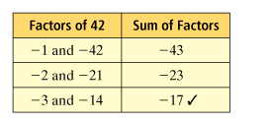
Factoring x² − bx + c
Factor d² − 17d + 42.
Since the middle term is negative, find the negative factors of 42. Identify the pair that has a sum of −17.
d² − 17d + 42 = (d − 3)(d − 14)

Slide 9
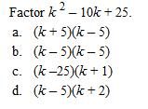

Slide 10
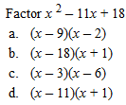

Slide 11
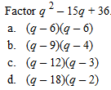

Slide 12
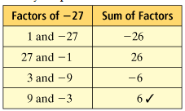
Factor m² + 6m − 27.
Identify the pair of factors of −27 that has a sum of 6.
m² + 6m − 27 = (m − 3)(m + 9)

Slide 13
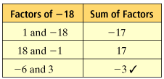
Factor p² − 3p − 18.
Identify the pair of factors of −18 that has a sum of −3.
p² − 3p − 18 = (p + 3)(p − 6)

Slide 14
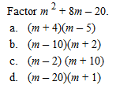

Slide 15
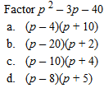

Slide 16
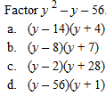

Slide 17
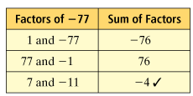
Factoring Trinomials With Two Variables
Factor h² − 4hk − 77k².
Find the factors of −77. Identify the pair that has a sum of −4.
h² − 4hk − 77k² = (h + 7k)(h − 11k)

Slide 18
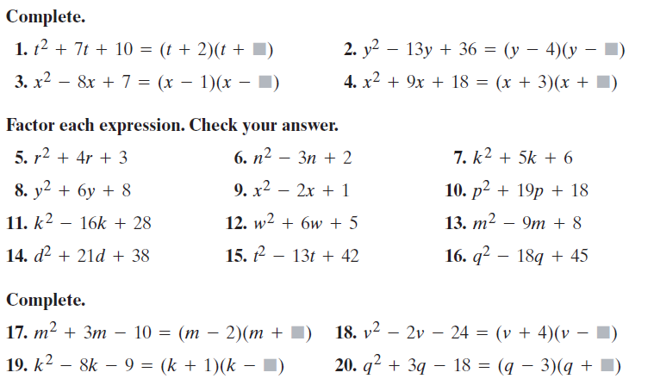
Textbook Practice

Slide 19
Lesson Assessment: Self Practice
  Complete the self-checking quiz. Use paper or a white board to work out your problems. Use your favorite method.
Multiplying Binomials- Regents – go to URL
  http://www.regentsprep.org/Regents/math/ALGEBRA/AV3/BinJava.htm

