Slide 1
Factoring Trinomials of the Type x² + bx + c
Use this lesson and activities to factoring!
Chapter 9. Lesson 5
Day 2

Slide 2
Lesson Goals
Yesterday you were introduced to factoring trinomials.
… And Why
To factor trinomials today we will look at the box method for factoring
We will practice more examples of factoring.

Slide 3
Take a Closer Look:
Factoring x² + bx + c
Factor x² + 7x + 12.
Find the factors of 12. Identify the pair that has a sum of 7.
Factors of 12 | Sum of Factors
 | 13
 | 8
 | 7
1 and 12
2 and 6
3 and 4
Answer:
x² + 7x + 12 = (x + 3)(x + 4).

Slide 4
Check for Understanding
1a. Factor g ² + 7g + 10.
Review
a. | (g + 1)(g + 10)
b. | (g + 7)(g + 1)
c. | (g + 7)(g + 10)
d. | (g + 2)(g + 5)

Slide 5
Factor v ² + 21v + 20.
a. | (v + 4)(v + 5)
b. | (v + 20)(v + 1)
c. | (v + 2)(v + 10)
d. | (v + 21)(v + 1)
Review

Slide 6
Factor a ² + 13a + 30.
a. | (a + 5)(a + 6)
b. | (a + 13) (a + 1)
c. | (a + 3)(a + 10)
d. | (a + 1)(a + 30)
Review

Slide 7
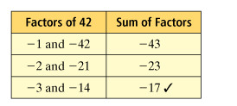
Factoring x² − bx + c
Factor d² − 17d + 42.
Since the middle term is negative, find the negative factors of 42. Identify the pair that has a sum of −17.
d² − 17d + 42 = (d − 3)(d − 14)

Slide 8
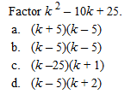
Review

Slide 9
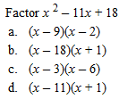
Review

Slide 10
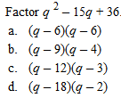
Review

Slide 11

Look Closer- Look at the Signs
You have to pay attention to the signs!
  x² + bx + c (__+__) (__+__)
  x² − bx + c (__-__) (__-__)
  x² − bx – c (__-__) (__+__)
  Knowing the signs will help you decide how to set up the factors.

Slide 12
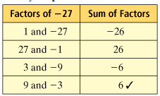
Factor m² + 6m − 27.
Identify the pair of factors of −27 that has a sum of 6.
m² + 6m − 27 = (m − 3)(m + 9)

Slide 13
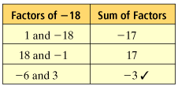
Factor p² − 3p − 18.
Identify the pair of factors of −18 that has a sum of −3.
p² − 3p − 18 = (p + 3)(p − 6)

Slide 14
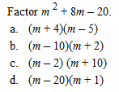

Slide 15
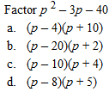

Slide 16
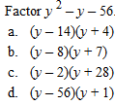

Slide 17
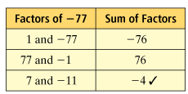
Factoring Trinomials With Two Variables
Factor h² − 4hk − 77k².
Find the factors of −77. Identify the pair that has a sum of −4.
h² − 4hk − 77k² = (h + 7k)(h − 11k)

Slide 18
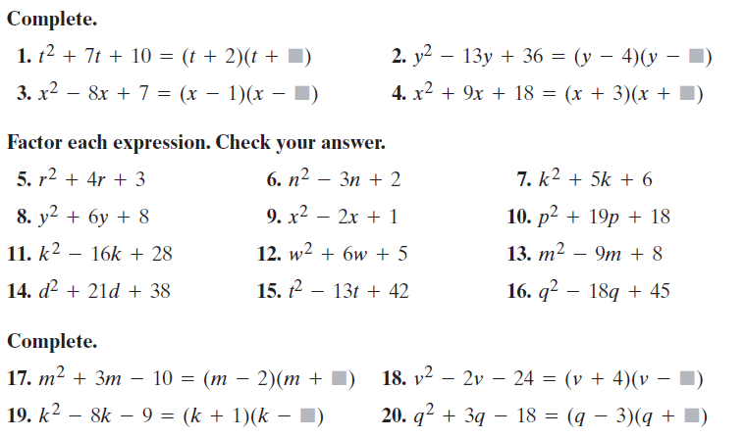
Textbook Practice Day 1

Slide 19
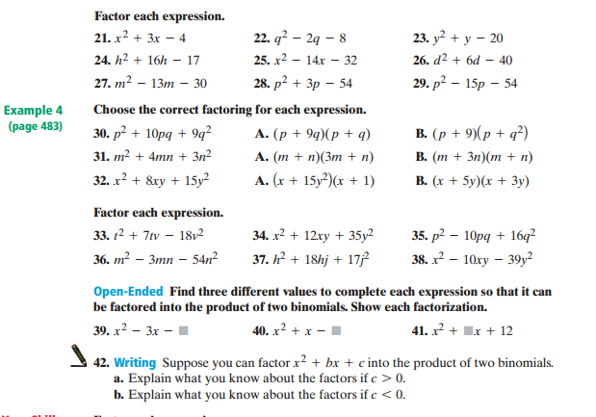
Day Two Textbook Problems

Slide 20
Lesson Assessment: Self Practice
  Practice Activity Quia Factoring:
  http://www.quia.com/rr/36611.html
  Try Some College Work:
  http://www.mccc.edu/~kelld/factoring/factoring.htm
  Practice and Check:
  http://www.algebrahelp.com/worksheets/view/factoring/trinomial.quiz

