Slide 1
Scatter Plots and Line of Best Fit
Lessons and Practice

Slide 2
Lesson Goals
Data Analysis and Probability Goal:
The learner will understand and use graphs and data analysis.
Objectives:
4.01 Collect, organize, analyze, and display data (including scatterplots) to solve problems.
4.02 Approximate a line of best fit for a given scatterplot; explain the meaning of the line as it relates to the problem and make predictions.

Slide 3
What is a scatter plot?
Scatter plots are similar to line graphs in that they use horizontal and vertical axes to plot data points.
However, they have a very specific purpose.
Scatter plots show how much one variable is affected by another. The relationship between two variables is called their correlation.

Slide 4

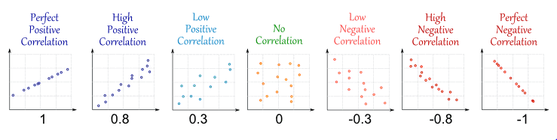
What is a Correlation?
Correlation is Positive when the values increase together, and
Correlation is Negative when one value decreases as the other increases

Slide 5
Activity Cards: Correlation Match
Directions:
Make three columns, Sort the Card into categories.
Positive, Negative, No Correlation.

Slide 6
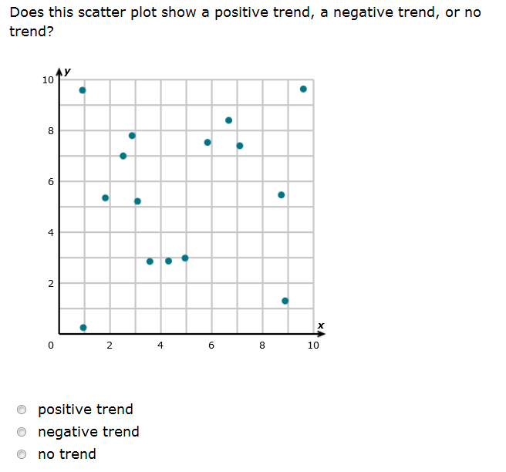
What’s the Trend?

Slide 7
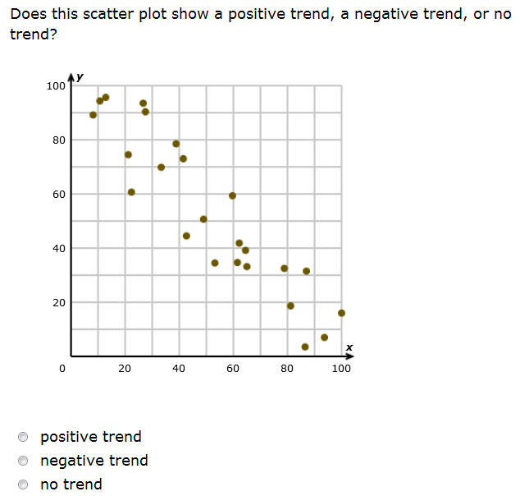
What’s the Trend?

Slide 8
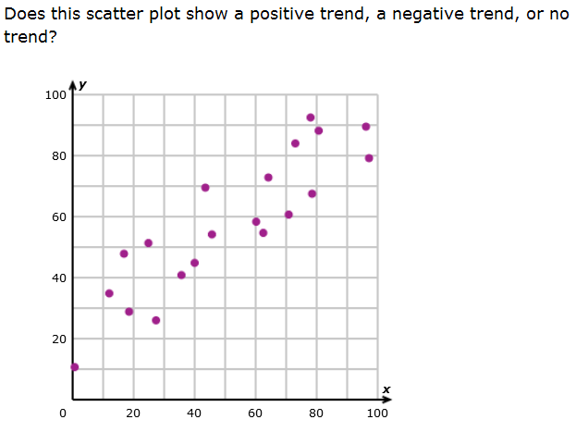
What’s the Trend?

Slide 9
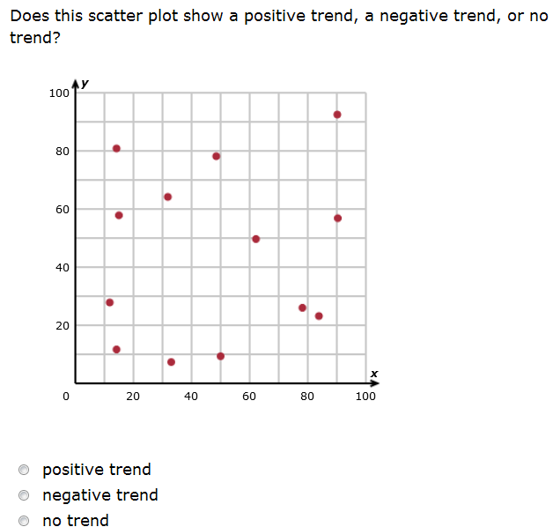
What’s the trend?

Slide 10

What is correlation?

Slide 11
What are Independent Variables?
Sometimes when creating a scatter plot there is a dependent and independent variable.
(Independent variable) causes a change in (Dependent Variable) and it isn't possible that (Dependent Variable) could cause a change in (Independent Variable).

Slide 12
Question 1

Slide 13
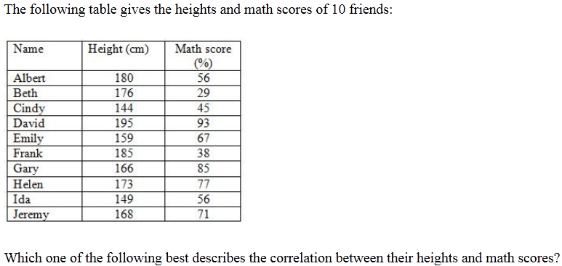
Question 2

Slide 14
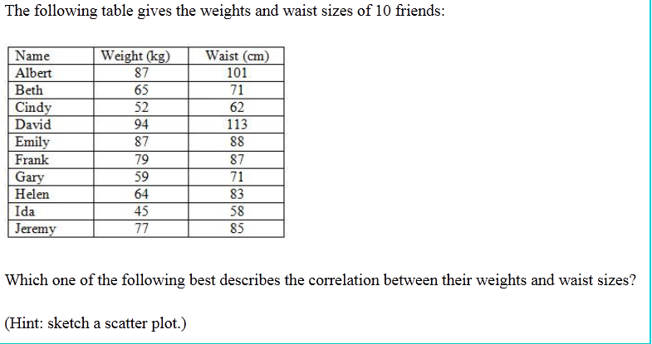
Question 3

Slide 15
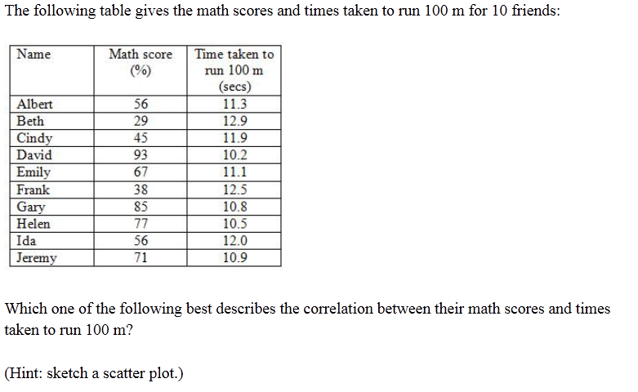
Question 4

Slide 16
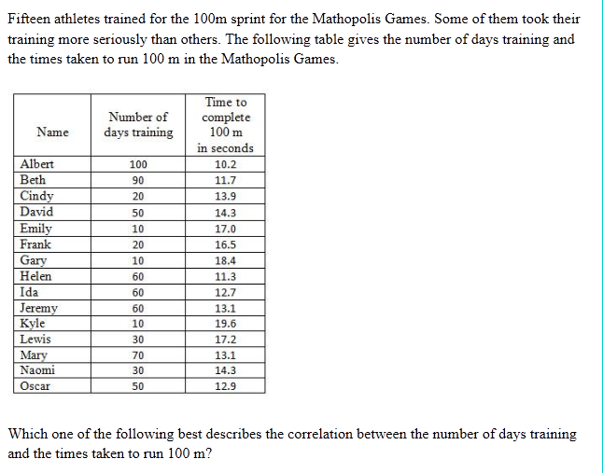
Question 5

Slide 17
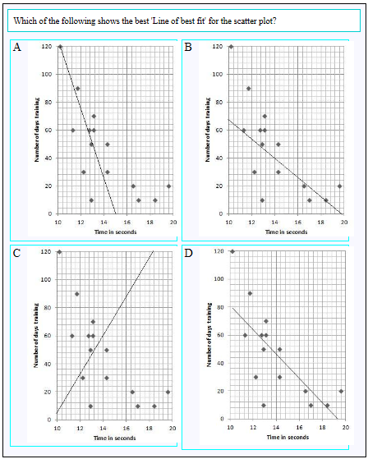
Question 6

Slide 18
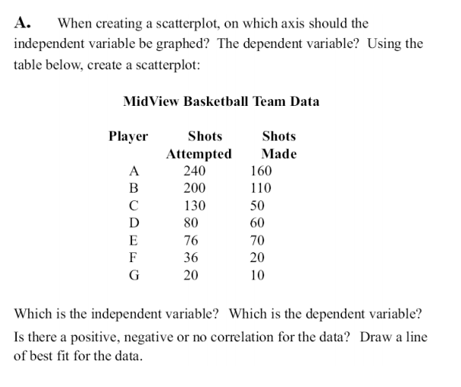
Question 7

Slide 19
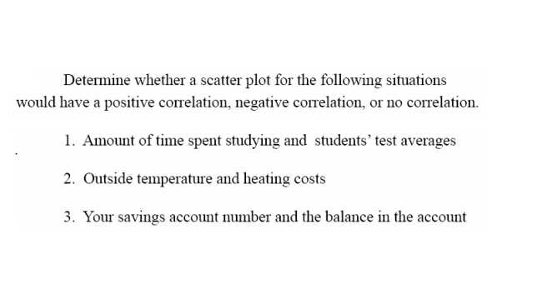
Question 8

Slide 20
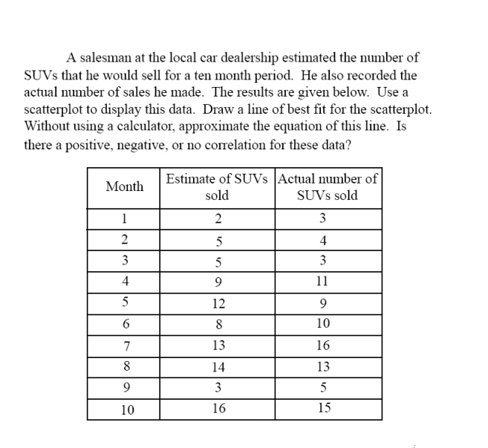
Question 9

Slide 21
What is the Line of Best Fit?
A line of best fit is a straight line that best represents the data on a scatter plot.
This line may pass through some of the points, none of the points, or all of the points.

Slide 22
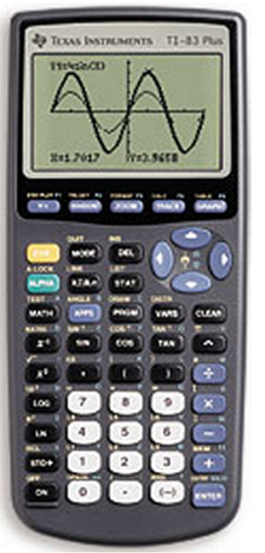
Using the Calculator
Goals:
Use a calculator to create a scatter plot
Determine the line of best fit

Slide 23
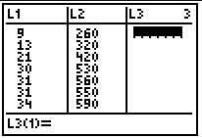
1. Enter the data in the calculator lists. Place the data in L₁ and L₂.
STAT, #1Edit, type values into the lists

Slide 24
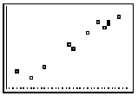
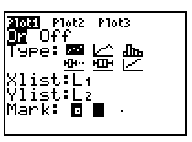
2. Prepare a scatter plot of the data. Set up for the scatterplot.
2nd StatPlot - choices shown at right.
Choose ZOOM #9 ZoomStat. Graph shown.

Slide 25
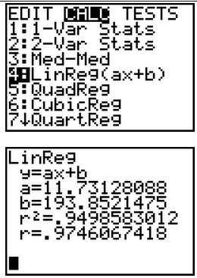

3. Have the calculator determine the line of best fit.
STAT → CALC #4 LinReg(ax+b)Include the parameters L₁, L₂, Y₁.(Y₁ comes from VARS → YVARS, #Function, Y₁)
You now have the values of a and b needed to write the equation of the line of best fit. See values at the right.
y = 11.73128088
+ 193.8521475

Slide 26
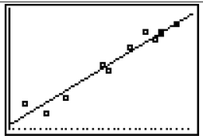
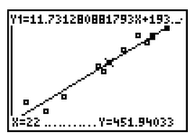
4. Graph the line of best fit.
Simply hit GRAPH.
To get a predicted value within the window, hit TRACE, up arrow, and type the desired value.
Question: Predict the total calories based upon 22 grams of fat.
ANS: 451.940 calories

Slide 27
Classwork and Assessment
Scatter Plot
Scatter Plot Practice
Regent Prep
  http://www.regentsprep.org/regents/math/algebra/AD4/PracPlot.htm
Tutor Vista
  http://worksheets.tutorvista.com/scatter-plot-and-correlation-worksheet.html
QUIA
Scatter Plot Practice
  http://www.quia.com/quiz/3652096.html

