Slide 1
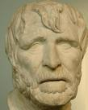
Hesiod

Slide 2
Biography
Born c. 700 BCE
Father worked in sea-trading in Cyme in Aeolis (coast of Asia Minor)
Father gave up sea-trading and moved to Ascra in Boetia, where Hesiod was born;

Slide 3
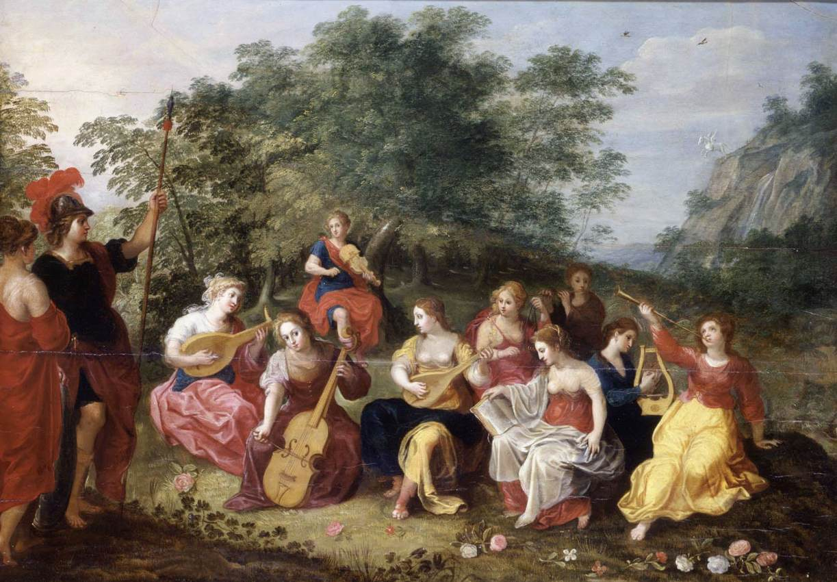
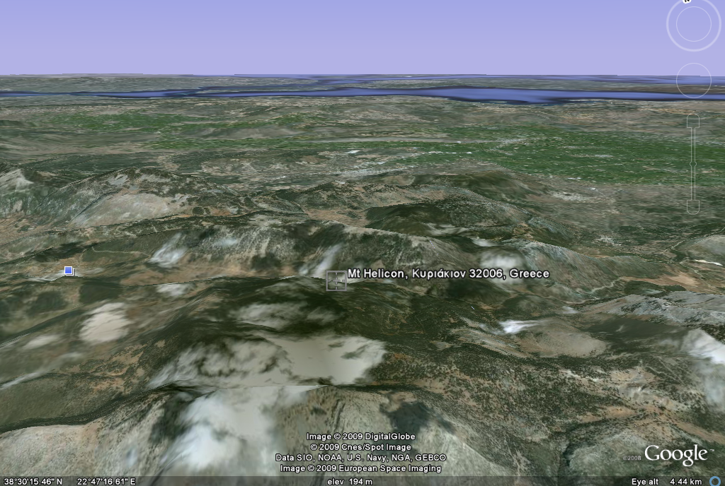
Biography
Hesiod grew up as a farmer, and was tending sheep on Mt. Helicon when his poetic call came.
The Muses called him to sing of the gods…

Slide 4
Poetic Career
Took part in a poetic contest at Chalcis in Euboea, and won a silver tripod
Wrote Works and Days, a long poem that extols hard work and industry associated with farm life (this later becomes a model for Vergil’s Georgics);
Wrote the Theogony, which describes the birth of the gods

Slide 5
Works and Days
828 hexameters of didactic poetry;
  Works: activities of the farming year
  Days: almanac of days in the month that are considered lucky or unlucky for particular activities
Main themes: justice, and the need for hard work, explained by the myth of the five ages of man and the story of Pandora

Slide 6
Theogony
1000 hexameter lines about the gods of Greece and their genealogy
Describes the rise of primordial gods (Chaos, Gaia, Tartarus and Eros), the birth of Uranus, the Titans, and the rise of the Olympian gods

Slide 7
Resources
Hesiod, Oxford Companion to Classical Literature, M. C. Howatson, Ed., (Oxford University Press: New York, 1989), op cit.
Theogony, Oxford Companion to Classical Literature, M. C. Howatson, Ed., (Oxford University Press: New York, 1989), op cit.
Works and Days, Oxford Companion to Classical Literature, M. C. Howatson, Ed., (Oxford University Press: New York, 1989), op cit.

