Slide 1
Cicero, Clodius, and the Pro Caelio

Slide 2
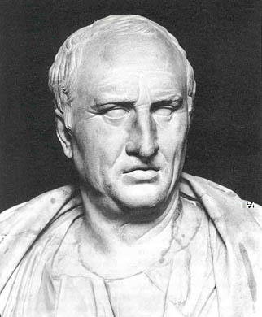
Marcus Tullius Cicero
DOB: 3 Jan 106 BC, Arpinum
DOD: 7 Dec 43 BC
Born into the family of a wealthy eques, eldest of two sons;
Sent to Rome to study law and philosophy;
Served under Cn. Pompeius Strabo during the Social War (90 – 88 BC)
81 BC: Delivers the speech Pro Quinctio in defense against charges made by the freedman of Sulla
80 BC: Successfully defended a client on a charge of parricide.

Slide 3
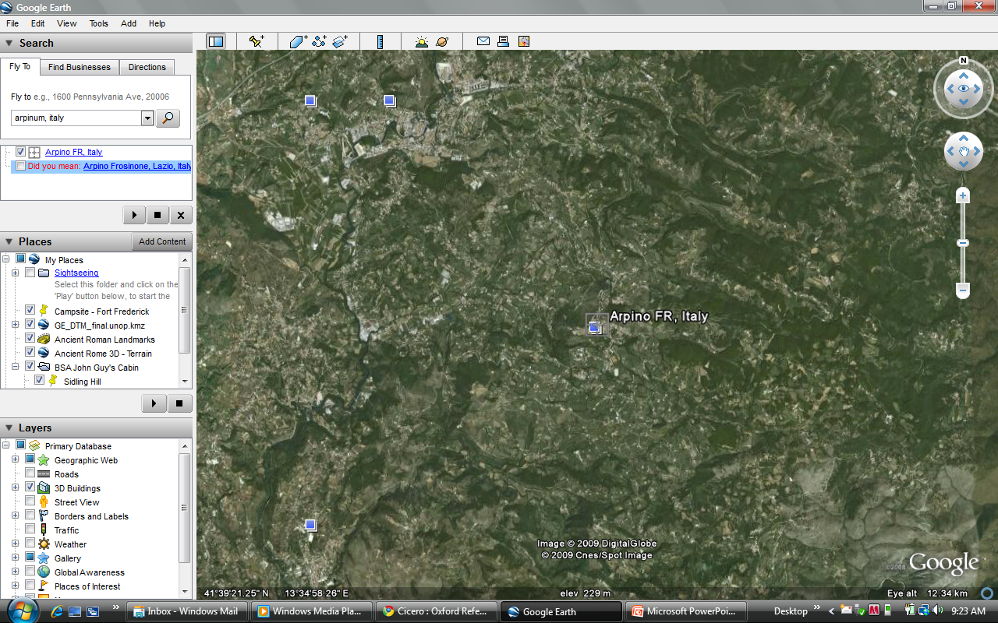

Slide 4
Curriculum Vitae
79 BC Travels to Greece for his health, studies rhetoric and philosophy in Athens and Rhodes; meets Titus Pomponius Atticus , who becomes a lifelong friend and correspondent
76 BC Elected Quaestor anno suo; served in Lilybaeum, in Sicily
70 BC, prosecuted Quintus Verres for corruption as governor of Sicily; defeated Hortensius to establish his reputation as an orator.
69 BC Aedile; 66 BC Praetor
63 BC Consul: broke up the Catilinarian Conspiracy ; declared Pater patriae
58 BC Banished from Rome as a result of charges brought by P. Clodius Pulcher; restored 57 BC
Retired more or less from public life, kept his head down during the Civil War; gave his first speech in 10 years in 45 BC on behalf of Marcellus, who had threatened prosecution against Caesar
Supported Octavian in the Second Triumvirate – made enemies with Antony with a series of speeches called the Phillipics; put on a proscription list, killed in 43 BC; his right and and his head were nailed to the Rostra in the Forum

Slide 5
Publius Clodius Pulcher
DOB: c. 92 BC
DOD: 52 BC
A scion of the ancient Claudii gens; according to one story, he changed it to sound more plebeian
Younger brother of 3 sisters
Known for loose morals; 61 BC attempted to sneak into the Bona Dea festival, held in the home of the Pontifex Maximus (Julius Caesar); prosecuted for impiety; Cicero destroyed his alibi;
Managed to be adopted into a plebeian family, so he could run for the tribunate
58 BC passed a law requiring the exile of any official who put a Roman citizen to death without benefit of trial; Cicero flees to Athens;
52 BC A chance encounter with a rival, Milo, on the Appian Way results in a riot, in which Clodius is killed; the plebs of Rome use the Curia as a funeral pyre.

Slide 6
Pro Caelio
Defense of M. Caelius Rufus; a young friend and political protégé of Cicero 63-61 BC (61 BC Caelius associates with Catiline)
Moves to the Palatine hill section of Rome to be closer to his lover, Clodia Metella Celer, wife of the Consul of 60, Q. Metellus Celer
56 BC, the affair is over, and charges are brought by L. Sempronius Atratinus on charges that he attempted the assassination of an Egyptian envoy and the poisoning of Clodia herself.
After Cicero’s speech, Caelius is acquited, and Clodia fades from view;
52 BC Tribune; 49 BC, attempted a rebellion in southern Italy with Milo, easily supressed by Caesar and put to death.

Slide 7

In his speech, Cicero convinces the jury of Caelius’s innocence in two major ways:
Portray Caelius as a satiric caricature: the innocent (that is, stupid) young man, seduced by the wily older woman;
Portray Clodia as an “un-natural” woman
  After her husband died in 59 BC, she failed to marry
  Creates a “dialogue” between Clodia and her ancestor, Appius Claudius Caecus, who upbraids her for her scandalous behavior (being unmarried at 30, without male supervision)
  Alludes to rumors about Clodius and his sisters
Quod quidem facerem vehementius, nisi intercederent mihi inimicitiae cum istius mulieris viro--fratrem volui dicere; semper hic erro.

Slide 8
Selected Bibliography
"Caelius Rufus, Marcus" The Concise Oxford Companion to Classical Literature. Ed. M.C. Howatson and Ian Chilvers. Oxford University Press, 1996. Oxford Reference Online. Oxford University Press. Paul VI Catholic High School. 19 May 2009 <http://www.oxfordreference.com/views/ENTRY.html?subview=Main&entry=t9.e498>
"Cicero" The Concise Oxford Companion to Classical Literature. Ed. M.C. Howatson and Ian Chilvers. Oxford University Press, 1996. Oxford Reference Online. Oxford University Press. Paul VI Catholic High School. 19 May 2009 <http://www.oxfordreference.com/views/ENTRY.html?subview=Main&entry=t9.e636>
"Cl dia" The Concise Oxford Companion to Classical Literature. Ed. M.C. Howatson and Ian Chilvers. Oxford University Press, 1996. Oxford Reference Online. Oxford University Press. Paul VI Catholic High School. 19 May 2009 <http://www.oxfordreference.com/views/ENTRY.html?subview=Main&entry=t9.e674>
“Clodia”. http://www.dl.ket.org/latinlit/historia/people/clodia.htm. Accessed 18 May 2009.
“Clodius”. http://www.dl.ket.org/latinlit/historia/people/clodius.htm. Accessed 18 May 2009
“M. Tullius Cicero, Pro Caelio 33-34”. http://www2.cnr.edu/home/sas/araia/cicero_clodia.html. Accessed 18 May 2009.

