Slide 1
Absolute Monarchs

Slide 2
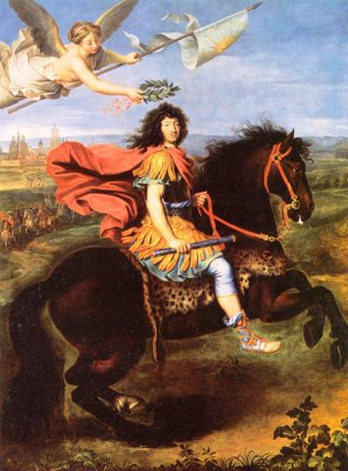
Essential Understandings:
The Age of Absolutism takes its name from a series of European monarchs who increased the power of their central governments.

Slide 3
Characteristics of Absolute Monarchies
They believed in the concept of rule by divine right- God gave them the power to rule over the power
Absolute monarchs centralized power
Had strong armies
Either controlled or tried to control the church
Lower classes had NO say in the government

Slide 4
Spanish Armada- 1588
Philip II of Spain wanted to impose Catholicism on the Dutch Calvinists
Elizabeth supported the Dutch declaring their independence which infuriated Philip so he raised an armada (huge fleet of ships) to invade England
130 ships, 33,000 men and it took 2 years to plan

Slide 5
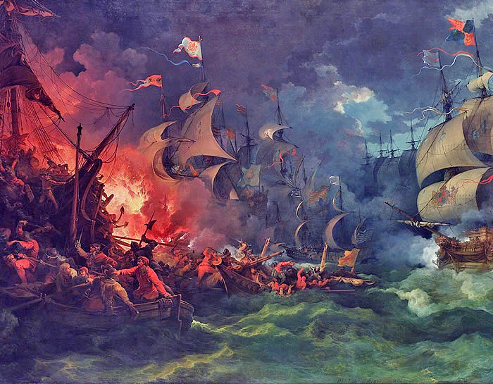
English Fire Ships and stormy weather scattered the Spanish Armada
English ships were smaller, faster, and cannons could fire MUCH farther
Many Spanish ships sank around Scotland and Ireland...only 65 ships made it back!

Slide 6
Louis XIV and Peter the Great: Absolute Monarchs

Slide 7
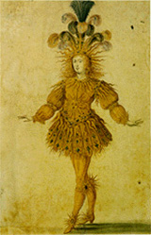
Louis XIV- reigned 1643-1715
King of France for 72 years- longest rule in Europe!
Nickname: The Sun King (Saw himself as Apollo)
Famous quote:”I am the state!” This is a great example of a monarch’s centralization of power

Slide 8
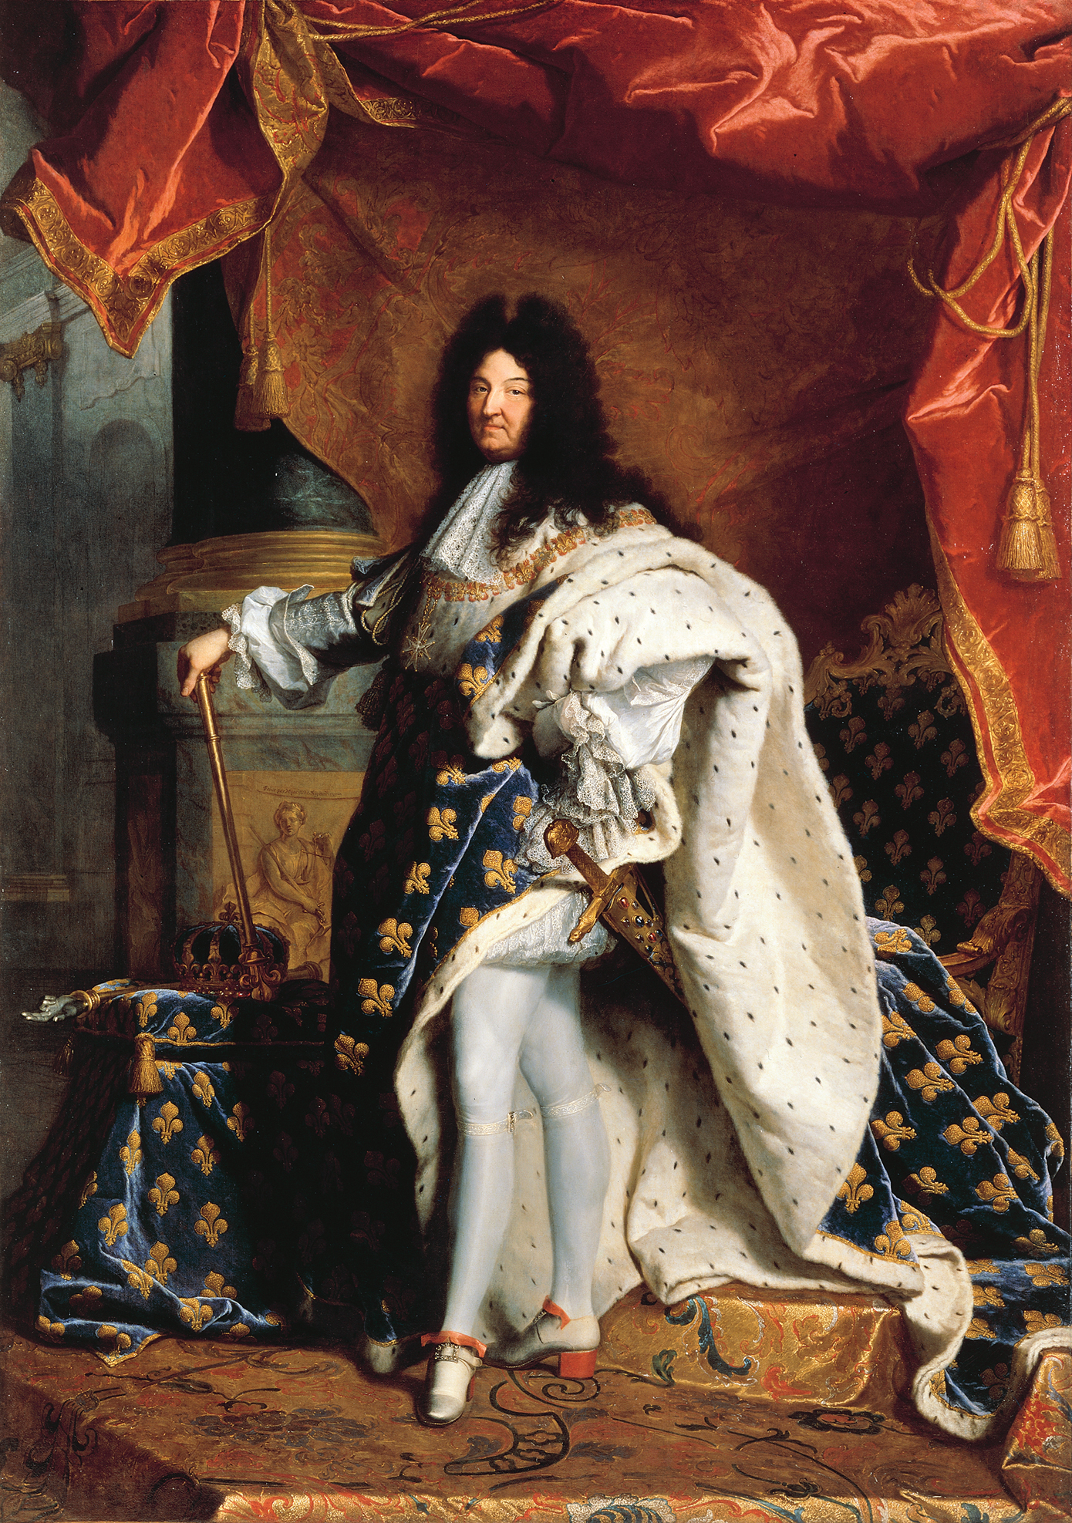

Slide 9
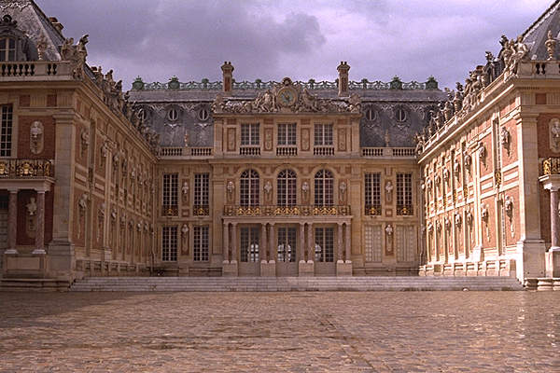
Palace of Versailles
Built the Palace of Versailles as a symbol of royal power
Versailles served as the new home for the central government

Slide 10
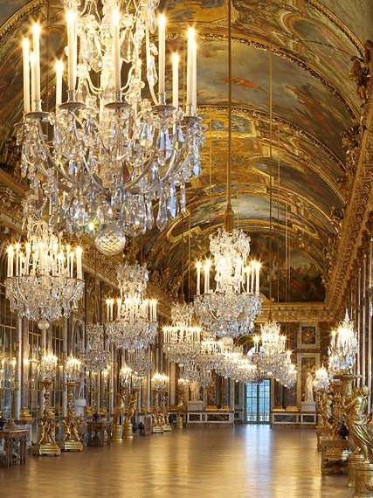
Hall of Mirrors- daily passage way for Louis XIV

Slide 11
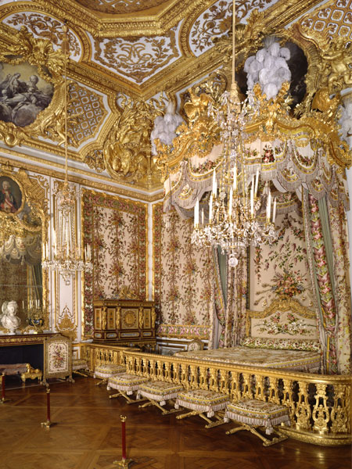
Queens Bed Chamber

Slide 12
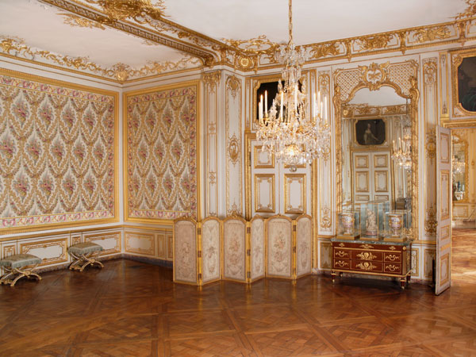
Kings Apartments

Slide 13
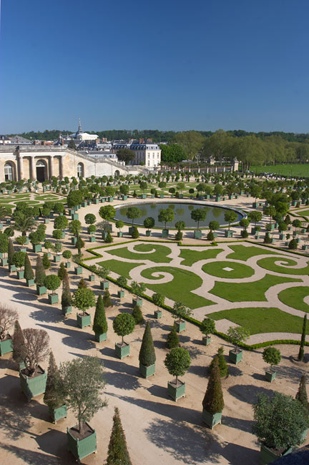
Nobility lived in the palace at least part of the year
Up to 10,000 people lived there
Was a way for Louis to show off and keep control
Featured 1,400 fountains (with running water!)

Slide 14
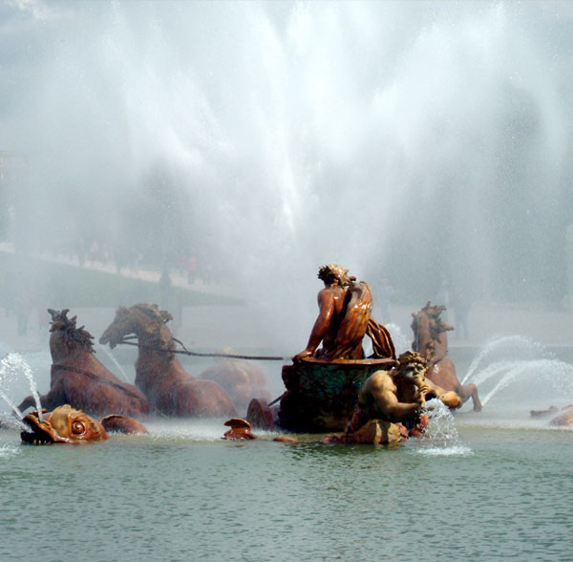
Apollo Fountain

Slide 15
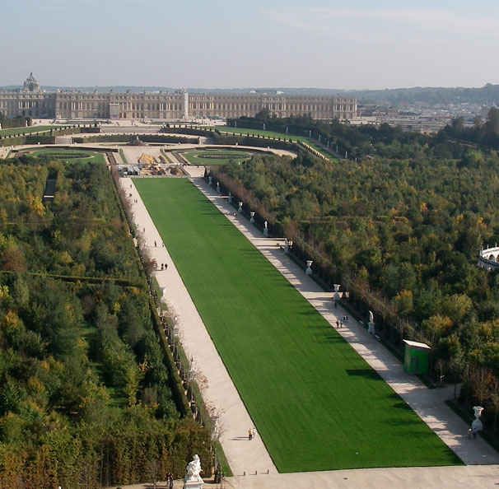
The Royal Walk

Slide 16
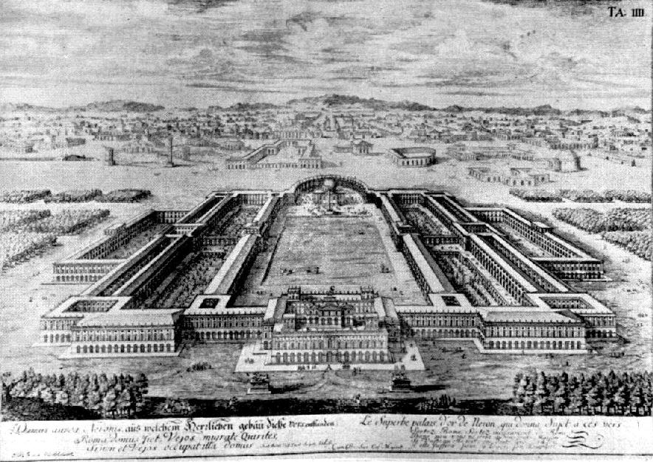

Slide 17
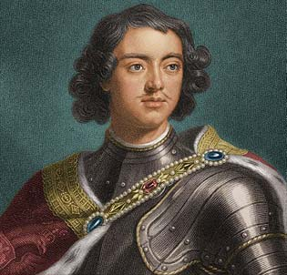
Peter the Great
Absolute monarch of Russia
Became known as Peter the Great for his efforts to westernize Russia

Slide 18
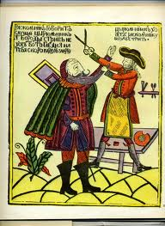
Westernization
Peter traveled to Europe to learn about shipbuilding and navigational technology
He wanted to gain the knowledge necessary to bring Russia into the modern age

Slide 19
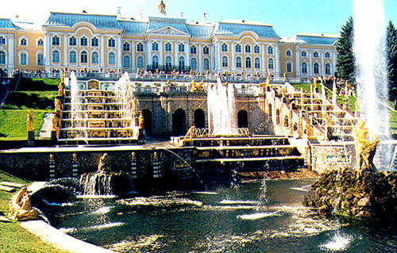
St. Petersburg
He built the capital city, St. Petersburg
It was built on a swamp, causing thousands to die
New model city of Russia and the government moved to St. Petersburg
Featured Western style architecture

Slide 20
English Civil War and Oliver Cromwell

Slide 21
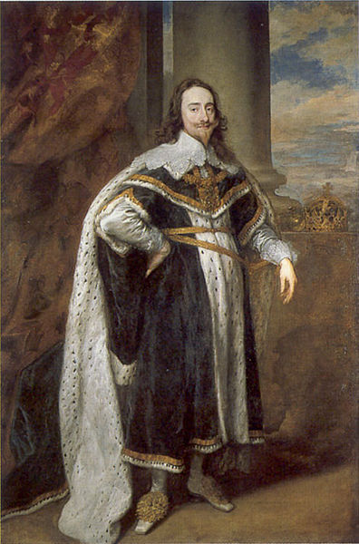
English Civil War
Charles I: King of England is forced to call on Parliament for the first time in 11 years because he needs to raise an army against Scotland.
The Scottish were refusing to convert from Calvinism which angered Charles I

Slide 22
It backfired! Charles I and Parliament raise an army against each other.
Charles I Army: Cavaliers- made up of nobility
Parliaments Army: Roundheads (they had close haircuts)- Made up of militia and merchants- had A LOT of money.

Slide 23
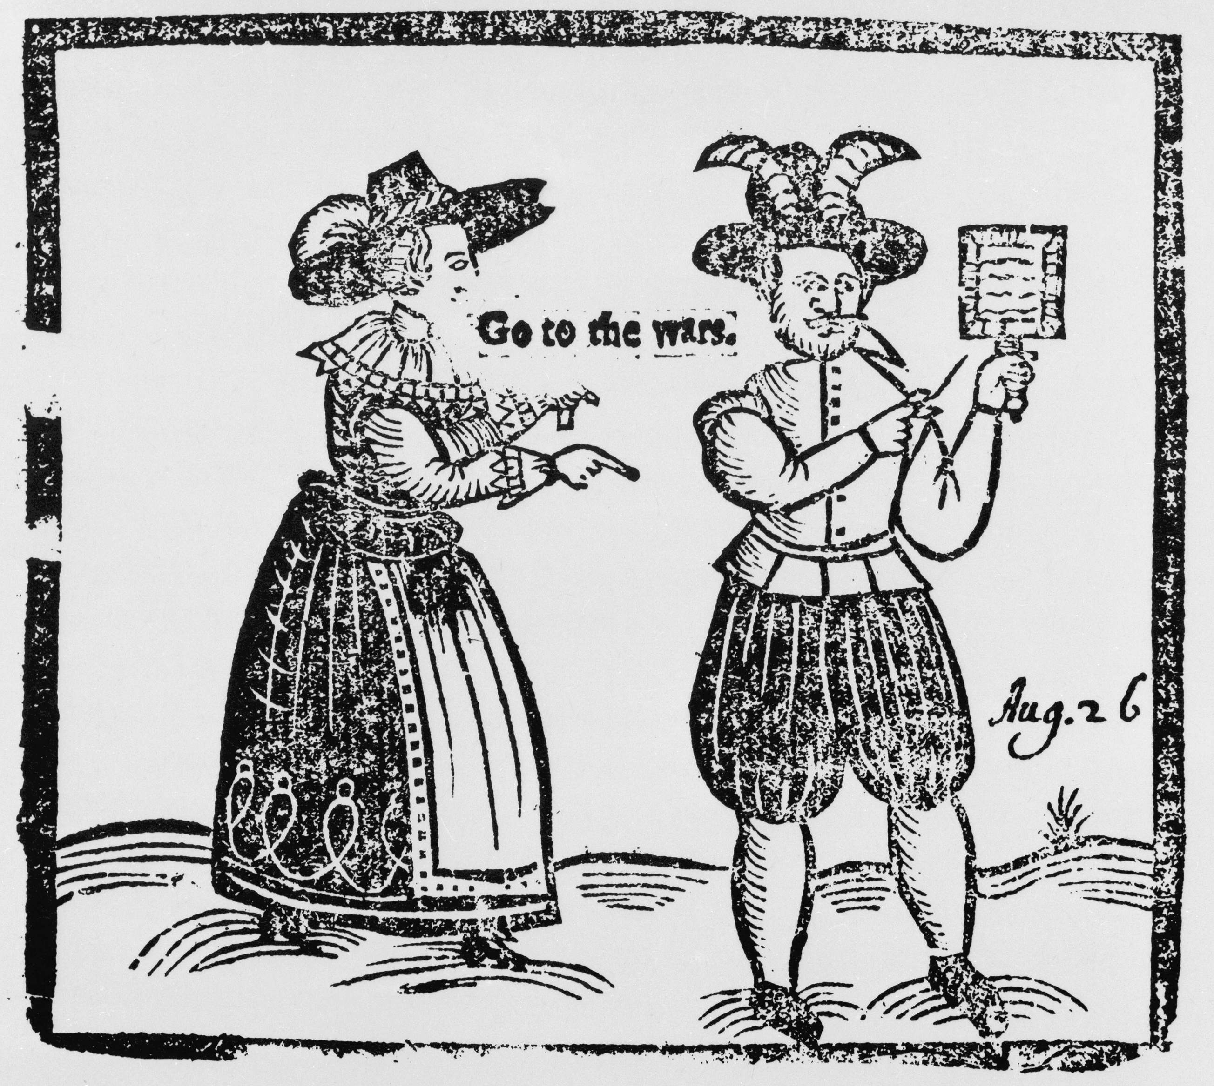

Slide 24
Parliament is losing so they join forces with the Scottish.
The Roundheads are led by Oliver Cromwell and with the help of the Scottish are able to crush the Cavaliers.
January 30, 1649: Charles I is publicly beheaded.
Some people tried to catch his blood because they felt it had royal power!
Kingship is abolished- England becomes a commonwealth: State ruled by elected officials.

Slide 25
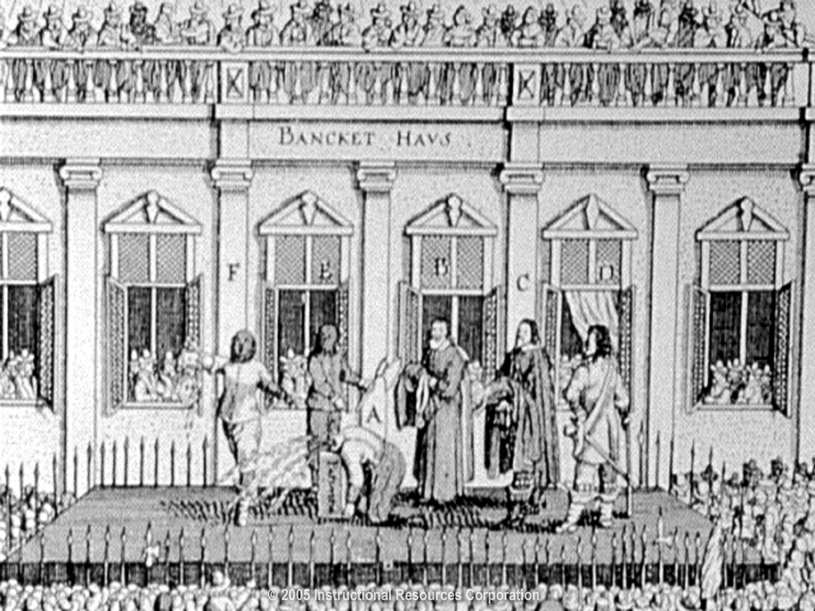

Slide 26
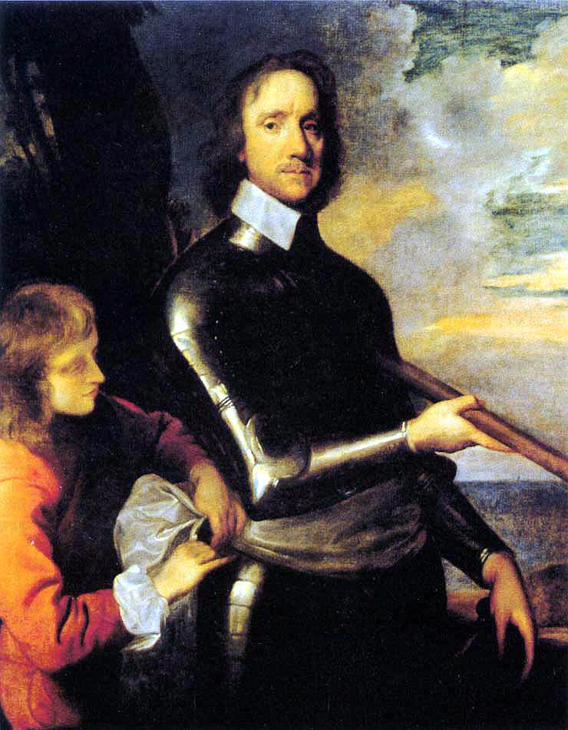
Oliver Cromwell
Puritan member of Parliament who leads the Roundheads to win the English Civil War.
Cromwell elects himself dictator of England after Parliament cannot decide on a new government.
People did not like his strict rule as he banned drinking, dancing, and gambling because of his religion.

Slide 27
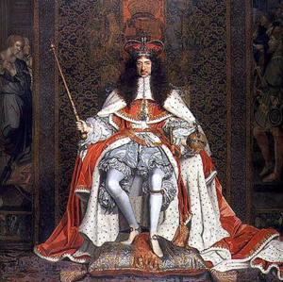
Cromwell dies in 1658 and his son Richard is a total failure as a ruler.
Parliament invites Charles I’s son Charles II to come back from Europe
England accepts the restoration of Charles II to the throne of England

Slide 28
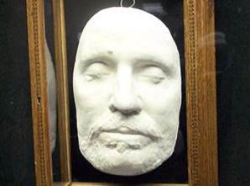
Death Mask of Oliver Cromwell

Slide 29
Restoration of the English Monarchy
Glorious Revolution and the English Bill of Rights

Slide 30
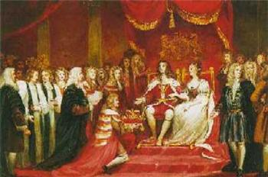
Glorious Revolution
After Charles II died, James II became King.
Everyone HATE James II because he was very Catholic and favored the Catholic nobility by giving them the best jobs.
James was eventually peacefully overthrown by his own daughter and her husband (William and Mary) who were Protestants.
William and Mary then ruled England.

Slide 31
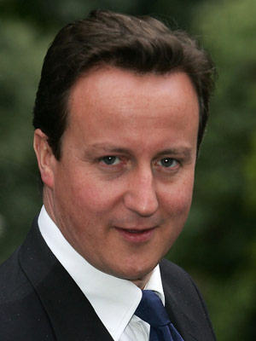
English Bill of Rights
William and Mary were forced to sign the English Bill of rights in 1689.
This increased the power of the Parliament and decreased royal power.
This also established a cabinet which was the link between the majority party in Parliament and the King
The cabinet still exists today and the leader of the cabinet= Prime Minister
David Cameron- currently Prime Minister of England

Slide 32
Essential Understandings
This also leads to the development of political parties and factions.
Political democracy rests on the principle that government derives power from the consent of the governed.
The foundations of the English rights include the jury trial, the Magna Carta, and common law.
The English Civil War and the Glorious Revolution prompted further development of the rights of Englishmen.

Slide 33
Introduction to the Age of Enlightenment

Slide 34
Introduction to the Age of Enlightenment

Slide 35
The Enlightenment
Applied reason to the human world, as well as to the rest of the natural world.
Stimulated religious tolerance
Fueled democratic revolutions around the world

Slide 36
Essential Understandings
Enlightenment thinkers believed that human progress was possible through the application of scientific knowledge and reason to issues of law and government.

Slide 37
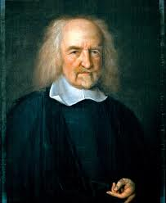
Enlightenment Thinkers and Their Ideas
Thomas Hobbes: Wrote Leviathan- Humans exist in a primitive “state of nature” and consent to government for self-protection.
Said that humans were cruel and greedy

Slide 38
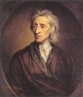
John Locke
Wrote Two Treatises on Government: Stated that people are sovereign (free) and consent to government for protection of natural rights to life, liberty, property.
Said people are born good!

Slide 39
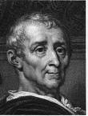
Montesquieu
Wrote The Spirit of Laws: The best form of government includes a separation of powers

Slide 40
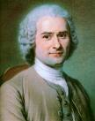
Jean-Jacques Rousseau
Wrote The Social Contract
Stated the government is a contract between rulers and the people

Slide 41
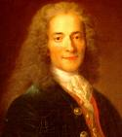
Voltaire
Stated that religious toleration should triumph over religious fanaticism
Believed in the separation of church and state

Slide 42
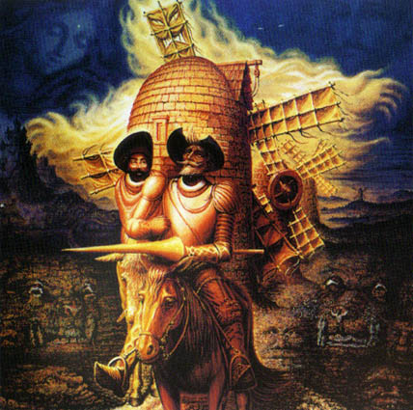

Music, Art, Literature, and New Technology

Slide 43
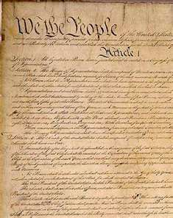
Influence of the Enlightenment
Political philosophies of the Enlightenment fueled revolution in the America’s and France
Thomas Jefferson’s Declaration of Independence incorporated Enlightenment ideas
The Constitution of the United States of America’s and Bill of Rights incorporated Enlightenment ideas

Slide 44
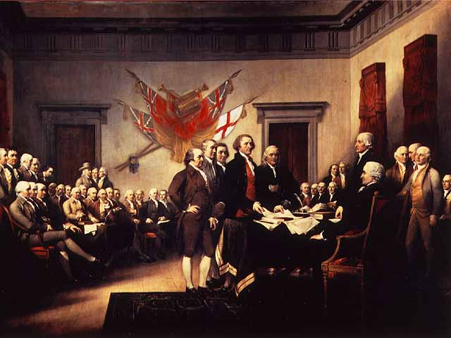
Essential Understandings
Enlightenment ideas influenced the leaders of the American Revolution and the writing of the Declaration of Independence

Slide 45
War: What is it good for?
Name of Conflict:
American
Revolution
Date: 1775-1781
England
(Loyalists, Tories)
American Colonists
(later helped by French)
VS.

Slide 46
War: What is it good for?
Caused By… | Resulted In…
High taxes after French & Indian War
No say in government
Enlightenment ideas (social contract, natural rights)
Boston Tea Party
Boston Massacre
Independence (Declaration of Independence)
Constitution of the United States
Where was it fought?
American colonies
Treaty Ending the War:
Treaty of Paris (1783)

Slide 47
Representative composers, artists, and writers
The sixteenth, seventeenth, and eighteenth centuries brought many changes in the arts, literature, and political philosophy
Baroque artistic style that is dramatic, full of excitement, and tension

Slide 48
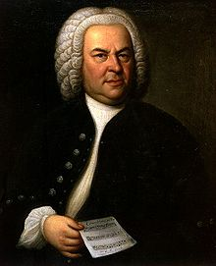
Johann Sebastian Bach
German Baroque composer who wrote complex religious works for organ and choirs

Slide 49
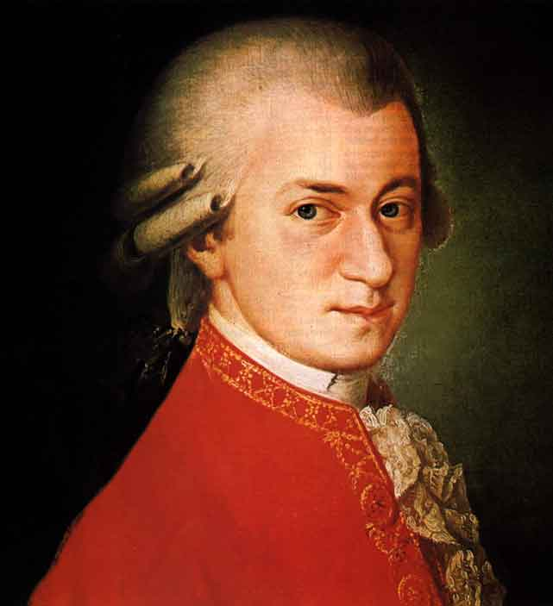
Wolfgang Amadeus Mozart
Austrian Classical composer. Child prodigy who wrote operas, symphonies, and religious music

Slide 50
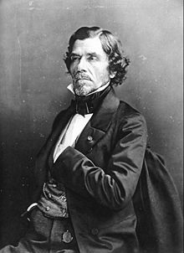
Eugène Delacroix
Painter (transition to the Romantic School of the nineteenth century.
Most famous for his painting Liberty Leading the People

Slide 51
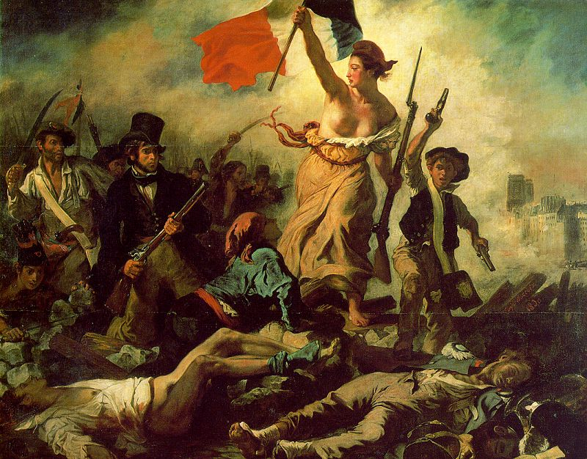

Slide 52
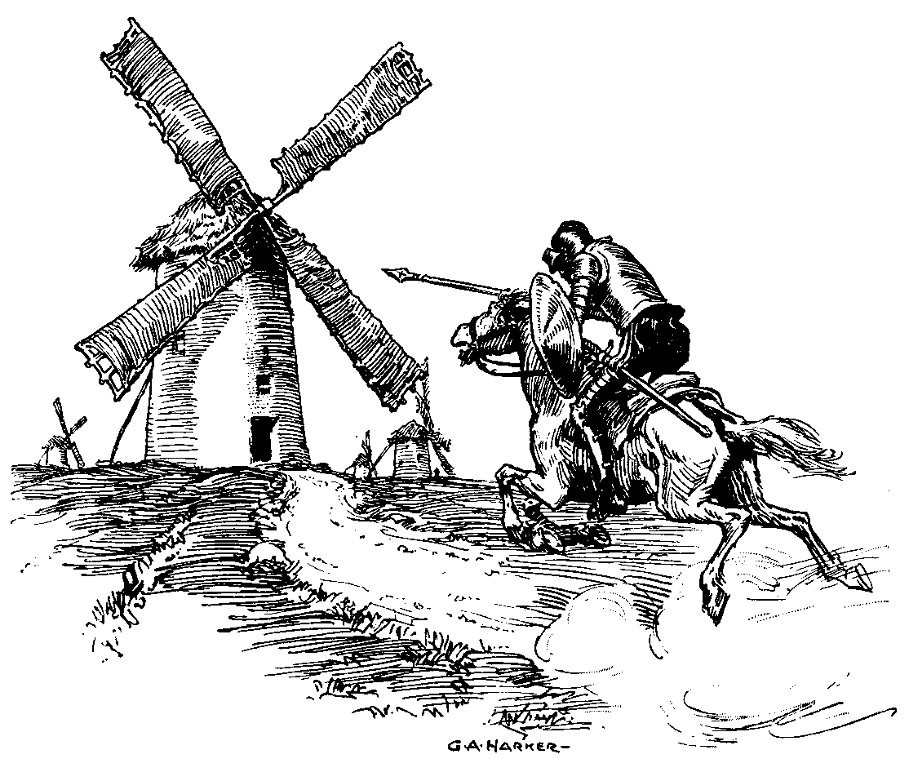
Painting depicted classical subjects, public events, natural scenes, and living people (portraits)
New forms of literature evolved such as the novel. The very first novel is Cervantes’ Don Quixote

Slide 53
Technologies
All weather roads improved year-round transport and trade.
New designs in farm tools increased productivity (agricultural revolution)
Improvements in ship design lowered the cost of transport

Slide 54
Essential Understandings
The Age of Reason witnessed inventions and innovations in technology that stimulated trade and transportation

Slide 55
The French Revolution
1789-1794

Slide 56
Essential Understandings
The ideas of the Enlightenment and French participation in the American Revolution influenced the French people to view their government in new ways
They overthrew the absolute monarchy and established a new government

Slide 57
Causes of the French Revolution
Influence of Enlightenment ideas
Influence of the American Revolution

Slide 58
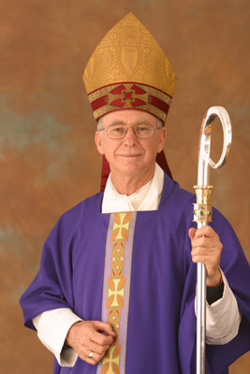
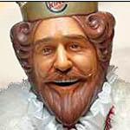

The Three Estates
1st Estate: the Clergy
  (Church Folk)
2nd Estate: the Nobles
3rd Estate: Commoners (Everyone else!)

Slide 59
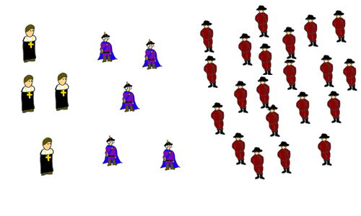
So what’s the problem?
a few clergy, some nobles, lots of people in the third estate

Slide 60

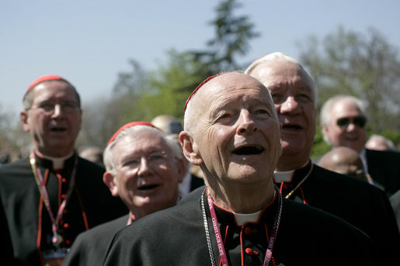
The problem is…who is paying the taxes??
The rest of the population (98%) had to pay almost all of the taxes.
The clergy and nobles get special privileges and have to pay very little or no taxes.
That made them happy.
That made them angry.

Slide 61

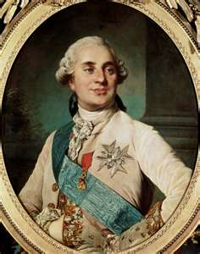
Louis XVI as a Person
He was out of touch with the people
He spent his days tinkering with clocks and locks…Maria didn’t like it because he got dirty!
He was tried for treason and sent to the guillotine on January 21, 1793

Slide 62
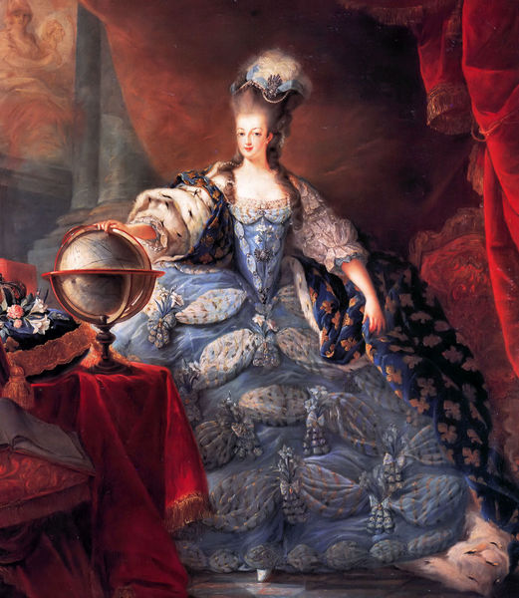
Marie Antoinette
Louis’ Austrian wife
Maria Theresa’s 15th child
The French people blamed her for France’s financial problems
She was convicted of treason and sentenced to be guillotined
She was executed on Oct. 16, 1793

Slide 63
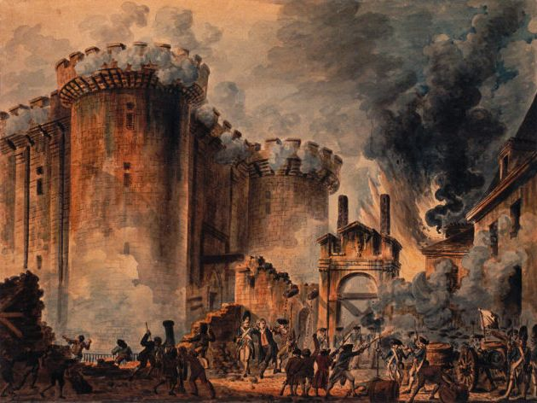
Events of the French Revolution
Storming of the Bastille: July 14, 1789
The Bastille was a prison for political prisoners (also held weapons and gunpowder)
800 Parisians gathered to released the prisoners and get weapons.
The angry mob captured soldiers, and warden beheading them and released the SEVEN prisoners the Bastille held at the time.
When told of the incident, Louis asked, “is it a revolt?” A noble replied, “No sire, it is a revolution.”

Slide 64
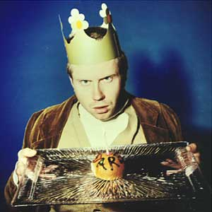
The Declaration of Rights of Man
Basically, it was what the Revolution was about:
  No absolute rulers
  No privilege (sorry, rich people)
  Liberty
  Political equality
  Signed by Louis XVI on Oct. 5, 1791

Slide 65
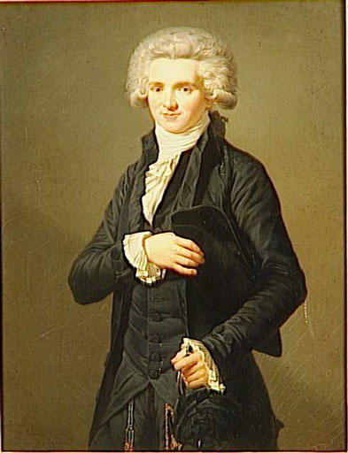
Reign of Terror
Led by Maximilien Robespierre
Robespierre’s idea to destroy enemies of the Revolution
18,500 – 40,000 people were killed
1,300 were killed in the last month
It ended when Robespierre was sent to the guillotine

Slide 66


Slide 67
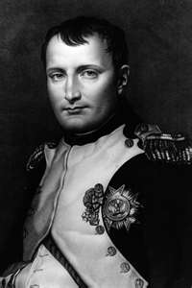
Outcomes of the French Revolution
End of the absolute monarchy of Louis XVI
Rise of Napoleon

Slide 68
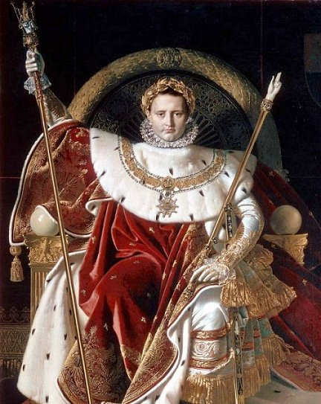
Legacy of Napoleon

Slide 69
Why was Napoleon popular?
He encouraged new industry and built roads
Let peasants keep land they had bought during the revolution
Created the Napoleonic Code:
*featured Enlightenment ideas- equality of all citizens before the law, religious toleration, and advancement based on merit
He wanted to unify Europe under French domination (create a new Empire)
He awakened feelings of national pride and growth of nationalism (love and pride for country)

Slide 70
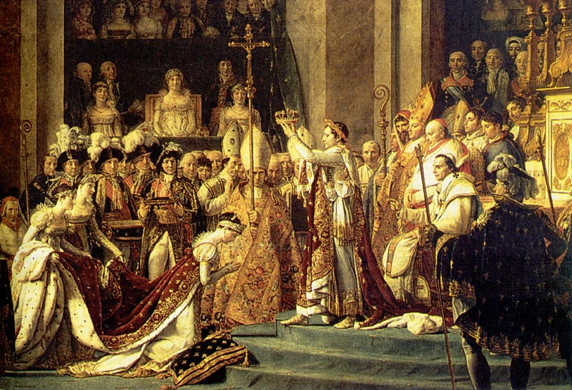

Slide 71
Building an Empire
Napoleon controlled much of Europe through forceful diplomacy
Put friends and relatives on the thrones of Europe ex: Joseph Bonaparte ruled Spain
Forced alliances across Europe
The French people were proud of what he had done for France

Slide 72

Many Europeans liked the spread of Enlightenment ideas, but saw the French as foreign oppressors.
Nationalists rebelled against the French
Napoleon invaded Russia with 422,000 men in 1812, however the Russians burned crops and villages to avoid battle with the French (scorched earth policy)

Slide 73
Only 10,000 soldiers returned from defeat in Russia!
Napoleon abdicated the throne and was exiled, he built up his forces for 100 days, and attempted to takeover Belgium at the Battle of Waterloo
He lost, was exiled again, and died in 1821 after 6 years on the island.

Slide 74
Essential Understandings
The French Revolution left a powerful legacy for world history: secular society, nationalism, and democratic ideas
Napoleons attempt to unify Europe under French domination was unsuccessful

Slide 75
Congress of Vienna: September, 1814 to June, 1815
“Turning Back the Hands of Time”

Slide 76
Essential Understandings
The Congress of Vienna attempted to restore Europe as it had been before the French Revolution and the Napoleonic conquests

Slide 77
Legacy of the Congress of Vienna
Balance of Power Doctrine- Surround France with strong countries to keep it subdued
Restoration of monarchies- Put kings back on the thrones of Europe to quell any revolutionary ideas
Redrew the map of Europe
Created new political philosophies (liberalism vs conservatism

Slide 78
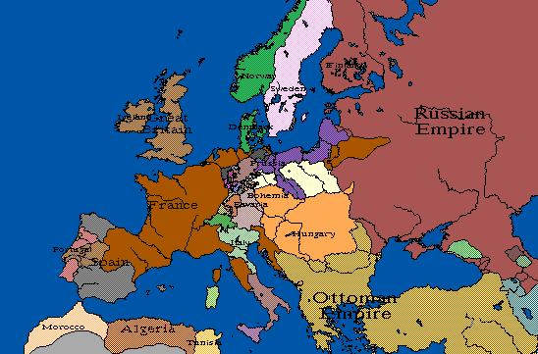
Europe in 1812 (during the reign of Napoleon)

Slide 79
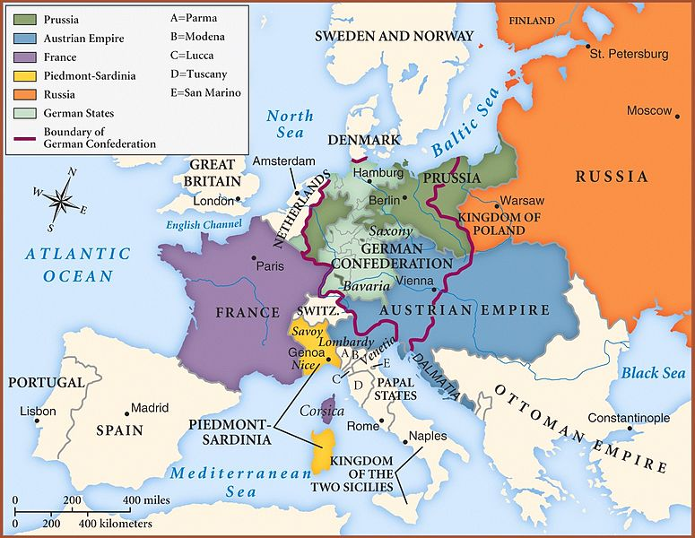
September, 1814 to June, 1815
Europe after the Congress of Vienna in 1815

Slide 80
Latin American Revolutions

Slide 81
Essential Understandings
Latin American revolutions of the 19th century were influenced by the clash of European cultures in the development of governments and ruling powers
Spanish conquests in Latin America saw the rapid decline of native populations and introduction of slaves from Africa.
Conquistadors were given governmental authority by the crown, becoming known as viceroys.

Slide 82
Characteristics of the colonial system
Colonial governments mirrored the home government.
Catholicism had a strong influence on the development of the colonies.
A major element of the economy was the mining of precious metals (gold and silver) for export

Slide 83
Major colonial cities
Major cities were established as outposts of colonial authority:
-Havana
-Mexico City
-Lima
-São Paulo
-Buenos Aires

Slide 84
Rigid Class Structure
Viceroy- Colonial officer
Creoles:
Person of European
descent born in
the colonies
Mestizo: Person of mixed Native American and European descent

Slide 85

Influence of the American and French Revolutions on Latin America
Slaves in Haiti rebelled, abolished slavery, and won independence
Father Miguel Hidalgo started the Mexican independence movement.
The French, Spanish, and Portuguese colonies gained independence there

Slide 86

Selected countries that gained independence during the 1800s
Mexico
Haiti
Colombia
Venezuela
Brazil

Slide 87
Essential Understandings
The American and French Revolutions took place in the late 1700s.
Within twenty years, the ideas and examples of these revolutions influence the people of Latin America to establish independent nations, most notably in Haiti and Mexico

Slide 88

Contributions of Toussaint L’Ouverture
In 1700’s Haiti was controlled by France
L'Ouverture was a former slave who led Haitian rebellion against the French in 1791
He defeated the armies of three foreign powers: Spain, France, Britain

Slide 89

“We are fighting so that liberty – the most precious of all earthly possessions – may not perish.” L’Ouverture

Slide 90

In 1802 Napoleon sent his army to reconquer Haiti.
L’Ouverture raised a rebellion again and France was forced to sign a truce and Haiti was granted independence in 1804

Slide 91

Contributions of Simón Bolivar
Was a native resident, a creole, who led revolutionary efforts
Liberated the northern areas of Latin America (Venezuela, Ecuador, Peru, and Bolivia)
Earned the nickname “The Liberator”

Slide 92
Essential Understandings
The contributions of Toussaint L’Ouverture and Simón Bolivar led to the development of independent states in Latin America in the nineteenth century.

Slide 93

The Monroe Doctrine
Issued by American President, James Monroe in 1823.
Latin American nations were now acknowledged to be independent!
The United States would regard as a threat to its own peace and safety any attempt by European powers to impose their system on any independent state in the Western Hemisphere.
Basically…they told Europe to GO AWAY!

Slide 94
Essential Understandings
After the American Revolution, the United States wished to prevent foreign interference in America.
The Monroe Doctrine was issued in 1823, alerting European powers that the American continents should not be considered for any future colonization.

