Slide 1
World War Two

Slide 2
Economic and Political Causes of World War Two

Slide 3
Appeasement: Allies give in to Hitler
When Germany violates the Treaty of Versailles by creating a union between Austria and Germany in March 1938, the Western nations appeased Hitler by not enforcing the treaty.
Appeasement: giving in to the demands of an aggressor in order to keep peace

Slide 4
British and French leaders caved to Hitler’s demands at the Munich Conference, Sept 1938
Why did Europe appease Hitler?
Political divisions, did not want to confront Germany, Great Depression, pacifism: (opposition to all war)

Slide 5

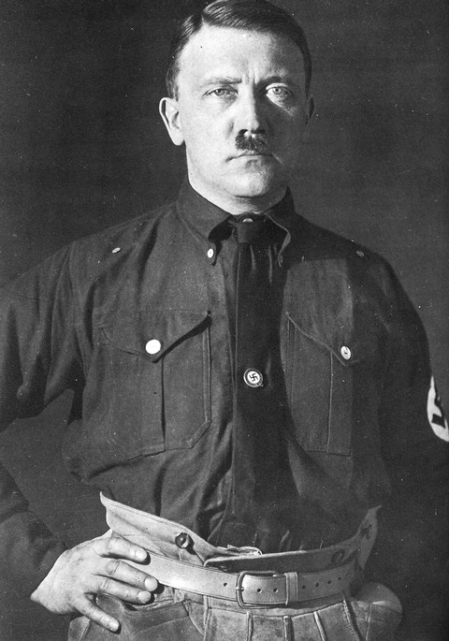
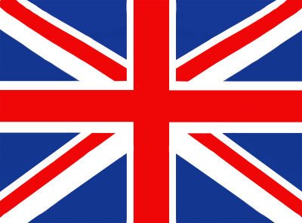
“Please, Hitler, don’t start another war!!!”
Love, France & GB

Slide 6
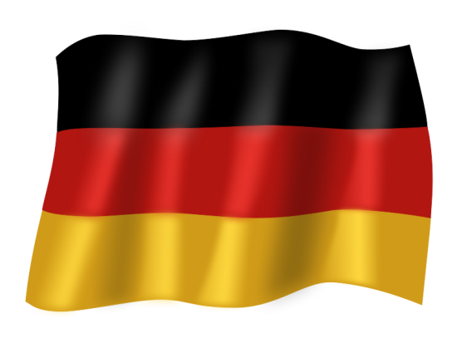
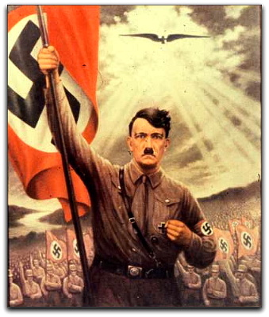
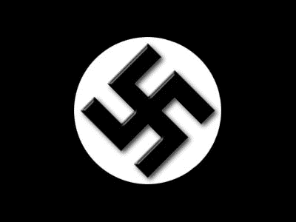
German Nationalism

Slide 7

Causes of WWII
Aggression by the totalitarian powers of Germany, Italy, and Japan
Nationalism (again)
Failures of the Treaty of Versailles
Weakness of the League of Nations
You better stop that, Hitler!

Slide 8
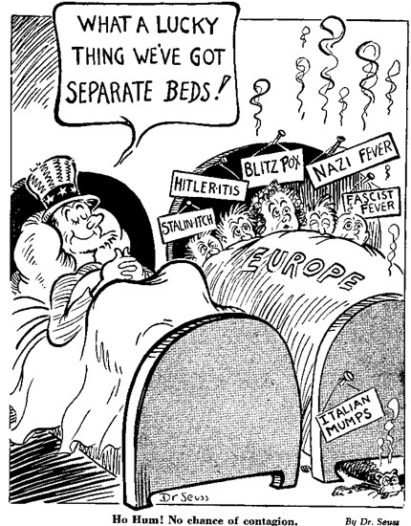
Pacifism
Pacifism: opposition to all war (sought peace at whatever price)
The rest of Europe and the United States is dealing with the world wide depression so they are following policies of isolationism and pacifism.
The US passes Neutrality acts in 1937

Slide 9
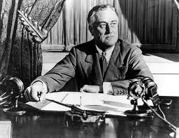
Franklin D. Roosevelt- President of US during WWII

Slide 10
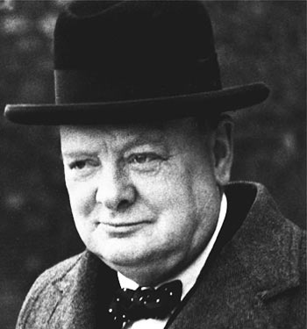
Winston Churchill- British Prime Minister

Slide 11
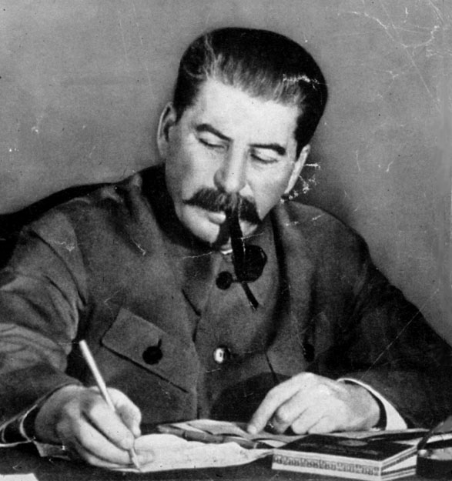
Joseph Stalin- Soviet Dictator

Slide 12
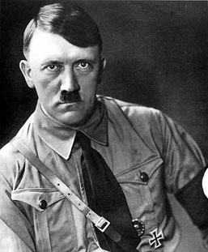
Adolf Hitler- Nazi dictator of Germany

Slide 13
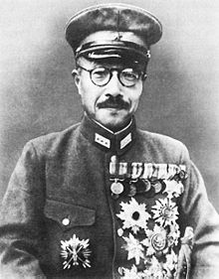
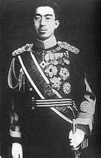
Hideki Tojo- Japanese General
Hirohito- Emperor of Japan
Tojo
Hirohito

Slide 14
WWII: CHART
ALLIES: “Big Three”- U.S. (FDR-Franklin Delano Roosevelt) Great Britain (Winston Churchill) Soviet Union (Joseph Stalin) | AXIS: Tripartite Pact (1940)- Germany (Adolf Hitler) Italy (Benito Mussolini) Japan (Emperor Hirohito, but really Hideki Tojo in charge)
 | .

Slide 15
Major Events of WWII- European Theatre and the Holocaust

Slide 16
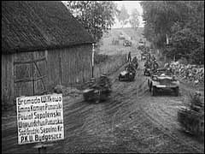
Invasion of Poland
September 1, 1939
~ Germany invades Poland
~ Trigger that sets off World War II
September 3, 1939
~ France and Great Britain declare war on Germany because of the invasion of Poland

Slide 17
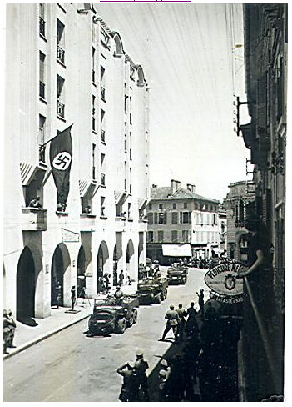
Fall of France
May 1940
Germany invades France
Italy joins war against France
France surrenders within two months
Vichy government set up in France- puppet state of Germany under General Petain

Slide 18
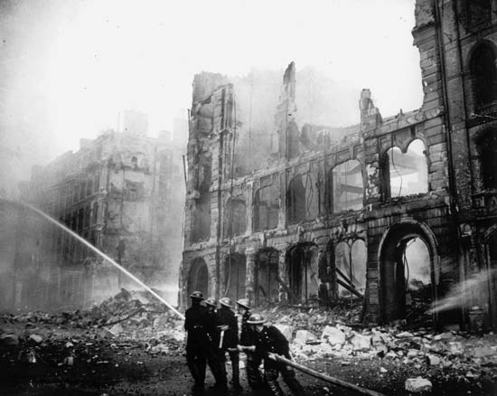
Battle of Britain
July 1940
Germany begins blitzkrieg attacks on Britain
“Battle of Britain”- German attempt to annihilate the British before the Americans joined the war

Slide 19
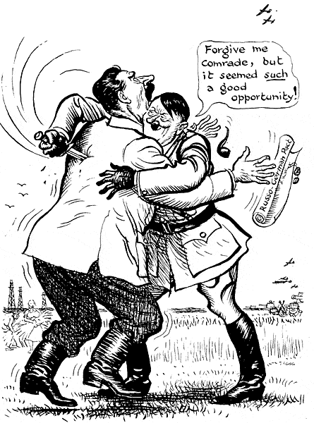
Germany invades Soviet Union
June 1941
Germany attacks Soviet Union
Reneges on Nazi-Soviet Pact in an attempt to gain oil resources in the Soviet Union

Slide 20
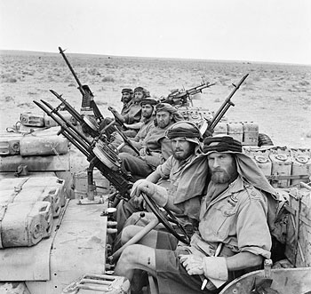
The War in Northern Africa
May 1942
Germany/Italian offensive advances into Northern Africa
Italian motivation to reclaim territories controlled by the Roman Empire

Slide 21
Essential Understandings of the Holocaust
There had been a climate of hatred against Jews in Europe and Russia for centuries

Slide 22
Elements leading to the Holocaust
Totalitarianism combined with nationalism
History of anti-Semitism
Defeat in World War I and economic depression blamed on German Jews
Hitler’s belief in the master race

Slide 23
Final solution: Extermination camps, gas chambers
genocide: The systematic and purposeful destruction of a racial, political, religious, or cultural group

Slide 24
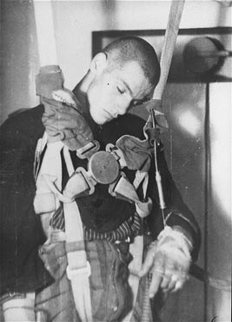
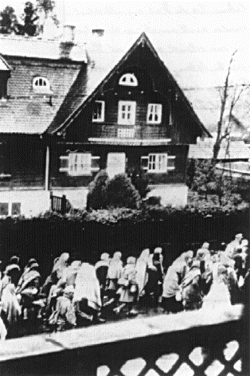
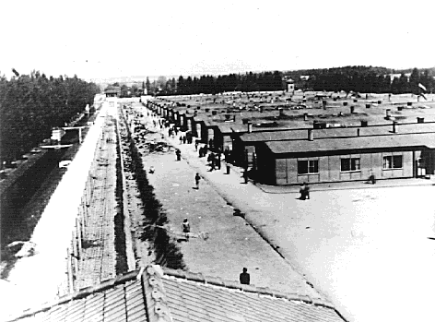
Nazis Open Dachau

Slide 25
Nuremburg Laws Decreed
Jews cannot marry non Jews
Jews are forbidden to display the national flag (i.e.- Swastika)

Slide 26
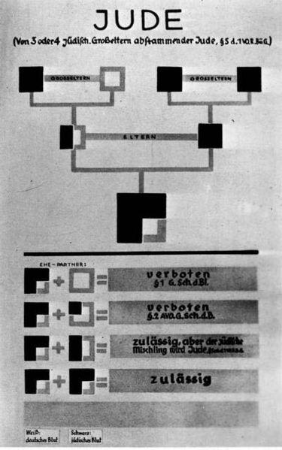

Slide 27
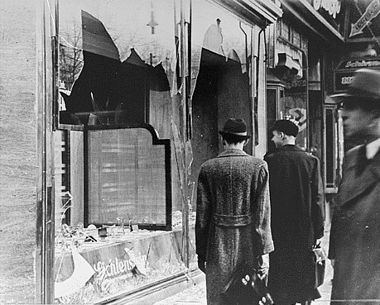
Kristillnacht
“Night of the Broken Glass”

Slide 28
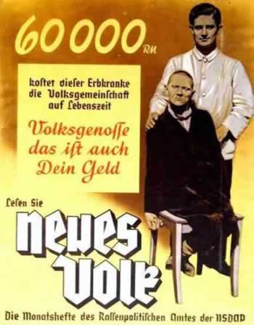
Nazi Euthanasia
“This undesirable costs German tax payers about 60,000 marks a year, but we have a better, Final Solution to this problem”

Slide 29
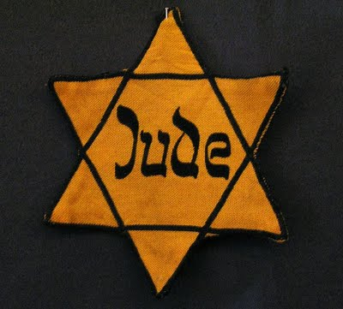

German Jews Ordered to Wear Yellow Stars

Slide 30
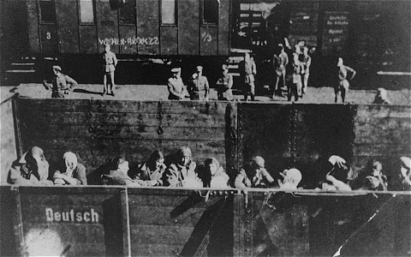
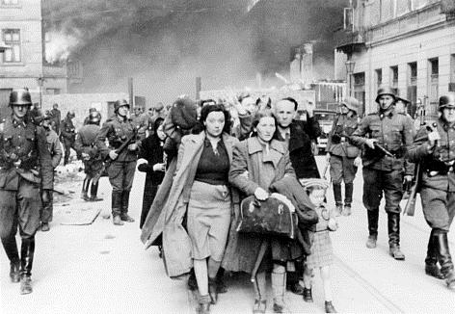
Jewish Deportation

Slide 31
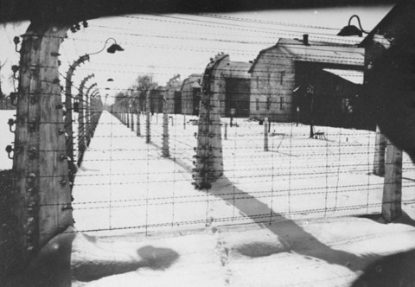
Opening of Auschwitz

Slide 32
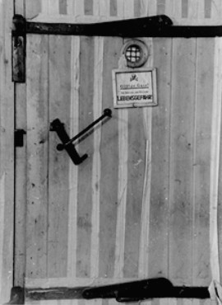

Slide 33
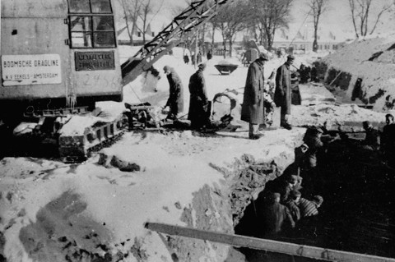

Slide 34
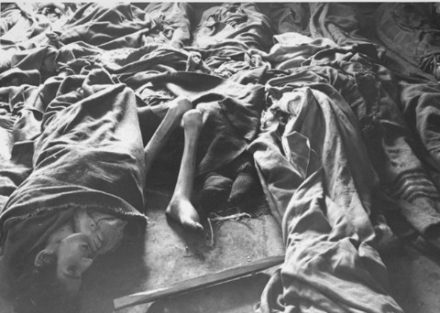

Slide 35
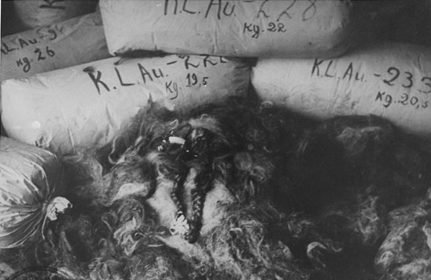
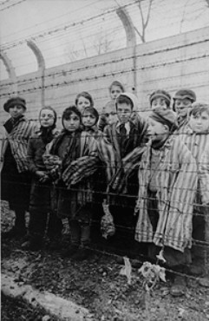

Slide 36
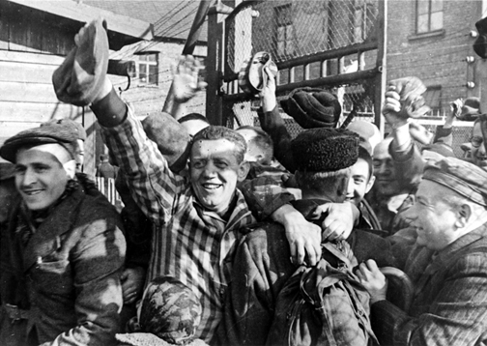
Soviets Liberate Auschwitz

Slide 37
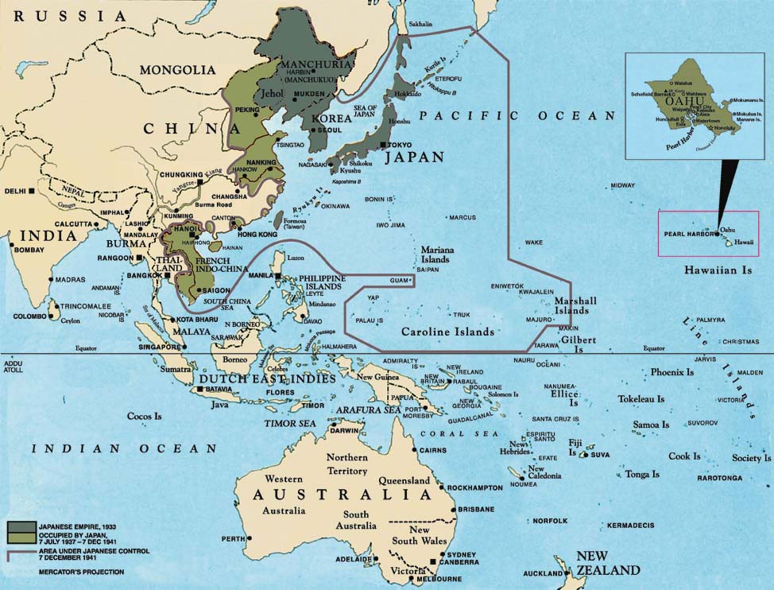
Major Events of WWII- Pacific Theatre

Slide 38
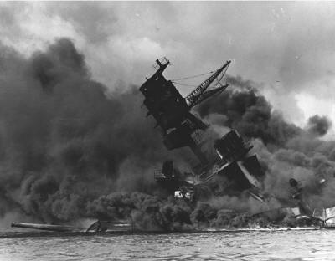
Dec. 7, 1941- Japanese attack Pearl Harbor and U.S.
enters WWII. Japan then invades the Philippines and
Indonesia hoping that America would accept Japanese
predominance in Asia

Slide 39
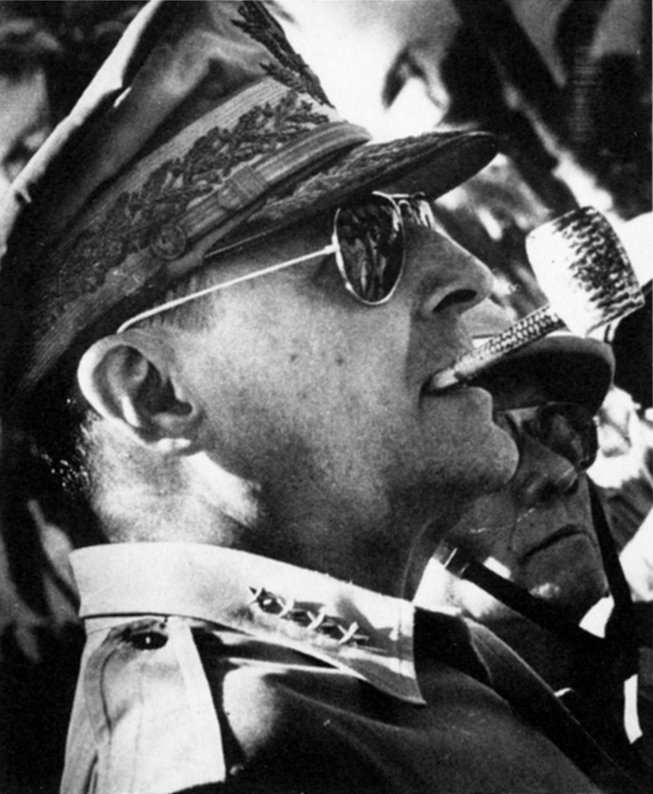
Douglas MacArthur
U.S. General who leads “Island Hopping” campaigns in the Pacific to bring the US military closer to Japan

Slide 40
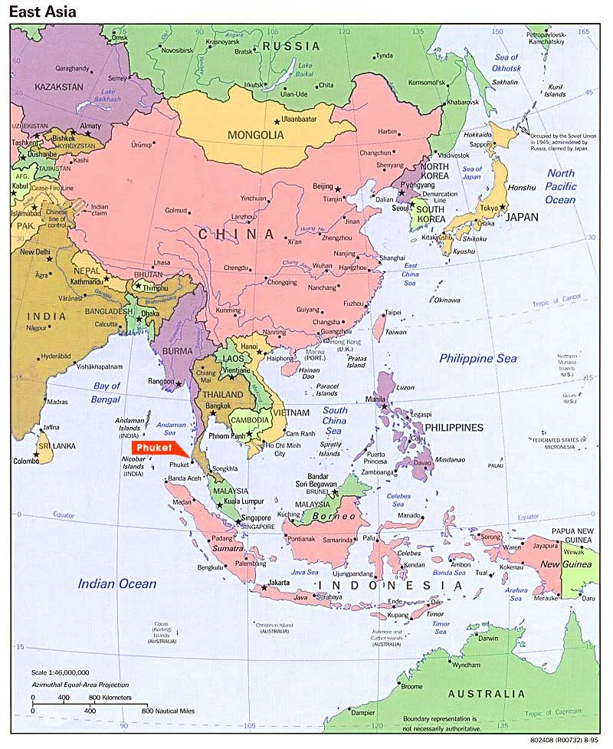

Feb. to March and April to June 1945- Iwo Jima and Okinawa
Why is victory at these
tiny Islands so
important?
Brings Allies within
360 miles of Japan
Brought America closer than ever to Japan. Cost thousands
of lives– even more Japanese, as Japanese fought fiercely
for every inch of the islands.
Japanese would rather commit suicide than surrender– (Kamikaze)

Slide 41
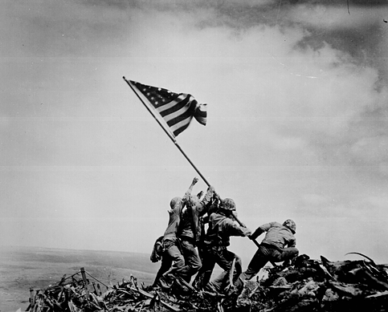
Victory at Iwo Jima creates this lasting
symbol of American victory in Pacific

Slide 42
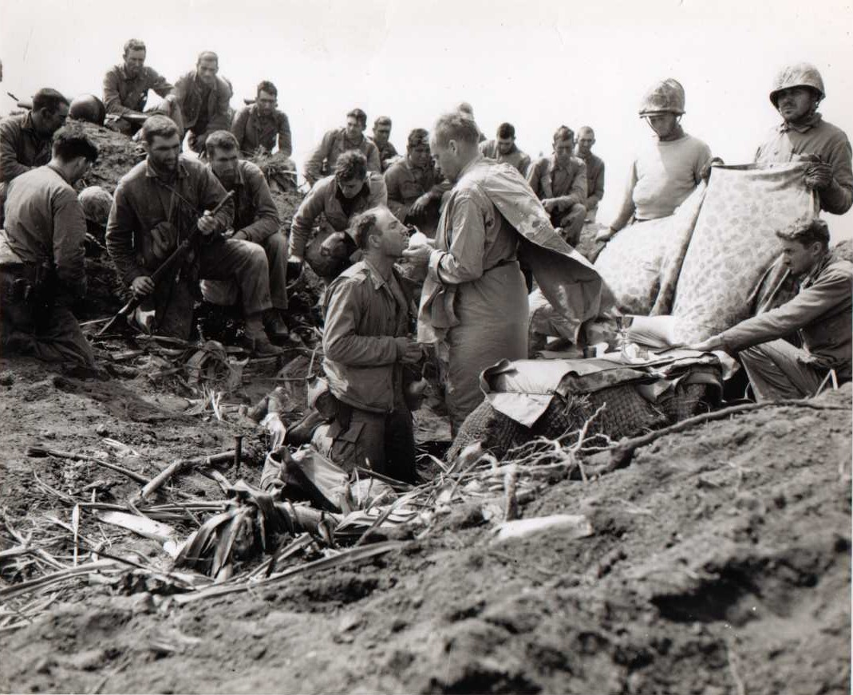
What was the Human Cost of taking
Iwo Jima and Okinawa?
American Death Toll:
6,000 Iwo Jima
7,500 Okinawa
Japanese Death Toll:
Over 120,000

Slide 43
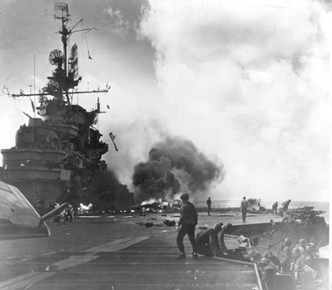
Kamikaze Pilots

Slide 44
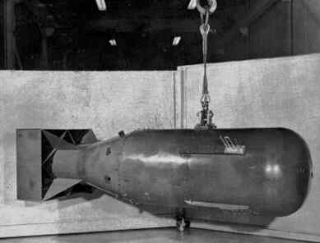
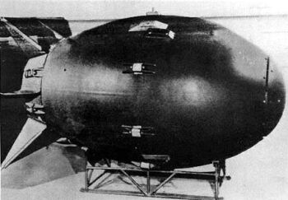
August 1945- Atomic Bomb
Prospect of terrible casualties if U.S. invaded Japan lead to
Harry Truman ordering use of atomic bomb on cities of
Hiroshima and Nagasaki to force surrender. Tens of thousands
of people killed. Japan surrenders.
Little Boy
Fat Man

Slide 45
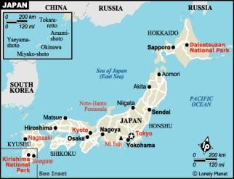
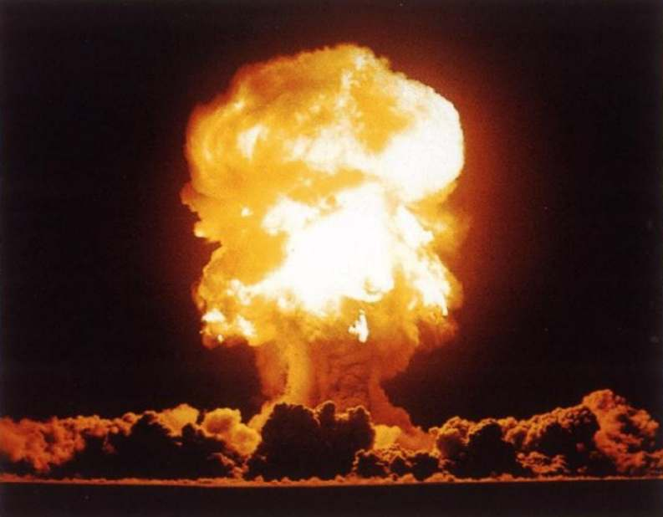

Slide 46
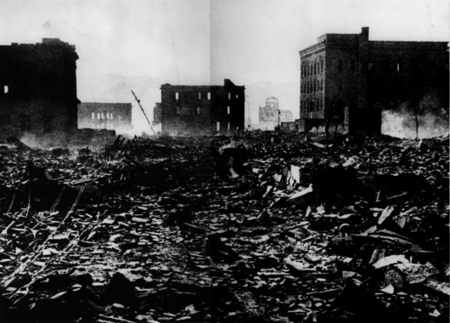
Hiroshima

Slide 47
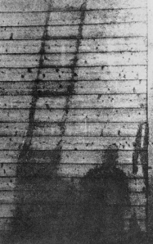
People/objects were instantly evaporated from intense heat of blast often leaving behind their shadows imprinted on the wall

Slide 48
Essential Understandings
Many economic and political causes led to World War II. Major theaters of war included Africa, Europe, Asia, and the Pacific Islands. Leadership was essential to the Allied victory.

Slide 49
End of and Outcomes of World War II

Slide 50
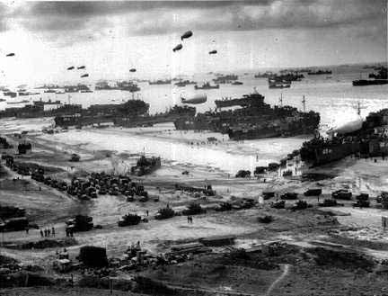
D-Day- Allied commander in Europe
June 6th, 1944
Allied troops land on Normandy
Goal= take France back from the Axis powers and invade Germany

Slide 51
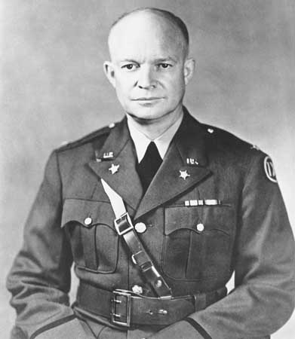
Led by Dwight. D. Eisenhower- Allied commander in Europe

Slide 52
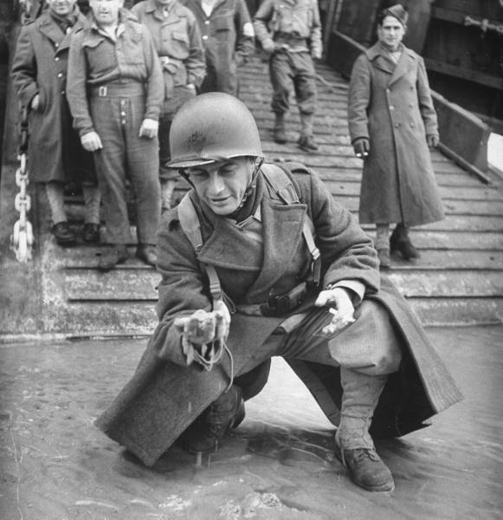
Liberation of France
August 1944
France is liberated by Allied forces
Direct result of the successful surprise attack on the beaches of Normandy

Slide 53

Ending the War
Pacific Theatre: Dropping the atomic bombs on Hiroshima and Nagasaki
European Theatre: V-E Day (Victory in Europe)- May 7, 1945, Germans surrendered after Allies took Berlin

Slide 54
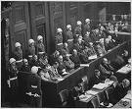
War Crimes Trials
Nuremburg Trials: 142 German and Austrian officials found guilty!
Charges brought against officials: conspiracy, crimes against peace, war crimes, crimes against humanity
Some received death sentences, showing that officials could be held responsible for actions during wartime

Slide 55
Outcomes of World War Two
Loss of empires by European powers
Establishment of two major powers in the world: US and the Soviet Union (USSR)
War crimes trials (Nuremburg)
Division of Europe between Democratic powers and the Soviet Union (communist satellites) NATO vs. Warshaw Pact

Slide 56

Outcomes continued
George Marshall- US Gen. (later U.S. Secretary of State)
Marshall Plan: plan to rebuild Europe (economic and political win/win)
35 Billion dollars in aid

