Slide 1
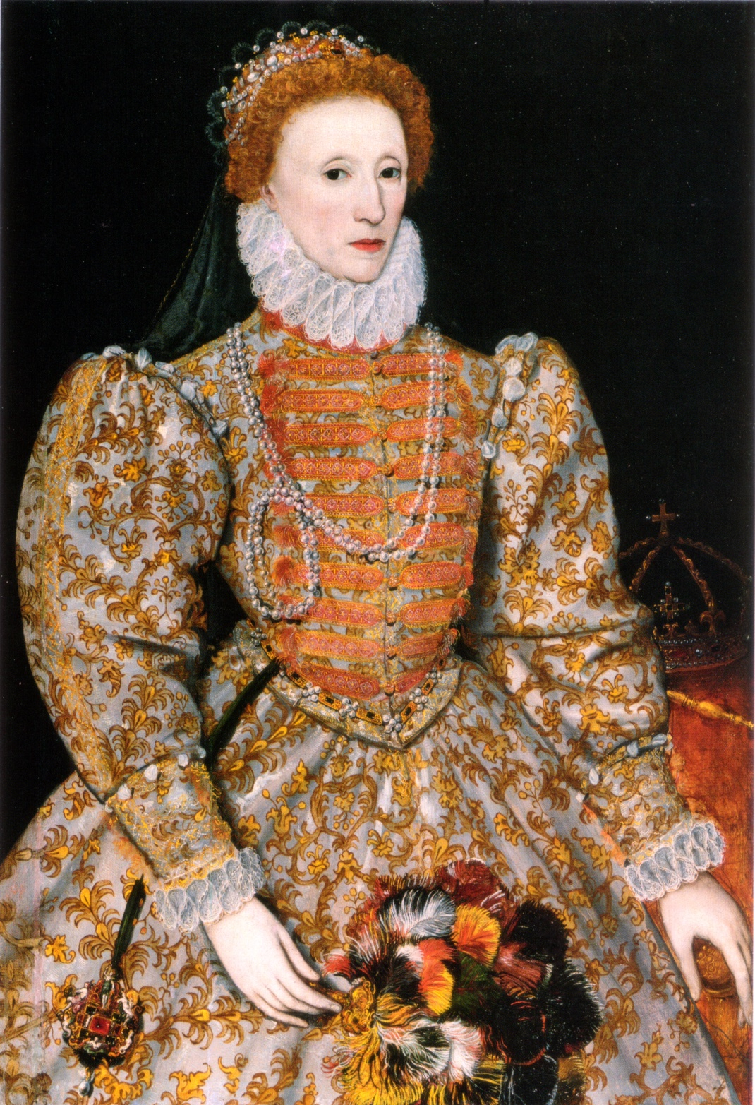
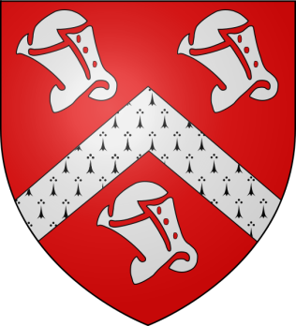
Elizabeth
Like her father King Henry VIII ,queen Elizabeth believed in the tenants of divine right, yet they both consulted and controlled the English parliament, recognizing the value of good relations with the representative body.
Queen Elizabeth was the last of the Tudor dynasty as she had no brothers or sisters and no heirs due to the fact that she never married.
When Elizabeth died the throne shifted to her relatives the Scottish Stuarts.

Slide 2
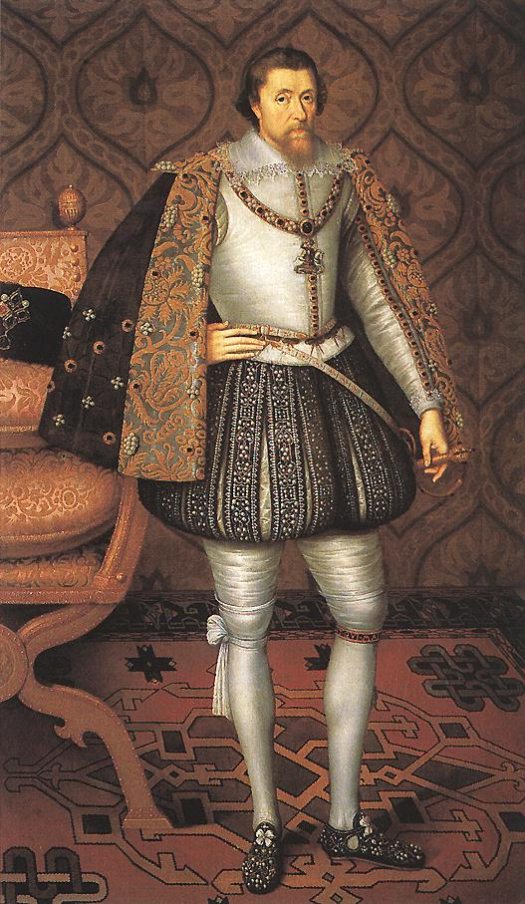
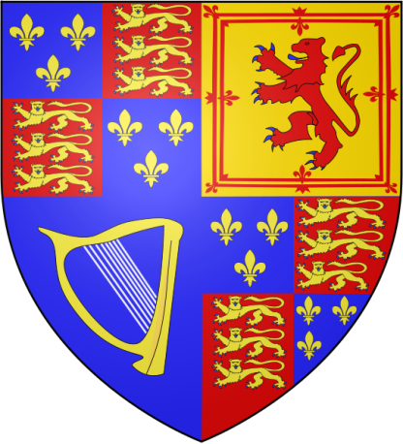
The Stuarts: James I of England
James had been the king of Scotland for 36 years . Under his reign Scotland, England and Ireland were ruled by one monarch.
James also believed in divine right and absolute rule but did not have the same views as the Tudors when it came to dealing with parliament.
Like other English kings James needed to go to parliament to raise money to finance his court and wage wars.
After several clashes with parliament over the budget James dissolved the body after members refused to raise funds for the king until they discussed foreign affairs.

Slide 3
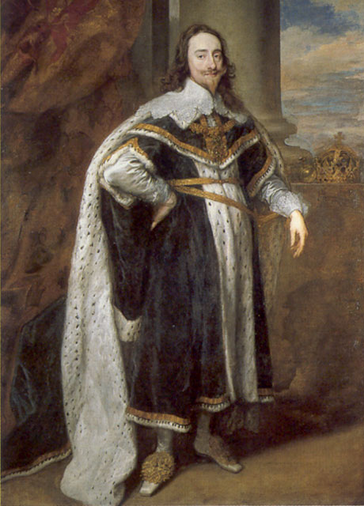

Charles I
Charles adopted
several problems from
his late father. He shared
James’ lack of admiration for the English parliament as well as challenges from dissenters called puritans.
Charles also needed to raise funds, calling on parliament to serve its king.
Before Parliament would do anything Charles had to sign the Petition of Right, a document which limited the kings powers of raising taxes himself and imprisonment without just cause.
Charles signed the document, ignored its contents and then dissolved Parliament a year later.
This made him many enemies.

Slide 4
REVIEW
The Stuarts were the ruling family of what country before inheriting the English throne?
Who did the King of England have to go to to raise funds for court life and taxes?
What two groups did both James I and Charles I have problems with?

Slide 5
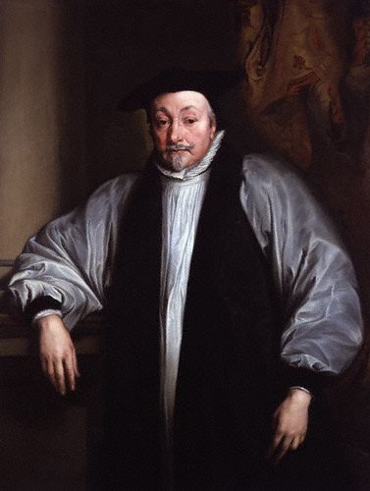
Charles and Parliament
Charles was not only making enemies in the English Parliament but also among religious dissenters.
The Archbishop of Canterbury, William Laud was forcing the Anglican Church (Church of England) on dissenters, dismissing or imprisoning religious officials who did not obey.
When Laud attempted to force the Scottish to accept the Anglican prayer book the Scots revolted.
English citizens would pay no more taxes so Charles called parliament into session to raise funds to put down the rebellion.
Charles had to agree to several concessions including allowing the execution of Laud.
The king heard rumors that his catholic queen would be impeached and led armed guards into parliament to arrest five of the most radical members.

Slide 6
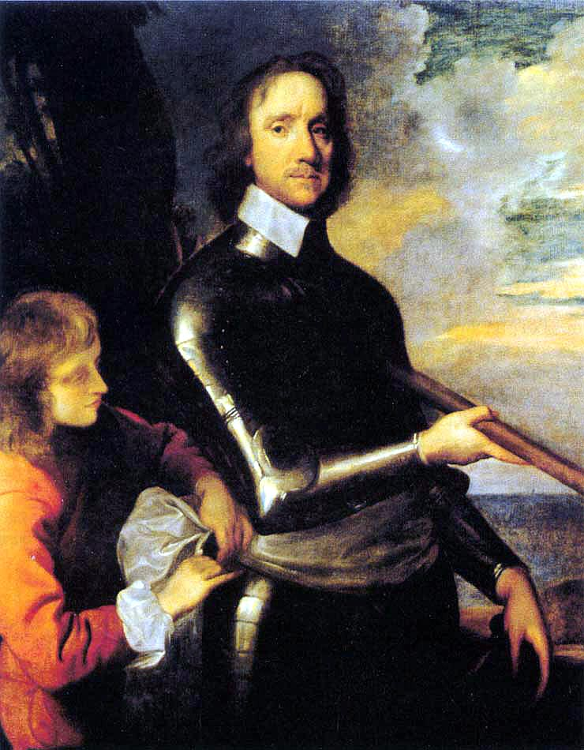
Oliver Cromwell
It was evident that a conflict was imminent between the forces of parliament and those loyal to the king.
Charles fled to the North while Parliament raised an army around London in the south.
The war was fought over seven years in two parts involving a Scottish invasion, and an Irish rebellion, with battles won and lost on both sides of the conflict.
Eventually the New Model Army (a mostly puritan consolidated parliamentary force) led by Oliver Cromwell was victorious over the royalists and seized Charles.
Afterwards a number of royalist leaders were executed for taking part in the second civil war.

Slide 7
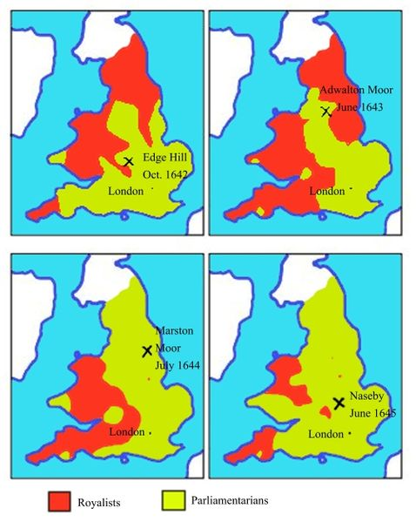
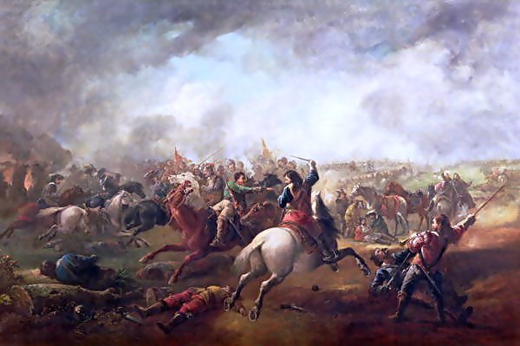

The English Civil War

Slide 8
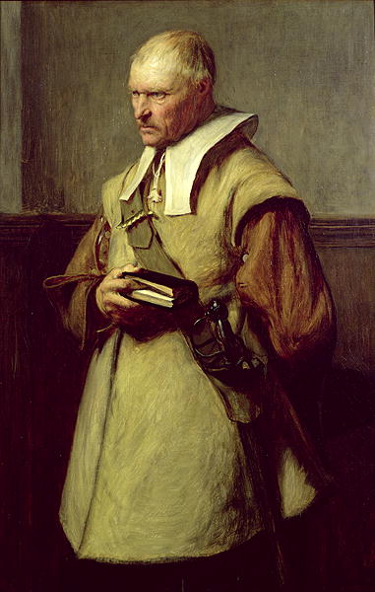
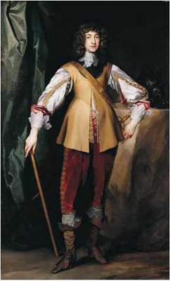
The Two Sides
Roundhead
Parliamentarian
Cavalier
Royalist
Country gentry, town-dwelling manufacturers, and puritan clergy.
Led by Oliver Cromwell
Wore haircuts close to the head.
Well trained, wealthy nobles.
Supported the king
Wore plumed hats and long hair.

Slide 9
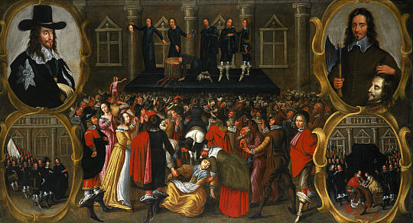
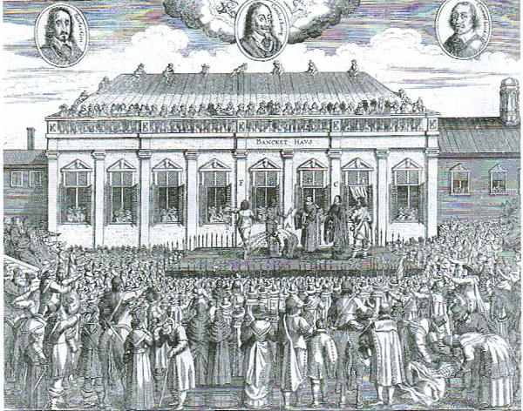
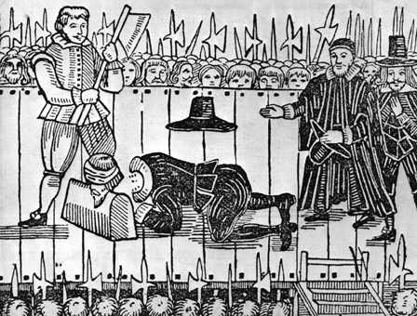
SOL
Oliver Cromwell and the execution of Charles I
Execution of Charles I
Charles was put on trail, charged with high treason and executed in 1649.
This marked the first time a monarch had been tried, sentenced, and killed by his own people.

Slide 10
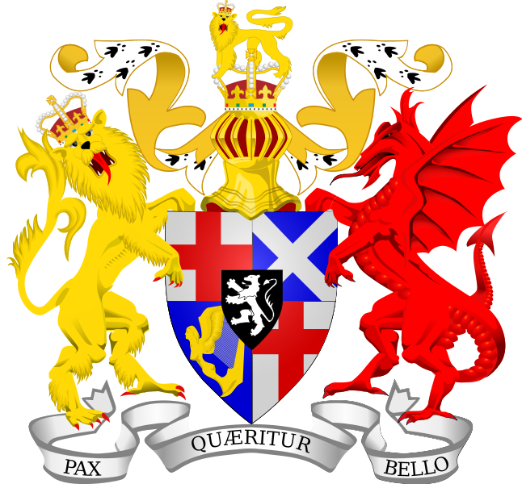
The Commonwealth
After Charles was executed the monarchy was abolished by the house of commons (the rump parliament) along with the House of Lords and the Church of England.
Cromwell was designated the new countries leader later given the title “Lord Protector.”
The Commonwealth immediately faced invasion from Ireland and Scotland as royalists attempted to place Charles II on the throne yet these threats were soon neutralized by Cromwell's army.
Strict Puritan laws were enacted which frowned on theatres, taverns, dancing, gambling, and Catholicism .
Cromwell dismissed the rump parliament and ruled Britain by himself (the Protectorate) for five years until his death.

Slide 11
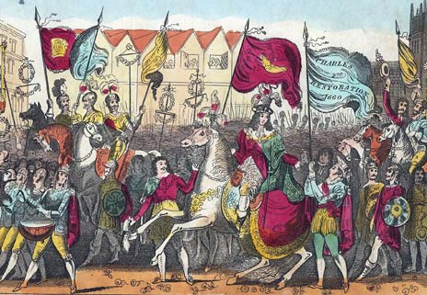
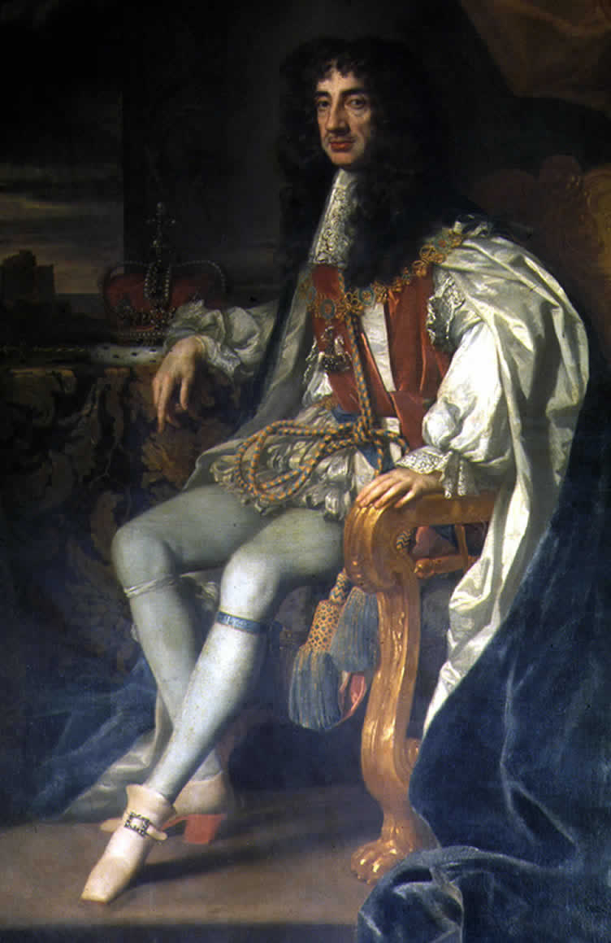
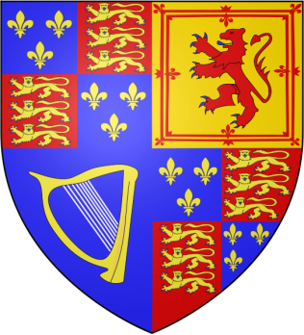
Restoration of the Monarchy, Charles II
The New Model Army did not have faith in Cromwell’s son as a leader and replaced him with Parliament.
Parliament reflecting the peoples weariness of military rule under puritan law invited Charles II to take the throne.
Many of the supporters of the Commonwealth were pardoned while those who participated in the trial and execution of Charles I were hunted down and killed.
SOL
The restoration of Charles II

Slide 12
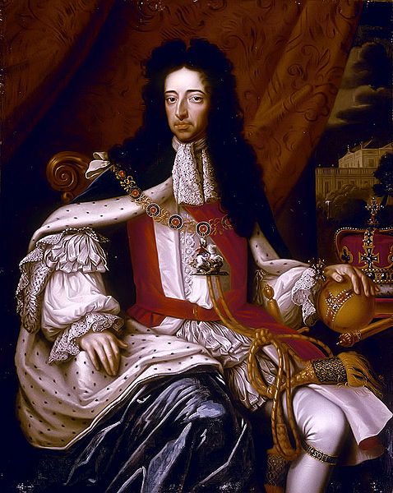
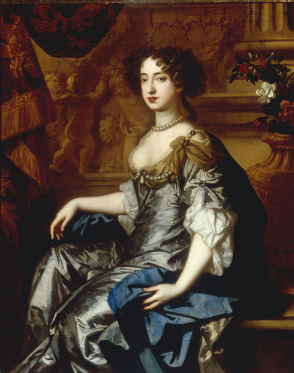
The Glorious Revolution
After Charles II death his brother James II took the English throne.
James was a Catholic and a firm believer in absolute monarchy, he ignored and suspended laws and appointed Catholics to high offices in the government.
A troubled parliament decided to invite James’ protestant daughter and her husband from the Netherlands to take the throne.
William and Mary arrived in England with an army to take power away from James but didn’t need to fire a shot as the “revolution” was overwhelmingly accepted.
James fled and Britain's kings would not rule without Parliament ever again.
SOL
Development of the rights of Englishmen: Glorious Revolution (William and Mary).

Slide 13
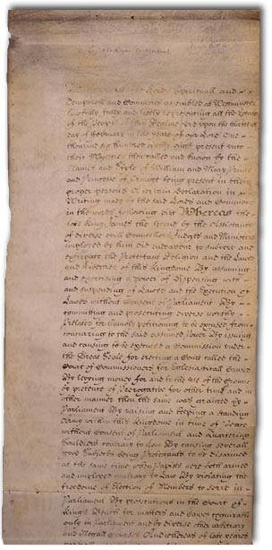
The English Bill of Rights
Before parliament would allow William and Mary to occupy the empty throne it drew up a bill of rights outlying the limits of the English Monarchy and establishing civil liberties.
Parliament
Had to be summoned regularly
Freedom of speech
Freedom to elect members without the monarch
Had to be consulted before:
The army could move against the people
New taxes were created
Religion:
Protestant had the right to bear arms
NO CATHOLIC COULD BE THE RULER OF BRITTAIN
The People:
Freedom from cruel and unusual punishment
Trial by jury
Habeas Corpus
SOL
Development of the rights of Englishmen: Increased Parliamentary Power over royal power

