Slide 1
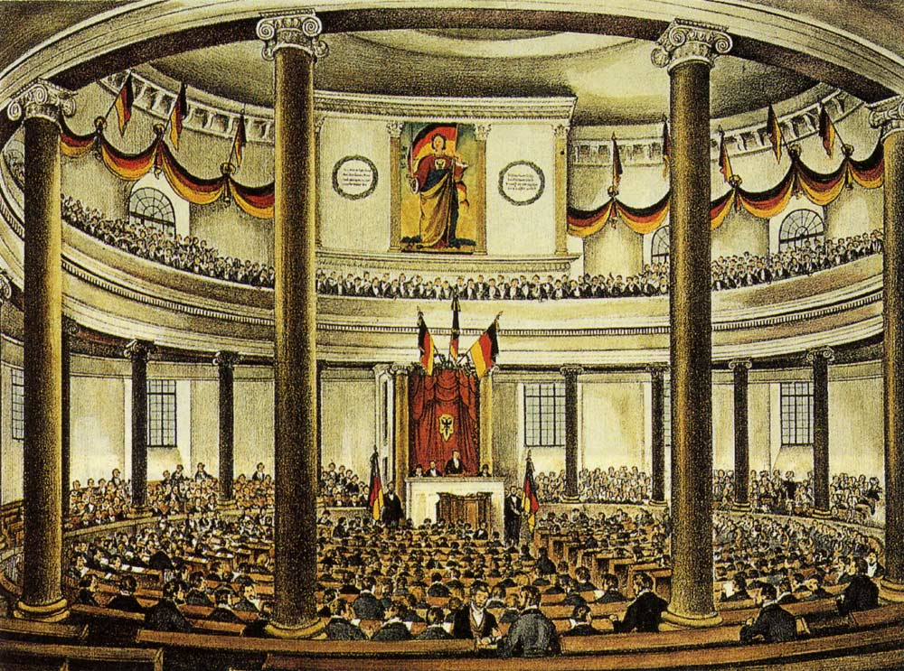
Russia and Revolution

Slide 2
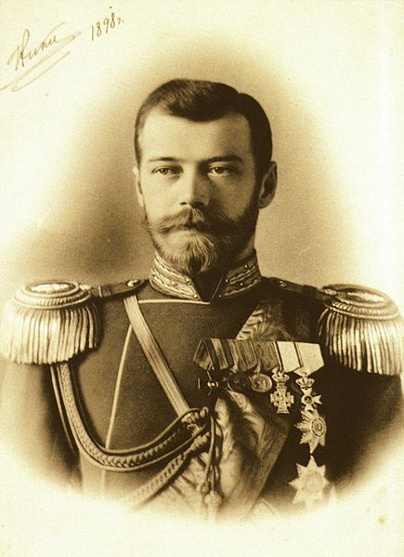
The March Revolution
Setting the Stage
  Russia was still ruled by feudalism
  Most peasants were living in poverty
  A small middle-class existed as Russia began to industrialize
Czar Nicholas II
  Refused any limits to his power
  Relied on his secret police to enforce his will

Slide 3
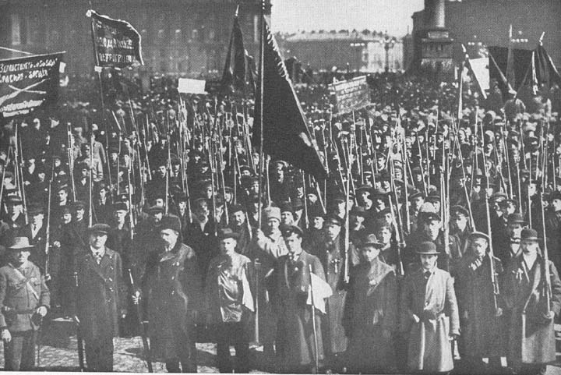
The March Revolution
Duma: an elected legislature that held no real power over the Czar
Moderate Reformers: wanted a constitution and basic social change
  Wanted to fix the court system and reform the bureaucracy

Slide 4
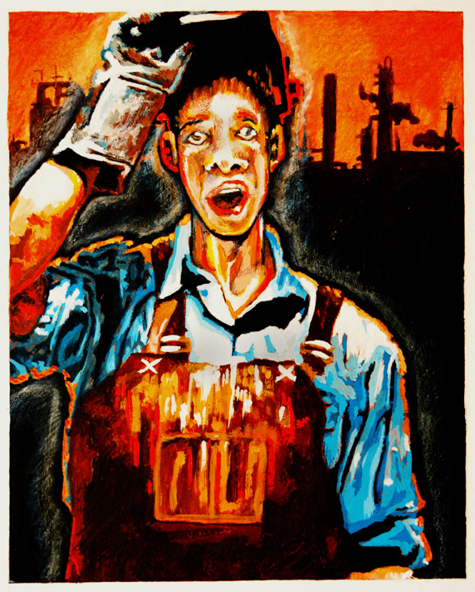
March Revolution
Marxists: followers of Marx’s ideas (communism)
  Wanted to overthrow the government
  Thought the proletariat would rise up and set up a communist government in Russia
  Proletariat= urban working class

Slide 5
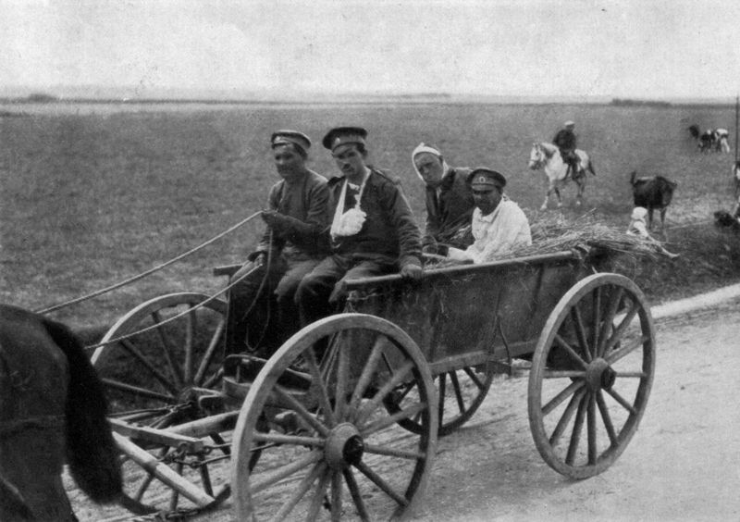
The March Revolution
World War I
  United Russians behind the army
  Quickly drained Russia’s resources
  Many soldiers went without basic necessities
  In 1915, Russia suffered 2 million casualties

Slide 6
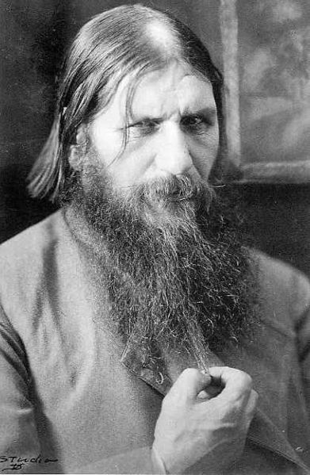
Gregory Rasputin
Illiterate peasant / “holy man”
Czarina Alexandra relied on him for advice and as a healer to her ailing son
Rasputin’s influence weakened the Russian peoples’ confidence in government
Afraid of a revolution, a group of nobles murdered Rasputin in late 1916

Slide 7
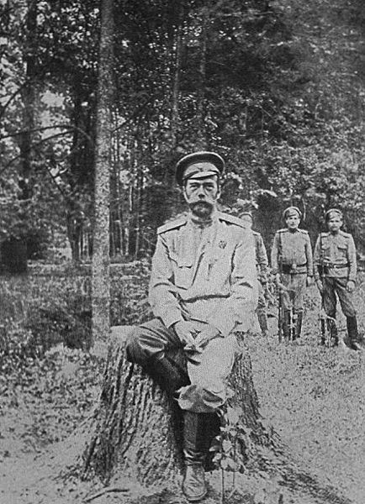
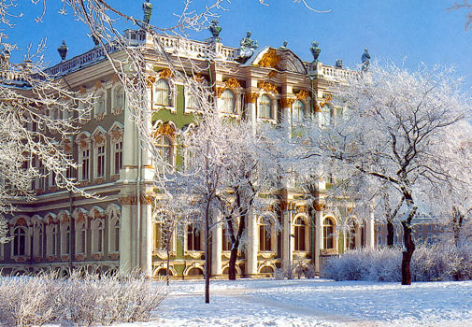
End of the Monarchy
Poor military performance in the war combined with food shortages and a workers strike in St. Petersburg
Troops refused to fire on protestors outside the Winter Palace
The Czar was forced to abdicate

Slide 8
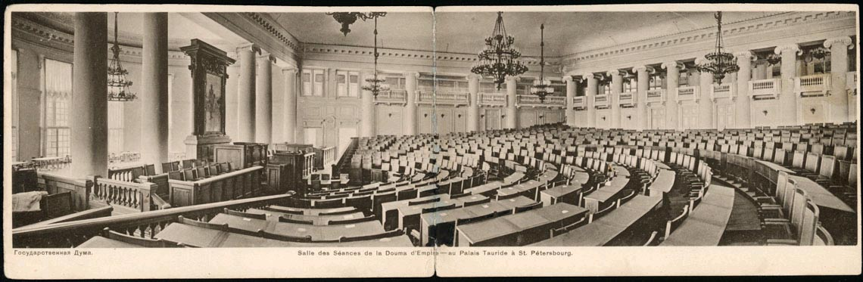
New Government
The Duma
  set up a provisional government
  Began writing a constitution
  Continued Russian participation in the war
Russian People
  Fed up with the war
  Peasants wanted land
  Revolutionary socialists set up Soviets, or workers and soldiers councils

Slide 9
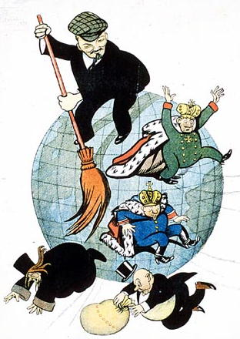
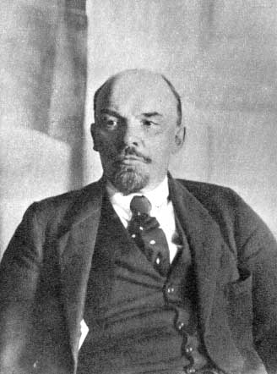
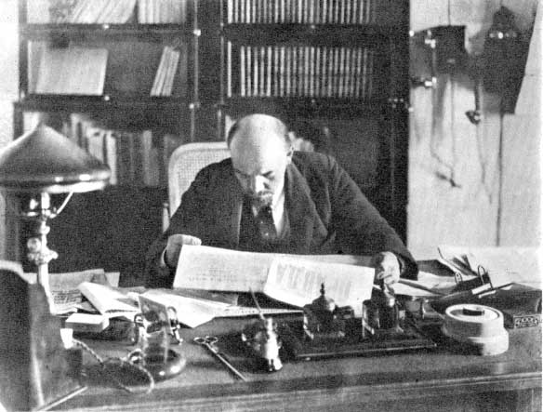
Vladimir Lenin
Lived in Switzerland to keep out of reach of the Czar’s secret police
Wanted to set up a “dictatorship of the proletariat”
His followers were called Bolsheviks

Slide 10
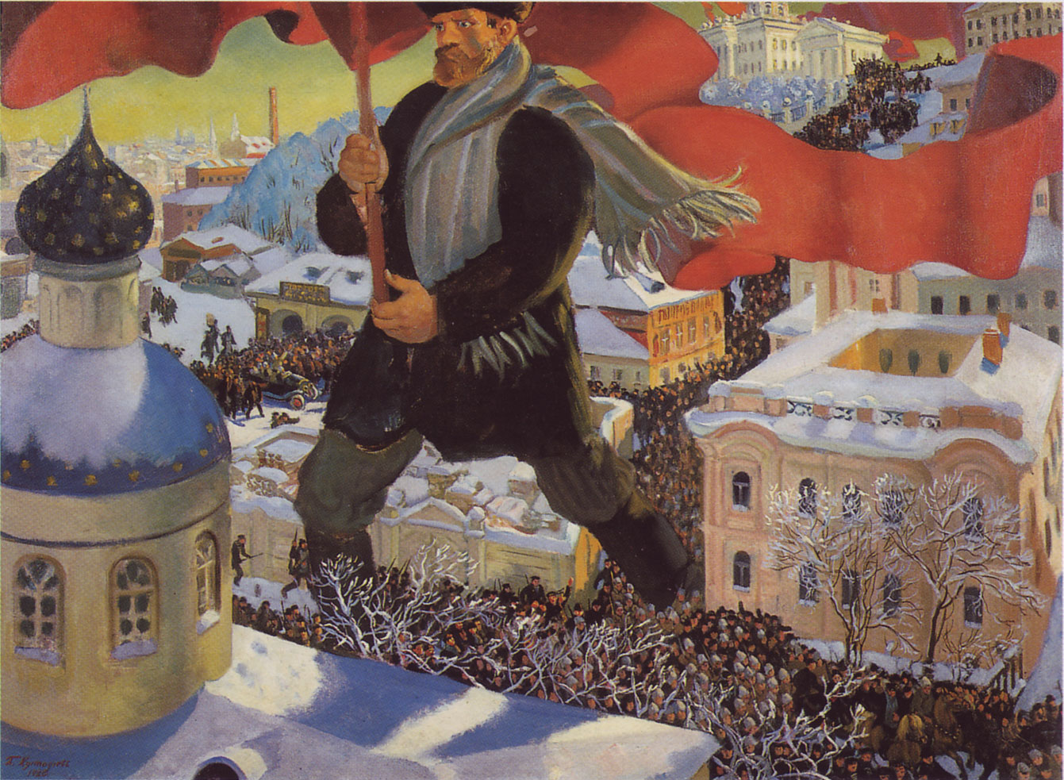
The November Revolution
Red Guards: armed factory workers
Deserted sailors from the Russian fleet joined the Red Guards and attacked the provisional government
In a matter of days, Lenin’s forces had overthrown the provisional government
Quickly gained control of other cities, ended private ownership, and redistributed land and factories to the people

Slide 11
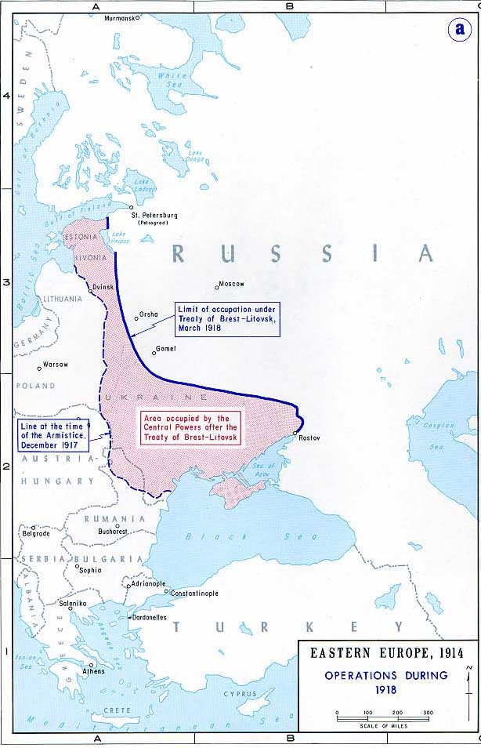
Treaty of
Brest-Litovsk
Ended Russian participation in the war
Gave up huge tracts and territory
Bolsheviks needed to focus on fighting off people still loyal to the Czar, or “Whites”

Slide 12
Russian Civil War
3 years of war between the whites and reds
Nationalist movements in Poland, Estonia, Latvia, and Lithuania broke free
Nationalist movements in Ukraine and Central Asia failed
Western democracies sent troops to help the whites
  Created Soviet distrust of the West
Millions perished from starvation and disease

Slide 13
Soviet Union
Government
  Democratic and Socialist constitution
  Supreme Soviet-universal suffrage for 18 and up
  In reality, only party members had full rights
    Used army and secret police to enforce will
War Communism
  Gov’t took over banks, mines, and factories
  Forced peasants to give surpluses to cities
  Peasants were drafted to the army or factory

Slide 14
NEP
Lenin was forced to retreat from war communism
  Factory output had fallen
  Peasants stopped producing grain
New Economic Plan (NEP)
  Gov’t kept control of banks, big industry, and foreign trade
  Small businesses started and farmers sold surplus crops
  Lenin saw this as temporary

Slide 15
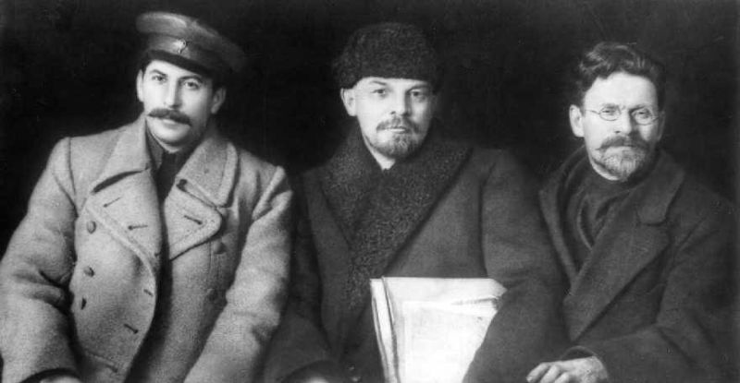

Slide 16
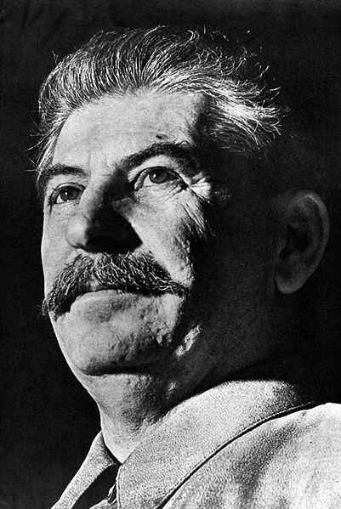
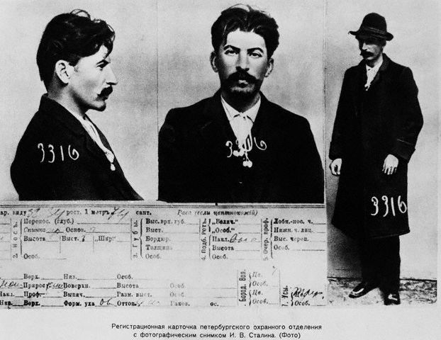
Stalin and Trotsky battled for power after Lenin’s death
  Ended with Stalin in power and Trotsky in Mexico

Slide 17
Comrade Stalin
Stalin quickly went to work by revoking the NEP
Started the Five Year Plans and developed Russia’s Command Economy
  Command Economy: gov’t makes all economic decisions
  Five Year Plans: aimed at building heavy industry, improving transportation, and increasing farm output

Slide 18
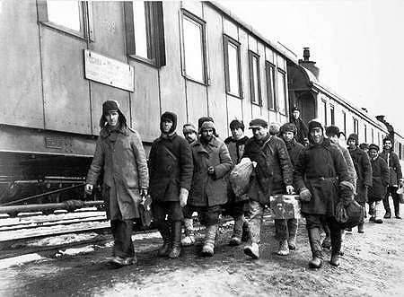
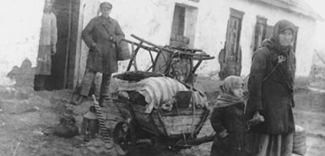
Five Year Plans
Peasants were able to keep their houses
  All else went to the state “collectives”
  Farm animals and all machinery
Kulaks: wealthy peasants
  Land was confiscated and sent to work camps

