Slide 1
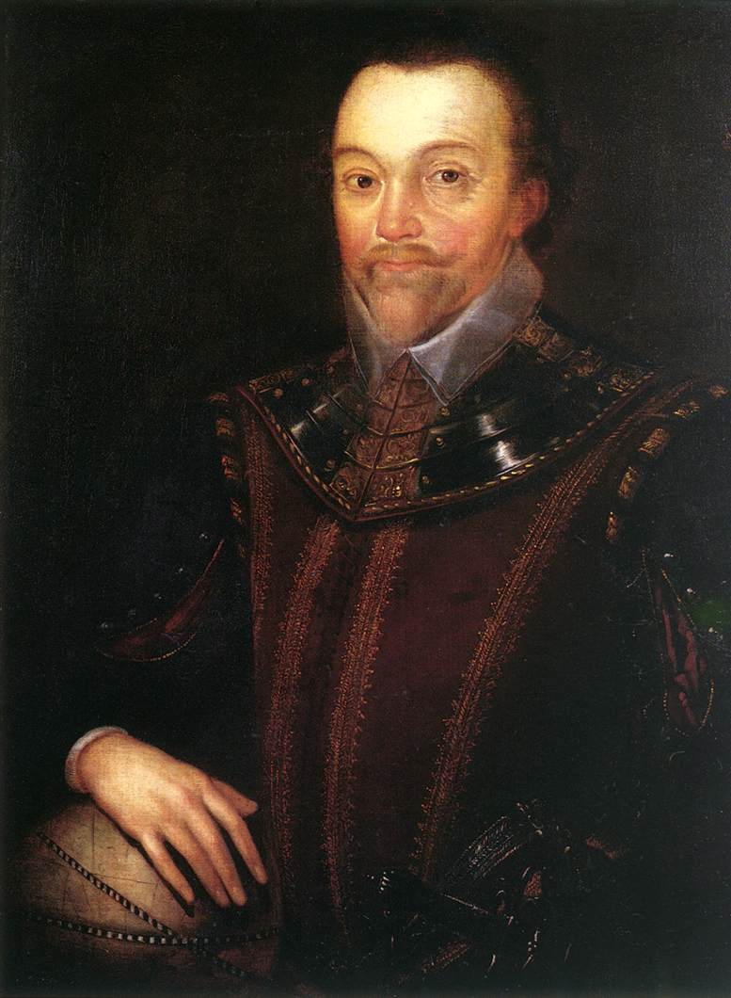
Francis Drake
SOL
Taking command of his own ship by the age of 20 Francis Drake was a natural seamen.
Having several close run-ins with Catholic Spanish forces when he was young caused Drake to dislike and distrust the Spanish immensely.
In his early years off the American coast Drake sailed as a slave trader and privateer against Spanish holdings in the new world.
Later Queen Elizabeth I sent Drake on a mission against Spanish holdings along the Pacific by way of the Strait of Magellan.
Creation of empires and destruction of native peoples.

Slide 2
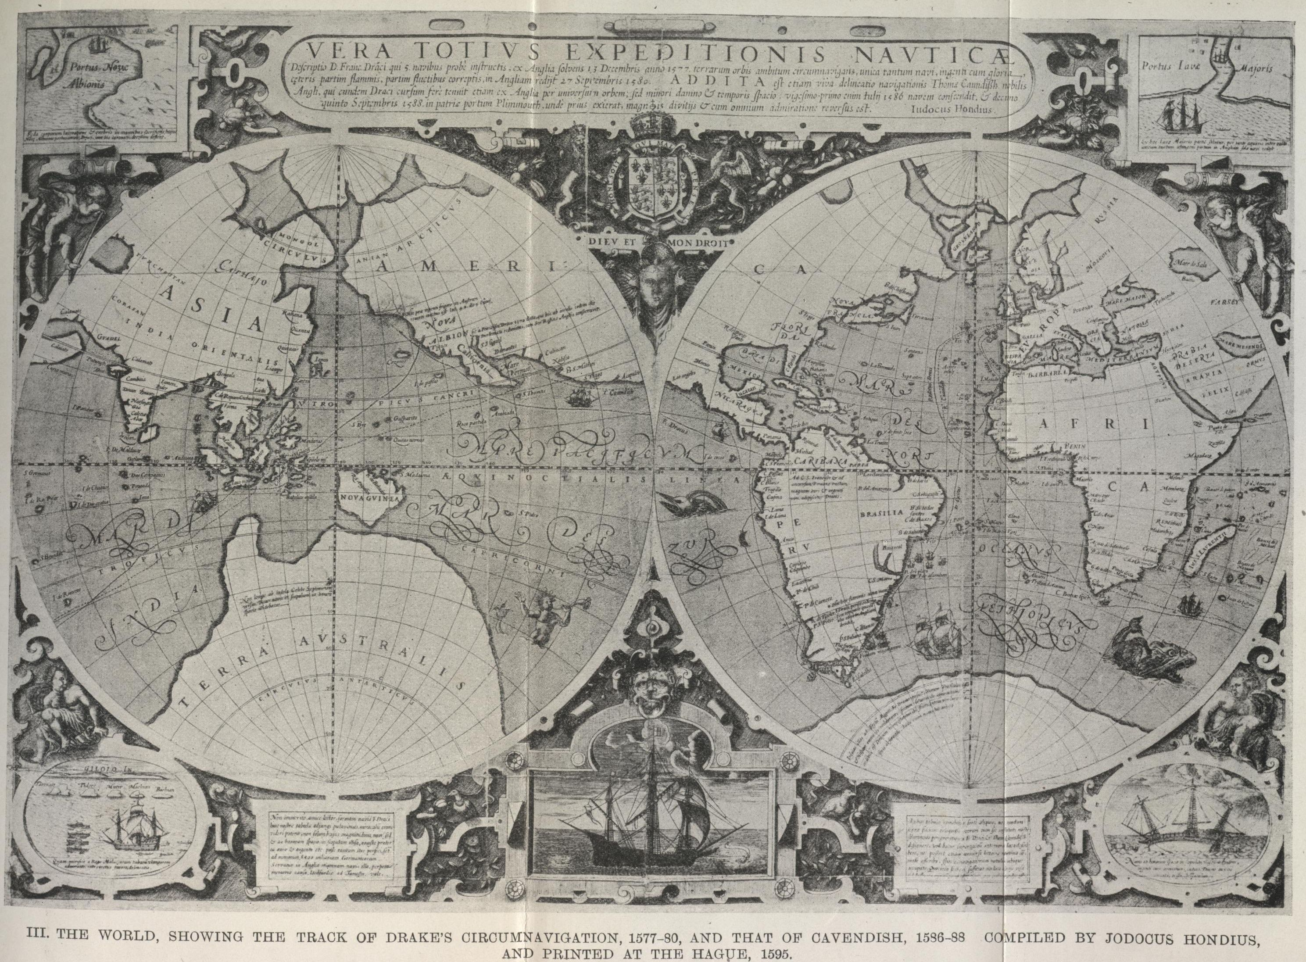
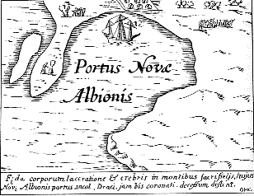
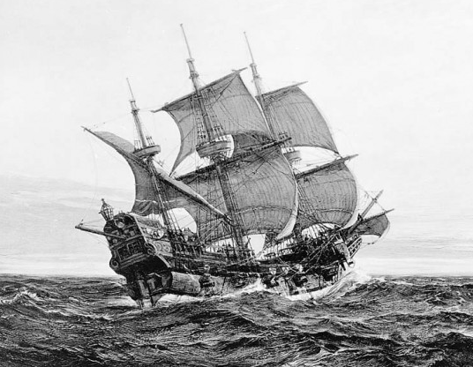
Drake arrives back in England with a sizable amount of spices and Spanish loot.
Drake leaves England with 5 ships and 163 men.
Drake stops at the Spice Islands to trade.
By the time Drake arrives at the Pacific he has one remaining ship left, the Golden Hinde.
While Drake and his crew search for the northwest passage they claim North America for England calling it Nova Albion (New England)

Slide 3
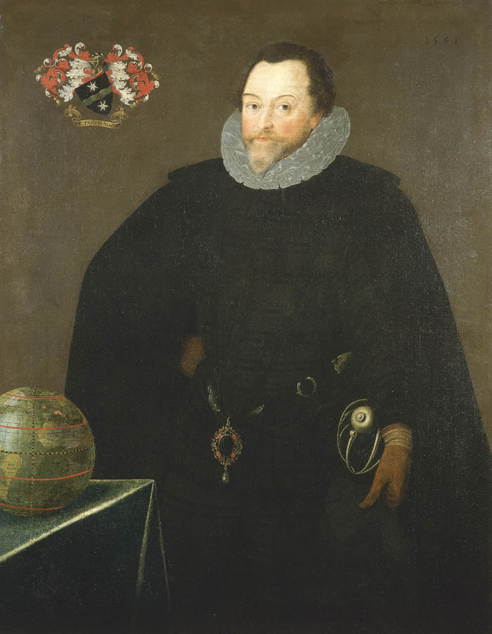
Drake was successful at attacking several Pacific Spanish ports and robbing Spanish ships at sea.
While at camp in “New England” Drake took part in one of the first protestant masses on the North American continent, which was a spit in the eye of the Catholic church.
The significance of Drakes “claim” of North America for the English was not meant to be subtle or ceremonial. All English maps from then on claimed the territory above Spanish New Mexico as “Nova Albion”. This would go on to affect American ideals of manifest destiny and negotiations after the Mexican-American War.
Drake returned from his voyage with 59 of his sailors.

Slide 4
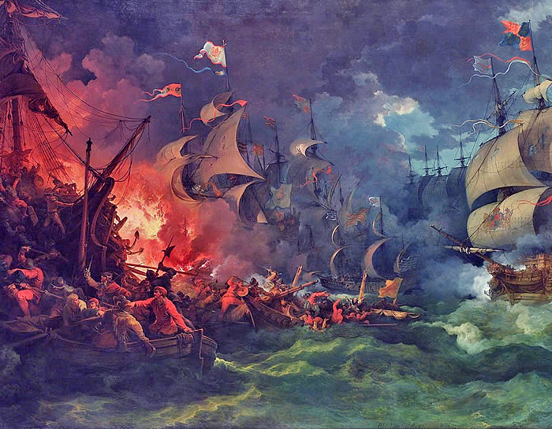
When war broke out between England and Spain Drake sailed to the new world sacking two Spanish cities and capturing a Florida fort.
Later Drake sailed into two of Spain’s largest ports destroying merchant ships and delaying a planned invasion of England for a year.
When the Spanish Armada did attack England Drake was the vice admiral of the force which overpowered it.

