Slide 1
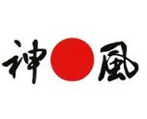
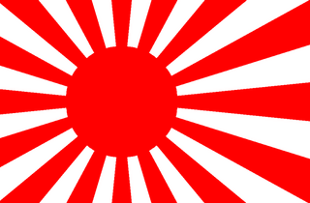
Japan’s Road to War

Slide 2
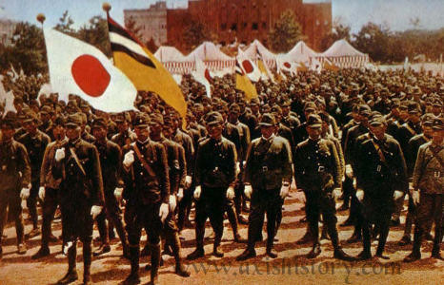
Japan Felt Disrespected
Treaty of Versailles
      Japan left unsatisfied
Washington Naval Conference
      5:5:3 ratio
American Immigration Policy
      Japanese immigrants excluded on the West Coast
Manchukuo
      America refused to recognize it

Slide 3
The China Incident
The Chinese proved more resilient than the Japanese thought
    Japanese Army was beginning to wear down
In 1940, Japanese – American trade treaty ended
    U.S. refused to renew
Japanese focus turned to the south (Thailand, Burma, Malaya, French Indochina, and Dutch East Indies)
    Valuable war supplies and materials (tungsten, rubber, tin, rice, oil)

Slide 4
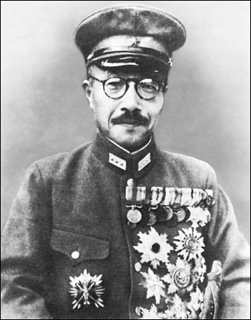
Tensions Growing
General Hideki Tojo promoted from
Minister of War to Premier
Escalation of militaristic attitudes
As Japan became more openly
expansionist, the U.S. let it be known
that they disapproved
Negotiations continued through November of 1941 but Japan had already made up its mind that war with the U.S. was inevitable

Slide 5
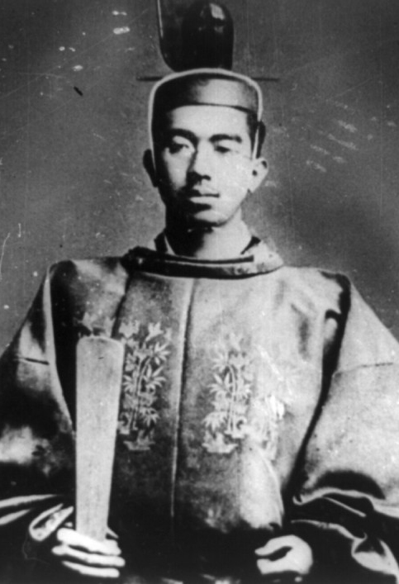
Bushido
Ancient Japanese code of honor –
Think Samurai Warriors
Emperor Hirihito →
Used this as a tool to motivate
the masses to fight and die in the
name of the Emperor
This was not the true intentions of
the Bushido code

Slide 6
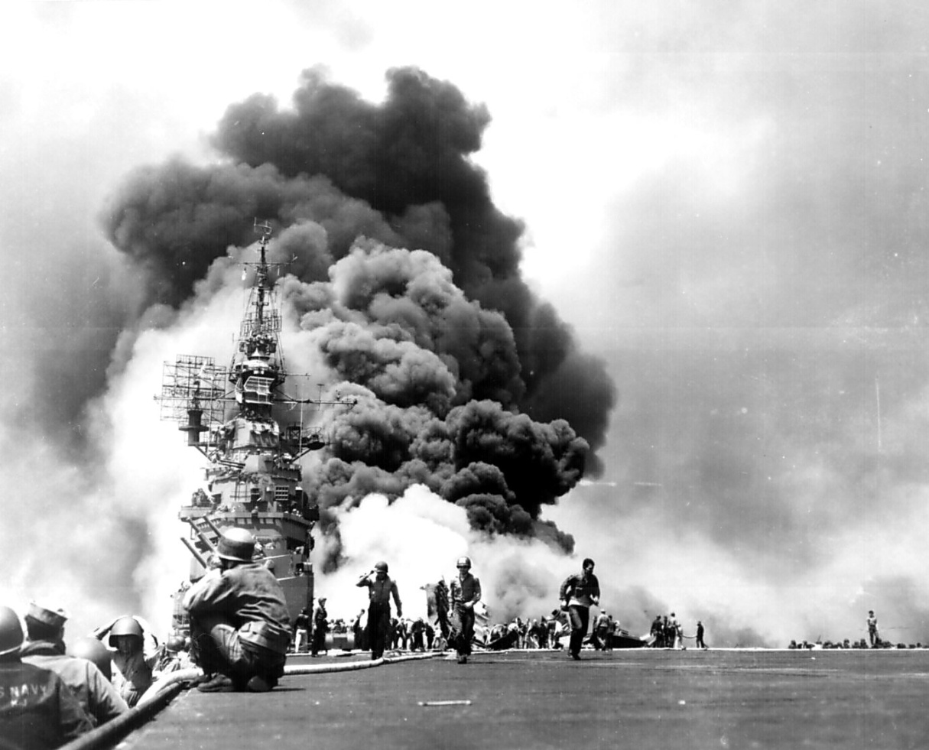
Kamikazes
1281 – Mongol Emperor Kublai Khan’s invasion repelled by a typhoon
  A sign from the Sun Goddess
Twentieth century version of the Divine Wind
The Japanese deliberately
crashed their planes into
American targets
Death for their Emperor
Sign of desperation

