Slide 1
Personal Finance 5.01
How do the rights and responsibilities of consumers affect the buying experience?

Slide 2
K
Write one thing you know about the following topics
Consumer rights
Consumer responsibilities
Consumer protection

Slide 3
W
Write one thing you WANT to know about the following topics
Consumer rights
Consumer responsibilities
Consumer protection

Slide 4
Key Terms Preview

Slide 5
A Recent Purchase
Discuss with a partner a recent purchase of a durable, non-consumable item (camera, cell phone, ipod, ear phones, etc.)
Share and discuss responses to the following questions:
Describe the process used to select this item for purchase.
What sources of information did you use to help you decide what to purchase?
Return to whole group to share highlights of discussions.
Summarize; discuss findings.

Slide 6
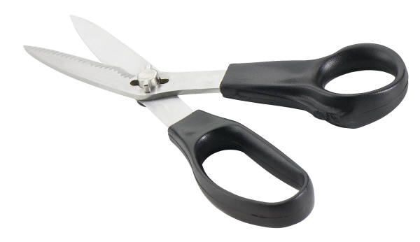
Consumer Rights & Responsibilities Flipper
Fold in half (hamburger style)
Open back up
Fold each side into the center crease
Cut the flaps
Make reference lines so you know where to write!

Slide 7

PF 5.01
Consumer
Rights and Responsibilities

Slide 8

Consumers have rights and accompanying responsibilities.
Exercising consumer rights and responsibilities helps to balance the marketplace.

Slide 9
Consumer Rights
A basic set of protections, agreed upon by society and written into law, that apply to purchases of merchandise and services in the United States

Slide 10
Right to be safe
Consumers should be protected against products that are hazardous

Slide 11
Right to be informed
Consumers should be protected against dishonest advertising, labeling, or sales practices. They should be given the facts needed to make informed choices.

Slide 12
Right to choose
Consumers should have the opportunity to select from a range of goods and services, make free choices of items for purchase, and choose place of purchase.

Slide 13
Right to be heard
Consumers should know that their interests will be considered in the making of laws.

Slide 14
Right to redress
Consumers are entitled to swift and fair remedies for wrongs that are done.

Slide 15
Right to consumer education
Consumers should have the opportunity to learn how to be effective consumers.

Slide 16
Right to service
Consumers have the right to expect convenience, courtesy, and responsiveness from businesses.

Slide 17
Right to a healthy environment
Consumers have a right to live and work in an environment that is non-threatening to the well-being of present and future generations.

Slide 18
Consumer Responsibilities
Types of activities a consumer is expected to perform as part of a purchase decision

Slide 19
Responsibility to use products safely
Consumers should use products as they are meant to be used.

Slide 20
Responsibility to use information
Consumers should look for information about products they plan to buy and use it to compare and evaluate different brands and models.

Slide 21
Responsibility to choose carefully
Consumers should use their buying power intelligently to encourage ethical business practices and safe, reliable products.

Slide 22
Responsibility to speak up
Consumers should let public officials know their opinions about consumer issues.

Slide 23
Responsibility to seek redress
Consumers should pursue remedies when products and services do not meet expectations.

Slide 24
Responsibility to learn
Consumers should take advantage of every opportunity to develop and improve consumer skills.

Slide 25
Responsibility to reward good service
Consumers should be courteous and responsive to businesses in return. They should show their appreciation for good service by patronizing businesses that provide it.

Slide 26
Responsibility to care for the environment.
Consumers should respect the earth and overall environment by measures such as responsible waste disposals, preservation and conservation of natural resources.

Slide 27
Consumer Reports Activity
What kinds of information did you find in Consumer Reports that would help you be a more effective consumer?
How would the information help you make better purchases?
What are some other useful sources of information? (websites, brochures, magazine articles, etc.)

Slide 28
Sources of Consumer Protection

Slide 29
Federal Agencies:
Federal Trade Commission (FTC) – Ensure fair transactions, product labels, privacy
Department of Labor (DOL) – Ensure fair and reasonable working conditions
Food and Drug Administration (FDA) – Protect against unsafe food, drugs, cosmetics
Consumer Product Safety Commission (CPSC) – Set safety standards for products
Department of Housing and Urban Development (HUD) – Supervises programs related to housing needs and fair housing opportunities
United States Department of Agriculture (USDA) – Inspects and sets standards for meat, poultry, and canned foods

Slide 30
State Agencies:
Attorney General’s Office – takes legal action on behalf of the state and its citizens
NC Cooperative Extension – provides unbiased research-based consumer education and information

Slide 31
Merchant Services
Warranty and return policies – provide guidelines for dissatisfied customers
Consumer affairs departments – deal with consumer concerns and complaints

Slide 32
Consumer Advocacy Groups
Better Business Bureau (BBB) – provide reliability reports on businesses, accept consumer complaints
News media – provide consumer investigative reports
National consumer organizations – provide consumer advocacy, educational materials, product/service information

Slide 33

WRAL – local sources of consumer info
Restaurant Ratings
Nail Salons
Consumer Complaints
Buying in Bulk Video
Smart Shopper

Slide 34
Making a Successful Written Complaint

Slide 35
Components of a written complaint:
Company Name and Address
Salutation/greeting
Opening
Body
Closure

Slide 36
Salutation or Greeting:
Directs your complaint to a specific person or position and establish a pleasant rapport.
Identify to whom your complaint letter, email, or conversation will be directed

Slide 37

Opening:
The purpose of the opening is to establish the reason you are contacting the organization.
Write the first few lines of the letter or telephone conversation to identify the reason you are contacting the person or position in the organization.

Slide 38
Body:
The purpose of the body is to describe the details of the problems encountered with the company’s product and to request the desired remedy.
Describe the problem(s) or product defect(s) experienced.
Request a specific remedy such as a refund, a credit to your account, or product replacement.

Slide 39
Closure:
The purpose of closure is to request a response within a certain time period.
Request a written response within a specific time period. Generally, two to three weeks.

Slide 40
Making a Successful Verbal Complaint
Act quickly
Address the right source
Be specific and factual
Be reasonable
Suggest a solution

Slide 41
L
Write two things you have learned on your sticky note and place it in the L section of the KWL poster.

Slide 42

Review K and W sticky notes

Slide 43
Questions/Comments/Concerns

