Slide 1
PF 6.01
Basic Shopping Options
&
Effective Shopping Practices

Slide 2

Options for Shopping in Stores
Retail stores obtain goods from wholesale sources and sell directly to consumers.
Department stores sell a wide variety of goods and services from a single store.
Warehouse clubs and superstores offer price advantages and wide product selection.
Factory outlet stores are owned by the manufacturer or distributor of the merchandise.
Notes:
Click the links for a list of stores

Slide 3

Options for Shopping in Stores (continued)
Discount stores sell certain lines of merchandise at lower prices.
Consignment or thrift stores sell used merchandise at greatly reduced prices.
Specialty stores sell specialized goods and services --- e.g., shoe shops and gas stations.

Slide 4

Options for Shopping in Stores
Pros
Variety of merchandise in one area or under one roof
Close to home for last-minute or emergency shopping
Offers special prices with a membership card
Malls offer special attractions and promotions for customers
Can try on clothes

Slide 5
Options for Shopping in Stores (continued)
Pros
Items are easy to exchange
Offer payment plans
Offer store credit cards
Can work with knowledgeable sales people
Stores offer special services---e.g., gift wrapping

Slide 6
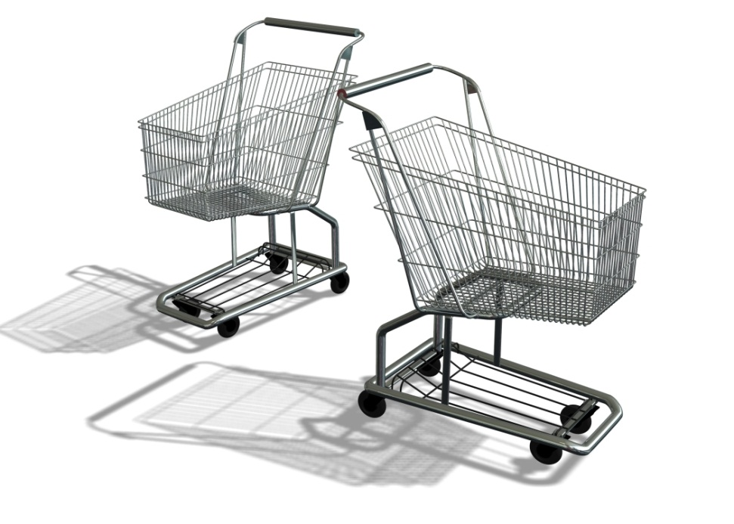
Options for Shopping in Stores (continued)
cons
Takes time to buy costly items
Limited space
Picked-over merchandise
Large crowds on sale days and weekends
Must find a place to park

Slide 7

Options for Shopping at Home
Door-to-door---salesperson comes to home, either by invitation or not
Catalog shopping --- shopper calls on telephone to buy goods listed in a catalog
Telemarketing – seller calls on telephone to sell goods or services
T-commerce – shopping in response to ads on television
E-commerce – buying goods and services on the Internet, including Internet auctions

Slide 8

Options for Shopping at Home
Pros
Buy any time seven days a week
Can obtain special orders
Will deliver
Can purchase on the spot with TV remote control or computer mouse
Buy from the comfort and convenience of home
Can buy from a worldwide market

Slide 9

Options for Shopping at Home
cons
May not know the physical location of the seller
Must have a credit card to pay
May not understand exactly what is being bought
Must check seller’s privacy policy before giving personal/financial information
Must keep a complete record of each transaction
Offers that sound too good to be true may not be
Must check exchange policies; may be more costly or difficult to exchange items
Will have shipping and handling costs added
Must check reliability, legitimacy, and security of sellers before buying
Cannot see or feel quality, size, and/or true color

Slide 10

Effective Shopping Practices
Basic Effective shopping Practices
Plan before you shop
Comparison shop for products and services
Shop wisely in stores and at home

Slide 11
Effective Shopping Practices
Plan Before You Shop
Decide if shopping at home or shopping in stores is most appropriate
Where there is a choice, decide whether it is advisable to purchase goods or services
Check reliability and services of stores and distance-sellers
Decide when to buy

Slide 12
Effective Shopping Practices
Comparison Shop for Products
Research the product --- become familiar with various forms of the product
Compare products --- brand name, store brands, and generics; size of packages, features
Understand warranties that guarantee quality standards of products
Talk to people who have made the same purchase
Check the Internet for consumer information, magazines, and other publications

Slide 13


Effective Shopping Practices
Comparison Shop for Services
Identify a person(s) or a business(es) that provide the desired service
Check qualifications --- skills, reliability, and professional ethics
Interview the service-provider; ask for demonstrations/work samples
Check the provider’s references and his/her record with the Better Business Bureau
Check to see if provider is licensed, bonded, or insured
Pay close attention to terms of agreements, and read carefully before signing

Slide 14
Effective Shopping Practices
Shop wisely in stores
Consider the value of time and energy, as well as money, when shopping
Handle money, cash, and credit cards with care
Get receipts and sales slips; file in an organized place
Deal fairly and honestly with others in the marketplace
Report unfair/dishonest business practices to proper authorities

Slide 15

Effective Shopping Practices
Shop Wisely at Home
Know name and physical location of seller
Understand what you are buying, all details of sale, and description of product
Compare prices with other retailers
Only buy from secure sites
Check seller’s privacy policy before giving out personal and financial information
Pay by credit card
Find out delivery date, return and refund policy
Check product promptly when delivered

Slide 16
Sources
Financial Fitness, National Program www.fcclainc.org
Unit pricing lesson plan http://www.emints.org/ethemes/resources/S00001755.shtml
Comparison shopping lesson http://www.moneyinstructor.com/wsp/wsp0042.asp
Online shopping tips
  http://www.privacyrights.org/fs/fs23-shopping.htm
  http://www.onguardonline.gov/
Personal Finance 7086 Curriculum Guide

