Slide 1
Transportation
What are transportation options in your community?

Slide 2
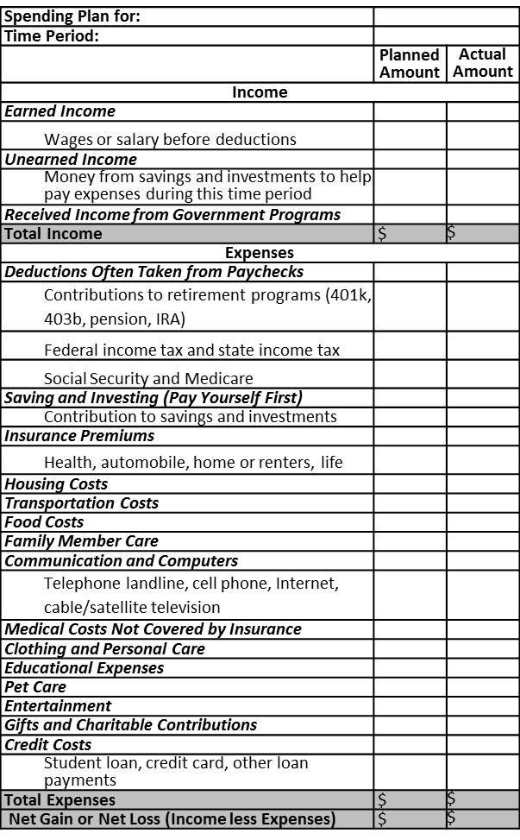

Food, Transportation and Housing:
Over 60% of Average Spending
Source: 2011 Consumer Expenditure Survey
What influences spending choices?

Slide 3
Public Transportation
Examples include: taxi, subway, bus, etc.
Pros
Does not require extra cost of ownership expenses
Typically cost effective
Cons
May not be convenient or require more travel time
Availability depends on the location

Slide 4
Purchasing an Automobile
Dealership
New and used vehicles
Convenient hours
Private Sources
Typically pre-owned vehicles

Slide 5
Do Your Research!
Before working with sales personnel
Evaluate your needs and wants
Identify the right type of vehicle for you and desired features
Research expected costs
You are responsible for yourself!
Advance research will maximize your satisfaction with the purchase!

Slide 6
What are typical automobile ownership expenses?
Automobile payment
(if credit is used)
Fuel
Maintenance and Repairs
License and Registration (yearly fee)
Insurance
Parking
(in some locations)
Before purchasing a vehicle, be sure you can afford the total cost of ownership

Slide 7
Marina’s Out-of-Pocket Expenses
Marina purchased a 2013 Honda Accord
Monthly Payment
Purchase Price | $21,548
Down Payment | $2,154.80
Interest Rate | 2.84%
Monthly Payment | $347.09
Total Paid (down payment + loan) | $22,980.20
5-Year Average Out-of-Pocket (15,000 miles driven per year)
Fuel | $9,852
Insurance | $3,915
State fees (licensing) | $1,932
Maintenance | $1,945
Repairs | $1,758
5 Year Total | $19,402
Monthly Amount | $323.37
Marina’s monthly loan is $347.09, but on average, the car will cost her,
$670.46 per month to own!
Source: bankrate.com
Source: kbb.com

Slide 8
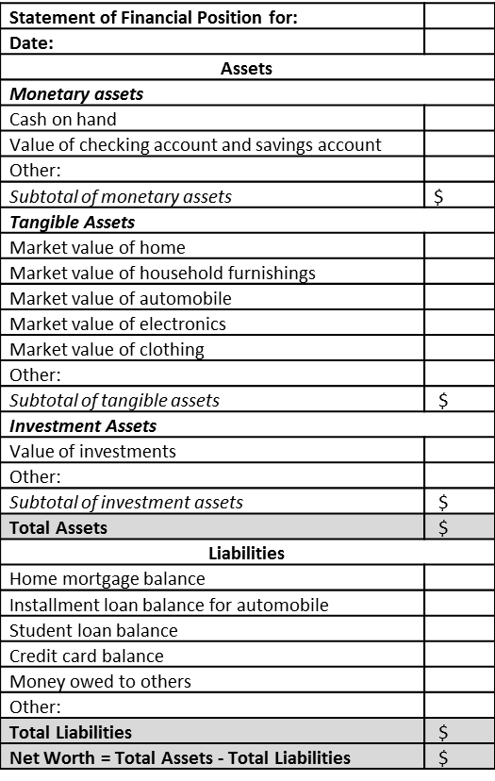
Depreciation
The value of most vehicles depreciates (lowers) over time
Make sure you don’t owe more than you own if credit is used
One of the biggest costs of ownership
The Statement of Financial Position should record the market value of the vehicle that day

Slide 9
What features would you look for in an automobile?
Cost
Size
Usage
Gas mileage
Safety Ratings
Reliability
Environmental Impact
Depreciation
Upgraded features

Slide 10
Using Credit
Credit history will most likely be checked to determine if a loan will be granted and the terms
Automobile Dealerships
Depository Institutions
Loan rates vary significantly between lenders.
Shop around before negotiating.

Slide 11
Down Payment
Amount required (if any) varies
If selling a current vehicle, research the vehicles worth in advance of talking to others
If you trade-in your vehicle, negotiate the trade-in value separately from the price of your new vehicle

Slide 12
Leasing
Leasing – renting a product while the ownership
remains with the lease grantor
You pay a specified amount of money (usually monthly) for a specific time
Once lease expires, vehicle returned to the lease grantor
Read the contract closely – look for hidden costs

Slide 13
Summary
Housing, transportation, and food
Over 60% of spending
Determine if renting or owning a home is best for you
Housing
Consider the total cost of owning a vehicle
Transportation
Eat well-balanced meals high in nutrition that fit into your spending plan
Food

