Slide 1
Major Expenditures: Housing, Transportation and Food
Advanced Level

Slide 2
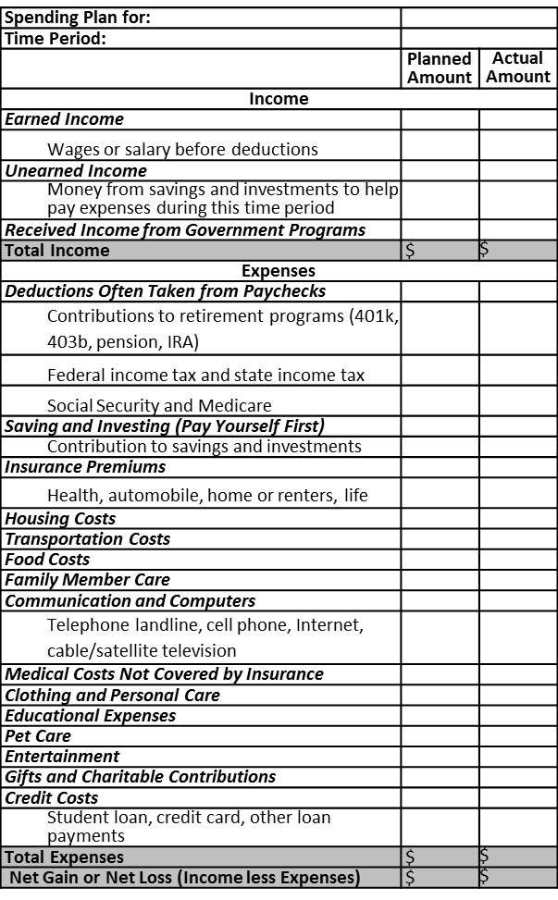

Food, Transportation and Housing: Over 60% of Average Spending
Source: 2011 Consumer Expenditure Survey
What influences spending choices?

Slide 3
Your Present Self Impacts Your Future Self
Planned buying process is essential
Credit is often used to purchase housing and transportation
Choices impact net worth
Choices impact financial well-being

Slide 4
Housing (Renting and Owning)
Describe your dream house

Slide 5
Housing: Largest Expense for Most
Prices vary greatly
Size
Location
Amenities
Choose housing that fits your personal needs
and spending plan

Slide 6
Renting a Home – Important Terms
Landlord
Person who owns a property and chooses to allow others to live there for rent
Rent
Price paid for the use of someone else’s property
Tenant
Person who rents the property

Slide 7
What are common rental expenses?
The cost of housing is more than rent!
Utilities (all or some may be included in rent)
Household furnishings (some may be furnished)
Renters Insurance – provides payment to renters to cover the damage and loss of property in addition to liability losses
Communications (internet, television, phone)

Slide 8
Where can you find a place to rent?
Sources
Online
News-paper
Friends/Family
Bulletin Boards
Property Management Company

Slide 9
When Comparing Properties
Make a list of essential vs. preferred features
If possible, visit properties of interest
Understand the policies
Know what you can afford and calculate the total cost
What are examples of essential vs. preferred features?

Slide 10
What types of questions would you ask when comparing rental properties?
Direct Costs
Rent & Length of Rental
How much is rent?
Utilities
Who is responsible for each bill?
Amenities (furniture, pool, laundry, etc)
What is available?
Are there additional charges for usage?
When is it due?
What is the rental contract length?

Slide 11
What types of questions would you ask when comparing rental properties?
Policies
Policies
What are the property features and restrictions - overnight guest and pet policies, parking, safety features?
Eviction terms
What are the eviction terms?
Landlord/Property Manager Access
What are my rights?
Repairs and maintenance
Who is responsible for the work and fees?

Slide 12
What types of questions does a landlord ask on a rental application?
Helps a landlord evaluate if they will rent to you
Who will be living at the property
Income/employment verification
Rental history
References
Credit history check

Slide 13
Rental Agreement
Rental agreement (lease)
Contract specifying the tenant’s and landlord’s legal responsibilities
Make sure all expenses and policies are clearly outlined
Don’t pay any deposits or rent payments without a rental agreement!

Slide 14
What initial expenses may be required to rent a property?
One or both expenses may be required:
Pre-payment
First and last month’s rent
Security Deposit
Money paid to a landlord to cover cleaning costs and damage repairs beyond normal wear and tear

Slide 15
Purchasing a Home
Real estate agent - Licensed individual representing a buyer or seller in a contractual transaction to purchase real property
Helps buyers:
Find a property that addresses their needs and wants
Find a property that fits their spending plan
Work through the contract and closing process

Slide 16
Home Loan
Lender evaluates many factors including:
Credit history
Income
Net worth
Income and expense statement
Most use credit to purchase a home
Lender determines the maximum amount that can be borrowed and the credit terms

Slide 17
Two Significant Initial Expenses
Down Payment
Portion of the purchase price not borrowed
Typically 5-20% of purchase price
Closing Costs
Fees and charges associated with the purchase of a property
Typically 1-4% of purchase price
Mortgage insurance – protecting the lender if the borrower provides less than 20% down payment

Slide 18
Mortgage Payment
A payment to pay off the loan used to purchase housing
Mortgage payments typically include:
Cost of the home
Interest
Funds to pay property taxes
Funds to pay homeowners insurance

Slide 19
What are typical home ownership expenses?
Housing expenses are more than a mortgage!
Utilities
Household Furnishings
Communications (Internet, television, phone)
Special Assessments
Homeowner’s Association Dues
Maintenance and repairs

Slide 20
Purchasing a $250,000 Home
Scenario 1: Down Payment 3.5% Interest Rate  30 Year Loan
 | 20% Down Payment | 5% Down Payment
Down Payment | $50,000 | $12,500
Monthly Mortgage Payment | $1,158.51 | $1,326.90
Total paid | $417,062.18 | $477,683.21
$8,708.33 paid for mortgage insurance!
Scenario 2: Credit Score $50,000 Down Payment 30 Year Loan
 | 780 Credit Score | 720 Credit Score
Interest | 3.3% | 3.5%
Monthly Mortgage Payment | $1,136.33 | $1,158.51
Total paid | $409,077.76 | $417,062.18
$7,924.42
Additional interest paid
Source: mortgagecalculator.org

Slide 21
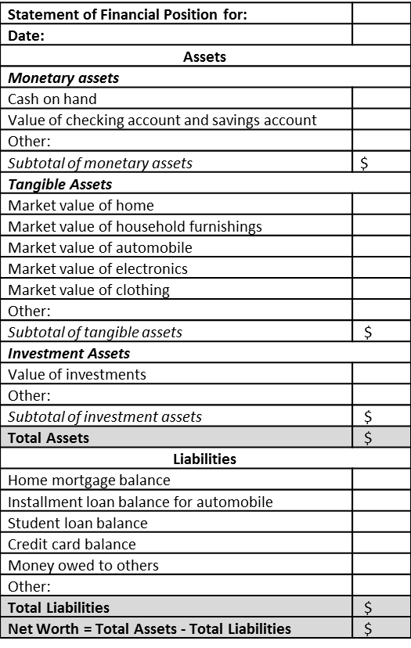
Statement of Financial Position
Equity – the monetary value of a property minus the amount owed
Benefits of owning
Pride of ownership
Tax benefits
Risks of owning
Unanticipated expenses
Property value may decrease
Opportunity to build equity
May be difficult to sell

Slide 22
Rent vs. Own Activity
Set-up: work in groups of 2-3
Supplies: piece of butcher paper and markers
Activity: For both renting and owning, brainstorm:
2 Pros
2 Cons
Rent |  | Own
Pros | Cons | Pros | Cons

Slide 23
Rent |  | Own
Pros | Cons | Pros | Cons
Lower move-in cost | Subject to terms of the rental agreement | Potential to gain equity | May have significant negative effects on credit history is home loan is not paid according to the terms of the loan
Easier to move | May have restrictions such as no pets | Tax benefits | Large initial cost (down payment, closing costs)
No (or little) maintenance and repairs | Few or no opportunities for home improvements (appliances, paint, etc.) | May improve credit history if the home loan is paid according to the terms of the loan | Additional expenses
Less responsibility | No equity is gained | Free to make home improvements | More risky than renting
Typically less expensive than home ownership | No tax benefits | No restrictions (unless restricted by the specific homeowner’s association) | Usually requires additional resources (time, money) to maintain
Utilities are sometimes included in rent payment |  |  | Not as easy to move

Slide 24
Summary
Housing, transportation, and food
Over 60% of spending
Determine if renting or owning a home is best for you
Housing
Consider the total cost of owning a vehicle
Transportation
Eat well-balanced meals high in nutrition that fit into your spending plan
Food

