Slide 1
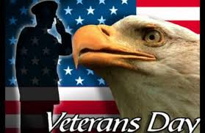
Native American Studies
SOCI 1100 4A
Day #21
November 11, 2014
http://www.youtube.com/watch?v=617_3PxKEOk&list=PLntY0iCKyhzy5HnxUD3Ybe3rQCoaZ6P1B

Slide 2
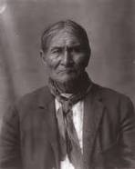
Agenda
Geronimo
Artists
Review
  Course objectives
  Pictures and terms
  (answer key at the end)
Geronimo

Slide 3
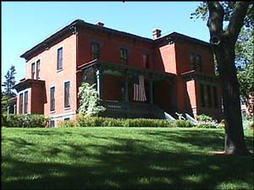
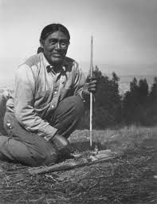
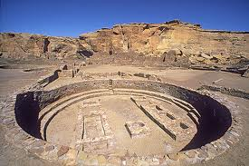
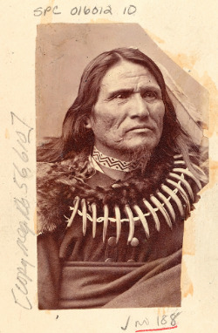
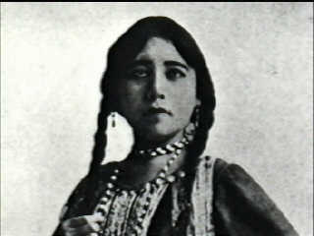
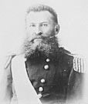

Slide 4
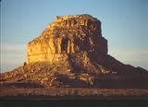
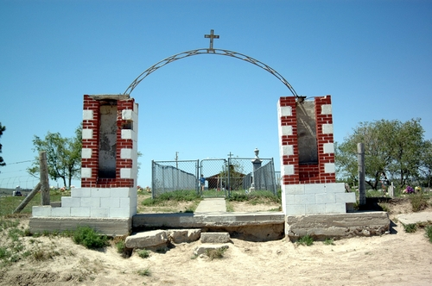
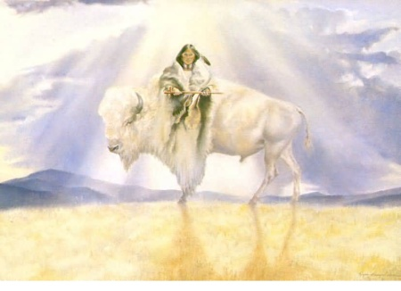
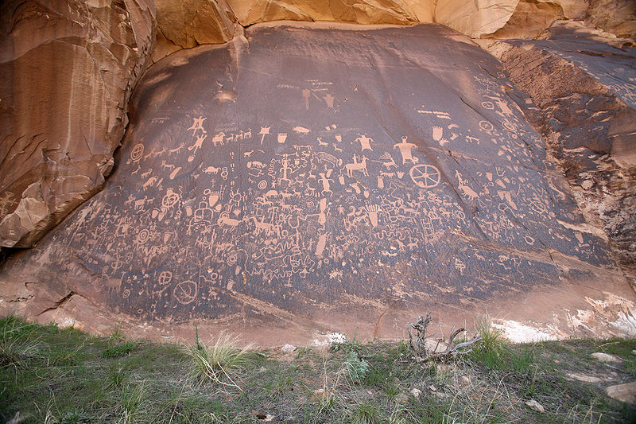

Slide 5
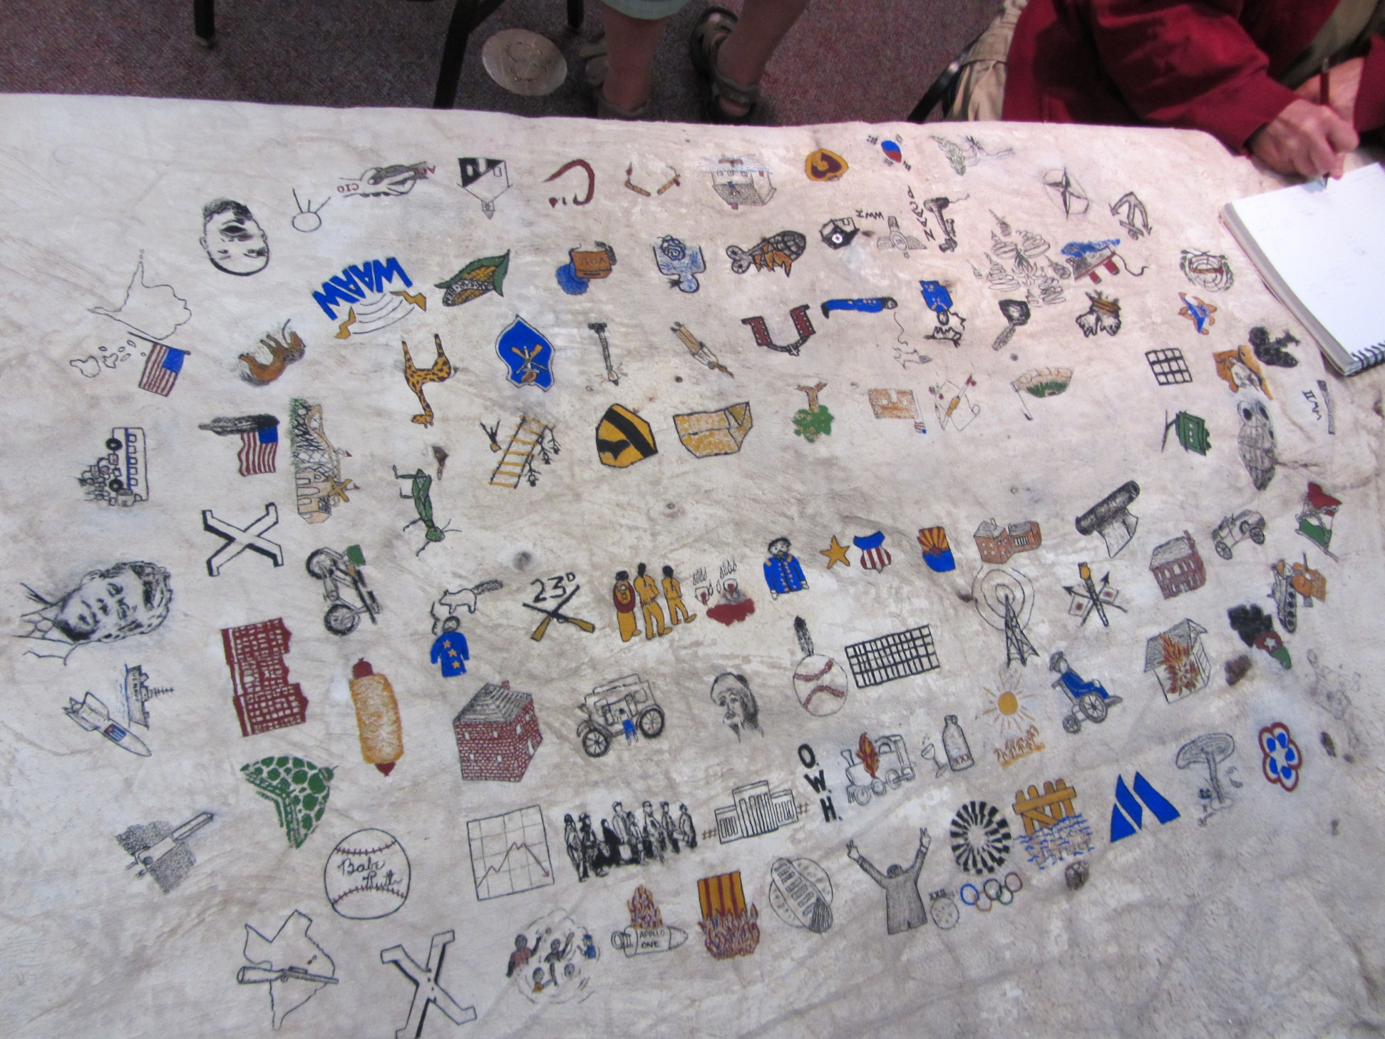

Slide 6
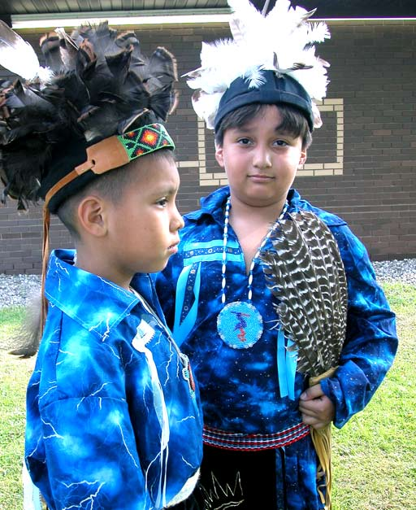
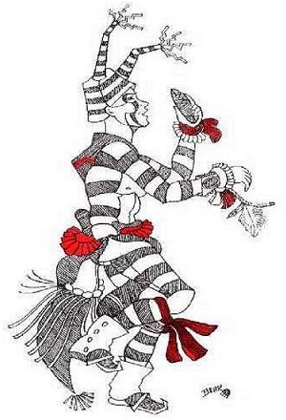
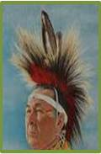
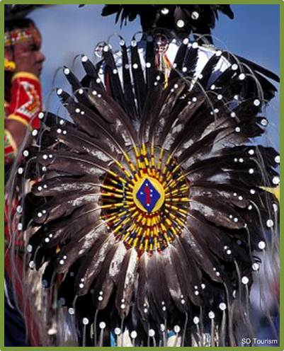
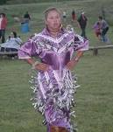
Regalia

Slide 7
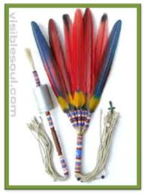
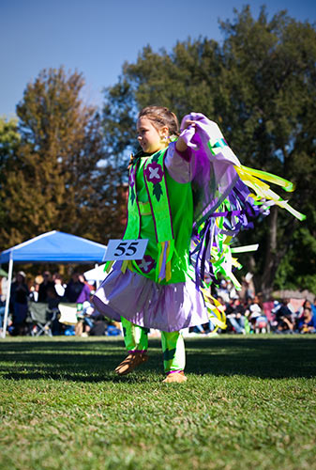
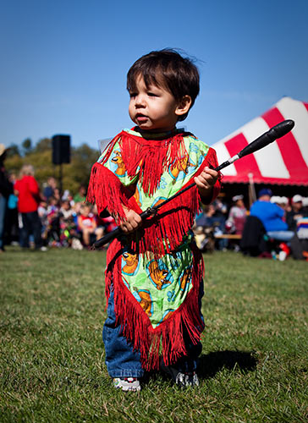
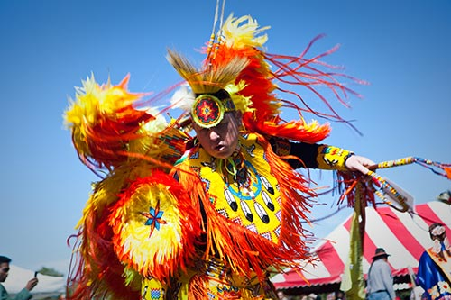
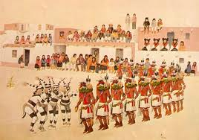

Slide 8
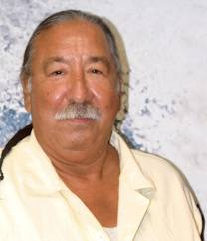

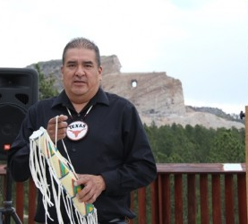
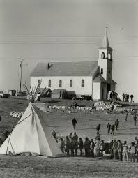
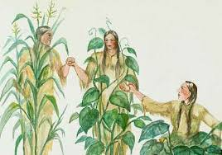


Slide 9
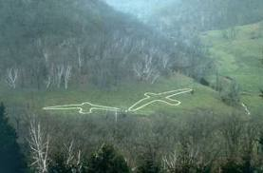
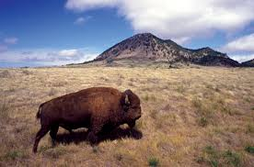
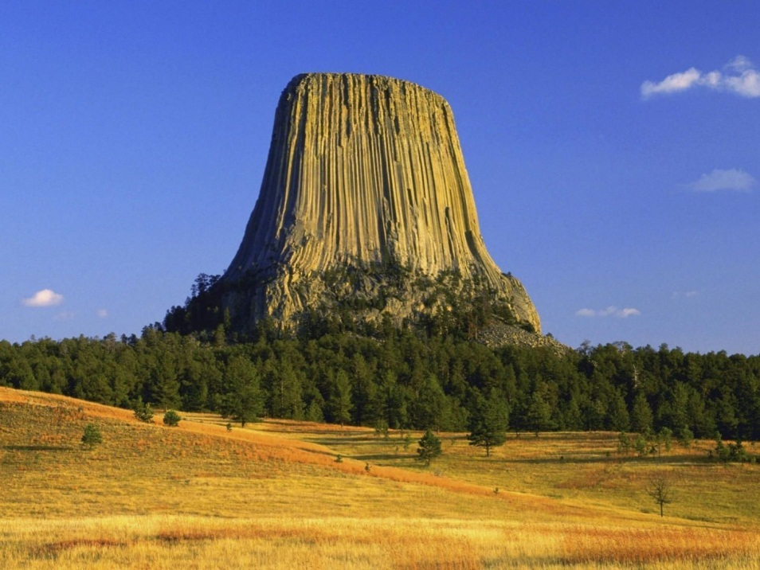
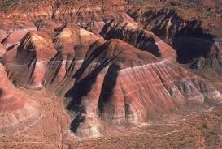
Sacred Places

Slide 10
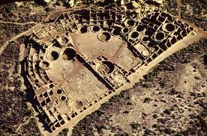
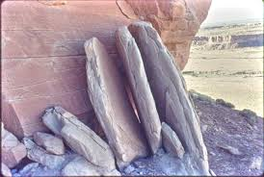
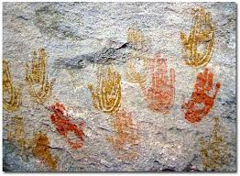
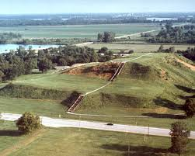

Slide 11
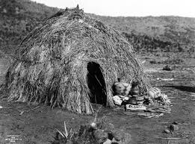
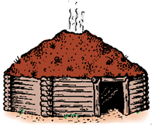
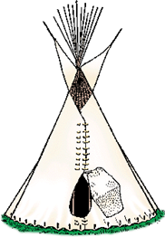
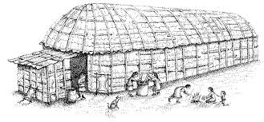

Slide 12
Key
Slide 3 Crook House at Fort Omaha; Great Kiva in Chaco Canyon; Ishi – the last Yahi; Standing Bear; Lost Bird; General George Crook
Slide 4 Wounded Knee Cemetary – mass grave; Fajada Butte in Chaco Canyon; Newspaper Rock in Eastern Utah; White Buffalo Calf Woman
Slide 5 Fort Omaha Buffalo Robe – Lakota Wintercount

Slide 13
Slide 6; boys in traditional Seneca headdress and regalia; porcupine quill head roach; Koshare – Hopi clown; bustle – men’s traditional dancer; jingle dress
Slide 7 Gourd Dance fan and rattle; women’s fancy shawl dancer; tiny tot grass dancer; Kacina Dance; men’s fancy dancer
Slide 8 Leonard Peltier; Oneida (Iroquois) Nation seal; Steve Tamayo at Crazy Horse Monument; Wounded Knee uprising in 1973; three sisters planting technique; Navajo Nation Seal

Slide 14
Slide 9 Effigy Mounds; Bear Butte; Devil’s tower; Badlands
Slide 10 Pueblo Bonito; Sun Dagger atop Fajada Butte; pictograph hands; Cahokia Mounds today
Slide 11 Navajo hogan; Apache traditional wickiup; Iroquois longhouse; Lakota tipi

Slide 15
Assignment
Buffalo Robe papers
Final Quiz
Come to Mule Barn for class on Thursday!!!

