Slide 1

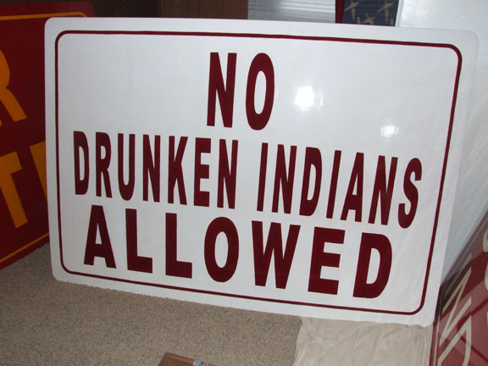
Native American Studies SOCI 1100 4A Day #17 Fall 2014

Slide 2
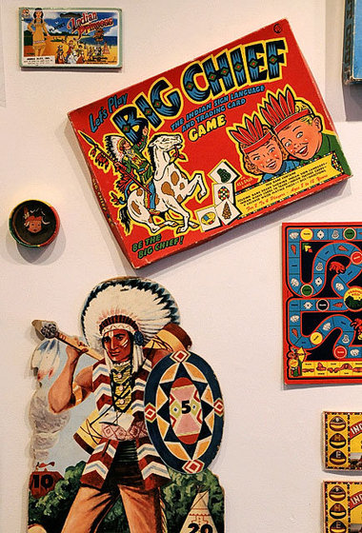
Agenda
Ethnocentrism and Stereotypes
Whiteclay NE
Children of the Plaines

Slide 3
Ethnocentrism
The tendency to use one’s own culture as a standard against which other groups or cultures are measured
Positive features: national pride, patriotism, willingness to fight for one’s way of life
Negative features: prejudice, discrimination

Slide 4
In-groups versus Out-groups
If we see our way as good, those who are like us are seen as in-groups
All others, then, are viewed as out-groups
We feel different degrees of social distance from out-groups
The more distant, the more we tend to polarize our feelings or judgments

Slide 5
Polarity of Judgments
In-Group: Our way
Good
Right
Honest
Intelligent
Clean
Etc.
Out-Group: Their way
Bad; Evil
Wrong
Dishonest, Sneaky
Stupid
Dirty
Etc.

Slide 6
Prejudice
Categorical
Irrational
Like or dislike
Applied to all members of a group
Based on irrelevant information such as racial or cultural characteristics
Notes:
Ethnocentrism serves a function because it allows us to feel national pride, patriotism, and to develop a sense of self-identity. A major dysfunction of ethnocentrism is that it allows us to make judgments and feel distances. It helps us develop prejudices against or in favor of certain individuals or categories. Prejudice motivates us to categorize individuals by looks, accent, family name, or other behavior. Generally these categories are superficial, arbitrary, and illogical.
We can be prejudiced in favor of something but generally we view the negative side of prejudice -- we feel prejudice against someone or something.
If we feel prejudice against individuals who have the target (hated) characteristic, we tend to believe that everyone who shares that characteristic deserves our negative assessment. Thus we say we hate or dislike all members of that group. For example, at a faculty dinner another teacher’s date asked if I minded if he smoked. I said I did and he said “too bad, it’s a free country.” His actions may lead me to perceive ALL smokers as rude and become intolerant of ALL SMOKERS.

Slide 7
Discrimination
Acting out prejudice
Systematically grants advantages or disadvantages based on competition for a society’s resources and rewards
Notes:
When we turn the prejudicial beliefs we hold into some sort of action, we are guilty of discrimination.
Very often our negative assessment of another category of individuals springs from one bad experience or even just the fear that a bad experience might take place. We feel anxiety that turns into animosity. We feel that we must compete with others for jobs, water, food, money, even space on the bus, etc. So we behave in such a way that we try to limit the access of the feared minority group members to jobs, natural resources, money, etc. For example, we may say that “they” must sit in the back 3 rows of the bus as was true for African Americans in the South prior to the Civil Rights Movement.

Slide 8
Prejudice = Attitude or Belief
Discrimination = Behavior or Action
Notes:
So, the difference between prejudice and discrimination is that prejudice goes on in your mind and discrimination shows up in your activities. It might be possible to have one without the other but generally the two go hand in hand.
Go to the Course Communication area:
In the long run, it is easier to control one than the other. Which do you think is easiest to control? Why? Cite some real life examples to support your answer.

Slide 9
Stereotyped Thinking
Thinking that involves hasty generalizations
Based on incomplete and often erroneous information
It is a matter of perception
About all members of a group or category
http://www.youtube.com/watch?v=z6vMTZZZMqQ (13:50)
Notes:
The dictionary definition of stereotype is “to give a fixed, unvarying form to” something. When we apply the impressions we have about individuals or isolated incidents to all members of a group, we are giving them that “fixed and unvarying form” and unfortunately, it is usually a negative form.
Recall my example about the rude smoker. I will feel prejudice against smokers because I believe all of them to be rude and inconsiderate.
Maybe an adolescent male driver was speeding and recklessly cut me off as I was trying to exit from the Interstate this morning. I may come to the hasty generalization that all young male drivers are dangerous and ought to be kept off the road.
The humor of racial, ethnic, and other jokes meant to point out the “stupidity” another group is based on our willingness to stereotype members of that group.

Slide 10
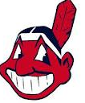
Stereotypes
Are resistant to change even when shown to be in error by factual evidence
Ethnophaulisms – pejorative and negative names for groups, i.e. Redskins what names can you think of that have been attached to Native Americans
Chief Wahoo
Notes:
It seems that when we have formed stereotypes, we have a difficult time “letting go” of them and changing our minds about the individuals or groups. “Women drivers” continue to be vilified in spite of the fact that women receive fewer tickets, have many fewer accidents than males in all age categories and often pay significantly lower insurance rates than their male counterparts.

Slide 11
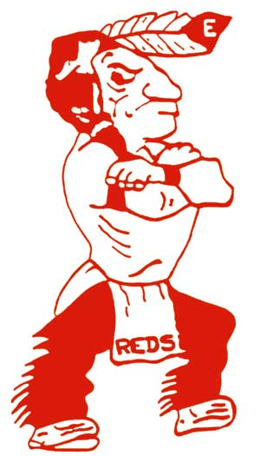
Indian mascots exhibit either idealized or comical facial features and "native" dress, ranging from body-length feathered (usually turkey) headdresses to more subtle fake buckskin attire or skimpy loincloths. Some teams and supporters display counterfeit Indian paraphernalia, including foam tomahawks, feathers, face paints, and symbolic drums and pipes.

Slide 12
Forty years after the civil rights battles of the 1960s, Native Americans and civil rights advocates are still fighting a decades-old battle to end the depiction of American Indians on football helmets, basketball courts and team jerseys. They say such images foster a shallow and inaccurate understanding of Native American cultures, reinforce stereotypes of the noble savage or red-faced warrior, and encourage racist behavior among sports fans. (From Take Me Out of the Ball Game by Holly Beck, 1/31/05)
http://www.bluecorncomics.com/mascots.htm

Slide 13

In August 2005, the NCAA forbid college teams from using names of native American tribes as team mascots, unless that school has written permission to use the tribe name, from active members of the tribe (see Florida State). Politicians in the state are trying to keep the name, Fighting Sioux as the team name for the state’s university.

Slide 14
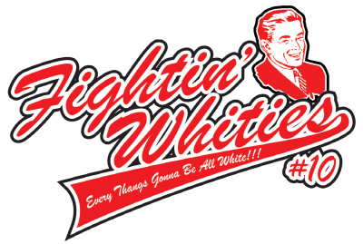

Slide 15
The Fighting Whites (alternatively identified as Fightin' Whites, Fighting Whities, or Fightin' Whities) were an intramural basketball team formed at the University of Northern Colorado in 2002 and named in response to the Native American mascot controversy.

Slide 16
The intramural college team briefly attracted a storm of national attention because of its satirical protest about stereotypes of Native Americans being used as sports mascots, particularly the "Fightin' Reds" of Eaton High School in Eaton, Colorado, not far from the university in Greeley. The Reds' mascot has been described as "a caricature Indian with a misshapen nose, [wearing] a loincloth and eagle feather".

Slide 17
According to polling results published in Sports Illustrated in February 2002,
“ Although most Native American activists and tribal leaders consider Indian team names and mascots offensive, neither Native Americans in general nor a cross section of U.S. sports fans agree. According to the article, "There is a near total disconnect between Indian activists and the Native American population on this issue.” http://en.wikipedia.org/wiki/Native_American_mascot_controversy
http://www.bluecorncomics.com/mascots.htm

Slide 18
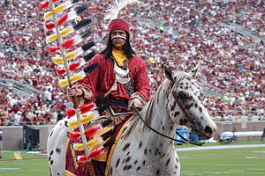

Chief Osceola and Renegade the official mascots of Florida State University.
Since the 1980s Florida State University has forged a relationship with the Seminole Tribe of Florida, who have given the school their blessing to use the Seminole and Osceola imagery.
Sammy Seminole was the first mascot of the Florida State University Seminoles. He was introduced in 1958 and was retired in 1972 in an effort to find a less insensitive mascot.

Slide 19
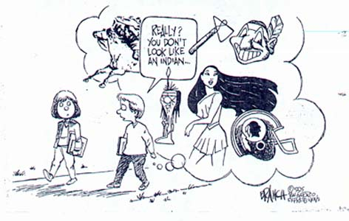

Slide 20
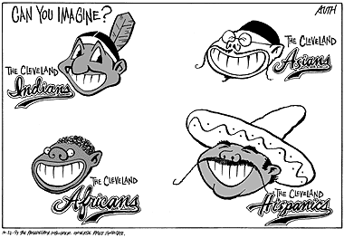

Slide 21
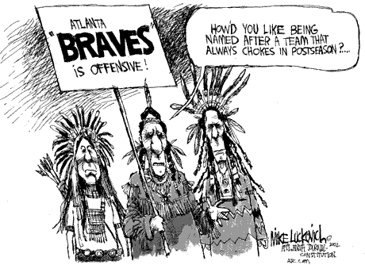

Slide 22
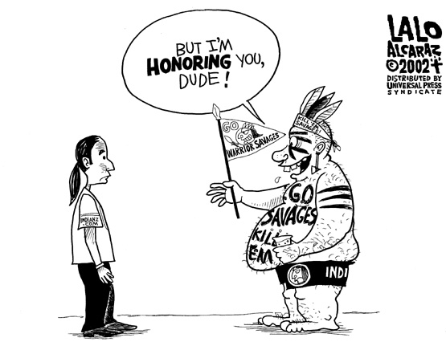

Slide 23
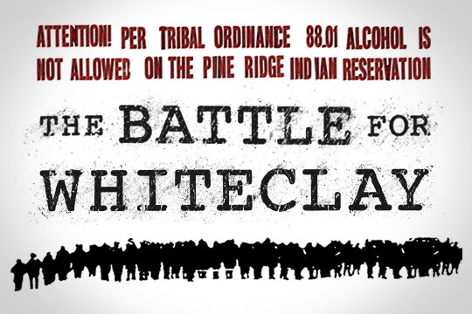
Does genocide continue?
Infliction of conditions of life calculated to bring physical destruction
http://www.youtube.com/watch?v=HDAdhOxuTwk

Slide 24
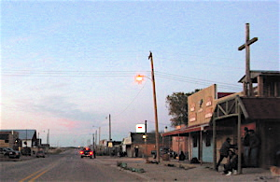
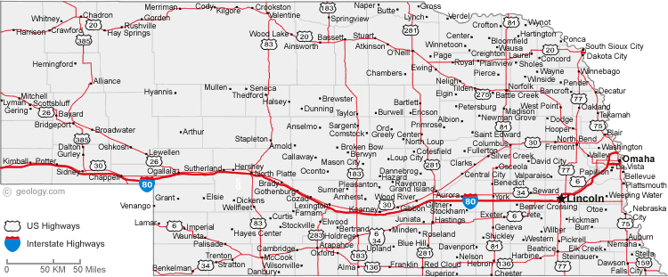
White Clay, NE

Slide 25
Continued Exploitation?
Whiteclay, NE: population 14 people
4 off sale liquor stores that sell 4.5 million cans of beer a year (approx. 11,000 cans per day).
Whiteclay borders the Pine Ridge Indian Reservation, home of the Oglala Lakota
4 predatory liquor dealers make millions of dollars each year off of the Oglala's and the social costs of their business are experienced on the Pine Ridge side of the border.

Slide 26
Unquestionable Injustice
the town of Whiteclay has no legal place for these 11,000 cans of beer to be consumed
You can't drink the beer at any of the off sale liquor stores.
You can't drink it in your car or on the street.
You certainly can't drink alcohol let alone possess it on the Pine Ridge Indian Reservation.
Despite evidence of daily illegalities there has been almost no police intervention.
The state government of Nebraska enjoys the excess taxes from Whiteclay and yet claims to not have the funds to adequately police the area.

Slide 27
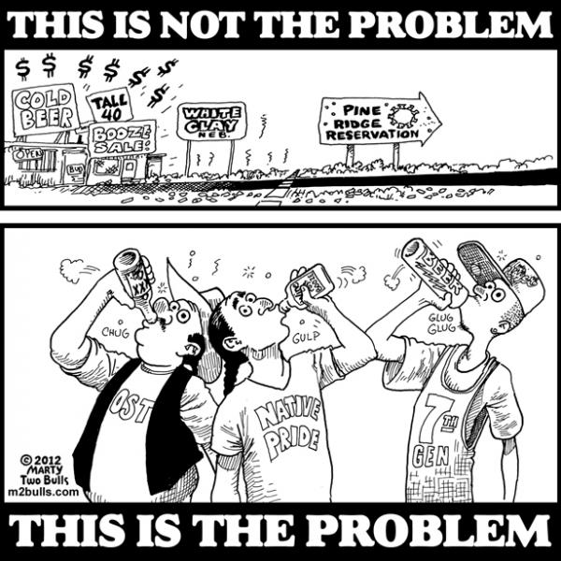

Slide 28
http://en.wikipedia.org/wiki/Whiteclay,_Nebraska
On February 9, 2012, the Oglala Sioux Tribe filed a federal lawsuit against Whiteclay's liquor stores, as well as national beer distributors and manufacturers, including Anheuser-Busch, Molson Coors Brewing Company, Pabst Brewing Company, and Miller Brewing Company. The lawsuit alleges that the defendants knowingly sold and distributed beer with the intent of consumption on the Pine Ridge Indian Reservation, where alcohol is banned and alcohol-related problems are rampant.^{[21]}
According to the suit:
The illegal sale and trade in alcohol in Whiteclay is open, notorious and well documented by news reports, legislative hearings, movies, public protests and law enforcement activities. All of the above have resulted in the publication of the facts of the illegal trade in alcohol and its devastating effects on the Lakota people, especially its children, both born and unborn.^{[21]}

Slide 29
The OST is seeking $500 million in damages for reimbursement of the "cost of health care, social services and child rehabilitation caused by chronic alcoholism on the reservation, which encompasses some of the nation's most impoverished counties."^{[21]} The tribe is represented in the suit by Tom White, the tribe's Omaha-based attorney.^{[2]} As White said, "In a town of 11 people selling 4.9 million 12-ounce servings of beer, there is no way that alcohol could be legally consumed. It's just impossible."

Slide 30
On October 1, 2012, the U.S. District Judge John M. Gerrard dismissed the Oglala Sioux Tribe's lawsuit against the beer stores and associated companies, saying that the federal court did not have jurisdiction over the issue. He dismissed it "without prejudice, meaning the tribe could take its claims to state court."^{[24]} The judge acknowledged that beer sales contributed to problems on the reservation.^{[24]}
Nebraska state response
As noted, the Nebraska legislature created bills to increase funding for police protection and health services in the area. In February 2012 Nebraska lawmakers were
"considering legislation that would allow the state to limit the types of alcohol sold in areas like Whiteclay. The measure would require local authorities to ask the state to designate the area an 'alcohol impact zone.'"^{[21]} Under the legislation, the state liquor commission would be authorized to "limit the hours alcohol sellers are open, ban the sale of certain products or impose other restrictions."^{[21]}
The measure was introduced by Nebraska state Senator LeRoy J. Louden of Ellsworth, whose district includes Whiteclay. Sheridan County officials support it.^{[21]}

Slide 31
Pine Ridge Oglala Lakota Reservations
Children of the Plains
http://www.youtube.com/watch?v=GACcBe9Be58

Slide 32
Assignment
Buffalo Robe Papers will be assigned on 10/28 and are due 11/6 unless otherwise announced

Slide 33
Buffalo Robe Project
We will be working on the descriptions for the Fort Omaha Wintercount
Choosing topics - Thursday
Papers due November 6

Slide 34
