Slide 1
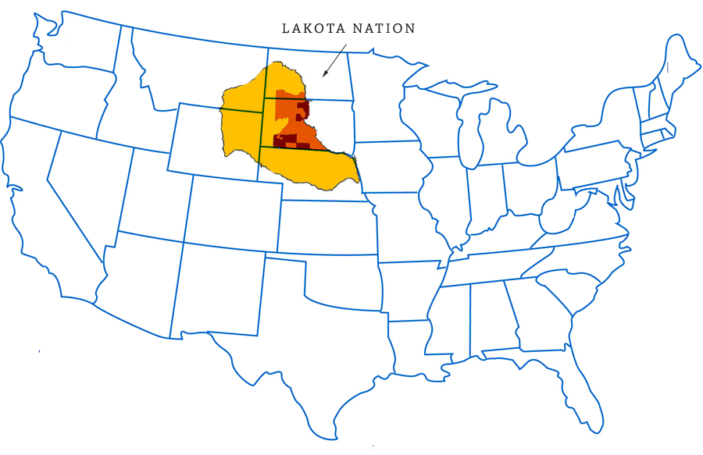
Welcome to Native American Studies – SOCI 1100

Slide 2
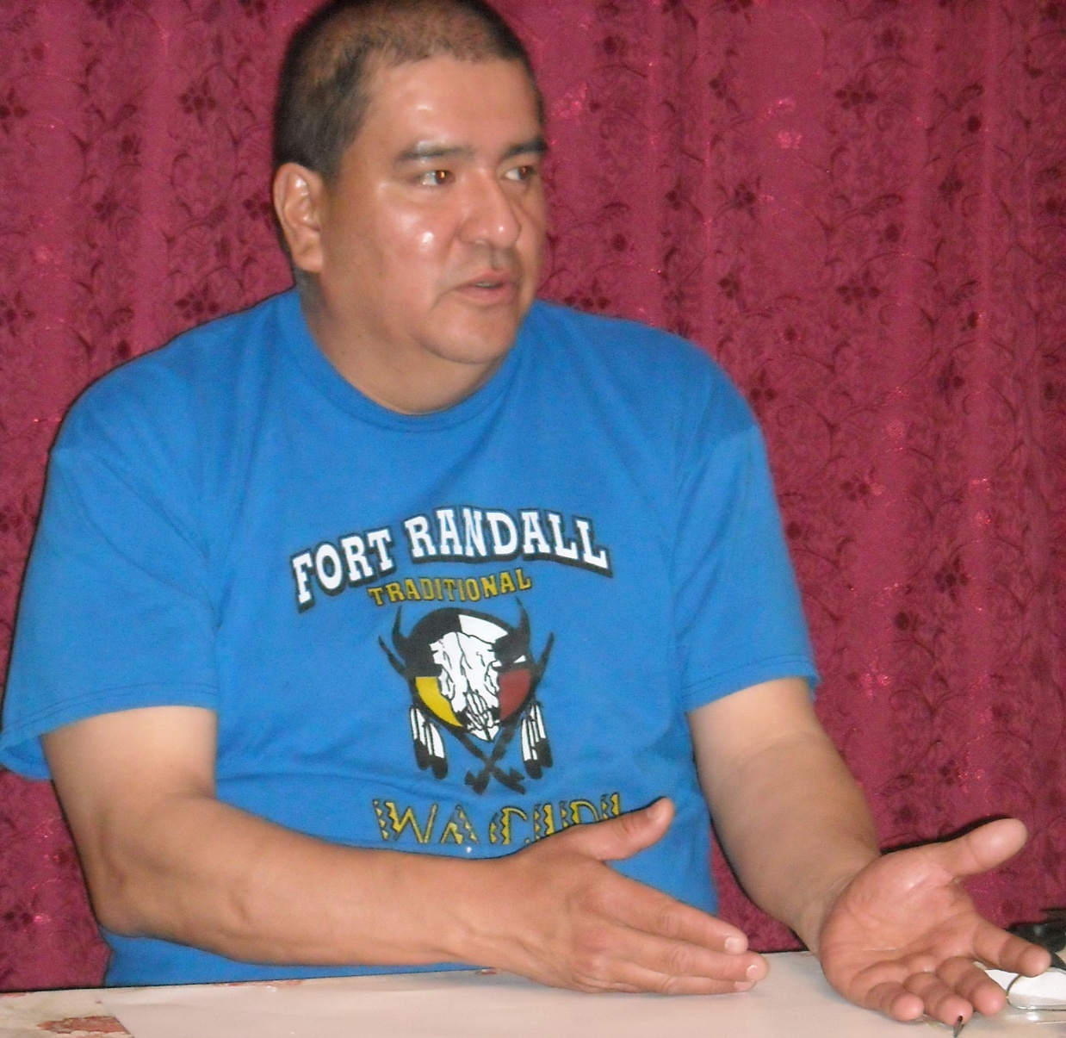
Agenda Day 18
Morning Song http://www.youtube.com/watch?v=TChazq0npVQ&feature=related
Steve Tamayo

Slide 3
Assignment
Watch the 55 minute video - Oceti Sakowin
http://watch.sdpb.org/video/1472853204/
http://watch.sdpb.org/video/1472853204/

Slide 4

Medicine Wheel

