Slide 1
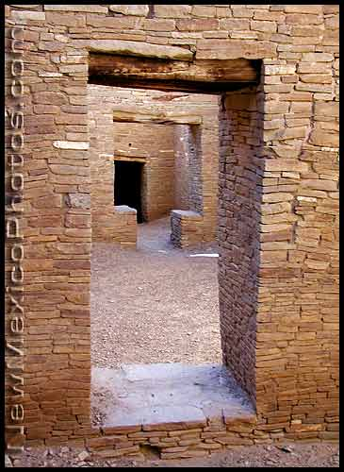
Welcome to Native American Studies – SOCI 1100 4A
Fall, 2014
Room 237
Fort Omaha Bldg. #10

Slide 2
Agenda Day #3 September 9, 2014
Continue with historic regional information
Watch Part 1 of 500 Nations

Slide 3
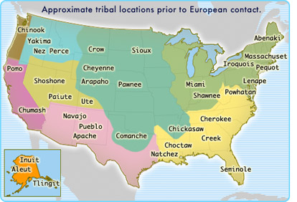

Slide 4
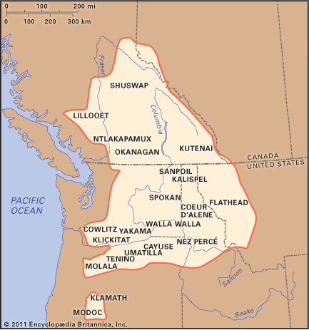
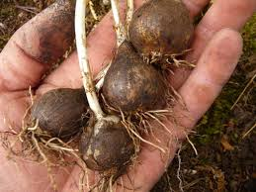
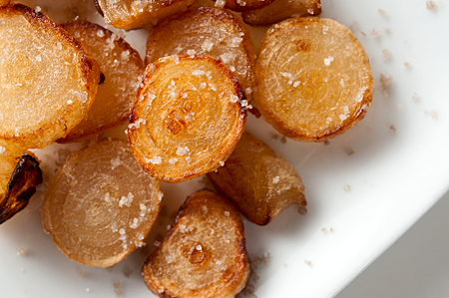
Indians of the Plateau consumed camas bulbs.

Slide 5
Going into this process, I knew a few key things about eating and cooking with blue camas, camassia quamash: First, they are nasty when eaten raw. They are crunchy enough, but when you chew on them the bulbs get gummy and stick to your teeth. There’s also a soapy taste in there, too. Not good eats.
What did the Indians do with camas? Almost without exception, they baked them, slow and low, in an earth oven.
Camas needs to be cooked slowly and for a long time before you do anything else with it. If you skip this step, all the inulin in the bulb will still be present when you serve them, and you will all be farting like crazy in a few hours. Slow, moist cooking breaks the inulin down into fructose. I cooked the bulbs at 220 degrees for 12 hours to get to a point where the bulbs were still savory, but with a hint of sweetness like a parsnip. You could try cooking longer or hotter for different effects.
http://honest-food.net/2011/07/26/cooking-blue-camas/

Slide 6
500 Nations Chaco Canyon

Slide 7
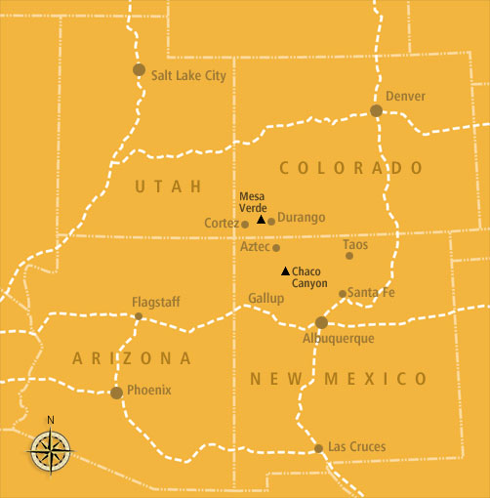
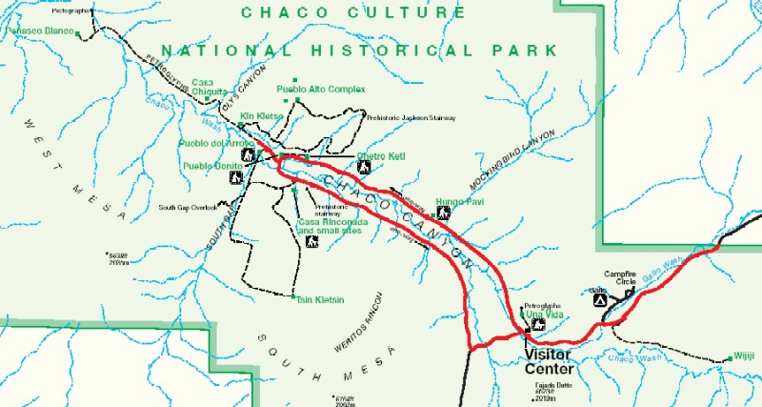

Slide 8
Chaco Canyon
View the accomplishments of their culture
Think about the things the had to use (material culture)
Think about the things they did not have
Imagine their cognitive and normative cultural features
T-shaped door???

Slide 9
Sky-watchers of Chaco
Notes:
1

Slide 10
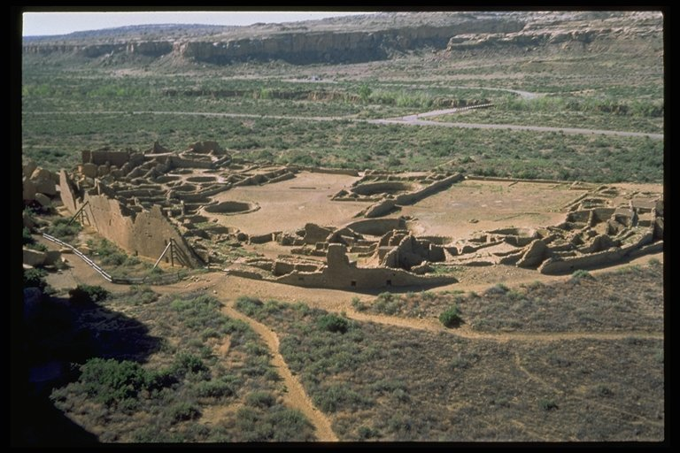
A center of Anazazi culture
Pueblo Bonito
http://www.he.net/~mine/anasazi/p_bonito_show_5.html

Slide 11
Pueblo Bonito
800 rooms
2000 - 5000 people
one of several large townsites in the Canyon
surplus of subsistence goods
trading and ceremonial center

Slide 12
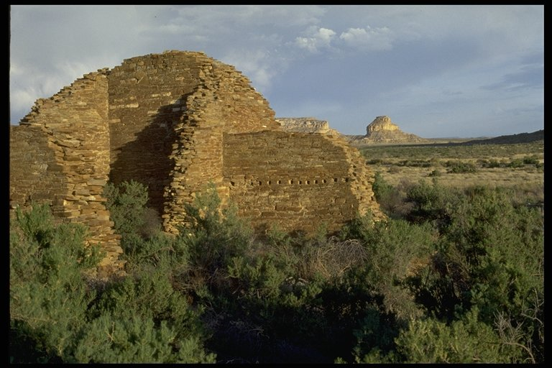
You look across the Canyon to Fajada Butte

Slide 13
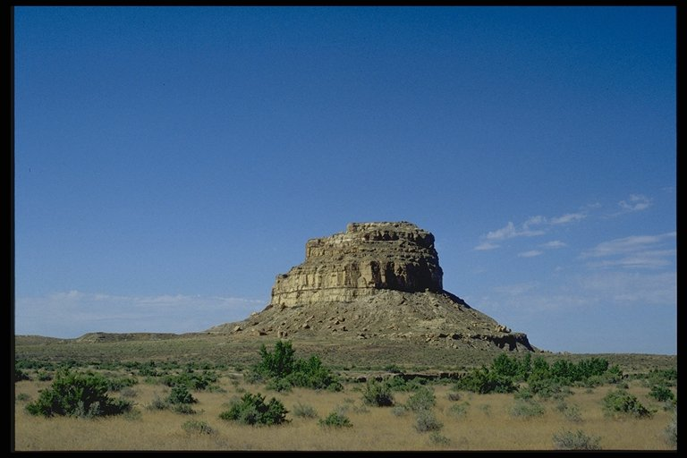
Fajada Butte
http://www.youtube.com/watch?v=sS73UpIy7zs&feature=related
Notes:
4

Slide 14
Midday Summer Solstice
Notes:
5

Slide 15
THE SOLAR "CLOCK"
Did the stone slabs fall there, or were they placed?
Why mid-day rather than sunrise?
Was the spiral carved first or last?
Can it really plot the cycle of the moon?
http://www.youtube.com/watch?v=607Jlae8P1c
Notes:
6

Slide 16
Solstice Window Pueblo Bonito
Notes:
7

Slide 17
Other aspects of life in the canyon
the arts
agriculture
religion
astronomy

Slide 18
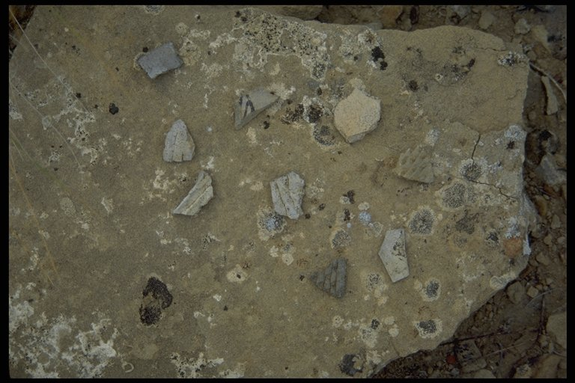
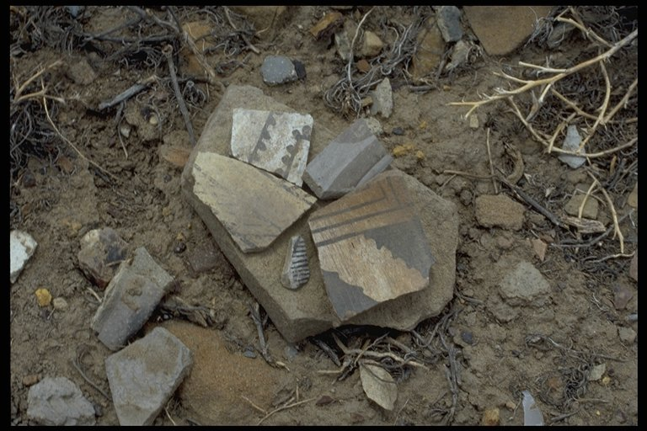
Potters practiced their craft ….

Slide 19
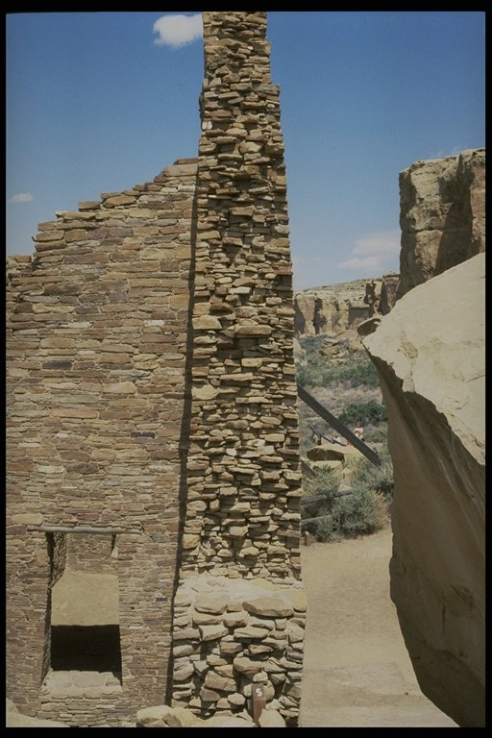
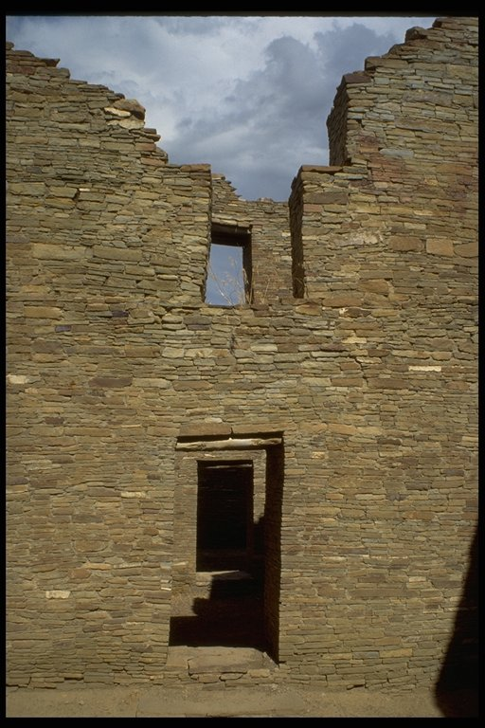
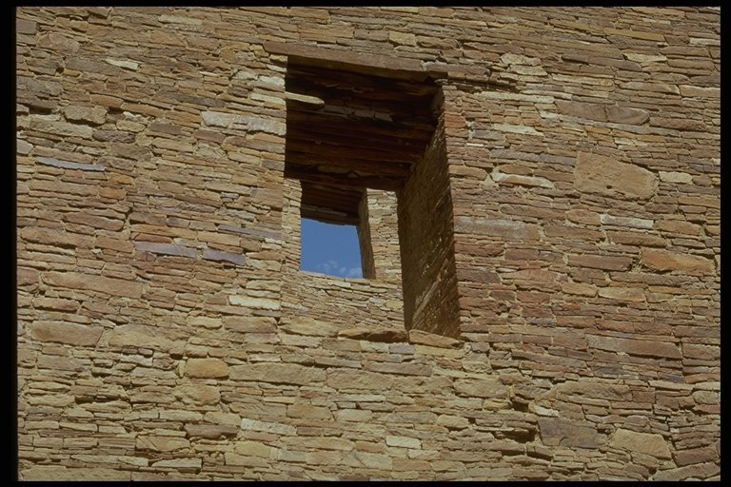
Masons perfected the art of building

Slide 20
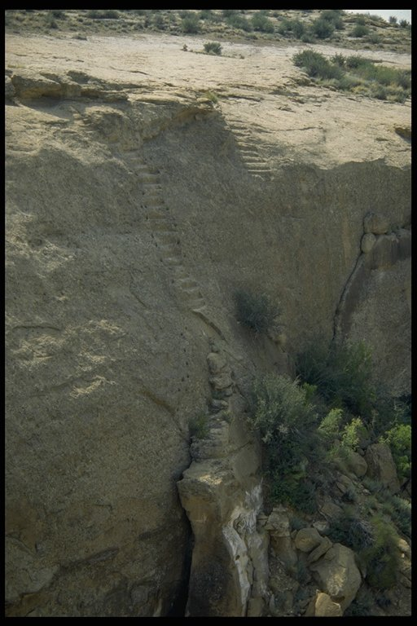
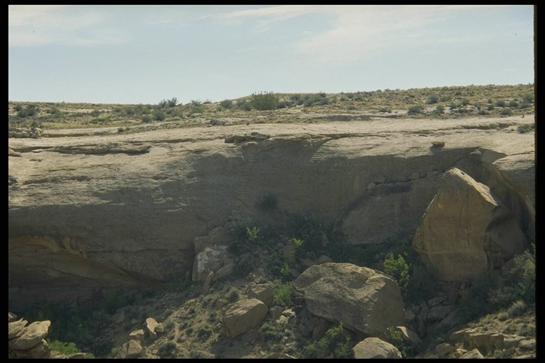
Jackson Stairway

Slide 21
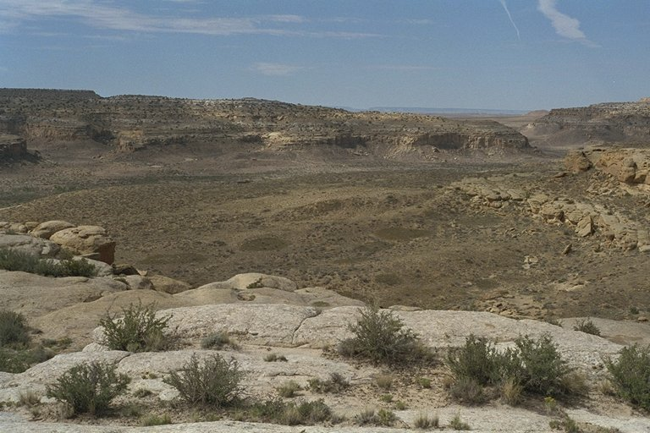
Farmers cultivated and irrigated fields

Slide 22
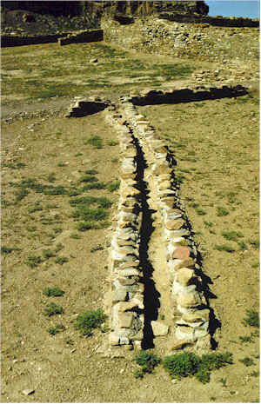
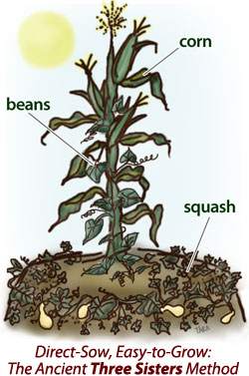
Water Control for Irrigation
Notes:
8

Slide 23
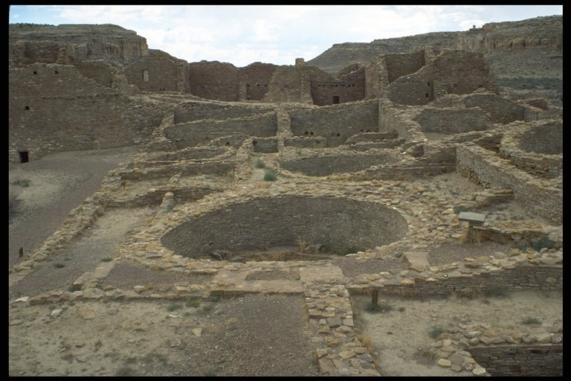
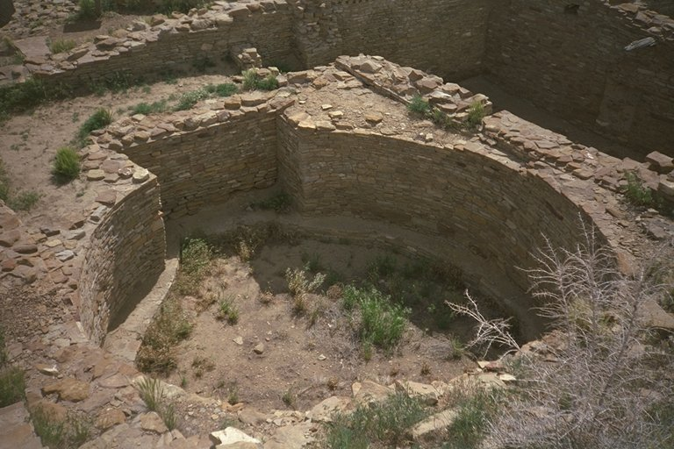
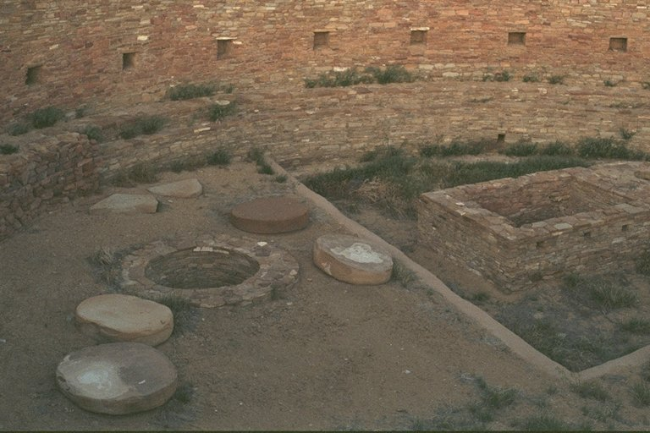
Spiritual life flourished

Slide 24
Astronomers identified new sites
Sighting the
Crab Nebula
Notes:
8

Slide 25
Assignment
Keep working on Week 1 assignments
Writing assignment is due Thursday
Begin reading for Week #2
Plan to attend powwow, if possible
Powwow promotion will be held at MCC's South Omaha Campus, Connector Commons on Friday, September 12, 11 a.m. to 12 noon. Host Northern Drum Wahpekute may be there to sing. Rich Barea is identifying dancers and Steve Tamayo will narrate.

