Slide 1
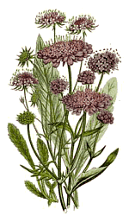
SOCI 1100 Day #13 10/20/15

Slide 2
Agenda
Finish discussing boarding schools
Lost Bird
Reprise of Standing Bear information
Genocide - Ishi

Slide 3
Indian Boarding School Plan (Bill Means and Albert White Hat)
http://www.youtube.com/watch?v=Avt-5cfb3ng

Slide 4
National Public Radio Story May, 2008
May 12, 2008
http://www.npr.org/templates/story/story.php?storyId=16516865
http://www.npr.org/player/v2/mediaPlayer.html?action=1&t=1&islist=false&id=16516865&m=90366243
May 13, 2008
http://www.npr.org/templates/story/story.php?storyId=17645287&ps=rs
For further information, click on links for full transcription of news story.
Additional information: http://minnesota.publicradio.org/display/web/2006/03/14/whathappened/

Slide 5
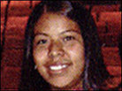
Sheila Patterson came to Sherman Indian High School from the San Carlos Apache Reservation in Arizona. Patterson misses her home, but she says she needed to get away from bad influences at her old high school.

Slide 6
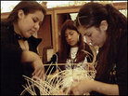
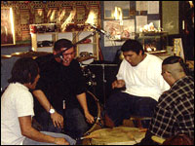
Students at Sherman learn traditional skills such as basket weaving. They are also taught American Indian languages and sing traditional songs.

Slide 7
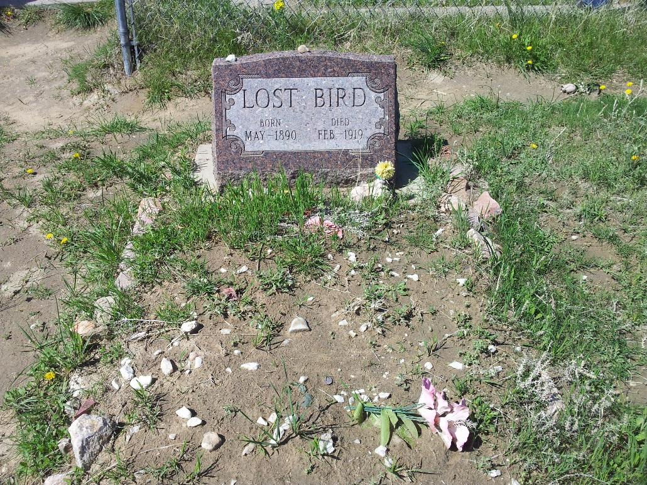
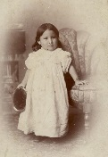
Lost Bird
Wakova’s prophecy and the Ghost Dance

Slide 8
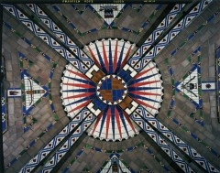
Standing Bear
Central Sun Medallion in East Chamber Dome

Slide 9
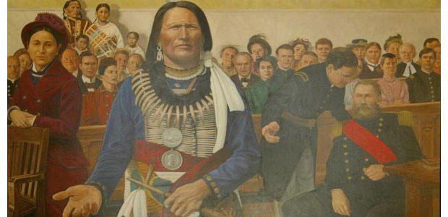

Slide 10
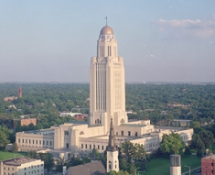
Nebraska State Capitol
The central room of the 14th Floor Observation Level is the Memorial Chamber, it is “dedicated to the forms of heroism called for in the public service and in devotion to humanity”.
The inscription beneath the murals is taken from Abraham Lincoln’s Second Inaugural Address.

Slide 11
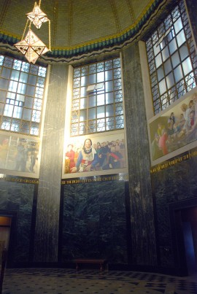
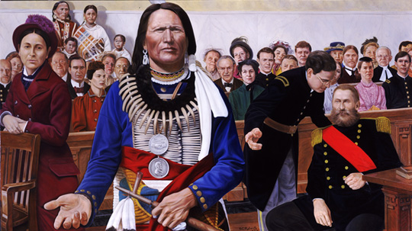
mural by Stephen Roberts, 1996
The Ideal of Freedom
Americans and Nebraskans have gone to war to advance the rights of people.

Slide 12
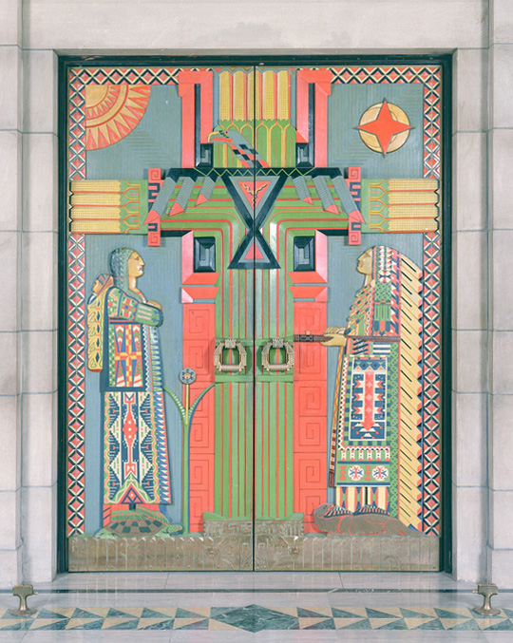
The colorful doors to the Warner Chamber tell of Native American culture and life. Corn, the Native American's main agricultural crop and important food source is in the center of the doorway, represented as a tree of life. The Thunderbird, a symbol of rain and life is pictured at its center. On the sides, an Indian man is standing on an otter, a symbol of medicine and an Indian woman is standing on a turtle, symbol of fertility.

Slide 13
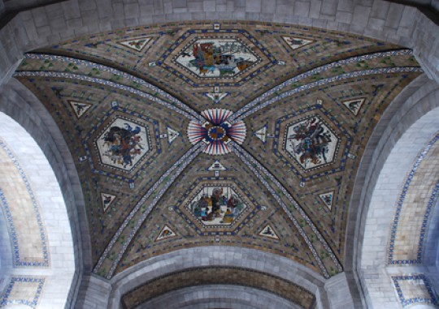
Hildreth Meiere's ceiling mosaics within the chamber represent the daily activities of the Native American cultures of the Plains: women hoeing corn, a war party, a tribal council, and a buffalo hunt. The mosaics and decorative borders were designed to look like Native American beadwork.

Slide 14
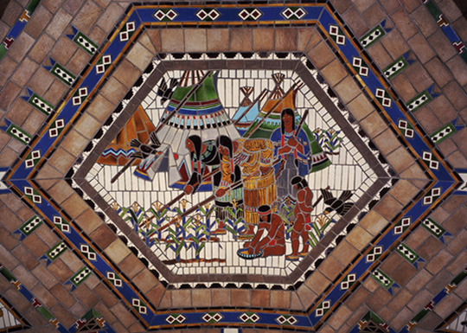

Slide 15
Genocide Convention
The Convention on the Prevention and Punishment of the Crime of Genocide was adopted by the United Nations General Assembly on 9 December 1948 as General Assembly Resolution 260.
Article 2 of the Convention defines genocide as
...any of the following acts committed with intent to destroy, in whole or in part, a national, ethnical, racial or religious group, as such:

Slide 16
Killing members of the group;
Causing serious bodily or mental harm to members of the group;
(c) Deliberately inflicting on the group conditions of life calculated to bring about its physical destruction in whole or in part;
(d) Imposing measures intended to prevent births within the group;
(e) Forcibly transferring children of the group to another group.
— Convention on the Prevention and Punishment of the Crime of Genocide, Article 2.

Slide 17
Total Destruction! The extinction of an entire tribal group – the Yahi of California.
http://www.youtube.com/watch?v=JxuvqOAAYzI&list=LPRubYrFju_rA&index=3&feature=plcp
Uploaded on Jan 24, 2012
I made this for my Introduction to Cultural Anthropology Course SOC145 at Sinclair Community College.
Begin film: The Last of His Tribe

Slide 18
Assignment
Buffalo Robe Papers will be assigned on 10/22 and are due 11/10 unless otherwise announced

