Slide 1
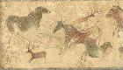
SOCI 1100 4A Fall 2015
Day #3
September 15, 2015

Slide 2
Agenda
Film
Finish graphic presentations
Steve Tamayo video

Slide 3
Why and How do we Study Native Americans?
500 Nations -- In class today we will watch the first 16 minutes of Part 1
(https://www.youtube.com/watch?v=m6K4ar1nm5A)

Slide 4
Pictographs
Pictographs are painted onto stone and are much more fragile than petroglyphs. The paint is a mineral or vegetal substance combined with some sort of binder like fat residue or blood. If the paint was not properly mixed with a binder it would not adhere well to the stone and the pictograph would quickly flake away. Pictographs were painted in locations where they would be protected from the elements: in caves, alcoves, under ledges and overhangs.

Slide 5
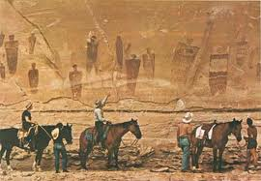
PICTOGRAPHS ON WALL OF HORSESHOE CANYON, believed to have been made by Fremont people about 1,000 years ago. Photograph by Walter Meayers Edwards, © 1971 National Geographic Society. http://www.nps.gov/history/history/online_books/geology/publications/bul/1327/sec3.htm

Slide 6
Fremont Culture
The Fremont people, who were mainly hunters, seemingly left no artifacts, but they did leave beautiful pictographs, or rock paintings, such as the group of ghostly human figures on the sandstone wall of Horseshoe Canyon

Slide 7
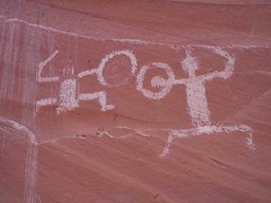
Defiance House was discovered in 1959. Exploring the area before Lake Powell was created, University of Utah archeologists followed a dangerous hand-and-toe-hold trail up the sandstone cliff and were delighted to find an Anasazi site where "most of the roofs were still in place, and... two perfect red bowls still had scraps of food in them.“ They named the site "Defiance House“ for the large pictograph (rock painting) of warriors brandishing clubs and shields. http://www.nps.gov/glca/historyculture/defiancehouse.htm

Slide 8

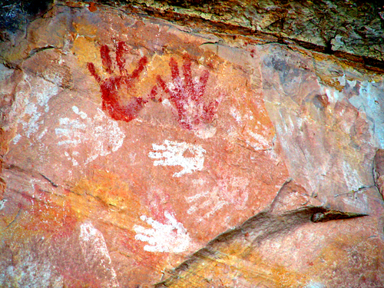
Desert Culture Pictograph, California
These hand prints are over 800 years old. They were found above Double Stack Ruin in Butler Wash near Bluff,Utah. For more info, visit Beyond Mesa Verde

Slide 9
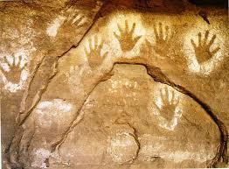
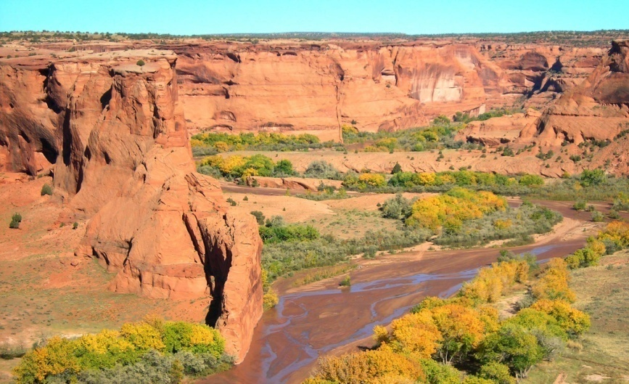
These hands were made by blowing the paint onto the hand leaving a negative image.
They are in Canyon de Chelly National Monument, Chinle, Arizona
http://www.nps.gov/cach/index.htm

Slide 10
Intaglios
Intaglios are large ground drawings created by removing the pebbles that make up desert pavement. Intaglios are usually in the outline of animals (zoomorphs) or human-like figures (anthropomorphs). Intaglios are found on mesas along the Colorado River more so than in other places.
http://www.petroglyphs.us/

Slide 11
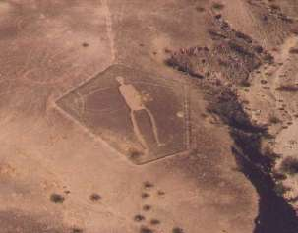
The geoglyphics vary in form, style and size with the largest figure in the Blythe area, a man over 165 feet long, thought to be a giant hunter, being constructed like the other figures in the area through the removal of a surface layer of darkened rock, exposing a lighter soil underneath. http://www.blytheareachamberofcommerce.com/intag.htm

Slide 12
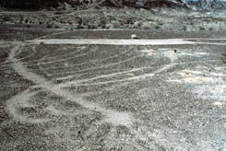
Intaglios are very susceptible to damage. This arm of the largest figure neat Blythe, CA, illustrates the damage caused by vehicle tires. If you visit an intaglio remember that even footsteps can damage the figures.

Slide 13
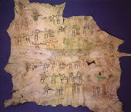
Another Graphic History: Wintercounts
For generations, Plains Indians drew pictographs to document their daily experiences.
The Lakota term for winter count is wniyetu wowapi. The word Wowapi translates as “anything that can be read or counted.” Waniyetu is the Lakota word for year, which is measured from first snow to first snow.
http://www.aktalakota.org/index.cfm?cat=1&artid=182

Slide 14
Winter counts were dynamic documents of recorded history. Variations between similar counts occurred if a community historian chose to emphasize a different aspect of an event or select another event all together. Differences among winter count narratives may also be the result of inaccurate translation from Lakota to English. The winter count, like history, is selective representation of a people’s past. The narratives usually reflect both the community’s history and culture.

Slide 15
Winter counts were also used by individuals within the tribal community to record specific events in their own lives. Tribal communities made up of members of extended family or tiospayes also recorded their story and experiences on a winter count so it was not uncommon to have multiple copies of winter counts within a community.
https://mccneb.ensemblevideo.com/app/library.aspx?PageNumber=2&ResultsPerPage=10 start at 15:30
Source: http://www.aktalakota.org/index.cfm?cat=1&artid=182

Slide 16
Buffalo Robe Project
MCC “Art of the Americas” students have completed the process of painting a traditional winter count depicting the history of Fort Omaha on a brain-tanned buffalo robe that was gifted to the college by Lakota artist Steve Tamayo.

Slide 17
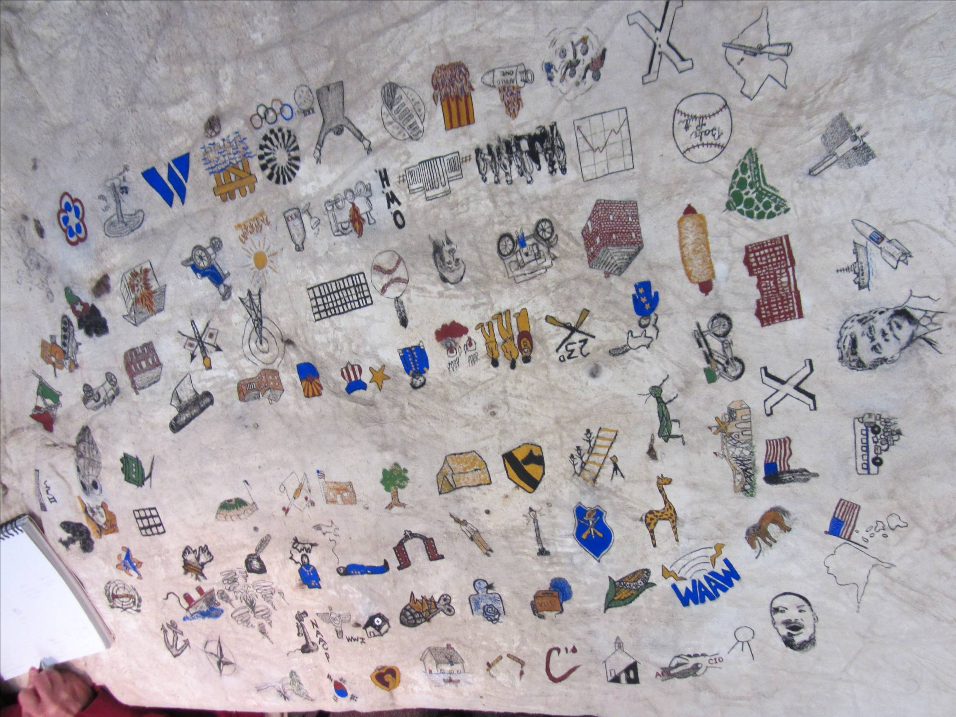

Slide 18
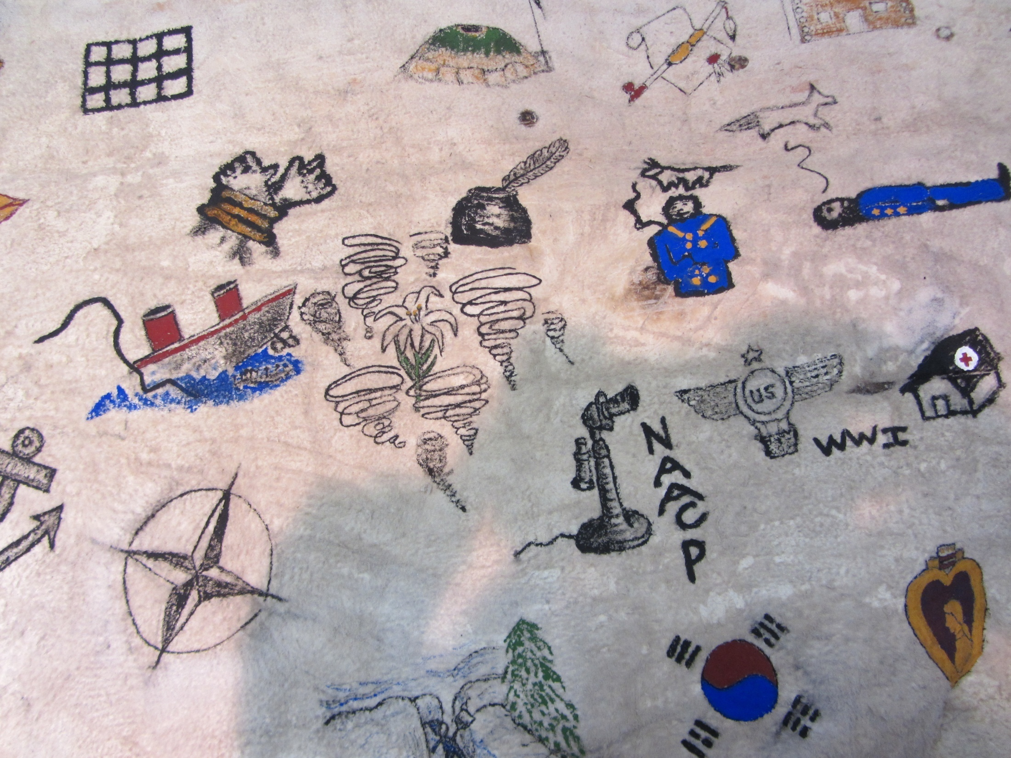

Slide 19
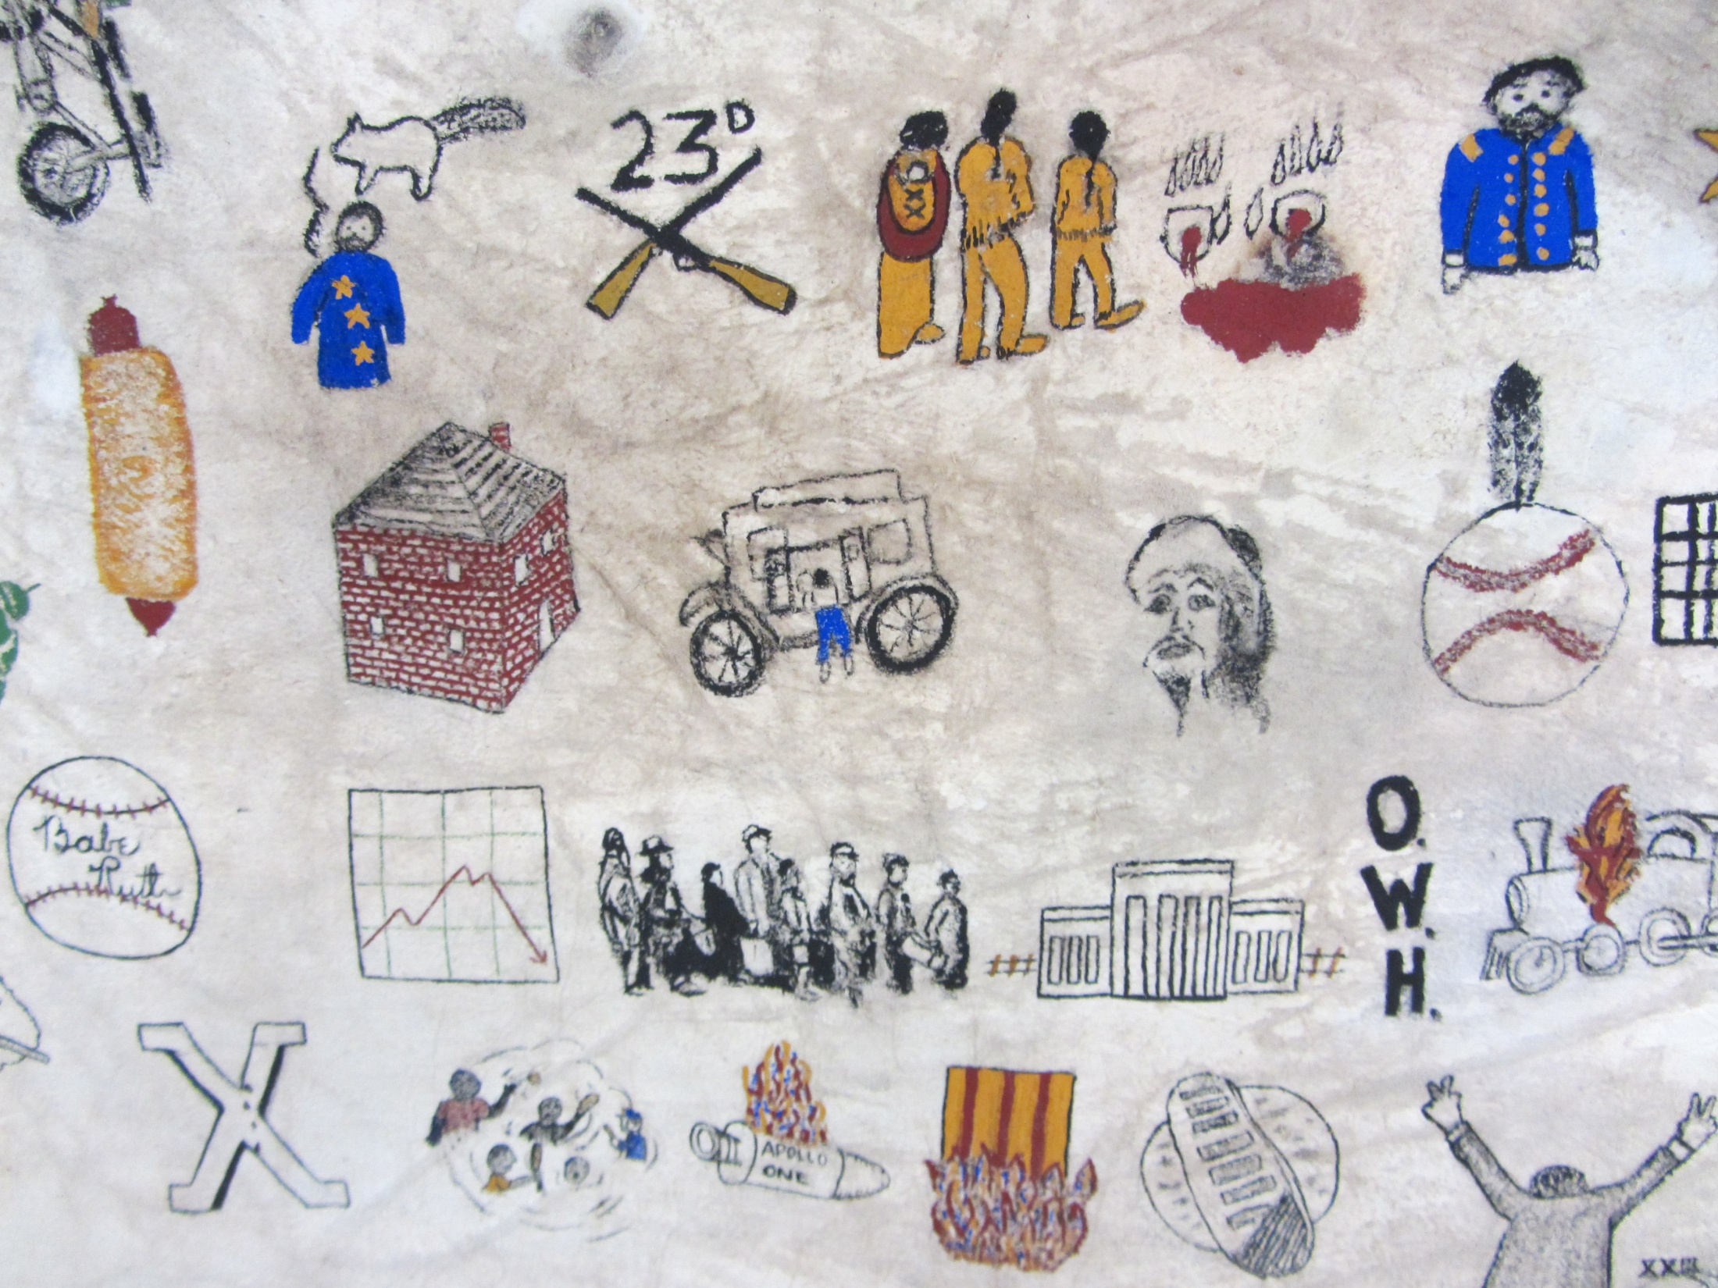

Slide 20
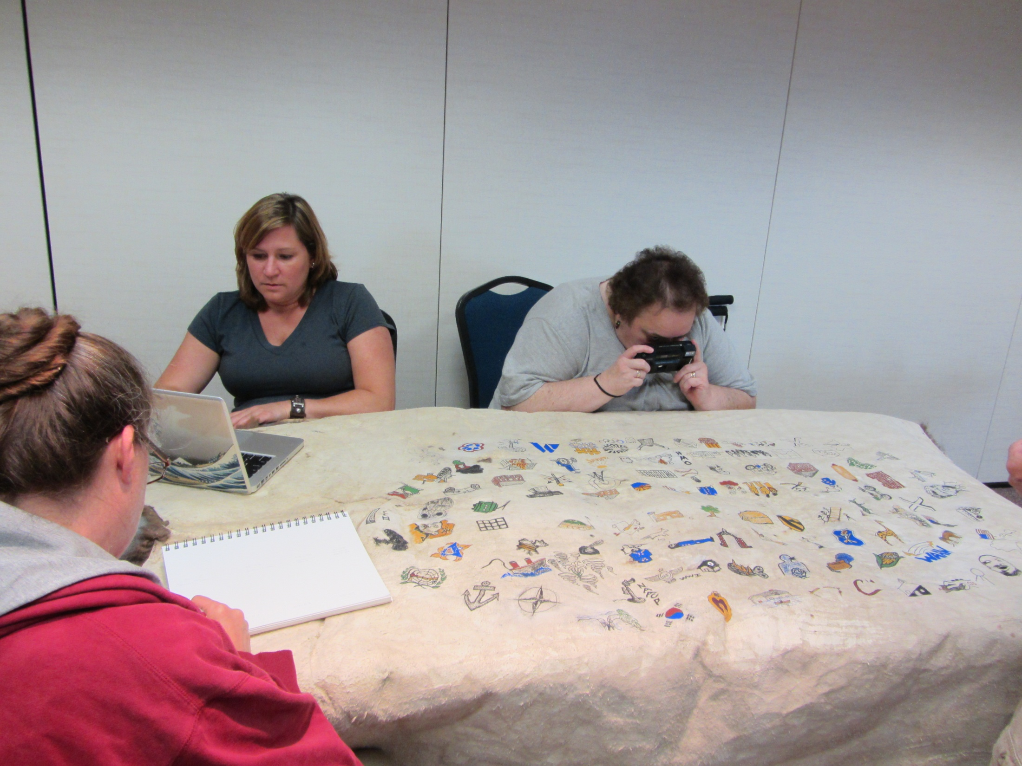
Art of the Americas instructor Susan Healy
Student Artist: Lisa

Slide 21
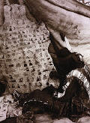
Kills Two, Brule´ Sioux Medicine Man, is painting on a deer hide the “Big Missouri” Winter Count – the pictorial record of their tribe from 1876-1926. Photography by John A. Anderson, c. 1923

Slide 22
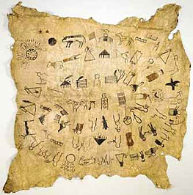
Lakota Wintercounts
Lone Dog – 1800 - 1870
This version of the Lone Dog count painted on cow hide was acquired by the museum in 1952 from an antique dealer without any information on who made it or when.
http://wintercounts.si.edu/index.html

Slide 23
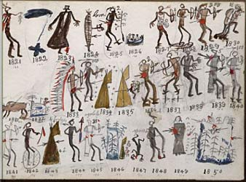

Slide 24
http://wintercounts.si.edu/index.html
Great Sioux Reservation
http://wintercounts.si.edu/html_version/pdfs/map.cmyk.pdf
Depiction of Various Tribal Groups in wintercounts
http://wintercounts.si.edu/html_version/pdfs/peoples.pdf

Slide 25
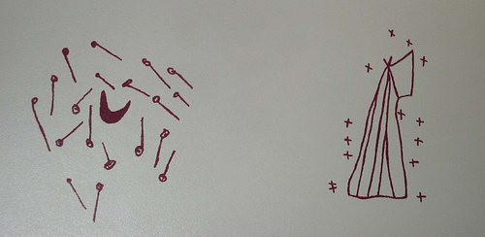
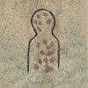
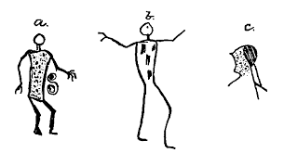
Wintercount Symbols
Meteor shower
Small pox or measles epidemic

Slide 26
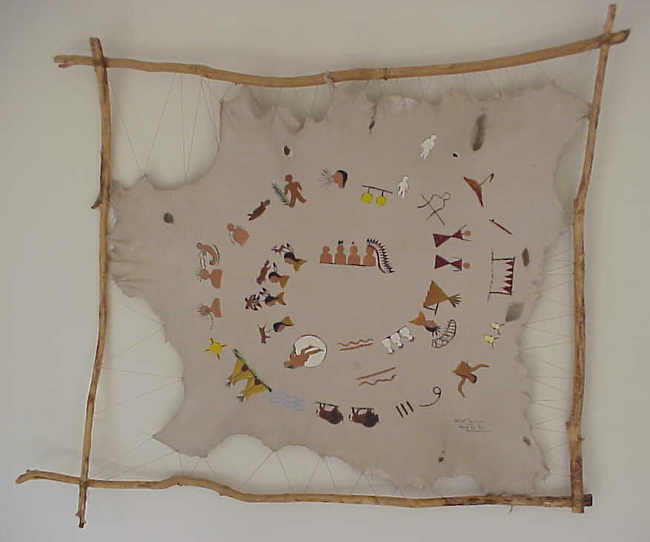

Slide 27
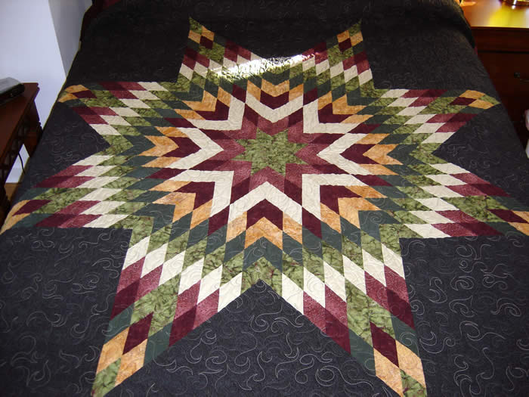

Slide 28
Assignment
Stop in Mule Barn and look at the Buffalo Robe
Be sure you have looked at the demographic information in this week’s assignment

Slide 29
Five-Hundred Nations Part 1
https://www.youtube.com/watch?v=E7Ls57OFhaM
We watched the first 16 minutes or so

