Slide 1
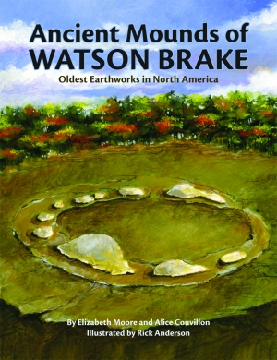
SOCI 1100
Day 8
October 1, 2015

Slide 2
Mound Builder Cultures
prehistoric inhabitants of North America
constructed earthen mounds for burial, residential and ceremonial purposes
Pre-Columbian cultures of the Archaic period; Woodland period (Adena and Hopewell cultures); and Mississippian period
dating from roughly 3000 BCE to the 16th century CE
regions of the Great Lakes, the Ohio River valley, and the Mississippi River valley

Slide 3
Archaic Period
Mound building started at an early date in North America
  well before the pyramids of Egypt were constructed
Earliest known site: Watson Brake consists of an oval formation of 11 mounds from three to 25 feet tall connected by ridges to form an oval nearly 900 feet across.
located in the floodplain of the Ouachita River near Monroe, Louisiana
purpose of these 11 mounds is unclear
been dated to about 5400 years ago (approx. 3400 BCE)

Slide 4
Watson Brake
Mound-building began five millennia ago and continued until the arrival of Europeans. The earthworks they built are striking evidence of Louisiana's earliest residents. They also are a testimony to the complexity of an ancient culture that remains largely a mystery.
Ouachita River Mounds: A Five Millennium Mystery By Lori Tucker

Slide 5
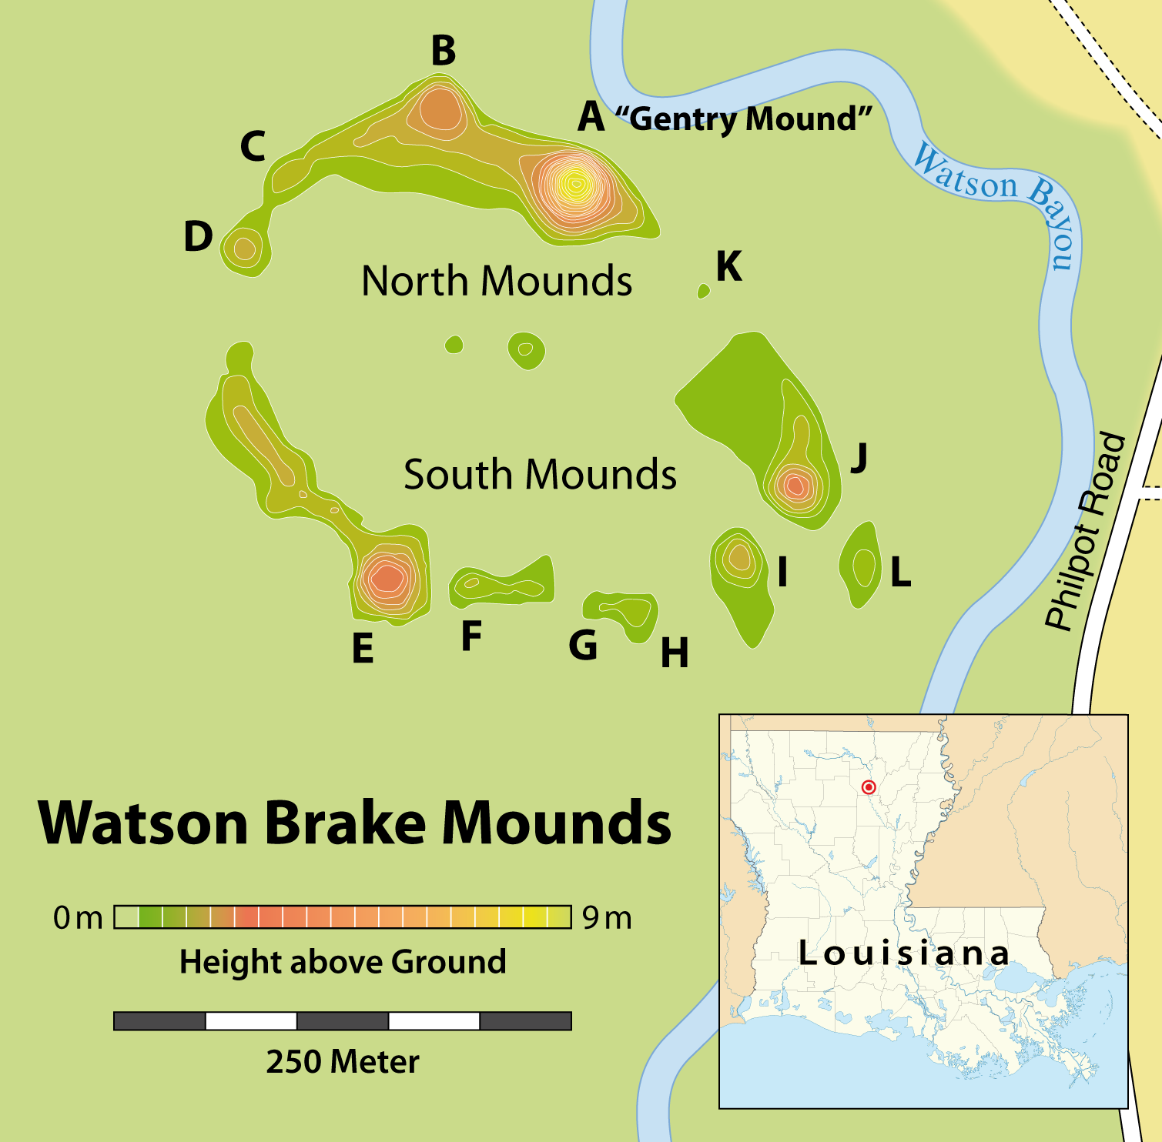
Watson Brake

Slide 6
Watson Brake
Reca Bamburg Jones, a local resident, was long aware of three of the mounds on the overgrown site and, in the early 1980s, she was instrumental in bringing the site to the attention of professional archeologists.
In 1981, after logging revealed more of the site, she discerned the pattern of eleven mounds connected by ridges, a complex 280 yards across.
In 1983 she and John Belmont published the site in a survey of pre-history in the Ouachita River Valley.

Slide 7
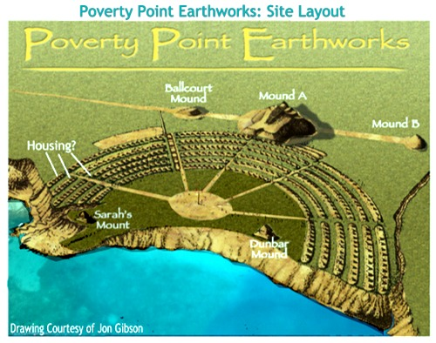
Early Mississippian Period
Poverty Point Culture
http://www.youtube.com/watch?v=itCWu-m-23E

Slide 8
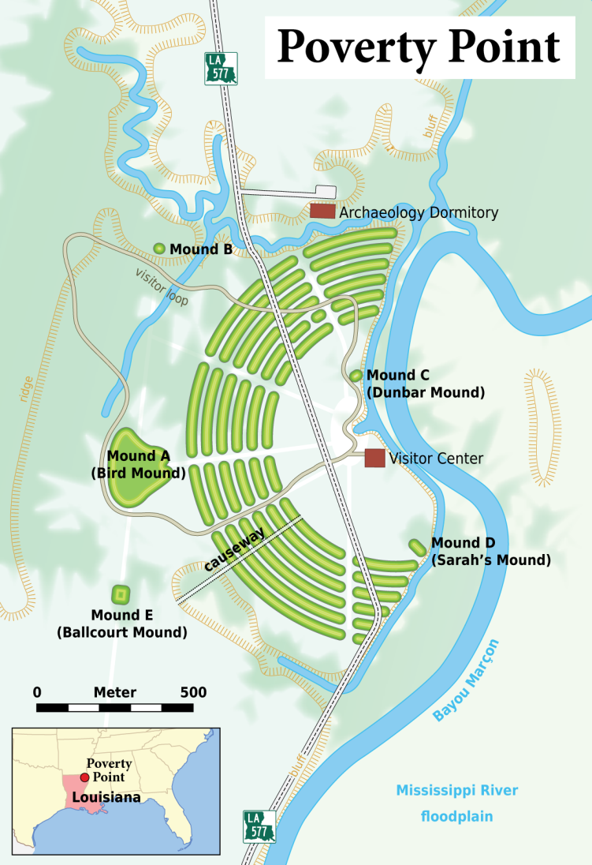
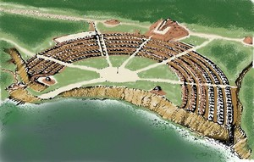
Poverty Point
http://www.youtube.com/watch?v=YnUUNwuwA8Y

Slide 9
Poverty Point
The monument contains some of the largest earthen mounds in North America. A city with a population of 4,000 to 5,000 flourished at Poverty Point from about 1700 to 700 bce. The central structure of the site is composed of six concentric earthen ridges arranged in a horseshoe shape. It is thought that the ridges may have been foundations for living areas. To the west of the ridges is Poverty Point Mound, a massive earthen effigy of a bird in flight that is 700 feet (210 meters) across and 70 feet (20 meters) high.

Slide 10
The preagricultural people that built the mounds were a highly sophisticated and well-adapted society. Tools and vessels fashioned from materials traced to places as distant as the Ohio River valley point to a well-developed trade network. Unique artifacts found at the site include thousands of hand-built clay “stones” that were used for convection cooking.

Slide 11
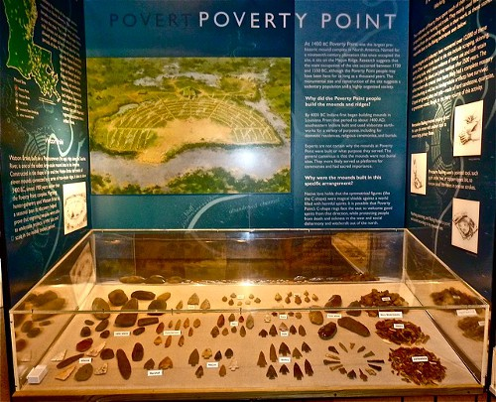

Slide 12
Woodland Period
from roughly 1000 BCE to 1000 CE in the eastern part of North America
The term "Woodland Period" was introduced in the 1930s as a generic header for prehistoric sites falling between the Archaic hunter-gatherers and the agriculturalist Mississippian cultures.

Slide 13
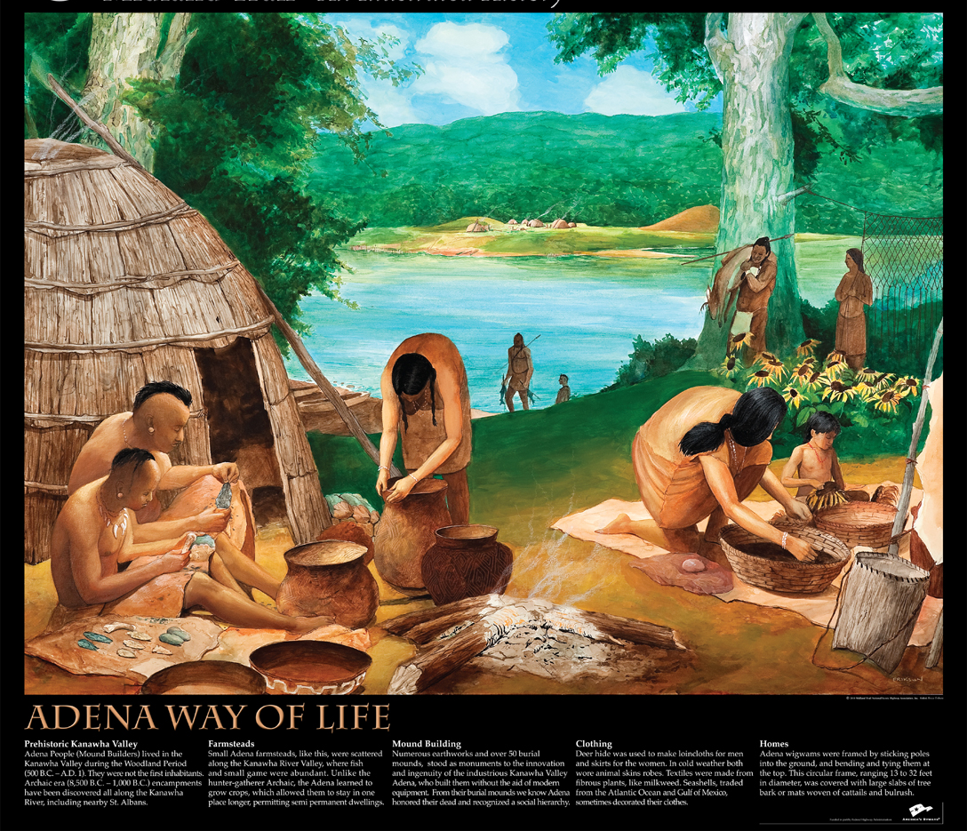
The Adena culture is
the best-known early Woodland culture
Researchers are now redefining
the period to begin with not only pottery, but appearance
of permanent settlements, burial practices,
and horticulture
of starchy seed plants

Slide 14
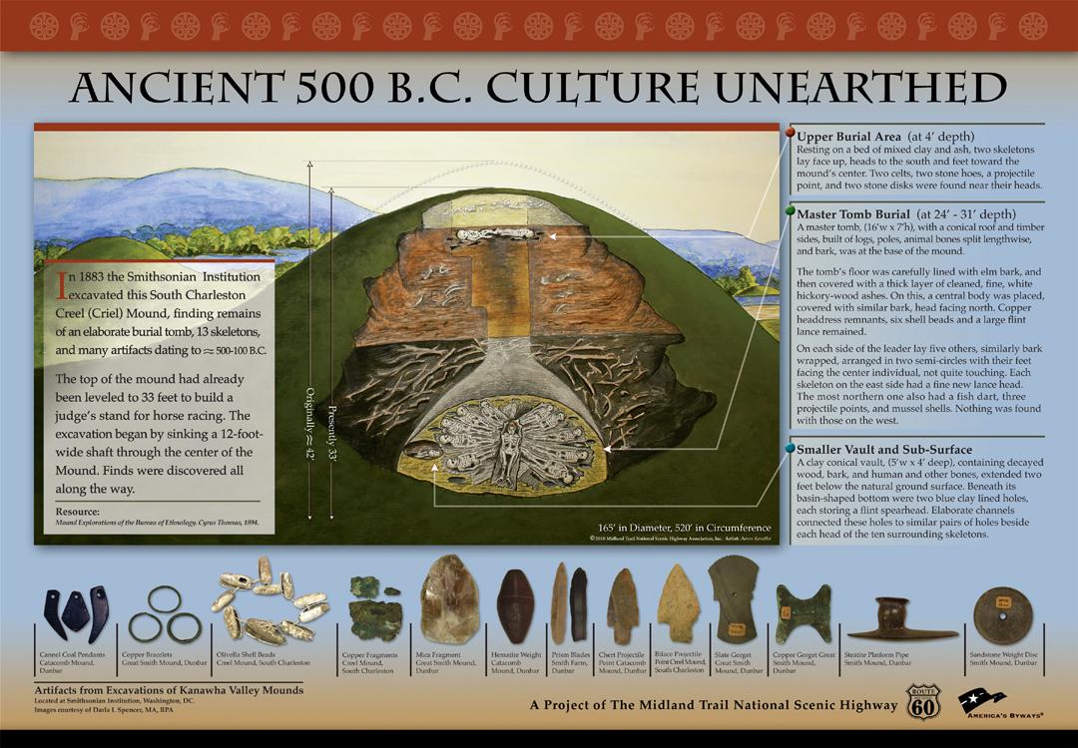

Slide 15
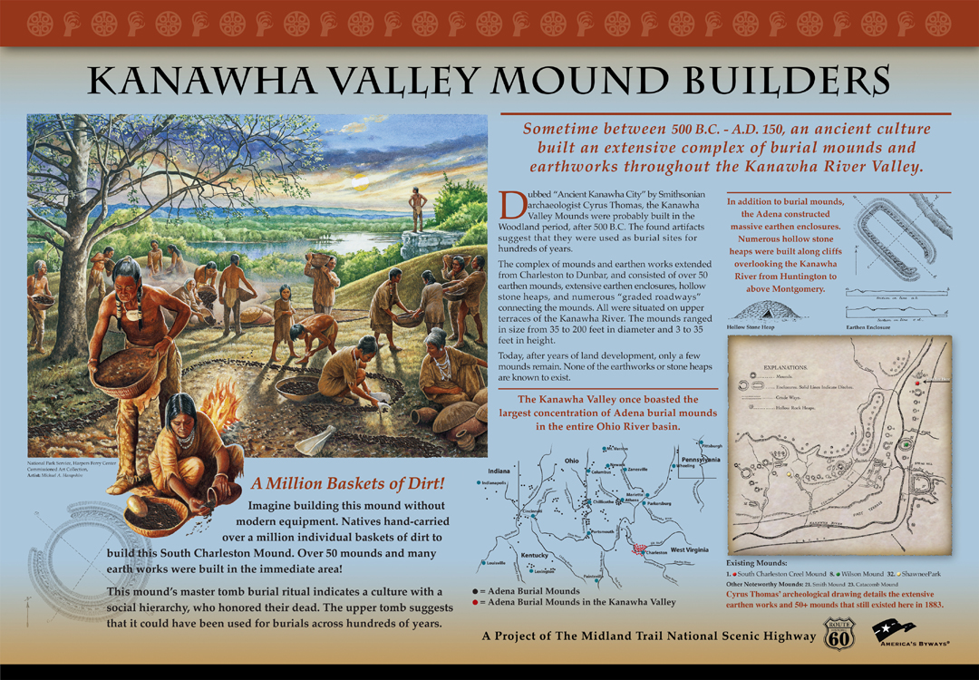

Slide 16
The late Woodland period was a time of apparent population dispersal
In most areas construction of burial mounds decreased drastically, as well as long-distance trade in exotic materials
bow and arrow technology gradually overtook the use of the spear and atlatl
agricultural production of the "Three Sisters" (maize, beans, and squash) was introduced

Slide 17
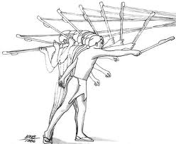
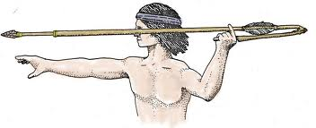
Atlatl and Spear
Atlatl or spear-thrower is a tool that uses leverage to achieve greater velocity in spear-throwing.
http://www.nps.gov/efmo/photosmultimedia/loader.cfm?csModule=security/getfile&PageID=200972

Slide 18
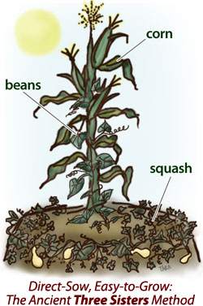

Three Sisters

Slide 19
Hopewell Tradition
Flourished along rivers in the northeastern and midwestern United States from 200 BCE to 500 CE.
The Hopewell tradition was not a single culture or society, but a widely dispersed set of related populations.
They were connected by a common network of trade routes, known as the Hopewell Exchange System.

Slide 20
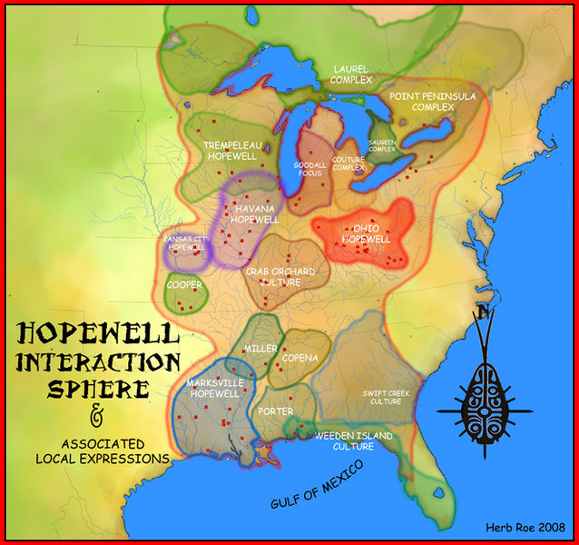
http://en.wikipedia.org/wiki/List_of_Hopewell_sites

Slide 21
Hopewell Exchange System
At its greatest extent, the Hopewell exchange system ran from the Southeastern United States into the southeastern Canadian shores of Lake Ontario.
Within this area societies participated in a high degree of exchange with the highest amount of activity along waterways.
The Hopewell exchange system received materials from all over the United States.

Slide 22
Most of the items traded were exotic materials and were received by people living in the major trading and manufacturing areas.
These people then converted the materials into products and exported them through local and regional exchange networks.
The objects created by the Hopewell exchange system spread far and wide and have been seen in many burials outside the Midwest.^{[2]}

Slide 23
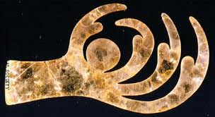
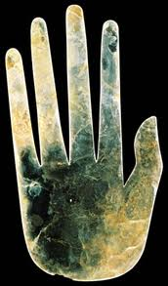
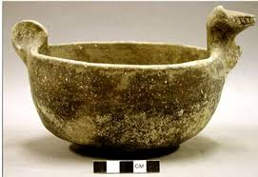
The Hopewell created some of the finest craftwork and artwork of the Americas. Most of their works had some religious significance, and their graves were filled with necklaces, ornate carvings made from bone or wood, decorated ceremonial pottery, ear plugs, and pendants. Some graves were lined with woven mats, mica (a flaky clear mineral), or stones.

Slide 24
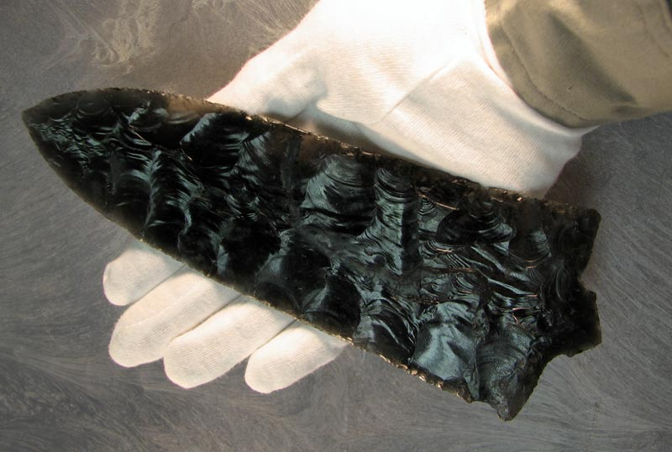
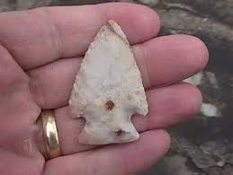
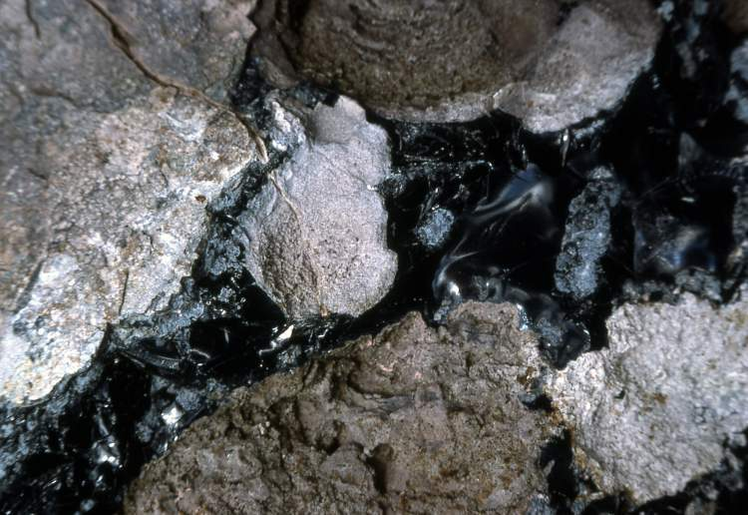
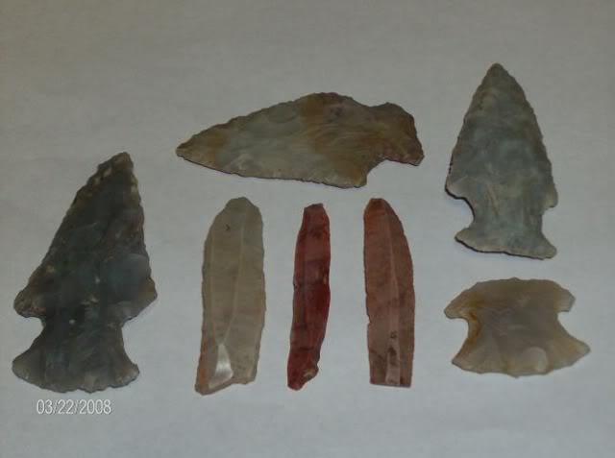

Slide 25
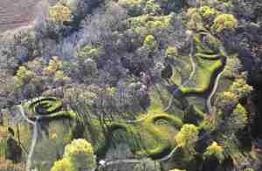
An impressive earthwork at a quarter mile length (400 m), it is comparable to stonehenge or Notre Dame in its architectural marvel. It combines three patterns that we examine further in this chapter, the egg, the sinuous shape, and the spiral. It tells a story for sure, it may have been a water harvesting device, and it was for sure a solar/ lunar calendar. Furthermore, it is inspirational and its ability to survive the plow from the European Colonists is remarkable.

Slide 26
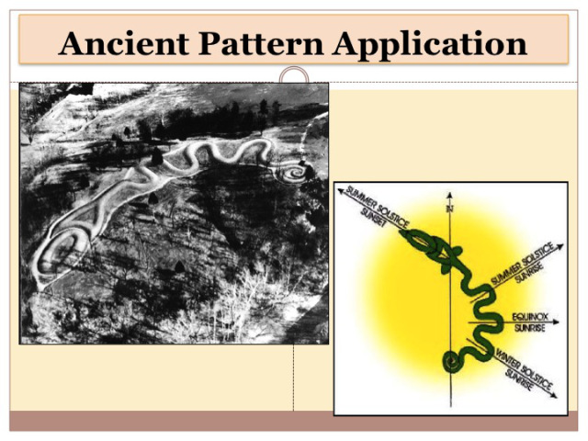

Slide 27
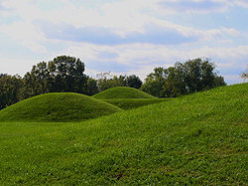
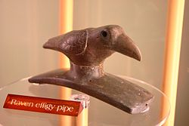
The Mound of Pipes at Mound City (near Chillicothe, Ohio) produced over 200 stone smoking pipes depicting animals and birds in well-realized three-dimensional form

Slide 28
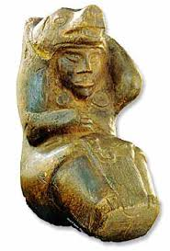
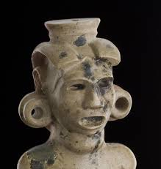
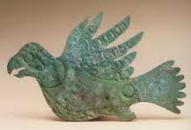

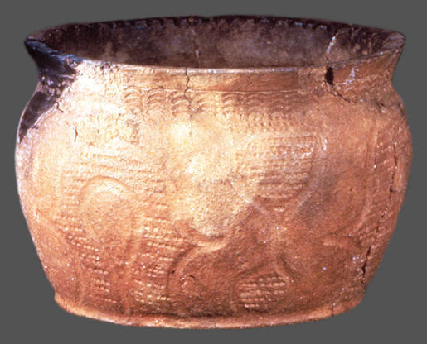
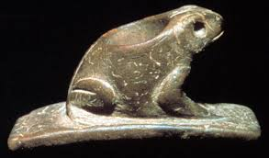
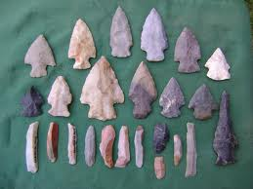
Hopewell Artifacts

Slide 29
Mississippian period (after A.D. 1000)
Maize agriculture spread throughout the East.
Populations expanded and became increasingly sedentary.
At Cahokia Mounds (near East St. Louis, Ill.) the largest earthwork in North America was built, a temple mound measuring nearly 100 ft high and 975 ft long
Many large ceremonial centers with temple mounds appeared throughout the South, especially in the Mississippi Valley

Slide 30
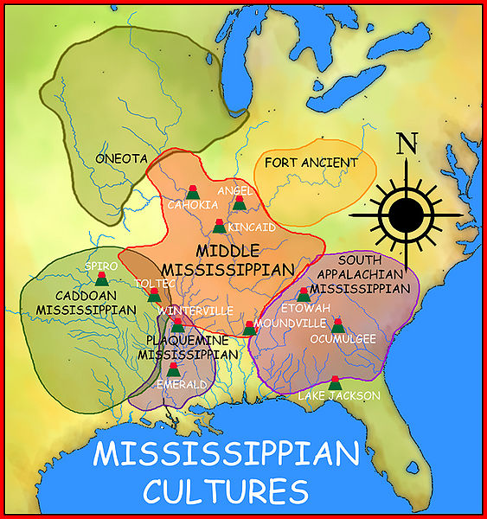

Slide 31
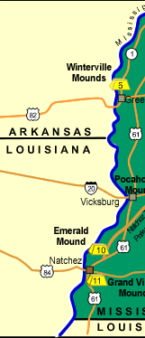
Mississippi
Mound
Sites
Bear Creek Mound and Village Site, 45 miles northeast of Tupelo
Pharr Mounds, 23 miles northeast of Tupelo
Owl Creek Site, 18 miles southwest of Tupelo
Bynum Mound and Village Site, 28 miles southwest of Tupelo
Winterville Site, 6 miles north of Greenville
Jaketown Site, 4 miles north of Belzoni
Nanih Waiya Mound and Village, northeast of Philadelphia
Pocahontas Mound A, 9 miles north of Jackson
Boyd Mounds Site, northeast of Jackson
Emerald Mound Site, 10 miles northeast of Natchez
Grand Village of the Natchez Indians, Natchez
http://www.nps.gov/nr/travel/mounds/map.htm

Slide 32
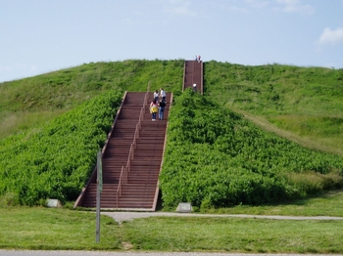
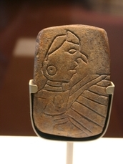
Humans first arrived at Cahokia around 700 AD, but sometime around 1050
the population exploded for unknown reasons and the city became a
regional center of what is known as the Mississippian culture.

Slide 33
Cahokia Mounds
At its peak (1050-1250 AD), the city was home to 10-15,000 residents,
with the regional population estimated to have been as large as 40,000.
That means it may have been the biggest world metropolis of its time,
surpassing even London.
To understand this site, it is important to explore the Mound Builder Cultures.

Slide 34
Cahokia Mounds
the city of Cahokia was inhabited from about A.D. 700 to 1400
at its peak from 1,100 to 1,200 A.D.
the city covered nearly six square miles and boasted a population of as many as 100,000 people
houses were arranged in rows around open plazas
agricultural fields and a number of smaller villages surrounded and supplied the city
Cahokians were known to have traded with other tribes as far away as Minnesota.
http://www.youtube.com/watch?v=P_aSBfHpytE&feature=related
http://cahokiamounds.org/

Slide 35
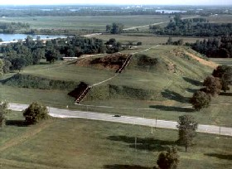
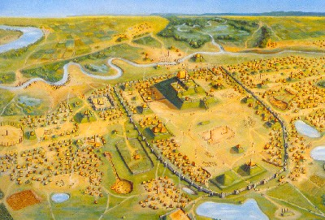
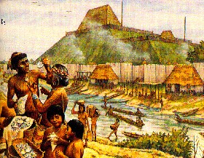
http://www.youtube.com/
watch?v=4JI9I-fqdGg&feature=related
http://www.youtube.com/
watch?NR=1&v=tYvrMrVILgE

Slide 36
Cahokia, America’s Lost City
Time Life/BBC/TLC production 1998
http://www.youtube.com/watch?v=hIbTXGkdJ0w&feature=related
http://www.youtube.com/watch?v=WfJENUpQfIM&feature=related
http://www.youtube.com/watch?v=KwEc_dH_oR4&feature=related
http://www.youtube.com/watch?v=VfrbR-FJbJc&feature=related
http://www.youtube.com/watch?v=46P33GpG-wU&feature=related
http://www.youtube.com/watch?v=7ern56o9ezc&feature=related

Slide 37
References
Squier, A.M., E.G.; Davis M.D., E.H. (1847). Ancient Monuments of the Mississippi Valley. Washington DC: Smithsonian Institution.
Mound Builders — Infoplease.com http://www.infoplease.com/ce6/sci/A0834239.html#ixzz1cD352NBN
http://www.legendsofamerica.com/il-cahokia.html

Slide 38
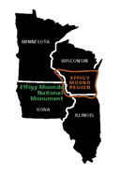
Effigy Mounds
http://www.nps.gov/mwr/_cs_apps/fls_photoGallery/customcf/display-slideshow.cfm?gID=236605
http://www.nps.gov/efmo/index.htm
The mounds preserved here are considered ceremonial and sacred sites by many Americans, especially the Monument's 12 affiliated American Indian tribes.
The 2,526 acre Monument includes more than 200 American Indian mounds

Slide 39
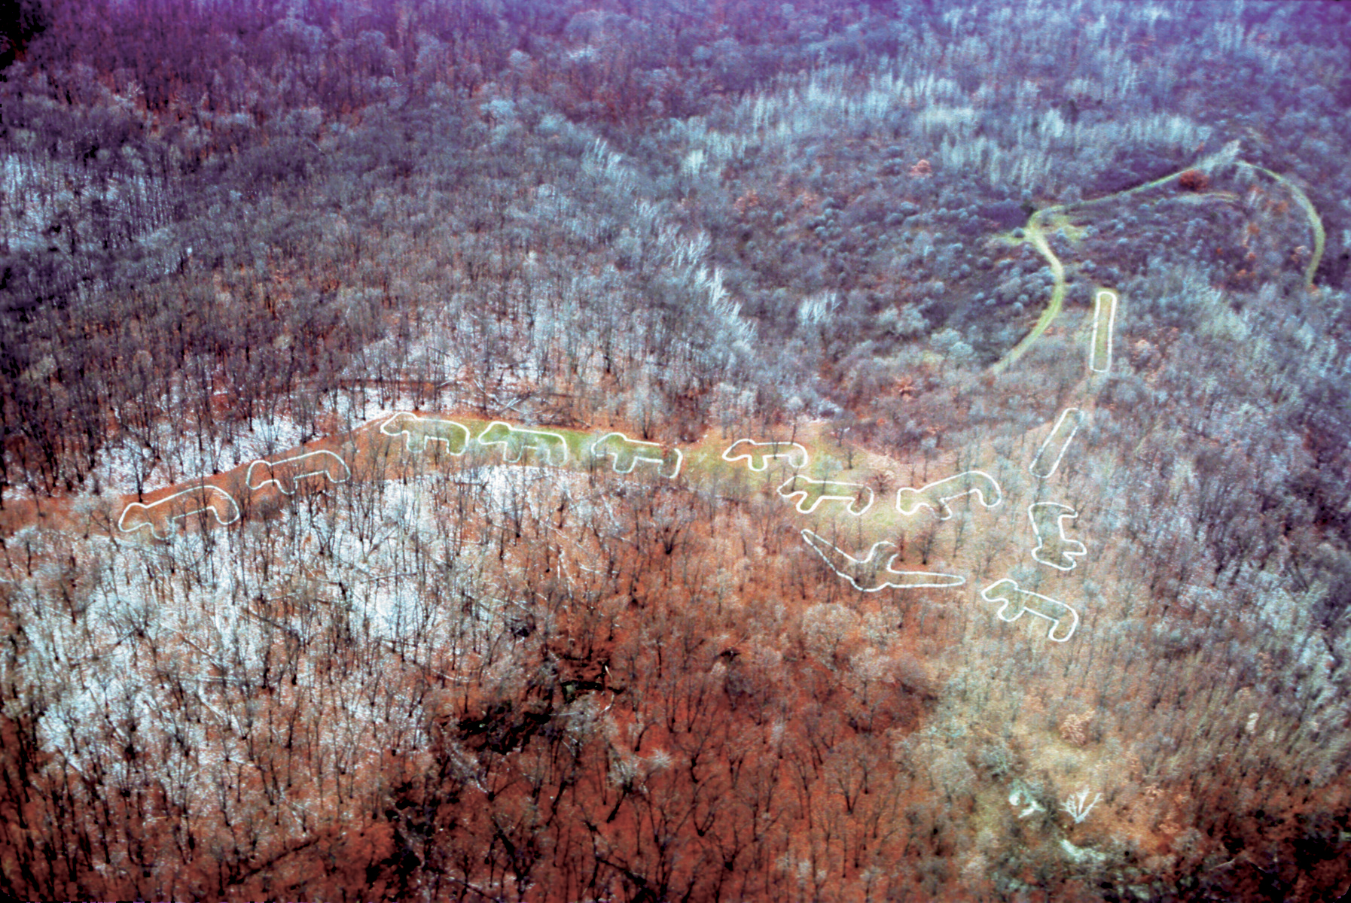

Slide 40
Present day American Indian tribes affiliated with Effigy Mounds National Monument include:
Iowa Tribe of Kansas and Nebraska
Iowa Tribe of Oklahoma
Otoe-Missouria Tribe of Oklahoma
Ho-Chunk Nation of Wisconsin
Winnebago Tribe of Nebraska
Upper Sioux Community of Minnesota
Shakopee Mdewakanton Sioux Community In the State of Minnesota
Lower Sioux Indian Community In the State of Minnesota
Prairie island Indian Community In the State of Minnesota
Sac and Fox Tribe of the Mississippi in Iowa
Sac and Fox Nation of Missouri in Kansas and Nebraska
Sac and Fox Nation of Oklahoma

Slide 41
The construction of effigy mounds was a regional cultural phenomenon. Mounds of earth in the shapes of birds, bear, deer, bison, lynx, turtle, panther or water spirit are the most common images. Like earlier groups, the Effigy Moundbuilders continued to build conical mounds for burial purposes, but their burial sites lacked the trade goods of the preceding Middle Woodland Culture. The Effigy Moundbuilders also built linear or long rectangular mounds that were used for ceremonial purposes that remain a mystery.

Slide 42
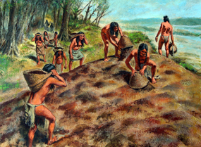

Slide 43
Clues can be found in American Indian legends and mythology and to a lesser extent, scientific research. The stories and legends of the Native Americans whose ancestors built the mounds describe the effigy mounds as ceremonial and sacred sites. Archeologists believe the effigy mounds delineated territories of choice gathering and hunting grounds. Unfortunately, much of the data is inconclusive.

Slide 44
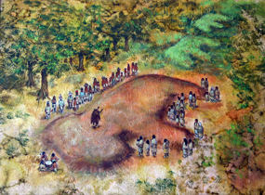
Bear Mound Ceremony

Slide 45
History of Effigy Mounds Area
Father Jacques Marquette, a Jesuit priest, and Louis Jolliet, a French cartographer born in Canada, are credited with the historic discovery of the Mississippi River on June 17, 1673.
They were guided on their mission by two Indian guides from the Fox Valley of Wisconsin.
Marquette and Jolliet's exploration claimed the land along the river for France and the people who followed began the fur trade era, one of the most colorful chapters in the history of the area.

Slide 46
Fur Traders
In 1685, Nicholas Perrot established Fort St. Nicholas near present-day Prairie du Chien to protect the French interests in the fur trade.
In 1781, Michael Brisbois, the first independent fur trader to live in Prairie du Chien, established a good working relationship with the Indians and the area soon developed into a profitable fur trading post.

Slide 47
John Jacob Astor set up a post of the American Fur Company at Prairie du Chien in 1808 on St. Feriole Island. This corporation was important during conflict between the French, British, Americans and Indians.

Slide 48
In 1805, Zebulon Pike was sent to the area by the U.S. Army to establish a post after the Louisiana Purchase added new land west of the Mississippi River to the United States.
Pike selected a fort site on the bluff overlooking the convergence of the Wisconsin and Mississippi Rivers.
Pike's journal makes no mention of the mounds of this region, although he very likely saw them.

Slide 49
In 1825, the U.S. government called for a Great Council of Plains and Woodlands tribes in an attempt to put an end to unrest and establish tribal boundaries.
As many as 10,000 Native Americans and U.S. Army personnel met on St. Feriole Island. By 1830, a "neutral zone" was established as a buffer area between the tribes. This neutral zone was located north of the present national monument.

Slide 50
In 1881, Theodore Lewis and Alfred Hill began a project to map out the mound groups along the Mississippi River. The project was funded by Hill, who had ties with the railroad. Lewis mapped out several mound groups in the present monument. Lewis' survey shows 66 mounds including three effigies, on the terrace where the present-day Visitor Center is located. All but six of the original mounds were destroyed by farming activity by 1930.

Slide 51
The Sny Magill Unit of Effigy Mounds National Monument preserves at least 106 mounds representing the largest group of mounds in one location found in North America. The Unit contains two bird mounds, three bear mounds, 6 linear mounds and 95 conical mounds including a 2500 year old red ochre mound.
more...

Slide 52
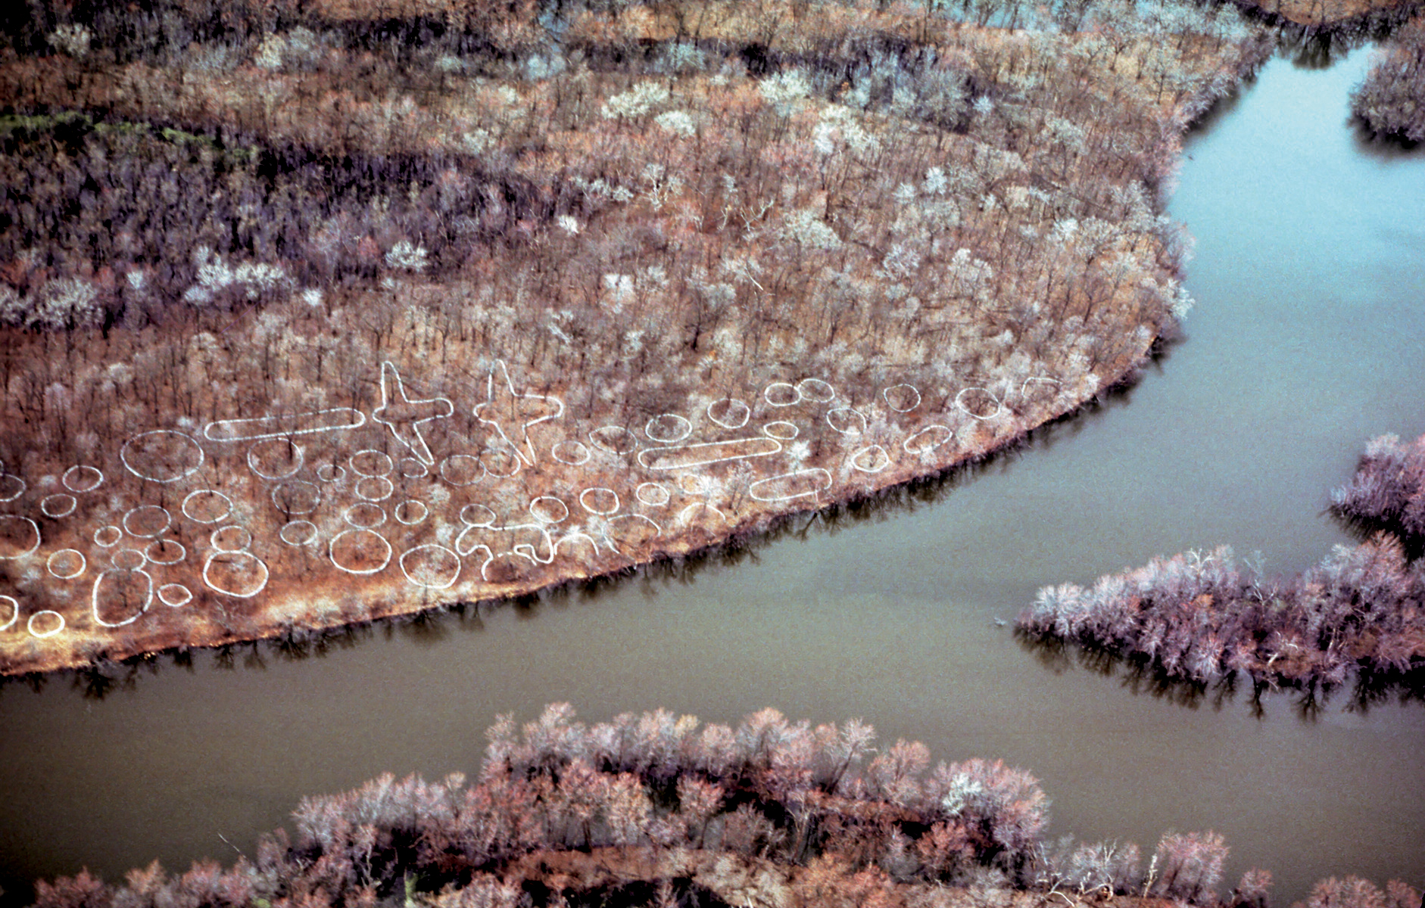

Slide 53
9 minute video of Effigy Mounds National Monument
http://www.youtube.com/watch?v=qd2OguWCTTo
1:16 family video
http://www.youtube.com/watch?v=yUurvJL7CbQ&feature=related
7 minute personal video
http://www.youtube.com/watch?v=eyMZRPztyok&feature=related

Slide 54
Assignment
If possible, watch this video
https://www.youtube.com/watch?v=l0ZMVTgvzIk
Answer reading questions – due October 13
See Quia page for questions

Slide 55
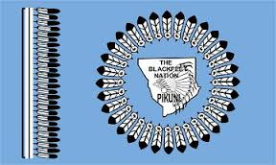

Slide 56
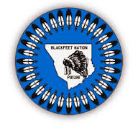

Slide 57
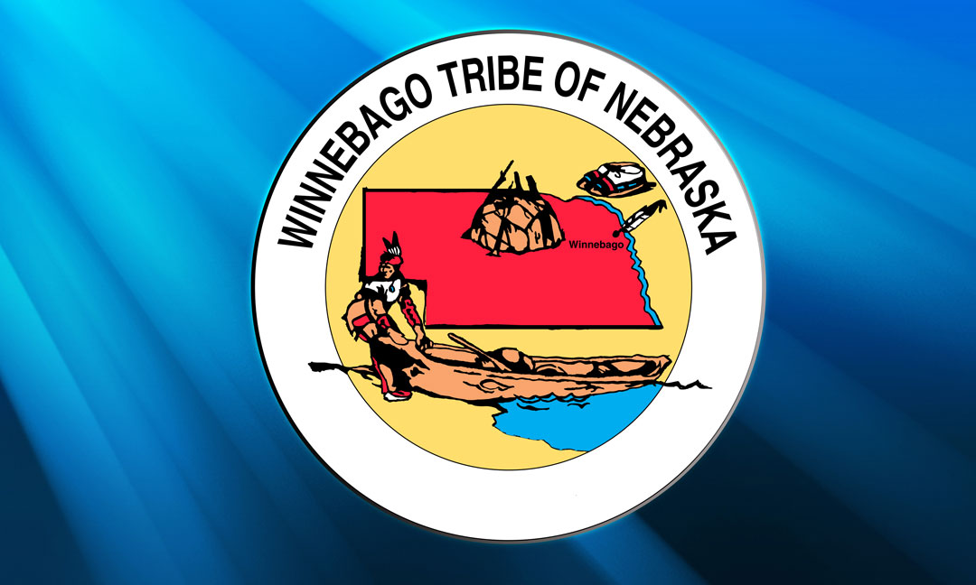

Slide 58


