Slide 1
SOCI 1100 4A Day # 16 October 29, 2015

Slide 2
Agenda
Finish Ishi
Review game
Language Preservation

Slide 3
Vocabulary Review

Slide 4
Native American Languages
Endangered
Revival
Revitalization
http://www.youtube.com/watch?v=pROGfJ4qcmQ&feature=fvwrel

Slide 5
Related Terminology
A language which has no native speakers (people who grew up speaking the language as a child) is called "dead" or "extinct."
… no native speakers in the youngest generation is called "moribund.“
very few native speakers is called "endangered" or "imperiled."

Slide 6
Current State of Tribal Languages
Language revival and language revitalization are attempts to preserve endangered languages
Of the 800+ Amerindian languages, five hundred are endangered or worse
In North America only Navajo usage is increasing

Slide 7
History
Amerindian languages were deliberately destroyed, particularly in North America
As recently as the 1950's, Indian children were being forcibly removed from non-English-speaking households and sent to boarding schools to be "socialized."
They were routinely punished there for speaking their languages
Indian-speaking parents began hiding their languages in hopes of keeping their children in their houses or at least making school life easier for them.

Slide 8
Revival and Revitalization
Once the majority of the young people in a community don't understand a language anymore, its usage declines rapidly.
This is where language revival and language revitalization come in.
Language revival is the resurrection of a "dead" language, one with no existing native speakers.
Language revitalization is the rescue of a "dying" language.

Slide 9
By inspiring the younger generations to take an interest and pride in their ancestral languages, and by providing the means for them to learn it,
it is possible to reverse downward linguistic trends.
Laura Redish, 2001, http://www.native-languages.org/revive.htm

Slide 10
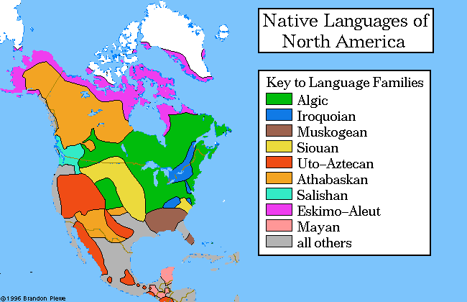
Native American Language Groups

Slide 11
We Shall Remain
http://www.pbs.org/wgbh/amex/weshallremain/native_now/language

Slide 12
Language Variety
There were perhaps a thousand languages spoken in the Americas before the arrival of Europeans - about 250 in the present territory of the United States alone
The spoken languages were neither primitive nor simple, and many had grammars as complex as those of Russian and Latin.
However, with the exception of an ideographic system used by the Mayans and their neighbors near the Yucatan peninsula, none of the native languages of America had a writing system until the arrival of Europeans.

Slide 13
The Maps
The boundaries on the map are not to be seen as rigid.
They are meant to represent the approximate regions where each language family was spoken at the time that European civilization reached the areas in question.
The areas shaded on the map were not political regions where a central government ruled over a single race, maintaining uniform control within specified borders

Slide 14
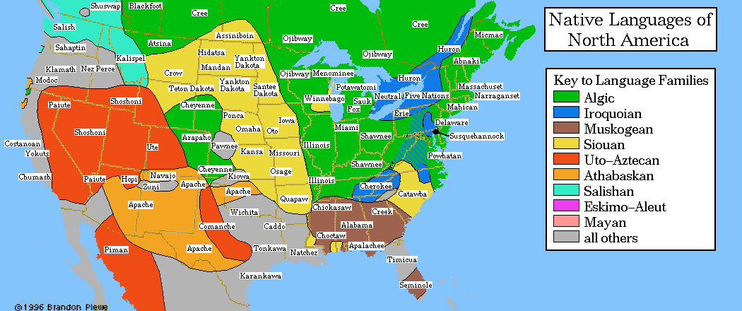
Indigenous Language Families of North America

Slide 15
Native Speakers
Only 8 indigenous languages of the area of the continental United States currently have a population of speakers in the U.S. and Canada large enough to populate a medium-sized town.
Only Navajo still has a population of greater than 25,000 within the U.S.

Slide 16
Native Speakers
Language | Family | Locations | Speakers
Navajo | Athabaskan | AZ, NM, UT | 148,530
Cree | Algic | MT, Canada | 60,000
Ojibwa | Algic | MN, ND, MT, MI, Canada | 51,000
Cherokee | Iroquoian | OK, NC | 22,500
Dakota | Siouan | NE, ND, SD, MN, MT, Canada | 20,000
Apache | Athabaskan | NM, AZ, OK | 15,000
Blackfoot | Algic | MT, Canada | 10,000
Choctaw | Muskogean | OK, MS, LA | 9,211

Slide 17
Reviving Language
Hupa Language
http://www.youtube.com/watch?v=qTX5iobS0h4&feature=related
Language – the Heart of our Culture
https://www.youtube.com/watch?v=MnMS44xjbcw
Native languages to be taught is schools
http://www.youtube.com/watch?v=rwcGNr5eUcs&feature=related

Slide 18
Sources
http://www.cogsci.indiana.edu/farg/rehling/nativeAm/ling.html
Indigenous Language Institute
http://www.ilinative.org/index.html
View short video with Wes Studi
http://travel.nationalgeographic.com/travel/enduring-voices/
Salmon Songs http://www.youtube.com/watch?v=q-aTzsMMJEs&NR=1&feature=endscreen

Slide 19
Disappearing Languages
Every 14 days a language dies. By 2100, more than half of the more than 7,000 languages spoken on Earth—many of them not yet recorded—may disappear, taking with them a wealth of knowledge about history, culture, the natural environment, and the human brain.
http://www.youtube.com/watch?v=kGpOXWDZKwU&feature=channel_video_title

Slide 20
Examples -- Sauk and Fox
Two Turtles
http://www.youtube.com/watch?v=IAZI2DsU6Dg
Terrie Kinsey, who is of Cherokee and Euchee heritage, serves as the language program coordinator for the Sac and Fox Nation of Oklahoma. She creates and organizes language resources for tribal members to encourage interest in their language, for example by collecting clan stories from the elders to produce illustrated books.

Slide 21
Assignment
Week 8 Questions due November 5
Topics for Buffalo Robe Project will be due on November 10
Tell us something contemporary about your tribe –language preservation November 3
Find a current or recent Native American Artist and be ready to report on November 17

