Slide 1

SOCI 1010
Class 19
11/10/15

Slide 2
Agenda
Attendance activity (http://www.quia.com/hm/491835.html)
Symbol Presentations
Finish Cult Activity
Begin Population and Ecology

Slide 3
Cult Phenomenon
Characteristics
Living, charismatic leader
Physical and psychological isolation
Obedience to rituals and practices
Mind control techniques
“Love-bombing” recruitment techniques

Slide 4
Cults
People’s Temple (Jim Jones)
Heaven’s Gate (Marshall Applewhite)
Unification Church (Moonies)
Children of God (Moses Berg)
Church of Scientology (L. Ron Hubbard)
Branch Davidians (David Koresh)

Slide 5
Cult Assignment
Who are they?
How did they make it into the news?
What is a basic idea behind the cult’s belief system?
How much membership – now or in the past?
Other? Did you find anything else of interest?
Be ready for report out.

Slide 6




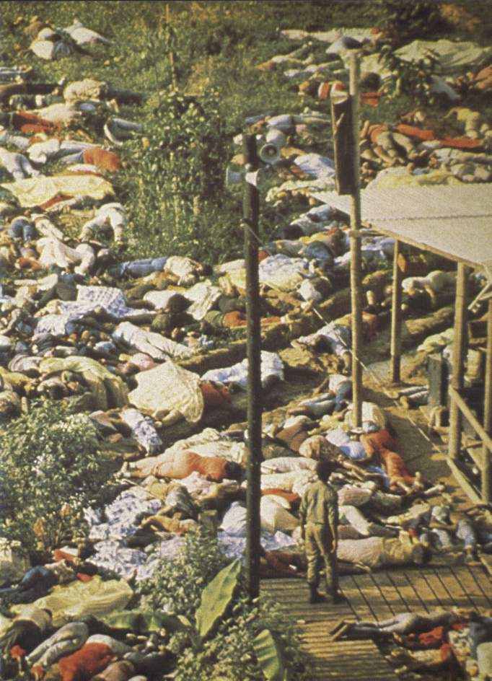



Cults

Slide 7

Cults
People’s Temple (Jim Jones)
The End of Jonestown
Heaven’s Gate (Marshall Applewhite) (suicides)
Unification Church (Moonies)
http://www.youtube.com/watch?v=EF6sQj-59h0
Children of God/The Family (Moses Berg) (flirty fishing) (April defending)
Church of Scientology (L. Ron Hubbard) (Xenu)
  http://www.youtube.com/watch?v=s6CBRC6eDIE
Branch Davidians (David Koresh)
Join Us -- https://www.amazon.com/gp/product/B00GJWYAWM/ref=nav_timeline_asin?ie=UTF8&psc=1

Slide 8
Deprogramming
http://www.youtube.com/watch?v=NL0uxDscjdo
Conspiracy Theories
http://www.youtube.com/watch?v=FAAgzAL7QBw&feature=related
http://www.youtube.com/watch?v=qI4R1g3YT-s&feature=channel

Slide 9
Did you know that every day (worldwide)
200 million couples make love
100 million billion sperm are released
50 million ovules are produced
800,000 ovules are fertilized
400,000 babies are born

Slide 10
Everyday (worldwide)
140,000 people die
Of these, 30,000 are children younger than age 5
50,000 die of infection
35,000 die from cardiovascular disease
15,000 die from cancer
10,000 die as the result of violence
10,000 children die as the result of diarrhea
1000 women die in childbirth
http://popexpo.web.ined.fr/eMain.html

Slide 11

Population
http://www.ined.fr/en/everything_about_population/population-games/quiz/etes-vous-demographe

Slide 12
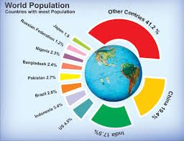

Slide 13


Slide 14
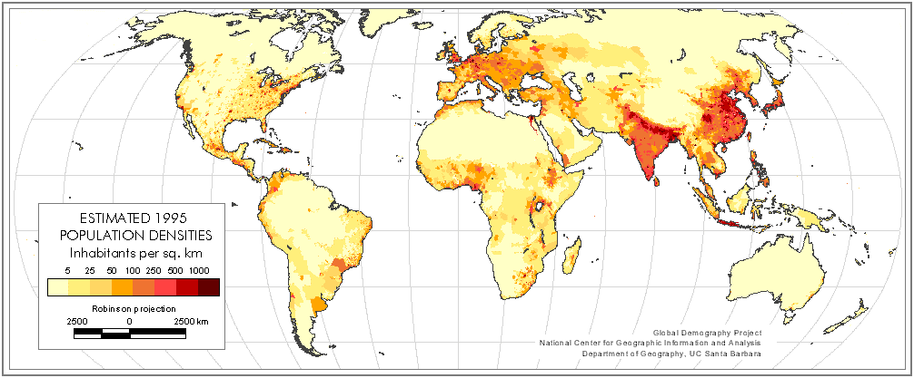
Demography
The study of the size, composition, growth and distributions of human population
Major variables
  Births
  Deaths
  Movement
  http://www.ined.fr/en/homepage_of_ined_website/
Notes:
2
In the last unit, we take a little different approach. We are looking at things from the macrosociological perspective for the most part as we study the variables that influence population growth and change, the cyclical tendencies to congregate in cities and alternately move out of them and cultural uses and abuses of the environment.
At the same time, some of these issues are microsociological -- strongly influenced by personal choices such as when and if to marry, when and whether to have children, and one’s own stewardship of natural resources.
We will begin with population and the study of population, a subfield of sociology called demography, and explore the variables that influence population statistics -- births, deaths and movement.

Slide 15

Birth Variables
Crude birth rate
  number of live births per 1000 population
Fertility Rate
  number of children born to women 15-45
  number of children the average woman bears
Notes:
Births -- adding members to the population by having babies.
In demography, “crude” rates give us some very general, thumbnail information about a population. Generally crude rates are the expression of some variable in proportion to the total population. Crude rates do not give us very specific information but enable us to make broad comparisons between one country and another between regions, ethnic or racial categories, etc.
The crude birth rate is the total number of births divided by the total population. It includes in the denominator a large number of individuals who are not eligible to have babies -- children, males and post-menopausal women.
A more specific statistic related to birth rate is the fertility rate which is the total number of births divided by the number of individuals who are likely to actually have produced them -- women aged 15 - 45. Now, we all know of exceptions to that age span, such as babies born to young adolescents or to older women. The age span 15 - 45 accounts for the best average age category for women of child-bearing age and is information that is generally available in census data.

Slide 16


Birth, continued
Fecundity
  maximum production possible by each woman
  number of children women are capable of bearing
Notes:
While fertility measures the number of children the average woman bears, fecundity rate measures how close her actual production comes to her maximum potential for reproduction.
This rate will probably be more meaningful to the women in the class. If you reach maximum fecundity, you would have been pregnant at ever possible opportunity throughout your lifetime of fertility. Not counting multiple births, you probably have the potential of producing 25-40 babies. Obviously, there is an element of chance related to the timing of ovulation and intercourse and ovulation. Further, multiple pregnancies would take a toll on your body and conception and gestation would be more and more difficult. Thus, no woman would ever actually reach maximum fecundity.
On the other hand, fecundity statistics can give us a basis for comparing cultural groups and/or nations. For instance, the average American family of 2 point something children represents a fairly low level of fecundity. But, Roman Catholic families may have a higher level of fecundity than other religious groups where birth control is more acceptable. Developing nations where women must produce a number of babies to ensure that some survive to adulthood would also reflect higher fecundity rates than the U. S.

Slide 17
Death Variables
Mortality rates
Crude Death rate
  number of deaths per 1000
Age and Cause specific Death Rates
  infant mortality rates
  deaths due to cancer or AIDS
Notes:
Births represent additions to the population and deaths represent subtractions. The term for death rate is “mortality” rate. As with the birth rate, the crude death rate is the total number of deaths divided by the total population. The product in both cases, then, is multiplied by some value of 100, 1000 or 100,000 so that it yields a meaningful whole number. (Just as fractions from percents are multiplied by 100)
More meaningful than the crude rate, are the specific rates.
We often look at death rates for a specific age group (age-specific rate). The most frequently cited of these is the infant mortality rate -- the total number of infants who die between birth and their first birthday divided by the total number of babies between birth and age 1.
Cause-specific rates measure deaths as the result of a specific disease or process. We can look at death rates as the result of influenza, automobile accidents, cancer, diabetes, drunk driving, etc. For example the death rate from HIV/AIDS in 1999 would be calculated by dividing the total number of people who died in 1999 as a result of HIV/AIDS by the total number of deaths for that calendar year.

Slide 18
Migration: Movement of Population
Net migration rate
  difference between number moving in and the number moving out
  immigration minus emigration
Notes:
We also explore how mobile a population is or how mobility affects a particular population category. In other words, how much do people move around and how does that movement affect social life?
For any area, the net migration rate is the difference between the in-migration and the out-migration. (just as your net pay is the amount you actually have left after taxes, savings, social security, dues, etc. have been removed from your total salary)
The term for movement into an area is immigration -- the people who move in are immigrants. But those same people left somewhere and probably left a void. The term for movement out of an area is emigration.
Alla is an emigrant (someone who moved out) from Russia who settles in Omaha. She emigrated from Russia and immigrated to the United States.
People emigrate for all kinds of reasons -- political, social, intellectual, familial, occupational, racial, professional, environmental, etc. Large scale emigration of professionals such as doctors can leave behind a real void but can be a real advantage for the culture into which they immigrate.

Slide 19

Internal Migration
Movement from one area to another within the country or state
Notes:
We have the most accurate information about movement from country to country. Movement from region to region within a country may also have a significant social impact.
For example, a particularly bitter winter, an active hurricane season, a series of earthquakes or tornadoes might serve as motivation for large numbers of persons to leave their homes in search of what they perceive to be a more pleasant, less dangerous place to live. During the “Dust Bowl” drought of the 1930’s many rural residents of western Nebraska, Kansas, and Oklahoma left the Midwest and moved to the farming regions of California and Oregon. The social and economic impact of such movement is considerable for both regions, but it is harder to track and measure.
In the last part of the 20th and early 21st centuries, where is the internal migration in the United States? Go to the discussion and answer this question. Comment on the advantages and disadvantages of internal migration and on the social impact that results from this movement. For example, how does it affect agricultural and industrial production, tax bases, need for social services and health care, or traffic and housing?

Slide 20
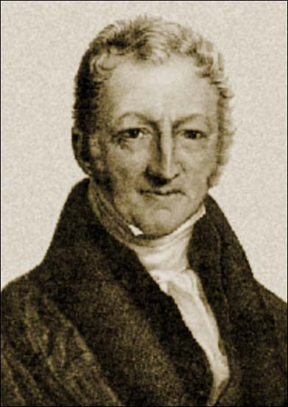
“Essay on the Principle of Population” by Thomas Malthus, 1798
Food supply increases at a linear rate (arithmetic)
  1,2,3,4,5 etc.
population increases exponentially (geometrically)
  2,4,8,16,32 etc.
Notes:
Although we tend to think of population issues from the context of the times in which we live, throughout history, people have been concerned with population issues.
Two-hundred years ago Thomas Malthus predicted that food supply would not be able to keep up with population increases. We can improve on our production of food with mechanized farming techniques, hybridized seeds, irrigation, pesticides and fertilizers. But, the rate of improvement is slow and will eventually hit a limit. The rate of improvement is linear and arithmetic -- over x number of generations, we can double or even triple our production capabilities. At the same time, however, population numbers may be improving at a much faster rate (geometrically). As we triple or ability to produce food, we may produce as many as 8 times as many people. Eventually, we will not be able to keep up!

Slide 21
If population growth continues unchecked, then population will
outstrip the food supply
  positive checks
  preventative checks
Neo-Malthusians
  doubling time shortens with each generation
  6 billion reached 10/12/99
  http://www.worldometers.info/world-population/
Notes:
Malthus proposed two ways to check population growth. One, the positive, will reduce dangerously high numbers you already have and thus take some of the strain off of your food supply and resources. The other, the preventive, requires proactive behavior now to prevent population problems in the future.
From our perspective, achieving that positive impact on population numbers is not the result of events that are very “positive”. Malthus’ positive checks are things like wars, plagues and famines -- events that result in large scale loss of life. The end result, however, you do have fewer mouths to feed.
Malthus’ preventive checks (remember, he was writing 200 years ago) are late marriage and periodic abstinence. He assumed that most births occurred within the marital bond so if you delayed getting married for several years, you reduced your opportunities to produce children. Also, if you gave up sex for several months every year, again, you limit the number of opportunities you have for conception. Modern day contraceptive techniques, such as the birth control pill, would be preventive checks.
In the late 20th century, there was renewed interest in Malthus’ ideas. View this website and comment on it in the discussion.
http://www.popexpo.net/eMain.html

Slide 22
By 2050 in China and India, the number of single men seeking to marry is expected to exceed the number of eligible women by over 50%. This suggests the degree of marriage market saturation.
What does all this mean for the demography of the future?
Due to the cumulative effect of sex ratio at birth imbalances on the marriage market, the marriage squeeze will be considerably higher than simple age structure comparisons indicate. Current cohorts of future husbands, men who are marrying at later ages, are larger than those of their potential future wives since these men were born several years before the women and in larger cohorts.

Slide 23
Returning to a normal sex ratio at birth will not end the marriage squeeze because there is a backlog of earlier cohorts; i.e., a gradual accumulation of single men on the marriage market. For each period, not only new arrivals but also men who have not yet found a wife have to be taken into account.
An increase in spousal age difference would considerably reduce marriage market squeeze, while a rise in the number of single women would have the opposite effect.
The surpluses of single men expected in China and India are so great that easing the problem significantly through international migration does not seem plausible.

Slide 24
Assignment
Keep up with the work and catch up any late assignments
You should have finished through
  Module 9

