Slide 1
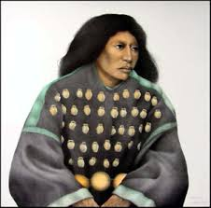
SOCI 1100 Day #21 11/17/15

Slide 2
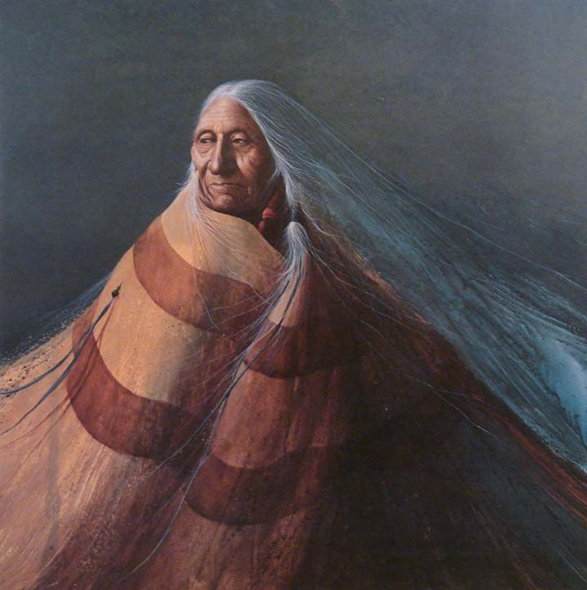
Agenda
Guest speaker: Cassie Rhoads-Carroll – Split Feather Syndrome and Grandmother comments
Tribal artists - reports
Finish discussing language preservation
Review activity, if time
Discuss grades and remaining assignments

Slide 3
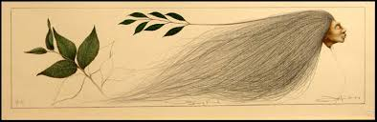
Reports on Native American artists

Slide 4
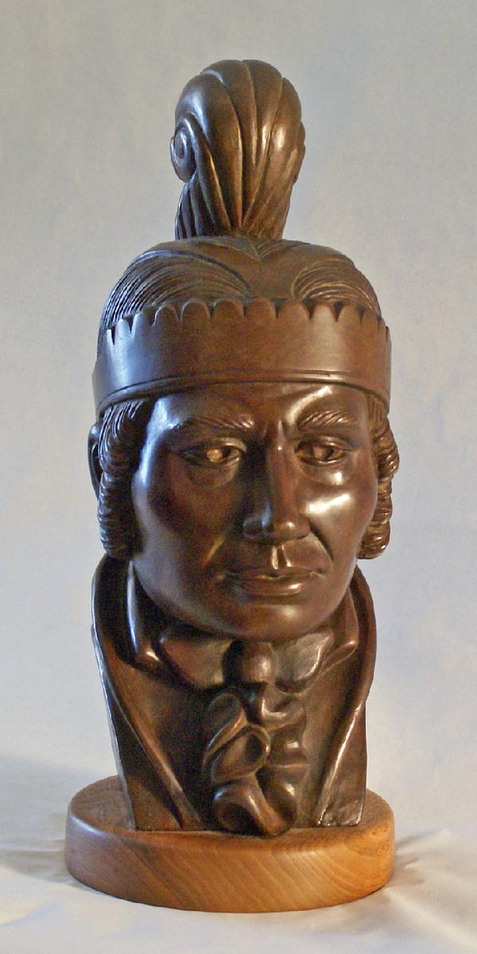
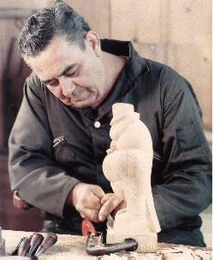
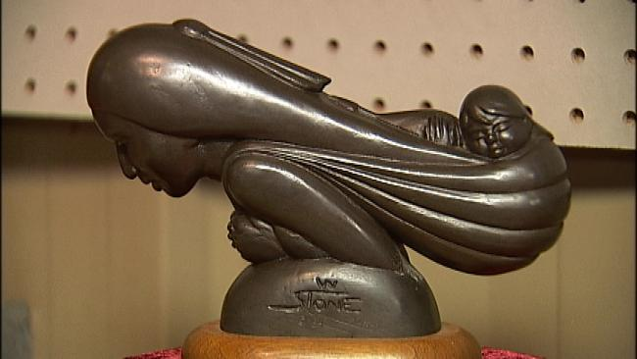
Willard Stone
“Exodus”
“William McIntosh”

Slide 5
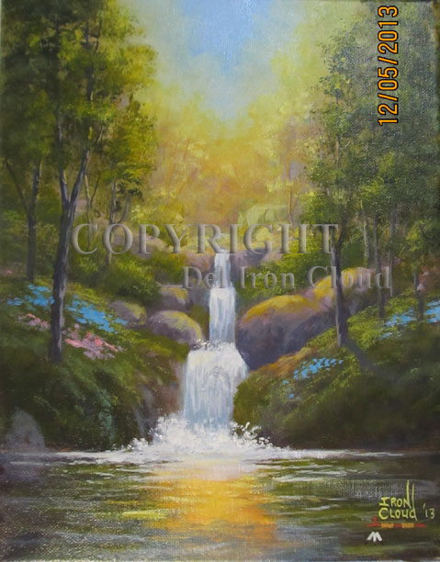
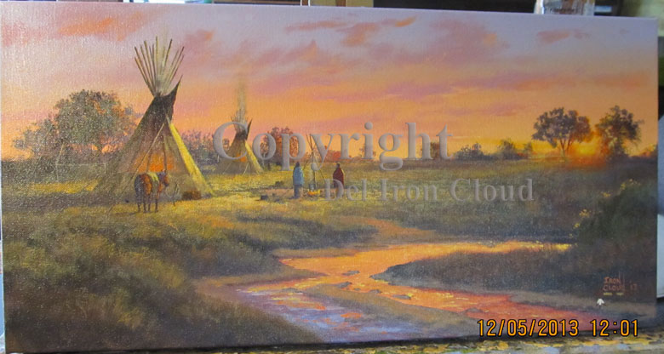
Del Iron Cloud

Slide 6
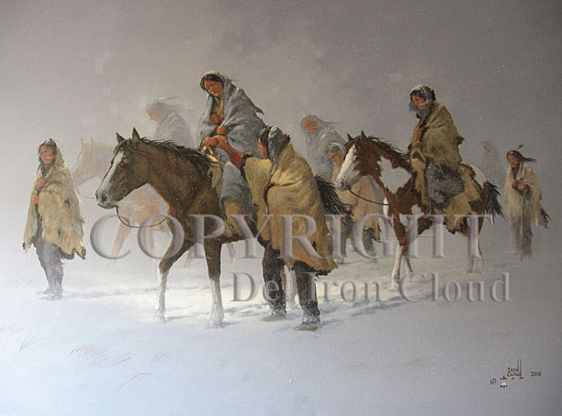

Slide 7

Native American Artist
Dawn Jackson
Animation Cel Paintings
By Terence LaVallie

Slide 8
Quick Bio
Over 20 years, Ms. Jackson has served as Manager, Global Strategies for Diversity & Inclusion for Walt Disney Parks and Resorts; Executive Director, American Indian National Center for TV & Film – ABC Prospect Studios; and Los Angeles City/County American Indian Commissioner. A partner and producer with Red-Horse Native Productions, her credits include Naturally Native, True Whispers, Choctaw Code Talkers. Jackson is also a celebrated fine artist and painter. She is a member of the Saginaw Chippewa Indian Tribe of Michigan.

Slide 9
Her Art Animation Cel Paintings
Each original is hand inked and painted on clear layers of acetate using India ink and animation cel vinyl paint.
Completed paintings can take between 40 - 100+ hours to ink, paint and assemble. All of the details featuring bead work and feathers are painted on the top layer.

Slide 10
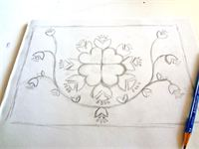
Step 1. Original concept
Pencil sketch of original design

Slide 11
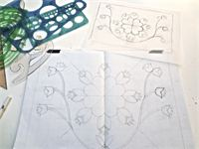
x
Step 2. Create tight pencil of design
Using graph paper, straight edges and templates prepare the design for inking

Slide 12
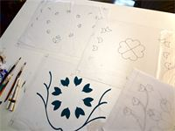
x
Step 3. Ink design
Individual 16-field animation cels are inked with India ink.

Slide 13
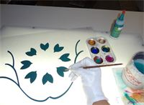
z
Step 4. Paint layers
Each layer is painted in reverse on a light table using animation cel vinyl paint.

Slide 14
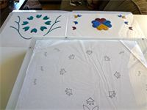
x
Step 5. Check alignment
Throughout the inking and painting process the cel layers are allowed to dry and then checked to make sure they fit together to create the finished design

Slide 15
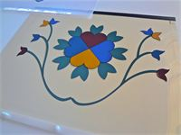
x
Step 6. Layers are fit together
Cel layers are flipped over and using an animation peg bar they are fit together to check alignment

Slide 16
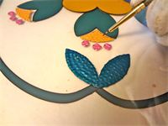
c
Step 7. Surface painting
To create a beaded effect, top layer is painted on the front

Slide 17
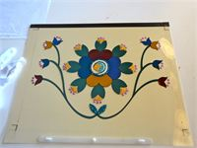
Step 8. Surface detail is complete
Layers are fit together and a background paper is selected to complete the design

Slide 18
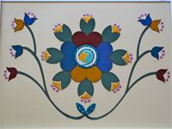
Step 9. Painting is finished
Painting is ready to be matted and framed.

Slide 19
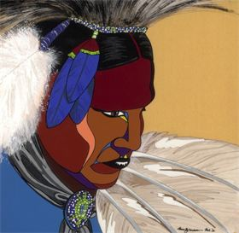
Finished Work

Slide 20
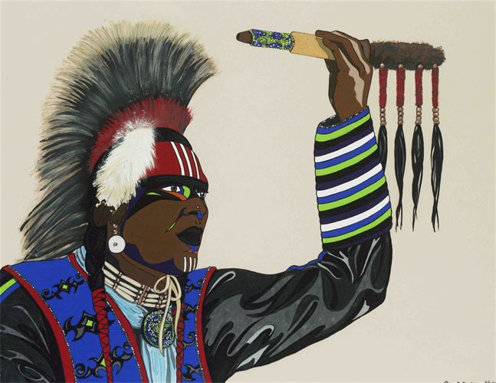

Slide 21
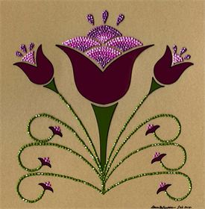

Slide 22
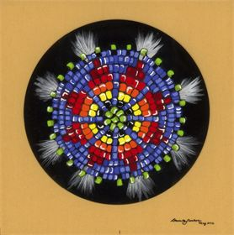

Slide 23
Sources
http://dawnjacksoncreative.vpweb.com/Image-Gallery---Graphics.html
http://fnx.org/operatingteam/dawn-jackson

Slide 24
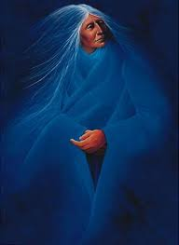
Assignment
Tell us something contemporary about your tribe – tribal government, important individuals, economic endeavors, etc. - due 11/19
Finish up any unfinished assignments by 11/22
Test over vocabulary, images, etc. on Thursday!!!
http://www.quia.com/pages/ jfauchier25/1100fa15
http://www.msnbc.com/the-ed-show/watch/cowboys-and-indians-unite-to-reject-keystone-240171587938

Slide 25
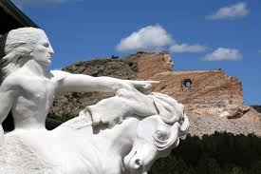
SOCI 1100 Pictures for Review

Slide 26
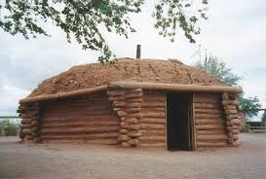
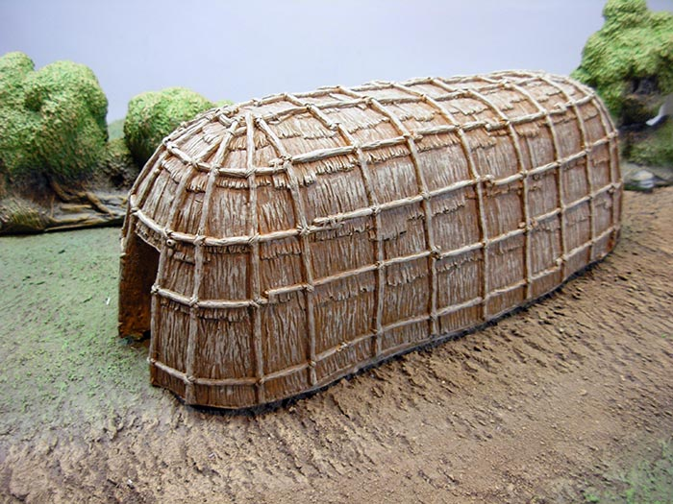
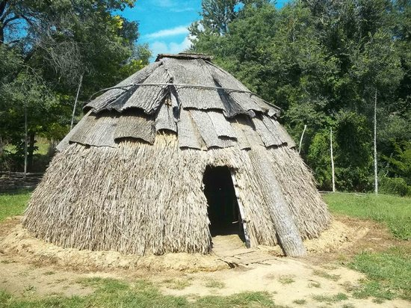
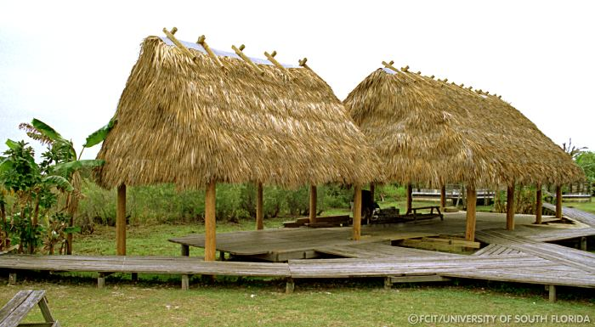
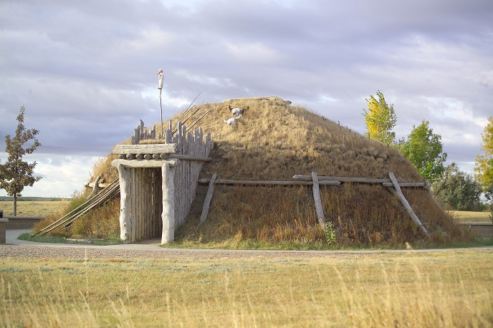
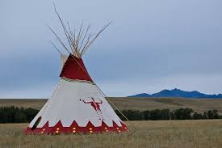

Slide 27
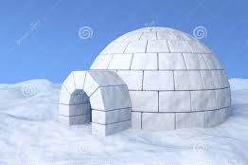
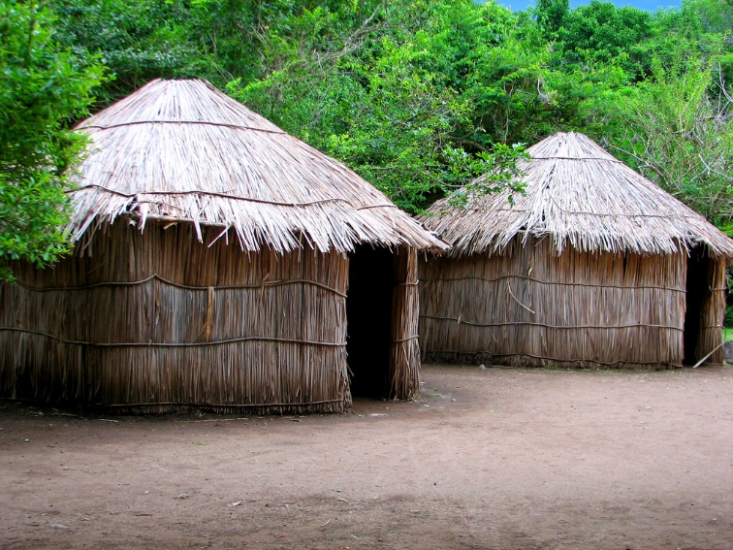
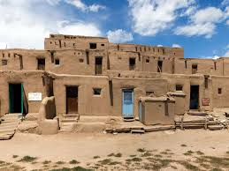
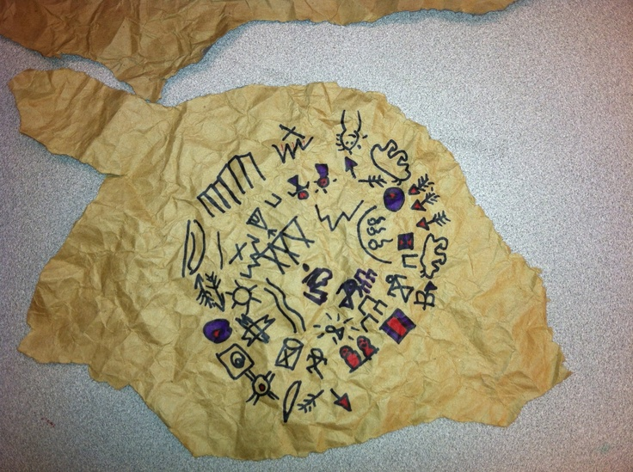
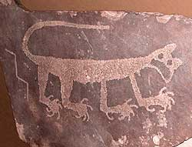
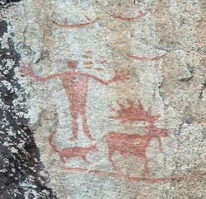

Slide 28
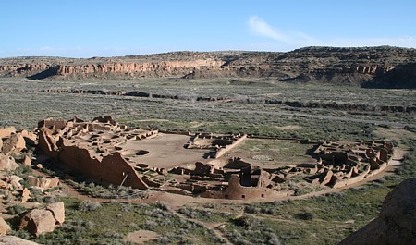
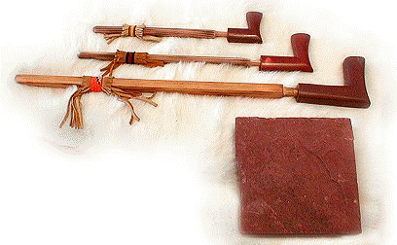
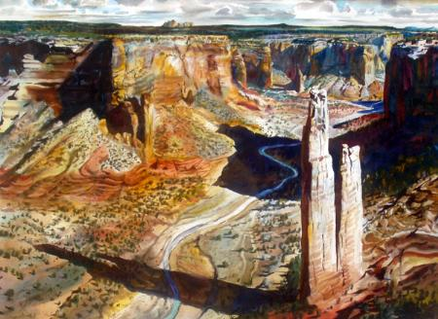
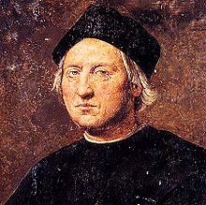
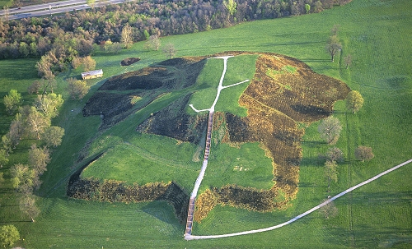
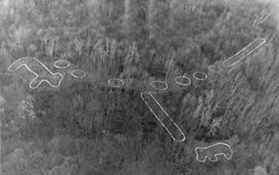

Slide 29
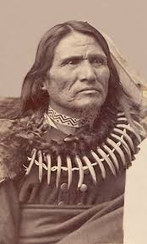
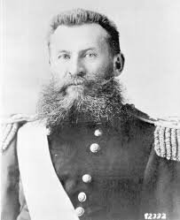
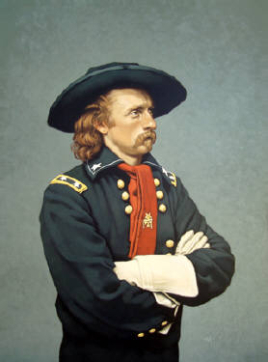
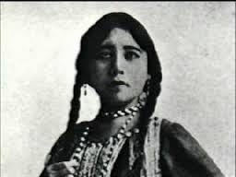
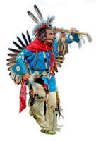
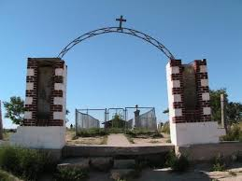
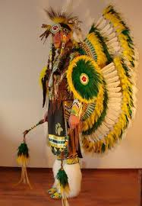
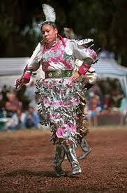

Slide 30








