Slide 1
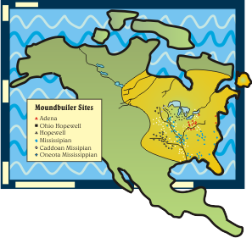
Mound Builders
SOCI 1100 Day #7
September 29, 2015

Slide 2
Agenda
The last of the Anasazi notes
Tribal Creation Stories and Seals
Mound Builders

Slide 3
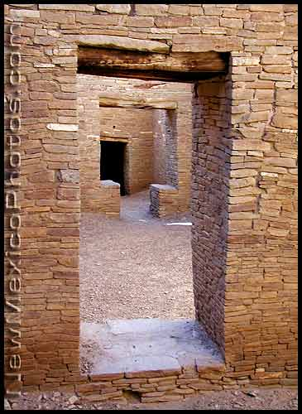
Chaco Canyon
View the accomplishments of their culture
Think about the things the had to use (material culture)
Think about the things they did not have
Imagine their cognitive and normative cultural features

Slide 4
Sky-watchers of Chaco
Notes:
1

Slide 5
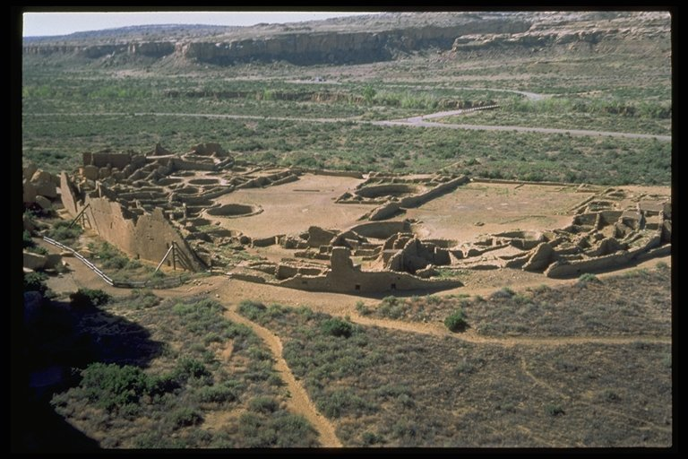
A center of Anazazi culture
Pueblo Bonito
http://www.he.net/~mine/anasazi/p_bonito_show_5.html

Slide 6
Pueblo Bonito
800 rooms
2000 - 5000 people
one of several large townsites in the Canyon
surplus of subsistence goods
trading and ceremonial center

Slide 7
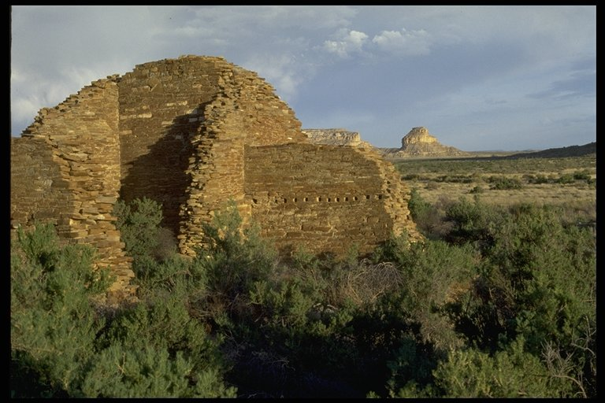
You look across the Canyon to Fajada Butte

Slide 8
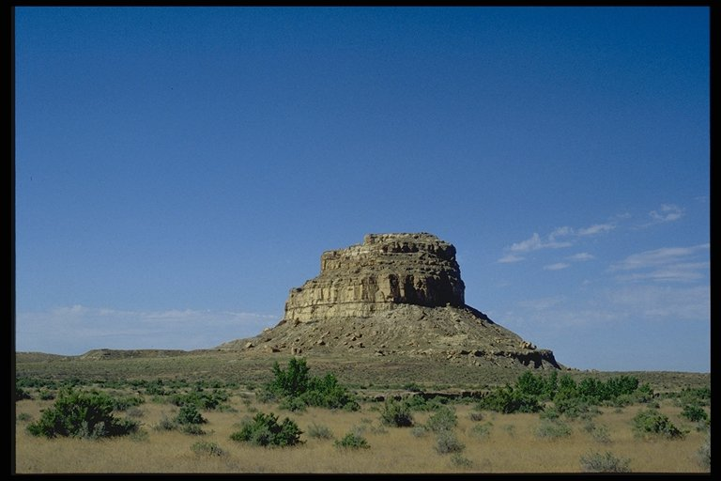
Fajada Butte
http://www.youtube.com/watch?v=sS73UpIy7zs&feature=related
Notes:
4

Slide 9
Midday Summer Solstice
Notes:
5

Slide 10
THE SOLAR "CLOCK"
Did the stone slabs fall there, or were they placed?
Why mid-day rather than sunrise?
Was the spiral carved first or last?
Can it really plot the cycle of the moon?
http://www.youtube.com/watch?v=607Jlae8P1c
Notes:
6

Slide 11
Solstice Window Pueblo Bonito
Notes:
7

Slide 12
Other aspects of life in the canyon
the arts
agriculture
religion
astronomy

Slide 13
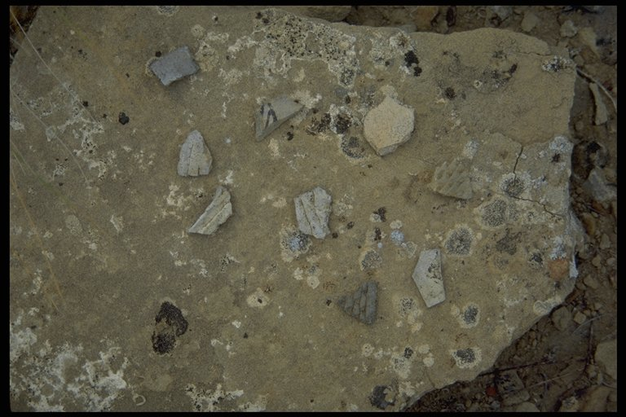
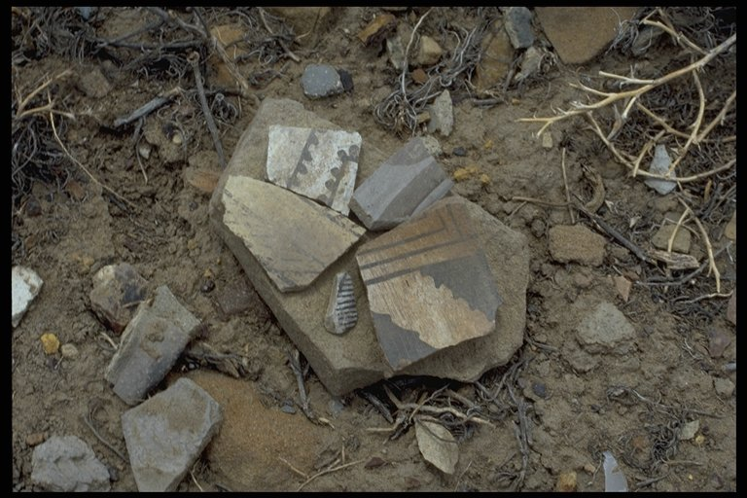
Potters practiced their craft ….

Slide 14
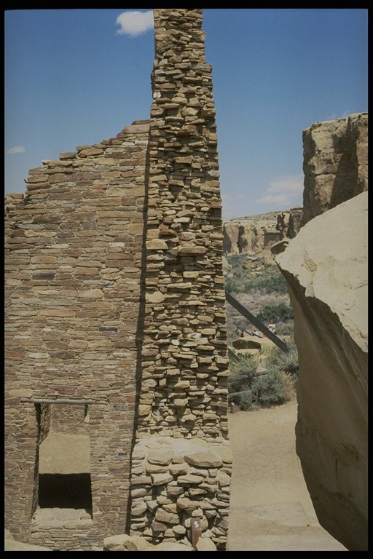
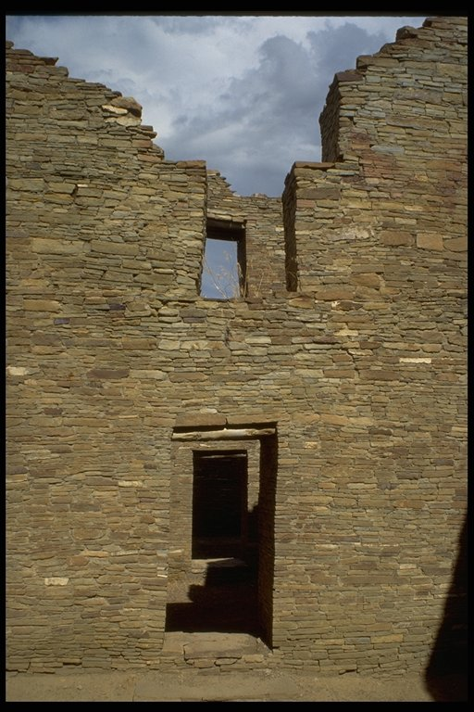
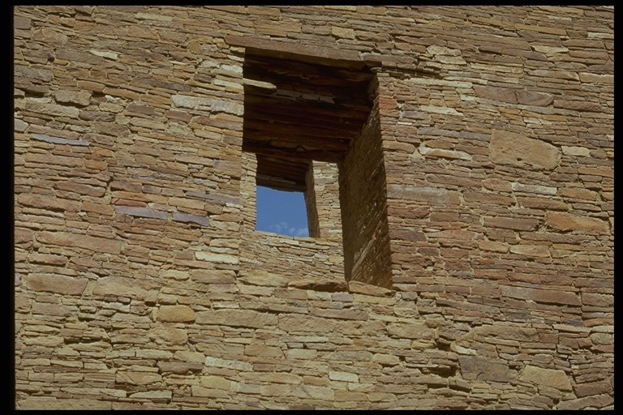
Masons perfected the art of building

Slide 15
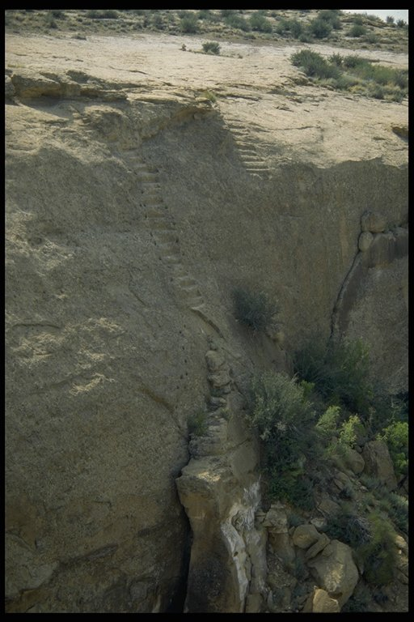
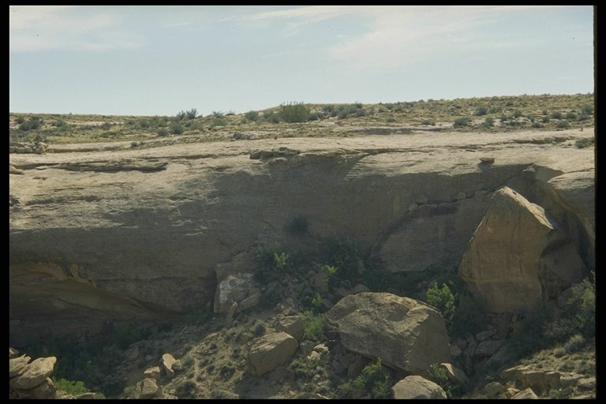
Jackson Stairway

Slide 16
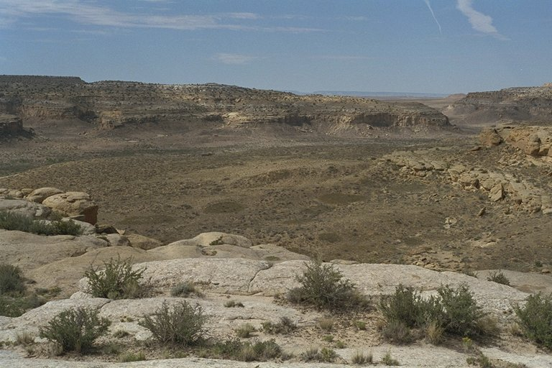
Farmers cultivated and irrigated fields

Slide 17
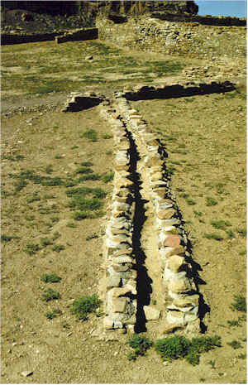
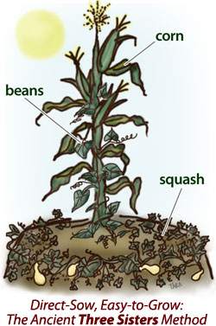
Water Control for Irrigation
Notes:
8

Slide 18
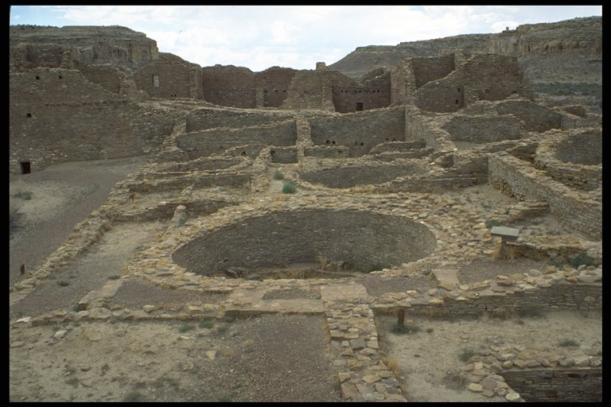
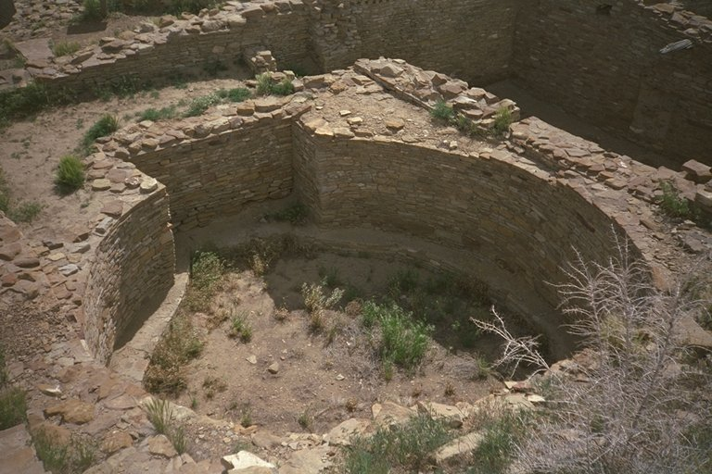
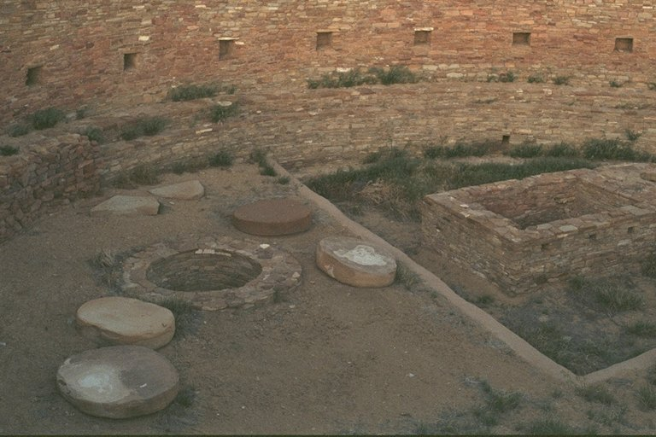
Spiritual life flourished

Slide 19
Astronomers identified new sites
Sighting the
Crab Nebula
Notes:
8

Slide 20
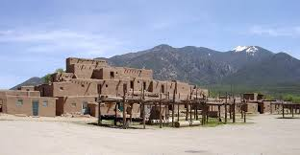


Indianpueblo.org
http://tmbci.kkbold.com/

Slide 21

http://www.standingrock.org/history/
https://books.google.com/books?id=HOMJIhXWyhgC&lpg=PA222&ots=0-PpTDTc5K&dq=standing%20rock%20sioux%20tribe%20seal&pg=PA222#v=onepage&q&f=false p. 222

Slide 22


Slide 23


Slide 24


Slide 25


Slide 26
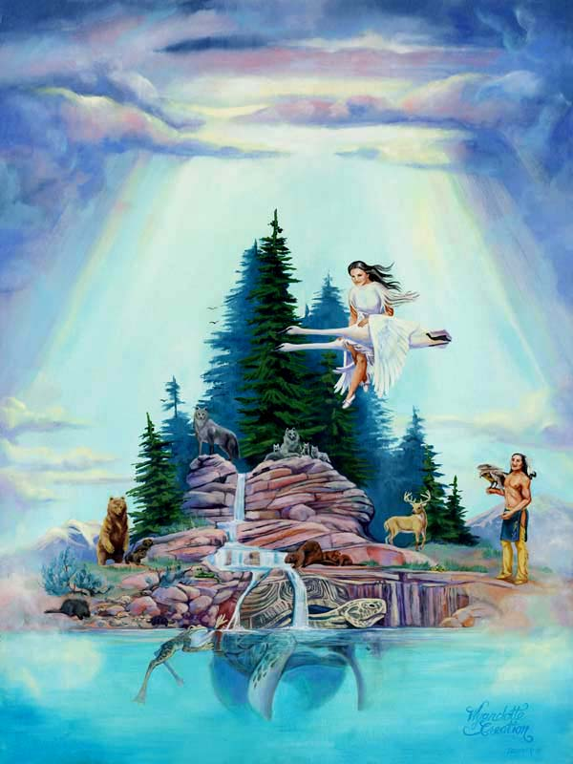

Slide 27
Assignment
Creation story and seal, if not presented today
Week 3 readings for week 4
I will be handing out questions for weeks 1 - 4 on Thursday. They will be due on October 10.

