Slide 1
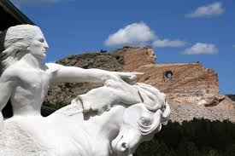
SOCI 1100 Pictures for Review

Slide 2
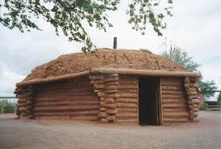
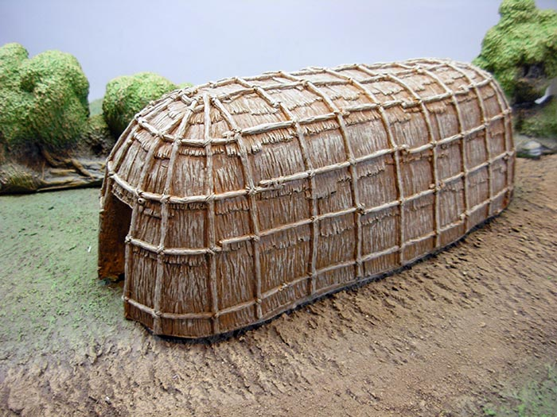
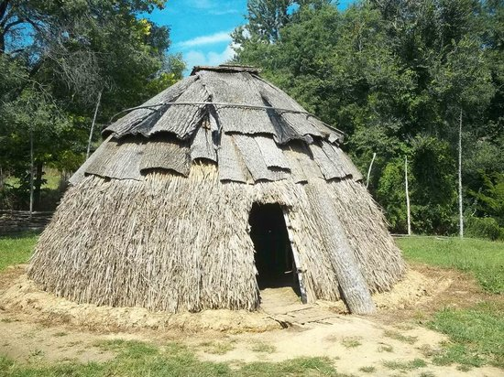
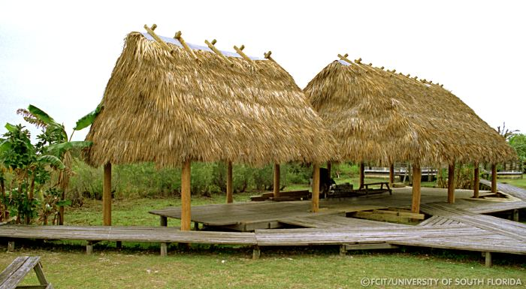
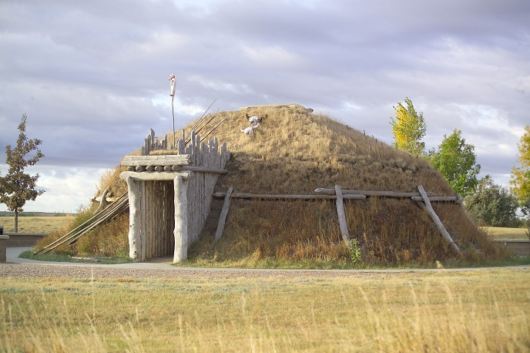
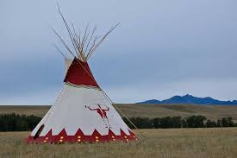

Slide 3
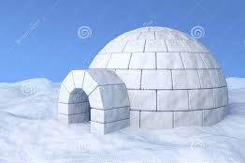
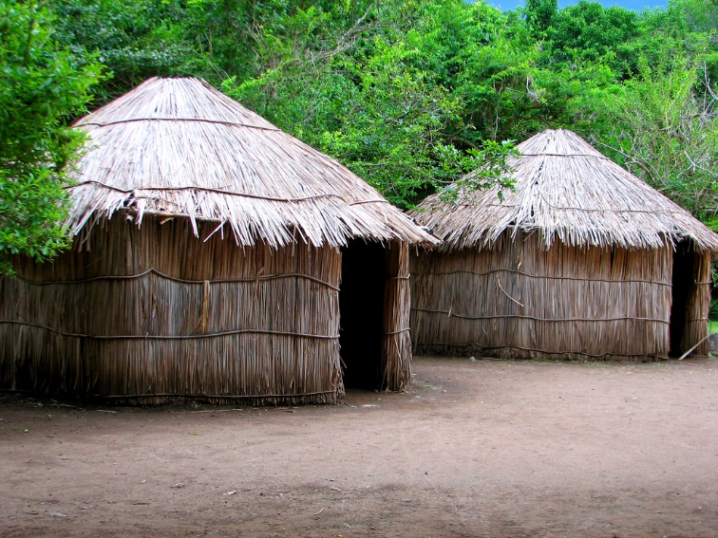
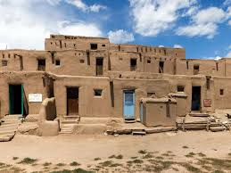
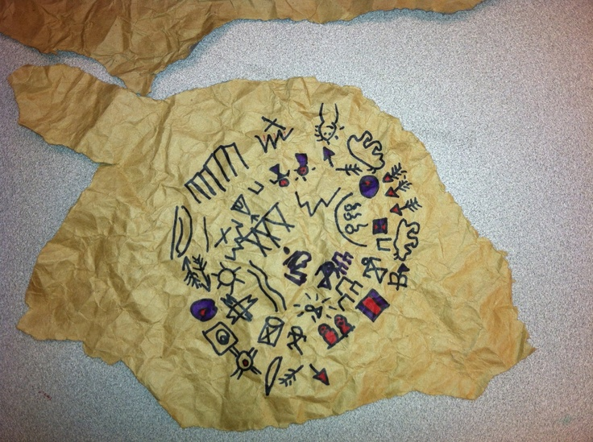
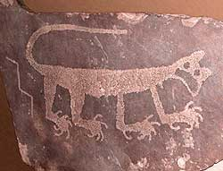
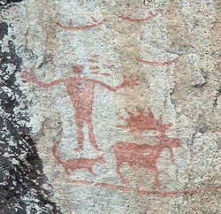

Slide 4
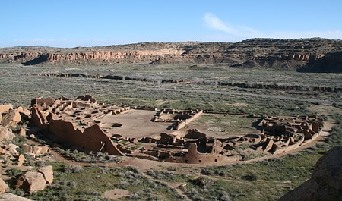
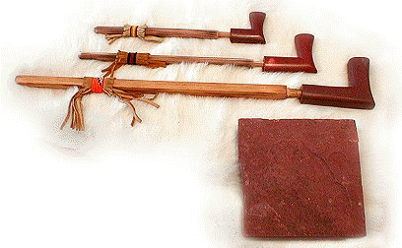
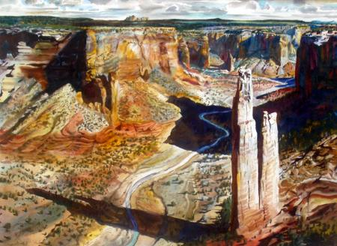
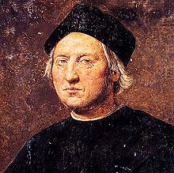
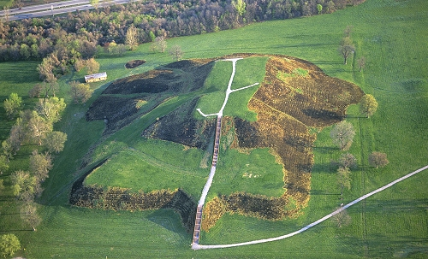
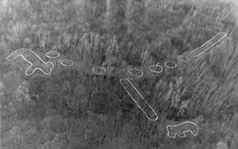

Slide 5
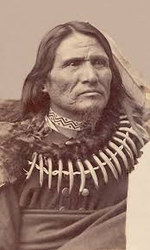
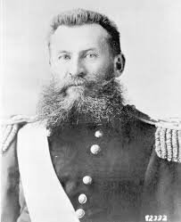
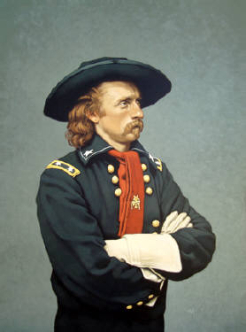
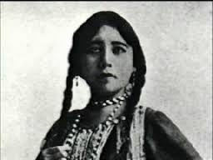
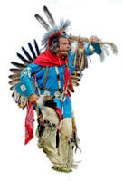
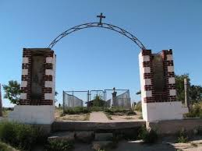
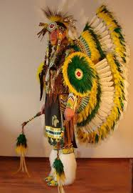
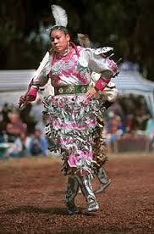

Slide 6
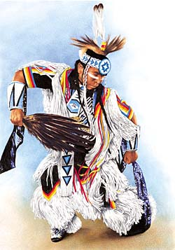
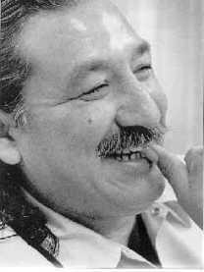
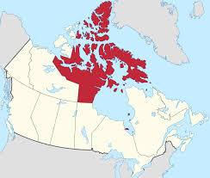
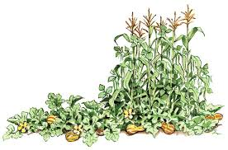
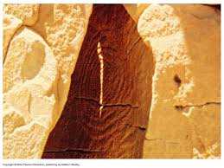
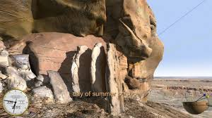
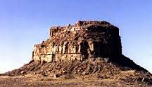

Slide 7
Can you match these with the correct picture? Would you be able to name the tribe based on the picture and name of the dwelling? You should be able to do so.
Name of Dwelling
Tribes who lived in them
Longhouse
Earth Lodge
Chickee
Tipi
Hogan
Wigwam
Igloo
Bohio
Pueblo
Iroquois
Mandan, Hidatsa, Arikara, Ho Chunk
Seminole
Lakota
Navajo
Apache
Inuit
Tieno
Taos, Acoma, etc.

Slide 8
Answer key
Follow along in pictures left to right
Wintercount
Petroglyph
Pictograph
Pueblo Bonito -- Chaco Canyon
Pipestone
Spider Rock - Canyon de Chelly
Columbus
Cahokia Mounds
Effigy Mounds
Standing Bear
George Crook
George Armstrong Custer
Zintkala Nuni (Lost Bird)
Wounded Knee cemetary
Fancy dancer
Jingle dancer
Men’s traditional dancer
Grass dancer
Leonard Peltier
Three sisters planting
Nunavut
Sun Dagger – Chaco Canyon
Fajada Butte – Chaco Canyon
Sun Dagger Chaco Canyon
Dwellings (left to right)
Hogan
Longhouse
Wigwam
Chickee
Earth lodge
Tipi
Igloo
Bohio
Pueblo

