Slide 1
Circular Motion

Slide 2
Question?
Which moves faster on a merry-go-round, a horse near the outside rail or one near the inside rail?
Does a tossed football rotate or revolve?
How could you create artificial gravity in a space station?
We will answer these questions as we learn about circular motion.

Slide 3
Rotation VS. Revolution
Axis: a straight line around which rotation takes place
Rotation: When an object turns about an internal axis.
Revolution: When an object turns about an external axis.

Slide 4
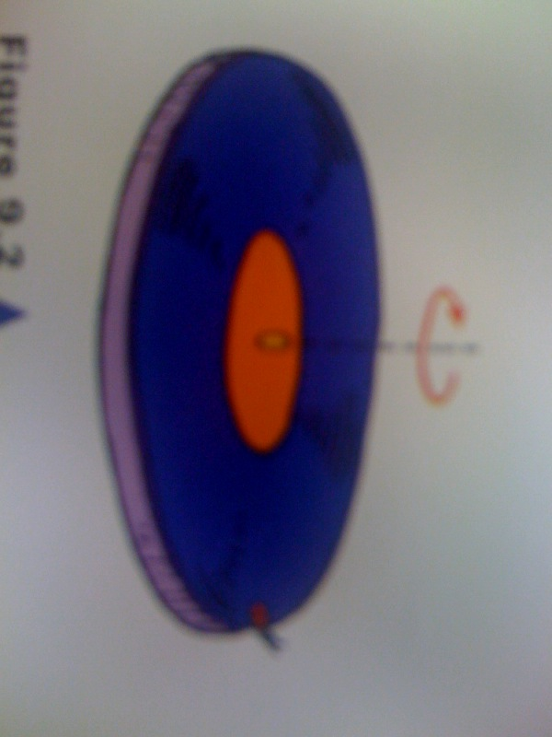
Example: A record on a turntable spins on an internal axis. (rotation) If a bug were to sit on the edge of the record, it would be revolving about the axis.
So, would the thrown football be revolving or rotating?

Slide 5
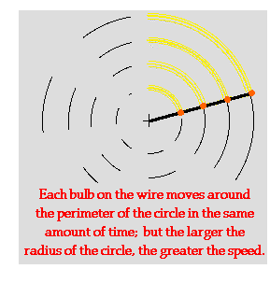
Linear Speed
Remember: s=d/t
If the outside horse is going a greater distance over the same period of time, it is traveling faster.
Linear Speed (Tangential Speed): The speed of something moving along a circular path.
The outermost edge of the merry-go-round will have the largest linear speed.

Slide 6
Rotational Speed
Rotational Speed (angular speed) is the number of rotations per unit of time. All parts of a merry go round and the turntable rotate about their axis in the same amount of time. Thus, all parts have the same rate of rotation.
Number of rotations
unit of time
Commonly expressed in RPM
(rotations per minute)

Slide 7
Centripetal Force
Any force that is directed at a right angle to the path of a moving object and that tends to produce circular motion.
Gravitational force directed toward the center of the Earth holds the moon in an almost circular orbit around the Earth. Electrons revolving around the nucleus of the atom are held in their orbits by an electrical force that is directed inward toward the nucleus.

Slide 8
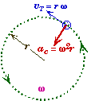

Centripetal Force and Acceleration
In order for an object to execute circular motion - even at a constant speed - the object must be accelerating towards the center of rotation. This acceleration is called the centripetal or radial acceleration

Slide 9
Centripetal Force and Acceleration
a_{c} = Centripetal acceleration SI: m/s²
v_{T}= Tangential velocity or speed SI: m/s
r= Radius of object's path SI: m
w= Angular velocity SI: rad/s

Slide 10
Centripetal Force
Boston University Physics Applets: Masses on a Turntable
written by Andrew Duffy
This web page is an interactive physics problem focusing on circular motion. It simulates a common physics demonstration involving identical masses on a horizontal turntable located at different distances from center. The initial question asks which mass will slide off the turntable first, as the rotation rate increases. As the turntable accelerates, a Frictional force vs. Time graph is simultaneously plotted. A side view of the situation along with the relevant forces is also shown.
This item is part of a collection of similar simulation-based activities developed for students of introductory physics.
http://physics.bu.edu/~duffy/semester1/c7_turntable.html

Slide 11
Simulated Gravity
How would you simulate gravity by using Centripetal Force? Think about acceleration.
Would the simulated gravitational force be the same in all areas of the space station? Why or why not?
Occupants in today’s space shuttle feel weightless because they lack a support force. They’re not pressed against a supporting floor by gravity , nor do they experience a centripetal force due to spinning.

