Slide 1

MESPA Workshop: Quia and Jing
- Tech tools to Enhance Teaching
Presented by Jim Painchaud

Slide 2
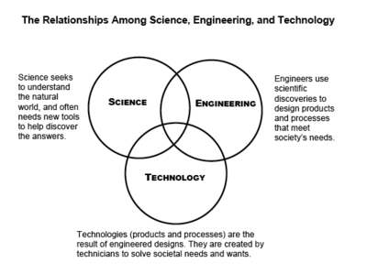

Slide 3
Mary Ann Wolf
Executive Director of SETDA
Says
Notes:
Add more slides after I record my introduction and then set with one word and one picture slides.

Slide 4
“Online learning communities, education portals, and coaching and mentoring are some of the proven methods for providing sustainable professional development for our teachers."

Slide 5
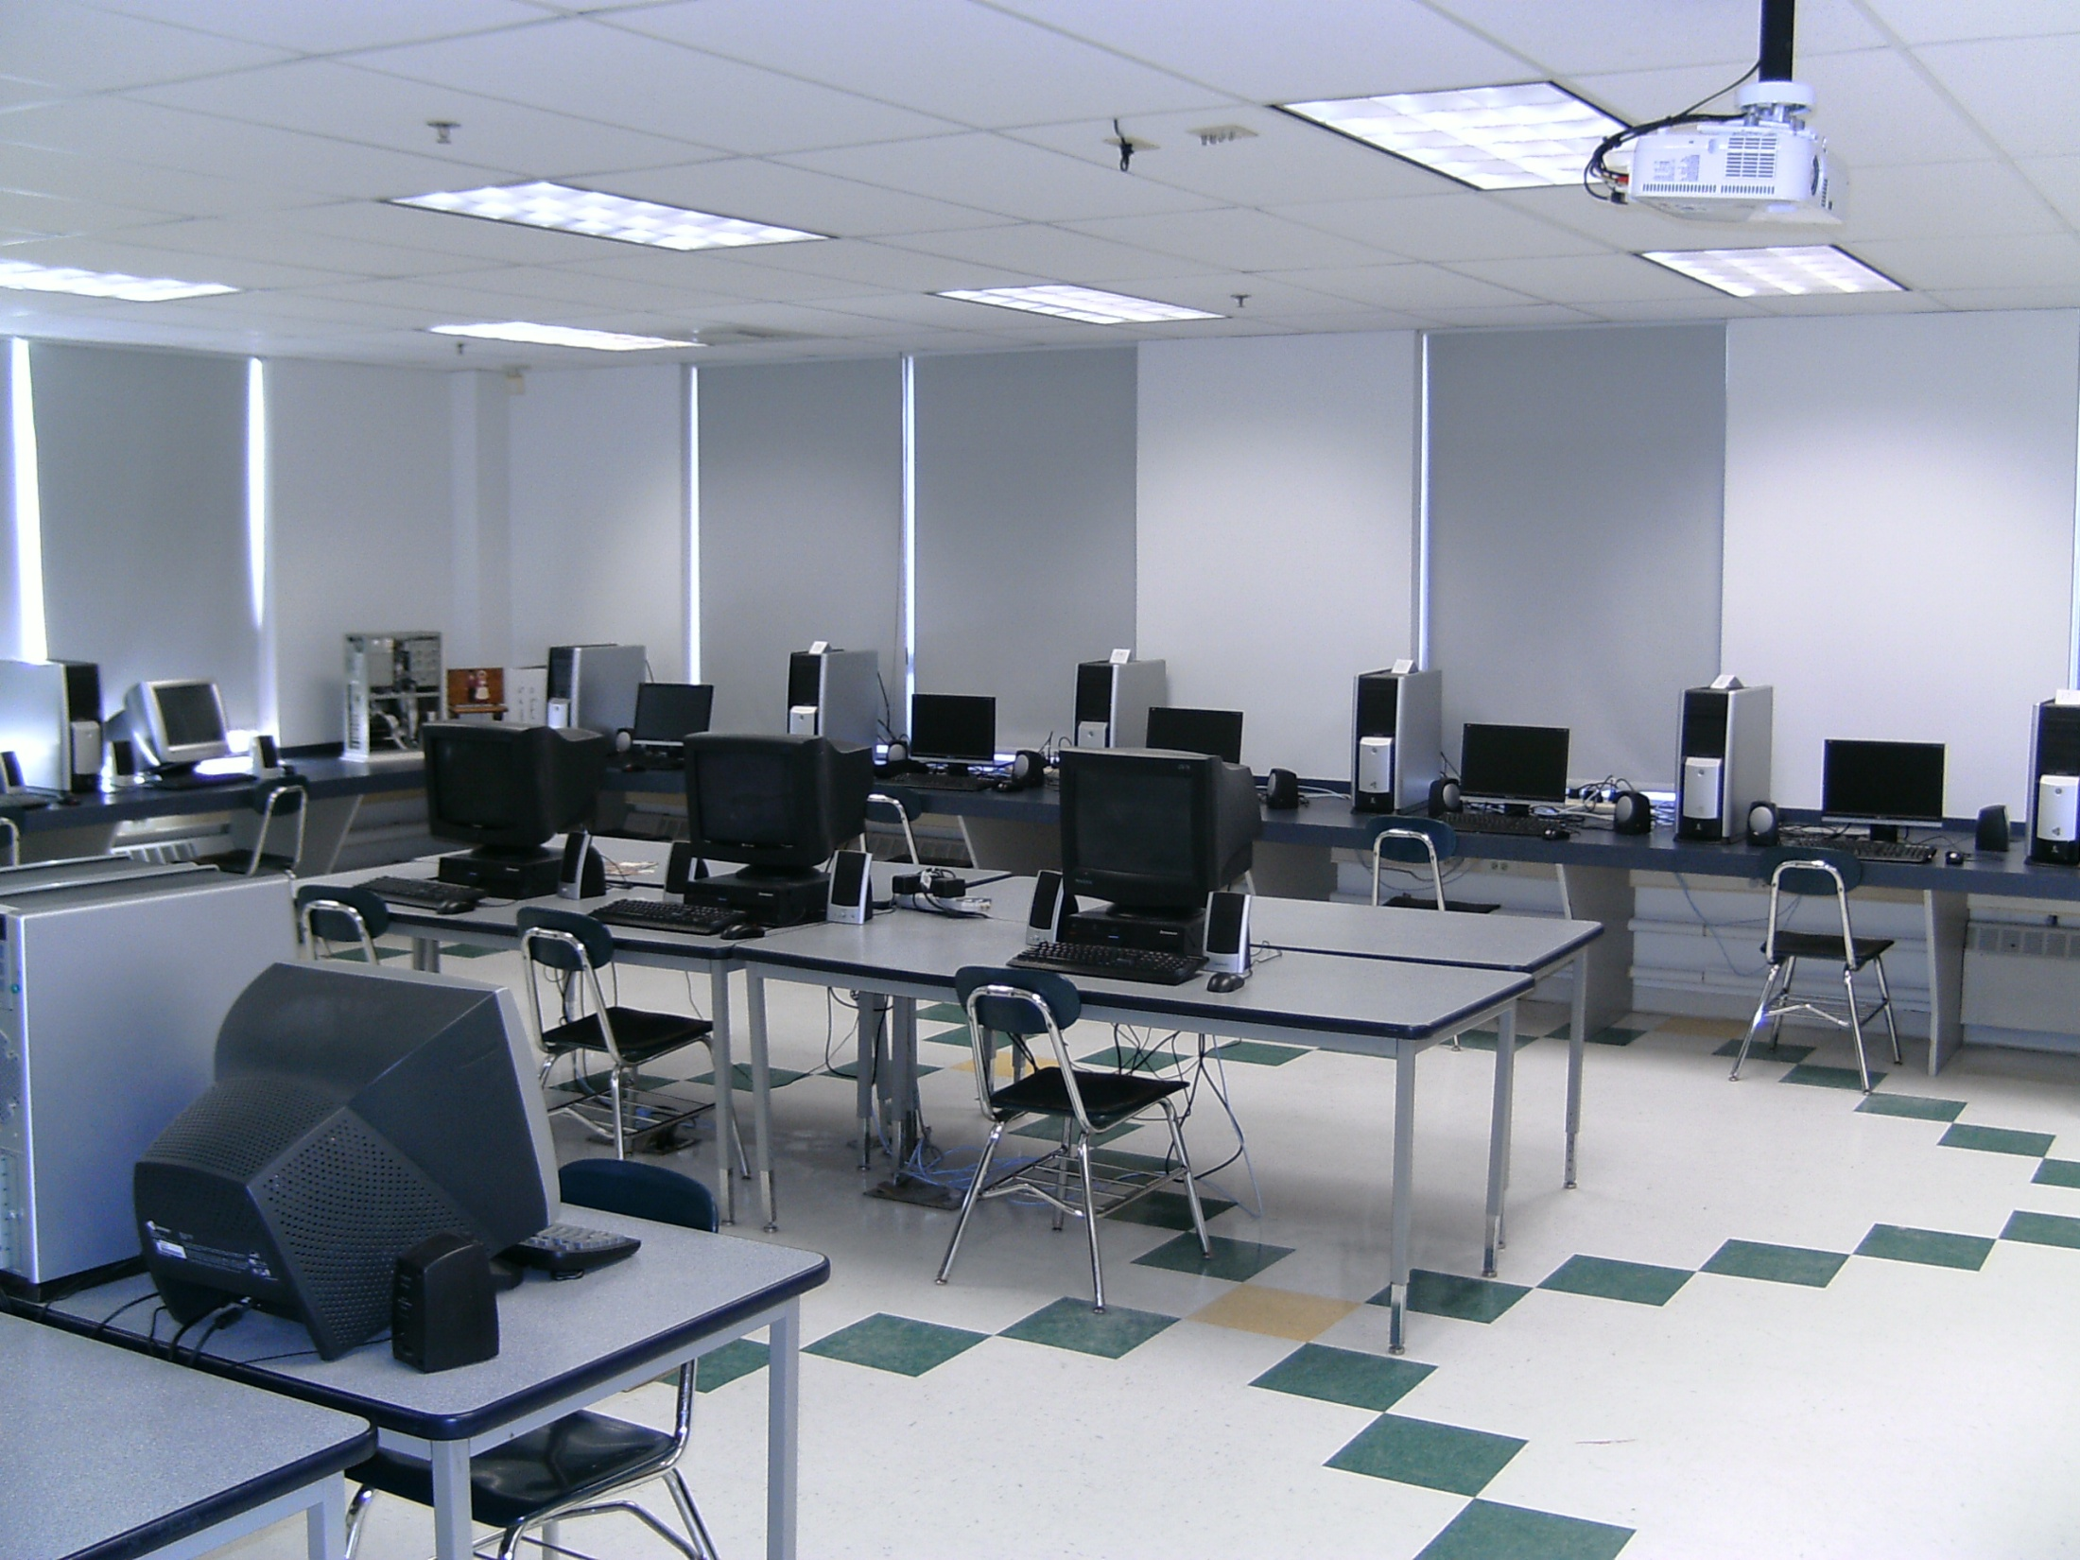

Slide 6
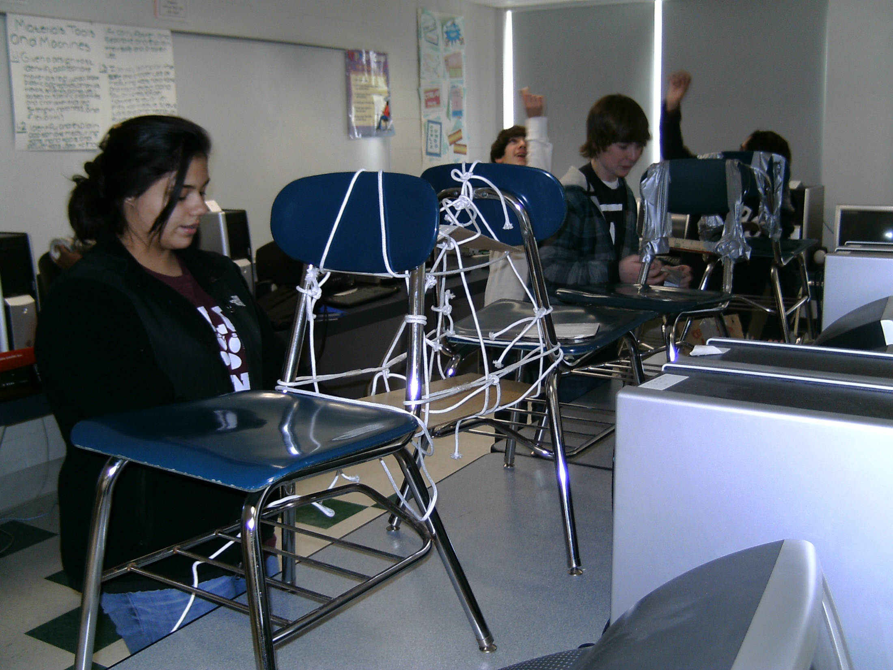

Slide 7
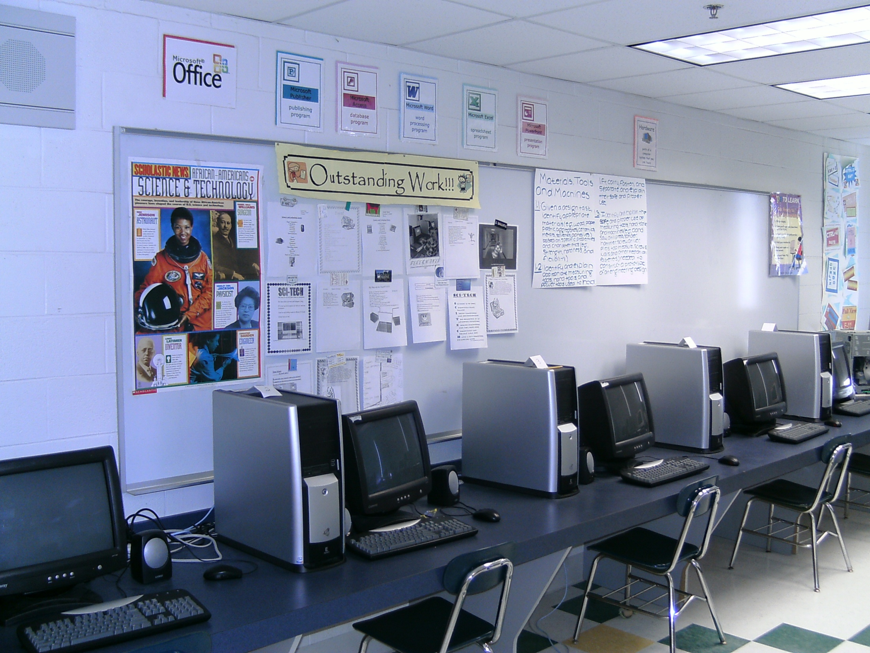

Slide 8
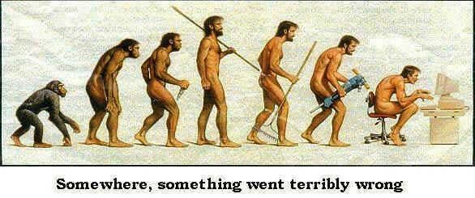

Slide 9
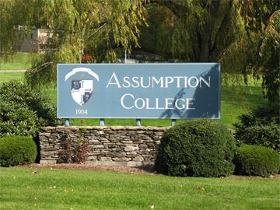

Slide 10


Slide 11
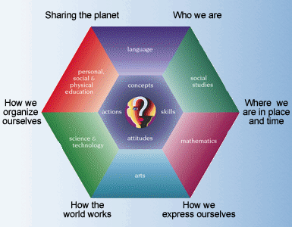

Slide 12
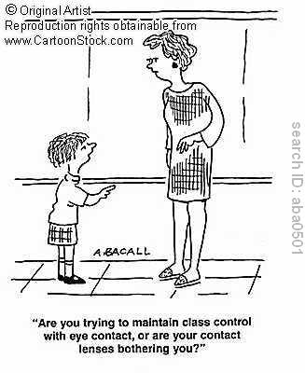

Slide 13
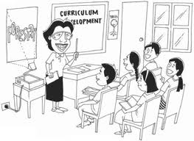

Slide 14
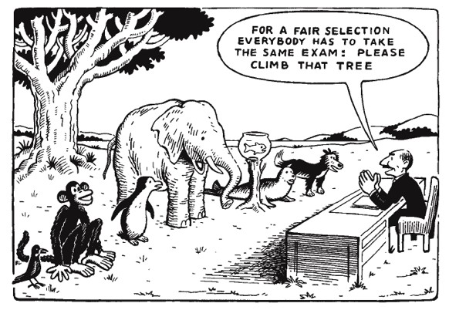

Slide 15
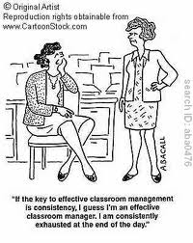

Slide 16
I didn’t have
A
CLUE !

Slide 17
Universal Design for Learning (UDL) is defined as
a framework for designing curricula developed by the Center for Applied Special Technology (CAST) that connects the principles of universal design to principles of learning supported by brain research.

Slide 18
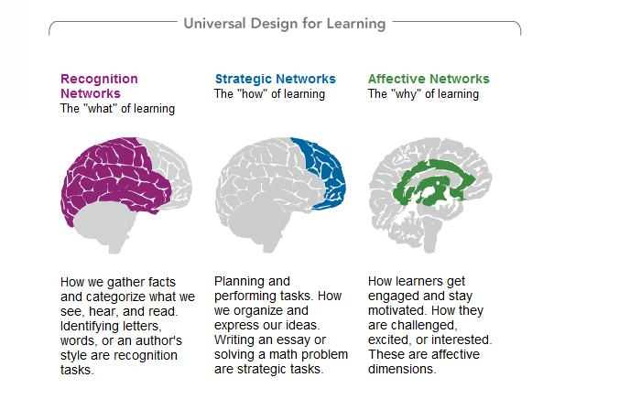

Slide 19
And CAST defines UDL as:
An educational approach to teaching, learning, and assessment, drawing on new brain research and new media technologies to respond to individual learner differences.

Slide 20
These principles according to CAST include:
The provision of multiple, flexible methods of presentation
The provision of multiple, flexible methods of expression and apprenticeship
And the provision of multiple, flexible options for engagement

Slide 21
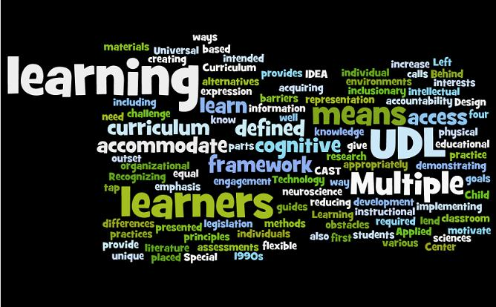

Slide 22
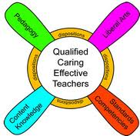

Slide 23
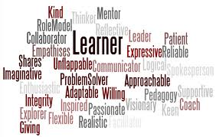

Slide 24
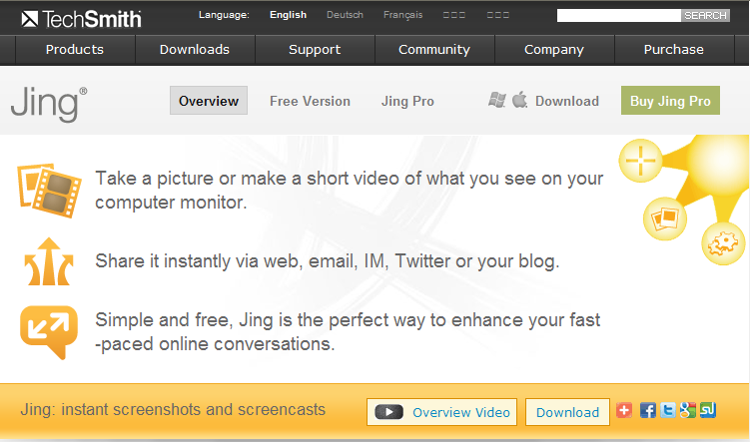

Slide 25
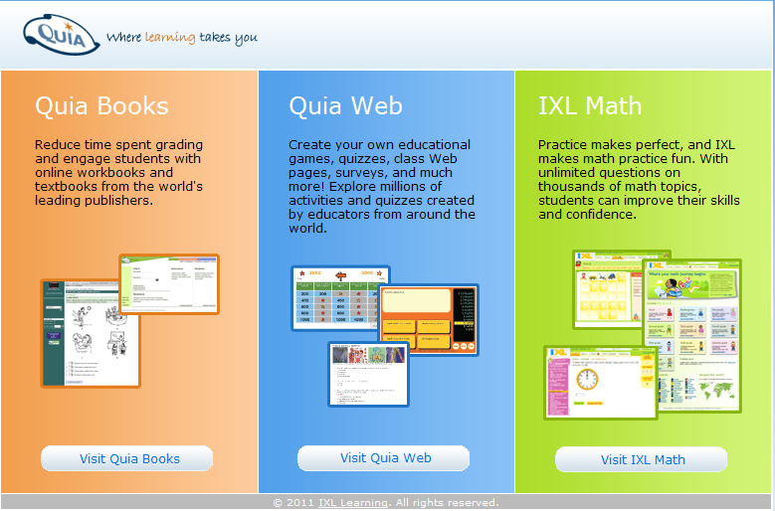

Slide 26
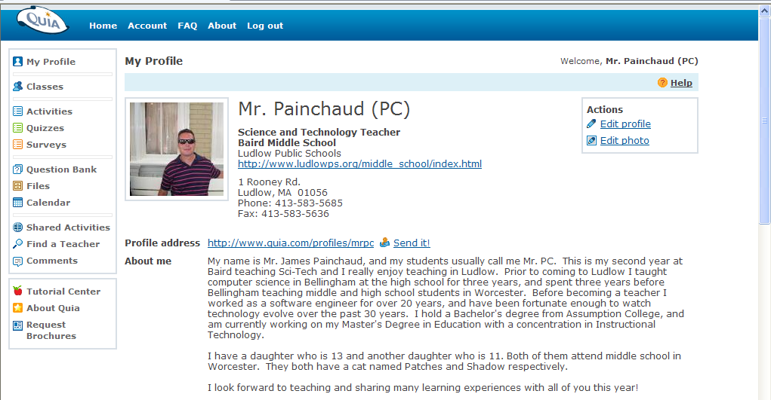

Slide 27
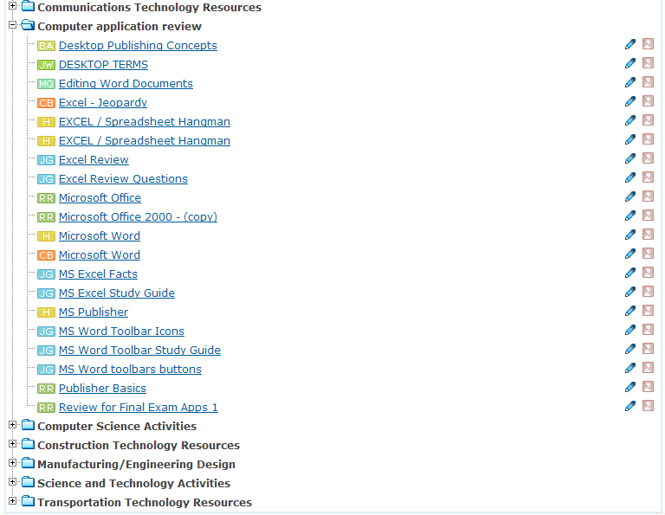

Slide 28
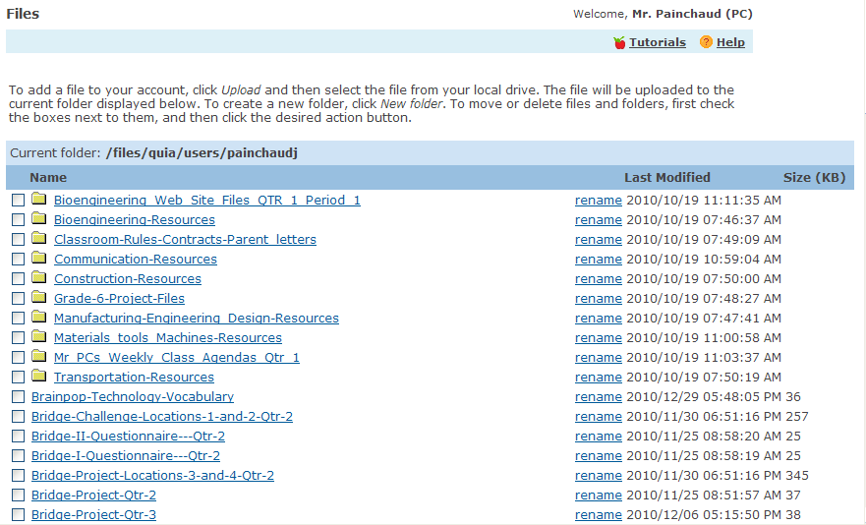

Slide 29
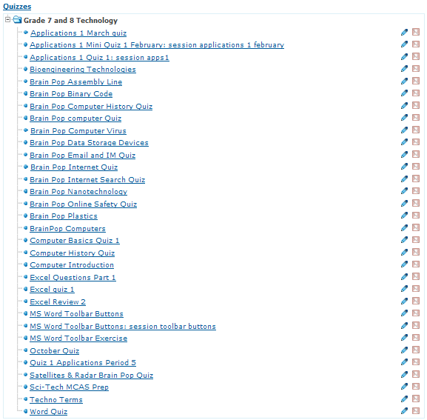

Slide 30
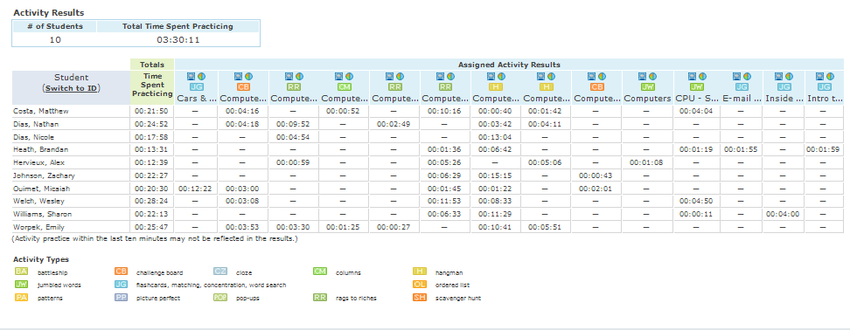

Slide 31
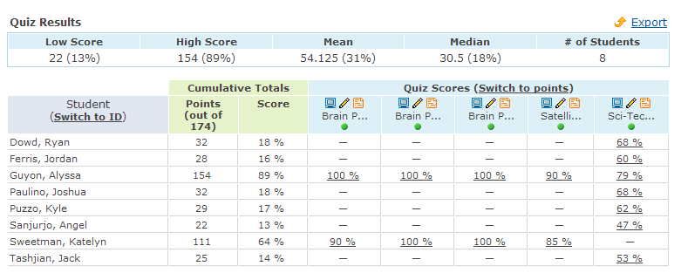

Slide 32
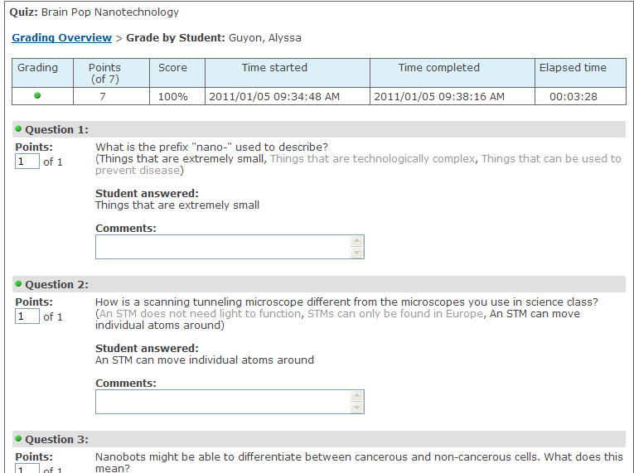

Slide 33
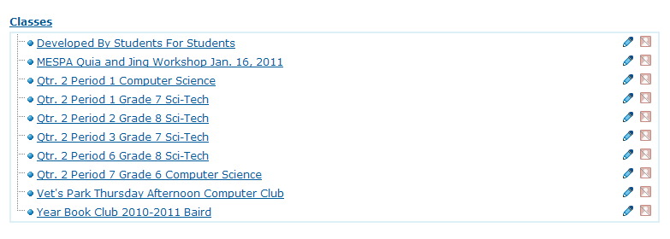

Slide 34
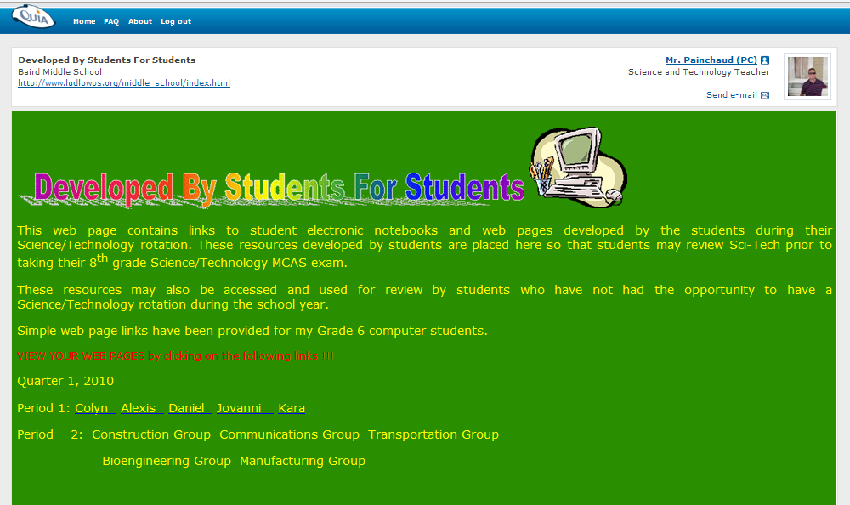

Slide 35
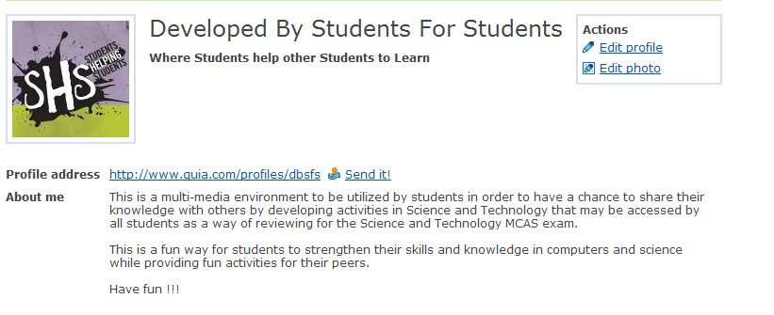

Slide 36


Slide 37
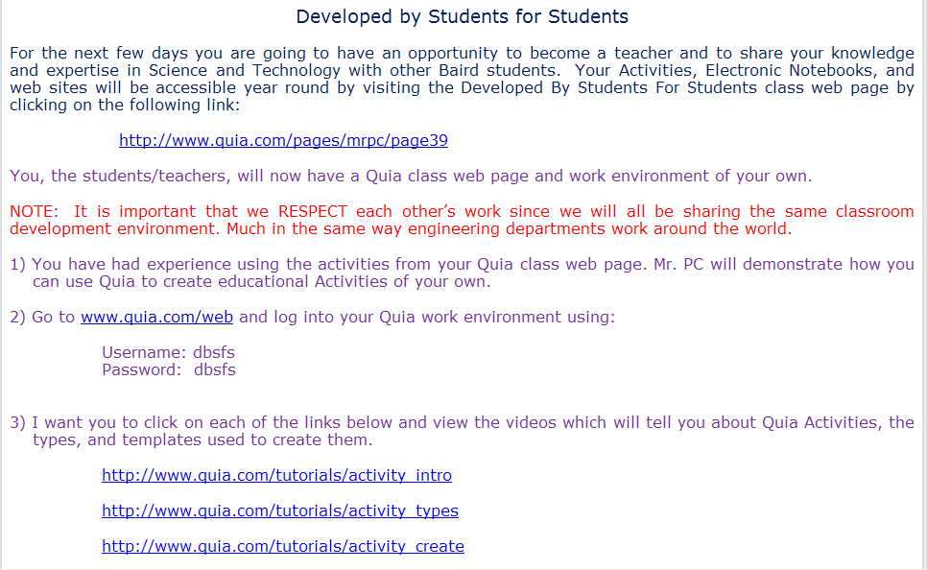

Slide 38
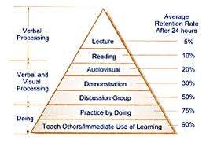

Slide 39
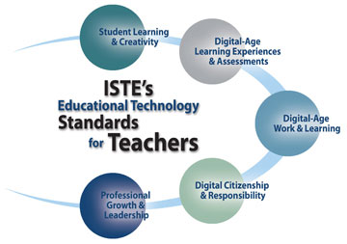

Slide 40
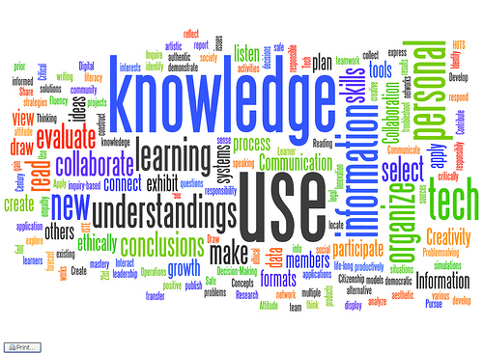

Slide 41
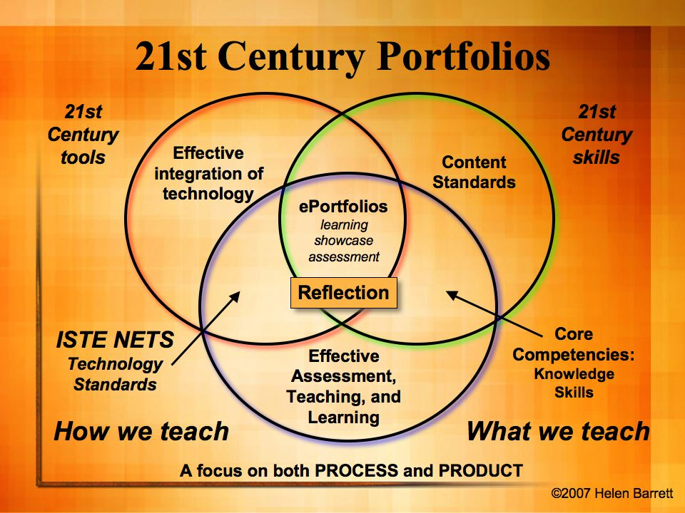

Slide 43
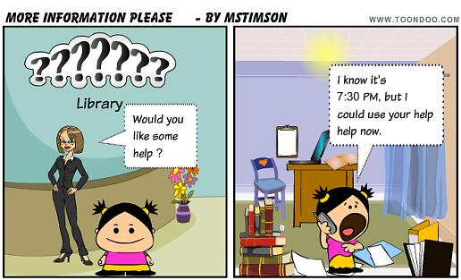

Slide 44
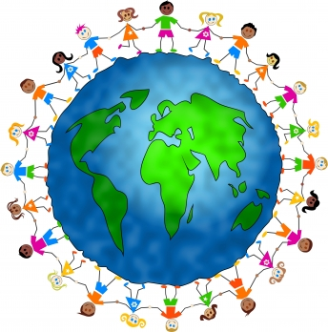

Slide 45
Quia and Jing

