Slide 1
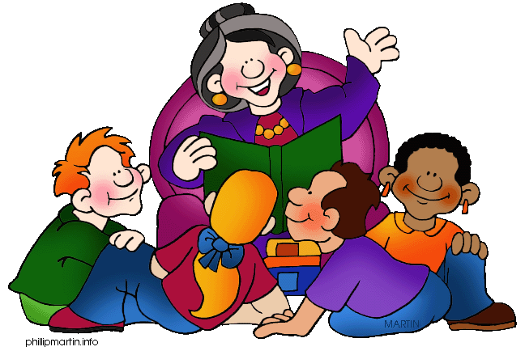
The Earth Dragon Awakes
Copyright © 2011 Tiffany Thayer
Notes:
1

Slide 2
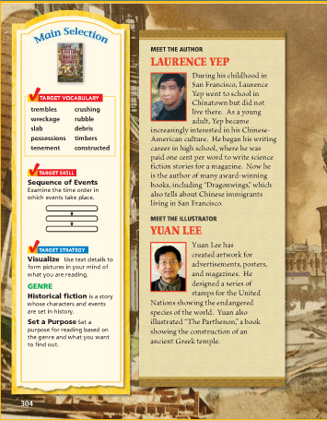

Slide 3
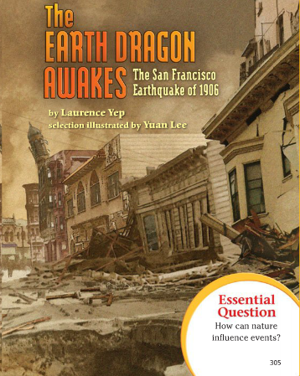

Slide 4
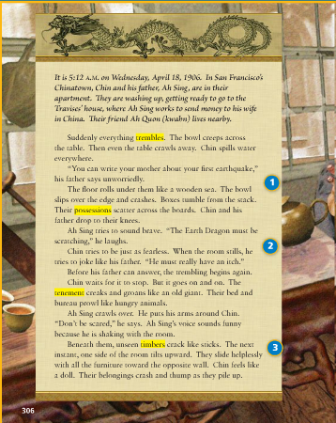
1
2
3

Slide 5
Why doesn’t Ah Sing seem worried when the earthquake first strikes?
Answer
Copyright © 2011 Tiffany Thayer

Slide 6
Answer:
He may have been through small earthquakes before or he does not want to alarm his son.
Copyright © 2011 Tiffany Thayer

Slide 7
What does Ah Sing mean when he says “the Earth Dragon must be scratching?”
Answer
Copyright © 2011 Tiffany Thayer

Slide 8
Answer:
He is talking about the earthquake; he is using a figure from Chinese folklore to describe the earthquake.
Copyright © 2011 Tiffany Thayer

Slide 9
Where in the building do you think the unseen timbers are located?
What evidence supports your answer?
Answer
Copyright © 2011 Tiffany Thayer

Slide 10
Answer:
Underneath the floors
The text says the timbers are beneath the room, and that the floor tilts up when they crack.
Copyright © 2011 Tiffany Thayer

Slide 11
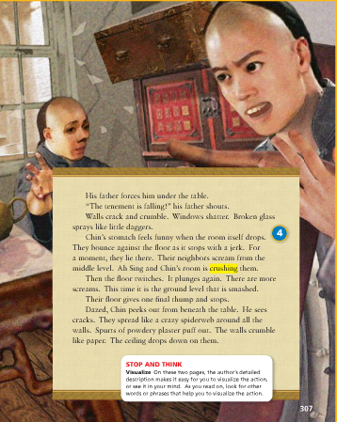
4

Slide 12
Why does Ah Sing decide to push Chin under the table?
Answer
Copyright © 2011 Tiffany Thayer

Slide 13
Answer:
To protect both of them from being hurt by glass and objects bouncing around the room and because he cares deeply about his son.
Copyright © 2011 Tiffany Thayer

Slide 14
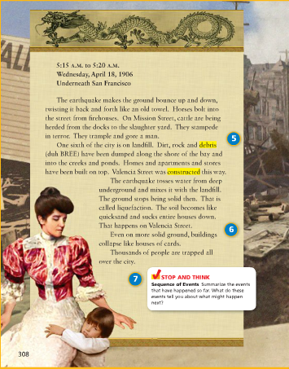
5
6
7

Slide 15
Why do horses and cattle “stampede in terror”?
Answer
Copyright © 2011 Tiffany Thayer

Slide 16
Answer:
They are frightened by the ground’s movement. They are desperate to get away from it.
Copyright © 2011 Tiffany Thayer

Slide 17
Why do the buildings on Valencia Street get pulled underground?
Answer
Copyright © 2011 Tiffany Thayer

Slide 18
Answer:
The buildings were built on top of a landfill- dirt and rocks dumped along shorelines and into creeks or ponds. During the Earthquake, the water underneath the landfill mixes with the solid materials, becoming a liquid and pulling the buildings under the ground.
Copyright © 2011 Tiffany Thayer

Slide 19
Why do you think the author switches from the events happening in Ah Sing’s tenement to the scene on the street?
Answer
Copyright © 2011 Tiffany Thayer

Slide 20
Answer:
To show what is happening outside the building and around the city.
Copyright © 2011 Tiffany Thayer

Slide 21
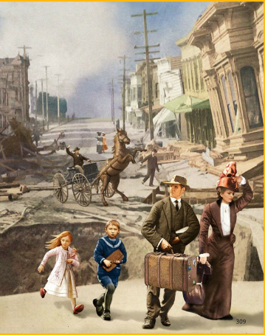

Slide 22
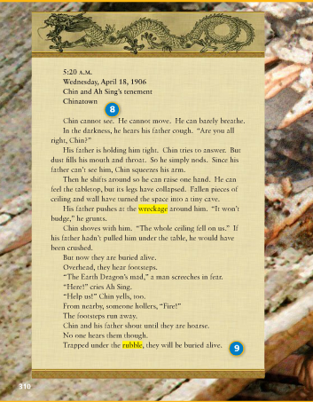
8
9

Slide 23
How does the author signal the switch back to Chin and his father?
Answer
Copyright © 2011 Tiffany Thayer

Slide 24
Answer:
He inserts a note with the time, date, and location.
Copyright © 2011 Tiffany Thayer

Slide 25
Which details on p. 310 suggest Chin and his father are in trouble?
Answer
Copyright © 2011 Tiffany Thayer

Slide 26
Answer:
They cannot move or see; it is hard to breath because of all the dust; the space becomes a tiny cave, burying them alive.
Copyright © 2011 Tiffany Thayer

Slide 27
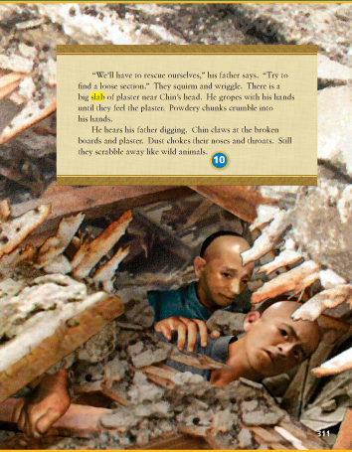
10

Slide 28
What happens after Chin and his father realize that they are buried alive? How might this influence future events?
Answer
Copyright © 2011 Tiffany Thayer

Slide 29
Answer:
They hear voices, and the footsteps running away; they yell but no one responds so they begin to dig themselves out; it is likely that they will have to help themselves if they are to survive.
Copyright © 2011 Tiffany Thayer

Slide 30
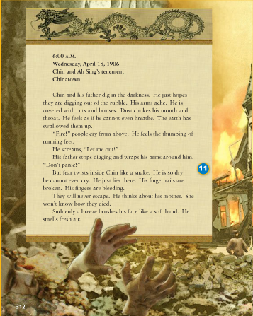
11

Slide 31
In what way are Chin’s and Ah Sing’s reactions to being trapped similar? How are they different?
Answer
Copyright © 2011 Tiffany Thayer

Slide 32
Answer:
Similar: both try desperately to free themselves
Differences: Chin gets very frightened and panics when he hears someone outside cry “fire”; Ah Sing remains calm and tries comforting Chin, telling him not to panic.
Copyright © 2011 Tiffany Thayer

Slide 33
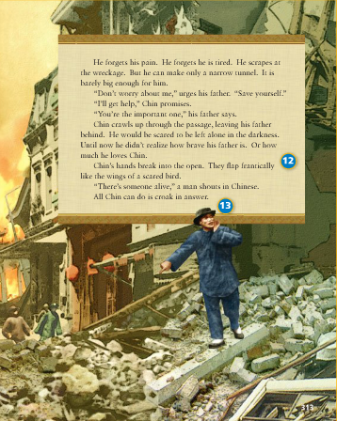
12
13

Slide 34
Chin’s father urges him to save himself, saying, “you’re the important one.” What decision does Chin face at this point?
Answer
Copyright © 2011 Tiffany Thayer

Slide 35
Answer:
Chin is afraid of dying in the rubble. He does not want to leave his father behind, but if he can get out he may be able to get help to save his father.
Copyright © 2011 Tiffany Thayer

Slide 36
What will happen now that Chin has been found? Why do you think so?
Answer
Copyright © 2011 Tiffany Thayer

Slide 37
Answer:
He will be rescued and find a way to help his father. They have been together from the start; his father has tried to protect him.
Copyright © 2011 Tiffany Thayer

Slide 38
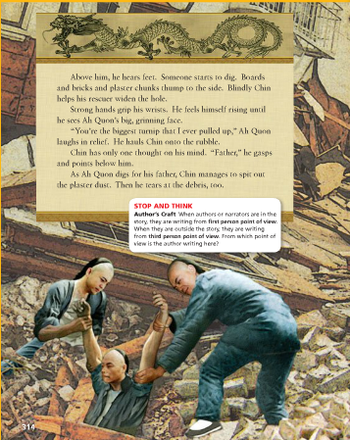

Slide 39
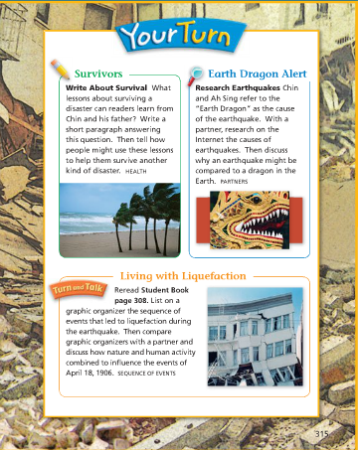

Slide 40
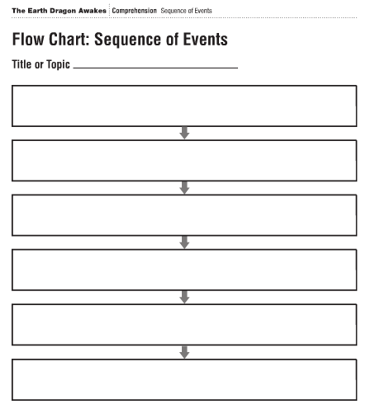

Slide 41
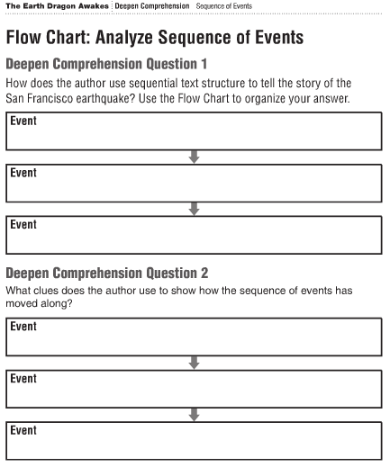

Slide 42

How did you do?

