Slide 1
CHEMICAL BASIS OF LIFE
Chpt 2 & 3

Slide 2
Introduction
Chemicals are the stuff that make up
  our bodies,
  the bodies of other organisms, and
  the physical environment.
© 2012 Pearson Education, Inc.
Notes:
Biology is a multidisciplinary science, and concepts of both chemistry and physics apply.

Slide 3
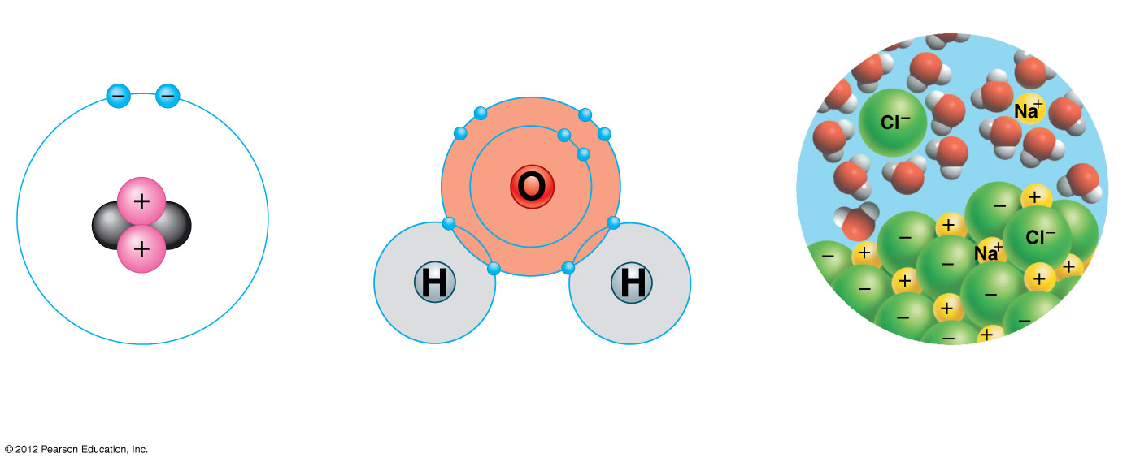
Figure 2.0_2
Chapter 2: Big Ideas
Elements, Atoms,
and Compounds
Chemical Bonds
Water’s Life-
Supporting Properties
Notes:
3
Figure 2.0_2 Chapter 2: Big Ideas

Slide 4
Introduction
Life’s chemistry is tied to water.
  Life first evolved in water.
  All living organisms require water.
  The chemical reactions of your body occur in cells consisting of 70–95% water.
© 2012 Pearson Education, Inc.
Notes:
Biology is a multidisciplinary science, and concepts of both chemistry and physics apply.

Slide 5
Matter is composed of chemical elements.
  An element is a substance that cannot be broken down to other substances.
  There are 92 elements in nature—only a few exist in a pure state.

Slide 6
2.1 Organisms are composed of elements, in combinations called compounds
A compound is a substance consisting of two or more different elements in a fixed ratio.
Compounds are more common than pure elements.
Sodium chloride, table salt, is a common compound of equal parts of sodium (Na) and chlorine (Cl).
© 2012 Pearson Education, Inc.
Notes:
Student Misconceptions and Concerns
The dangers posed by certain chemicals in our food and broader environment have sometimes misled people to associate chemicals with harm. People might not want chemicals added to their food or in their environment. Students often fail to appreciate the chemical nature of our bodies and our world and the potential harm or benefits of naturally occurring chemistry. They often fail to understand why “natural” does not necessarily mean good. (Consider presenting a long list of naturally occurring toxins to make this point.) Your class may benefit from a class discussion of these misconceptions about our attitudes toward chemicals.
Teaching Tips
1. The text notes the unique properties of pure sodium, pure chlorine, and the compound sodium chloride formed when the two bond together. Consider challenging your students to think of other simple examples of new properties that result when a compound is formed (for example, water, formed from hydrogen and oxygen, and rust, formed from iron and oxygen).
2. Students might be interested in the following aside: One of the challenges of raising captive, exotic animals is meeting the unique dietary requirements of a species. A zoo might have trouble keeping a particular animal because zoologists have not identified all of the trace elements required in the animal’s diet.

Slide 7
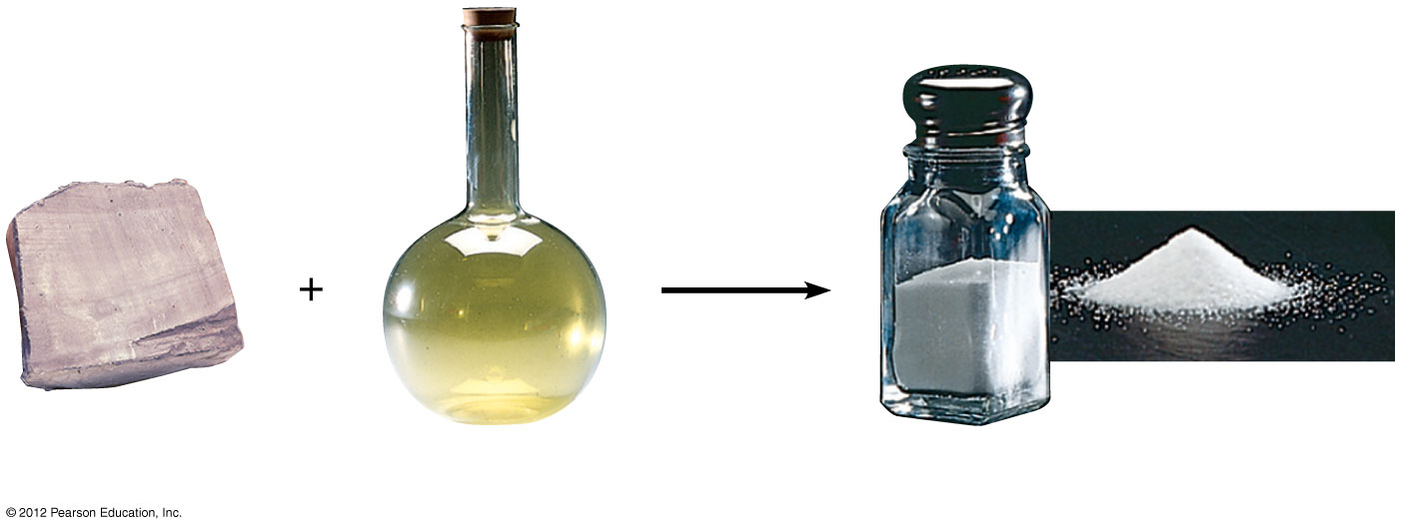
Figure 2.1
Sodium
Chlorine
Sodium chloride
Notes:
7
Figure 2.1 The emergent properties of the edible compound sodium chloride

Slide 8
2.1 Organisms are composed of elements, in combinations called compounds
About 25 elements are essential to life.
Four elements make up about 96% of the weight of most living organisms. These are
  oxygen,
  carbon,
  hydrogen, and
  nitrogen.
Trace elements are essential but are only needed in minute quantities.
© 2012 Pearson Education, Inc.
Notes:
Student Misconceptions and Concerns
The dangers posed by certain chemicals in our food and broader environment have sometimes misled people to associate chemicals with harm. People might not want chemicals added to their food or in their environment. Students often fail to appreciate the chemical nature of our bodies and our world and the potential harm or benefits of naturally occurring chemistry. They often fail to understand why “natural” does not necessarily mean good. (Consider presenting a long list of naturally occurring toxins to make this point.) Your class may benefit from a class discussion of these misconceptions about our attitudes toward chemicals.
Teaching Tips
1. The text notes the unique properties of pure sodium, pure chlorine, and the compound sodium chloride formed when the two bond together. Consider challenging your students to think of other simple examples of new properties that result when a compound is formed (for example, water, formed from hydrogen and oxygen, and rust, formed from iron and oxygen).
2. Students might be interested in the following aside: One of the challenges of raising captive, exotic animals is meeting the unique dietary requirements of a species. A zoo might have trouble keeping a particular animal because zoologists have not identified all of the trace elements required in the animal’s diet.

Slide 9
2.2 CONNECTION: Trace elements are common additives to food and water
Some trace elements are required to prevent disease.
  Without iron, your body cannot transport oxygen.
  An iodine deficiency prevents production of thyroid hormones, resulting in goiter.
  Fluoride is added to municipal water and dental products to help reduce tooth decay.
© 2012 Pearson Education, Inc.
Notes:
Student Misconceptions and Concerns
The dangers posed by certain chemicals in our food and broader environment have sometimes misled people to associate chemicals with harm. People might not want chemicals added to their food or in their environment. Students often fail to appreciate the chemical nature of our bodies and our world and the potential harm or benefits of naturally occurring chemistry. They often fail to understand why “natural” does not necessarily mean good. (Consider presenting a long list of naturally occurring toxins to make this point.) Your class may benefit from a class discussion of these misconceptions about our attitudes toward chemicals.
Teaching Tips
1. Students might be interested in the following aside: One of the challenges of raising captive, exotic animals is meeting the unique dietary requirements of a species. A zoo might have trouble keeping a particular animal because zoologists have not identified all of the trace elements required in the animal’s diet.
2. Many breakfast cereals are fortified with iron (see Figure 2.2c). As noted in Module 2.2, you can crush the cereal and extract distinct iron particles with a magnet. An overhead projector or video imaging device should clearly reveal the iron particles stuck to the magnet. This short practical demonstration can help connect an abstract concept to a concrete example.

Slide 10
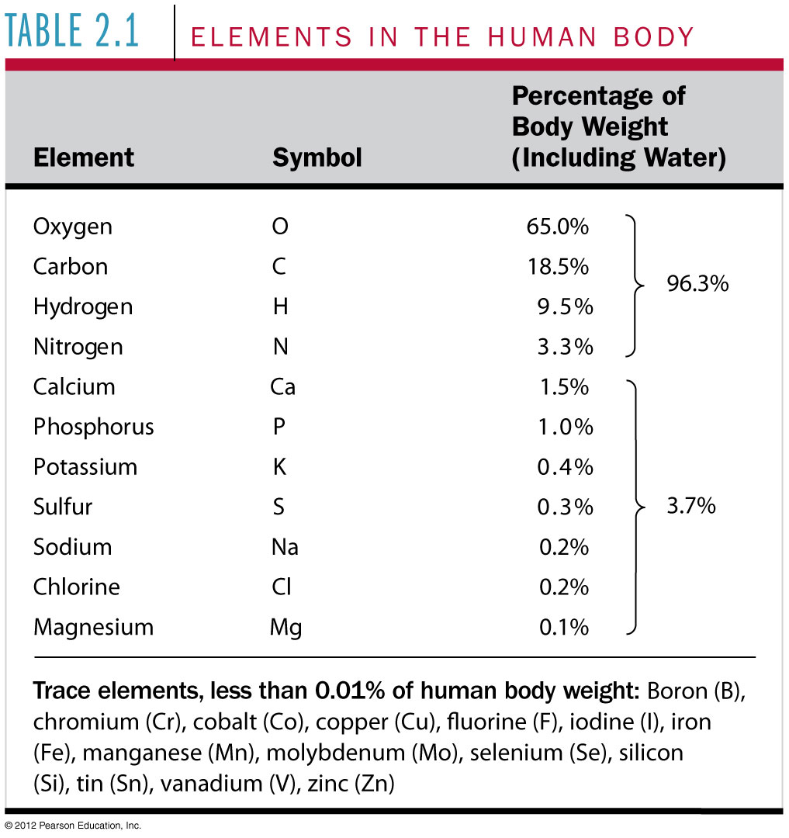
Table 2.1
Notes:
10
Table 2.1 Elements In the Human Body

Slide 11

Figure 2.2A
Notes:
11
Figure 2.2A Goiter, a symptom of iodine deficiency, in a Burmese woman

Slide 12
2.6 Covalent bonds join atoms into molecules through electron sharing
Water has atoms with different electronegativities.
  Oxygen attracts the shared electrons more strongly than hydrogen.
  So, the shared electrons spend more time near oxygen.
  The oxygen atom has a slightly negative charge and the hydrogen atoms have a slightly positive charge.
  Because of these polar covalent bonds, water is a polar molecule.
© 2012 Pearson Education, Inc.
Notes:
Student Misconceptions and Concerns
Students with limited backgrounds in chemistry will benefit from a discussion of Table 2.6 and the differences and limitations of representing atomic structure. The contrast in Table 2.6 is a good beginning for such a discussion. In addition to comparing how the positions of electrons are depicted, note the problems with the sense of scale as discussed in Module 2.3.
Teaching Tips
Consider challenging your students to suggest relationships in human lives that are analogous to each of the three types of chemical bonds (covalent, ionic, and hydrogen). Evaluating the accuracy of potential analogies requires careful analysis of the chemical bonding relationships and practices critical thinking skills. Small groups might provide immediate critiques before passing along analogies for the entire class to consider. The following is one example. Ionic and covalent bonds are different types of relationships. Consider this analogy. A woman taking out a loan has a specific relationship to her bank. She owes the bank money, something she got from the bank. A man shares an office with another man. Both look out the same window and answer the same phone. Ionic bonds are like a bank loan, in which something is borrowed. Covalent bonds are like sharing an office, with items (electrons) shared by both members of the relationship. After presenting this analogy, ask your students to modify the office analogy to represent a polar covalent bond. (Perhaps one man in the office sits closer to the window and the phone.)
Have your students try to calculate the number of covalent bonds possible for a variety of atoms. (Carbon, for example, can form up to four covalent bonds.) Then provide the students with a list of elements and the number of outer electrons for each and have them make predictions about the chemical formula for many types of molecules. (For example, carbon could form covalent bonds with four hydrogen atoms.)
Modules 2.6 and 2.8 discuss the special bonding in and between water molecules. Many students do not appreciate the importance of weak chemical bonds in water and cellular chemistry. Extra time and attention may be required to address this special aspect of chemistry.

Slide 13
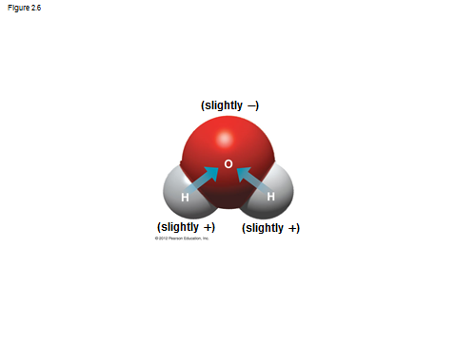

Slide 14
WATER’S LIFE-SUPPORTING PROPERTIES
© 2012 Pearson Education, Inc.

Slide 15
2.10 Hydrogen bonds make liquid water cohesive
The tendency of molecules of the same kind to stick together is cohesion.
  Cohesion is much stronger for water than other liquids.
  Most plants depend upon cohesion to help transport water and nutrients from their roots to their leaves.
The tendency of two kinds of molecules to stick together is adhesion.
© 2012 Pearson Education, Inc.
Notes:
Student Misconceptions and Concerns
Students are unlikely to have carefully considered the four special properties of water that are apparent in our world. However, these properties are of great biological significance and are often familiar parts of our lives. The connections between these properties and personal experiences can invest great meaning into a discussion of water’s properties. A homework assignment asking for examples of each of these properties in each student’s experiences will require reflection and may produce meaningful illustrations. Similarly, quizzes or exam questions matching examples to a list of the properties may require high-level evaluative analysis.
Teaching Tips
1. Here is a way to help your students think about the sticky nature of water in their lives. Ask them to consider the need for a towel after a shower or a bath. Once we get out of the shower or bath, we have left the source of water. So why do we need the towel? A towel helps us dry off water that is still clinging to our bodies because water molecules are polar. The molecules on cell surfaces are also polar, so our skin and the water stick to each other.
2. Some students may be intrigued if you tell them that you too can stand on the surface of water—when it is frozen. Thus, it is necessary to note a liquid water surface when discussing surface tension.

Slide 16
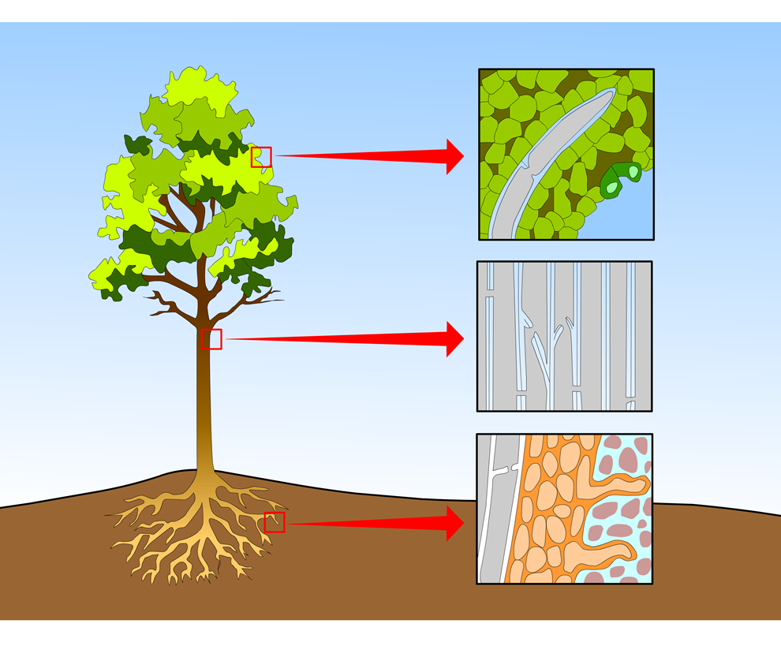
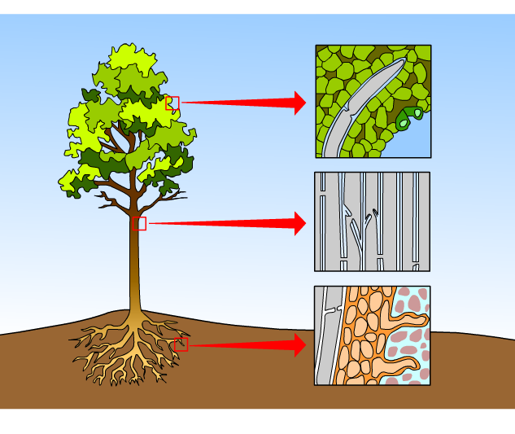
Animation: Water Transport
Right click on animation / Click play
© 2012 Pearson Education, Inc.
Notes:
Student Misconceptions and Concerns
Students are unlikely to have carefully considered the four special properties of water that are apparent in our world. However, these properties are of great biological significance and are often familiar parts of our lives. The connections between these properties and personal experiences can invest great meaning into a discussion of water’s properties. A homework assignment asking for examples of each of these properties in each student’s experiences will require reflection and may produce meaningful illustrations. Similarly, quizzes or exam questions matching examples to a list of the properties may require high-level evaluative analysis.
Teaching Tips
Here is a way to help your students think about the sticky nature of water in their lives. Ask them to consider the need for a towel after a shower or a bath. Once we get out of the shower or bath, we have left the source of water. So why do we need the towel? A towel helps us dry off water that is still clinging to our bodies because water molecules are polar. The molecules on cell surfaces are also polar, so our skin and the water stick to each other.
Some students may be intrigued if you tell them that you too can stand on the surface of water—when it is frozen. Thus, it is necessary to note a liquid water surface when discussing surface tension.

Slide 17
2.10 Hydrogen bonds make liquid water cohesive
Cohesion is related to surface tension—a measure of how difficult it is to break the surface of a liquid.
  Hydrogen bonds give water high surface tension, making it behave as if it were coated with an invisible film.
  Water striders stand on water without breaking the water surface.
© 2012 Pearson Education, Inc.
Notes:
Student Misconceptions and Concerns
Students are unlikely to have carefully considered the four special properties of water that are apparent in our world. However, these properties are of great biological significance and are often familiar parts of our lives. The connections between these properties and personal experiences can invest great meaning into a discussion of water’s properties. A homework assignment asking for examples of each of these properties in each student’s experiences will require reflection and may produce meaningful illustrations. Similarly, quizzes or exam questions matching examples to a list of the properties may require high-level evaluative analysis.
Teaching Tips
Here is a way to help your students think about the sticky nature of water in their lives. Ask them to consider the need for a towel after a shower or a bath. Once we get out of the shower or bath, we have left the source of water. So why do we need the towel? A towel helps us dry off water that is still clinging to our bodies because water molecules are polar. The molecules on cell surfaces are also polar, so our skin and the water stick to each other.
Some students may be intrigued if you tell them that you too can stand on the surface of water—when it is frozen. Thus, it is necessary to note a liquid water surface when discussing surface tension.

Slide 18
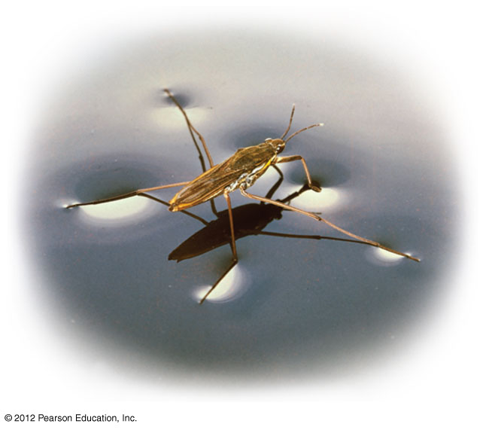
Figure 2.10
Notes:
18
Figure 2.10 Surface tension allows a water strider to walk on water.

Slide 19
2.12 Ice is less dense than liquid water
Water can exist as a gas, liquid, or solid.
Water is less dense as a solid than a liquid because of hydrogen bonding.
When water freezes, each molecule forms a stable hydrogen bond with its neighbors.
  As ice crystals form, the molecules are less densely packed than in liquid water.
  Because ice is less dense than water, it floats.
© 2012 Pearson Education, Inc.
Notes:
Student Misconceptions and Concerns
1. Students are unlikely to have carefully considered the four special properties of water that are apparent in our world. However, these properties are of great biological significance and are often familiar parts of our lives. The connections between these properties and personal experiences can invest great meaning into a discussion of water’s properties. A homework assignment asking for examples of each of these properties in each student’s experiences will require reflection and may produce meaningful illustrations. Similarly, quizzes or exam questions matching examples to a list of the properties may require high-level evaluative analysis.
2. Students at all levels struggle with the distinction between heat and temperature. Students might also expect that all ice is about the same temperature, 0 ºC. Redefining and correcting misunderstandings often takes more class time and energy than introducing previously unknown concepts.
Teaching Tips
1. Ask your students if the ocean levels would change if ice did not float. They can try this experiment to find out, or you can begin class with the demonstration and watch the progress throughout the class period. Place several large chunks of ice in a glass and fill the glass up completely with water to the top rim. Thus, the ice cubes should be sticking up above the top of the filled glass. Will the glass overflow when the ice melts? (No.) This phenomenon is important when we consider the potential consequences of global warming. If floating glaciers melt, ocean levels will not be affected. However, if the ice over land melts, we can expect higher ocean levels.
2. Module 2.12 notes the insulating effect of ice forming at the surface of a lake. This phenomenon would not occur if ice were denser than water. Challenge students to think of other consequences from the expansion of water when it forms ice. (These include the ability to widen cracks in rocks, roads, and sidewalks!)

Slide 20
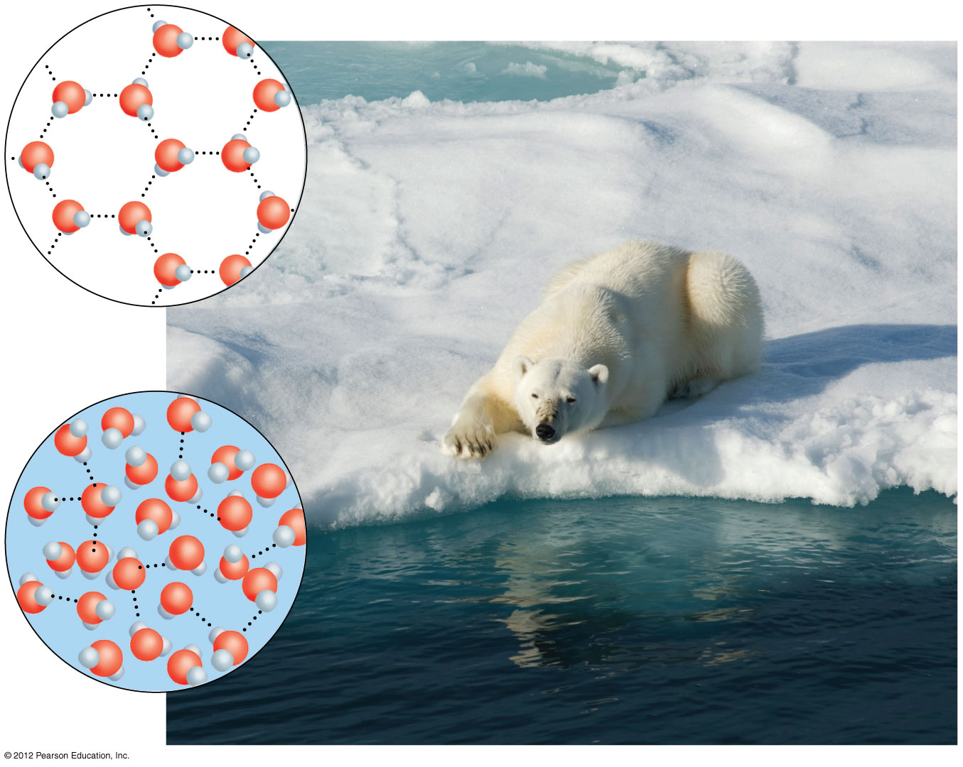
Figure 2.12
Ice
Hydrogen bonds are stable.
Hydrogen
bond
Liquid water
Hydrogen bonds constantly break and re-form.
Notes:
20
Figure 2.12 Hydrogen bonds between water molecules in ice and water

Slide 21
2.13 Water is the solvent of life
A solution is a liquid consisting of a mixture of two or more substances.
  The dissolving agent is the solvent.
  The substance that is dissolved is the solute.
  An aqueous solution is one in which water is the solvent.
© 2012 Pearson Education, Inc.
Notes:
Student Misconceptions and Concerns
Students are unlikely to have carefully considered the four special properties of water that are apparent in our world. However, these properties are of great biological significance and are often familiar parts of our lives. The connections between these properties and personal experiences can invest great meaning into a discussion of water’s properties. A homework assignment asking for examples of each of these properties in each student’s experiences will require reflection and may produce meaningful illustrations. Similarly, quizzes or exam questions matching examples to a list of the properties may require high-level evaluative analysis.
Teaching Tips
A simple demonstration of a solute dissolving in a solvent can focus students’ attention on the process when discussing solutions. Using colored water and white sugar or salt may make it easier to see and reference while you are discussing the process. Such simple visual aids add life to a lecture. (You might also add corn oil to the top of the solution to demonstrate the properties of hydrophobic substances, and challenge your class to explain why oil and water do not mix.)

Slide 22
2.13 Water is the solvent of life
Water’s versatility as a solvent results from the polarity of its molecules.
Polar or charged solutes dissolve when water molecules surround them, forming aqueous solutions.
Table salt is an example of a solute that will go into solution in water.
© 2012 Pearson Education, Inc.
Notes:
Student Misconceptions and Concerns
Students are unlikely to have carefully considered the four special properties of water that are apparent in our world. However, these properties are of great biological significance and are often familiar parts of our lives. The connections between these properties and personal experiences can invest great meaning into a discussion of water’s properties. A homework assignment asking for examples of each of these properties in each student’s experiences will require reflection and may produce meaningful illustrations. Similarly, quizzes or exam questions matching examples to a list of the properties may require high-level evaluative analysis.
Teaching Tips
Have students compare the seasonal ranges of temperatures of Anchorage and Fairbanks, Alaska. (Many websites, such as www. weather.com, provide weather information about various cities.) These two northern cities have large differences in their annual temperature ranges. Make the point that the coastal location of Anchorage moderates the temperature.
The following analogies may help students to understand the relationships between evaporation, heat, and temperature. (a) Ask students how the average on an exam would be affected if the brightest students didn’t take the test. (b) The authors note that the performance of a track team would drop if the fastest runners did not compete. In both analogies, removing the top performers lowers the average, just as the evaporation of the most active water molecules cools the evaporative surface.
It’s not the heat, it’s the humidity. The efficiency of evaporative cooling is affected by humidity. As humidity rises, the rate of evaporation decreases, making it more difficult to cool our heat-generating bodies on a warm and humid summer day.

Slide 23
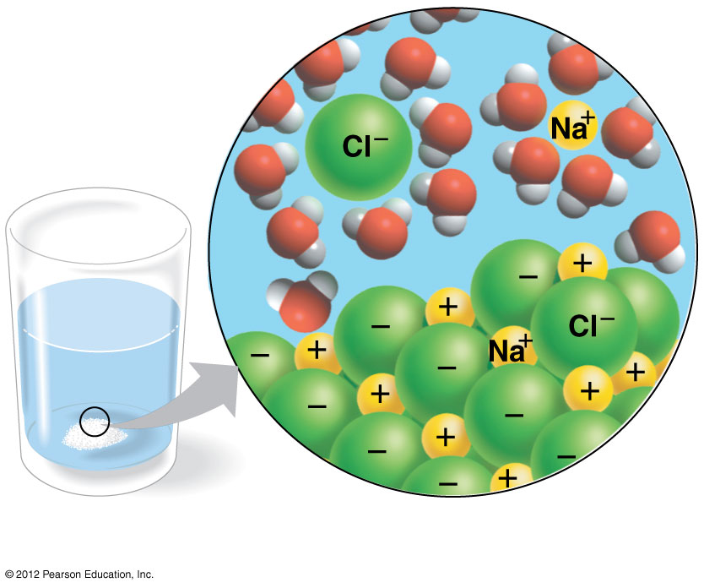
Figure 2.13
Ion in
solution
Salt crystal
Notes:
23
Figure 2.13 A crystal of salt (NaCl) dissolving in water

Slide 24
2.14 The chemistry of life is sensitive to acidic and basic conditions
In aqueous solutions, a small percentage of water molecules break apart into ions.
  Some are hydrogen ions (H⁺).
  Some are hydroxide ions (OH–).
  Both types are very reactive.
© 2012 Pearson Education, Inc.
Notes:
Teaching Tips
Discussions of pH are enhanced by lab activities that permit students to test the pH of everyday items (foods and household solutions). If students do not have opportunities to conduct such tests in lab, consider testing a few items during your class (pH paper or a basic pH meter will, of course, be necessary).

Slide 25
2.14 The chemistry of life is sensitive to acidic and basic conditions
A compound that releases H⁺ to a solution is an acid.
A compound that accepts H⁺ is a base.
The pH scale describes how acidic or basic a solution is.
  The pH scale ranges from 0 to 14, with zero the most acidic and 14 the most basic.
  Each pH unit represents a tenfold change in the concentration of H⁺.
© 2012 Pearson Education, Inc.
Notes:
Teaching Tips
Discussions of pH are enhanced by lab activities that permit students to test the pH of everyday items (foods and household solutions). If students do not have opportunities to conduct such tests in lab, consider testing a few items during your class (pH paper or a basic pH meter will, of course, be necessary).

Slide 26
2.14 The chemistry of life is sensitive to acidic and basic conditions
A buffer is a substance that minimizes changes in pH. Buffers
  accept H⁺ when it is in excess and
  donate H⁺ when it is depleted.
© 2012 Pearson Education, Inc.
Notes:
Teaching Tips
Discussions of pH are enhanced by lab activities that permit students to test the pH of everyday items (foods and household solutions). If students do not have opportunities to conduct such tests in lab, consider testing a few items during your class (pH paper or a basic pH meter will, of course, be necessary).

Slide 27
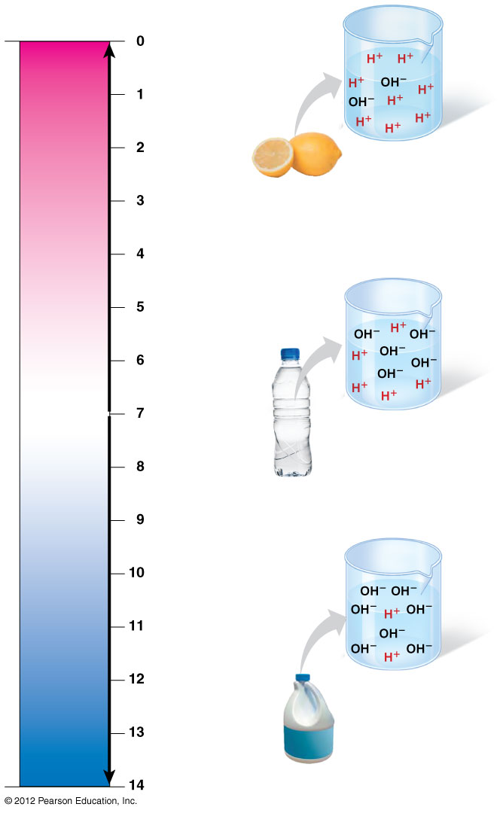
Figure 2.14
pH scale
Battery acid
Lemon juice,
gastric juice
Acidic solution
Increasingly ACIDIC
(Higher H⁺ concentration)
Vinegar, cola
Tomato juice
Rainwater
Human urine
NEUTRAL
[H⁺]=[OH⁻]
Saliva
Pure water
Neutral solution
Human blood,
tears
Seawater
Increasingly BASIC
(Higher OH⁻ concentration)
Milk of magnesia
Household ammonia
Basic solution
Household bleach
Oven cleaner
Notes:
27
Figure 2.14 The pH scale reflects the relative concentrations of H⁺ and OH⁻.

Slide 28
2.15 CONNECTION: Acid precipitation and ocean acidification threaten the environment
When we burn fossil fuels (coal, oil, and gas), air-polluting compounds and CO₂ are released into the atmosphere.
  Sulfur and nitrous oxides react with water in the air to form acids.
  These acids fall to Earth as acid precipitation, which is rain, snow, or fog with a pH lower than 5.2.
  CO₂ dissolving in seawater lowers ocean pH in a process known as ocean acidification.
© 2012 Pearson Education, Inc.
Notes:
Teaching Tips
The Environmental Protection Agency (EPA) website, www.epa.gov/acidrain/, includes useful information about acid rain and related science experiments.
2. In Module 2.15, the authors note that threats to water quality are addressed in Chapter 38. If your course does not include Chapter 38, consider covering some of those threats in your discussion of acid precipitation.

Slide 29
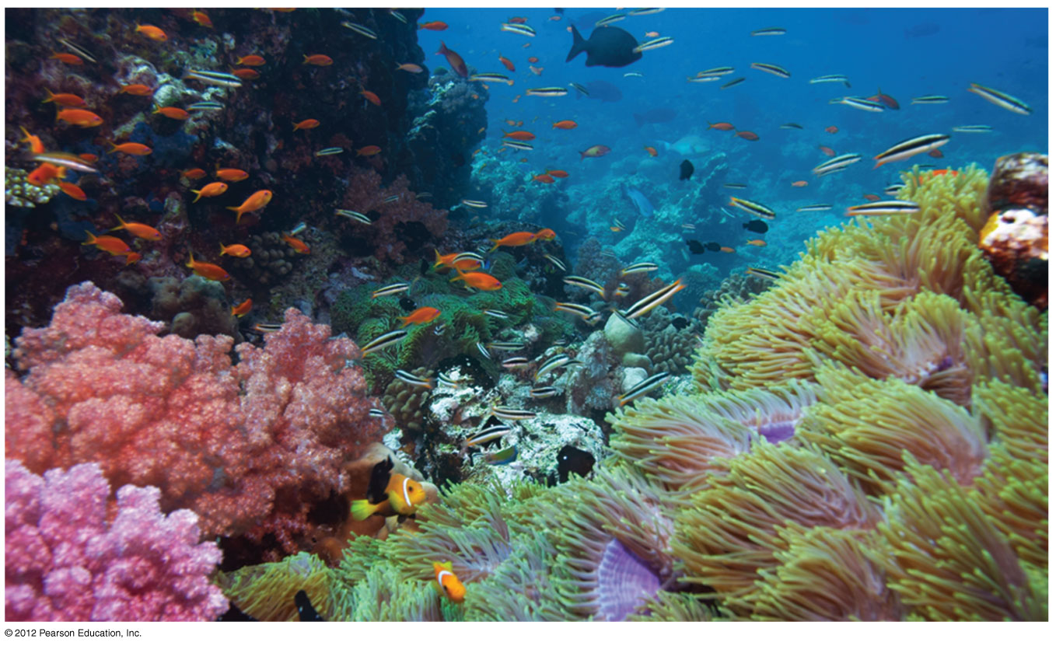
Figure 2.15
Notes:
29
Figure 2.15 Coral reefs are threatened by ocean acidification.

Slide 30
2.16 EVOLUTION CONNECTION: The search for extraterrestrial life centers on the search for water
The emergent properties of water support life on Earth.
When astrobiologists search for signs of extraterrestrial life on distant planets, they look for evidence of water.
The National Aeronautics and Space Administration (NASA) has found evidence that water was once abundant on Mars.
© 2012 Pearson Education, Inc.
Notes:
Teaching Tips
The SETI (Search For Extraterrestrial Intelligence) Institute’s Mission is to “explore, understand, and explain the origin, nature, and prevalence of life in the universe.” Your students might enjoy exploring this respected scientific organization’s website at www.seti.org.

Slide 31
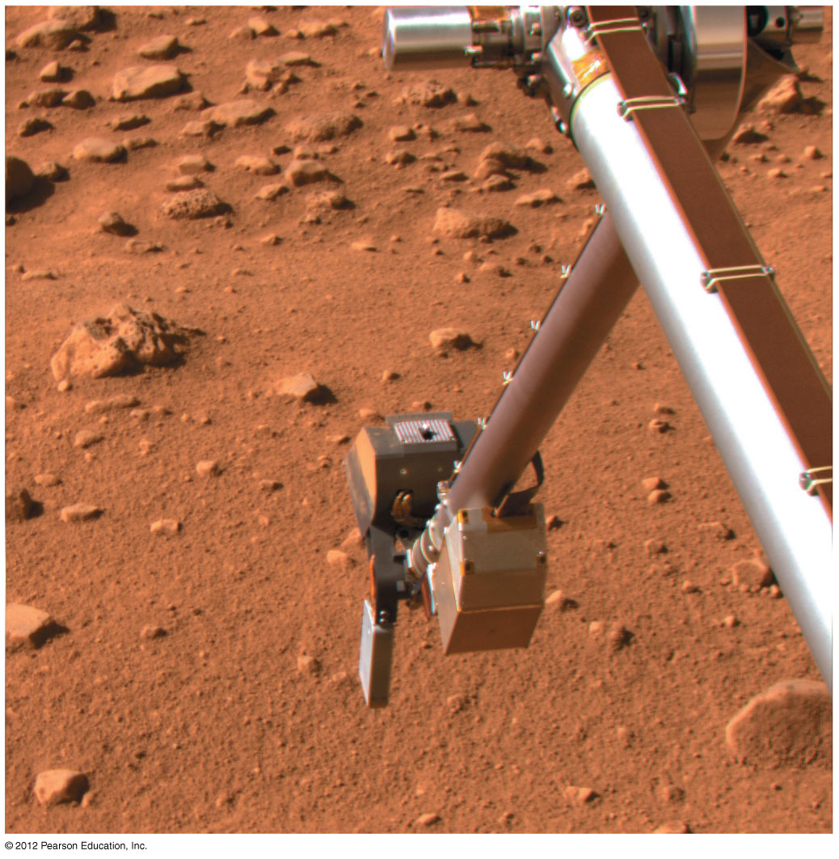
Figure 2.16
Notes:
31
Figure 2.16 Robotic arm of the Phoenix Mars Lander probing for evidence of water

Slide 32
INTRODUCTION TO ORGANIC COMPOUNDS
Chapter 3
© 2012 Pearson Education, Inc.
Notes:
32

Slide 33
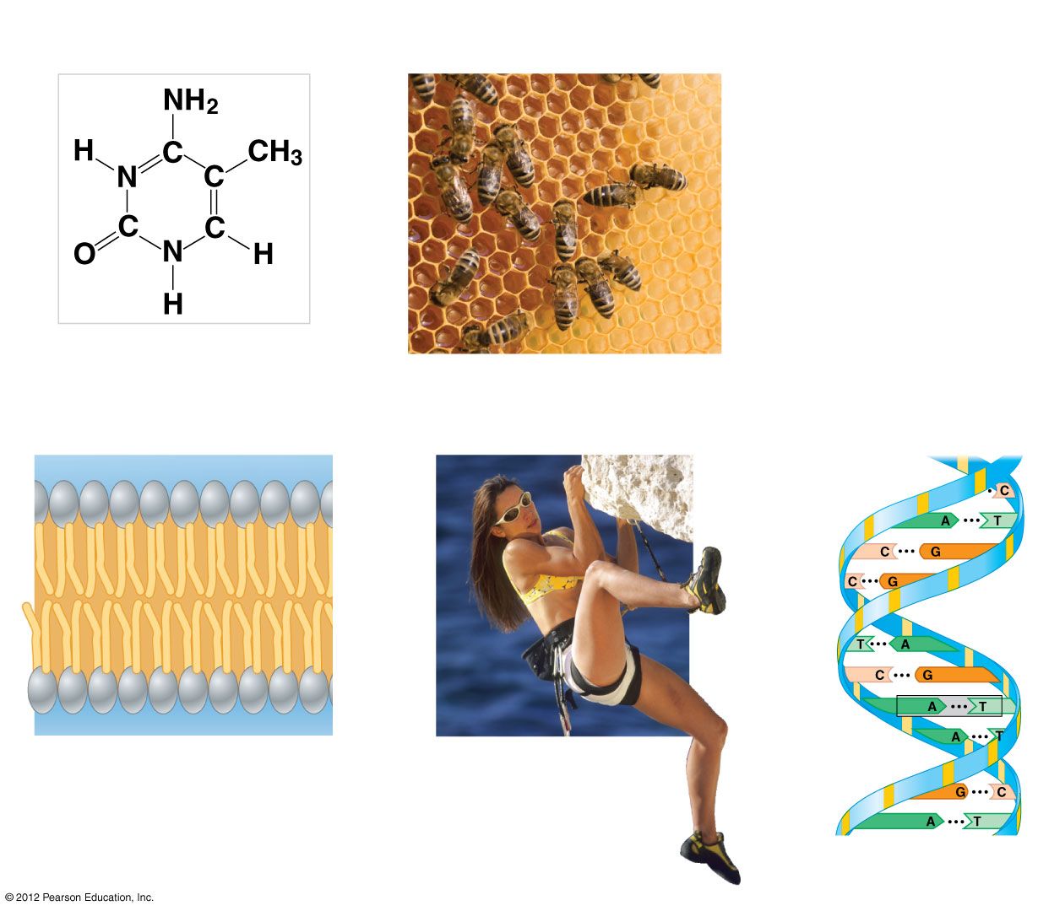
Figure 3.0_1
Chapter 3: Big Ideas
Introduction to Organic
Compounds
Carbohydrates
Lipids
Proteins
Nucleic Acids
Notes:
33
Figure 3.0_1 Chapter 3: Big Ideas

Slide 34
3.1 Life’s molecular diversity is based on the properties of carbon
Molecules found in cells are composed of carbon bonded to
  other carbons and
  atoms of other elements like hydrogen & oxygen & nitrogen
Carbon-based molecules are called organic compounds.
© 2012 Pearson Education, Inc.
Notes:
34
Student Misconceptions and Concerns
General biology students might not have previously taken a chemistry course. The concept of molecular building blocks that cannot be seen can be abstract and difficult to comprehend for such students. Concrete examples from our diets and good images will increase comprehension.
Students might need to be reminded about the levels of biological organization. The relationship between atoms, monomers, and polymers can be confusing as each is discussed. Consider noting these relationships somewhere in the classroom (such as on the board) where students can quickly glance for reassurance.
Teaching Tips
One of the great advantages of carbon is its ability to form up to four bonds, permitting the assembly of diverse components and branching configurations. Challenge your students to find another element that might also permit this sort of adaptability. (Like carbon, silicon has four electrons in its outer shell.)
Toothpicks and gumdrops (or any other pliable small candy) permit the quick construction of chemical models. Different candy colors can represent certain atoms. The model of the methane molecule in Figure 3.1 can thus easily be demonstrated (and consumed)!

Slide 35
3.1 Life’s molecular diversity is based on the properties of carbon
A carbon skeleton is a chain of carbon atoms that can be
  branched or
  unbranched.
Compounds with the same formula but different structural arrangements are called isomers.
© 2012 Pearson Education, Inc.
Notes:
35
Student Misconceptions and Concerns
General biology students might not have previously taken a chemistry course. The concept of molecular building blocks that cannot be seen can be abstract and difficult to comprehend for such students. Concrete examples from our diets and good images will increase comprehension.
Students might need to be reminded about the levels of biological organization. The relationship between atoms, monomers, and polymers can be confusing as each is discussed. Consider noting these relationships somewhere in the classroom (such as on the board) where students can quickly glance for reassurance.
Teaching Tips
One of the great advantages of carbon is its ability to form up to four bonds, permitting the assembly of diverse components and branching configurations. Challenge your students to find another element that might also permit this sort of adaptability. (Like carbon, silicon has four electrons in its outer shell.)
Toothpicks and gumdrops (or any other pliable small candy) permit the quick construction of chemical models. Different candy colors can represent certain atoms. The model of the methane molecule in Figure 3.1 can thus easily be demonstrated (and consumed)!

Slide 36
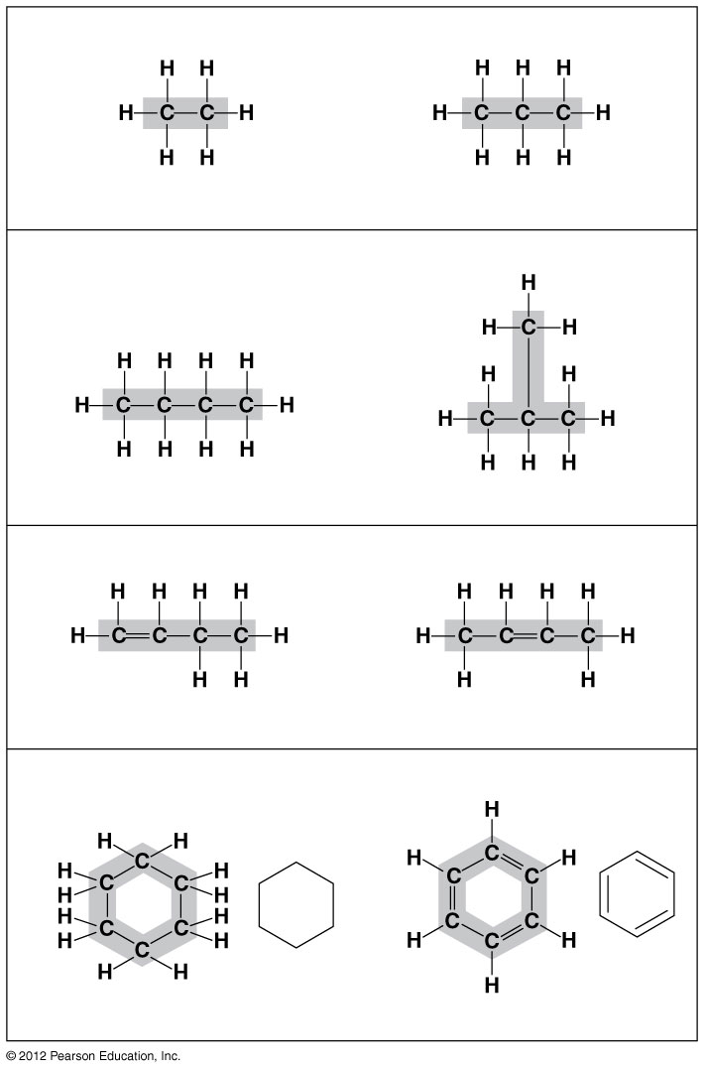
Figure 3.1B
Length. Carbon skeletons vary in length.
Ethane
Propane
Branching.
Skeletons may be unbranched
or branched.
Butane
Isobutane
Double bonds. Skeletons may have double bonds.
1-Butene
2-Butene
Rings. Skeletons may be arranged in rings.
Cyclohexane
Benzene
Notes:
36
Figure 3.1B Four ways that carbon skeletons can vary

Slide 37
3.3 Cells make a huge number of large molecules from a limited set of small molecules
There are four classes of molecules important to organisms:
  carbohydrates,
  proteins,
  lipids, and
  nucleic acids.
© 2012 Pearson Education, Inc.
Notes:
37
Student Misconceptions and Concerns
General biology students might not have previously taken a chemistry course. The concept of molecular building blocks that cannot be seen can be abstract and difficult to comprehend for such students. Concrete examples from our diets and good images will increase comprehension.
Teaching Tips
1. Train cars linking together to form a train is a nice analogy to linking monomers to form polymers. Consider adding that as the train cars are joined, a puff of steam appears—a reference to water production and a dehydration reaction when linking molecular monomers.
2. The authors note that the great diversity of polymers mainly results from the arrangement of polymers, the different sequences made possible by combinations or permutations of the same monomers. Consider illustrating this by simply asking students how many different ways can we arrange the letters A, B, and C, using each letter, and only once, to form 3-lettered words. The answer is 6 permutations: ABC, ACB, BAC, BCA, CBA, CAB (the factorial of 3). And if letters can be repeated, the answer is 27 (= 3³): AAA, BBB, CCC, ABB, ACC, etc.

Slide 38
3.3 Cells make a huge number of large molecules from a limited set of small molecules
The four classes of biological molecules contain very large molecules.
  called macromolecules because of their large size.
  They are also called polymers because they are made from identical building blocks strung together.
  The building blocks of polymers are called monomers.
© 2012 Pearson Education, Inc.
Notes:
38
Student Misconceptions and Concerns
General biology students might not have previously taken a chemistry course. The concept of molecular building blocks that cannot be seen can be abstract and difficult to comprehend for such students. Concrete examples from our diets and good images will increase comprehension.
Teaching Tips
1. Train cars linking together to form a train is a nice analogy to linking monomers to form polymers. Consider adding that as the train cars are joined, a puff of steam appears—a reference to water production and a dehydration reaction when linking molecular monomers.
2. The authors note that the great diversity of polymers mainly results from the arrangement of polymers, the different sequences made possible by combinations or permutations of the same monomers. Consider illustrating this by simply asking students how many different ways can we arrange the letters A, B, and C, using each letter, and only once, to form 3-lettered words. The answer is 6 permutations: ABC, ACB, BAC, BCA, CBA, CAB (the factorial of 3). And if letters can be repeated, the answer is 27 (= 3³): AAA, BBB, CCC, ABB, ACC, etc.

Slide 39
3.3 Cells make a huge number of large molecules from a limited set of small molecules
Monomers are linked together to form polymers through dehydration synthesis reactions, which remove water.
  This is an anabolic reaction-building
Polymers are broken apart by hydrolysis, the addition of water.
  This is a catabolic reaction-taking apart
All biological reactions of this sort are mediated by enzymes, which speed up chemical reactions in cells.
  The sum total of both reactions is metabolism
© 2012 Pearson Education, Inc.
Notes:
39
Student Misconceptions and Concerns
General biology students might not have previously taken a chemistry course. The concept of molecular building blocks that cannot be seen can be abstract and difficult to comprehend for such students. Concrete examples from our diets and good images will increase comprehension.
Teaching Tips
1. Train cars linking together to form a train is a nice analogy to linking monomers to form polymers. Consider adding that as the train cars are joined, a puff of steam appears—a reference to water production and a dehydration reaction when linking molecular monomers.
2. The authors note that the great diversity of polymers mainly results from the arrangement of polymers, the different sequences made possible by combinations or permutations of the same monomers. Consider illustrating this by simply asking students how many different ways can we arrange the letters A, B, and C, using each letter, and only once, to form 3-lettered words. The answer is 6 permutations: ABC, ACB, BAC, BCA, CBA, CAB (the factorial of 3). And if letters can be repeated, the answer is 27 (= 3³): AAA, BBB, CCC, ABB, ACC, etc.

Slide 40
3.3 Cells make a huge number of large molecules from a limited set of small molecules
A cell makes a large number of polymers from a small group of monomers. For example,
  proteins are made from only 20 different amino acids and
  DNA is built from just four kinds of nucleotides.
The monomers used to make polymers are universal.
© 2012 Pearson Education, Inc.
Notes:
40
Student Misconceptions and Concerns
General biology students might not have previously taken a chemistry course. The concept of molecular building blocks that cannot be seen can be abstract and difficult to comprehend for such students. Concrete examples from our diets and good images will increase comprehension.
Teaching Tips
1. Train cars linking together to form a train is a nice analogy to linking monomers to form polymers. Consider adding that as the train cars are joined, a puff of steam appears—a reference to water production and a dehydration reaction when linking molecular monomers.
2. The authors note that the great diversity of polymers mainly results from the arrangement of polymers, the different sequences made possible by combinations or permutations of the same monomers. Consider illustrating this by simply asking students how many different ways can we arrange the letters A, B, and C, using each letter, and only once, to form 3-lettered words. The answer is 6 permutations: ABC, ACB, BAC, BCA, CBA, CAB (the factorial of 3). And if letters can be repeated, the answer is 27 (= 3³): AAA, BBB, CCC, ABB, ACC, etc.

Slide 41
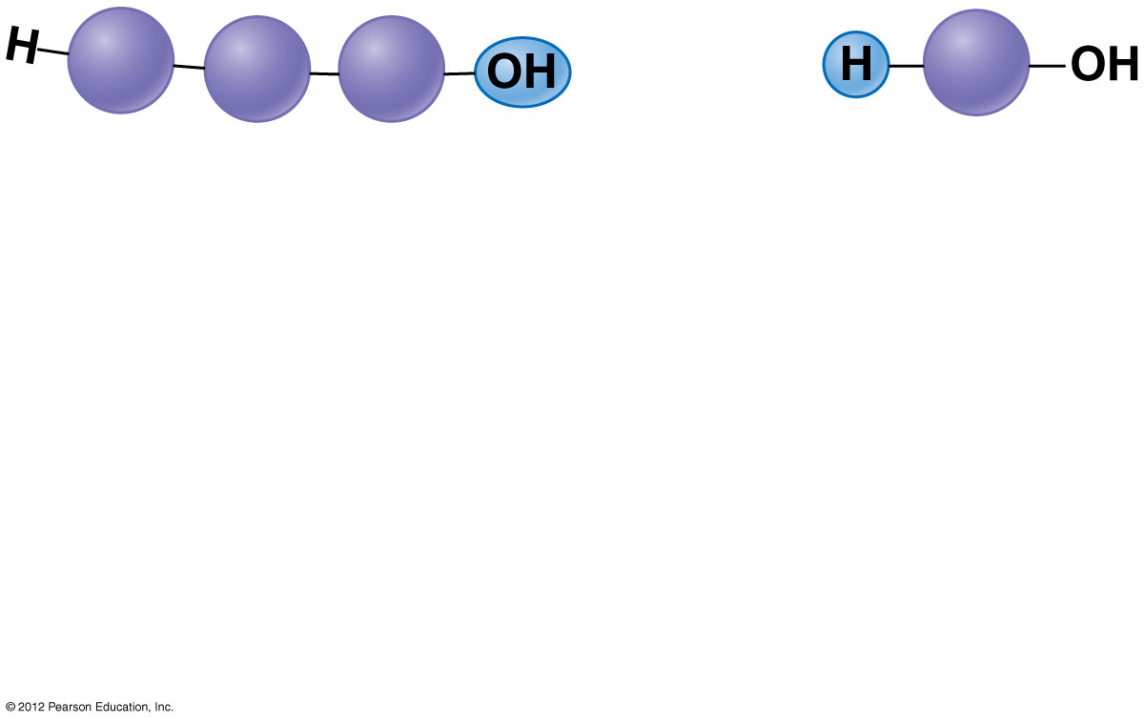
Figure 3.3A_s1
Short polymer
Unlinked
monomer
Notes:
41
Figure 3.3A_s1 Dehydration reaction building a polymer chain (step 1)

Slide 42
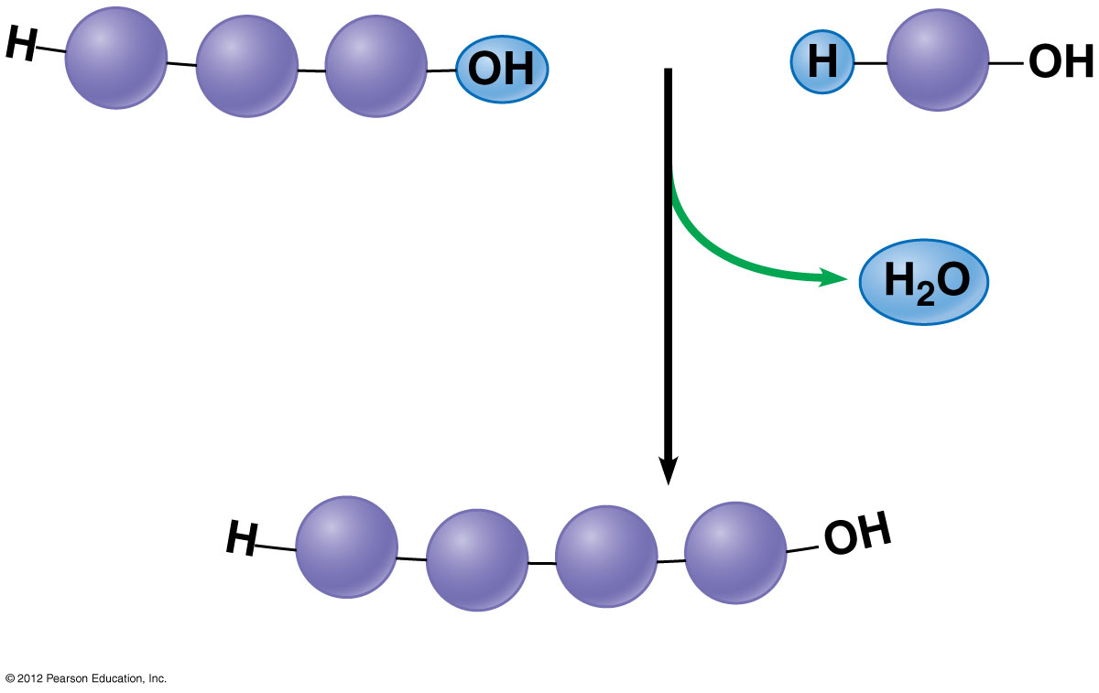
Figure 3.3A_s2
Short polymer
Unlinked
monomer
Dehydration reaction
forms a new bond
Longer polymer
Notes:
42
Figure 3.3A_s2 Dehydration reaction building a polymer chain (step 2)

Slide 43
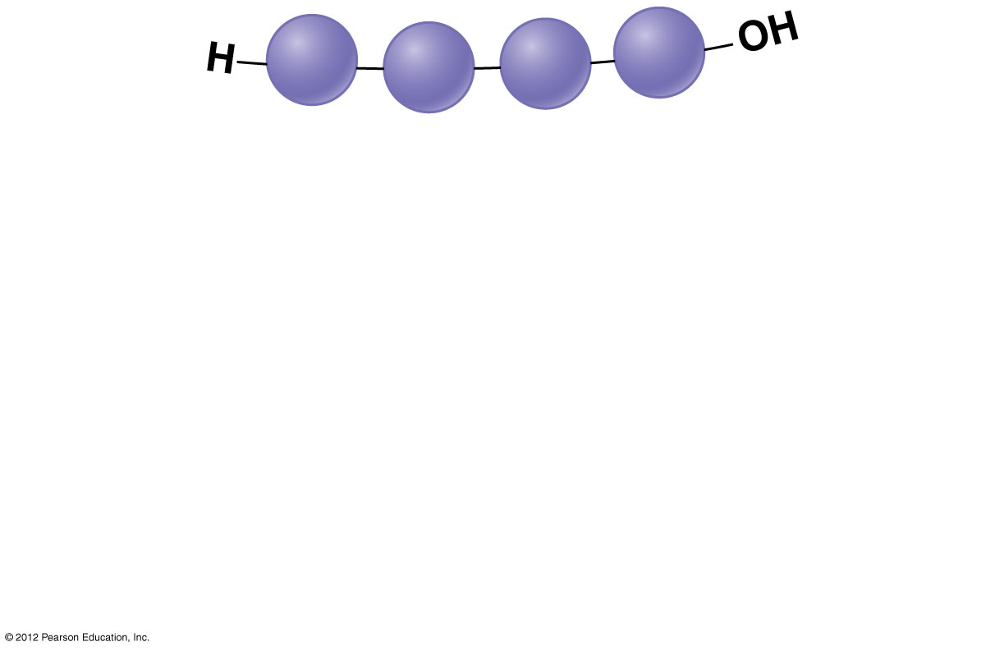
Figure 3.3B_s1
Notes:
43
Figure 3.3B_s1 Hydrolysis breaking down a polymer (step 1)

Slide 44
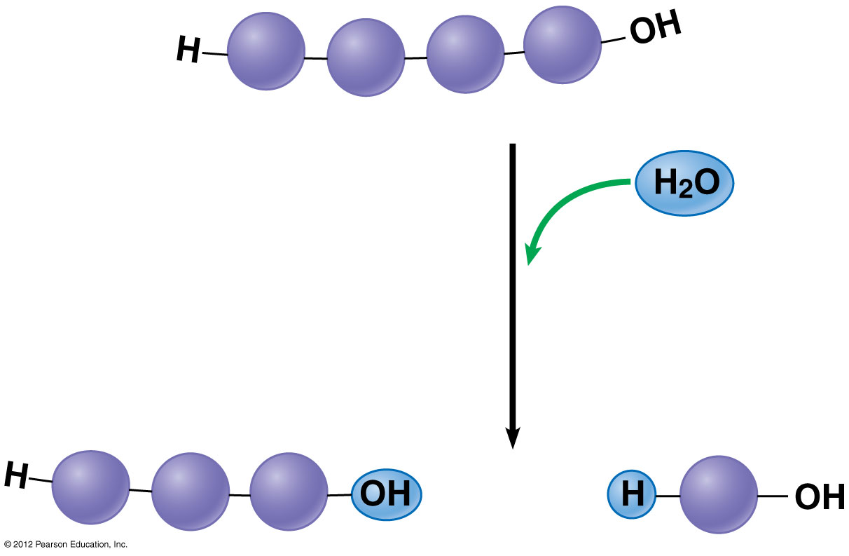
Figure 3.3B_s2
Hydrolysis
breaks a bond
Notes:
44
Figure 3.3B_s2 Hydrolysis breaking down a polymer (step 2)

Slide 45
CARBOHYDRATES
© 2012 Pearson Education, Inc.
Notes:
45

Slide 46
3.4 Monosaccharides are the simplest carbohydrates
Carbohydrates range from small sugar molecules (monomers) to large polysaccharides.
Sugar monomers are monosaccharides, such as those found in honey,fruit
  glucose, and
  fructose.
Monosaccharides can be hooked together to form
  more complex sugars called disaccharides and
  polysaccharides.
© 2012 Pearson Education, Inc.
Notes:
46
Student Misconceptions and Concerns
1. Consider reinforcing the three main sources of calories with food items that clearly represent each group. Bring clear examples to class as visual references. For example, a can of Coke or a bag of sugar for carbohydrates, a tub of margarine for lipids, and some beef jerky for protein (although some fat and carbohydrates might also be included).
2. The abstract nature of chemistry can be discouraging to many students. Consider starting out this section of lecture by examining the chemical groups on a food nutrition label. Candy bars with peanuts are particularly useful, as they contain significant amounts of all three sources of calories (carbohydrates, proteins, and lipids).
Teaching Tips
If your lectures will eventually include details of glycolysis and aerobic respiration, this is a good point to introduce the basic concepts of glucose as fuel. Just introducing this conceptual formula might help: eating glucose and breathing oxygen produces water and usable energy (used to build ATP) plus heat and carbon dioxide exhaled in our breath.

Slide 47
3.4 Monosaccharides are the simplest carbohydrates
The carbon skeletons of monosaccharides vary in length.
  Glucose and fructose are six carbons long.
  Others have three to seven carbon atoms.
Monosaccharides are
  the main fuels for cellular work and
  used as raw materials to manufacture other organic molecules.
© 2012 Pearson Education, Inc.
Notes:
47
Student Misconceptions and Concerns
1. Consider reinforcing the three main sources of calories with food items that clearly represent each group. Bring clear examples to class as visual references. For example, a can of Coke or a bag of sugar for carbohydrates, a tub of margarine for lipids, and some beef jerky for protein (although some fat and carbohydrates might also be included).
2. The abstract nature of chemistry can be discouraging to many students. Consider starting out this section of lecture by examining the chemical groups on a food nutrition label. Candy bars with peanuts are particularly useful, as they contain significant amounts of all three sources of calories (carbohydrates, proteins, and lipids).
Teaching Tips
If your lectures will eventually include details of glycolysis and aerobic respiration, this is a good point to introduce the basic concepts of glucose as fuel. Just introducing this conceptual formula might help: eating glucose and breathing oxygen produces water and usable energy (used to build ATP) plus heat and carbon dioxide exhaled in our breath.

Slide 48
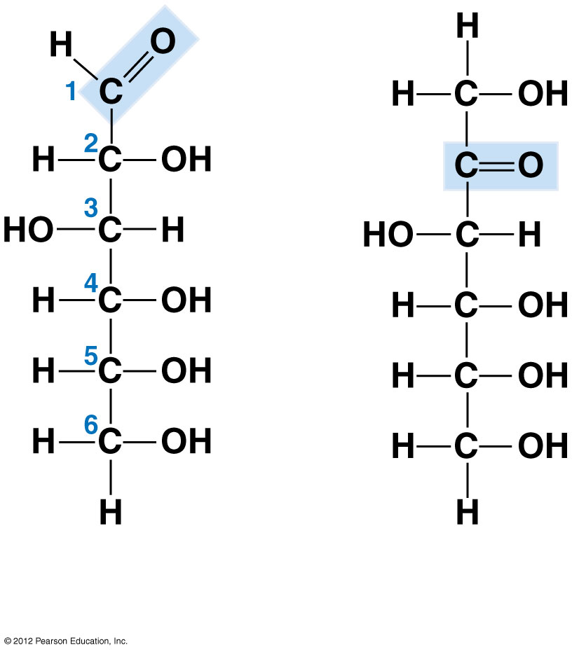
Figure 3.4B
Glucose
(an aldose)
Fructose
(a ketose)
Notes:
48
Figure 3.4B Structures of glucose and fructose

Slide 49
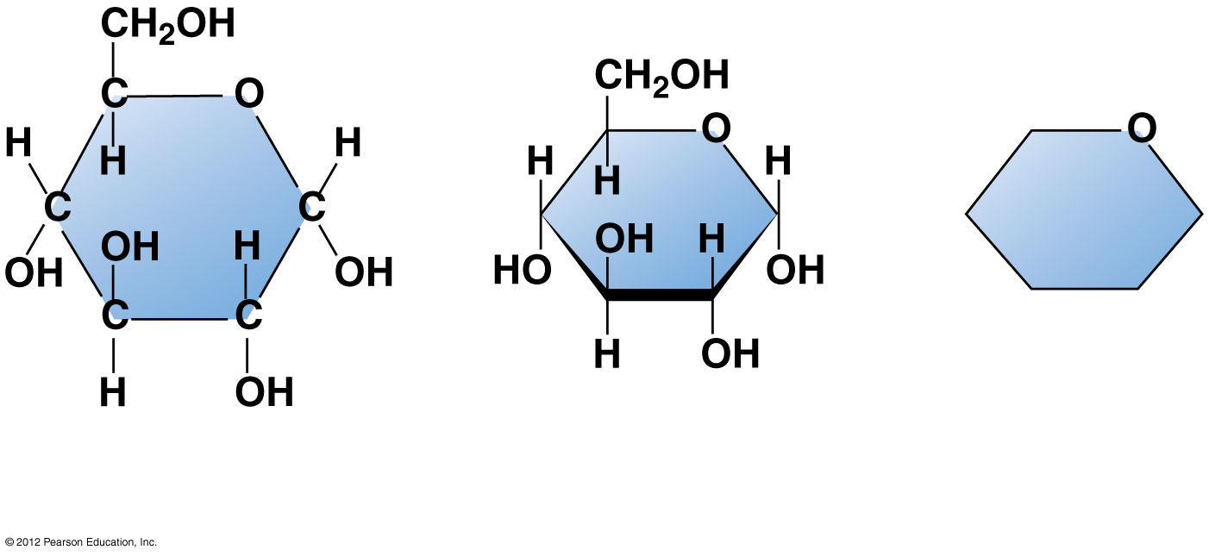
Figure 3.4C
6
5
4
1
3
2
Structural
formula
Abbreviated
structure
Simplified
structure
Notes:
49
Figure 3.4C Three representations of the ring form of glucose

Slide 50
3.5 Two monosaccharides are linked to form a disaccharide
Two monosaccharides (monomers) can bond to form a disaccharide in a dehydration reaction.
The disaccharide sucrose is formed by combining
  a glucose & fructose
The disaccharide maltose is formed from two glucose monomers.
© 2012 Pearson Education, Inc.
Notes:
50
Student Misconceptions and Concerns
Consider reinforcing the three main sources of calories with food items that clearly represent each group. Bring clear examples to class as visual references. For example, a can of Coke or a bag of sugar for carbohydrates, a tub of margarine for lipids, and some beef jerky for protein (although some fat and carbohydrates might also be included).
Teaching Tips
Learning the definitions of word roots is invaluable when learning science. Learning the meaning of the prefix word roots “mono” (one), “di” (two), and “poly” (many) helps to distinguish the structures of various carbohydrates.

Slide 51
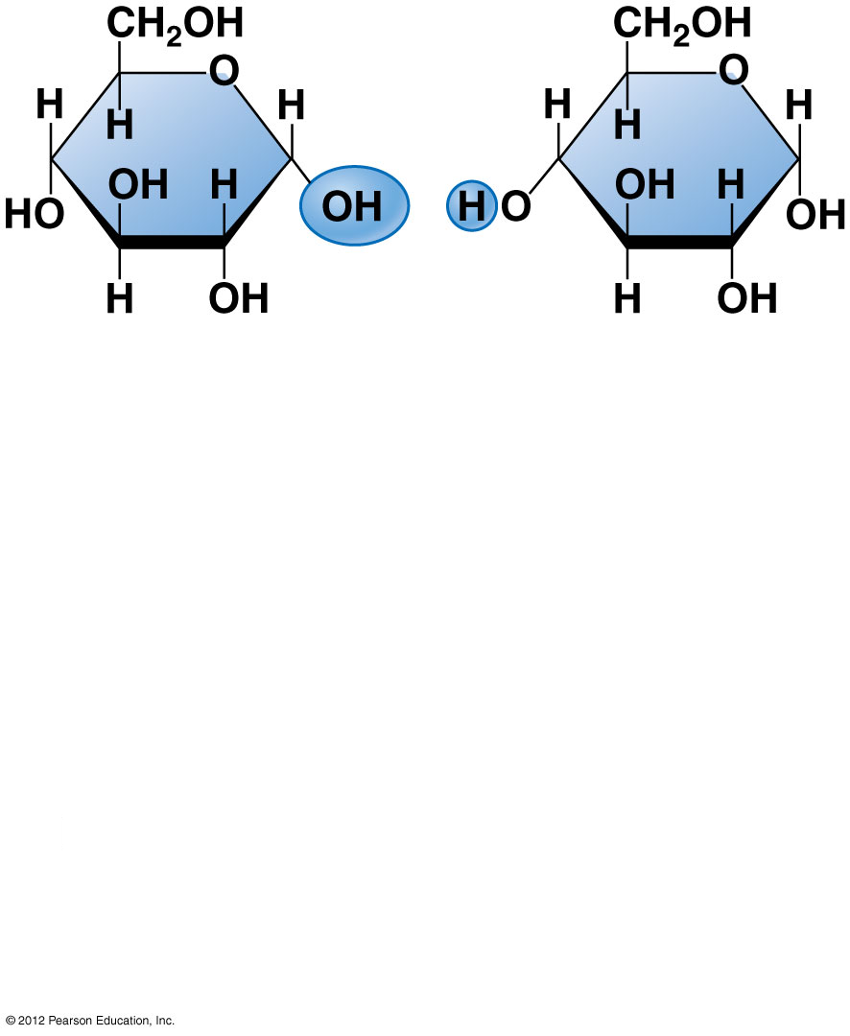
Figure 3.5_s1
Glucose
Glucose
Notes:
51
Figure 3.5_s1 Disaccharide formation by a dehydration reaction (step 1)

Slide 52
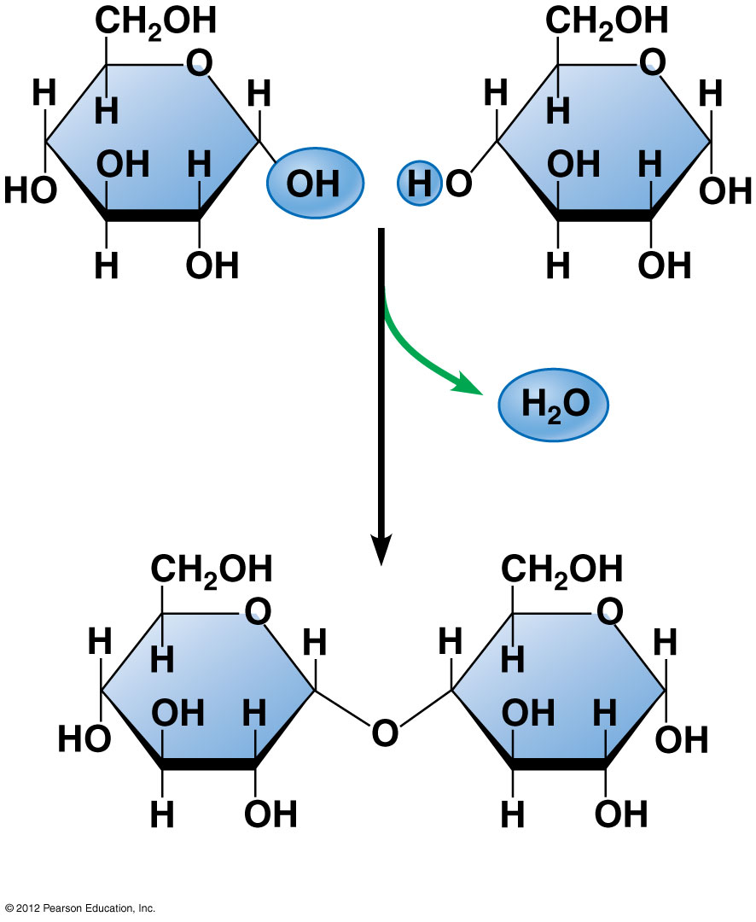
Figure 3.5_s2
Glucose
Glucose
Maltose
Notes:
52
Figure 3.5_s2 Disaccharide formation by a dehydration reaction (step 2)

Slide 53
3.7 Polysaccharides are long chains of sugar units
Polysaccharides are
  macromolecules and
  polymers composed of thousands of monosaccharides (monomers)
Polysaccharides may function as
  storage molecules or
  structural compounds.
© 2012 Pearson Education, Inc.
Notes:
53
Student Misconceptions and Concerns
Consider reinforcing the three main sources of calories with food items that clearly represent each group. Bring clear examples to class as visual references. For example, a can of Coke or a bag of sugar for carbohydrates, a tub of margarine for lipids, and some beef jerky for protein (although some fat and carbohydrates might also be included).
Teaching Tips
1. A simple exercise demonstrates the enzymatic breakdown of starches into sugars. If students place an unsalted cracker in their mouths, holding it in their mouths while it mixes well with saliva, they might soon notice that a sweeter taste begins to emerge. The salivary enzyme amylase begins the digestion of starches into disaccharides, which may be degraded further by other enzymes. These disaccharides are the source of the sweet taste.
2. The text notes that cellulose is the most abundant organic molecule on Earth. Ask your students why this is true.
3. The cellophane wrap often used to package foods is a biodegradable material derived from cellulose. Consider challenging students to create a list of other cellulose-derived products (such as paper.)
4. An adult human may store about a half of a kilogram of glycogen in the liver and muscles of the body, depending up recent dietary habits. A person who begins dieting might soon notice an immediate weight loss of 2–4 pounds (1–2 kilograms) over several days, reflecting reductions in stored glycogen, water, and intestinal contents (among other factors).

Slide 54
3.7 Polysaccharides are long chains of sugar units
Starch is
  a polysaccharide made of glucose monomers,
  used by plants to store energy
Glycogen is
  a polysaccharide made of glucose monomers,
  used by animals for energy storage.
© 2012 Pearson Education, Inc.
Notes:
54
Student Misconceptions and Concerns
Consider reinforcing the three main sources of calories with food items that clearly represent each group. Bring clear examples to class as visual references. For example, a can of Coke or a bag of sugar for carbohydrates, a tub of margarine for lipids, and some beef jerky for protein (although some fat and carbohydrates might also be included).
Teaching Tips
1. A simple exercise demonstrates the enzymatic breakdown of starches into sugars. If students place an unsalted cracker in their mouths, holding it in their mouths while it mixes well with saliva, they might soon notice that a sweeter taste begins to emerge. The salivary enzyme amylase begins the digestion of starches into disaccharides, which may be degraded further by other enzymes. These disaccharides are the source of the sweet taste.
2. The text notes that cellulose is the most abundant organic molecule on Earth. Ask your students why this is true.
3. The cellophane wrap often used to package foods is a biodegradable material derived from cellulose. Consider challenging students to create a list of other cellulose-derived products (such as paper.)
4. An adult human may store about a half of a kilogram of glycogen in the liver and muscles of the body, depending up recent dietary habits. A person who begins dieting might soon notice an immediate weight loss of 2–4 pounds (1–2 kilograms) over several days, reflecting reductions in stored glycogen, water, and intestinal contents (among other factors).

Slide 55
3.7 Polysaccharides are long chains of sugar units
Cellulose
  is a polymer of glucose makes plant cell walls.
Chitin is
  a polysaccharide used by insects and crustaceans to build an exoskeleton.
© 2012 Pearson Education, Inc.
Notes:
55
Student Misconceptions and Concerns
Consider reinforcing the three main sources of calories with food items that clearly represent each group. Bring clear examples to class as visual references. For example, a can of Coke or a bag of sugar for carbohydrates, a tub of margarine for lipids, and some beef jerky for protein (although some fat and carbohydrates might also be included).
Teaching Tips
1. A simple exercise demonstrates the enzymatic breakdown of starches into sugars. If students place an unsalted cracker in their mouths, holding it in their mouths while it mixes well with saliva, they might soon notice that a sweeter taste begins to emerge. The salivary enzyme amylase begins the digestion of starches into disaccharides, which may be degraded further by other enzymes. These disaccharides are the source of the sweet taste.
2. The text notes that cellulose is the most abundant organic molecule on Earth. Ask your students why this is true.
3. The cellophane wrap often used to package foods is a biodegradable material derived from cellulose. Consider challenging students to create a list of other cellulose-derived products (such as paper.)
4. An adult human may store about a half of a kilogram of glycogen in the liver and muscles of the body, depending up recent dietary habits. A person who begins dieting might soon notice an immediate weight loss of 2–4 pounds (1–2 kilograms) over several days, reflecting reductions in stored glycogen, water, and intestinal contents (among other factors).

Slide 56
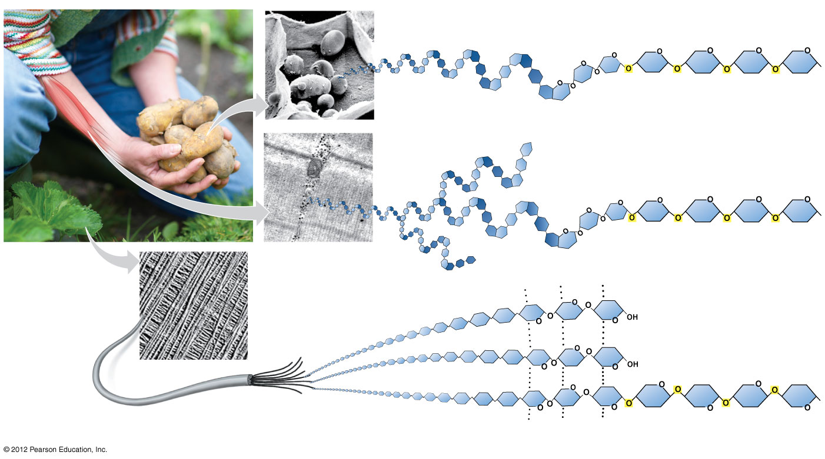
Figure 3.7
Starch granules
in potato tuber cells
Starch
Glucose
monomer
Glycogen granules
in muscle
tissue
Glycogen
Cellulose microfibrils
in a plant cell wall
Cellulose
Hydrogen bonds
Cellulose
molecules
Notes:
56
Figure 3.7 Polysaccharides

Slide 57
3.7 Polysaccharides are long chains of sugar units
Polysaccharides are usually hydrophilic (water-loving).
Bath towels are often made of cotton, which is mostly cellulose & water absorbent.
© 2012 Pearson Education, Inc.
Notes:
57
Student Misconceptions and Concerns
1. Students may struggle with the concept that a pound of fat contains more than twice the calories of a pound of sugar. It might seem that a pound of food would potentially add on a pound of weight. Other students may have never understood the concept of calories in the diet, simply following general guidelines of avoiding fatty foods. Furthermore, fiber and water have no caloric value but add to the weight of food. Consider class discussions that explore student misconceptions about calories, body weight, and healthy diets.
2. Students might struggle to extrapolate the properties of lipids to their roles in an organism. Ducks float because their feathers repel water instead of attracting it. Hair on our heads remains flexible because of oils produced in our scalp. Examples such as these help connect the abstract properties of lipids to concrete examples in our world.
Teaching Tips
1. The text in Module 3.8 notes the common observation that vinegar and oil do not mix in this type of salad dressing. A simple demonstration can help make this point. In front of the class, mix together colored water and a yellow oil (corn or canola oil work well). Shake up the mixture and then watch as the two separate. (You may have a mixture already made ahead of time that remains separated; however, the dye may bleed between the oil and the water.) Placing the mixture on an overhead projector or other well-illuminated imaging device makes for a dramatic display of hydrophobic activity!
2. The text notes that a gram of fat stores more than twice the energy of a gram of polysaccharide, such as starch. You might elaborate with a simple calculation to demonstrate how a person’s body weight would vary if the energy stored in body fat were stored in carbohydrates instead. If a 100-kg man carried 25% body fat, he would have 25 kg of fat in his body. Fat stores about 2.25 times more energy per gram than carbohydrate. What would be the weight of the man if he stored the energy in the fat in the form of carbohydrate? (2.25 x 25 = 56.25 kg of carbohydrate + 75kg (nonfat body weight) = 131.25 kg, an increase of 31.25%)
3. Margarine in stores commonly comes in liquid squeeze containers, in tubs, and in sticks. These forms reflect increasing amounts of hydrogenation, gradually increasing the stiffness from a liquid, to a firmer spread, to a firm stick of margarine. As noted in the text, recent studies have suggested that unsaturated oils become increasingly unhealthy as they are hydrogenated. Students might therefore remember that as margarine products increase in stiffness, they generally become less healthy. Public attention to hydrogenation and the health risks of the resulting trans fats are causing changes in the use of products containing trans fats.

Slide 58
LIPIDS
© 2012 Pearson Education, Inc.
Notes:
58

Slide 59
3.8 Fats are lipids that are mostly energy-storage molecules
Lipids-made of C,H,O
  are water insoluble (hydrophobic, or water-fearing) compounds, non-polar
  important in long-term energy storage (fat) insulation, protection
  contain twice the energy as polysaccharides
© 2012 Pearson Education, Inc.
Notes:
59
Student Misconceptions and Concerns
1. Students may struggle with the concept that a pound of fat contains more than twice the calories of a pound of sugar. It might seem that a pound of food would potentially add on a pound of weight. Other students may have never understood the concept of calories in the diet, simply following general guidelines of avoiding fatty foods. Furthermore, fiber and water have no caloric value but add to the weight of food. Consider class discussions that explore student misconceptions about calories, body weight, and healthy diets.
2. Students might struggle to extrapolate the properties of lipids to their roles in an organism. Ducks float because their feathers repel water instead of attracting it. Hair on our heads remains flexible because of oils produced in our scalp. Examples such as these help connect the abstract properties of lipids to concrete examples in our world.
Teaching Tips
1. The text in Module 3.8 notes the common observation that vinegar and oil do not mix in this type of salad dressing. A simple demonstration can help make this point. In front of the class, mix together colored water and a yellow oil (corn or canola oil work well). Shake up the mixture and then watch as the two separate. (You may have a mixture already made ahead of time that remains separated; however, the dye may bleed between the oil and the water.) Placing the mixture on an overhead projector or other well-illuminated imaging device makes for a dramatic display of hydrophobic activity!
2. The text notes that a gram of fat stores more than twice the energy of a gram of polysaccharide, such as starch. You might elaborate with a simple calculation to demonstrate how a person’s body weight would vary if the energy stored in body fat were stored in carbohydrates instead. If a 100-kg man carried 25% body fat, he would have 25 kg of fat in his body. Fat stores about 2.25 times more energy per gram than carbohydrate. What would be the weight of the man if he stored the energy in the fat in the form of carbohydrate? (2.25 x 25 = 56.25 kg of carbohydrate + 75kg (nonfat body weight) = 131.25 kg, an increase of 31.25%)
3. Margarine in stores commonly comes in liquid squeeze containers, in tubs, and in sticks. These forms reflect increasing amounts of hydrogenation, gradually increasing the stiffness from a liquid, to a firmer spread, to a firm stick of margarine. As noted in the text, recent studies have suggested that unsaturated oils become increasingly unhealthy as they are hydrogenated. Students might therefore remember that as margarine products increase in stiffness, they generally become less healthy. Public attention to hydrogenation and the health risks of the resulting trans fats are causing changes in the use of products containing trans fats.

Slide 60
3.8 Fats are lipids that are mostly energy-storage molecules
three types of lipids:
  fats,
  phospholipids, and
  steroids.
A fat is a large lipid made from
  1-glycerol and
  3-fatty acids.
© 2012 Pearson Education, Inc.
Notes:
60
Student Misconceptions and Concerns
1. Students may struggle with the concept that a pound of fat contains more than twice the calories of a pound of sugar. It might seem that a pound of food would potentially add on a pound of weight. Other students may have never understood the concept of calories in the diet, simply following general guidelines of avoiding fatty foods. Furthermore, fiber and water have no caloric value but add to the weight of food. Consider class discussions that explore student misconceptions about calories, body weight, and healthy diets.
2. Students might struggle to extrapolate the properties of lipids to their roles in an organism. Ducks float because their feathers repel water instead of attracting it. Hair on our heads remains flexible because of oils produced in our scalp. Examples such as these help connect the abstract properties of lipids to concrete examples in our world.
Teaching Tips
1. The text in Module 3.8 notes the common observation that vinegar and oil do not mix in this type of salad dressing. A simple demonstration can help make this point. In front of the class, mix together colored water and a yellow oil (corn or canola oil work well). Shake up the mixture and then watch as the two separate. (You may have a mixture already made ahead of time that remains separated; however, the dye may bleed between the oil and the water.) Placing the mixture on an overhead projector or other well-illuminated imaging device makes for a dramatic display of hydrophobic activity!
2. The text notes that a gram of fat stores more than twice the energy of a gram of polysaccharide, such as starch. You might elaborate with a simple calculation to demonstrate how a person’s body weight would vary if the energy stored in body fat were stored in carbohydrates instead. If a 100-kg man carried 25% body fat, he would have 25 kg of fat in his body. Fat stores about 2.25 times more energy per gram than carbohydrate. What would be the weight of the man if he stored the energy in the fat in the form of carbohydrate? (2.25 x 25 = 56.25 kg of carbohydrate + 75kg (nonfat body weight) = 131.25 kg, an increase of 31.25%)
3. Margarine in stores commonly comes in liquid squeeze containers, in tubs, and in sticks. These forms reflect increasing amounts of hydrogenation, gradually increasing the stiffness from a liquid, to a firmer spread, to a firm stick of margarine. As noted in the text, recent studies have suggested that unsaturated oils become increasingly unhealthy as they are hydrogenated. Students might therefore remember that as margarine products increase in stiffness, they generally become less healthy. Public attention to hydrogenation and the health risks of the resulting trans fats are causing changes in the use of products containing trans fats.

Slide 61
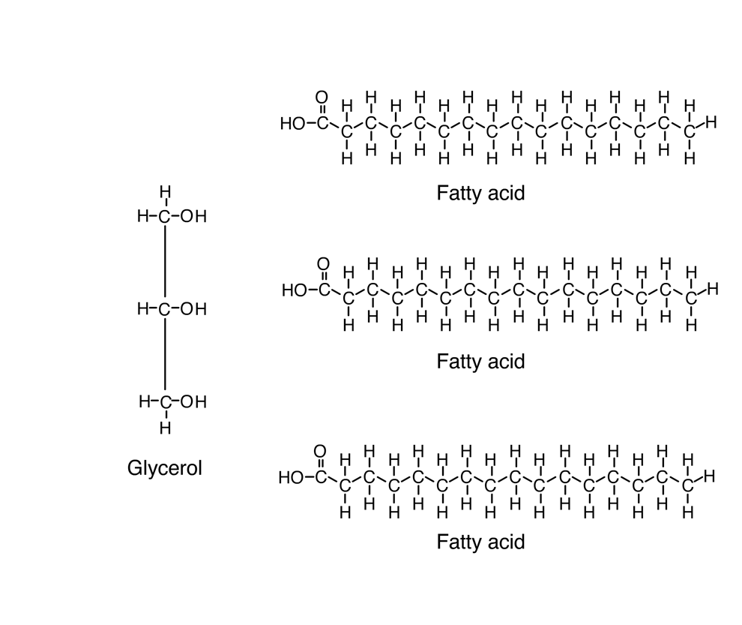

Animation: Fats
Right click on animation / Click play
© 2012 Pearson Education, Inc.
Notes:
61
Student Misconceptions and Concerns
1. Students may struggle with the concept that a pound of fat contains more than twice the calories of a pound of sugar. It might seem that a pound of food would potentially add on a pound of weight. Other students may have never understood the concept of calories in the diet, simply following general guidelines of avoiding fatty foods. Furthermore, fiber and water have no caloric value but add to the weight of food. Consider class discussions that explore student misconceptions about calories, body weight, and healthy diets.
2. Students might struggle to extrapolate the properties of lipids to their roles in an organism. Ducks float because their feathers repel water instead of attracting it. Hair on our heads remains flexible because of oils produced in our scalp. Examples such as these help connect the abstract properties of lipids to concrete examples in our world.
Teaching Tips
1. The text in Module 3.8 notes the common observation that vinegar and oil do not mix in this type of salad dressing. A simple demonstration can help make this point. In front of the class, mix together colored water and a yellow oil (corn or canola oil work well). Shake up the mixture and then watch as the two separate. (You may have a mixture already made ahead of time that remains separated; however, the dye may bleed between the oil and the water.) Placing the mixture on an overhead projector or other well-illuminated imaging device makes for a dramatic display of hydrophobic activity!
2. The text notes that a gram of fat stores more than twice the energy of a gram of polysaccharide, such as starch. You might elaborate with a simple calculation to demonstrate how a person’s body weight would vary if the energy stored in body fat were stored in carbohydrates instead. If a 100-kg man carried 25% body fat, he would have 25 kg of fat in his body. Fat stores about 2.25 times more energy per gram than carbohydrate. What would be the weight of the man if he stored the energy in the fat in the form of carbohydrate? (2.25 x 25 = 56.25 kg of carbohydrate + 75kg (nonfat body weight) = 131.25 kg, an increase of 31.25%)
3. Margarine in stores commonly comes in liquid squeeze containers, in tubs, and in sticks. These forms reflect increasing amounts of hydrogenation, gradually increasing the stiffness from a liquid, to a firmer spread, to a firm stick of margarine. As noted in the text, recent studies have suggested that unsaturated oils become increasingly unhealthy as they are hydrogenated. Students might therefore remember that as margarine products increase in stiffness, they generally become less healthy. Public attention to hydrogenation and the health risks of the resulting trans fats are causing changes in the use of products containing trans fats.

Slide 62
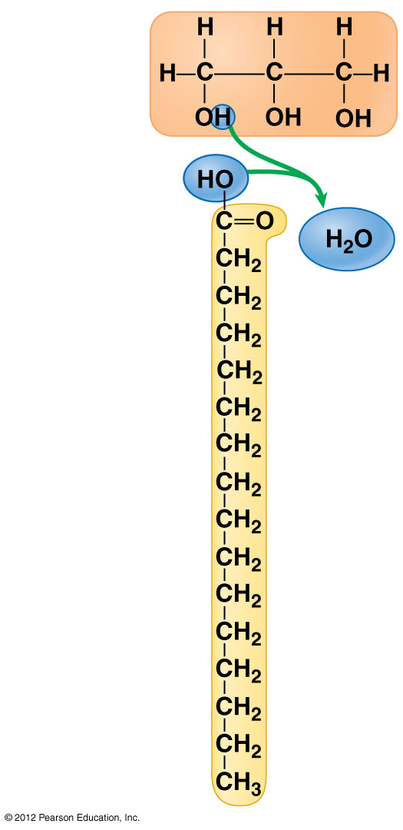
Figure 3.8B
Glycerol
Fatty acid
Notes:
62
Figure 3.8B A dehydration reaction linking a fatty acid molecule to a glycerol molecule

Slide 63
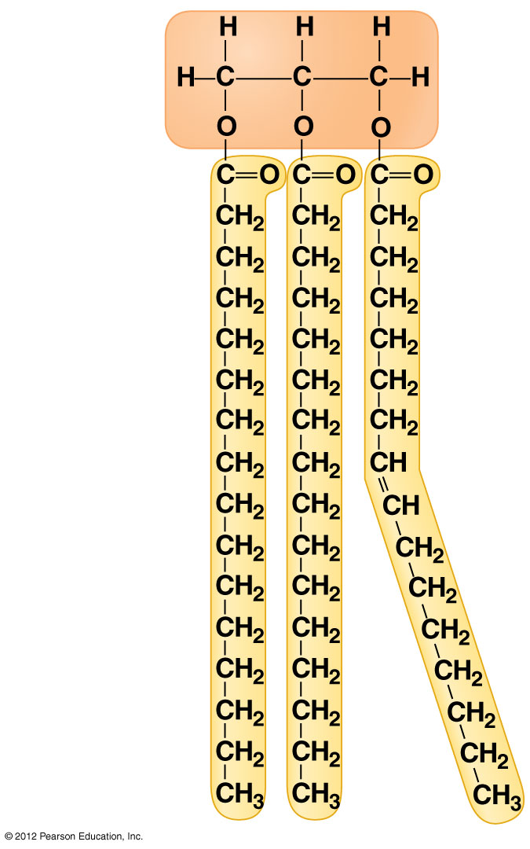
Figure 3.8C
Glycerol
Fatty acids
Notes:
63
Figure 3.8C A fat molecule (triglyceride) consisting of three fatty acids linked to glycerol

Slide 64
3.8 Fats are lipids that are mostly energy-storage molecules
Some fatty acids have double bonds, forming unsaturated fatty acids that
  have one less H at double bond of C,
  cause kinks in the C chain,
  Not solid at room temp-oil- plants-olive oil
Fatty acids filled up with H are saturated fatty acids-are solid at room temp meat-animal- butter
© 2012 Pearson Education, Inc.
Notes:
64
Student Misconceptions and Concerns
1. Students may struggle with the concept that a pound of fat contains more than twice the calories of a pound of sugar. It might seem that a pound of food would potentially add on a pound of weight. Other students may have never understood the concept of calories in the diet, simply following general guidelines of avoiding fatty foods. Furthermore, fiber and water have no caloric value but add to the weight of food. Consider class discussions that explore student misconceptions about calories, body weight, and healthy diets.
2. Students might struggle to extrapolate the properties of lipids to their roles in an organism. Ducks float because their feathers repel water instead of attracting it. Hair on our heads remains flexible because of oils produced in our scalp. Examples such as these help connect the abstract properties of lipids to concrete examples in our world.
Teaching Tips
1. The text in Module 3.8 notes the common observation that vinegar and oil do not mix in this type of salad dressing. A simple demonstration can help make this point. In front of the class, mix together colored water and a yellow oil (corn or canola oil work well). Shake up the mixture and then watch as the two separate. (You may have a mixture already made ahead of time that remains separated; however, the dye may bleed between the oil and the water.) Placing the mixture on an overhead projector or other well-illuminated imaging device makes for a dramatic display of hydrophobic activity!
2. The text notes that a gram of fat stores more than twice the energy of a gram of polysaccharide, such as starch. You might elaborate with a simple calculation to demonstrate how a person’s body weight would vary if the energy stored in body fat were stored in carbohydrates instead. If a 100-kg man carried 25% body fat, he would have 25 kg of fat in his body. Fat stores about 2.25 times more energy per gram than carbohydrate. What would be the weight of the man if he stored the energy in the fat in the form of carbohydrate? (2.25 x 25 = 56.25 kg of carbohydrate + 75kg (nonfat body weight) = 131.25 kg, an increase of 31.25%)
3. Margarine in stores commonly comes in liquid squeeze containers, in tubs, and in sticks. These forms reflect increasing amounts of hydrogenation, gradually increasing the stiffness from a liquid, to a firmer spread, to a firm stick of margarine. As noted in the text, recent studies have suggested that unsaturated oils become increasingly unhealthy as they are hydrogenated. Students might therefore remember that as margarine products increase in stiffness, they generally become less healthy. Public attention to hydrogenation and the health risks of the resulting trans fats are causing changes in the use of products containing trans fats.

Slide 65
3.8 Fats are lipids that are mostly energy-storage molecules
Hydrogenated vegetable oils are unsaturated fats with H added to make solid-margarine
This hydrogenation creates trans fats associated with health risks.
© 2012 Pearson Education, Inc.
Notes:
65
Student Misconceptions and Concerns
1. Students may struggle with the concept that a pound of fat contains more than twice the calories of a pound of sugar. It might seem that a pound of food would potentially add on a pound of weight. Other students may have never understood the concept of calories in the diet, simply following general guidelines of avoiding fatty foods. Furthermore, fiber and water have no caloric value but add to the weight of food. Consider class discussions that explore student misconceptions about calories, body weight, and healthy diets.
2. Students might struggle to extrapolate the properties of lipids to their roles in an organism. Ducks float because their feathers repel water instead of attracting it. Hair on our heads remains flexible because of oils produced in our scalp. Examples such as these help connect the abstract properties of lipids to concrete examples in our world.
Teaching Tips
1. The text in Module 3.8 notes the common observation that vinegar and oil do not mix in this type of salad dressing. A simple demonstration can help make this point. In front of the class, mix together colored water and a yellow oil (corn or canola oil work well). Shake up the mixture and then watch as the two separate. (You may have a mixture already made ahead of time that remains separated; however, the dye may bleed between the oil and the water.) Placing the mixture on an overhead projector or other well-illuminated imaging device makes for a dramatic display of hydrophobic activity!
2. The text notes that a gram of fat stores more than twice the energy of a gram of polysaccharide, such as starch. You might elaborate with a simple calculation to demonstrate how a person’s body weight would vary if the energy stored in body fat were stored in carbohydrates instead. If a 100-kg man carried 25% body fat, he would have 25 kg of fat in his body. Fat stores about 2.25 times more energy per gram than carbohydrate. What would be the weight of the man if he stored the energy in the fat in the form of carbohydrate? (2.25 x 25 = 56.25 kg of carbohydrate + 75kg (nonfat body weight) = 131.25 kg, an increase of 31.25%)
3. Margarine in stores commonly comes in liquid squeeze containers, in tubs, and in sticks. These forms reflect increasing amounts of hydrogenation, gradually increasing the stiffness from a liquid, to a firmer spread, to a firm stick of margarine. As noted in the text, recent studies have suggested that unsaturated oils become increasingly unhealthy as they are hydrogenated. Students might therefore remember that as margarine products increase in stiffness, they generally become less healthy. Public attention to hydrogenation and the health risks of the resulting trans fats are causing changes in the use of products containing trans fats.

Slide 66
3.9 Phospholipids and steroids are important lipids with a variety of functions
Phospholipids make up all cell membranes
  two fatty acids attached to glycerol & a phosphate group added
© 2012 Pearson Education, Inc.
Notes:
66
Student Misconceptions and Concerns
Students might struggle to extrapolate the properties of lipids to their roles in an organism. Ducks float because their feathers repel water instead of attracting it. Hair on our heads remains flexible because of oils produced in our scalp. Examples such as these help connect the abstract properties of lipids to concrete examples in our world.
Teaching Tips
Before explaining the properties of a polar molecule such as a phospholipid, have students predict the consequences of adding phospholipids to water. See if the class can generate the two most common configurations: (1) a lipid bilayer encircling water (water surrounding the bilayer and water contained internally) and (2) a micelle (polar heads in contact with water and hydrophobic tails clustered centrally).

Slide 67
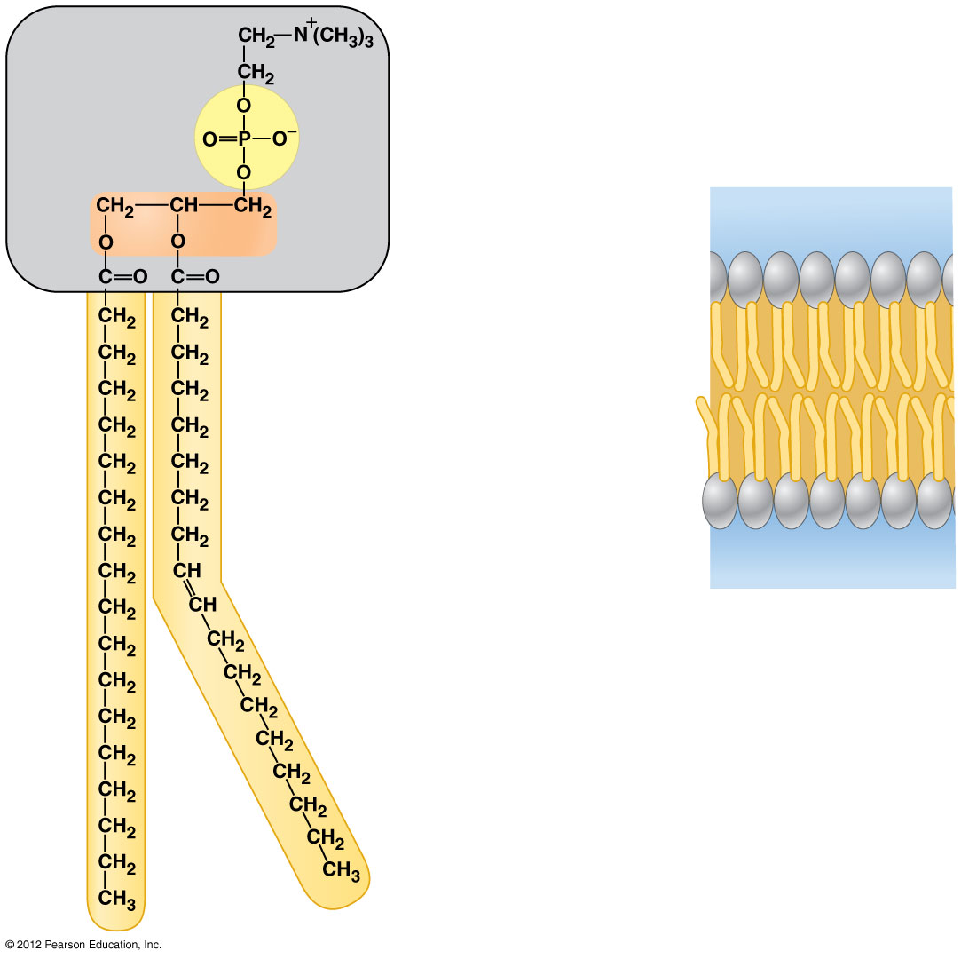
Figure 3.9A-B
Phosphate
group
Glycerol
Hydrophilic heads
Water
Hydrophobic tails
Symbol for phospholipid
Water
Notes:
67
Figure 3.9A-B Detail of a phospholipid membrane

Slide 68
3.9 Phospholipids and steroids are important lipids with a variety of functions
Phospholipids cluster into a bilayer-2 layers
The hydrophilic heads (glycerol & p) are in contact with H2O inside & outside cell env
The hydrophobic tails (f.a.) band in the center of the bilayer.
© 2012 Pearson Education, Inc.
Notes:
68
Student Misconceptions and Concerns
Students might struggle to extrapolate the properties of lipids to their roles in an organism. Ducks float because their feathers repel water instead of attracting it. Hair on our heads remains flexible because of oils produced in our scalp. Examples such as these help connect the abstract properties of lipids to concrete examples in our world.
Teaching Tips
Before explaining the properties of a polar molecule such as a phospholipid, have students predict the consequences of adding phospholipids to water. See if the class can generate the two most common configurations: (1) a lipid bilayer encircling water (water surrounding the bilayer and water contained internally) and (2) a micelle (polar heads in contact with water and hydrophobic tails clustered centrally).

Slide 69
3.9 Phospholipids and steroids are important lipids with a variety of functions
Steroids are lipids in which the carbon skeleton contains four fused rings.
Cholesterol is a
  common component in animal cell membranes
  starting material for making steroids, including sex hormones.
© 2012 Pearson Education, Inc.
Notes:
69
Student Misconceptions and Concerns
Students might struggle to extrapolate the properties of lipids to their roles in an organism. Ducks float because their feathers repel water instead of attracting it. Hair on our heads remains flexible because of oils produced in our scalp. Examples such as these help connect the abstract properties of lipids to concrete examples in our world.
Teaching Tips
Before explaining the properties of a polar molecule such as a phospholipid, have students predict the consequences of adding phospholipids to water. See if the class can generate the two most common configurations: (1) a lipid bilayer encircling water (water surrounding the bilayer and water contained internally) and (2) a micelle (polar heads in contact with water and hydrophobic tails clustered centrally).

Slide 70
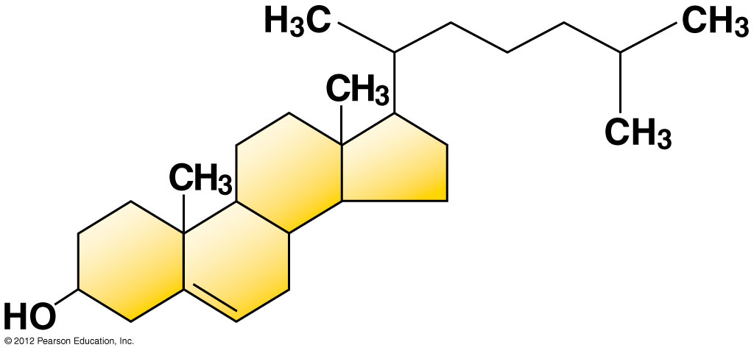
Figure 3.9C
Notes:
70
Figure 3.9C Cholesterol, a steroid

Slide 71
3.10 CONNECTION: Anabolic steroids pose health risks
Anabolic steroids
  are synthetic variants of testosterone,
  can cause a buildup of muscle and bone mass, and
  are often prescribed to treat general anemia and some diseases that destroy body muscle.
© 2012 Pearson Education, Inc.
Notes:
71
Student Misconceptions and Concerns
Students might struggle to extrapolate the properties of lipids to their roles in an organism. Ducks float because their feathers repel water instead of attracting it. Hair on our heads remains flexible because of oils produced in our scalp. Examples such as these help connect the abstract properties of lipids to concrete examples in our world.
Teaching Tips
The consequences of steroid abuse will likely be of great interest to your students. However, the reasons for the damaging consequences might not be immediately clear. As time permits, consider noting the diverse homeostatic mechanisms that normally regulate the traits affected by steroid abuse.

Slide 72
3.10 CONNECTION: Anabolic steroids pose health risks
Anabolic steroids are abused by some athletes with serious consequences, including
  violent mood swings,
  depression,
  liver damage,
  cancer,
  high cholesterol
  high blood pressure.
© 2012 Pearson Education, Inc.
Notes:
72
Student Misconceptions and Concerns
Students might struggle to extrapolate the properties of lipids to their roles in an organism. Ducks float because their feathers repel water instead of attracting it. Hair on our heads remains flexible because of oils produced in our scalp. Examples such as these help connect the abstract properties of lipids to concrete examples in our world.
Teaching Tips
The consequences of steroid abuse will likely be of great interest to your students. However, the reasons for the damaging consequences might not be immediately clear. As time permits, consider noting the diverse homeostatic mechanisms that normally regulate the traits affected by steroid abuse.

Slide 73
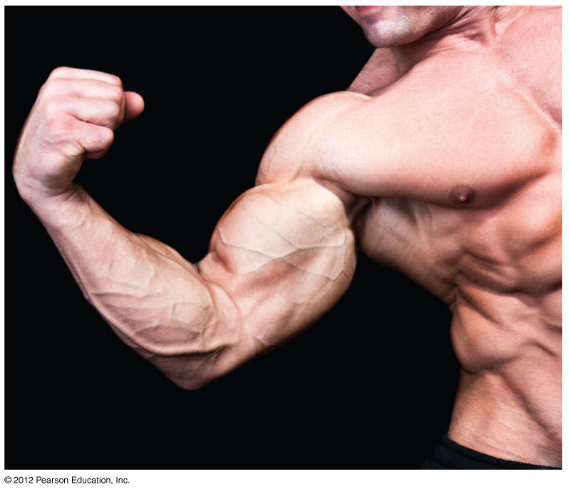
Figure 3.10
Notes:
73
Figure 3.10 Bodybuilder

Slide 74
PROTEINS
© 2012 Pearson Education, Inc.
Notes:
74

Slide 75
3.11 Proteins are made from amino acids linked by peptide bonds
Proteins are-C,H,O,N
  growth & repair of cells
  examples are hormones, enzymes, antibodies
Proteins are made from 20 different amino acid monomers
© 2012 Pearson Education, Inc.
Notes:
75
Teaching Tips
1. Many analogies help students appreciate the diversity of proteins that can be made from just 20 amino acids. The authors note that our language uses combinations of 26 letters to form words. Proteins are much longer “words,” creating even more diversity. Another analogy is to trains. This builds upon the earlier analogy when polymers were introduced. Imagine making different trains about 100 cars long, using any combination of 20 types of railroad cars. Mathematically, the number of possible trains is 20¹⁰⁰, a number beyond imagination.
2. The authors note that the difference between a polypeptide and a protein is analogous to the relationship between a long strand of yarn and a sweater knitted from yarn. Proteins are clearly more complex!

Slide 76
3.11 Proteins are made from amino acids linked by peptide bonds
Amino acids have
  an amino group (NH3)
  a carboxyl group (COOH) (which makes it an acid).
Also bonded to the central carbon is
  a hydrogen atom and
  a chemical group we call R, makes each aa different
© 2012 Pearson Education, Inc.
Notes:
76
Teaching Tips
1. Many analogies help students appreciate the diversity of proteins that can be made from just 20 amino acids. The authors note that our language uses combinations of 26 letters to form words. Proteins are much longer “words,” creating even more diversity. Another analogy is to trains. This builds upon the earlier analogy when polymers were introduced. Imagine making different trains about 100 cars long, using any combination of 20 types of railroad cars. Mathematically, the number of possible trains is 20¹⁰⁰, a number beyond imagination.
2. The authors note that the difference between a polypeptide and a protein is analogous to the relationship between a long strand of yarn and a sweater knitted from yarn. Proteins are clearly more complex!

Slide 77
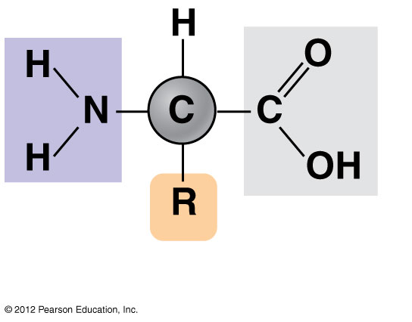
Amino acid
Amino
group
Carboxyl
group
Notes:
77
Figure 3.11A General structure of an amino acid

Slide 78
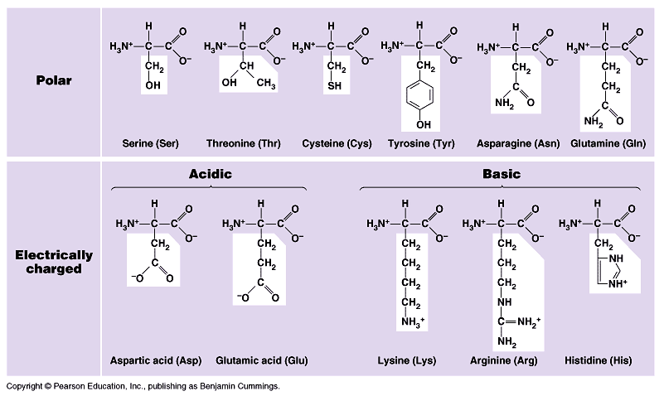

Slide 79
3.11 Proteins are made from amino acids linked by peptide bonds
Amino acid monomers link by _______
aa + aa = peptide bond
2=dipeptide
Many aa= polypeptide.
What’s the opposite reaction of tearing a protein apart called ______
© 2012 Pearson Education, Inc.
Notes:
79
Teaching Tips
1. Many analogies help students appreciate the diversity of proteins that can be made from just 20 amino acids. The authors note that our language uses combinations of 26 letters to form words. Proteins are much longer “words,” creating even more diversity. Another analogy is to trains. This builds upon the earlier analogy when polymers were introduced. Imagine making different trains about 100 cars long, using any combination of 20 types of railroad cars. Mathematically, the number of possible trains is 20¹⁰⁰, a number beyond imagination.
2. The authors note that the difference between a polypeptide and a protein is analogous to the relationship between a long strand of yarn and a sweater knitted from yarn. Proteins are clearly more complex!

Slide 80
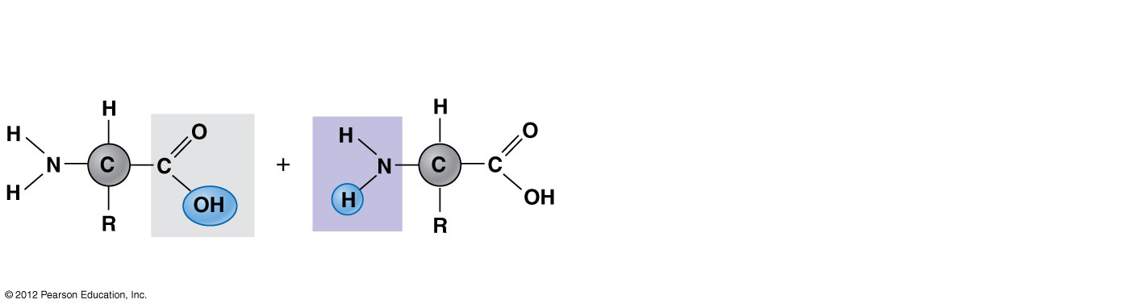
Figure 3.11C_s1
Carboxyl
group
Amino
group
Amino acid
Amino acid
Notes:
80
Figure 3.11C_s1 Peptide bond formation (step 1)

Slide 81
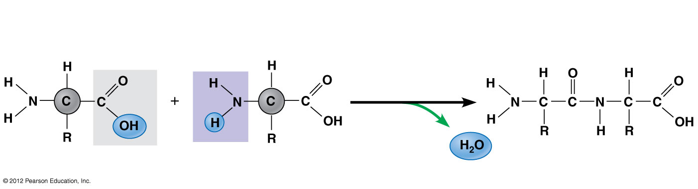
Figure 3.11C_s2
Peptide
bond
Carboxyl
group
Amino
group
Dehydration
reaction
Amino acid
Amino acid
Dipeptide
Notes:
81
Figure 3.11C_s2 Peptide bond formation (step 2)

Slide 82
3.12 A protein’s specific shape determines its function
Probably the most important role for proteins is as enzymes, proteins that
  serve as catalysts (cause reactions) regulate the chemical reactions within cells.
  E + S ES E + P
© 2012 Pearson Education, Inc.
Notes:
82
Student Misconceptions and Concerns
The functional significance of protein shape is an abstract molecular example of form and function relationships, which might be new to some students. The binding of an enzyme to its substrate is a type of molecular handshake, which permits specific interactions. To help students think about form and function relationships, share some concrete analogies in their lives—perhaps flathead and Phillips screwdrivers that match the proper type of screws or the fit of a hand into a glove.
Teaching Tips
Most cooking results in changes in the texture and color of food. The brown color of a cooked steak is the product of the denaturation of proteins. Fixatives such as formalin also denature proteins and cause color changes. Students who have dissected vertebrates will realize that the brown color of the muscles makes it look as if the animal has been cooked.

Slide 83
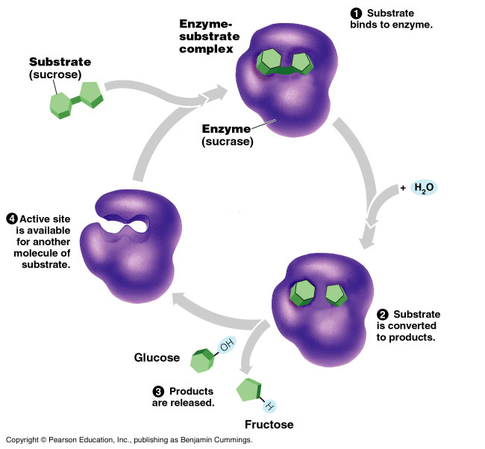

Slide 84
3.12 A protein’s specific shape determines its function
Other jobs of proteins
  Structural proteins provide the structure of body parts.
  Contractile proteins are found within muscle.
  Defensive proteins - antibodies of the immune system.
  Signal proteins are hormones and other chemical messengers.
  Receptor proteins transmit signals into cells-cell surface
  Transport proteins carry oxygen.
  Storage proteins serve as a source of amino acids for developing embryos.
© 2012 Pearson Education, Inc.
Notes:
84
Student Misconceptions and Concerns
The functional significance of protein shape is an abstract molecular example of form and function relationships, which might be new to some students. The binding of an enzyme to its substrate is a type of molecular handshake, which permits specific interactions. To help students think about form and function relationships, share some concrete analogies in their lives—perhaps flathead and Phillips screwdrivers that match the proper type of screws or the fit of a hand into a glove.
Teaching Tips
Most cooking results in changes in the texture and color of food. The brown color of a cooked steak is the product of the denaturation of proteins. Fixatives such as formalin also denature proteins and cause color changes. Students who have dissected vertebrates will realize that the brown color of the muscles makes it look as if the animal has been cooked.

Slide 85
NUCLEIC ACIDS
© 2012 Pearson Education, Inc.
Notes:
85

Slide 86
3.14 DNA and RNA are the two types of nucleic acids
Genes make protein
Genes consist of DNA(deoxyribonucleic acid), a type of nucleic acid.
DNA is inherited from an organism’s parents.
DNA provides directions for its own replication- as in cell division
DNA directs the synthesis of proteins.
© 2012 Pearson Education, Inc.
Notes:
86
Student Misconceptions and Concerns
Module 3.14 is the first time the authors present the concept of transcription and translation, discussed extensively in later chapters. The basic conceptual flow of information from DNA to RNA to proteins is essential to these later discussions.
Teaching Tips
The “NA” in the acronyms DNA and RNA stands for “Nucleic acid.” Students often do not make this association without assistance.

Slide 87
3.14 DNA and RNA are the two types of nucleic acids
DNA does not build proteins directly.
DNA makes ribonucleic acid (RNA).
  DNA is transcribed into RNA.
  RNA is translated into proteins.
© 2012 Pearson Education, Inc.
Notes:
87
Student Misconceptions and Concerns
Module 3.14 is the first time the authors present the concept of transcription and translation, discussed extensively in later chapters. The basic conceptual flow of information from DNA to RNA to proteins is essential to these later discussions.
Teaching Tips
The “NA” in the acronyms DNA and RNA stands for “Nucleic acid.” Students often do not make this association without assistance.

Slide 88
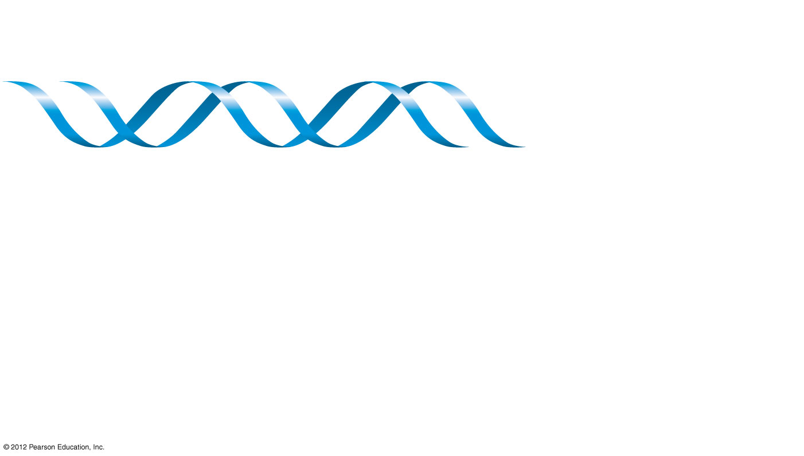
Figure 3.14_s1
Gene
DNA
Notes:
88
Figure 3.14_s1 The flow of genetic information in the building of a protein (step 1)

Slide 89
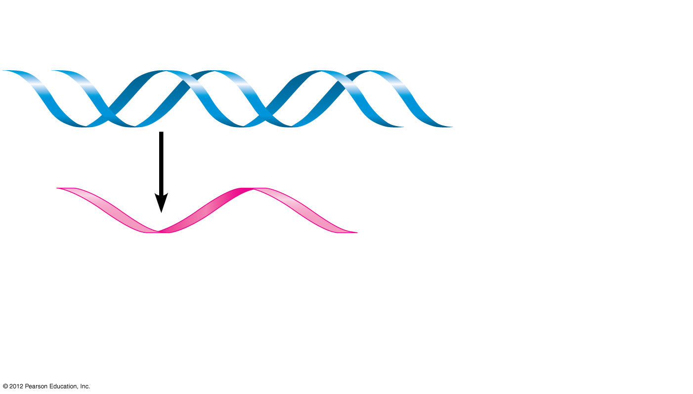
Figure 3.14_s2
Gene
DNA
Transcription
Nucleic acids
RNA
Notes:
89
Figure 3.14_s2 The flow of genetic information in the building of a protein (step 2)

Slide 90
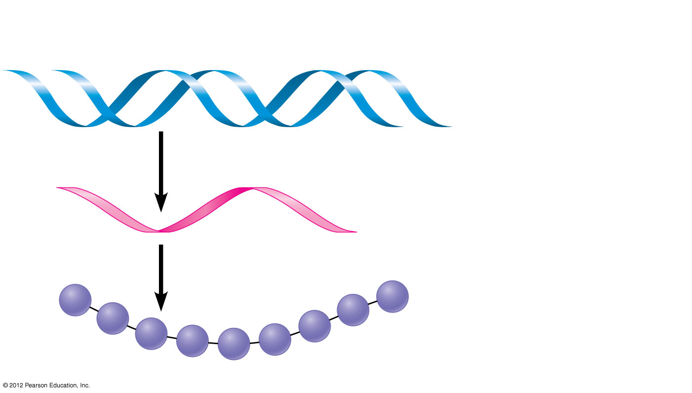
Figure 3.14_s3
Gene
DNA
Transcription
Nucleic acids
RNA
Translation
Protein
Amino
acid
Notes:
90
Figure 3.14_s3 The flow of genetic information in the building of a protein (step 3)

Slide 91
Lab tests
Carbohydrates
  Benedicts solution-monosaccharides
  Iodine-polysaccharides
  Fats
  sudan IV
  brown bag
  Proteins
  biurets
  nitric acid
Starts blue-add heat- orange
Rust-no heat-blue/black
Red droplets form
Rub sample on bag-translucent spot
Blue-violet
Clear-yellow

