Slide 1
Chapter 10
Place and Development of Channel Systems
Copyright © 2014 by The McGraw-Hill Companies, Inc. All rights reserved
Notes:
For use only with Perreault/Cannon/McCarthy or Perreault/McCarthy texts.
© 2014 McGraw-Hill Companies, Inc. McGraw-Hill/Irwin
CHAPTER TEN
Lecture Notes for
Basic Marketing 19e

Slide 2
At the end of this presentation, you should be able to:
10-2
Understand what product classes suggest about Place objectives.
Understand why some firms use direct channel systems while others work with intermediaries and indirect systems.
Understand how and why marketing specialists develop to make channel systems more effective.
Understand how to develop cooperative relationships and avoid conflict in channel systems.
Know how channel members in vertical marketing systems shift and share functions to meet customer needs.
Notes:
At the end of this presentation, you should:
1. Understand what product classes suggest about Place objectives.
2. Understand why some firms use direct channel systems while others work with intermediaries and indirect systems.
3. Understand how and why marketing specialists develop to make channel systems more effective.
4. Understand how to develop cooperative relationships and avoid conflict in channel systems.
5. Know how channel members in vertical marketing systems shift and share functions to meet customer needs.
This slide refers to material on p. 254.
2

Slide 3
At the end of this presentation, you should be able to:
10-3
Understand the differences between intensive, selective, and exclusive distribution.
Know how multichannel distribution and reverse channels operate.
Know the main approaches firms use to reach customers in international markets.
Understand important new terms.
Notes:
At the end of this presentation, you should be able to:
Understand the differences between intensive, selective, and exclusive distribution.
Know how multichannel distribution and reverse channels operate.
Know the main approaches firms use to reach customers in international markets.
Understand important new terms.
This slide refers to material on p. 254.
3

Slide 4
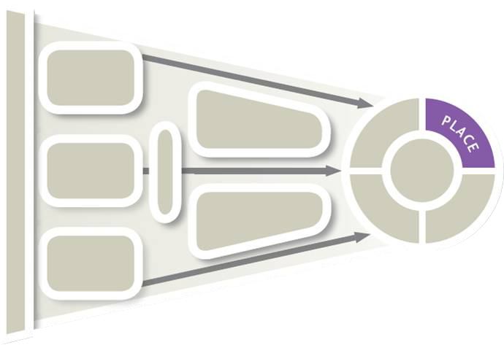
Marketing Strategy Planning Process
10-4
Notes:
→ In this presentation we will look more closely at one of the four Ps – Place.
When managers think about Place, they are concerned with making goods and services available in the right quantities, right locations, when customers want them.
This slide refers to material on p. 255.
4

Slide 5
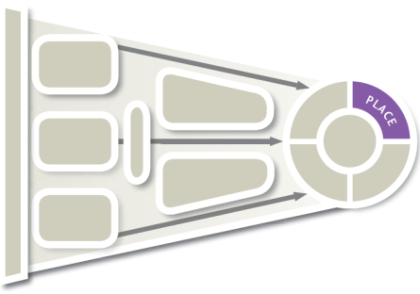
Marketing Strategy Planning Decisions for Place (Exhibit 10-1)
10-5
CH 10: Place and Development of Channel Systems
CH 11: Distribution Customer Service & Logistics
CH 12: Retailers, Wholesalers & Their Strategy Planning
Place objectives
Direct vs. indirect
Channel specialists
Channel relationships
Market exposure
Notes:
Summary Overview
Place is the part of the marketing mix that deals with making goods and services available in the right quantities and locations when customers want them.
Key Issues
Channel of distribution: any series of firms or individuals participating in the flow of products from producer to final user or consumer. Among the key strategy decision areas in distribution are:
The organization must develop objectives for Place.
There must be a choice of the type of channels, such as direct-to-customer, or indirect—involving intermediaries.
If the chosen channel is indirect, the marketer must determine the degree of market exposure desired.
In addition, the marketer must decide on the types of intermediaries needed, how many of them are needed, and how to manage them.
The type of channel is also related to the level of customer service required by the target customer.
Finally, physical distribution activities must be developed and managed in order to achieve the distribution objectives.
Discussion Question: It is often said that unlike the other elements of the marketing mix, distribution is mostly invisible to consumers unless something goes wrong. What does this statement mean?
This slide refers to material on pp. 254-255.
→ Indicates place where slide “builds” to include the corresponding point (upon mouse click).
5

Slide 6
Place Decisions Are Guided by “Ideal” Place Objectives
10-6
Product
Classes
Suggest Place
Objectives
Key
Issues
Place
System
Is Not
Automatic
Place Decisions
Have
Long-run Effects
Notes:
Summary Overview
Customers may have different needs with respect to time, place, and possession as they make different purchases.
Key Issues
Product classes suggest place objectives.
Different levels of customer urgency, convenience, and product information needs naturally suggest different place needs as well.
Discussion Question: Think about the differences among convenience, shopping, and specialty goods. How would the distribution objectives differ for each product type? (Hint: Refer to Exhibit 8-6.)
→ The place system is not automatic.
More than one place arrangement may be appropriate or needed to reach different target markets effectively.
→ Place decisions have long-run effects, and are usually harder to change than those made for the other components of the mix.
In part, this is because other firms in the channel of distribution may carry out much of the place strategy.
Gaining access to desired retail space or outlets typically involves a great deal of time and then is bound by contractual arrangements.
This slide refers to material on pp. 255-256.
→ Indicates place where slide “builds” to include the corresponding point (upon mouse click).
6

Slide 7

Channel System May Be
Direct or Indirect
10-7
Greater Control
Some
Reasons
For Choosing
Direct Channels
Lower Cost
Internet Makes Direct Distribution Easier
Direct Contact with Customers
Suitable Intermediaries
Not Available
Notes:
Summary Overview
Marketing channels can be direct or indirect. Direct contact with customers helps a company keep abreast of market changes. Often, this is a preferred way of handling place decisions. However, some products require the work of specialists to match producer output to user needs.
Key Issues
Why a firm might want to use direct distribution.
One reason is to get better control over the whole marketing job .
→ They might be able to serve target customers at a lower cost. Also, wholesalers and retailers with different objectives may not meet the firm's need.
The Internet makes direct distribution easier for many firms.
Discussion Question: If direct distribution is so attractive because of the wide reach of the Internet, why have so many dot-com direct distributors failed?
→ A firm having direct contact with customers is more aware of changes in customer attitudes.
→ Making adjustments is often easier and faster because intermediaries are not involved.
→ Sometimes, suitable intermediaries are not available or will not cooperate.
This slide refers to material on pp. 256-257.
→ Indicates place where slide “builds” to include the corresponding point (upon mouse click).
7

Slide 8

Direct Channels Are Common with Business Customers and Services
10-8
Notes:
Summary Overview
Many business products are sold direct-to-customer. For example, robotic solution, featured in this ad for Fanuc Robotics, might be sold direct.
Key Issues
In business markets, there are fewer transactions, orders tend to be larger, and customers tend to be concentrated in geographic areas.
Once relationships are established, e-commerce systems can handle routine replenishment.
Service firms also frequently use direct channels. However, some producers use intermediaries to provide after-sale services.
Some consumer products are sold direct, such as vacuum cleaners, cosmetics, and household products.
Direct sales of consumer products have grown in popularity in many international markets.
Discussion Question: Mary Kay cosmetics are typically sold through independent distributors who are not employees of Mary Kay Cosmetics, Inc. These independent distributors purchase products from Mary Kay and resell them. Therefore, is Mary Kay a true direct channel?
Direct marketing: direct communication between a seller and an individual using a promotion method other than face-to-face selling.
Direct marketing is more concerned with promotion than it is with distribution.
This slide relates to material on pp. 258-259.

Slide 9
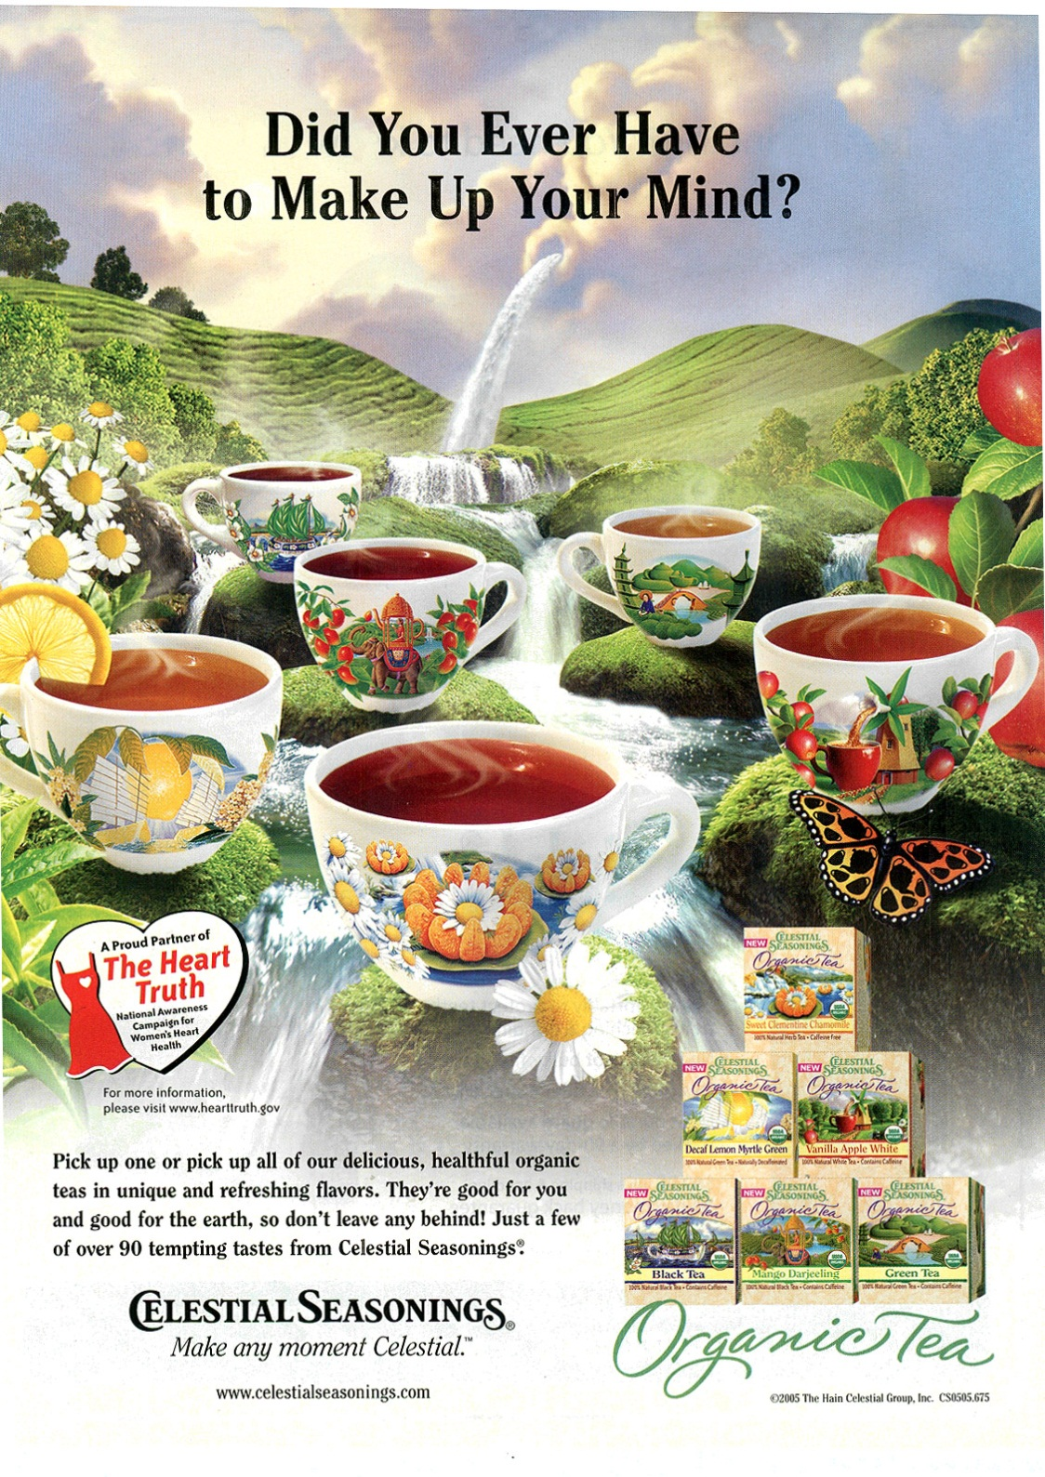
When Indirect Channels Are Best
10-9
Notes:
Summary Overview
Even if a producer would like to handle the whole distribution job, sometimes it is simply not feasible.
Key Issues
Consumers want convenience.
For example, as illustrated by this ad for Celestial Seasonings – Organic Tea, consumers may be spread over a wide area and prefer to shop at a specific place.
Some consumers see department or retail stores as THE place to shop for consumer products, and they will buy only those brands carried by their favorite store.
Convenience is a major reason why so many consumer product producers rely on indirect channels.
Discussion Question: Would Celestial Seasonings ever want to use direct distribution to final consumers? What things would the company consider in deciding whether to establish a direct or indirect linkage with a final consumer?
This slide relates to material on pp. 259.

Slide 10
Checking Your Knowledge
10-10
Andrea’s Kitchen is a catering business that operates by means of its own website. Customers order party platters, pastries, and other foods that the company makes to order. The items are then vacuum-packed in dry ice and shipped to the customer’s address via overnight delivery. Andrea’s Kitchen is part of a(n):
A. indirect channel.
B. dual channel.
C. intermediary channel.
D. direct channel.
E. traditional channel.
Notes:
Answer: D
Checking your knowledge (answer explanation):
Web-based e-commerce systems give many firms direct access to customers. This website allows customers to place orders and provide information so that Andrea’s Kitchen can ship directly to them. Andrea’s Kitchen is an example of a direct channel. The best answer selection is ‘D’.
This slide relates to material on pp. 257.

Slide 11
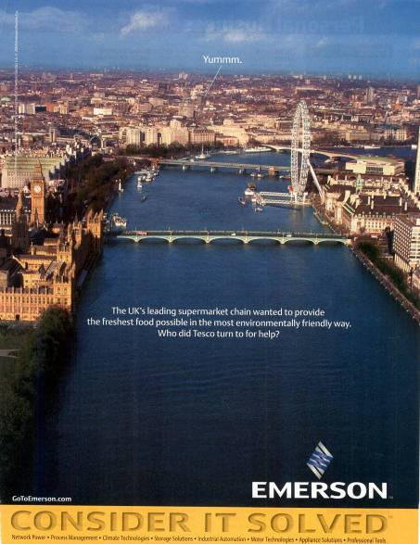
Channel Specialists May Reduce Discrepancies and Separations
10-11
Notes:
Summary Overview
The assortment and quantity of products consumers desire may be different than the assortment and quantity of products offered by producers. Considerable distances may separate producers and consumers. Customers may not be adequately informed about product choices. Channel specialists have evolved to deal with these market separations and discrepancies.
Key Issues
Intermediaries may supply needed information to consumers and bring buyers together with sellers.
Intermediaries can take advantage of their understanding of customers to predict consumer needs and develop accurate demand forecasts.
This information can reduce channel costs, smooth out production runs, and permit easier access to international markets.
Intermediaries can help to rectify discrepancies of quantity and assortment.
Discrepancy of quantity: the difference between the quantity of products it is economical for a producer to make and the quantity that consumers or users really want.
As shown in this ad, Tesco (a UK supermarket) utilizes Emerson to deliver “the freshest foods available” to its customers. Emerson serves as an intermediary assisting Tesco with adjusting discrepancies of quantity and assortment.
Discussion Question: Other than a grocery store, can you provide examples of other intermediaries that deal with discrepancy of quantity? How do they do it?
This slide relates to material on pp. 260-261.

Slide 12
A Discrepancy of Assortment
10-12
Skiing?
Skis, Poles
Goggles
Wax
Sporting Goods Retailer
Notes:
Summary Overview
A discrepancy of assortment is the difference between the lines of products a producer typically makes and the assortments final consumers or users want. Like discrepancies of quantity, intermediaries are equipped to deal with discrepancies of assortment.
Key Issues
Wholesalers and retailers adjust this discrepancy by bringing assortments of different types to consumers.
The need to resolve discrepancies of assortment can lead to a complex web of relationships involving many firms.
Discussion Question: Some retailers have broadened their assortments in recent years, while others have deepened their assortments. For example, Walgreen’s is more than just a drugstore in that it carries many lines of products. On the other hand, Circuit City has abandoned large home appliances, such as refrigerators and dishwashers, to concentrate on offering a deeper selection of electronics. How can you explain these different strategies in terms of discrepancies of assortment?
This slide relates to material on pp. 261.

Slide 13
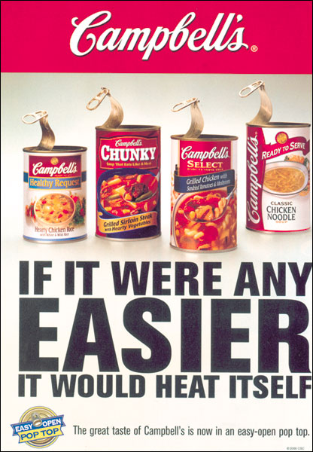
A Discrepancy of Assortment
10-13
Notes:
Summary Overview
A discrepancy of assortment is the difference between the lines of products a producer typically makes and the assortments final consumers or users want. Like discrepancies of quantity, intermediaries are equipped to deal with discrepancies of assortment.
Key Issues
For example, in this ad, Campbell’s specializes in producing soup as its major product line.
However, consumers purchasing food items typically want to buy other things besides soup during a trip to the grocery store.
Food wholesalers and retailers adjust this discrepancy by bringing assortments of different types of foods to consumers.
The need to resolve discrepancies of assortment can lead to a complex web of relationships involving many firms.
Discussion Question: Some retailers have broadened their assortments in recent years, while others have deepened their assortments. For example, Walgreen’s is more than just a drugstore in that it carries many lines of products. On the other hand, Circuit City has abandoned large home appliances, such as refrigerators and dishwashers, to concentrate on offering a deeper selection of electronics. How can you explain these different strategies in terms of discrepancies of assortment?
This slide relates to material on pp. 261.

Slide 14
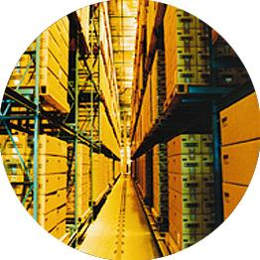
Channel Specialists Adjust Discrepancies with Regrouping Activities
10-14
Accumulating
Bulk-Breaking
Assorting
Sorting
Notes:
Summary Overview
Regrouping activities are activities that adjust discrepancies in quantity or assortment.
Key Issues
Channel specialists adjust quantity discrepancies by accumulating and bulk-breaking.
Accumulating: collecting products from many small producers.
Bulk-breaking: dividing larger quantities into smaller quantities. Several levels of a channel may be involved.
Discussion Question: When consumers purchase household products from a warehouse store, such as Costco or Sam’s Club, they often have to buy larger quantities than they would normally buy for their immediate use. How are they compensated for taking on some of the bulk-breaking that a traditional retailer might provide?
Wholesalers and retailers adjust assortment discrepancies by sorting and assorting.
→ Sorting: separating products into the grades and qualities desired by consumers.
→ Assorting: putting together a variety of products to give a target market what it wants.
Even without a physical form, distribution remains an important marketing strategy decision for firms with digital products.
It is important for marketers to watch for changes needed in assortments and quantities as consumer needs change, or as the marketing environment shifts.
This slide refers to material on pp. 261-262.
→ Indicates place where slide “builds” to include the corresponding point (upon mouse click).

Slide 15
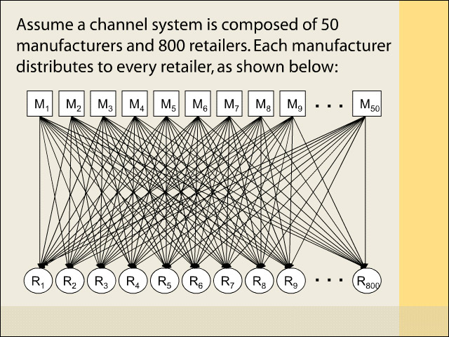
Interactive Exercise: Channel Efficiency
10-15
Notes:
The objective of this exercise is to show a graphical example that indicates how adding a wholesale level can, in fact, reduce total transaction costs in a channel of distribution. The exercise contains a hypothetical example, assuming that there are 50 manufacturers and 800 retailers in a channel system. The total transaction cost in a channel system with no wholesale level is computed and compared to the total transaction costs in channels that contain one and two wholesalers, respectively.
Working through the exercise, the students will learn how the number of transactions and the total cost of transactions go down when a wholesaler is added to the channel system.
For complete information and suggestions on using this Interactive Exercise, please refer to the “Notes on the Interactive Exercise” section for this chapter in the Multimedia Lecture Support Package to Accompany Basic Marketing. That same information is available as a Word document in the assets folder for the PowerPoint file.
This slide refers to material on pp. 261-262.

Slide 16
Channel Relationship Must Be Managed
10-16
Choosing the Type of Relationship
Key
Issues In
Channel
Management
Whole-Channel Product-Market Commitment
Conflict Handling
Role of Channel Captain
Notes:
Summary Overview
Just as intermediaries are specialists in certain areas, they are also separate businesses that may not have the same objectives as the marketer of the product.
Key Issues
The marketing manager must choose the type of channel system to join or develop.
The whole channel should have a product-market commitment. All members must focus on the same target market at the end of the channel and share the various marketing functions in appropriate ways.
Discussion Question: How might a producer generate a common product-market commitment among all channel members?
Traditional channel system: members make little or no effort to cooperate with each other.
→ Channel specialization can lead to conflict that gets in the way.
Vertical conflict is conflict between two firms at different levels in the channel of distribution, as between a producer and wholesaler.
Horizontal conflict occurs between two firms at the same level in the channel of distribution, such as two retailers.
Managing channel conflict: Some level of conflict may be inevitable—or even useful if that is what it takes for customers at the end of the channel to receive better value.
Most marketing managers try to avoid conflicts that harm relationships with channel partners.
→ Channel captain: a manager who guides channel relationships. The captain helps direct the activities of the whole channel and tries to avoid or resolve channel conflicts.
This slide refers to material on pp. 262-264.
→ Indicates place where slide “builds” to include the corresponding point (upon mouse click).

Slide 17
Producers or Intermediaries May Be Channel Captains (Exhibit 10-2)
10-17
A. How strategy decisions are handled
in a producer-led channel
B. How strategy decisions are handled
in a retailer-led channel
Producer’s
part of
the job
Intermediary’s
part of
the job
Producer’s
part of
the job
Retailer’s
part of
the job
Place
Product
Product
Place
Customers
Customers
Price
Price
Promotion
Promotion
Notes:
Summary Overview
Although it is often the case that producers assume leadership positions in channels of distribution, powerful intermediaries may also serve as channel captains. In recent years, it has become more popular for intermediaries to take on this role.
Key Issues
This exhibit illustrates an example of how a producer-led channel might operate.
The producer develops the product and the price structure, but relies mainly on intermediaries to help with distribution and promotion.
→ Wholesalers or retailers might also be channel captains, either because of their size or their proximity to consumers.
In this case, the intermediary takes on all of the place and promotion functions, and part of the pricing and product functions.
A retailer or wholesaler might get involved with the product and pricing by developing dealer brands.
When intermediaries are large and wield channel power because of their size, they can influence the structure and processes in the channel.
Large retailers buy in such large volume from producers that they often bypass wholesalers and deal with the producers directly.
They also secure volume discounts from producers.
This slide refers to material on pp. 265-266.

Slide 18
Vertical Marketing Systems Focus on Final Customers (Exhibit 10-3)
10-18
Characteristics
Type of channel
Traditional
Vertical marketing systems
Administered
Contractual
Corporate
Amount of cooperation
Little or
none
Some to good
Fairly good
to good
Complete
Control maintained by
None
Economic power and leadership
Contracts
One company ownership
Examples
Typical “inde-pendents”
General Electric
McDonald’s
Florsheim
Notes:
Summary Overview
Compared to a traditional channel, in a vertical marketing system, the whole channel focuses on the same target market at the end of the channel.
Key Issues
→ Corporate channel system: characterized by the ownership of each level of the channel by the same corporation, giving the appearance that the firm is going direct.
Vertical integration -- the buying of other firms by one member of the channel. Any level of the channel may become the acquiring corporation.
Administered channel system: channel members informally agree to cooperate with each other. Such agreements typically cover procedures to routinize ordering, standardize accounting, and coordinate promotion efforts.
Discussion Question: Do you think there might be the potential for a channel captain to emerge in an administered system? Why or why not?
Contractual channel system: channel members formally agree to cooperate via contracts. Many popular franchise systems are examples of contractual channels.
Vertical marketing systems are a dominant force in the marketplace. In fact, they capture a majority of retail sales and should increase their share in the future.
This slide refers to material on pp. 266-268.
→ Indicates place where slide “builds” to include the corresponding point (upon mouse click).

Slide 19
Channel Relationships
10-19
Notes:
This video clip highlights the concepts of channel captain and administered channel system with an example from Briggs & Stratton.
(video clip length 2:18)
Video Operation:
Use the onscreen player controls to operate the video.
To view the video at Full Screen, right-click the video and choose Full Screen. To go back to your presentation you can either hit the Escape key, right-click on the video and uncheck Full Screen, or type Alt+Enter. You can do this at anytime during the video playback.
Under certain circumstances, the video may not fill the video player window. To restore, right-click the video player object and select Zoom 200%.
The videos will only play in Slide Show View. Macros must be enabled in order to play the videos from within PowerPoint.
This slide refers to material on p. 267.

Slide 20
Checking Your Knowledge
10-20
Dave Tindall runs “Maid to Perfection,” a residential and business cleaning service. He paid a fee to be part of the “Maid to Perfection” system of local operators. The written agreement gives him the right to use the company name and operations manual, and the agreement promises Dave that there will not be another “Maid to Perfection” operator in his immediate area. He operates as a semi-independent entrepreneur, but is still part of a national organization. Dave is part of a(n):
A. traditional channel.
B. contractual channel.
C. corporate channel.
D. administered channel.
E. dual channel.
Notes:
Answer: B
Checking your knowledge answer explanation:
In contractual channel systems, channel members agree by contract to cooperate with each other. Dave owns a franchise of “Maid to Perfection.” Most franchise systems are examples of contractual channels. The best answer selection is ‘B’.
This slide relates to material on pp. 267.

Slide 21
The Best Channel System Should Achieve Ideal Market Exposure
10-21
Market
Exposure
Strategies
Intensive
Selective
= number of
outlets
Exclusive
Notes:
Summary Overview
Ideal market exposure makes a product available widely enough to satisfy target customers’ needs but not exceed them. Too much exposure increases marketing costs and such inefficiency is detrimental to both the firm and the customers who ultimately pay more for products.
Key Issues
Intensive distribution: selling the product through all responsible and suitable wholesalers and retailers who will stock and/or sell the product.
Intensive distribution means “sell it where they buy it.”
This exposure is particularly appropriate for convenience products, because consumers do not want to expend a lot of effort to find them.
Selective distribution: selling only through those intermediaries who will give the product special attention.
Selective distribution means “sell it where it sells best.”
This exposure is typically associated with shopping products.
Selective distribution can reduce costs and get better partners.
Selective distribution gets special effort from channel members.
Selective distribution often moves to intensive as the market grows.
Exclusive distribution means selling through only one intermediary in a particular geographic area.
Exclusive distribution sometimes makes sense, especially when dealing with specialty products.
Discussion Question: How is the image of a product related to its ideal market exposure?
This slide refers to material on pp. 268-269.
→ Indicates place where slide “builds” to include the corresponding point (upon mouse click).

Slide 22
Intensive Distribution
10-22
Notes:
Intensive distribution is commonly used for convenience products, such as the Philips light bulbs shown in this ad.
Video Operation:
Use the onscreen player controls to operate the video.
To view the video at Full Screen, right-click the video and choose Full Screen. To go back to your presentation you can either hit the Escape key, right-click on the video and uncheck Full Screen, or type Alt+Enter. You can do this at anytime during the video playback.
Under certain circumstances, the video may not fill the video player window. To restore, right-click the video player object and select Zoom 200%.
The videos will only play in Slide Show View. Macros must be enabled in order to play the videos from within PowerPoint.
This slide refers to material on p. 268.

Slide 23
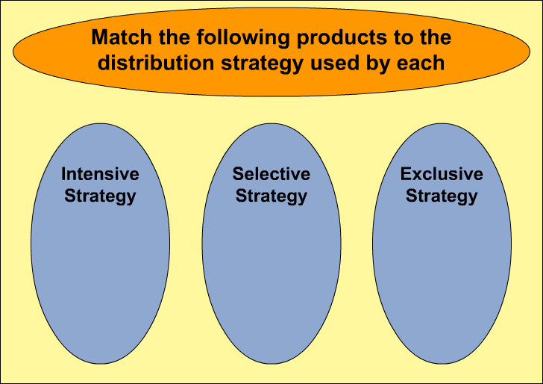
Interactive Exercise: Ideal Market Exposure
10-23
Notes:
The purpose of this exercise is to help students relate their understanding of the different levels of distribution intensity to the distribution strategies employed in the marketing of consumer goods and business products. Three consumer goods and three business products are listed; students are challenged to match each product to the distribution strategy that each exemplifies.
For complete information and suggestions on using this Interactive Exercise, please refer to the “Notes on the Interactive Exercise” section for this chapter in the Multimedia Lecture Support Package to Accompany Basic Marketing. That same information is available as a Word document in the assets folder for the PowerPoint file.
This slide refers to material on pp. 268-269.

Slide 24
Checking Your Knowledge
10-24
Chocolate Dreams is a manufacturer of expensive, high- quality, hand-made “old style” candies that are sold through fine department stores and certain bookstores and fine gift shops. The ideal market exposure for products manufactured by Chocolate Dreams is:
A. intensive.
B. comprehensive.
C. exclusive.
D. extensive.
E. selective.
Notes:
Answer: E
Checking your knowledge (answer explanation):
Selective distribution is selling through only those intermediaries who will give the product special attention. Companies commonly use selective distribution to gain some of the advantages of exclusive distribution—while still achieving fairly widespread market coverage. Chocolate Dreams is using selective distribution. The best answer selection is ‘E’.
This slide relates to material on pp. 268.

Slide 25
Limiting Market Exposure
10-25
Producer
Vertical
Arrangements
May Be Legal
Wholesaler
Retailer 1
Retailer
Retailer 2
Retailer
Retailer 3
Horizontal Arrangements Are Illegal
Notes:
Summary Overview
Exclusive distribution is an area considered under U.S. antimonopoly laws. Courts currently focus on the potential harm to competition in answering the question, “Is limiting market exposure illegal?”
Key Issues
Horizontal arrangements among competitors are illegal.
These arrangements exist among the firms at one level of the channel.
They are considered to be collusion that reduces competition and harms customers.
→ Vertical arrangements may or not be illegal.
These arrangements exist across different levels of the channel.
Courts weigh the possible good effects of these arrangements against the possible restrictions on competition.
Discussion Question: Rolex watches are typically distributed via strict arrangements between Rolex and its “authorized dealers.” These arrangements limit the pricing latitude that dealers have in selling Rolexes. Can you create arguments that: a.) this arrangement benefits customers; and b.) this arrangement harms customers?
Firms should be cautious about entering into exclusive distribution arrangements. The courts can force companies to change long-standing channel structures and pay large damage awards.
This slide refers to material on pp. 269.
→ Indicates place where slide “builds” to include the corresponding point (upon mouse click).

Slide 26
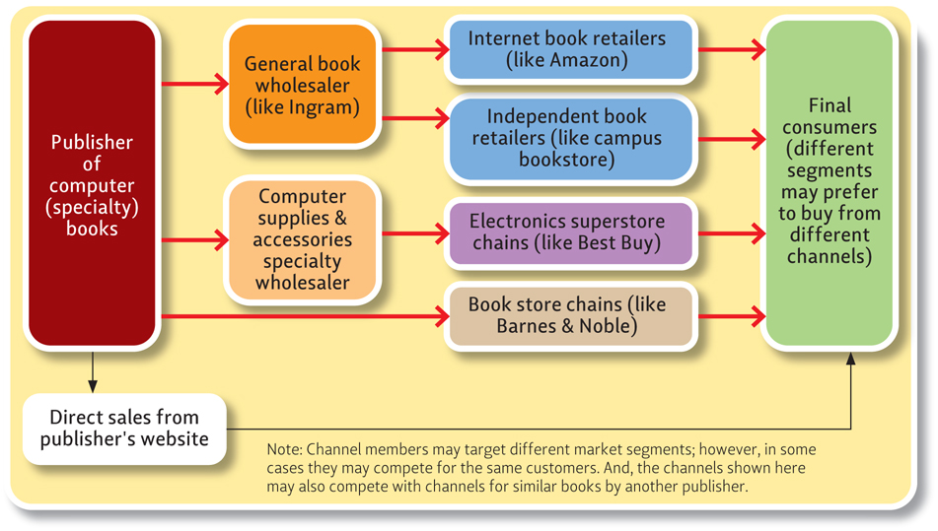
Channel Systems Can Be Complex (Exhibit 10-4)
10-26
Notes:
Summary Overview
Channels of distribution can involve a complex set of relationships among many organizations.
Key Issues
This exhibit shows an example of a channel arrangement for a publisher of computer books.
Books pass first to the wholesale level, either to general book wholesalers or wholesalers of computer accessories and supplies.
The general book wholesaler resells to online retailers or to other independent bookstores.
The computer supplies wholesaler distributes to electronics superstores or large bookstore chains.
However, there may also be some direct sales from the publisher’s Web site to provide adequate coverage.
Multichannel distribution: occurs when a producer uses several competing channels to reach the same target market.
Discussion Question: If you were an established bookstore, how would you react to a publisher’s announcement that it planned to sell direct via a Web site?
Ethical decisions may be required to deal fairly with all channel members across all channels.
Environmental factors cause the development of reverse channels—channels used to retrieve products from consumers. A comprehensive distribution strategy means that reverse channels must be planned for in the event they are needed.
New laws require reverse channels in some industries.
Reverse channels are sustainable and profitable.
Plan for reverse channels.
This slide refers to material on pp. 270-273.

Slide 27
Key Elements of Distribution Strategy
10-27
Notes:
When Netflix took an early lead in the home delivery of DVD movies, Blockbuster fought back. Blockbuster took advantage of its stores and now offers customers the convenience of home delivery and the speed of picking up movies at a local store. This ad from Blockbuster introduces the Blockbuster Total Access.
Video Operation:
Use the onscreen player controls to operate the video.
To view the video at Full Screen, right-click the video and choose Full Screen. To go back to your presentation you can either hit the Escape key, right-click on the video and uncheck Full Screen, or type Alt+Enter. You can do this at anytime during the video playback.
Under certain circumstances, the video may not fill the video player window. To restore, right-click the video player object and select Zoom 200%.
The videos will only play in Slide Show View. Macros must be enabled in order to play the videos from within PowerPoint.
This slide refers to material on p. 271.

Slide 28
Entering International Markets (Exhibit 10-5)
10-28
Exporting
Licensing
Management
Contracting
Joint
Venture
Direct
Investment
Generally increasing investment, risk, and control of marketing
Notes:
Summary Overview
All the strategy decisions for Place apply whether a firm is just focused on its domestic market or if it is also trying to reach target customers in international markets.
Key Issues
What are the five basic ways to enter international markets?
Exporting often comes first.
Usually get started by working with intermediaries- they are typically specialists in international marketing and the target country.
Often allows a firm to test an international market with low investment of time and money.
→ Licensing is often an easy way.
The licensee in the foreign market takes most of the risk, because it must make some initial investment to get started.
If good partners are available, this can be an effective way to enter a market.
→ Management contracting sells know-how:
Relatively low risk approach to international marketing.
Can be especially important in developing nations or ones where the government is less stable.
→ Joint venture increases involvement:
Sometimes this is the only way a firm can enter a new market.
→ Direct investment involves ownership.
It is a big commitment and usually means greater risks.
This slide refers to material on pp. 273-275.

Slide 29
You should now be able to:
10-29
Understand what product classes suggest about Place objectives.
Understand why some firms use direct channel systems while others work with intermediaries and indirect systems.
Understand how and why marketing specialists develop to make channel systems more effective.
Understand how to develop cooperative relationships and avoid conflict in channel systems.
Know how channel members in vertical marketing systems shift and share functions to meet customer needs.
Notes:
At the end of this presentation, you should:
1. Understand what product classes suggest about Place objectives.
2. Understand why some firms use direct channel systems while others work with intermediaries and indirect systems.
3. Understand how and why marketing specialists develop to make channel systems more effective.
4. Understand how to develop cooperative relationships and avoid conflict in channel systems.
5. Know how channel members in vertical marketing systems shift and share functions to meet customer needs.
This slide refers to material on pp. 254.

Slide 30
You should now be able to:
10-30
Understand the differences between intensive, selective, and exclusive distribution.
Know how multichannel distribution and reverse channels operate.
Know the main approaches firms use to reach customers in international markets.
Understand important new terms.
Notes:
At the end of this presentation, you should be able to:
Understand the differences between intensive, selective, and exclusive distribution.
Know how multichannel distribution and reverse channels operate.
Know the main approaches firms use to reach customers in international markets.
Understand important new terms.
This slide refers to material on pp. 246.

Slide 31
Key Terms
10-31
place
channel of distribution
direct marketing
discrepancy of quantity
discrepancy of assortment
regrouping activities
accumulating
bulk-breaking
sorting
assorting
traditional channel systems
channel captain
vertical marketing systems
corporate channel systems
vertical integration
administered channel systems
contractual channel systems
Notes:
Summary Overview
These are key terms you should be familiar with based upon the material in this presentation.
Key Issues
Place: making goods and services available in the right quantities and locations--when customers want them.
Channel of distribution: any series of firms or individuals who participate in the flow of products from producer to final user or consumer.
Direct marketing: direct communication between a seller and an individual customer using a promotion method other than face-to-face personal selling.
Discrepancy of quantity: the difference between the quantity of products it is economical for a producer to make and the quantity final users or consumers normally want.
Discrepancy of assortment: the difference between the lines a typical producer makes and the assortment final consumers or users want.
Regrouping activities: adjusting the quantities and/or assortments of products handled at each level in a channel of distribution.
Accumulating: collecting products from many small producers.
Bulk‑breaking: dividing larger quantities into smaller quantities as products get closer to the final market.
Sorting: separating products into grades and qualities desired by different target markets.
Assorting: putting together a variety of products to give a target market what it wants.
Traditional channel systems: a channel in which the various channel members make little or no effort to cooperate with each other.
Channel captain: a manager who helps direct the activities of a whole channel and tries to avoid‑‑or solve‑‑channel conflicts.
Vertical marketing systems: channel systems in which the whole channel focuses on the same target market at the end of the channel.
Corporate channel systems: corporate ownership all along the channel.
Vertical integration: acquiring firms at different levels of channel activity.
Administered channel systems: various channel members informally agree to cooperate with each other.
Contractual channel systems: various channel members agree by contract to cooperate with each other.
This slide refers to boldfaced terms appearing in Chapter 10.

Slide 32
Key Terms
10-32
ideal market exposure
intensive distribution
selective distribution
exclusive distribution
multichannel distribution
reverse channels
exporting
licensing
management contracting
joint venture
direct investment
Notes:
Summary Overview
These are additional key terms.
Key Issues
Ideal market exposure: when a product is available widely enough to satisfy target customers' needs but not exceed them.
Intensive distribution: selling a product through all responsible and suitable wholesalers or retailers who will stock and/or sell the product.
Selective distribution: selling through only those intermediaries who will give the product special attention.
Exclusive distribution: selling through only one intermediary in a particular geographic area.
Multichannel distribution: when a producer uses several competing channels to reach the same target market--perhaps using several intermediaries in addition to selling directly.
Reverse channels: channels used to retrieve products that customers no longer want.
Exporting: selling some of what the firm produces to foreign markets.
Licensing: selling the right to use some process, trademark, patent, or other right for a fee or royalty.
Management contracting: when the seller provides only management and marketing skills – others own the production and distribution facilities.
Joint venture: a domestic firm enters into a partnership with a foreign firm.
Direct investment: when a parent firm has a division (or owns a separate subsidiary firm) in a foreign market.
This slide refers to boldfaced terms appearing in Chapter 10.

