Slide 1
CHAPTER 12
Digestive System

Slide 2
Digestive System Overview
Digestive System
  Known as gastrointestinal tract
    Also known as digestive tract or alimentary canal
  Approximately 30 feet long
    Begins with mouth (oral cavity), ends with anus

Slide 3
Digestive System Overview
Digestive System
  Functions
    Prepare foods for absorption into the bloodstream
    Prepare foods for use by the body cells
    Responsible for elimination of solid wastes from the body

Slide 4
Digestive System Structures
Oral cavity (buccal cavity)
  Lips
  Cheeks
  Hard palate
    Rugae
  Soft palate

Slide 5
Digestive System Structures
Oral cavity (buccal cavity)
  Uvula
  Tongue
    Principle organ of the sense of taste
    Also assists in process of chewing (mastication) and swallowing (deglutition)

Slide 6
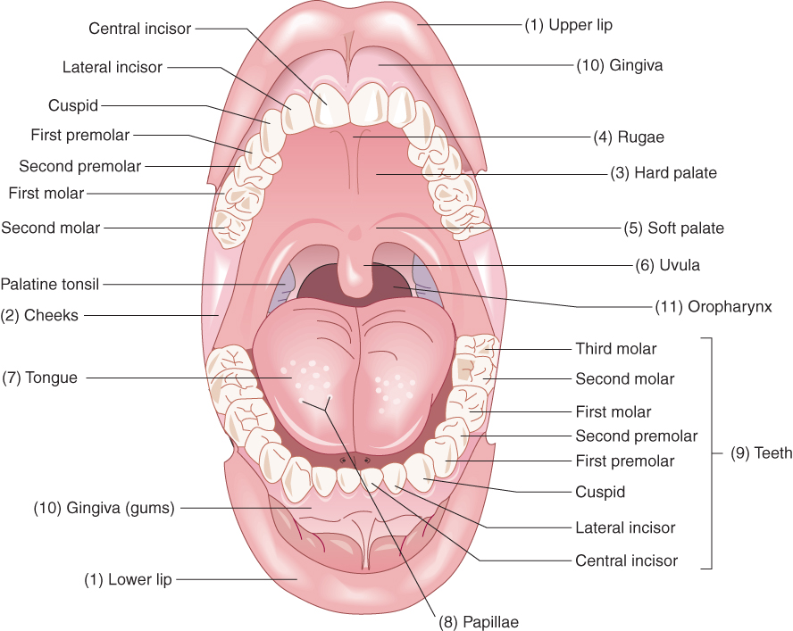
Digestive System Structures

Slide 7
Digestive System Structures
Salivary glands
  Three pairs
    Parotids
    Submandibulars
    Sublinguals
  Secrete saliva
    Mostly water, but contains mucus and digestive enzymes that aid in digestive process

Slide 8
Digestive System Structures
Salivary glands
  Digestive enzymes contained in saliva
    Amylase – aids in digestion of carbohydrates
    Lipase – aids in digestion of fats

Slide 9
Digestive System Structures
Pharynx
  Known as the throat
  Serves as passageway for both respiratory and digestive systems
  Oropharynx
    Section leading away from oral cavity

Slide 10
Digestive System Structures
Pharynx
  Nasopharynx
    Behind nasal cavity
  Laryngopharynx
    Lower portion – opens into esophagus and larynx

Slide 11
Digestive System Structures
Esophagus
  Receives food from pharynx and propels it to stomach
  Cardiac sphincter (lower esophageal sphincter) controls passage of food from esophagus into the stomach
    Relaxes = food enters stomach
    Contracts = stomach contents prevented from reentering the esophagus

Slide 12
Digestive System Structures
Stomach
  Fundus
    Upper rounded portion
  Body
    Central part

Slide 13
Digestive System Structures
Stomach
  Pylorus
    Lower tubular part (also called the gastric antrum)
    Pyloric sphincter regulates passage of food from stomach into the duodenum
  Folds in mucous membranes of stomach = rugae

Slide 14
Digestive System Structures
Stomach
  Gastric juices break down food in stomach
  Muscular action of stomach causes churning of food
    Mixes food with the secretions
    Chyme = liquid-like mixture of partially digested food and digestive secretions

Slide 15
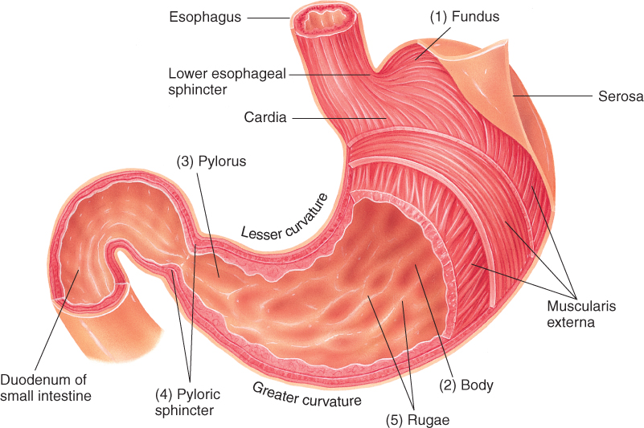
Digestive System Structures

Slide 16
Digestive System Structures
Small intestine
  Approximately 20 feet long
  Also known as the small bowel
  Divided into three parts
    Duodenum
    Jejunum
    Ileum

Slide 17
Digestive System Structures
Large intestine
  Cecum
    Appendix hangs from lower portion of cecum
  Ascending colon
    Hepatic flexure
  Transverse colon
    Splenic flexure

Slide 18
Digestive System Structures
Large intestine
  Descending colon
  Sigmoid colon
  Rectum
  Anus

Slide 19
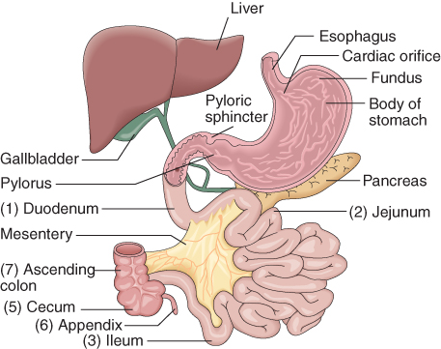
Digestive System Structures

Slide 20
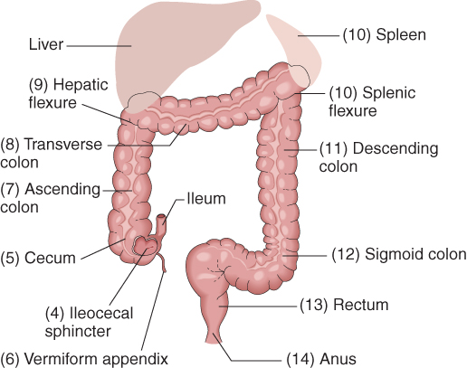
Digestive System Structures

Slide 21
Question
True or False: Basically, this 30-foot digestive system from mouth to anus breaks down food into what the body can use and gets rid of what it cannot.

Slide 22
Answer
True. Food must be broken down to a cellular level.

Slide 23
Video!

Slide 24
Accessory Organs of Digestion
Liver
  Located immediately under diaphragm, slightly to the right
  Only one digestive function
    Production of bile for emulsification of fats in small intestine
  Additional functions of liver
    Excretion of bile pigments into bile
    Synthesis of vitamin K-dependent plasma proteins
    Amino acid metabolism

Slide 25
Accessory Organs of Digestion
Liver
  Additional functions of liver
    Carbohydrate metabolism
    Fat metabolism
    Phagocytosis
    Detoxification
    Storage of vital nutrients

Slide 26
Accessory Organs of Digestion
Gallbladder
  Pear-shaped sac, located under surface of liver
  Main function:
    To store and concentrate bile produced by the liver
    Releases bile in response to presence of fatty content of food present in duodenum
    Emulsifies fats

Slide 27
Accessory Organs of Digestion
Pancreas
  Located in upper left quadrant of abdomen, behind stomach
  Functions as exocrine gland to manufacture digestive juices
    Trypsin – breaks down proteins
    Pancreatic lipase – breaks down fats
    Pancreatic amylase – breaks down carbohydrates
    Sodium bicarbonate – neutralizes acidic stomach contents

Slide 28
Accessory Organs of Digestion
Pancreas
  Functions as endocrine gland to manufacture insulin and glucagon
    Insulin – hormone that makes it possible for glucose to pass from blood through cell membranes to be used for energy
    Insulin also promotes conversion of excess glucose into glycogen
    Glucagon – hormone that stimulates the liver to convert glycogen into glucose in time of need

Slide 29
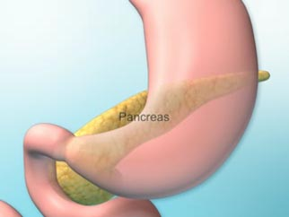
Animation
Click Here to Play Pancreas Animation

Slide 30
Accessory Organs of Digestion
Teeth
  Primary responsibility
    Chewing (mastication)
    Food is ground by teeth and softened by saliva
  Primary teeth = deciduous teeth
    Set of 20 teeth – appears around age 6 months
  Secondary teeth = permanent teeth
    Begin to appear around age 6

Slide 31
Common Signs and Symptoms
Achlorhydria
  Abnormal condition characterized by the absence of hydrochloric acid in the gastric juice
Anorexia
  Lack or loss of appetite, resulting in the inability to eat

Slide 32
Common Signs and Symptoms
Aphagia
  Condition characterized by the loss of the ability to swallow as a result of organic or psychologic causes
Ascites
  Abnormal accumulation of fluid within the peritoneal cavity
    Fluid contains large amounts of protein and electrolytes

Slide 33
Common Signs and Symptoms
Borborygmus
  An audible abdominal sound produced by hyperactive intestinal peristalsis
    Borborygmi are rumbling, gurgling, and tinkling noises heard when listening with a stethoscope

Slide 34
Common Signs and Symptoms
Constipation
  Difficulty in passing stools, or an incomplete or infrequent passage of hard stools
Diarrhea
  Frequent passage of loose, watery stools

Slide 35
Common Signs and Symptoms
Dyspepsia
  Vague feeling of epigastric discomfort after eating
  Involves an uncomfortable feeling of fullness, heartburn, bloating, and nausea
Dysphagia
  Difficulty in swallowing, commonly associated with obstructive or motor disorders of the esophagus

Slide 36
Question
This symptom may be relieved with Tums or Prilosec OTC.
  aphagia
  dyspepsia
  dysphagia
  borborygmus

Slide 37
Answer
b. Otherwise known as heartburn.

Slide 38
Common Signs and Symptoms
Emaciation
  Excessive leanness caused by disease or lack of nutrition
Emesis
  Material expelled from the stomach during vomiting
  Vomitus

Slide 39
Common Signs and Symptoms
Eructation
  Act of bringing up air from the stomach with a characteristic sound through the mouth
  Belching
Flatus; flatulence
  Air or gas in the intestine that is passed through the rectum

Slide 40
Common Signs and Symptoms
Gastroesophageal reflux
  Backflow of contents of stomach into esophagus
  Often result of incompetence of the lower esophageal sphincter
  Video!

Slide 41
Common Signs and Symptoms
Icterus
  A yellowish discoloration of the skin, mucous membranes, and sclera of the eyes, caused by greater than normal amounts of bilirubin in the blood
  Also called jaundice

Slide 42
Common Signs and Symptoms
Melena
  An abnormal, black, tarry stool containing digested blood
Nausea
  Unpleasant sensation often leading to the urge to vomit
Pruritus ani
  A common chronic condition of itching of the skin around the anus

Slide 43
Common Signs and Symptoms
Steatorrhea
  Greater than normal amounts of fat in the feces
    Characterized by frothy, foul-smelling fecal matter that floats
Vomit
  To expel the contents of the stomach through the esophagus and out of the mouth

Slide 44
Question
True or False: Nausea can lead to eructation and vomiting, which produces icterus.

Slide 45
Answer
False. Vomitus, or more commonly emesis, is the result of vomiting.

Slide 46
PATHOLOGICAL CONDITIONS
Digestive System

Slide 47
Achalasia
Pronounced
  (ak-al-LAY-zee-ah)
Defined
  Decreased mobility of the lower two-thirds of the esophagus along with constriction of the lower esophageal sphincter

Slide 48
Anal Fistula
Pronounced
  (AY-nal FISS-too-lah)
Defined
  Abnormal passageway in the skin surface near the anus, usually connecting with the rectum
    May occur as the result of a draining abscess

Slide 49
Aphthous Stomatitis
Pronounced
  (AFF-thus stoh-mah-TYE-tis)
Defined
  Small, inflammatory, noninfectious, ulcerated lesions occurring in the lips, tongue, and inside the cheeks of the mouth
  Also called canker sores

Slide 50
Appendicitis
Pronounced
  (ap-pen-dih-SIGH-tis)
Defined
  Inflammation of the vermiform appendix
    Usually an acute condition that can lead to rupture (perforation) with resultant inflammation of the peritoneum (peritonitis)

Slide 51
Celiac Disease
Pronounced
  (SEE-lee-ak dih-ZEEZ)
Defined
  Nutrient malabsorption due to damaged small bowel mucosa
    Gluten-sensitive disease

Slide 52
Cirrhosis
Pronounced
  (sih-ROH-sis)
Defined
  Disease of the liver that is chronic and degenerative, causing injury to the hepatocytes (liver’s functional cells)
    Fat infiltrates lobules of the liver, causing tissue covering the lobes to become fibrous
    Functions of liver eventually deteriorate

Slide 53
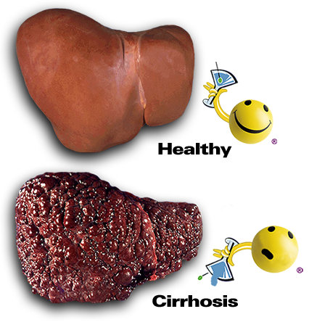

Slide 54
Question
If appendicitis is not caught in time, the appendix ruptures and spills its contents into the abdominal cavity. This causes inflammation of its lining, which is called the _____________.
  peritoneum
  pleura
  meninges
  perineum

Slide 55
Answer
a. Peritonitis is inflammation of the peritoneum.

Slide 56
Colorectal Cancer
Pronounced
  (koh-loh-REK-tal KAN-sir)
Defined
  Presence of a malignant neoplasm in the large intestine

Slide 57
Constipation
Pronounced
  (kon-stih-PAY-shun)
Defined
  A state in which the individual’s pattern of bowel elimination is characterized by a decrease in the frequency of bowel movements and the passage of hard, dry stools
    Individual experiences difficult defecation

Slide 58
Crohn’s Disease
Pronounced
  (KROHNZ dih-ZEEZ)
Defined
  Digestive tract inflammation of a chronic nature causing fever, cramping, diarrhea, weight loss, and anorexia

Slide 59
Dental Caries
Pronounced
  (DEN-tal KAIR-eez)
Defined
  Tooth decay caused by acid-forming microorganisms

Slide 60
Diverticular Disease
Pronounced
  (dye-ver-TIK-yoo-lar dih-ZEEZ)
Defined
  Expression used to characterize both diverticulosis and diverticulitis
    Diverticulosis = non-inflamed outpouchings or herniations of the muscular layer of the intestines, typically the sigmoid colon
    Diverticulitis = inflammation of these outpouchings

Slide 61
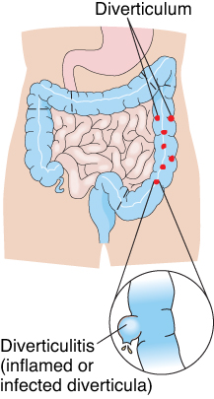
Diverticular Disease

Slide 62
Dysentery
Pronounced
  (DISS-en-ter-ee)
Defined
  A term used to describe painful intestinal inflammation typically caused by ingesting water or food containing bacteria, protozoa, parasites, or chemical irritants
    Person has frequent stools that often contain blood

Slide 63
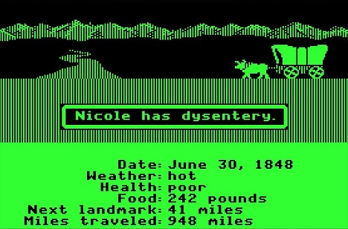

Slide 64
Question
True or False: Diverticular disease is a collective way of saying a person has diverticulosis with episodes of diverticulitis.

Slide 65
Answer
True. Diverticulosis must exist in order to have diverticulitis.

Slide 66
Esophageal Varices
Pronounced
  (eh-soff-ah-JEE-al VAIR-ih-seez)
Defined
  Swollen, twisted (tortuous) veins located in the distal end of the esophagus

Slide 67
Gallstones (Cholelithiasis)
Pronounced
  (koh-lee-lih-THIGH-ah-sis)
Defined
  Pigmented or hardened cholesterol stones formed as a result of bile crystallization

Slide 68
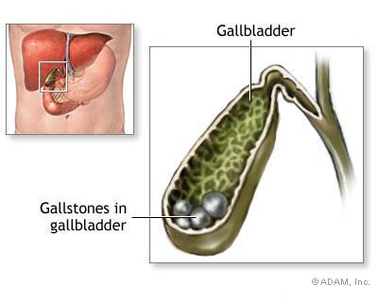

Slide 69
Hemorrhoids
Pronounced
  (HEM-oh-roydz)
Defined
  Hemorrhoid is an unnaturally distended or swollen vein (varicosity) in distal rectum or anus

Slide 70
Hepatitis
Pronounced
  (hep-ah-TYE-tis)
Defined
  Acute or chronic inflammation of the liver due to a viral or bacterial infection, drugs, alcohol, toxins, or parasites

Slide 71
Hernia
Pronounced
  (HER-nee-ah)
Defined
  Irregular protrusion of tissue, organ, or a portion of an organ through an abnormal break in the surrounding cavity’s muscular wall

Slide 72
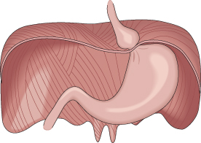
Hernia

Slide 73
Herpetic Stomatitis
Pronounced
  (her-PEH-tik stoh-mah-TYE-tis)
Defined
  Inflammatory infectious lesions in or on the oral cavity occurring as a primary or a secondary viral infection caused by herpes simplex

Slide 74
Question
In the picture of a hernia (Figure 12-9), what muscle is the stomach protruding through?
  abdominal muscle
  diaphragm
  intercostal muscle
  the stomach's own muscle

Slide 75
Answer
b. The cardiac sphincter is enlarged, which causes part of the stomach to protrude through the opening.

Slide 76
Intussusception
Pronounced
  (in-tuh-suh-SEP-shun)
Defined
  Telescoping of a portion of proximal intestine into distal intestine usually in the ileocecal region, causing an obstruction
    Typically occurs in infants and young children

Slide 77
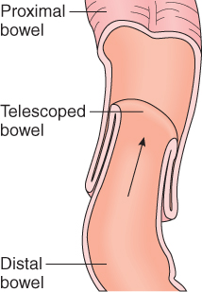
Intussusception

Slide 78
Peptic Ulcers (Gastric, Duodenal, Perforated)
Pronounced
  (PEP-tik ULL-sirz)
  (GAS-tric, doo-OD-en-al, PER-foh-ray-ted)
Defined
  Break in the continuity of the mucous membrane lining of the gastrointestinal tract as a result of hyperacidity or the bacterium Helicobacter pylori (H. pylori)

Slide 79
Peptic Ulcers
Symptoms of an ulcer
  Gnawing epigastric pain
  Heartburn or indigestion
  Nausea and vomiting
  Bloated feeling after eating

Slide 80
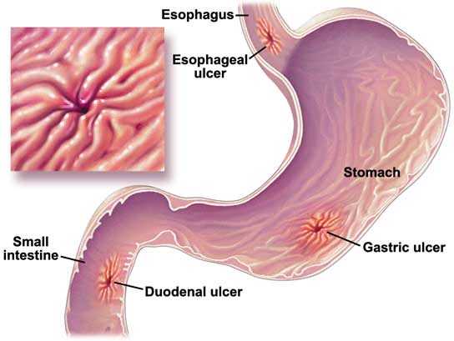

Slide 81
Polyps, Colorectal
Pronounced
  (PALL-ips, koh-loh-REK-tal)
Defined
  Small growths projecting from the mucous membrane of the colon or rectum
    May be sessile (attached by a base) or pedunculated (attached by a stalk)
    May vary in size and may be benign or pre-cancerous

Slide 82
Thrush
Pronounced
  (THRUSH)
Defined
  Fungal infection in the mouth and throat producing sore, creamy white, slightly raised curdlike patches on the tongue and other oral mucosal surfaces
    Caused by Candida albicans

Slide 83
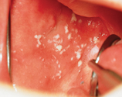
Thrush
(Image courtesy of Dr. Joseph Konzelman, School of Dentistry, Medical College of Georgia)

Slide 84
Ulcerative Colitis
Pronounced
  (ULL-sir-ah-tiv koh-LYE-tis)
Defined
  Chronic inflammatory condition resulting in a break in the continuity of the mucous membrane lining of the colon in the form of ulcers
    Characterized by large, watery, diarrheal stools containing mucus, pus, or blood

Slide 85
Volvulus
Pronounced
  (VOL-vyoo-lus)
Defined
  Rotation of loops of bowel causing a twisting on itself that results in an intestinal obstruction

Slide 86
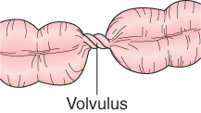
Volvulus

Slide 87
Question
Peptic ulcers and ulcerative colitis are a break in what lining?
  muscular lining
  serosal membrane
  mucous membrane
  epithelial membrane

Slide 88
Answer
c. The mucous coating is needed to protect underlying structures in a highly acidic environment.

