Slide 1
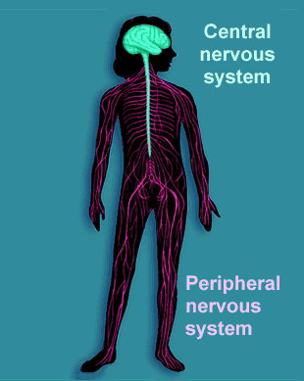
The Nervous System
Anatomy and Physiology and
Pathological Conditions

Slide 2
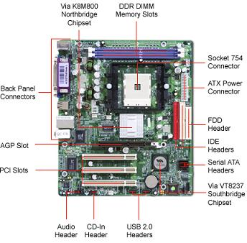
The Nervous system is similar to:
A Computer!
The Brain and Spinal Cord plus many nerves extending throughout the body are very much like a computer. Both are designed to send and receive signals.

Slide 3
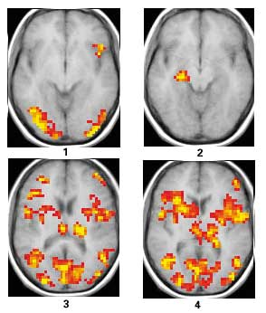
Watching the Brain “light up”
Neurologists and scientists who specialize in studying the brain can take pictures of the brain of a person who is involved in various activities.
“Brain mapping” attempts to relate the brain's structure to its function, or finding what parts give us certain abilities. (Nasr, Susan. “How the Brain Works”)

Slide 4
What Techniques/Procedures are used?
“Brain mapping is a collection of many different tools. Researchers must collect images of the brain, turn those images into data, and then use that data to analyze what happens in the brain as it develops.”
(Nasr, Susan. “How the Brain Works.”)
Positron Emission Tomography (PET) takes images of radioactive markers in the brain
Computer axial tomography (CAT) scan X-rays the brain from many angles and show structural abnormalities.

Slide 5
What Techniques/Procedures are used?
Electroencephalography (EEG) indicates electrically active locations in the brain using detectors implanted in the brain or worn on a cap.
Transcranial magnetic stimulation (TMS) noninvasively stimulates parts of the brain to trigger certain behaviors.
Functional MRI (fMRI) shows images of brain activity while subjects work on various tasks
Pharmacological MRI (phMRI) shows brain activity as drugs are administered.

Slide 6
Brain Mapping is unique and important because. . .
…it shows what part of the brain is active during certain activities or thought processes.

Slide 7
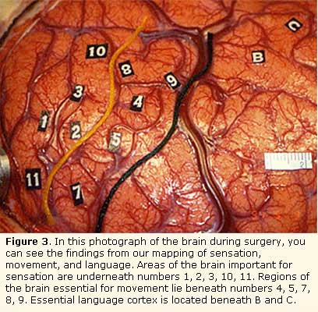

Slide 8
Let’s learn about the anatomy of the human nervous system
The nervous system is divided into two parts: the Central Nervous System (CNS) and the Peripheral Nervous System (PNS).

Slide 9
Central Nervous System
Peripheral Nervous System
What is it comprised of? Brain + Spinal Cord
What does it do?
Processes and stores sensory and motor information and controls consciousness.
What is it comprised of?
12 pairs of cranial nerves and 31 pairs of spinal nerves.
What does it do?
Transmits sensory and motor impulses back and forth to the CNS and the rest of the body.

Slide 10
Brain Components Video:
http://www.nlm.nih.gov/medlineplus/ency/anatomyvideos/000016.htm

Slide 11
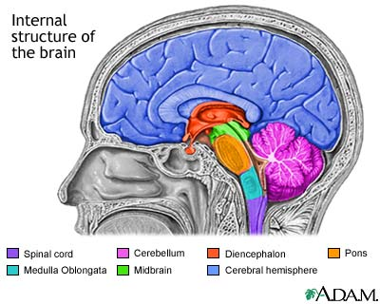
Structures of the Human Brain
The brain is one of the largest organs in adult humans. It weighs approximately 3 pounds and reaches full size by the time a person turns 18 years old. (Jones 2009)

Slide 12
The major structures of the brain include:
Cerebrum
Largest part, uppermost part of brain
Controls consciousness, memory, emotions, sensations, and voluntary movements

Slide 13
The major structures of the brain include:
Cerebral
Cortex
The surface of the Cerebrum

Slide 14
The major structures of the brain include:
Cerebellum
Attached to the brain stem
Maintains muscle tone and coordinating normal movement and balance

Slide 15
The major structures of the brain include:
Diencephalon
Located between the cerebrum and the midbrain.
Consists of several structures, including the thalamus, hypothalamus, and the pineal gland.

Slide 16
The major structures of the brain include:
Brain
Stem
Located between the Diencephalon and the spinal cord.
Consists of the midbrain, pons, and medulla oblongata.
Regulates breathing, heartbeat, and blood pressure.

Slide 17
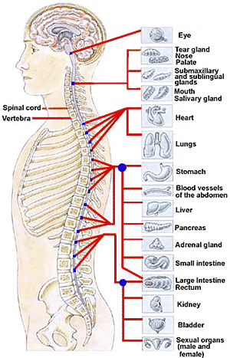
The Spinal Cord
The Spinal cord is the pathway for impulses traveling to and from the brain. It carries 31 pairs of spinal nerves that affect the limbs and lower part of the body. The spinal cord is protected by cerebrospinal fluid, 3-layer meninges, and the vertebral column.
(Jones 2009)

Slide 18
Concept Review and
Comprehension Check
What are the two parts of the Nervous System called?
(1) The Central Nervous System (CNS) and the Peripheral Nervous System (PNS)
(2) The Central Nervous System and the Lateral Nervous System
(3) The BNS and the PONS

Slide 19
What is the largest part of the human brain called?
Cerebellum
Diencephalon
Cerebrum

Slide 20
Identify one function that the brain stem regulates:
Heart muscle tone
Heart beat
digestion

Slide 21
What is the brain similar to?
A typewriter
A football
A computer

Slide 22
Word Elements
Relating to the Nervous System

Slide 23
Word Elements in Action
An + algesia
A + phasia
Cephal/o +
-algia
Neur/o +
-pathy
= analgesia: without sensitivity to pain
= aphasia: without speech; inability to speak
= cephalalgia: pain in the head/brain
= neuropathy: disease of the nerves

Slide 24
The Nervous System
Pathological Conditions

Slide 25
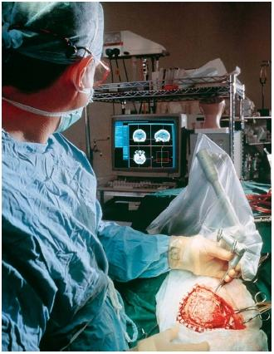
Categories of
Pathological Conditions
Neurologists and Neurosurgeons
deal with many different kinds of problems
involving the brain and spinal cord.
Notes:
Image Source: http://www.scienceclarified.com/images/uesc_10_img0559.jpg

Slide 26
Categories of
Pathological Conditions
Most brain and spinal cord disorders are classified into one of the following categories:
Congenital disorders
Degenerative, functional and seizure disorders
Infectious disorders
Intracranial tumors
Traumatic disorders
Vascular disorders
Peripheral nerve disorders
Disk disorders

Slide 27
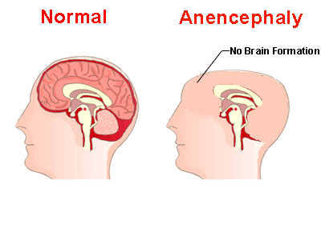
Congenital Disorders
Example: Anencephaly
Breakdown of word:
an- without, not
Encephal/0 = brain
-y = (noun ending)
What is it? A congenital disorder characterized by the absence of the brain and spinal cord at birth.
Notes:
Image Source: http://www.medindia.net/patients/patientinfo/Images/anencephaly.gif

Slide 28
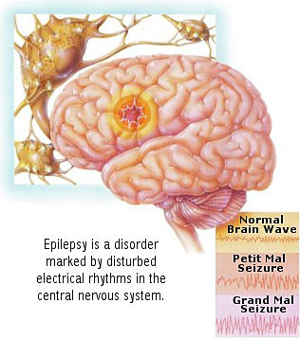
Seizure Disorders
Example: Epilepsy
Breakdown of word:
Epi- over, upon
-lepsy = seizure, attack
What is it? A syndrome of recurring episodes of excessive irregular activity in the central nervous system.
Notes:
Image Source: http://www.medindia.net/patients/patientinfo/Images/anencephaly.gif

Slide 29
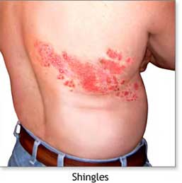
Infectious Disorders
Example: Shingles (Herpes Zoster”
What is it? An acute viral infection involving inflammation of the spinal or cranial nerves that produces a painful skin rash.
Notes:
Image Source: http://www.nlm.nih.gov/medlineplus/ency/images/ency/fullsize/19687.jpg

Slide 30
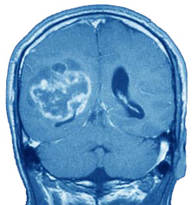
Intracranial tumors (primary)
Example: Glioblastoma
Breakdown of word:
Gli/o- gluey substance
blast = embryonic stage
-oma = tumor
What is it? A malignant (cancerous) brain tumor that starts in the glial cells of the brain.
Notes:
Image Source: http://www.wnyneuro-oncology.org/content/17/GlioblastomaMultiforme.jpg

Slide 31
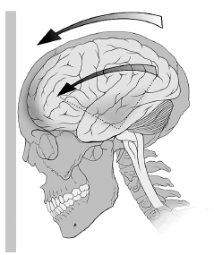
Traumatic Disorders
Example:
Cerebral Concussion
What is it? A brief interruption of brain function caused by blunt trauma to the head.
http://www.nlm.nih.gov/medlineplus/ency/anatomyvideos/000034.htm
Notes:
Image Source: http://hotink.theorem.ca/system/varsity/images/000/003/137/concussion_diagram_opt_small.jpg

Slide 32
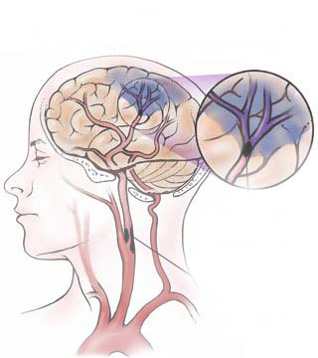
Vascular Disorders
Example: Cerebrovascular Accident (CVA)
What is it? Death of part of the brain due to decreased blood flow to that area. Also known as “stroke.”
http://www.nlm.nih.gov/medlineplus/ency/anatomyvideos/000123.htm
Notes:
Image Source: http://www.interhomeopathy.org/images/gallery/179-cva-ischemia.jpg

Slide 33
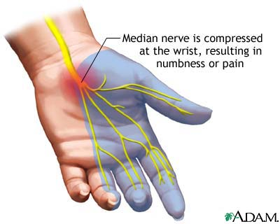
Peripheral Disorders
Example: Carpal tunnel syndrome
What is it? A pinched or compressed nerve in the carpal tunnel passage of the wrist.
Notes:
Image Source: http://www.nlm.nih.gov/medlineplus/ency/images/ency/fullsize/1081.jpg

Slide 34
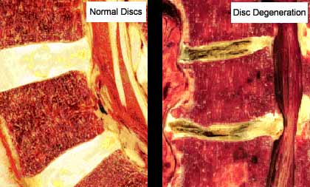
Disk Disorders
Example:
Degenerative disk
What is it? Deterioration of the intervertebral disk, usually due to constant motion and wearing on the disk.
Notes:
Image Source: http://www.vancouverspinedoctor.com/images/degenerative-disc-disease_clip_image001.jpg

Slide 35
Concept Review and
Comprehension Check
Based on the context of the reading, what does the word Congenital mean?
(1) From birth
(2) A degenerative disorder
(3) A brief interruption of consciousness

Slide 36
Based on the reading, what is the best meaning of “vascular disorder”?
Pain in the wrist
Problems that arise in the cerebral cortex
Problems that arise in the blood vessels to the brain

Slide 37
Which is an example of a virus affecting the nervous system?
Carpal tunnel syndrome
Shingles (Herpes zoster)
glioblastoma

Slide 38
What can cause a Cerebrovascular Accident (CVA)?
Low blood sugar
A car accident
Decreased blood flow to part of the brain

Slide 39
Word Elements in Action
A-
My/o
Troph/o
-ic
Scler/o
-osis
--------------------------------
Amyotrophic (lateral) Sclerosis = ALS = Lou Gehrig’s Disease =
Without, not
Muscle
Development
Pertaining to
Hard
Condition
-------------------------------
A condition pertaining to lack of muscle development and hardening (of muscles) due to loss of motor neurons in brain stem and spinal cord

Slide 40
Small Group Activity
You will work in small groups of 2-3 people. I will give you a sticky note with a technique or procedure to demonstrate/explain to the class.
Use physical demonstration to show location of procedure.
Tell how to break down the word into definable parts.
Explain why this procedure is useful.

