Slide 1
Surgical Technology
6th edition
CHAPTER 24
MINIMALLY INVASIVE, ENDOSCOPIC,
AND ROBOTIC-ASSISTED SURGERY

Slide 2
Minimally Invasive Surgery
Lesson 24.1
Discuss the advantages and constraints of minimally invasive surgery (MIS).
Describe the preparation of the patient for MIS.
Describe the function of each component of the imaging equipment used in MIS.

Slide 3
Types of Endoscopy
Minimally invasive surgery (MIS)
Diagnostic and operative endoscopy
Notes:
Some endoscopic procedures do not require incisions because the endoscope is introduced through a natural orifice. Examples of
endoscopic procedures not requiring an incision are bronchoscopies and colonoscopies.
Define telescope and endoscope. (A telescope is an optical instrument for magnifying the apparent size of distant objects. It consists, in principle, of two lenses: (1) the objective, being a positive lens which forms a real inverted image of the distant object; (2) the eyepiece through which the observer views a magnified image of that formed by the objective. An endoscope is a medical instrument for viewing the interior of the body: a medical instrument consisting of a long tube inserted into the body.)

Slide 4
Principles of MIS
Telescopic viewing
Cannula insertion
Protection of the body wall
Creation of a protective seal
Manipulation of telescopic instruments
Notes:
The goal of minimally invasive technique is primarily operative rather than diagnostic.
What function do the cannulas perform? (The cannulas protect the body wall and also maintain a seal between the inside of the body and the outside environment.)

Slide 5
Surgical Specialties
Principles are the same across all specialties
Common features
Telescopic instruments
Cannulas
Imaging system
Insufflation
Irrigation
Balloon expansion
Notes:
Reference Box 21-1, Common minimally invasive surgery procedures by specialty, in the textbook.
Because instruments are located deep in the body or within tightly enclosed tissue planes, a method of expanding body spaces or tissue planes is needed.

Slide 6
Advantages of MIS
Broad and comprehensive
Decreased tissue trauma
Reduced blood loss
Faster recovery
Outpatient procedures
Decrease in pain
Increase in patient satisfaction
Less costly
Notes:
Patients undergoing minimally invasive surgery are able to resume normal activities sooner, and the hospital stay is shortened.
Many minimally invasive surgeries are performed on an outpatient basis.

Slide 7
Limitations of MIS
Steep learning curves
Vision system errors
Instrumentation and equipment are expensive
Operative site is two-dimensional
Not everyone is a candidate
Notes:
Why are patients who have undergone previous abdominal procedures not good candidates for minimally invasive surgery? (Patients who have undergone previous abdominal procedures have a high risk of abdominal adhesions [scarring of organs that causes adherence to the peritoneal wall]. This presents a risk of perforation as the trocar and cannula are advanced through the body wall.)
Minimally invasive surgery requires long, delicate instruments, which are limited in their range of motion. Withdrawing and inserting them into body cavities can be awkward.

Slide 8
Risks Associated with MIS
Appropriate actions by staff
No greater or less then open surgery
Dependent upon
  Condition of the patient
  Positioning of the patient
  Insufflation and irrigation
  Equipment failures
Notes:
Understanding the equipment and system before surgery is critical. Troubleshooting and familiarity with the vision system is a mandatory requirement of perioperative staff.
Training includes manufacturer training, the study of procedure manuals and other documentation, and applying the knowledge directly to the equipment before use in surgery.

Slide 9
Patient Preparation
Positioning considerations
  Upper abdomen or lower esophagus
  Pelvic or lower abdominal procedures
  Thoracoscopy and nephroscopy
  Laryngoscopy, bronchoscopy, esophagoscopy, and mediastinoscopy
Skin prep and draping
  Allows for conversion to an open procedure
Notes:
Preoperative preparation for a minimally invasive procedure follows the same or similar protocols as open surgery.
Patient positioning for minimally invasive surgery is generally identical to open surgery.

Slide 10
Converting to an Open Case
All minimally invasive surgeries have the potential to become open cases
Perform this rapidly
Communicate with circulator
Quickly exchange instruments
Count added instruments and sponges
Notes:
Preoperative planning reduces the risk of accident.

Slide 11
Imaging System Used in MIS
Imaging system
Light source
Light cable
Telescope (endoscope)
Camera head
Camera control unit
Video cables
Monitor screen
Image management system
Notes:
Reference Figure 21-3, Imaging components used in minimally invasive surgery, in the textbook.
A malfunction in any one component of the system affects the other components and may reduce patient safety.

Slide 12
Light Sources and Fiberoptics
Light source
  Transmits light to the fiberoptics
Fiberoptic cable
  Transmits light from the light source to the camera head or telescope
Notes:
Reference Figure 21-4, Fiberoptic light source, and Figure 21-5, Fiberoptic cable connecting the light source to the endoscope, in the textbook.
The lighted end of the cable is capable of igniting materials such as drapes, sponges, and other materials.

Slide 13
Care and Safety of Fiberoptics
Handle cables gently by coiling loosely
Avoid striking on hard surfaces
Inspect before use
Turn light source off before disconnecting cable
Do not touch source bulbs with bare hands
Attach light guide with care
Keep replacement bulbs on hand
Clean according to manufacturer’s directions
Notes:
Reference Figure 21-6, Care of the fiberoptic cable and light source, in the textbook.
Why should you avoid striking the cable on a hard surface? (This can cause the fiberoptic bundles to fracture.)

Slide 14
Features of the Rigid Telescope
Optical angle is the direction in which lenses are focused on the image
Diameter refers to the diameter of the telescope shaft, and length refers to the length of the telescope shaft
Notes:
Optical angle is the direction in which lenses are focused on the image.
Diameter refers to the diameter of the telescope shaft, and length refers to the length of the telescope shaft.

Slide 15
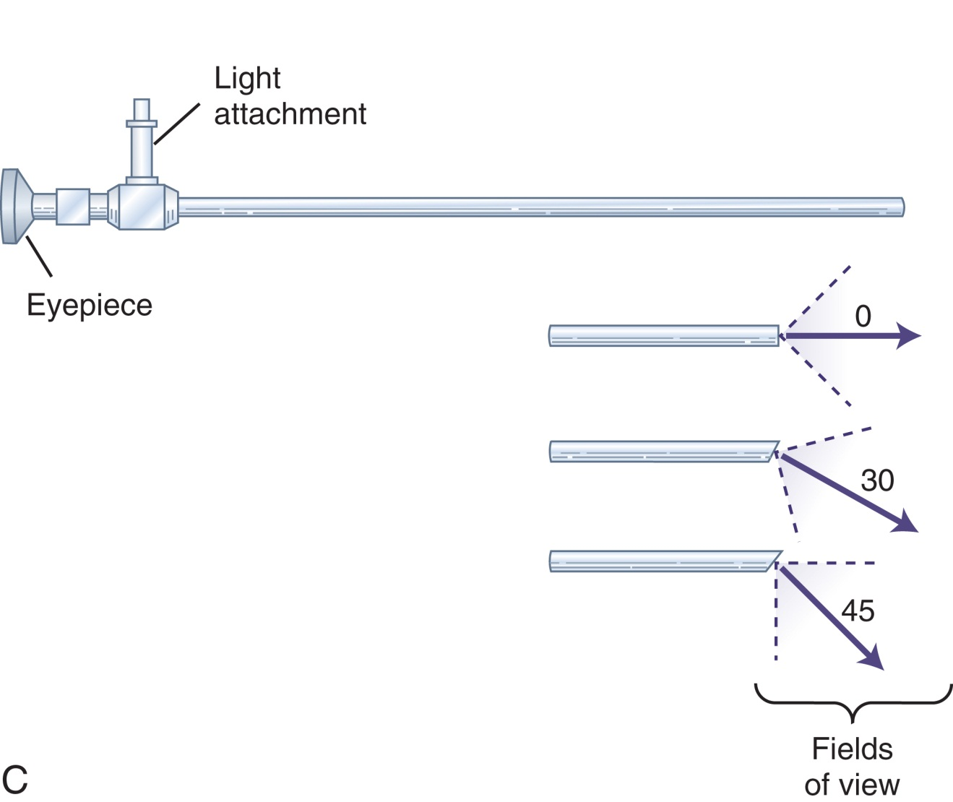
The Rigid Telescope
C redrawn from Phillips N: Berry and Kohn’s operating room technique, ed 10, St Louis, 2004, Mosby.
Notes:
Telescopes are delicate and expensive, and it is the responsibility of the technologist to handle and maintain the telescope.

Slide 16
Guidelines for Handling the Rigid Telescope
Hold by it by the heavier end
Prevent scratches or dents
Use lint-free material
Check telescope yourself for damages
Prevent lens fogging
Notes:
While everyone who handles endoscopic equipment has an equal responsibility to ensure the integrity of the instruments, it is the particular duty of the scrub to deliver a safe, properly working telescope to the surgeon.
What steps can be taken to prevent lens fogging during surgery? (To prevent fogging, the telescope may be maintained in a warm water bath before use. Defogging agents may also be used on the lens before use. Be sure to dry the lens to before handing it to the surgeon to ensure that there is no distortion resulting from defogging.)

Slide 17
The Video Camera and the Guidelines for Use
Camera head
  Focus ring
  Endocoupler
Care of camera
  Follow manufacturer's instructions
Camera control unit
  Receptacle for the camera
Notes:
What is the advantage of three-chip cameras? (Three-chip cameras produce natural color images, which is important for the identification of pathology.)
Why is focus adjustment made before surgery? (Focus adjustment is made before surgery. Do not repeatedly turn the camera head, because this can cause damage. Make sure the mount is locked during focusing.)

Slide 18
White Balance
Adjustment of the light color to other components in the system
Direct lens at a solid white object
Avoid porous or woven materials
Registers automatically once white balance completed
Notes:
Why must cameras be white-balanced before each procedure? (This is a procedure to adjust the light color to the other components in the system.)

Slide 19
Other MIS Equipment
Video cables
  Transmit digital signal
Output recorder
  Processes signals to send to the monitor
Monitor screen
  Shows projected image in real time
Equipment carts
  Safe storage of video system
Notes:
Reference Figure 21-12, Equipment cart with monitor, in the textbook.
An alternative to the equipment cart is suspension by overhead booms, which are commonly built into integrated operating rooms.

Slide 20
Specialty Telescopes
Resectoscope
Laparoscope
Arthroscope
Hysteroscope
Thoracoscope
Nephroscope
Cystourethroscope
Notes:
Specialty telescopes are designed to fit the anatomical and technical needs of the specific specialty.
Features include length, diameter, channels for continuous irrigation, and electrosurgical capability.

Slide 21
Equipment and Techniques Used in Endoscopic MIS
Lesson 24.2
Discuss the care of a rigid endoscope.
Describe the surgical technique used for insufflation in laparoscopy.
List the risks associated with insufflation.
Describe the trocar-cannula system used in all MIS

Slide 22
Equipment and Techniques Used in Endoscopic MIS
Lesson 24.2
Describe the specific electrosurgical risks of direct and capacitative coupling.
Describe the structure and function of a flexible endoscope.
Discuss the proper protocol for processing rigid and flexible endoscopes.

Slide 23
Operating Instruments
Supplied in different formats
  Reusable
  Disposable
  Reposable
Notes:
The grip mechanism on endoscopic instruments is important to the ergonomics and precision of the tool.
The amount of applied force is greatly reduced in an endoscopic instrument because of the short fulcrum and the flexibility of the instrument.

Slide 24
Types of Instruments
Retractors
Scissors
Forceps
Suction and irrigation tips
Surgical clips and staples
Notes:
Why is irrigation used throughout the endoscopic procedure?
When is endoscopic stapling commonly used?

Slide 25
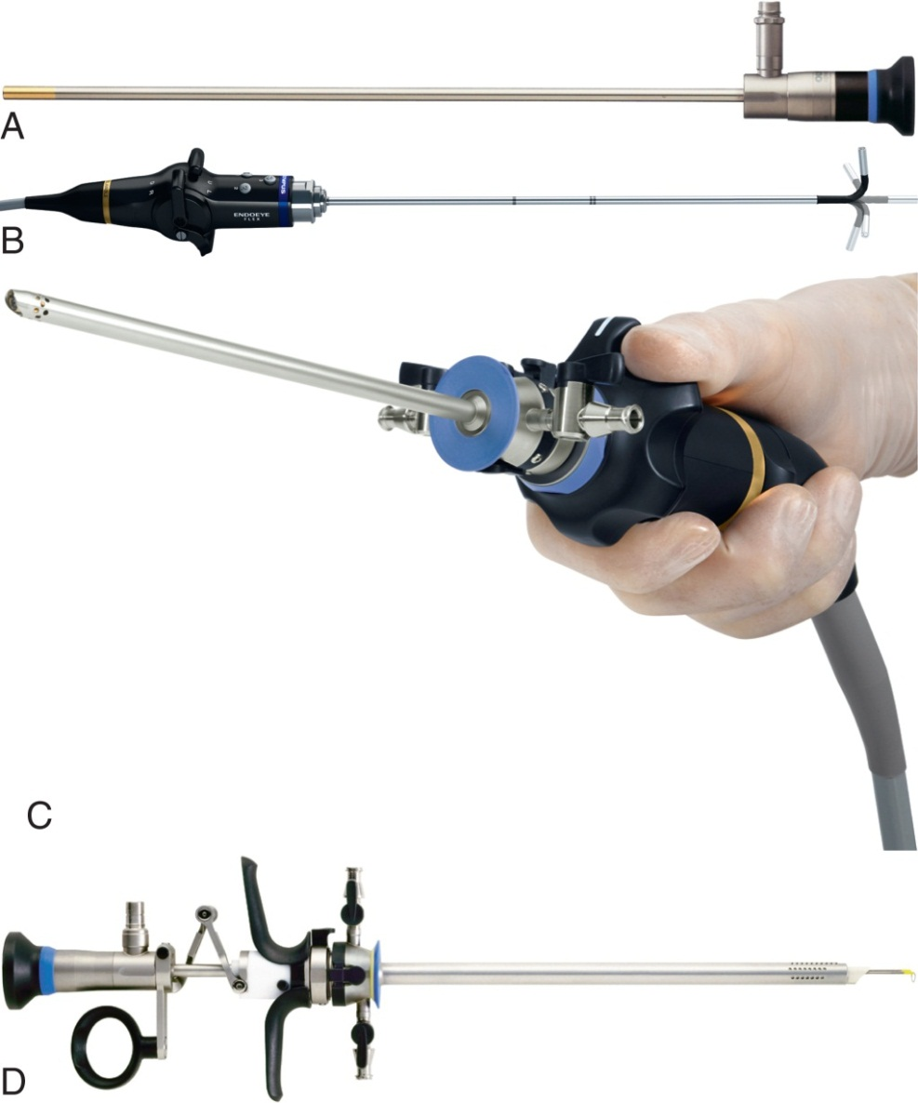
Endoscopes and Resectoscopes
Courtesy © Olympus, America, Inc.)
Notes:
Commonly used specialty telescopes and resectoscopes.

Slide 26
Insufflation Used in Laparoscopy
Pneumoperitoneum
  Veress needle
  Small stab incision
  Saline test
  Tubing attached
Notes:
A penetrating clamp is placed on each side of the umbilicus and lifted upward. A small stab wound is created in the superficial tissues at the umbilicus and Veress needle is pushed through. A 10-mL syringe of saline is attached to the needle to test for position in the abdominal cavity. Insufflation tubing is attached to the Veress needle.

Slide 27
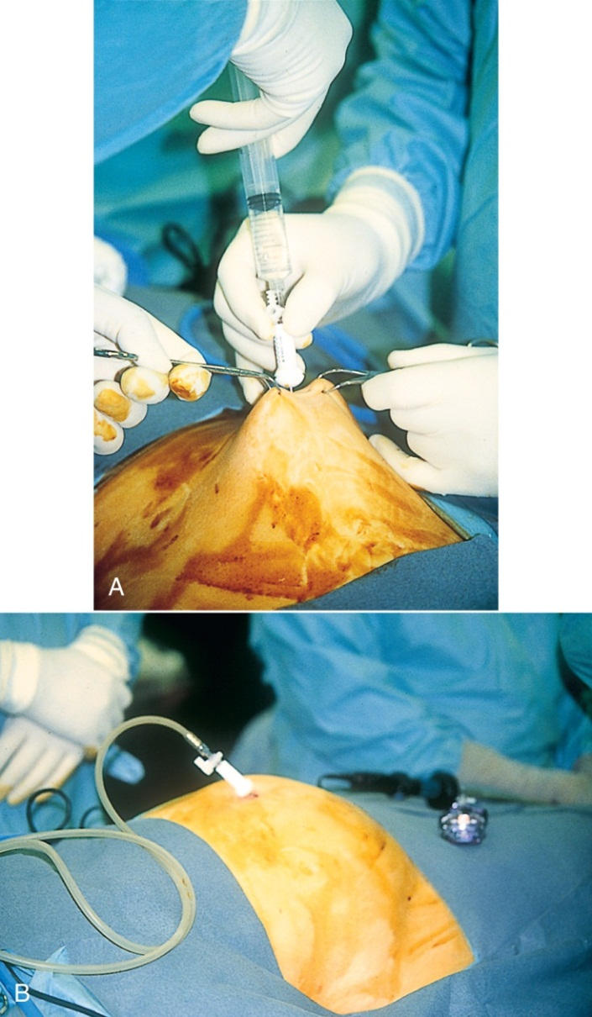
Insufflation of the Abdomen
From Nagle GM: Genitourinary surgery, St. Louis, 1997, Mosby.
Notes:
CO₂ is used to inflate the abdomen because it is readily absorbed by the body and is nontoxic and nonflammable.
Why is carbon dioxide gas warmed before insufflation? (This maintains the patient’s core temperature and prevents fogging of the telescope lens.)
What steps are taken to prevent air embolism? (Before it is attached, the tubing is flushed with CO₂ gas to purge any air from the tube and prevent air embolism.)

Slide 28
Continuous Irrigation
Fluids used
  Glycine
  Isotonic electrolytic solutions
  Mannitol
  Sorbitol
  Normal saline
Notes:
Continuous irrigation is used in arthroscopic MIS, hysteroscopy, and cystoscopy.
What are some of the risks of filling a body cavity or organ with fluid during surgery? (The risk exists that it will be absorbed into the vascular system; this is called intravasation. Injury is caused when the pressure of the irrigation fluid exceeds a safe level, causing fluid to enter the vascular system, thereby increasing blood pressure or causing electrolyte imbalance.)
Who is responsible for keeping track of the amount of fluid used and the amount of runoff during a procedure? (Both the surgeon and the circulating nurse monitor fluids.)

Slide 29
Balloon Dissection and Hemostasis
Balloon dissection
  Create anatomical space in tissue planes
Hemostasis
  Electrosurgery
  Sutures
  Ligation clips
  Ultrasonic technology
Notes:
The balloon dissector is used in reconstructive plastic surgery and vascular and abdominal wall procedures.

Slide 30
Trocar-Cannula System
Used to create ports or channels
Used to introduce instruments
Used for laparoscopy
Used for arthroscopy
Used for thoracoscopy
Notes:
Reference Figure 24-18, Trocar-cannula systems, in the textbook.

Slide 31
Trocar-Cannula System (Cont.)
Features
  Disposable
  Reusable
  Reposable
Size ranges
  5-8 mm
  5-10 mm
  10-15 mm
Notes:
Single-use trocars are commonly used.
Cannulas are designed to remain stable during surgery, providing a snug interface and a system for retention in surrounding tissue.

Slide 32
Features of Trocar-Cannulas
Pediatric: 5-8 mm
Adult: 5-10 mm
Large and special purpose (e.g., specimen retrieval): 10-15 mm

Slide 33
Trocar Placement and Tissue Expansion
Placement
  According to surgical procedure
Tissue expansion
  Insufflation
  Continuous irrigation
  Balloon expansion
Notes:
Because of the restricted visualization of the surgical anatomy, MIS can lead to inadvertent injury to tissues outside the focal area of the telescope.
Tissue planes are expanded atraumatically in order to create space at the surgical site.
Describe the various methods of tissue expansion. (Insufflation expands the abdominal wall and allows clear viewing of the abdominal viscera; continuous irrigation is used in joint spaces; balloon expansion is used in the tissue planes, such as the peritoneal space and inguinal area.)

Slide 34
Specimen Retrieval
Morcellation
Tissue shaving
Retractable tissue bags
Notes:
Describe morcellation. (Large specimens and dense tissue are reduced to small pieces by a process called morcellation. The morcellator reduces tissue to pulp, which can be suctioned from the wound.)
In what type of procedures is the tissue shaver commonly used? (Tissue shavers are used in endoscopic nasal and orthopedic procedures.)

Slide 35
Risks with MIS
Insulation failure
Direct coupling and capacitative coupling
Notes:
Insulation failure can lead to patient burns.
What are some causes of stray current? (Stray current occurs when stray electrosurgical energy seeks a circuit and jumps to an alternative conductive path [i.e., the break in insulation].)

Slide 36
Risk Reduction
Active electrode monitoring
Inspect instruments
Correct cannula use
Power setting problems
Reprocessing
Hospital guidelines
Cord placement
Prevent kinks and knots
Avoid wet surfaces with cords
Notes:
Active electrode monitoring systems are the most effective way of preventing burns.
All metal cannulas are safest. Avoid hybrid cannulas.

Slide 37
Risk Reduction (Cont.)
Ultrasonic energy
  Used to coagulate tissue
High-frequency bipolar electrosurgery
  Used to coagulate and cut tissue
Laser
  Used in conjunction with MIS
Suture and ligation devices
  Extracorporeal
  Intracorporeal
Notes:
Reference Figure 21-22, Endoscopic suture devices, in the textbook.
What is the difference between extracorporeal and intracorporeal suture technique? (In the extracorporeal suture technique, the knot is tied outside the body cavity and then pushed into place with a knot pusher. In the intracorporeal technique, the suture is knotted and tightened inside the body with two grasping instruments inserted into two separate cannula ports.)

Slide 38
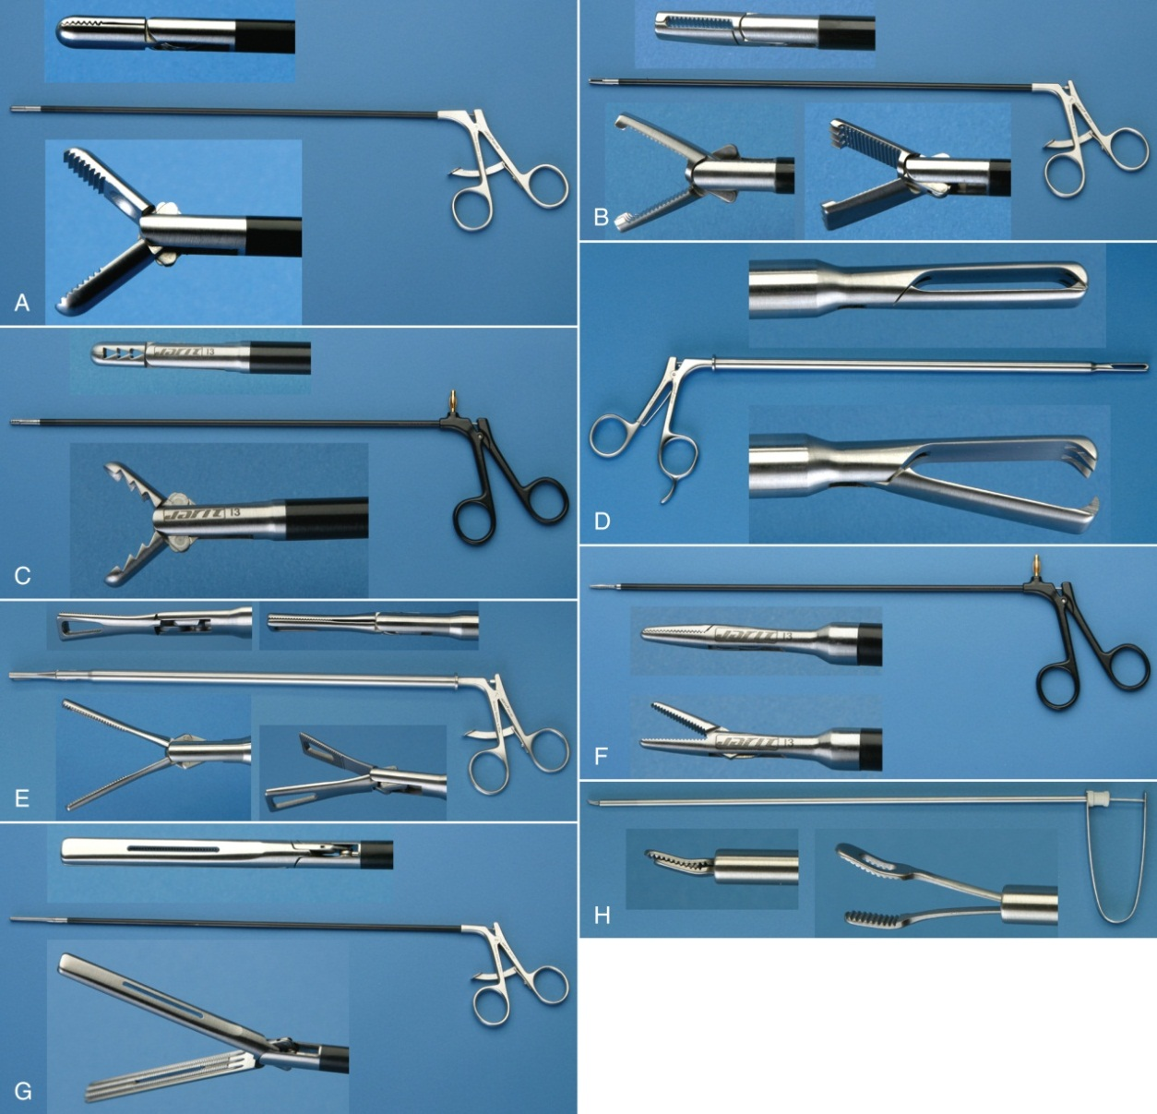
Rigid Endoscopic Instruments
Courtesy Jarit Instruments, Hawthorne, NY.
Notes:
The working tips of endoscopic graspers match those of graspers for open surgery.

Slide 39
When to Inspect MIS Instruments
Before use
During use
After use
After decontamination
Before disinfection and sterilization
Notes:
The chain of care starts before surgery and continues through the intraoperative and postoperative reprocessing periods.

Slide 40
What to Look For:
MIS Instrument Inspection
Working ability
Surface defects
Overall integrity
Free of debris and body fluids
Intraoperatively
  Clean instruments as you go
Notes:
Electrosurgical instruments must be checked for breaks in insulation. Even a small defect my result in an unintentional burn.
All instruments must pass through a cleaning and terminal decontamination or sterilization process immediately after use.

Slide 41
Endoscopic Setup
Keep endoscopic instruments in racks
Place telescopes on towel
Thermos can be used to prewarm scopes
Use nonpenetrating clamps to secure cords
Ensure correct cord for correct connection
Orient instruments with working tip down
Dim room lights for better visibility
Notes:
The scrub should be prepared and familiar with the facility equipment before participating as a solo scrub.
A dry run of equipment is a necessary part of learning endoscopic and MIS procedures.

Slide 42
Principles of Flexible Endoscopy
Viewing inside body passages or organs
Introduced through a natural opening
Advanced carefully
Biopsies and examination
Notes:
The most common use of the flexible endoscope is examination or visual exploration and biopsy.

Slide 43
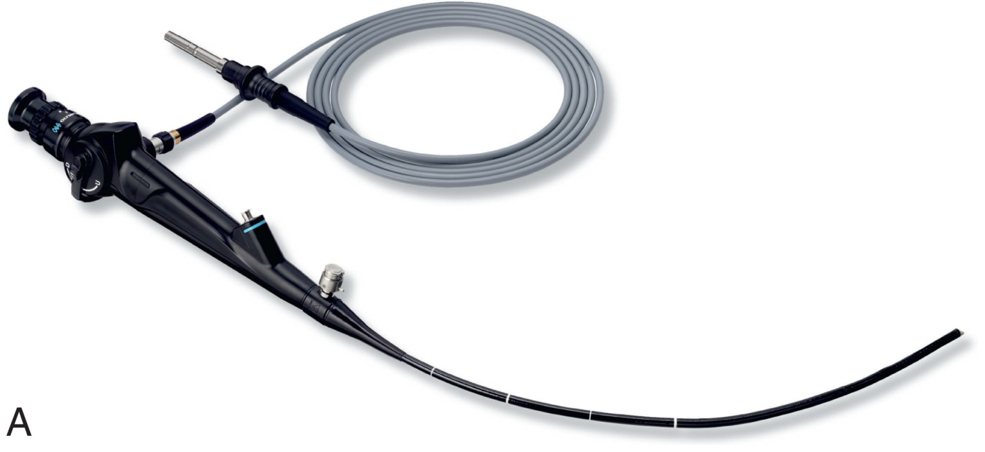
The Flexible Endoscope
Courtesy Olympus America, Center Valley, Pa.
Notes:
Flexible endoscopy is usually performed in an outpatient setting.
What are the responsibilities of the scrub during endoscopic procedures? (During the procedure, the scrub maintains suction and irrigation devices and helps place biopsy instruments into the endoscope. The scrub also receives specimens as they are withdrawn from the endoscope and properly preserves and documents them.)

Slide 44
Reprocessing Scopes and Instruments
Protocol and standards
Precleaning rigid scopes
  Guidelines
Precleaning optics
Notes:
Since the endoscope and instruments often come into contact with areas of the body that contain a high level of bioburden, a systematic cleaning process is necessary to ensure patient safety.
Hospital policy for reprocessing endoscopes follows Occupational Safety and Health Administration (OSHA) guidelines.
Discuss the guidelines for precleaning instruments, optical parts, and lenses. (Answers may vary.)

Slide 45
Reprocessing Scopes and Instruments (Cont.)
Flexible scope
Disinfection and sterilization
Notes:
Reference Figure 21-24, Automatic endoscope reprocessor, in the textbook.
Why are flexible scopes particularly difficult to clean? (The ports and long tube channels trap debris, and determining how much has been removed during cleaning is difficult.)
Sterilization methods vary with the type of equipment and the specifications of the manufacturer.

Slide 46
Robotic-Assisted Surgery
Lesson 24.3
Describe the principles of robotic surgery.
Discuss the concept of Cartesian geometry as it applies to robot design.
Describe robotic movements and classification.
Discuss training resources for robotic surgery.
List the three main components of robotic surgery and describe their function.
Identify possible methods of decontaminating and reprocessing robotic instruments.
Describe the roles of team members during robotic surgery.

Slide 47
Principles of Robotics
Mechanical device programmed to perform a task
Minimally invasive with computer guidance
Notes:
Robotic surgery combines the techniques of minimally invasive surgery with computer-guided instruments.

Slide 48
Robotic Movement
Enabled by articulated sections
Cartesian coordinate geometry
Spatial dimensions
Degree of rotation
Notes:
The surgical robotic system movements closely resemble the actions of the human body, allowing the arm to move up, down, side to side, and back and forth.

Slide 49
Classification of Robots
Their design
  Determines types of movements
Their reaching space (working envelope)
  Actual space in which they move
Notes:
What is the difference between a servo-controlled robot and a nonservo robot? (A servo robot responds through its sensors, whereas a nonservo robot has no feedback or sensing abilities.)
The da Vinci system is the one surgical robotics system in the United States that is approved for telesurgery.
What is robotic telesurgery? (In telesurgery, instruments are inserted manually or with electronic assistance but are controlled through a remote nonsterile console near the sterile field.)

Slide 50
Advantages of Robotic Surgery
Images are 3-dimensional
Reduce tremor and movement scale
Closely replicate human movement
Notes:
Robotic surgery allows greater depth perception and increased precision over traditional MIS.

Slide 51
Disadvantages of Robotic Surgery
Expensive and uses valuable resources
Requires on-site coordinator
Surgeons must receive training
Notes:
What does the absence of haptic feedback mean for surgeons being retrained on remote instrument manipulation? (During robotic telesurgery, the surgeon must rely on vision alone while manipulating the hand and foot controllers.)

Slide 52
Robotic Training
System preparation and management
Inanimate labs for skills development
Procedure training
Rehearsals
Video podcast
Notes:
All members of the surgical team must receive special training.
Training for the da Vinci system is available from the manufacturer at various locations.

Slide 53
Additional Resources
In-service programs with in-house personnel
In-service program with manufacturer’s representatives
Role observations
Rehearsals
Supervised practice
Mentoring and feedback
Notes:
The surgical technologist should have access to both on-site and off-site learning opportunities.
Continuing education is critical as the technology is modified and refined.

Slide 54
Surgical Specialties and Robotics
Orthopedic
Cardiovascular
General surgery
Gynecology
Urology
Neurology
Notes:
Robotics is rapidly evolving, and new procedures are being developed constantly.
What are some of the procedures performed using robotic-assisted MIS? (Joint replacement procedures, valve repair, lung resection, gastrointestinal resection,
removal of tumors, hysterectomy, myomectomy, sacrocolpopexy, prostatectomy, cystectomy, and tumor resection.)

Slide 55
Components of the Robotic System
Patient cart
Surgeon console
Imaging system
Notes:
Formal training is required to operate the robotic system safely.
In robotic-assisted surgery, the surgeon is not scrubbed but sits at the console and manipulates the instruments. The console is placed outside the sterile field but close enough for effective communication between the surgeon and other team members.

Slide 56
Instruments Used in Robotics
Scissors
Graspers
Knife
Probe
Needle holder
Ultrasonic energy instruments
Notes:
Reference Figure 21-27, Various instruments, in the textbook.

Slide 57
Decontaminating and Reprocessing Robotic Instruments
Life span
Online resource
Notes:
Some instruments have a “life span” – meaning they have a certain number of uses before they are not to be used again. Usually this number is ten (10).
These instruments should be sterilized between patients.
Robotic instruments should be cleaned, disinfected, and sterilized according to specific protocols; consult the manufacturer.
There are online resources that are excellent for providing info on reprocessing instruments, especially the da Vinci system.

Slide 58
Setup for Robotic Surgery
Room setup
  Optimizes safety and communication
Equipment positions guidelines
Sequence for robotic surgery
  Adjustment of components
  Nonsterile connections are made
  Sterile setup is completed
  Procedure begins
Notes:
The robotic surgery equipment should be positioned in a manner that protects the field from contamination.
The operative setup must be preplanned so that anesthesia time is not used for tasks that should take place before surgery.

Slide 59
Individual Roles in Robotic Surgery
Surgeon
Surgical assistant
Scrub
Circulator and coordinator
Notes:
Describe the roles of the various team members during robotic surgery. (The surgeon performs sterile techniques to place the trocars. He or she then breaks scrub to operate from the surgeon’s console. The surgeon returns to the sterile field (after scrubbing, regowning, and gloving) near the close of the procedure to remove the trocars and close the incisions. The surgeon directs the flow of the procedure and is responsible for coordinating the activities of everyone on the team. The surgical assistant performs other specific tasks at the sterile field. These include exchanging instruments on the sterile robotic arms and managing any instruments that are outside the control of the robotic system. For example, in gynecological surgery, the first or second assistant controls the uterine manipulator. The assistant works closely with the scrub to maintain a clean, safe operative field. Instrument exchanges and management of the sterile robotic components are the dual responsibility of the surgical assistant and the scrub. The scrub maintains the robotic instruments during surgery and assists or directs the draping procedures. After the cannulas have been placed, the scrub may direct the positioning of the patient cart. The scrub is familiar with the operation of all electronic and vision components, assisting in registration and white and black balance. He or she may also operate the clutch arms and, at the close of surgery, help retract all the instruments. The circulator directs all the scrubbed and nonsterile staff during surgery.)

Slide 60
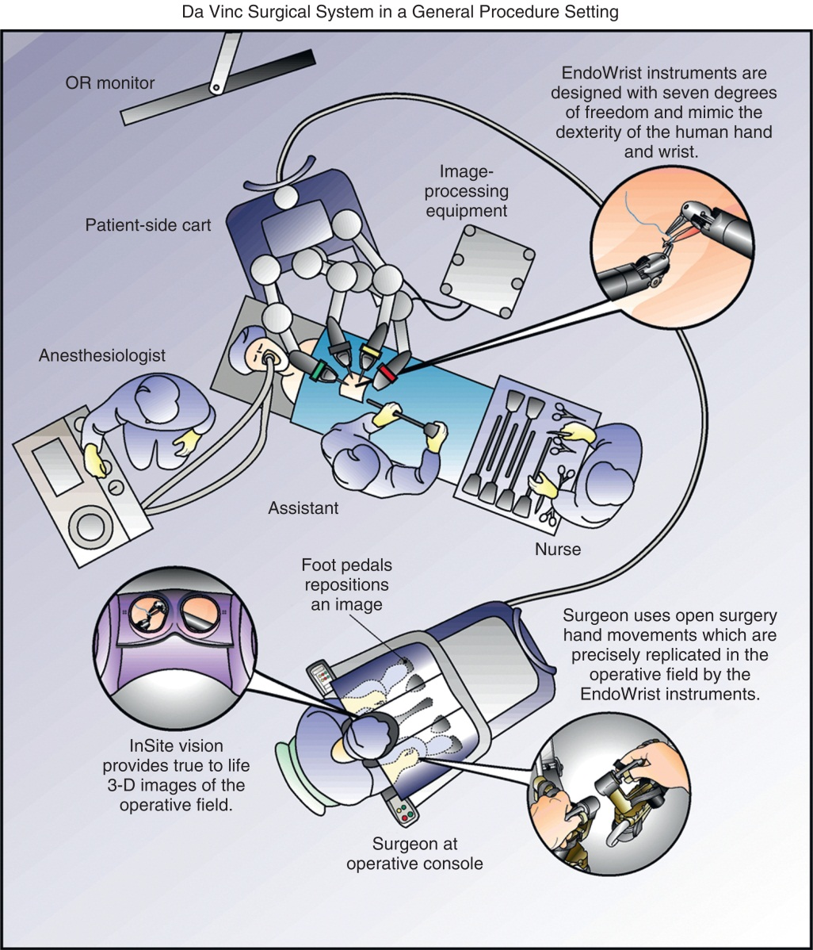
Room Setup:
Robotic-Assisted Surgery
Courtesy Intuitive Surgical, Inc., 2007.
Notes:
Components need to be positioned in a way that optimizes safety and communication among team members.

Slide 61
Questions?

