Slide 1

SAINT VIATOR HIGH SCHOOL
Class of 2012
The College Application Process

Slide 2
How to Gather Information about Colleges:
Visit Mrs. Duggan in the College Counseling Office.
Meet college reps during lunch periods. A calendar of
colleges visiting can be found on the counseling page
of the Saint Viator web site and Family Connections.
Explore the internet (Family Connections, Princeton Review
and Collegeboard are three great Web sites.)
Listen to the announcements and look at the bulletin
board outside the Counseling Office for information.
Visit college campuses.
Check out the “College Handbook” & the “Book of
Majors” in Mrs. Duggan’s office or the Counseling Office.

Slide 3

What do colleges for:
(in order of importance)
  1. School achievement (your high school
  transcript is the most important thing
  colleges will look at)
  2. Test scores (ACT/SAT)
  3. Letters of recommendation (if required)
  4. Essay (if required)
  5. Interview (if required)
  Activities (be sure to highlight those activities
  showing leadership, dedication, or uniqueness.)

Slide 4
There are 3 ways to complete
college applications
  Online application
  (preferred by most colleges)
  Common application
  (accepted by 456 colleges)
  Paper application
  (this would be very few colleges)

Slide 5
Online Application
Fill out the online application and download a
completed copy for your files.
Download the counselor report or school form if it
is required.
Please list Mrs. Duggan as counselor with the title college counselor on all forms.
Come to the Counseling Office and pick up one
transcript request form for each school where you will be
applying. It is recommended you have transcript request
forms handy while filling out the online application so you
know and can mark what is required to be mailed by the
Counseling Office
Attach the counselor/school form and any other required
forms to the transcript request form and place in the
“completed application” basket in the Counseling Office.
DEADLINES ARE IMPORTANT!

Slide 6
Common Application
Fill out the Common Application online. www.commonapp.org
Many schools will have a supplemental form to also fill out
online.
Complete the online application and then print or e-mail the
TEACHER EVALUATION forms, if required. You may e-mail
requests for letters of recommendation to teachers if they are
comfortable completing letters online. Be sure to check with
them.
Print the SECONDARY SCHOOL REPORT, MID-YEAR REPORT,
AND FINAL REPORT if required by the school.
Be sure to sign and date all forms.
Attach all required forms to the transcript request form and
place in the “completed application” basket in the
Counseling Office.
  Deadlines Are Important

Slide 7
SUMMARY
Steps to take at Saint Viator when filling out a
college application:
Complete all the required information.
Note carefully all deadlines.
Request letters of recommendation from teachers if needed. Be
sure to give them 10 school days to write the letter. Give teachers
a date the letter is due in the Counseling Office or online.
Complete a TRANSCRIPT REQUEST FORM for each school where you
apply. They are available in the
Counseling Office.
Attach all required documents to the transcript request form.
ACT/SAT Scores.
  We are required to send ALL scores that are reported to us. You can request that we NOT send any scores.
  If you only want a particular score sent, you can request individual scores directly from ACT by going to their website www.act.org.
EXPECT FIFTEEN (15) SCHOOL DAYS
FOR PROCESSING.

Slide 8
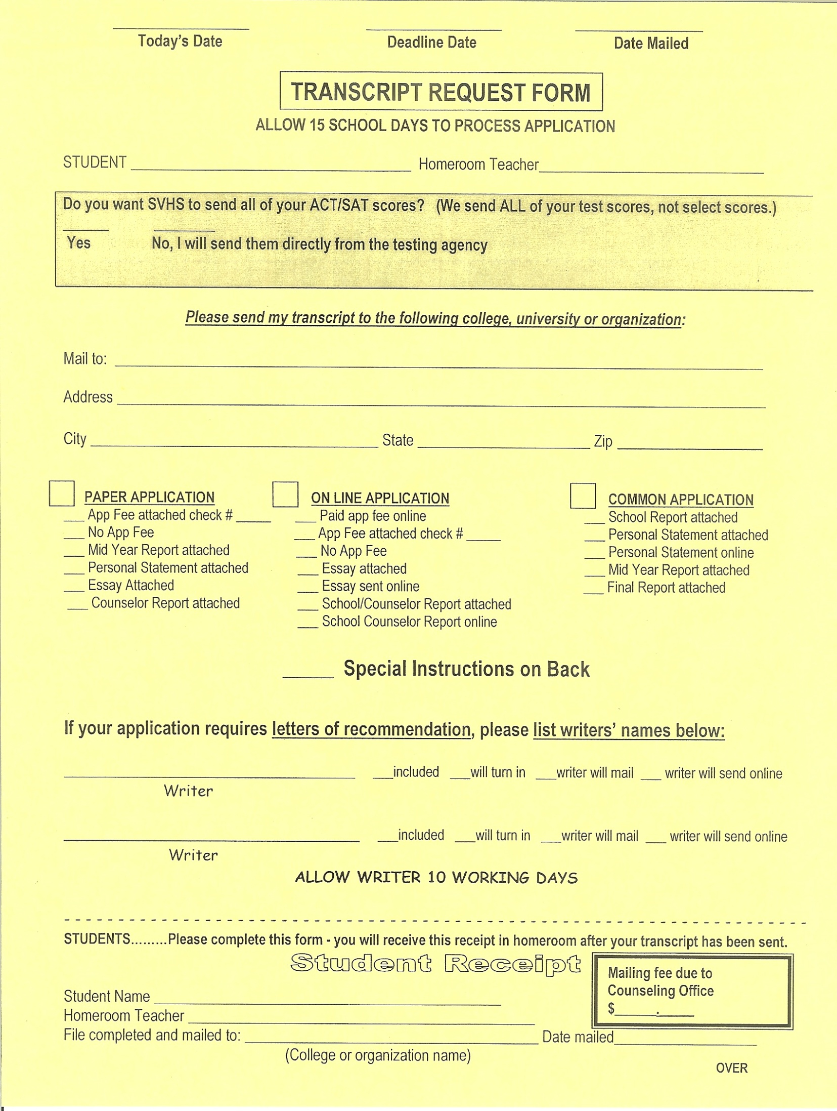

Slide 9
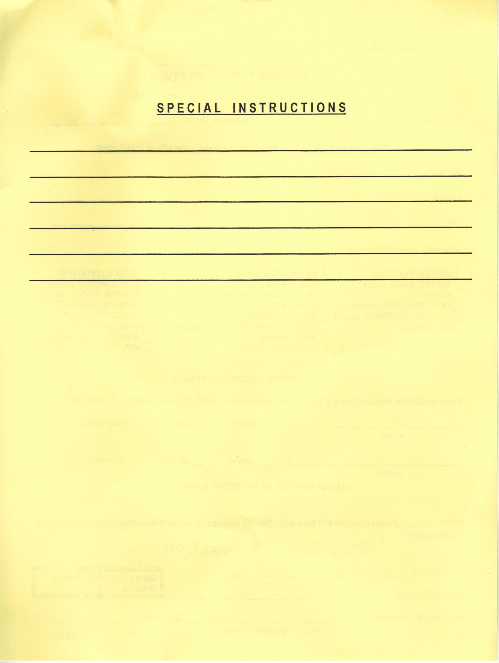

Slide 10
LETTERS OF RECOMMENDATION
All students should fill out a STUDENT SELF-ASSESSMENT FORM on Family Connection. You should click “update” when finished. You can always go back and add new things.
Print completed STUDENT SELF-ASSESSMENT and turn in to your Ethics teacher for extra credit.
Ask teachers IN PERSON to write you a letter of recommendation.
Give teachers a REQUEST FOR LETTER OF RECOMMENDATION FORM (available in the Counseling Office). Inform teachers of required deadlines.
Establish with each teacher whether he/she will mail or e-mail the
letter directly to the college or if it will be turned in to the
college counselor to be mailed with the application.
Take time to thank the people who help you with the application
process.

Slide 11
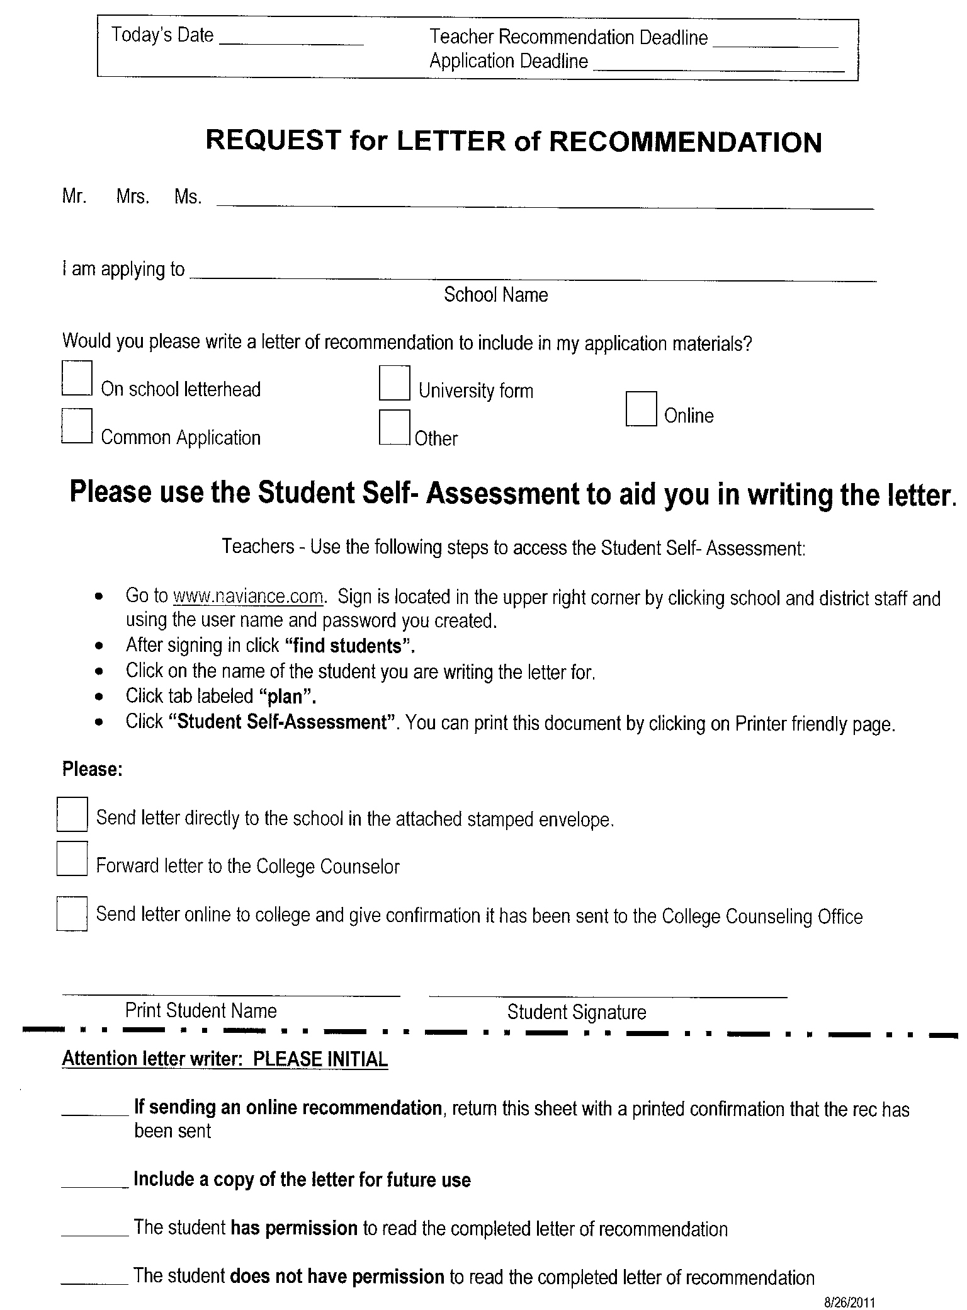

Slide 12
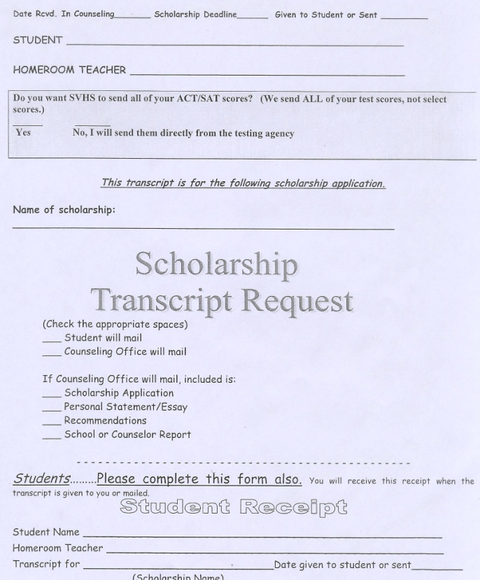
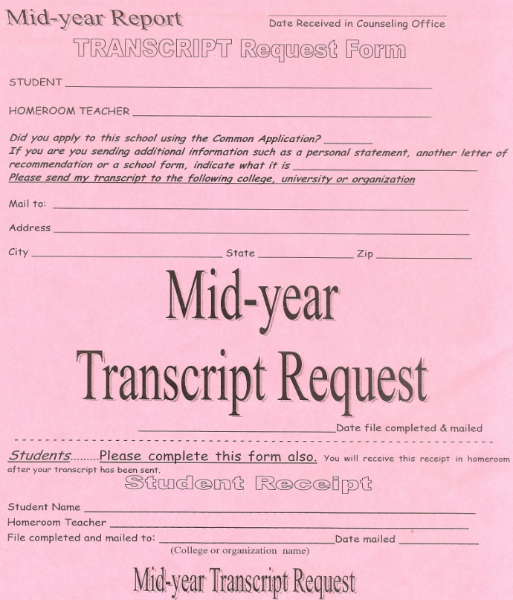
Some other forms you will need:
Mid-Year Transcript Request
Scholarship Transcript Request
If you apply for scholarships, you
must use this form to request
a scholarship transcript.
Many colleges request
you send your 1st semester
senior year transcript in
January.

Slide 13
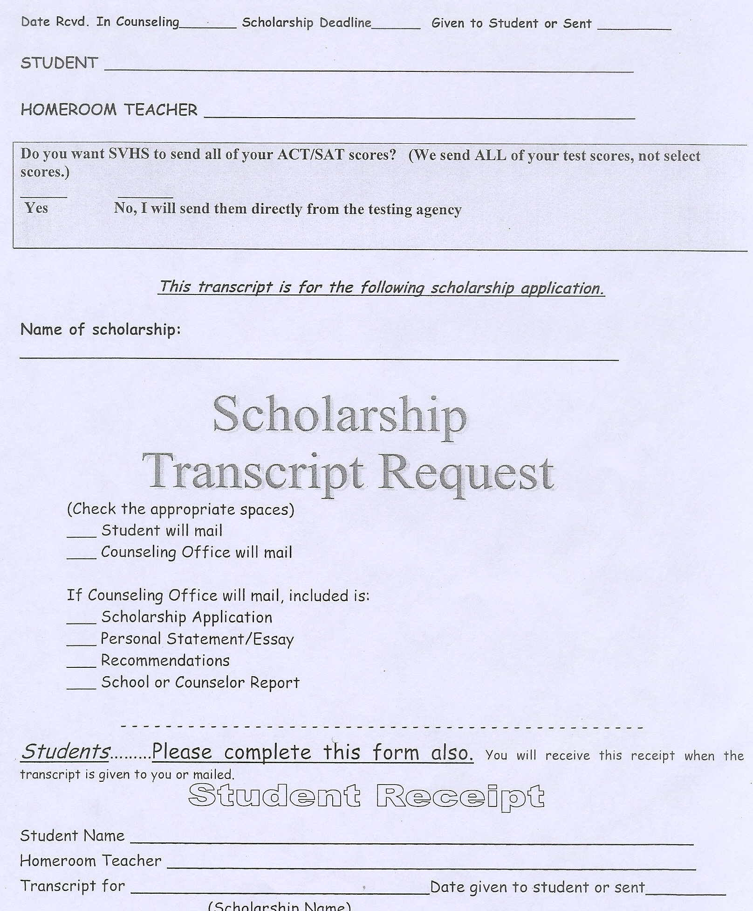

Slide 14


Slide 15
Upcoming College Events
Attend the College Panel at Saint Viator on September 14 at 7PM in the auditorium.
Attend the Financial Aid Night at Saint Viator on November 16 at 7PM in the auditorium.
FAFSA can be applied for on or after January 1, 2012

Slide 16
VERY Important Tips
Senior year counts. (see next slide)
GPA can still change!
All college admissions are temporary.
Colleges review your final transcript after graduation.

Slide 17
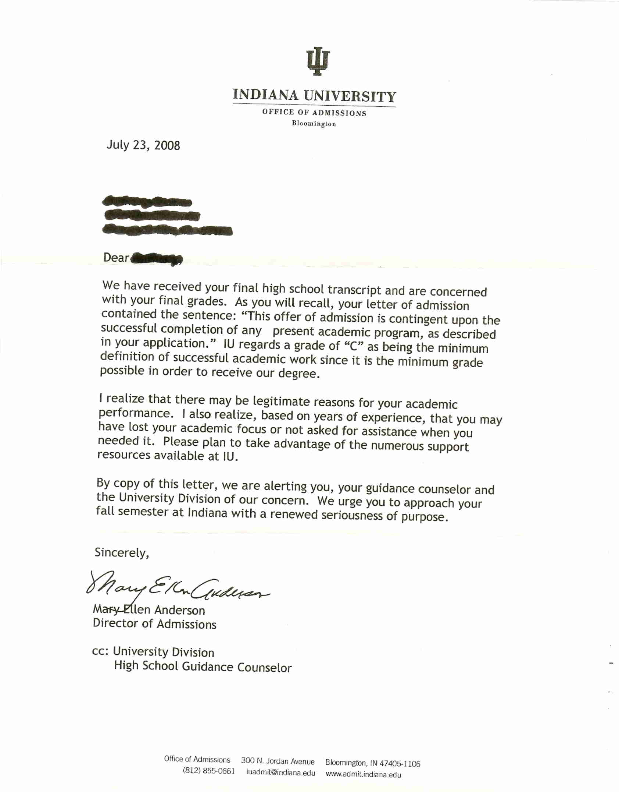

Slide 18
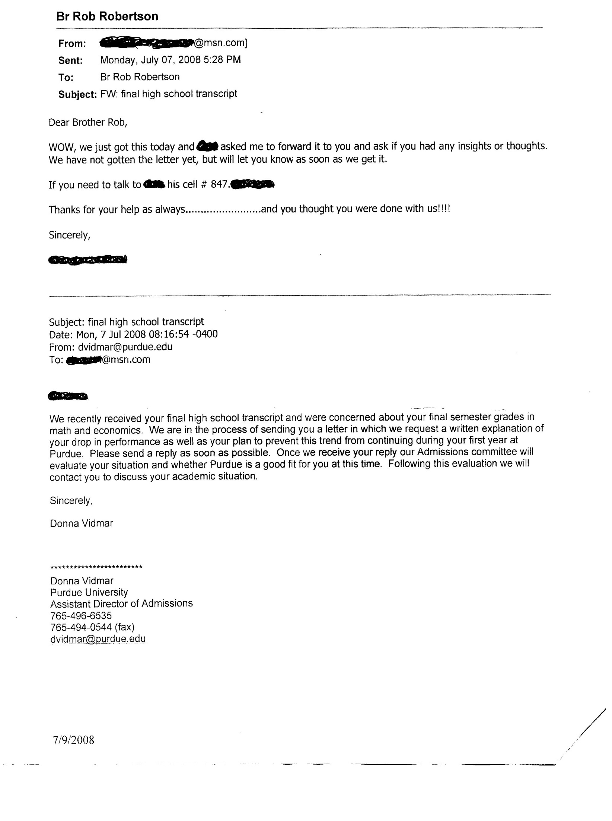

Slide 19
FINALLY!!
RELAX!
Have fun with the process.
Mrs. Duggan and Bro. Rob are
here to help you
JUST ASK!!!!

