Slide 1

SAINT VIATOR HIGH SCHOOL
Class of 2014
The College Application Process

Slide 2
How to Gather Information about Colleges:
Visit Mrs. Duggan in the College Counseling Office.
Meet college reps during lunch periods. A calendar of colleges visiting can be found on the counseling page of the Saint Viator web site and on Naviance.
Explore the internet (Naviance, Princeton Review
and College Board are three great Web sites.)
Listen to the announcements and check the bulletin
board outside the Counseling Office for information.
Visit college campuses.
Check out the “College Handbook” & the “Book of
Majors” in Mrs. Duggan’s office or the Counseling Office.

Slide 3

What do colleges for:
(in order of importance)
  1. School achievement (your high school
  transcript is the most important thing
  colleges will look at)
  2. Test scores (ACT/SAT)
  3. Letters of recommendation (if required)
  4. Essay (if required)
  5. Interview (if required)
  Activities (be sure to highlight those activities
  showing leadership, dedication, or uniqueness.)

Slide 4
How To Apply
Go to college website
Follow prompts to apply for undergraduate admission
Know all materials needed for complete application
Be sure to meet all admission and scholarship deadlines
School reports for Common Applications should be sent to college counselor , Mrs. Duggan at kduggan@saintviator.com not to Bro. Rob

Slide 5
How To Send Transcripts
Click “Request My Transcript” on Saint Viator home page.
Click “Get My Transcript Now”
You must be signed up to do this.
Follow the prompts.
“Hint” check no when asked about sharing information with colleges that may be interested in me. It will save you time

Slide 6
How To Send ACT/SAT scores
If sent when registered for ACT/SAT no action required.
If you need to send go to www.act.org and follow prompts for “send scores”
The fee is $11 per test/ per school that is sent
For SAT go to www.collegeboard.org, click on SAT, click send scores, $11.25
Saint Viator DOES NOT send ACT/SAT scores. It is your responsibility

Slide 7
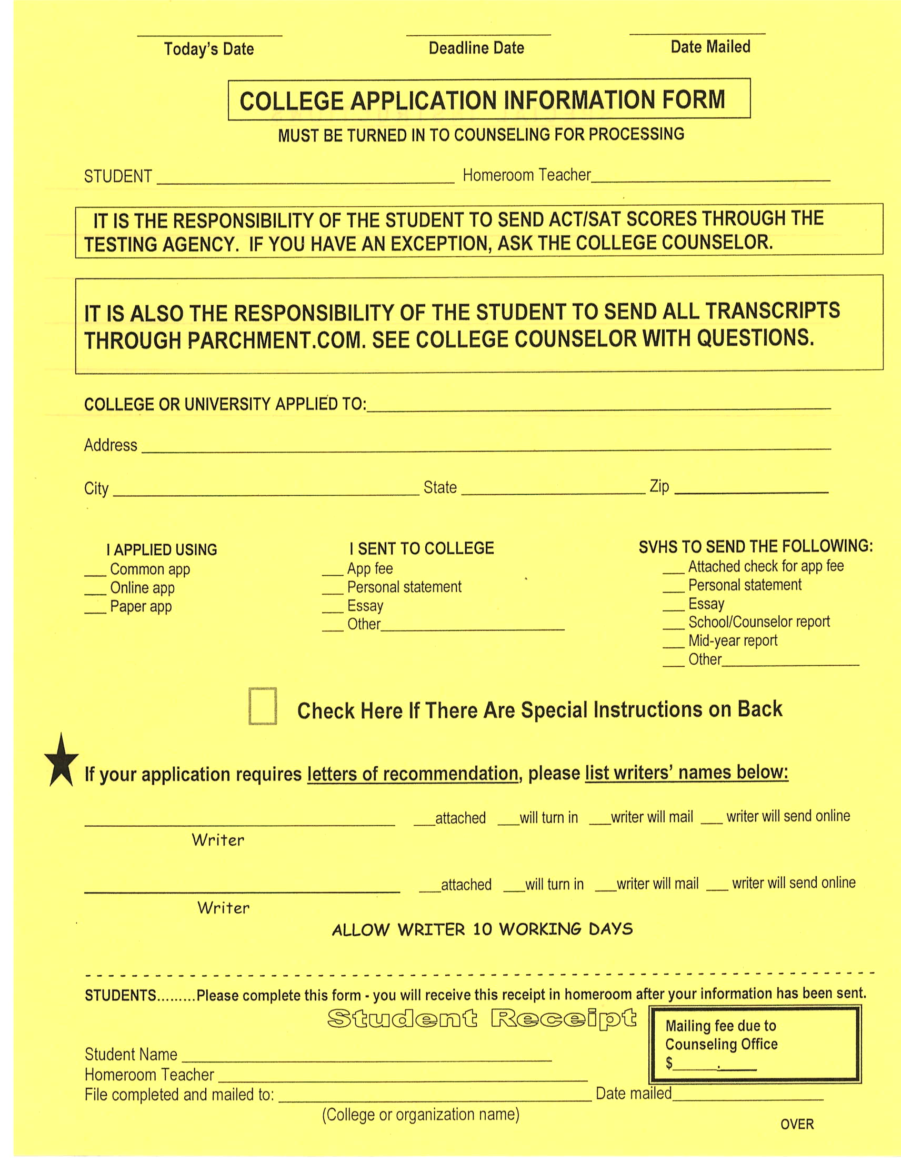

Slide 8


Slide 9
LETTERS OF RECOMMENDATION
Give staff 10 school days to write your letters of recommendation
All students should fill out a STUDENT SELF-ASSESSMENT FORM on Naviance. Click on ABOUT ME and find self-assessment on left. Click “update” when finished or it will not save. You can always go back and add new things.
Print completed STUDENT SELF-ASSESSMENT and turn in to your Ethics teacher for bonus points.
Ask teachers IN PERSON to write you a letter of recommendation.
Give teachers a REQUEST FOR LETTER OF RECOMMENDATION FORM (available in the Counseling Office). Inform teachers of required deadlines.
Establish with each teacher whether he/she will mail or e-mail the
letter directly to the college or if it will be turned in to the
college counselor to be mailed with the application.
Take time to thank the people who help you with the application
process.

Slide 11
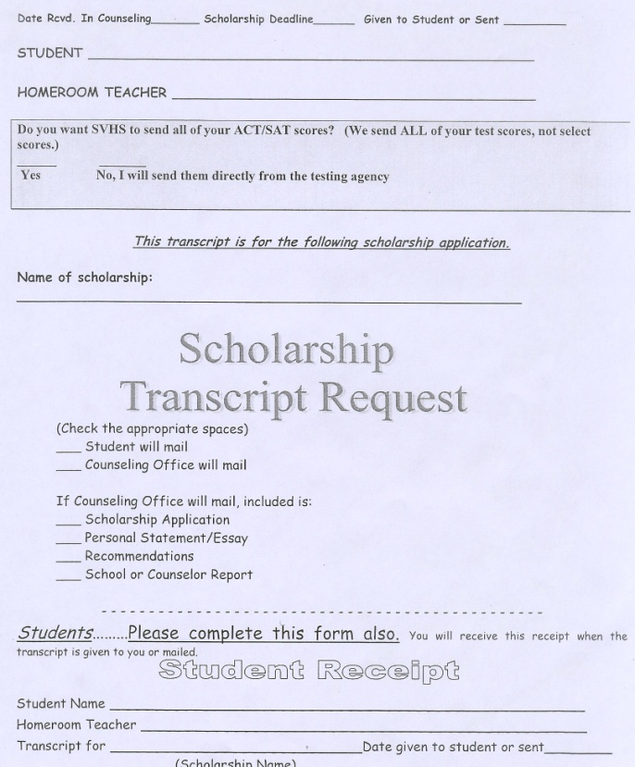
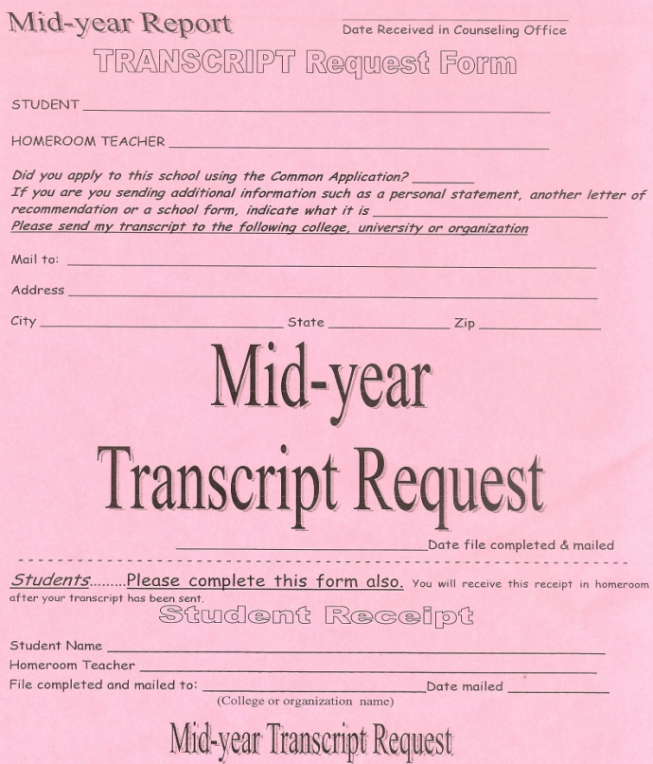
Some other forms you will need:
Mid-Year Transcript Request
Scholarship Transcript Request
If you apply for scholarships, you
must use this form to request
a scholarship transcript.
Many colleges request
you send your 1st semester
senior year transcript in
January.

Slide 12
Upcoming College Events
Attend the College Panel at Saint Viator on Thurs., September 26 at 7PM in the auditorium.
Attend the National College Fair at Navy Pier on Sat., Sept. 28 from 11:00 – 3:00.
Attend the Financial Aid Night at Saint Viator on Wed., November 13 at 7PM in the auditorium.
FAFSA can be applied for on or after January 1, 2014

Slide 13
VERY Important Tips
Senior year counts. (see next slide)
GPA can still change!
All college admissions are temporary.
Colleges review your final transcript after graduation.

Slide 14
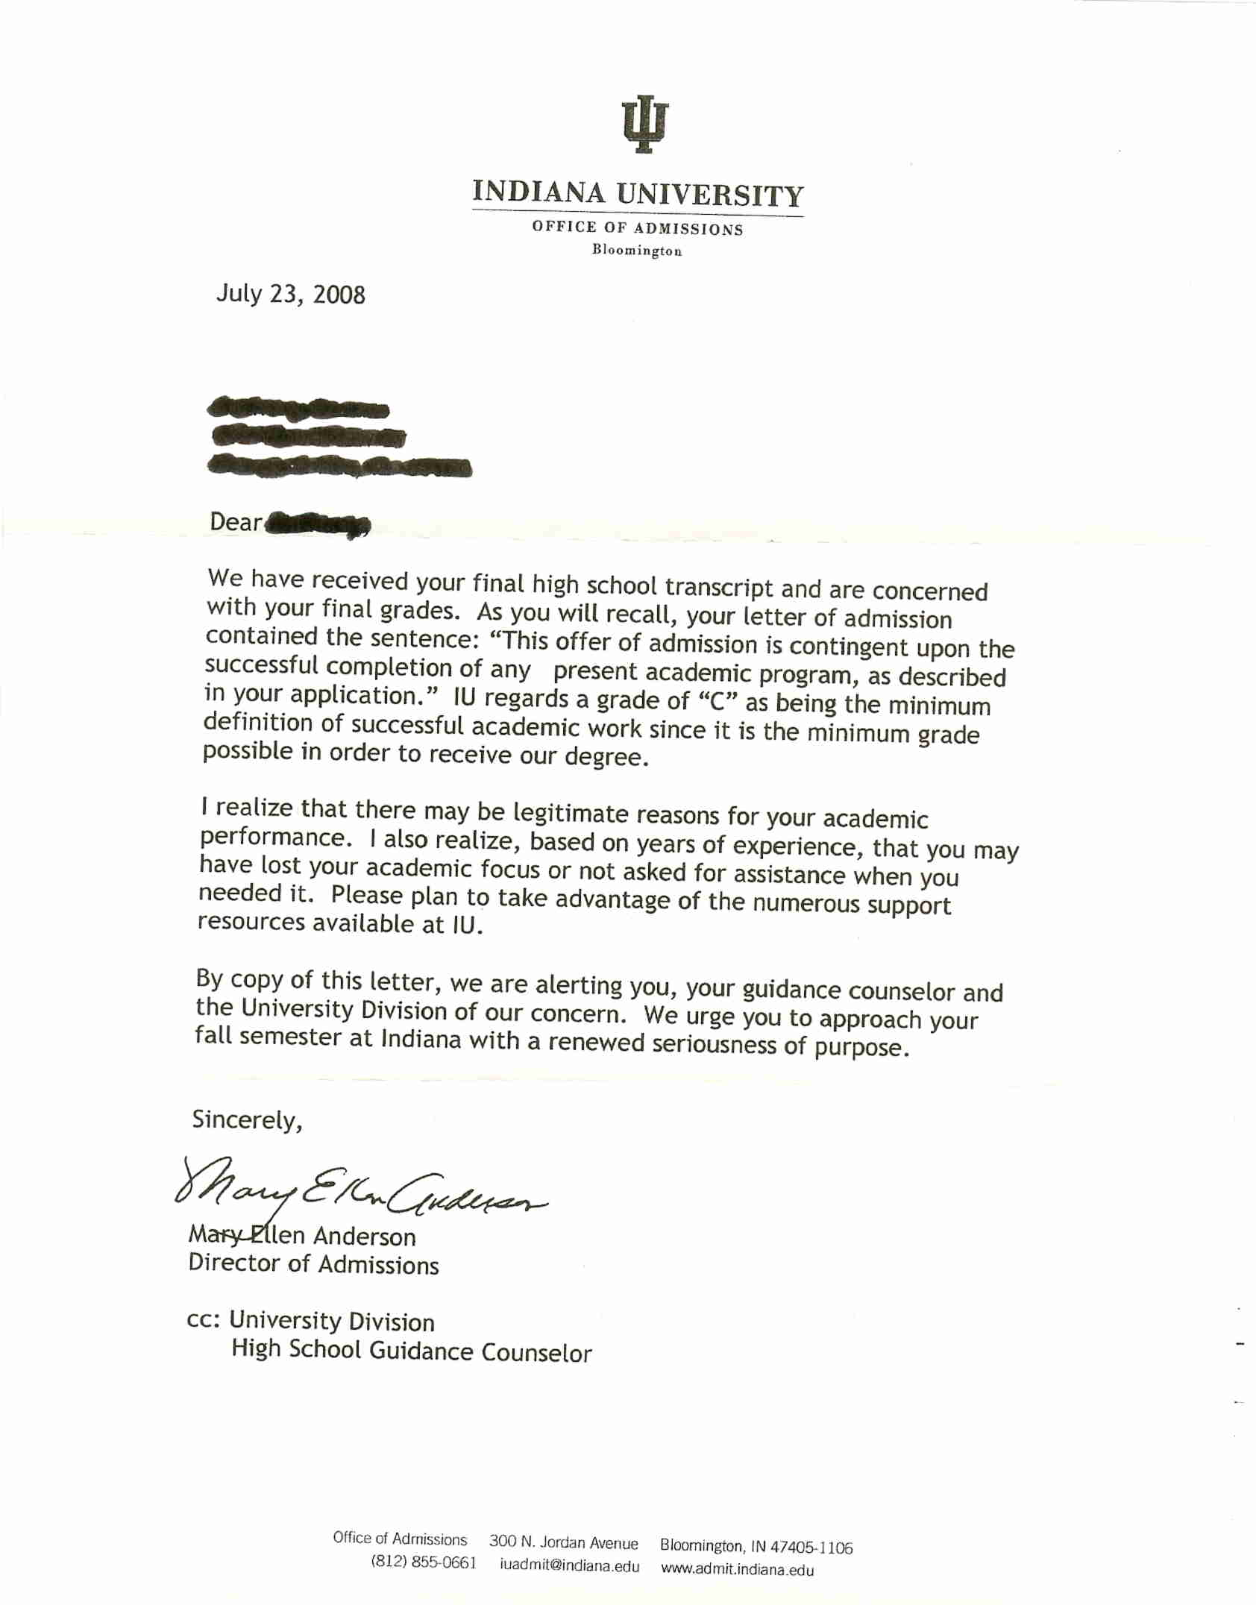

Slide 15
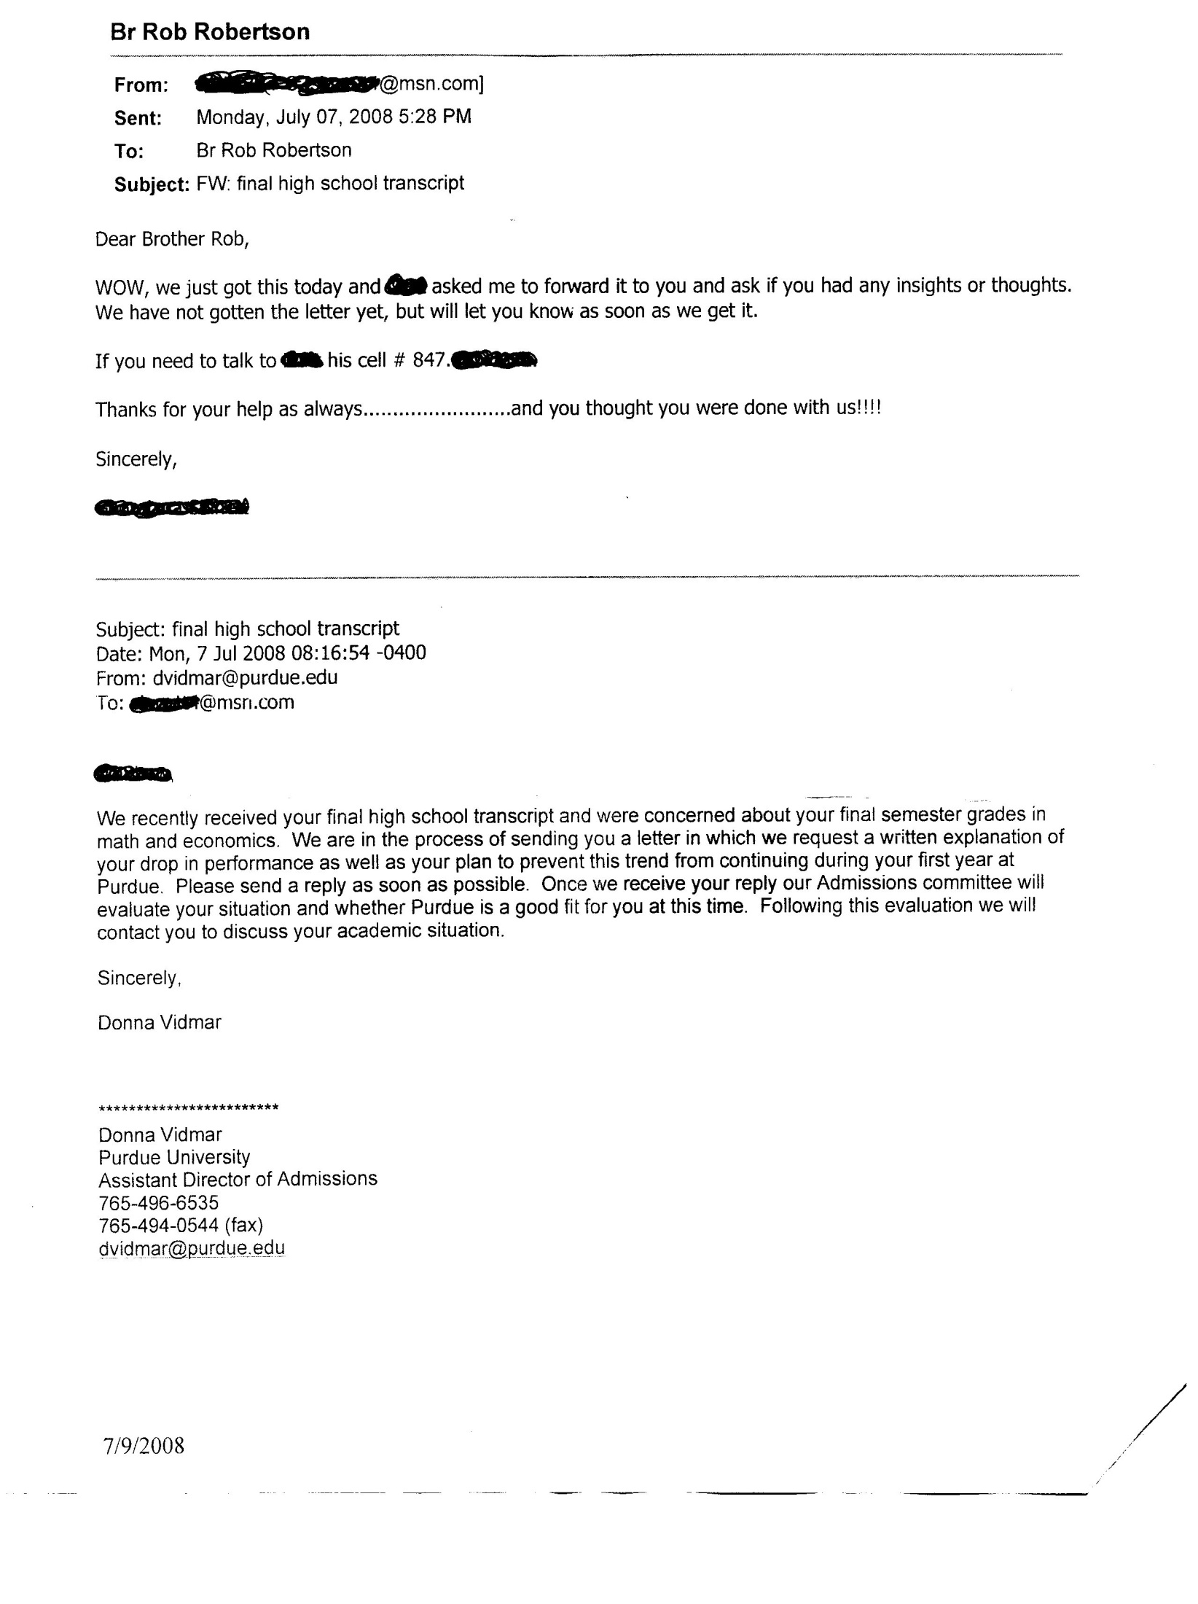

Slide 16
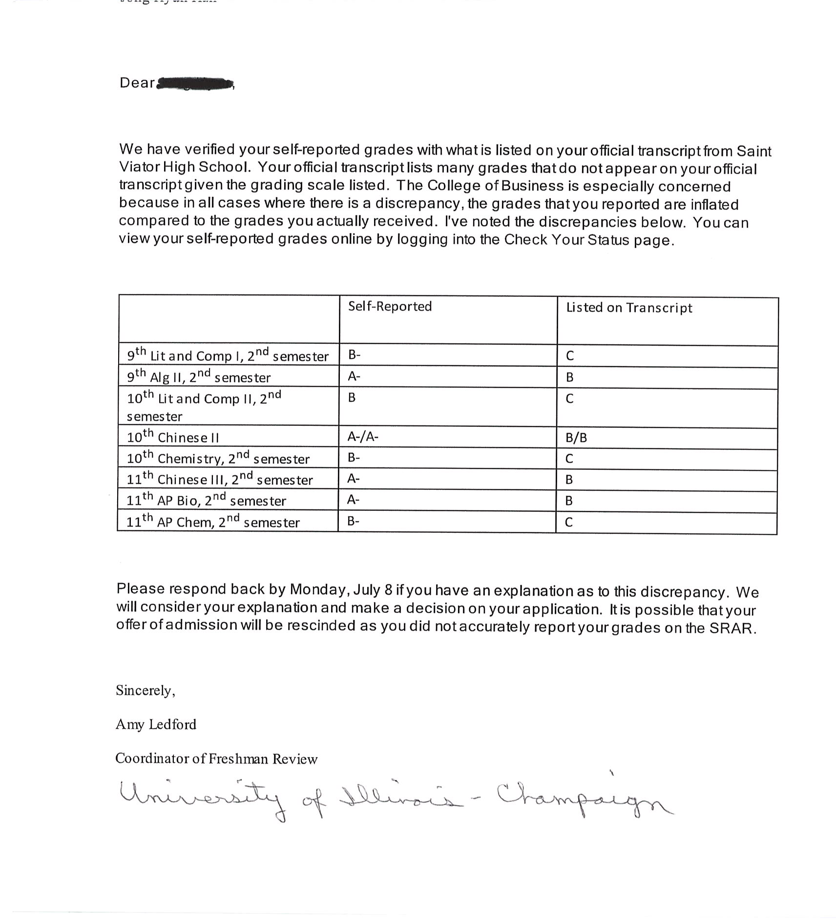

Slide 17
FINALLY!!
RELAX!
Have fun with the process
Mrs. Duggan and Br. Rob are
here to help you
JUST ASK!!!!

