Slide 1
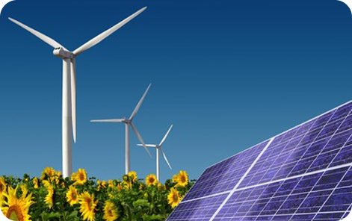
Renewable Energy
Module 2

Slide 2
Please write your names on your Modules …! ☺

Slide 3
Module Objectives
Define renewable energy
Compare renewable energy and non renewable energy
Describe different ways of generating renewable energy
  Solar Energy
  Wind Energy
  Water Energy
Conduct practical tasks to demonstrate the applications of solar cells, windmills and water turbine.

Slide 4
Introduction to Renewable Energy
Video
Question :
What is renewable energy?
Answer:
Renewable Energy is any naturally occurring, theoretically inexhaustible source of energy, as biomass, solar, wind, tidal, wave, and hydroelectric power, that is not derived from fossil or nuclear fuel.

Slide 5
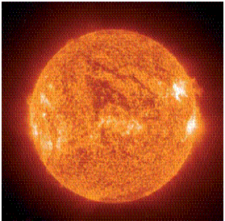
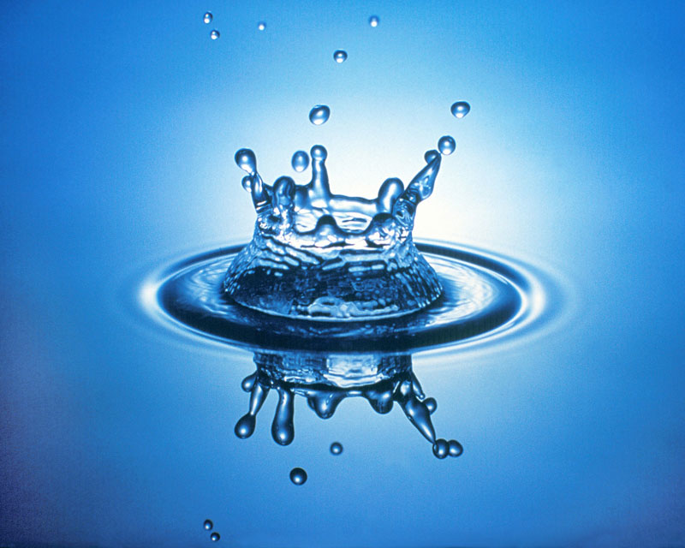
Example of renewable energy
One common example of renewable energy is when the sun is used to heat up water to provide hot water in a house. This is known as Solar energy, i.e. energy provided by the sun.

Slide 6

Other forms of renewable energy
There are many other types of renewable energy sources, examples include:
wind,
tidal (energy produced by waves in oceans and seas),
geothermal (underground heat) etc.

Slide 7
Difference between renewable energy and non renewable energy
Generators studied in Module 1
Real life generators use diesel or some other form of fuel
The energy produced by generators is used to power houses, machines, factories etc.
This source of energy is non-renewable.
who can tell me WHY?
Non-renewable energy sources such as gas and oil, once used these resources CANNOT be used again, i.e. one day we will run out of gas, oil etc.

Slide 8
Difference between renewable energy and non renewable energy
Another reason for the increase in the use of renewable energy sources is that:
  they provide energy with far less damage to the environment than renewable energy sources,
  because they do not produce much waste or pollution.
However, renewable energy is still expensive to produce compared to non-renewable sources.

Slide 9
Module Objectives
Define renewable energy
Compare renewable energy and non renewable energy
Describe different ways of generating renewable energy
  Solar Energy
  Wind Energy
  Water Energy
Conduct practical tasks to demonstrate the applications of solar cells, windmills and water turbine.

Slide 10
Open your Modules
Page number 5 and 6

Slide 11
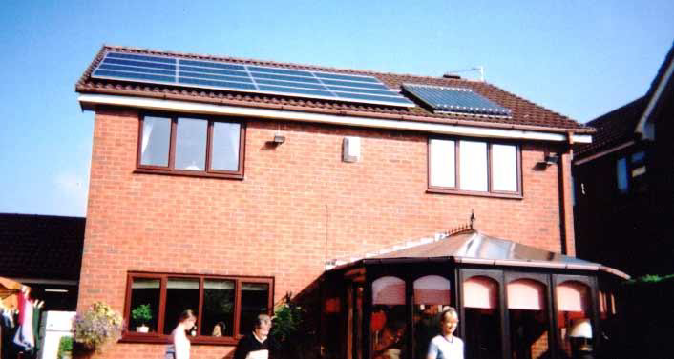
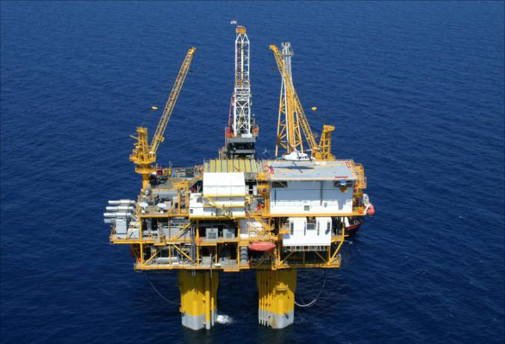
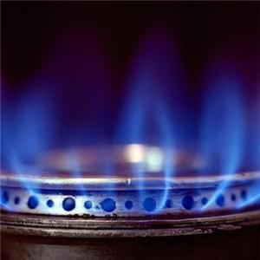
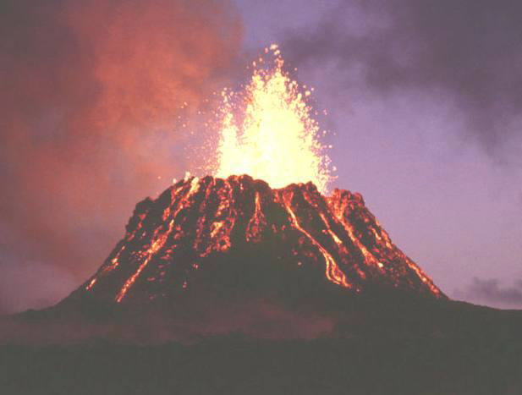

What kind of Energy is this?
Renewable Energy or Non Renewable Energy
Video

Slide 12
Module Objectives
Define renewable energy
Compare renewable energy and non renewable energy
Describe different ways of generating renewable energy
  Solar Energy §
  Wind Energy
  Water Energy
Conduct practical tasks to demonstrate the applications of solar cells, windmills and water turbine.

Slide 13
Solar Energy
Video
Video
The Sun has an immense output of energy.
Only a small part of this energy is intercepted by the earth, reaching us in the form of visible light.
The amount of power in the Sun’s rays that reach Earth is measured in watts per square meter.
Solar energy can be captured, for example, by solar cells
Notes:
Start with grade 09.08

Slide 14
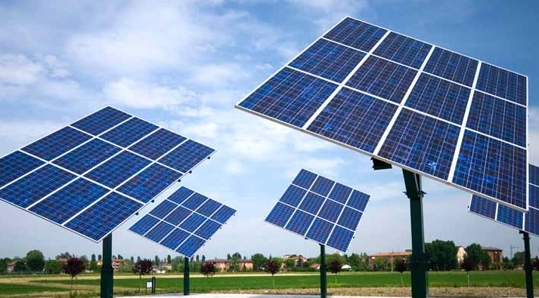
Solar Energy
Solar panels are designed to capture the suns energy
and convert it to more usable forms, such as heat or electricity

Slide 15
Technologies linked to Solar Energy
Passive Solar Energy
Active Solar Energy
Solar Cells
Activity: http://www.quia.com/jw/458933.html
Notes:
Finished till here for 09.10, 09.07, 09.12 and 09.11
Should finish till here for 09.08 , 09.06 and 09.09

Slide 16
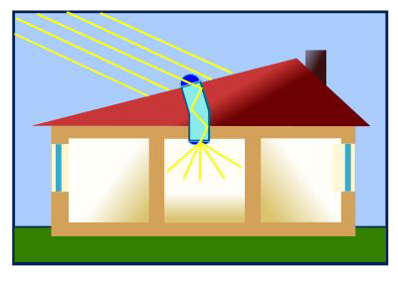
Passive Solar Energy
Passive solar energy:
  In this system the energy in sunlight is used for light and heat.
  In passive solar building design the Sun’s energy contribution is fully optimized by careful design of the building without using any additional mechanical equipment.

Slide 17
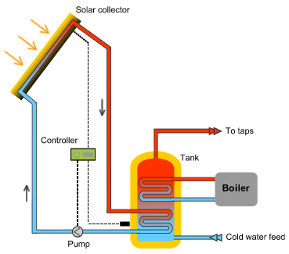
Active Solar Energy
Active solar energy:
  The Sun’s heat energy is transferred to special fluids held in solar collectors.
  This fluid is pumped through pipes in water tanks and the heat energy transferred to the water.

Slide 18
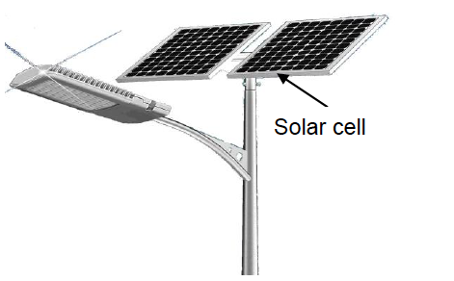
Solar Cells
Solar Cells: In this system the energy in visible light from the Sun is converted directly into an electric current by means of solar cells.
Using the photoelectric effect, loose electrons in the upper layer of the solar cell are caused to move, thus creating an electric current that can be used to operate an electrical device.
Video

Slide 19
Module Objectives
Define renewable energy
Compare renewable energy and non renewable energy
Describe different ways of generating renewable energy
  Solar Energy
  Wind Energy
  Water Energy
Conduct practical tasks to demonstrate the applications of solar cells, windmills and water turbine.

Slide 20
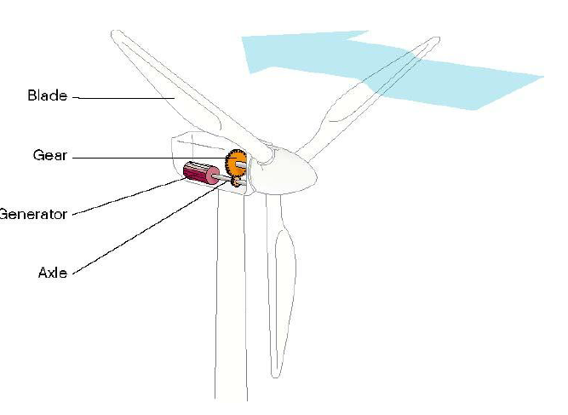
Wind Energy

Slide 21
Wind Energy
Wind energy can be captured by wind turbines.
Wind turbines are designed to capture the wind’s energy and convert it into a more useful form, such as electricity.

Slide 22
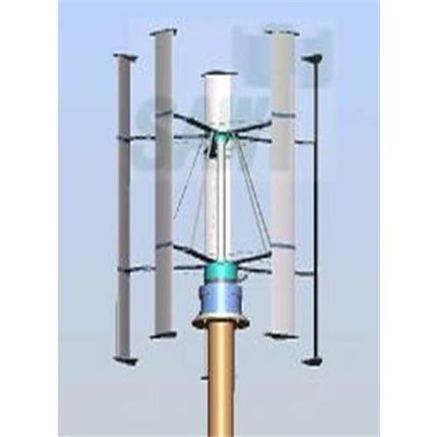
Wind Energy
Wind turbines with a vertical axis have a rotating axis and blades in a vertical position. They work equally effectively, irrespective of wind direction.
Video

Slide 23
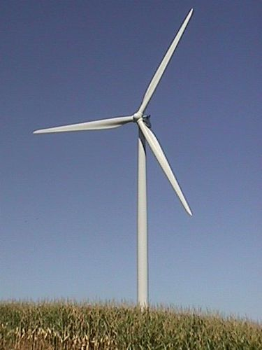
Wind Energy
Wind turbines with a horizontal axis have a rotating axis and blades in a horizontal position.
They must be faced with respect to wind direction and are the most common type of wind turbine to be found, both onshore and offshore.
Video

Slide 24
Module Objectives
Define renewable energy
Compare renewable energy and non renewable energy
Describe different ways of generating renewable energy
  Solar Energy
  Wind Energy
  Water Energy
Conduct practical tasks to demonstrate the applications of solar cells, windmills and water turbine.

Slide 25
Water Energy
What is the other name for water energy?
Moving water has kinetic energy. This can be transferred into useful energy in different ways.

Slide 26
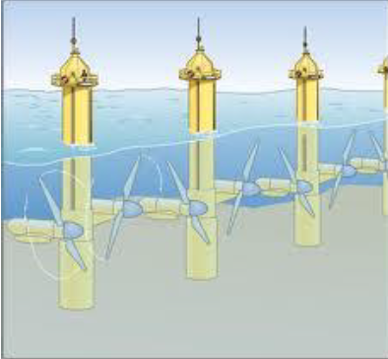

Tidal Energy
Tidal energy simply uses the energy in the sea to generate electricity.
There are several different ways in which the sea’s energy can be used to create electrical power and tidal power is one of them.

Slide 27
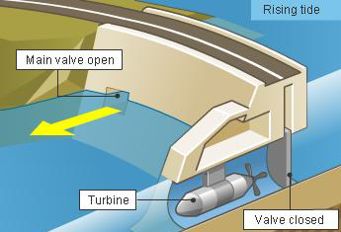
Tidal Barrages
Tidal barrages are built across the mouths of rivers.
As water moves in or out of the river’s mouth when the tide turns, the kinetic energy in the water is used to turn electricity generators.

Slide 28
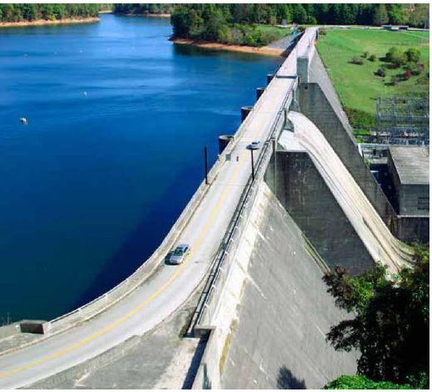
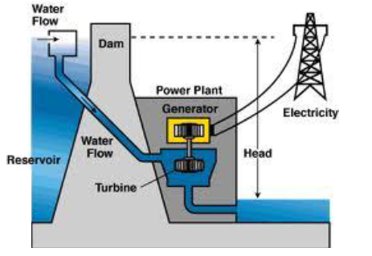
Hydroelectric Power
Hydroelectric power schemes store water high up in dams.
The water has gravitational potential energy which is released when it falls.
As the water rushes down through pipes, this stored energy is transferred to kinetic energy, which turns electricity generators.
Video
Video

Slide 29
Module Objectives
Define renewable energy
Compare renewable energy and non renewable energy
Describe different ways of generating renewable energy
  Solar Energy
  Wind Energy
  Water Energy
Conduct practical tasks to demonstrate the applications of solar cells, windmills and water turbine.

Slide 30
Glossary
Inexhaustible: incapable of finishing
Biomass: organic matter, especially plant matter, that can be converted to fuel and is therefore regarded as a potential energy source.
Solar: operating energy from sun
Tidal: dependent on tides
Hydroelectric: generation and distribution of electricity derived from the energy of falling water or any other hydraulic source.

Slide 31
Glossary
Solar cells: a photovoltaic cell that converts sunlight directly into electricity.
Solar panels: a bank of solar cells.
Passive: not involving visible reaction or active participation
Barrages: an artificial obstruction in a watercourse to increase the depth of the water, facilitate irrigation, etc

