Slide 1


SAINT VIATOR HIGH SCHOOL
Class of 2016
Registration 2014-2015

Slide 2
HIGH SCHOOL & COLLEGE REQUIREMENTS
Saint Viator High School
Graduation Requirements
for the Class of 2015
English--------------------------4.0
Religion-------------------------3.5
Social Studies***--------------3.0
Science-------------------------3.0
Mathematics-------------------3.0
Physical Education/Health---2.0
Fine Arts------------------------0.5
Computer Technology --------0.5
Modern World Language*----2.0
22 credits is the minimum requirement for graduation. The 22 credits must include all of the above.
Students must also complete 100 total hours of Christian Service.
*2 credits in Fine Arts may be substituted when approved by the Principal.
State Universities in Illinois
The minimum high school course requirements for admission to Illinois public universities:
English--------------------------------4.0
Social Studies------------------------3.0
Science--------------------------------3.0
Mathematics--------------------------3.0
Foreign Lang./ Music/ Art/ Vocational Education**---------------------------2.0
**Some schools may require both of these credits be in a single area, such as 2 credits in the same foreign language, 2 credits in art, 2 credits in music.
*** Students are also required to pass the Federal and State Constitution tests. Students will be expected to independently complete a study guide and take the test on designated dates.

Slide 3
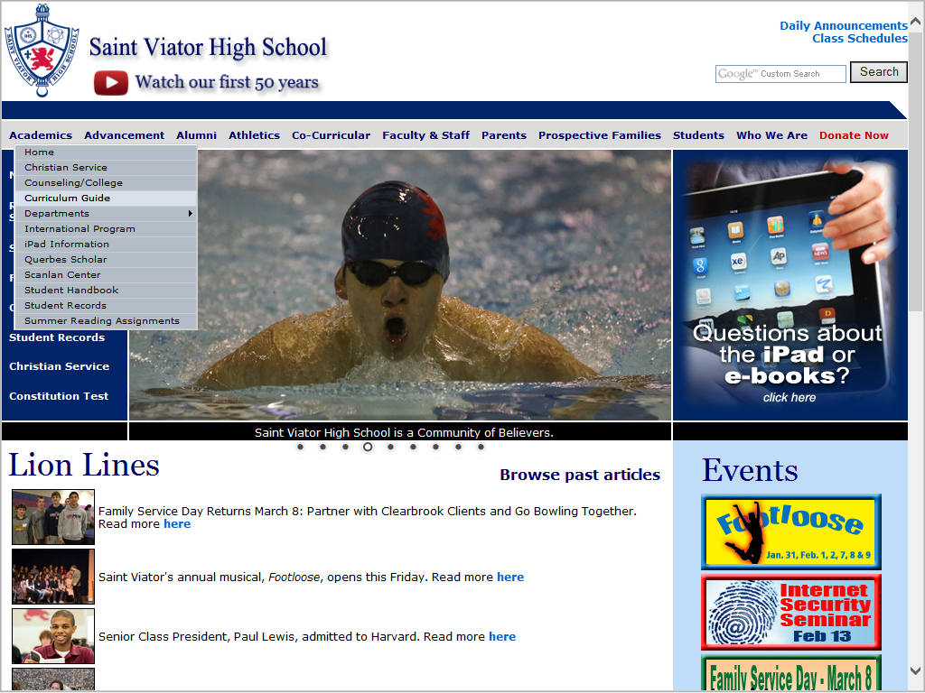
Course offerings
can be found online
in the
2014-2015
Curriculum Guide
Found on Viator
website under the
ACADEMICS tab
Course offerings
can be found online
in the
2014-2015
Curriculum Guide
Found on Viator
website under the
ACADEMICS tab
Notes:
Description of each class
Prerequisites for future planning

Slide 4
Junior Year- You MUST sign up for a minimum of 6 credits
Religion 0010 –Christian Discipleship .50 credits
English 0168- American Lit. 1.0 credits
0197- AP English & Comp 1.0 credits
*Sophomores who took American Lit. Honors, but are not going to take AP should sign up for 0153-0154 British Lt. I and II
Social 0395 –US History (college prep track) 1.0 credits
Studies 0399 – AP US History (honors track) 1.0 credits Electives: Contemporary World Issues (.5 credit), Sociology (.5 credit), Psychology (.5 credits), and Global Economics (.5 credits)
Students must also pass the Illinois and Federal Constitution tests by the last day of sophomore year.
Math Placement determined 1.0 credits by current teacher
Science Placement determined 1.0 credits
by current teacher
Physical PE III/IV .50 credits
Education PE III Leaders Prep .50 credits
Modern World Placement determined 1.0 credits
Language by current teacher
*Make sure you consider all the pros and cons of continuing with Modern World Language.
Electives May be needed to meet 6 credit minimum.

Slide 5
Science (3 Credits)
Freshman | Sophomore | Junior | Senior
Biology Lab 0711
Integrated Science Lab
Chemistry Lab 0720
Environmental Science Lab I/Lab II
Environmental Lab I/Lab II
Chemistry Lab 0702
Astronomy
Chemistry Lab II
Anatomy/Physiology Lab
Earth Science Lab
Chemistry Lab
Anatomy/Physiology Lab
Physics Lab
Environmental Lab I/Lab II
Astronomy
Chemistry Lab II
Biology Lab
Physics Lab
Anatomy/Physiology lab
Environmental Science Lab I/Lab II
Earth Science
Chemistry Lab
Biology Lab Honors
Anatomy/Physiology Lab
AP Biology Lab
AP Chemistry Lab
AP Physics Lab
Physics Lab Honors
Environmental Lab I/Lab II
Astronomy
Chemistry Lab II
Accelerated
Bio Honors
Chemistry Lab
Honors
Physics Lab Honors (must be in pre-calc)
AP Biology Lab
Notes:
1.0 credit of life science is required- if failed Bio, we need to talk about what other class you can take
Bio class over the summer would take its place
Chem Honors - Period and a half- meaning, it will overlap with lunch or study 2 times a week
AM Chem- students with 7 credits will get 1st priority

Slide 6
Math (3 Credits)
Freshman | Sophomore | Junior | Senior
Topics in College Algebra
Algebra I
0507
Geometry
0520
Algebra II
Advanced Math/Trig
Pre-Calculus Topics
Algebra I
Geometry
Algebra II/Trig
Pre-Calculus
Geometry
Algebra II/Trig
Pre-Calculus
Algebra I Honors
Geometry Honors
Algebra II/Trig Regular/Honors
Pre-Calculus
Regular/ Honors
Accelerated Algebra I Honors
Geometry Honors
Algebra II/Trig Regular/Honors
Pre-Calculus Regular/Honors
AP Calculus AB
Accelerated
Algebra/Geometry Honors
Algebra II/
Trigonometry Regular/Honors
Pre-Calculus Regular/Honors
AP Calculus BC
Notes:
C++ is an elective math class you can use to fulfill the gradation requirement in Computer Technology but only earns .5 credits in Math.

Slide 7
Math Electives
Introduction to Computer Science using C++ is an elective math class you can use to fulfill the gradation requirement in Computer Technology but only earns .5 credit in Math.
Introduction to Statistics earns a .5 credit in math

Slide 8

Fine Arts- many changes!!
Performing arts
  NEW CLASS: Percussion ensemble
    Prerequisite: Previous band experience or private piano studies

Slide 9
Art Design and Technology Program (formerly known as Visual Arts)
NEW CLASSES
  Introduction to Visual Arts (formerly Art I)
  2-D Design (formerly Art II)
  3-D Design (formerly Ceramics I)- will now include clay, plaster, wood, metals, etc.
  Advanced 2-D Design (formerly Advanced studies in art- charcoal, watercolors, pastels, and new tech in art
  Advanced 3-D Design (formerly Ceramics II)- ceramics, jewelry making, 3-D printing, metalwork, other sculpture, and emerging technologies in sculpture
  iPad Media Arts- Introduces students to photography, videography (using iMovie), and animation through use of iPad. Themes include landscape, sports photography, portraits, photojournalism, animation, and others!! (Counts toward technology requirement; students receive ½ credit in fine arts)

Slide 10
REGISTRATION PROCESS
  Registration will be conducted online.
  Registration will begin on February 19 and continue through March 1.
  Curriculum guides are available on the Saint Viator webpage.
  Directions for registration and deposit payments will be mailed home to all parents this month.
  Review classes prior to registration. You can only register for classes you have been pre-approved to take.
    Speak with your current teacher if you have questions or concerns with your recommendation for next year.
  You must register for a minimum of 6.0 credits junior year.
  Classes must be submitted and the registration deposit must be paid online for a student to be enrolled.

Slide 11
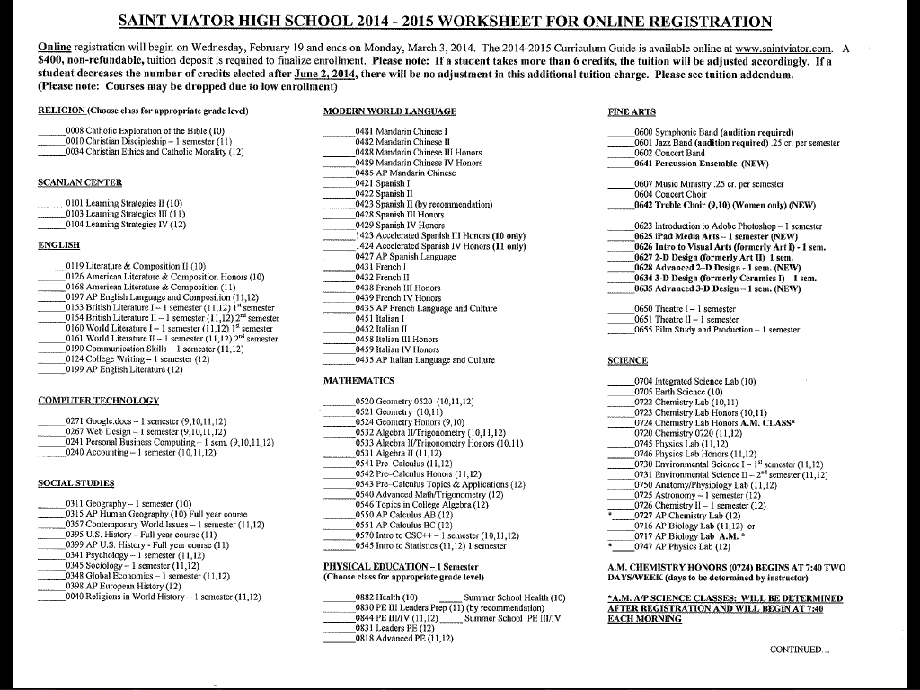

Slide 12
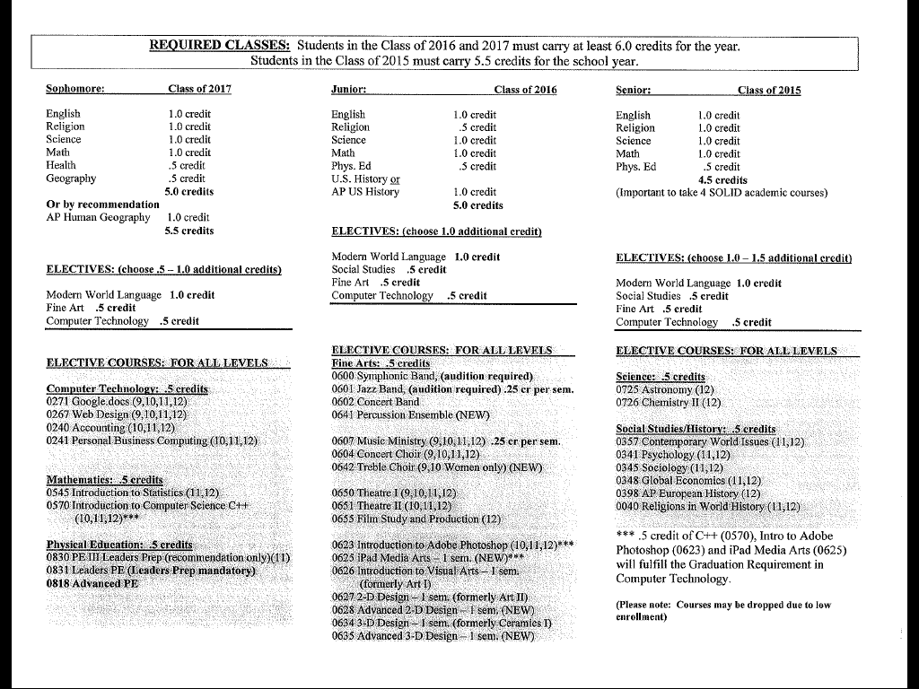

Slide 13
APPEAL PROCESS
Students who wish to change a selected class, must register for the class they were approved to take.
Students should then go back to their current teacher with their placement appeal.
When a teacher decides to change a placement, they will complete an appropriate form and submit the form to the registrar.
If the student is unable to resolve the placement issues with the teacher, they should then consult with their counselor.
All final appeals for placement must me submitted in writing to the Principal by May 15, 2014. Mrs. Manno will begin reviewing requests after Easter.
Students who drop a course after June 15, 2013 will continue to be charged the tuition based on their total credits as of June 15.

Slide 14
Course Changes
There will be NO changes made for teacher preferences or conflicts, convenience of meeting time, course conflicts with a student’s job, course is not what the student expected it to be, or personal opinion as to the difficulty of the course.
A schedule change will be considered only in the following situations: if a student has failed the last semester of the course in question or has failed to meet the prerequisite for the next level; if a student needs a course for college or graduation; or if there is an administrative change.
After the first day of classes, the only changes that will be considered are those resulting from an academic misplacement or a counselor request. A schedule change made after August 26, 2014, or January 27, 2015, will result in the student receiving a “WP” or “WF” on their transcript. A “69%” will be issued for drops beginning with the second week of a semester.
Students who drop a course after June 15, 2013 will continue to be charged the tuition based on their total credits as of June 15.
Notes:
Please try to be as accurate as possible with registration.
You can change courses later, but then it will depend on if there are openings in the course, if you will be able to add. Its easier if you register for it from the beginning.

Slide 15
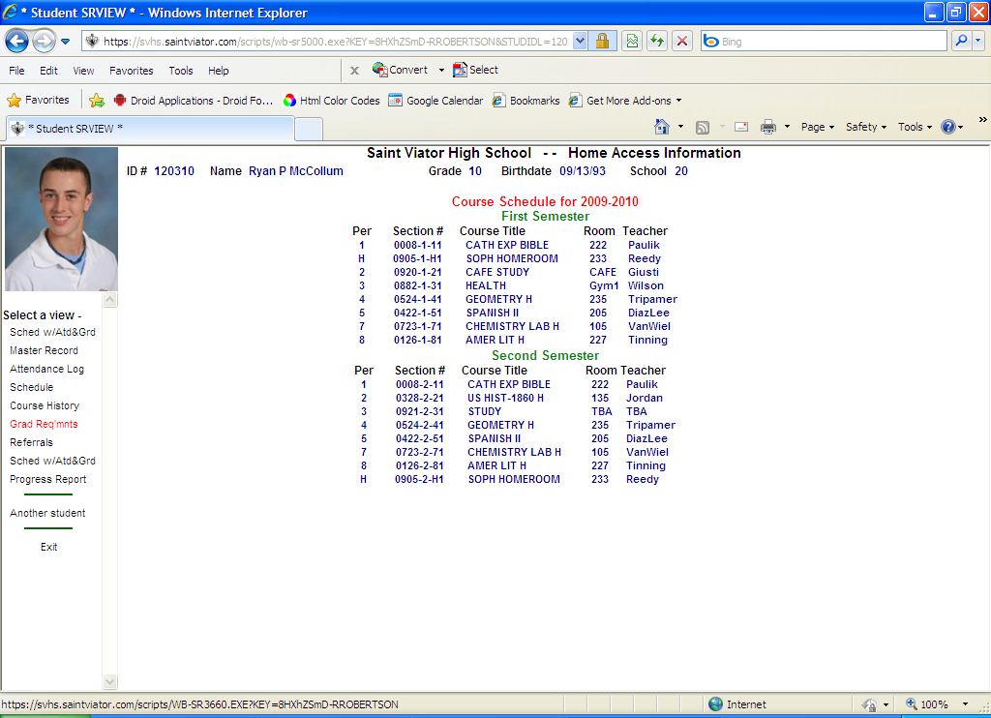

Slide 16
Please come see me
THIS WEEK if (leave a note for me if I’m not available)
You have not yet taken a Modern World Language
You did not take Geography or AP Human Geography
  No need to see me if you took Geography during the summer
Check your graduation requirements. Are you on track to graduate?
Check your recommendations from teachers- these are the level of classes for which you will be able to register!!!

Slide 17
Four Year Plan of Studies
Subject | Freshman Year | Sophomore Year | Junior Year | Senior Year
English (4 credits)
Religion (3.5 credits)
Social Studies (3 credits)
Math (3 credits)
Science (3 credits)
P.E./Health (2 credits)
Fine Arts (0.5 credits)
Comp. Tech. (0.5 credits)
Modern World Language (2 credits)
Electives
Service Requirement | 25 hours | 25 hours | 25 hours | 25 hours
Summer School
Total credits each year
Total Number of Credits:
(Must equal at least 22)
Notes:
Tenative plan, will help you map out classes for the next three years.
Important to meet all graduation requirements, but also to balance success and rigor.
Do you really need to take summer school?

Slide 18
Let’s take a look at Senior Year…
Seniors must sign up for a minimum for 5.5 credits.
The following courses are currently required for all Seniors:
Religion – 1.0 credit
English – 1.0 credit
Social Studies – 3 credits total (including 1 credit of U.S. History)
Physical Education - .50 credit
Seniors should consider taking the following electives to prepare for college:
Math – 1.0 credit
Science – 1.0 credit
Modern World Language – 1.0 credit
Electives
*As you plan your Senior year, be aware that some colleges (ie. Indiana University) will require a Senior to carry a minimum of 4 credits in solid academic subjects
(English, Math, Science, Social Studies, or Modern World Language).

Slide 19
SUMMER SCHOOL
Summer School registration will be on online
Tuesday, February 11,, 2013 only for the classes 2016 and 2015.
Registration for Summer School will be accepted until February 28, 2014
Online registration begins each day at 4:00 p.m. – 12 a.m. and will continue until all classes are full.
The Summer School Curriculum guide can be found on the Saint Viator Website. We will clean out the system as we open registration for summer, so do NOT sign in before the allotted time.
First Session: June 9- June 27
Second Session: July 7-July 25
Offices Closed: July 1-5

Slide 20
2014 Summer School Offerings
Session I- June 9-27
  8am-12pm
    PE III/IV
    Google.docs
    Geography
    Sociology
  12:30-4:30 p.m.
    Introduction to Visual Arts
Session II - July 7-25
  8 a.m. - 12 p.m.
    PE III/IV
**All courses are one-half credit**
***Summer school is not necessary for all students. Remember you must carry 6.0 credits during the school year***

Slide 21
Workshops- no credit
Constitution Review *
  June 9-13 12:30 - 4:30 p.m.
Writing for Honors and Advanced Placement Courses
  Tuesdays and Thursdays
    July 8, 10, 15, 17, 22, 24 12:30 - 1:30 p.m.
    July 8, 10, 15, 17, 22, 24 6:30-7:30 p.m.
*You may take the constitution test during the summer without taking the review as long as you have completed the online packets- The test will be given on June 13th at 12:30 pm.

Slide 22
Distance Learning through Virtual Academy
Saint Viator will offer 7 online courses next year through Virtual Academy-Archdiocese of Chicago
  These include classes that we do not offer at Saint Viator
  Online courses will not take part of daily curriculum or replace any required courses
    You will still be required to enroll in 6.0 credits at school
    Due to the rigorous nature of these courses, you must be approved to enroll in them
    Please come see me if you are interested!!

Slide 23
Distance Learning Classes
AP Statistics
AP Psychology
AP Art History
AP Computer Science A
Game Design
Marketing
Programming- Visual Basic.Net and Java

Slide 24
Registration Questions
I will not be in school February 18-21
Please try to come see me this week if you have questions about registration.
If you have questions when I am gone, please ask Br. Rob in the counseling office, and he will help you!

