Slide 1
SEM 1.07
SEM 1.10
EMPLOY SALES PROMOTION ACTIVITIES TO INFORM/REMIND CUSTOMERS OF BUSINESS/PRODUCT.

Slide 2

EXCLUSIVE SPONSOR
When a business purchases the rights to be the ONLY ONE OF ITS KIND to sponsor a sport entity, it is said to be an EXCLUSIVE SPONSOR or have sponsorship exclusivity.
Coke can have exclusivity in the soft-drink arena and NOT BE THE SOLE SPONSOR of the event.

Slide 3
PARTNERSHIP
Partnership is the term typically used to describe the relationship between a sponsor and the sport/event entity being sponsored. Both mutually benefit.
Ex. Wells Fargo sponsors PGA tournament at Quail Hollow Country Club in Charlotte, NC

Slide 4
MERGER
The terms merger, buyout, and takeover refer to ways a business can combine with another business or entity.
In a deal that would forever change the petroleum industry, Exxon and Mobil merged in 1999 to the tune of $82 billion. The entity has enjoyed tremendous success, turning record profits in each of the past several years.

Slide 5

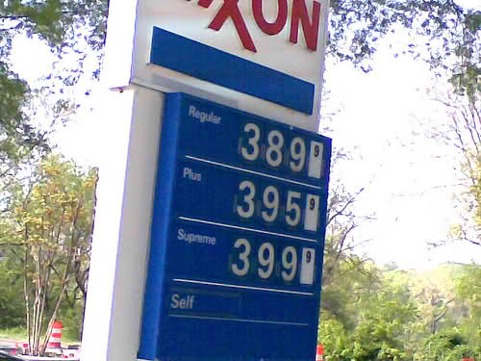
SPORTS PARTNERSHIP VS. BUSINESS MERGER
Sports Partnership
Business Merger

Slide 6
SPONSORSHIP PROPOSAL
Information about sponsorship, cost, marketing opportunities, and audience demographics are examples of information in the proposal. Would typically include references from previous clients.

Slide 7
AMBUSH MARKETING
Typically, it is a legal marketing technique where a non-sponsoring business tries to influence the market into believing that it is a sponsor.
Prior to the London Olympics, the Committee added rules to try and prevent such tactics.

Slide 8
AMBUSH MARKETING
During the torch relay, the Olympics’ brand police witnessed a window display at a real estate agency. The Olympic rings were made from plastic gym ropes and torches crafted from old “For Sale” signs.
Officials demanded the trademark-infringing display be removed or else face formal legal action: “. . . . . use of the Olympic rings in the window of a commercial office inevitably creates an association between the real estate chain and the Games and allows the real estate brand to benefit from the goodwill and excitement of the Olympic Torch Relay.”

Slide 9
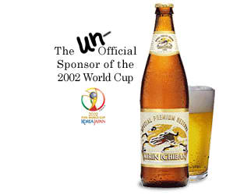
AMBUSH MARKETING

Slide 10
LOGOS - REDESIGN
A logo is a distinctive symbol, design, or group of letters. Professional sport teams have distinctive logos that set them apart from other teams.
If teams are losing support from fans, they often redesign their logos to make them new/more appealing to fans. This often promotes renewed interest in a team because fans are attracted to the new logo and buy new merchandise.

Slide 11
TEAM NAME AND TEAM COLORS
The redesigned logo sends a message that the team is updated and revitalized.
A well-designed logo should be bold, distinctive, and create instant recognition among fan bases. The logo should support the focus of the organization, such as the type of sport and other elements that create team recognition.

Slide 12
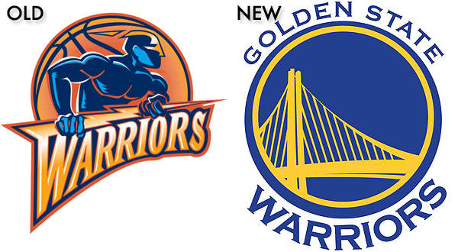
LOGOS - REDESIGNED

Slide 13
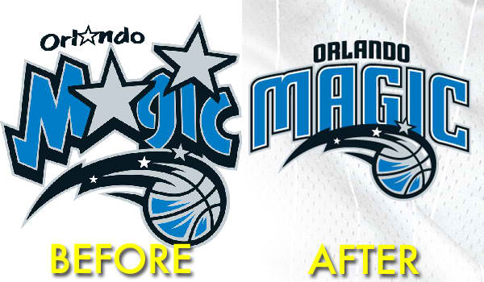
LOGOS - REDESIGNED

Slide 14
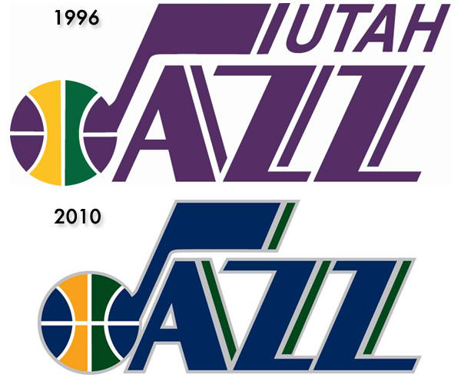
LOGOS - REDESIGNED

Slide 15
TEAM NAME AND TEAM COLORS
When designing the logo, a graphic designer should consider the team name, team colors, and the team mascot.
A graphic designer would NOT incorporate the image of a blue & red hawk for a team that adopts black & gold as the team colors and is named the Smithville Cougars. The team size and the team location are usually NOT the primary considerations when designing a basketball team's logo.

Slide 16
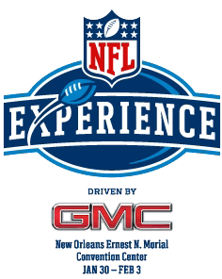
COUNTERFEITING ACTIVITIES
Popular events, such as the Super Bowl, often create a high demand for tickets. Since the stadium can only hold a certain amount of people, the demand is often much higher than supply.
Some people take advantage and print/sell counterfeit tickets.

Slide 17

COUNTERFEITING ACTIVITIES
To reduce the risk of counterfeiting, some organizations include special markings on the tickets that are difficult for counterfeiters to reproduce.
Adding watermarks or special printing processes tends to increase printing costs, but the benefits outweigh the costs.

Slide 18
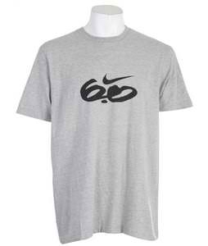

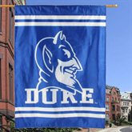

REVIEW

Slide 19
85. If Coca-Cola is the only soft-drink sponsor of your favorite team, Coca-Cola is considered a(n) __________ sponsor
A. Dynamic
B. Large-business
C. Sole
D. Exclusive

Slide 20
85. If Coca-Cola is the only soft-drink sponsor of your favorite team, Coca-Cola is considered a(n) __________ sponsor
A. Dynamic
B. Large-business
C. Sole
D. Exclusive

Slide 21
86. The relationship between a sponsor & a sport entity is often described as a:
A. Merger
B. Partnership
C. Buyout
D. Takeover

Slide 22
86. The relationship between a sponsor & a sport entity is often described as a:
A. Merger
B. Partnership
C. Buyout
D. Takeover

Slide 23
87. Information about sponsorship, cost, marketing opportunities, and audience demographics are examples of information:
A. Provided to ambush marketers
B. Included in a sponsorship proposal
C. Included in event programs
D. Provided to the city hosting the event

Slide 24
87. Information about sponsorship, cost, marketing opportunities, and audience demographics are examples of information:
A. Provided to ambush marketers
B. Included in a sponsorship proposal
C. Included in event programs
D. Provided to the city hosting the event

Slide 25
88. Mask Co. set up a hospitality tent outside the Olympics arena. Its goal was to have patrons view it as an Olympics sponsor, although it had not paid sponsorship fees. This is an example of which type of marketing:
A. Target
B. Ambush
C. Direct
D. Internet

Slide 26
88. Mask Co. set up a hospitality tent outside the Olympics arena. Its goal was to have patrons view it as an Olympics sponsor, although it had not paid sponsorship fees. This is an example of which type of marketing:
A. Target
B. Ambush
C. Direct
D. Internet

Slide 27
89. What do some professional sport teams do to promote renewed interest in a team that is losing support from fans?
A. Redesign logos
B. Increase prices
C. Send newsletters
D. Change sponsors

Slide 28
89. What do some professional sport teams do to promote renewed interest in a team that is losing support from fans?
A. Redesign logos
B. Increase prices
C. Send newsletters
D. Change sponsors

Slide 29
90. Which of the following are the most important considerations when designing a team logo:
A. Mascot & team size
B. Team name & team size
C. Team colors & team name
D. Location & mascot

Slide 30
90. Which of the following are the most important considerations when designing a team logo:
A. Mascot & team size
B. Team name & team size
C. Team colors & team name
D. Location & mascot

Slide 31
91. When creating tickets for a sport/event, organizations often embed special watermarks into the ticket design to:
A. Boost fan attendance rates
B. Reduce the tickets’ printing costs
C. Discourage counterfeiting activities
D. Communicate ticket purchase terms

Slide 32
91. When creating tickets for a sport/event, organizations often embed special watermarks into the ticket design to:
A. Boost fan attendance rates
B. Reduce the tickets’ printing costs
C. Discourage counterfeiting activities
D. Communicate ticket purchase terms

