Slide 1
Disorders of the eye
Astigmatism
Glaucoma
Presbyopia
Detached retina
Diabetic retinopathy
Color blindness
Hyperopia
Cataract
Myopia
Conjunctivitis
Have you heard of these conditions?
What do you know about them?

Slide 2
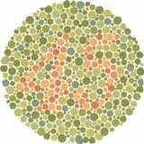
Disorders of the eye
Color blindness
Do you see the number?
What is color blindness?
What causes it?
Who is most likely to have color blindness?
Ishihara chart

Slide 3
Color Blindness
Occurs when there is a problem with the color sensing granules in nerve cells in the eye (cones)
If one pigment missing may have trouble telling between red or green most common type.
Cause
Mostly genetic about 1 in 10 men have some form of color blindness, very few women.
Treatment
No known
Special contact lenses and glasses may help
Check for color blindness with a Ishihara chart.

Slide 4

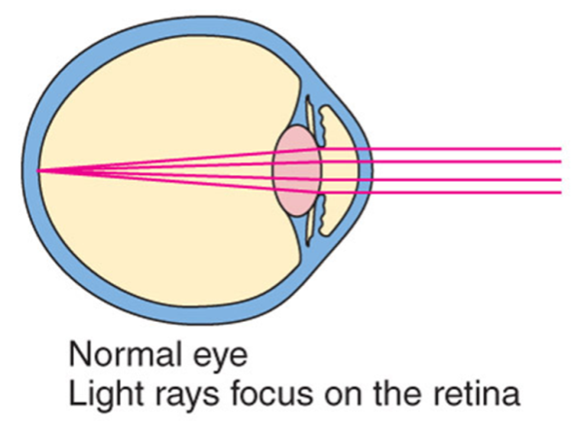
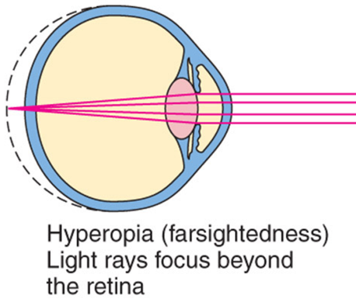
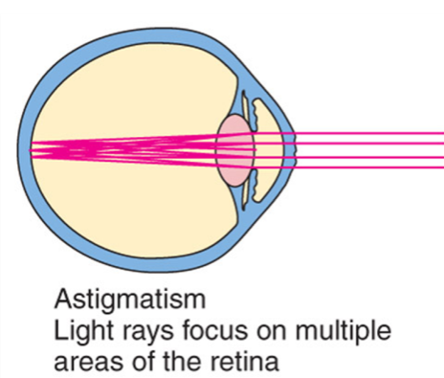
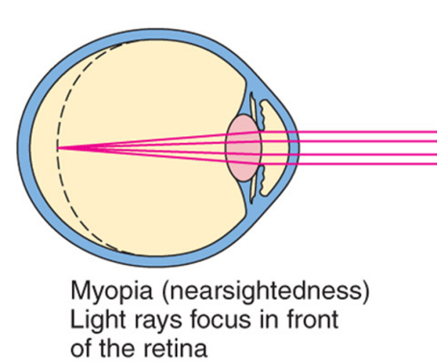
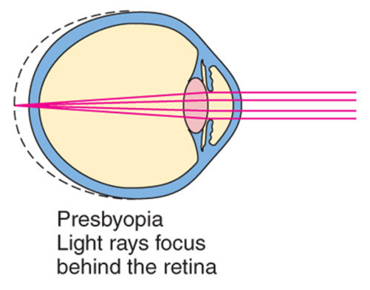
Problems with Focus
Compare the symptoms and treatments of these common eye disorders.
Can a person have more than one of these disorders? Explain.

Slide 5



Vision Defects
Presbyopia
Lens lose elasticity
Can’t focus on close or distant object
Usually after the age of 40
Treatment
Bifocals
Hyperopia
Farsighted, focal point beyond the retina because eyeball too short convex lens helps.
Myopia
Nearsightedness, eyeball too long
Concave lenses help

Slide 6


Visual Defects cont.
Astigmatism
Irregular curvature of the cornea or lens causing blurred vision and eye strain
Treatment
Corrective lenses.
Amblyopia: lazy eye
Poor vision in one eye because of abnormal dominance of the other eye
Usually occurs in childhood
If not corrected can lead to blindness in lazy eye
Treatment
Cover dominant eye forcing weak eye to work
Corrective lenses or surgery may be needed.

Slide 7
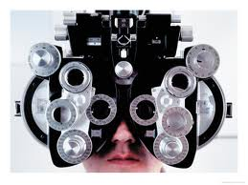
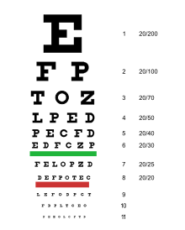
Testing vision
How do we test visual acuity?
What is 20/20?
What does PERRLA mean?
What is the difference between
an ophthalmologist and an optician?

Slide 8

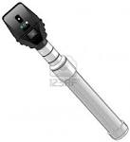
Snellen Chart
Snellen chart
Uses letter and symbols in calibrated heights to check vision defects
Measures visual acuity
Ophthalmoscope
Instrument used for viewing inside the eye.

Slide 9
Vision Defects
Continued

Slide 10
Conjuntivitis
Pink eye, inflammation of conjunctiva membrane in front of eye
Highly contagious
Caused by virus or bacteria
Symptoms
Redness, swelling, discharge, highly contagious
Treatment
Antibiotic eye drops
Sty Hordeolum
Abscess of an eyelash due to infection of a sebaceous gland
Symptoms
Red painful and swollen area on eyelid
Treatment
Warm wet compress

Slide 11
Vision Defects cont.
Glaucoma
Excessive intraocular pressure causing destruction of the retina and atrophy of the optic nerve.
Cause overproduction of aqueous humor, lack of drainage
Symptoms
Develop gradual mild aching
Loss of peripheral vision
Halo around light
Treatment
Object is to lower the intraocular pressure. May use special eye drops.
Cataracts
Lens of the eye gradually becomes cloudy, occurs after 70
Increase exposure to the sun may speed up development of cataracts
Causes
Painful gradual blurring and loss of vision
Lens turns from clear to milky white
Treatment
Surgical removal of the lens

Slide 12
Vision Defects cont.
Detached Retina
Occurs with aging or traumatic injury
The vitreous fluid contracts as it ages and pulls on retina causing a tear
Symptoms
Loss of central vision
Treatment
Laser or freezing
Macular Degeneration
Occurs as a person ages macula responsible for sharp central vision
Smoking can aggravate this condition
People with diabetics are more prone to this condition
Symptoms
Dimming or distortion of vision
Obvious at night
Two types
Dry gradual thin retina
Wet leakage under retina
Treatment
Laser

Slide 13

Vision Defects
Diabetic Retinopathy
Diabetes can harm your eyes, damages small blood vessels in the back of your eye
Cause
Uncontrolled diabetes
Symptoms
Trouble seeing at night
Floaters in the eyes
Blurred vision
Vision loss

Slide 14
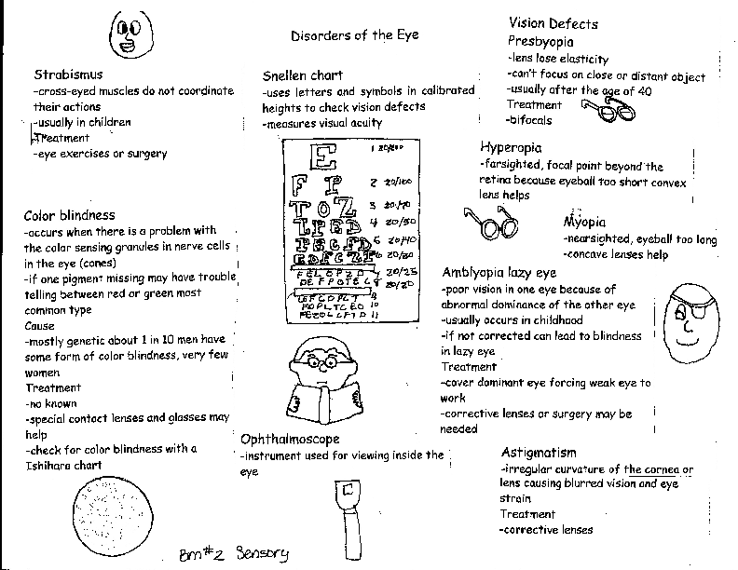

Slide 15
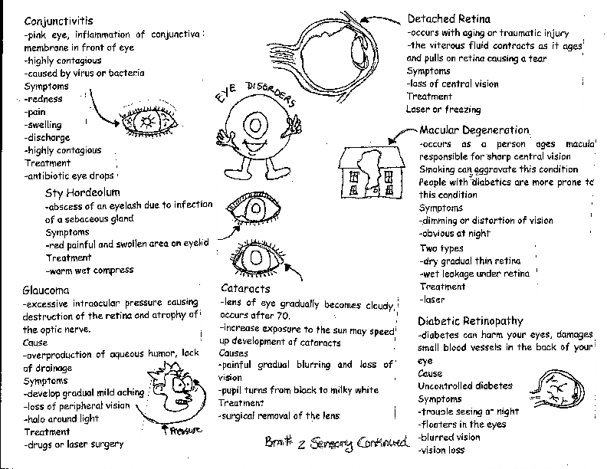

Slide 16
Questions for Bubble maps
BM Two A
How do we test for visual acuity?
What is 20/20
What does PERRLA mean?
Draw a pair of glasses that you would wear if you needed them. Be creative!
Color pictures on bubble map and write in color.
BM Two B
Pick two diseases or disorders of the eye and draw a picture of it and put the disease in the picture where it is affected. Describe what happens
Complete BM in color and write in color.

