Slide 1
Pregnancy
Anatomy and Physiology
Nursing Care
Nutrition
Chapters 10-12

Slide 2
General Terms, See page 235
Gravida; number of pregnancies
Term; 37 complete weeks
Preterm; 20-end of 37 weeks
Aborted; spontaneous or therapeutic
Living
Parity; note this is the number of fetuses delivered after 20 weeks gestation

Slide 3
GTPAL Questions
A woman presents to the clinic in the first trimester of pregnancy. She has three children living at home. One of them was born prematurely at 34 weeks. The other two were full term at birth. She has a history of one miscarriage. How do you record her obstetric history using the GTPAL format?
Kathy has just given birth to preterm twins. She has a four year old child from another pregnancy as well as had a miscarriage. How do you record her obstetric history?

Slide 4
Signs of pregnancy; page 238
Presumptive
Probable
Positive
Note that presumptive and probable signs have other possible causes Table 10-2

Slide 5
Estimating date of Birth; page 256
Nagele’s rule
Take the first day of the LMP, subtract 3 months and then add 7 days plus one year OR
Take the first day of the LMP add 7 days and count forward 9 months

Slide 6
Prenatal Care Schedule
First visit in first trimester
Monthly visits until 28 weeks gestation
Every 2 weeks until 36 weeks gestation
Every week until birth

Slide 7
Preconception Visit
To identify risk factors that may harm the health of patient or her fetus
To provide counseling on measures to promote optimum health of patient and fetus
Issues include
  Diabetes screen for high risk
  Rubella screening
  Folic acid intake
  Optimum weight
  STD screening; Safer sex practices
  Genetic screening if necessary

Slide 8
Lab Tests; Page 267
Initial labs, note you must gain consent for HIV testing
  Blood and Rh type as well as antibody screen
  Hct/HGB
  Rubella
  VDRL
  Urine culture and dip
  HBsAg
16 weeks gestation screening for neural tube defects (273)
Diabetes screening at 24-28 weeks gestation unless high risk
Group B strep at 35 weeks gestation.

Slide 9
Elements of Physical Exam at Visits
Blood Pressure
Urine dip for protein
Evaluation of edema
Fetal heart tones
Fundal height assessment
Leopold’s maneuvers in third trimester

Slide 10
Changes in the reproductive system; page 238
Pre pregnancy capacity 10 ml term 5 liters!
Above the symphysis pubis at 12-14 weeks
At umbilicus at 22-24 weeks
At xyphoid process at 38 weeks.
Note the probable signs of pregnancy are due to changes in the uterus and may also be symptoms of pathology
Increased blood flow; by term 1/6 of maternal blood flow is to the uterine vascular system!!
Increased leukorrhea
Glycogen rich vaginal environment means increased vulnerability to vaginal infections.

Slide 11
Fundal Height Measurement; 273
Is approximately the same in centimeters as gestational age from 18-30 weeks gestation
May detect interuterine growth retardation if the height is stable or decreased
May detect multifetal gestation or hydramnios if the height is greater than expected.

Slide 12
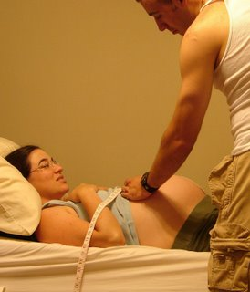
Fundal Height Measurement

Slide 13
Breast Changes; 242
Increasing Estrogen and Progesterone bring early presumptive breast symptoms
Nipples and areola become more pigmented
Increased blood supply
Second and Third trimesters growth of the mammary glands
Colostrum may be seen as early as 16 weeks gestation
Note that mothers who miscarry after 16 weeks gestation may have milk come in like mothers who deliver their babies.

Slide 14
Preparing for Breast feeding
Discuss feeding of infant early in prenatal care
Ask open ended questions such as, “what have you heard about breast feeding?” or “how do you plan to feed your baby?”
Gently give information on the benefits of breastfeeding to both Mom and Baby
Contraindications to breast feeding are:
  HIV positive
  Breast cancer
  Active tuberculosis???????

Slide 15
Breast feeding and TB according to the CDC
Breastfeeding should not be discouraged for women being treated with the first-line antituberculosis drugs because the concentrations of these drugs in breast milk are too small to produce toxicity in the nursing newborn. For the same reason, drugs in breast milk are not an effective treatment for TB disease or LTBI in a nursing infant. Breastfeeding women taking INH should also take pyridoxine (vitamin B6) supplementation.

Slide 16
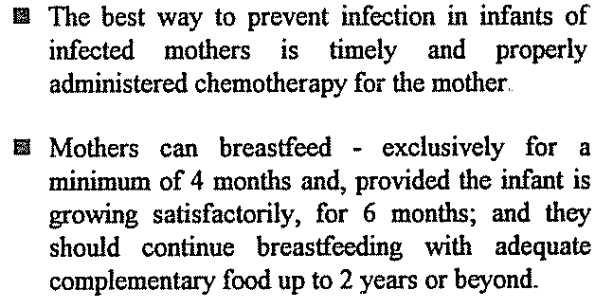
Breastfeeding and TB according to the WHO

Slide 17
Nipple inversion; 278
Anticipatory care for women with nipple inversion
Pinch test to determine
Exercises to break adhesions may cause uterine contractions and not proved to be helpful
Remember breast stimulation is contraindicated in women at risk for preterm labor
Breast shield a benign treatment but not clinically proven to be helpful; worn one to two hours a day in last trimester of pregnancy

Slide 18
Cardiovascular System Changes; 242
Slight cardiac hypertrophy that returns to normal after childbirth
Increase in Blood Volume and Cardiac Output to meet the demands of increased uterine vascularity
Pulse increases at 14-20 weeks to about 10-15 bpm
During second trimester normally the blood pressure decreases slightly
Supine hypotensive syndrome
Compression of iliac veins and inferior vena cava contributes to dependent edema, varicose veins and hemorrhoids

Slide 19
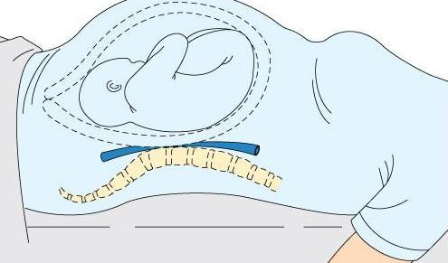
Supine Hypotension Syndrome

Slide 20
Supine hypotension
Symptoms
  Pallor
  Dizziness, faintness, breathlessness
  Tachycardia
  Nausea
  Clammy skin, sweating
Interventions
  Position woman on her side until her symptoms subside and vital signs are stable.

Slide 21
Blood volume and composition
Increased blood volume with plasma increase greater than the increase in RBC production.
This causes “hemodilution of pregnancy”
Normal hbg in pregnant woman >11
Normal hct>33
Compare to nonpregnant 12-16 and 37-47
Compare plasma volume of 2400 in non pregnant to 3700 in full term
White blood cell count increases in second trimester

Slide 22
Circulation and Coagulation Times
Circulation time decreases slightly by week 32
There is an increase in various clotting factors
Fibrinolytic activity is depressed
This all provides a protective function to decrease bleeding at birth
However this increases risk for thrombosis.

Slide 23
Respiratory
Oxygen requirements increase in response to the increase in maternal tissues as well as fetal needs.
Estrogen causes the ligaments of chest to relax and affords more chest expansion
Estrogen also causes increased vascularity of tissues
Hence the conditions of pregnancy of nasal stuffiness, epistaxis and changes in the voice.
Towards the end of pregnancy the diaphragm is displaced as much as 4 cm upwards.

Slide 24
Urinary Tract Changes
Increased risk for urinary tract infection due to:
  Stagnation of urine
  Increase in nutrients in urine
  Increase in pH of the urine
Urinary frequency due to pressure on the bladder
Hyperemia of the bladder may lead to blood in the urine
Renal function is most efficient when the woman lies in the lateral recumbent position and least efficient when the woman assumes a supine position. See statement on page 247 on pooling of fluid in the legs

Slide 25
Integumentary System
Hyperpigmentation
  Nipples/areola
  Chloasma or mask of pregnancy
  Linea nigra
Increase hair and nail growth
Accelerated sweat and sebaceous gland activity
Increased circulation and vasomotor activity
Increase stretch mark (striae gravidarum)

Slide 26
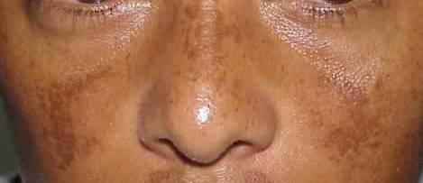
Chloasma or mask of pregnancy

Slide 27
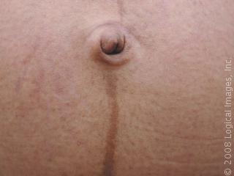
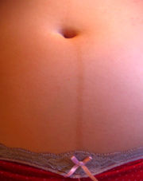
Linea Nigra

Slide 28
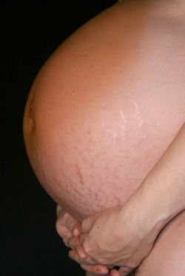
Striae gravidarum

Slide 29
Musculoskeletal System
Woman’s center of gravity shifts forward
Causes curvatures in the lumbosacral area as well as
Curvatures in the cervicodorsal region Page 249
Relaxin hormone prepares body for delivery but also causes
  Instability of sacral iliac joints
  Separation of the symphysis pubis
Muscles of the abdominal wall separate and stretch
  Diastasis recti abdominis; page 250

Slide 30
Prenatal Fitness
Posture and body mechanics page 280
Prevention and care of backache page 280
Rest and relaxation to diminish common discomforts to prepare for labor
Kegel exercises to improve pelvic floor muscles
Read over the exercise tips for pregnant women page 279

Slide 31
STOP EXERCISING WITH
*bleeding
* cramping
*faintness
*elevated blood pressure
*dizziness
*joint pain

Slide 32
Exercise guidelines for pregnancy
At least 3 times a week
Avoid overheating
Avoid deep flexion and extension
No prolonged laying on back after 4 months
Drink plenty of fluids
Rise up gradually
Talk test level of intensity
Monitor heart rate <140
Cool down

Slide 33
Gastrointestinal System; 250
Nausea in early pregnancy due to increased levels of hCG
Colon is displaced as uterus becomes an abdominal organ
Peristaltic activity is decreased
Hemorrhoid formation due to increased venous pressure

Slide 34
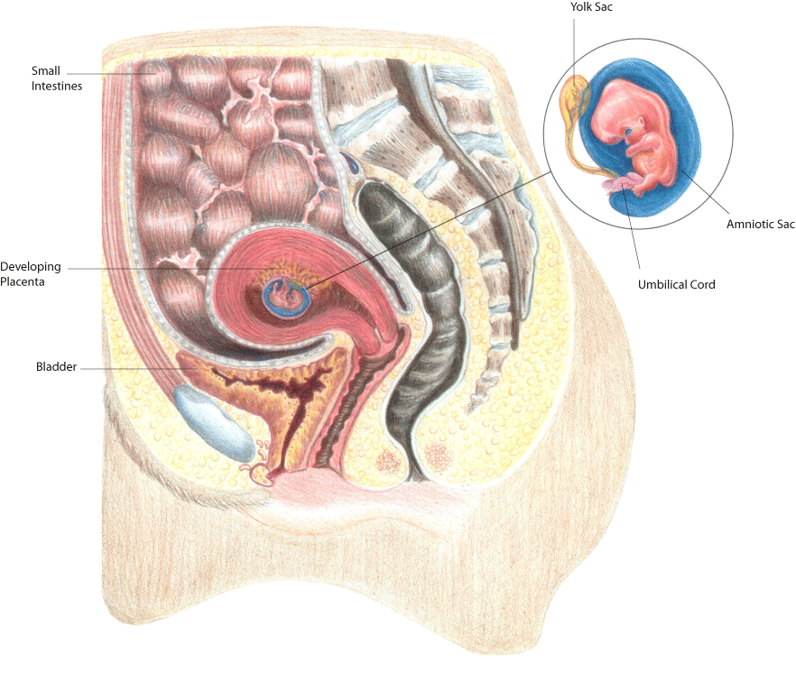
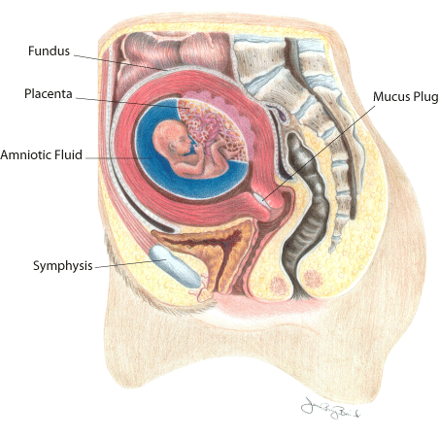

Slide 35
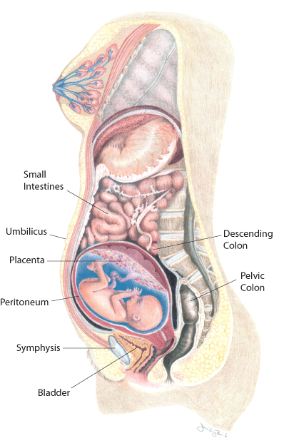
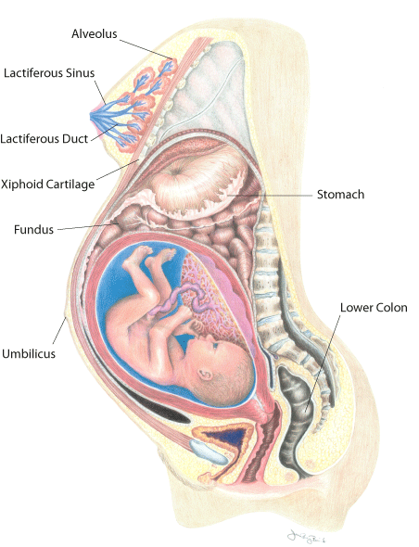

Slide 36
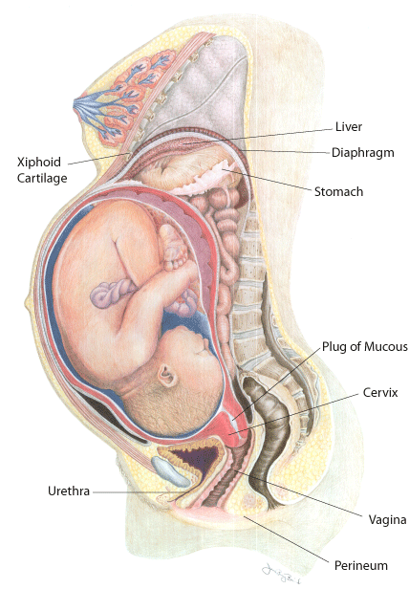
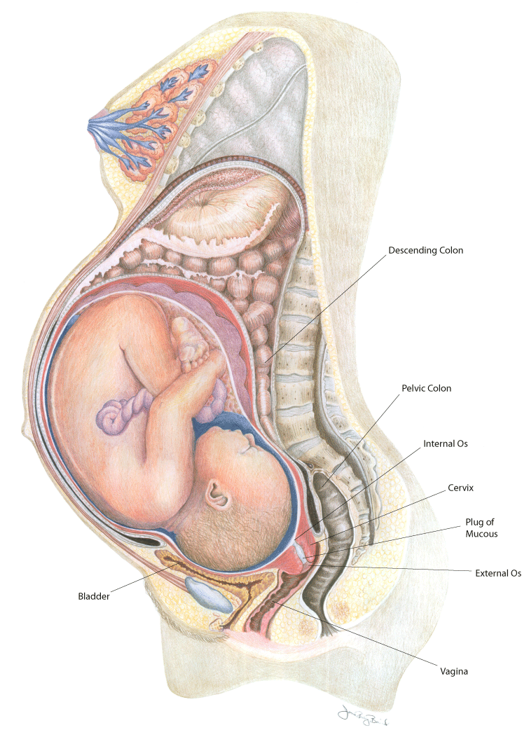

Slide 37
Recognizing Pre term Labor; 289
Uterine activity
  Uterine contractions more frequent than every 10 minutes persisting for one hour or more
  May be painful or painless
Discomfort
  Lower abdominal cramping
  Dull intermittent low back pain
  Menstrual like cramps
  Suprapubic pain or pressure
  Pelvic pressure or heaviness
  Urinary frequency
Vaginal Discharge
  Change in character and amount of usual discharge
  Rupture of amnionic membranes

Slide 38
Sexuality in Pregnancy BASICS
Abstain if uterine cramping or bleeding
Abstain if you have a history of premature dilation of the cervix or pre term labor
Make sure women are using safer sex behaviors to prevent STDs

Slide 39
Nutrition in Pregnancy
Need to know basics

Slide 40
Nutritional needs
An increase of 300 calories in the second and third trimester
Protein increase from 50 pre pregnancy to 60 Grams
Folic acid preconception for the prevention of neural tube defects 400 mcg
Folic acid needs increase to 600 mcg
Calcium remains at 1000 mg, remember adolescents need 1300 and most women do not have needs met adequately
Additional iron is needed at the end of the third trimester as blood volume is increasing 27-30 mg/day
Vitamin C needs are increased for tissue formation of fetus as well as enhancing the absorption of iron
Also note indicators of nutritional risk on page 313

Slide 41
Optimal Weight Gain Guidelines
Based on BMI page 309
Less than 19.8 or underweight
  Weight gain of 12.5-18 kgs
19.8-26 or “normal”
  Weight gain of 11.5-16 kgs
26-29 high BMI
  Weight gain of 7-11 kgs
Over 29 obese
  At least 7 kg
Adolescents should strive for upper end of recommendation

Slide 42
Other nutritional concerns
Mercury poison and fish consumption
  Limit fish intake to two 6 ounce servings a week
Listeria and food safety
  Type of bacteria in food that pregnant women and fetuses are vulnerable to
  Avoid hot dogs, lunch meats that are not reheated
  Avoid soft and semi soft cheese made from unpasteurized milk
  Avoid pate and meat spreads
  Avoid smoke seafood and fish
  Avoid undercooked meat, poultry and fish
  Teach safe food handling and storage practices

