Slide 1
Complications During Labor and Birth
Chapter 8

Slide 2
Amnioinfusion
Injection of warm saline into the uterus after the membranes have ruptured
Replaces the cushion for the umbilical cord
Indications
  Oligohydramnios
  Umbilical cord compression
  Helps reduce variable decelerations
  Dilution of meconium stained fluid

Slide 3
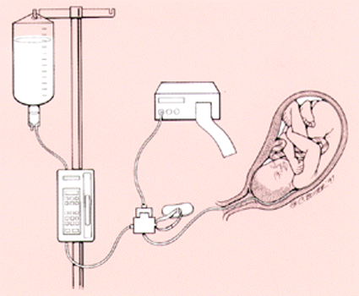
Notes:
Set up for an amnio infusion; mother will have an internal uterine pressure monitor and possibly an internal fetal heart monitor to the baby.

Slide 4
Amnionotomy
Artificial rupture of membranes
Stimulates prostaglandin production which stimulates labor
Committed to labor, no turning back
Complications
  Prolapse of umbilical cord
  Infection
  Abruptio Placenta

Slide 5
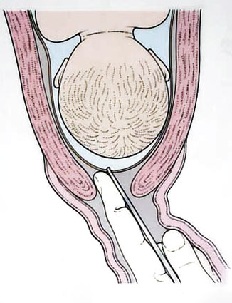
Amniotomy

Slide 6
Nursing Care for AROM
Monitoring fetal heart before and after for changes indicative of cord compression
Observe color, amount, odor of fluid
Monitor progress of labor
Monitor for infection
Provide comfort

Slide 7
Induction and Augmentation of Labor
See indications page 174 bullets
See contraindications page 175 bullets
Cervix must be “ripe” or ready
Cervical readiness determined by Bishops Score; page 175
  Score of 6 or higher based on assessment per your book, some resources say 8 or higher
Cervix can be “ripened” with prostaglandins before induction
  This is often done when the Bishop’s score is not 8 or above.
Notes:
This chapter has some errors in it in my opinion and the Bishops score is one of them.

Slide 8
Cervical Ripening
Fetal heart baseline
Heparin Lock placed
Prostaglandin insert placed
Observation for 2 hours for hyperstimulation
If procedure goes well, mother may go home and return the next day for induction or start induction 4-6 hours after ripening

Slide 9
Prostaglandin hyperstimulation
Uterine contractions that last more than 90 seconds
More than five contractions in 10 minutes
Remove insert
If gel, clean vagina out with wet gauze

Slide 10
Alternatives to Prostaglandin
Laminaria inserts
Foley catheter bulb
Sex; Semen has prostaglandin in it
Orgasm causes an increase in oxytocin
Nipple stimulation increases level of oxytocin
Walking, light exercise

Slide 11
Pitocin Induction
Pitocin is the synthetic form of oxytocin which stimulates contractions
Does not cross the blood brain barrier
Contractions can be stronger and more painful than Mom’s own contractions
Started at a very low rate and gradually increased until Mom is having active labor
Must have continuous monitoring of fetus and contractions
Notes:
The point that pitocin does not cross the blood brain barrier is not in the book. This is significant because oxytocin is a hormone that facilitates bonding in people. Natural child birth promoters are concerned that this interferes with the mothering process in the powerful results of a full natural hormone birth. In addition the contractions brought on my pitocin usually result in the use of an epidural earlier than a mother intended or at all if she was hoping to go natural.

Slide 12
Complications of Pitocin
Fetal compromise
Uterine rupture
Water intoxication
Increased pain
Increased risk of c section
Notes:
Hospitals are starting to require an informed consent to receive an induction with patien’ts signature. The consent at Valley states that the rate of c section doubles in first time moms who receive an induction. Statistics that I have seen on a local hospital’s yearly report was the 45% of moms who had an induction or augmentation ended up having a c section.

Slide 13
Complications
If either fetal compromise or if contractions are outside of normal parameters:
  Shut off oxytocin
  Run IV to dilute oxytocin
  Change woman’s position
  O2 10L/minute tight face mask

Slide 14
VERSION
Method of changing fetal presentation
See contraindications on page 176-77
Done after 37 weeks
Start with non stress test and biophysical profile
Terbutaline to relax the uterus
Done under ultrasound
Observed for two hours before being sent home
Rhogam to Rh negative mothers.

Slide 15
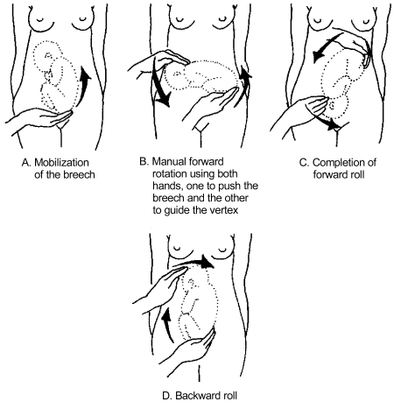
Fetal Version

Slide 16
Episiotomy and Lacerations
Episiotomy: surgical cutting to allow more room and to prevent lacerations
  It is thought that episiotomies heal easier than lacerations by some health care providers
Lacerations: a tear during birthing of vaginal or perineal tissues
See degrees of laceration on page 177
See nursing tip on page 177

Slide 17
Prevention
Often not considered by providers
Includes:
  Physiologic pushing according to mom’s urges
  Slower controlled birth
  Pushing upright or side lying are noted to be helpful
Notes:
Here is an interesting website with a horror story about episiotomy; http://www.themidwifenextdoor.com/?tag=lacerations

Slide 18
Risks of episiotomy
Technique of episiotomy
Risk
Technique
Infection
Extension of the episiotomy into the rectal tissues
Median or midline
  Easier to repair
  Heals neatly
Mediolateral or to the left
  Provides more room
  Less likely to extend into rectal sphincter

Slide 19
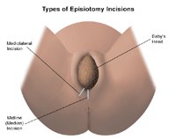
Types of Incisions

Slide 20
Nursing Care of Episiotomy or Laceration
Cold compresses first 12 to 24 hours
Warm compresses there after
Sitz baths
Oral analgesics
Lidocaine sprays
Assessment for infection, hematoma and hemorrhage from episiotomy or laceration

Slide 21
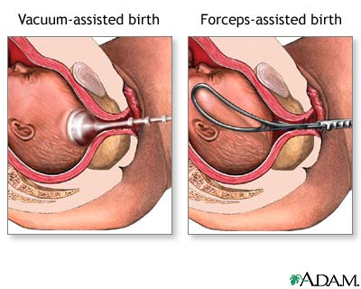
Forceps and Vacuum Asissted Delivery
Notes:
Forceps not only provide traction they can also help to rotate a baby’s head into a more favorable position

Slide 22
Forceps and Vacuum extraction indications
Mom is exhausted
Mom has medical needs to ease the delivery
Infant is showing signs of distress
  Cervix fully dilated
  Membranes are ruptures
  Bladder empty
  Fetal position at +2 station

Slide 23
Risks
Trauma to maternal tissue
  Vaginal lacerations
  Vaginal hematoma
  Perineal lacerations
Trauma to fetus
  Bruising, lacerations abrasions
  Cephalohematoma
  Intracranial hemorrhage

Slide 24
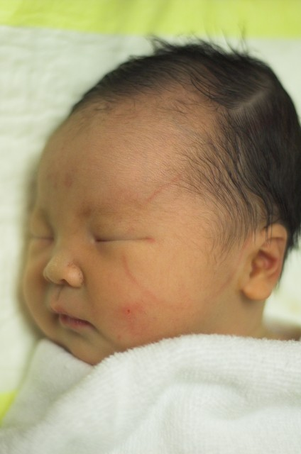

Slide 25
Nursing Care
Ice
Careful assessment for vaginal or perineal lacerations and hematoma
Assessment of infant for trauma/nerve damage

Slide 26
Cesarean Sections
Indications page 180
Contraindications page 180
Risks page 180
Although your book says that c sections are not usually done if the fetus is dead they are done if the mother’s health is at risk to deliver vaginally.

Slide 27
Pre-Op
Lab studies
Drug to reduce gastric acidity
Antibiotics
Indwelling foley catheter
Shaving
Cleansing of the abdomen

Slide 28
Recovery
VS q 15 minutes for 1-2 hours
IV maintenance
Fundus for firmness, height and midline position
Dressing for drainage
Lochia
Urinary out put
Cough, deep breath and moving
Compression stockings
Pain management
Support of incision when moving and breast feeding

Slide 29
Hypertonic Labor Dysfunction
Occurs during latency
Frequent, cramp like
Painful, non productive
Tense uterus even between contractions
RX:
  Mild sedation
  Occasionally terbutaline to relax

Slide 30
Hypotonic labor
Contractions too weak to be effective
Usually occurs with over distended uterus
RX:
  Amniotomy
  Labor augmentation
  Position changes
  Upright positions and moving
  Nipple stimulation
Notes:
Many labors are augmented with pitocin for “failure to progress” or hypotonic labor. Much can be done by giving the mom privacy, helping her to relax, changing her positions, keeping her moving and a trial of nipple stimulation

Slide 31
Compare and Contrast
See textbook page 186 to compare and contrast hypertonic and hypotonic labor

Slide 32
Ineffective Maternal Pushing
Exhaustion
Fear
Not being able to sense contractions and pushing efforts
Not knowing how to push

Slide 33
Macrosomic Fetus
Book defines at 4000 grams, some resources set at 4200 or 4500 grams.
Complications include
  Shoulder dystocia
  Episiotomy and lacerations
  Maternal hematomas
  Uterine atony and hemorrhage post partum
  Birth injury to baby
    Nerve injury
    Clavicle injury

Slide 34
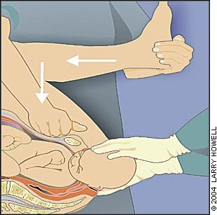
Shoulder Dystocia Help
Mc Roberts Maneuver and supra pubic pressure
Notes:
Note that the provider is pushing straight down above the symphysis pubis to release the shoulder from intrapment about the pubic bone. This technique is vastly different that pushing downward which will just further entrap the fetus.

Slide 35
Abnormal fetal presentations
Breech
  Usually a C-Section in the US
Asynclitic
  Head tilted to one side of the other
Posterior
  Most common issue

Slide 36
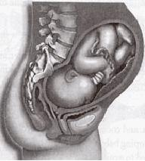
Back LABOR
Notes:
In back labor the baby is typically in the unfavorable posterior position and the back of the baby’s head is pushing on the mom’s coccyx

Slide 37
Posterior Babies, what we can do to help
Know the position pre labor and teach Mom suitable positions at home to encourage baby to turn before labor
Know positions in labor to help baby turn
  See bullets page 189
  (make correction on bullet on page 189)
  In side lying if the baby is in a ROP position lay on the right side and on the left side if in a LOP positions
Offer Mom comfort measures for back labor pain
Notes:
There is a website, spinningbabies.com which teaches a principle called optimal fetal positioning. But getting the baby in an optimum position before labor, labor can go much easier.

Slide 38
Comfort measures for back labor
Warm or cold compresses depending on mom’s preference.
Counter pressure to the back with
  Heal of hand
  Fist
  Tennis ball or other ball
  Do this continuously throughout the contraction
Double hip squeeze
  Do this continuously throughout the contraction
Jacuzzi

Slide 39
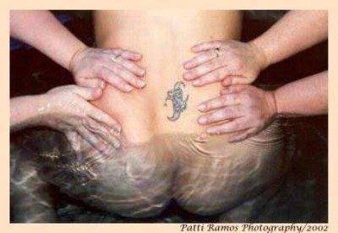
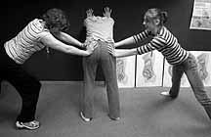
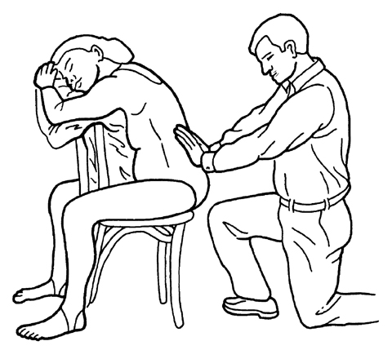
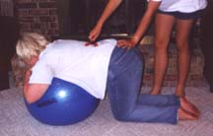
Notes:
Double hip squeeze is applying inward and downward pressure to the mom’s hips during the contractions. It is continuos during the contractions.
You want to make sure you are not on the sides of the hips as that would constrict pelvic expansion and fetal descent and rotation. The lady leaning on the ball might be rocking during her contraction to help and her support person is applying continuous pressure with her left hand while massaging her back with a massage tool.

Slide 40
Pelvis and Soft Tissue Problems
Not big enough pelvic outlet
  Cephalo pelvic disproportion
Soft Tissue obstructions
  Full bladder, void every two hours
  Fibroid tumors
  Scarred cervix
Another thought; poorly relaxed muscles.
Notes:
The last thought is not in the book. The pelvic floor and surrounding the pelvis is a complex grouping of muscles. If the mom is tense and is not able to relax and let go of these muscles, they themselves can become an obstruction to the birth of her baby. While in traditional child birth classes we address relaxation, little is done to target teaching a mother to relax her perineal floor and pelvic muscles.

Slide 41
The Psyche
Anxiety releases hormones that reduce contractility of the uterus
Negative aspects of “flight/fight”
  Uses glucose
  Diverts blood from uterus
  Increase tensions in pelvic floor
  Increase perception of pain

Slide 42
What nurses can do
Honor cultural traditions
Assist with coaching if coach not available or if coach needs assistance
Offer non pharmacologic comfort measures
Give anticipated reassurance on condition

Slide 43
Prolonged Labor
Based on the “Friedman curve”
“normal” progress is considered to be (during active labor)
  1.2 cm/hr for woman having her first child
  1.5 cm/hr for woman having her second child

Slide 44
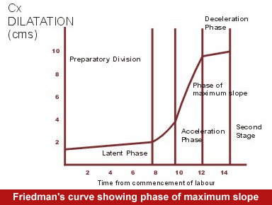
Friedman’s Curve

Slide 45
Work book on page 74

Slide 46
Precipitate Birth
Labor and birth completed in less than three hours
Sometimes Mom’s don’t know they are having or had labor until they are ready to push
The don’t need to push, the contractions are doing enough on their own!!
Complications:
  Maternal birth trauma: lacerations and hematomas
  Infant birth trauma: nerve damage and intracranial damage due to very rapid birth.
Notes:
Precipitate birth is not included in your book. If you wish a hand out Towle has a box in chapter eight on this (box 8-6) as well as the other texts on my desk.

Slide 47
What to do if baby is coming
Don’t try to transport on own, call 911
Lie Mom in side lying position and support upper leg, slows baby down
Gentle pressure to baby’s head, don’t push back in just slow the delivery a little bit
Check for cord around neck after delivery of head
Clean out mouth and nose
Hold tight for delivery of the body, it comes fast

Slide 48
The Baby is here!!!
Place baby on Mom’s lower abdomen until cord has stopped pulsating.
Once cord has stopped pulsating put baby on Mom’s chest, skin to skin and encourage breast feeding.
Observe baby for ABCs
Observe Mom for firm fundus once placenta is delivered.
Do not cut cord just keep placenta near Mom and remember it is attached when moving baby

Slide 49
Premature Rupture of Membranes
PROM and PPROM
PPROM is before 37 weeks gestation
Diagnosed by nitrazine paper turning blue
If at 36 weeks gestation (some resources would say 34 weeks) labor is induced within 24 hours

Slide 50
Nursing Care for PROM or PPROM
Observe for maternal infection
  Fever
  Uterine tenderness
  Fetal tachycardia
Observe for fetal compromise
  May be related to cord compression
  May be related to infection
Teach patient bullets on page 192 if going home
Fetal kick count error in book; 10 kicks in a 2 hour period

Slide 51
Preterm Labor
Labor between 20 and 37 weeks gestation
At 37 weeks considered term
Fetal fibronectin may be predictive of labor
Maternal symptoms page 193 bullets
Risk factors box 8-2 page 193

Slide 52
Preterm Labor Medical Care
Magnesium Sulfate
Terbutaline
Ritrodine
Prostaglandin synthesis inhibitors: Indomethacin
Calcium channel blockers Nifedipine or Procardia

Slide 53
Magnesium Sulfate
Carefully observe for toxicity
  Unable to arouse
  Diminished or absent reflexes
  Respiratory depression
  Therapeutic level 4-7
If unsuccessful fetus may experience
  Drowsiness, respiratory depression
  Interacts with aminoglycosides when utilized as antibiotics for the fetus

Slide 54
Terbutaline
Increased pulse
Increased blood pressure
Increased blood glucose
If labor continues infant may have compounded trouble with hypoglycemia

Slide 55
Ritrodine
Hypotension
Cardiac arrhythmias
Pulmonary edema
Increased blood glucose

Slide 56
Calcium channel blockers
Procardia or nifedipine
Vasodilation and flushing
Hypotension can be a problem

Slide 57
Indomethacin
Used rarely
May close ductus arteriosis
Is not used after 34 weeks gestation because of the increased risk of closing the ductus arteriosis
May reduce the amount of amnionic fluid

Slide 58
Contraindications to stopping preterm labor
Pre eclampsia
Placenta previa
Abruptio placentae
Chorioamnionitis
Fetal demise

Slide 59
Speeding Fetal Lung Maturation
Betamethasone
Two IM injections 24 hours apart
Given between 24-34 weeks gestation
May be given later in Mom’s with diabetes as diabetes slows fetal lung maturation

Slide 60
Nursing Care
Related to monitoring side effects and toxicity of medications utilized
Activity restriction
Fetal monitoring

Slide 61
Prolonged Pregnancy
Pregnancy lasting longer than 42 weeks.
Risks
  Aging placenta may not be meeting needs of fetus
  Infant may loose weight in utero
  Utero placental insufficiency during labor
  Hypoglycemia of infant at birth
  If placenta if doing well, could lead to macrosomic infant

Slide 62
Post 40 weeks
Twice weekly visits
NSTs and biophysical profiles (81)
Daily kick counts
When reaches 42 weeks: induction

Slide 63
Prolapsed Umbilical Cord
Complete
Palpated
Occult
See figures and bullets on page 194-195
Risk factors
  High in pelvis
  Small fetus
  Abnormal presentation
  hydamnios

Slide 64
Uterine Rupture
A tear in the wall of the uterus
Risk factors
  Previous c sections
  Grand multiparity
  Oxytocin stimulation
  Sustained blunt abdominal trauma

Slide 65
Symptoms of Uterine Rupture
Usually sudden onset of severe s/s
Shock
Abdominal pain
Pain in the chest or between the scapula
Cessations of contractions
Abnormal or absent fetal heart tones
Palpation of the fetus out side of the uterus

Slide 66
Uterine Inversion
Partial or complete turning inside out of the uterus
Rapid onset of shock because blood is not controlled at the site of the placenta
Replacement of the inverted uterus under general anesthesia, emergency surgery
Care centers around shock treatment and emergency surgery

Slide 67
Risk factors to uterine inversions
Prior deliveries.
Long labour (more than 24 hours).
Use of the muscle relaxant magnesium sulphate during labour.
Short umbilical cord.
Pulling too hard on the umbilical cord to hasten delivery of the placenta, particularly if the placenta is attached to the fundus.
Placenta accreta (the placenta has invaded too deeply into the uterine wall).
Congenital abnormalities or weaknesses of the uterus.
Notes:
This is a rare occurrence of .05%. One of the practices that we can NOT do is pull on the umbilical cord to hasten placental delivery.

Slide 68
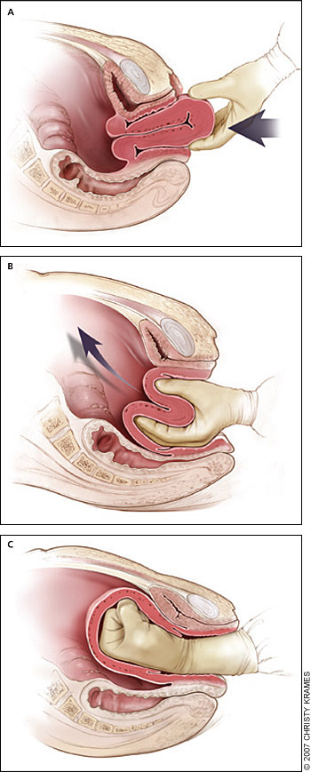
Notes:
Not all uterus inversions are as dramatic as this one, some are may collapse but not protrude outside of the cervix, some may protrude into the vagina but not out of the vagina.

Slide 69
Amniotic Fluid Embolism
Amniotic Fluid and its particles enter Mom’s circulation
Abrupt onset of hypotension and respiratory distress
Coagulation abnormalities occur
Management
  Emergency respiratory support
  Replacement of coag factors
  Packed red blood cells

