Slide 1
Struggle for Rights in the Progressive Era
African American and Women’s Rights (1877 – 1920)

Slide 2
African Americans
Review…
1619 – The 1st African “Americans” arrive at ________________ as slaves.

Slide 3
African Americans
Review…
1619 – The 1st African “Americans” arrive at Jamestown, Virginia as slaves.
1789 -- The new Constitution legitimizes slavery by …

Slide 4
African Americans
Review…
1619 – The 1st African “Americans” arrive at Jamestown, Virginia as slaves.
1789 -- The new Constitution legitimizes slavery by counting each one as 3/5 of a person
_____________ were people who thought slavery was morally wrong and tried to end it

Slide 5
African Americans
Review…
1619 – The 1st African “Americans” arrive at Jamestown, Virginia as slaves.
1789 -- The new Constitution legitimizes slavery by counting each one as 3/5 of a person
Abolitionists were people who thought slavery was morally wrong and tried to end it

Slide 6
African Americans
Review…
One abolitionist, ________________ encouraged President Lincoln to use black troops to fight in the Civil War.

Slide 7
African Americans
Review…
One abolitionist, Frederick Douglass encouraged President Lincoln to use black troops to fight in the Civil War.
Lincoln issued the __________________ freeing all the slaves in the South

Slide 8
African Americans
Review…
One abolitionist, Frederick Douglass encouraged President Lincoln to use black troops to fight in the Civil War.
Lincoln issued the Emancipation Proclamation freeing all the slaves in the South

Slide 9
African Americans
Review…
During Reconstruction civil rights were extended to African Americans with the passage of the…
  13th Amendment
  14th Amendment
  15th Amendment

Slide 10
African Americans
Review…
During Reconstruction civil rights were extended to African Americans with the passage of the…
  13th Amendment – Abolished Slavery
  14th Amendment
  15th Amendment

Slide 11
African Americans
Review…
During Reconstruction civil rights were extended to African Americans with the passage of the…
  13th Amendment – Abolished Slavery
  14th Amendment -- Guarantees Equality to everyone
  15th Amendment

Slide 12
African Americans
Review…
During Reconstruction civil rights were extended to African Americans with the passage of the…
  13th Amendment – Abolished Slavery
  14th Amendment -- Guarantees Equality to everyone
  15th Amendment – Black Men Can Vote

Slide 13
African Americans
Review…
When Reconstruction ends, white southerners regain control of Southern state governments and find ways to keep equality and rights from African Americans

Slide 14


Notes: African Americans
Sharecropping – Plantation owners would rent plots of land to former slaves in return for a share of their crops.

Slide 15
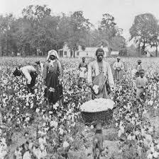
Notes: African Americans
Sharecropping – Plantation owners would rent plots of land to former slaves in return for a share of their crops.
  Problem: Black sharecroppers would start out with a debt they could never earn enough to pay off, keeping them tied down by the plantation owners

Slide 16
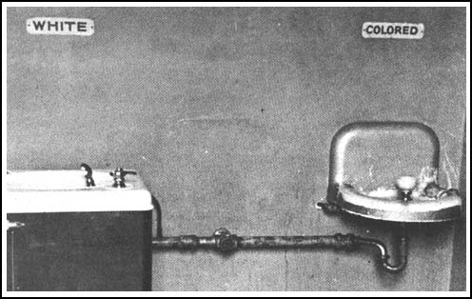
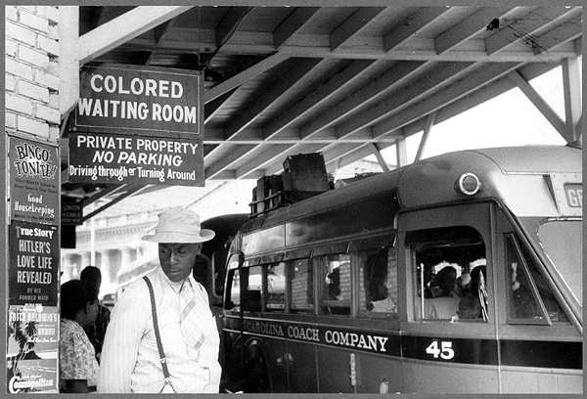
Notes: African Americans
Jim Crow Laws were passed forcing the separation of the races in public places

Slide 17
Notes: African Americans
Intimidation and hate crimes were directed against African Americans
Lynching – the illegal execution, typically by hanging, of someone by an angry mob

Slide 18
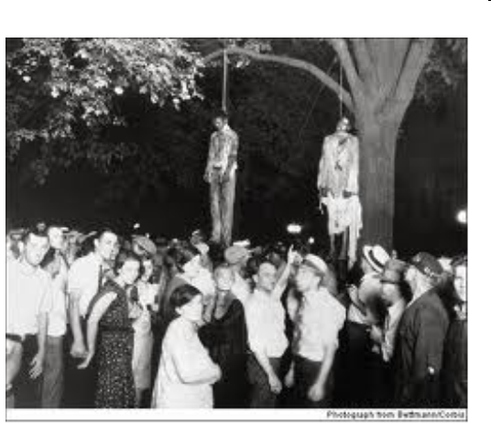
Lynching

Slide 19
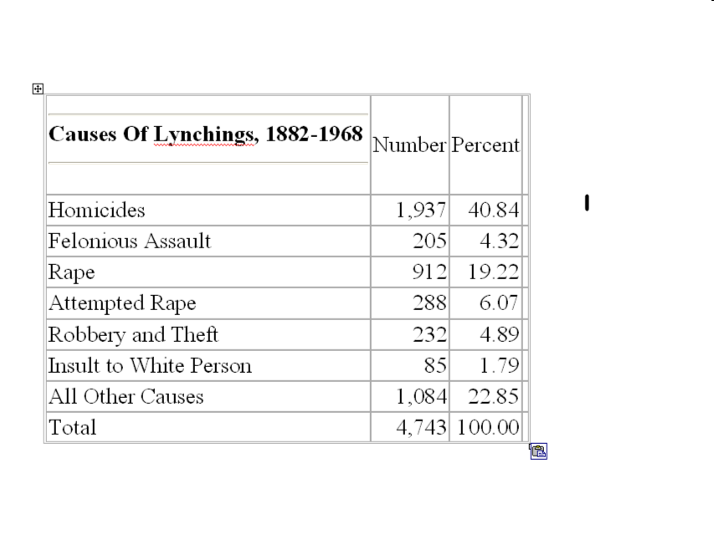


Slide 20
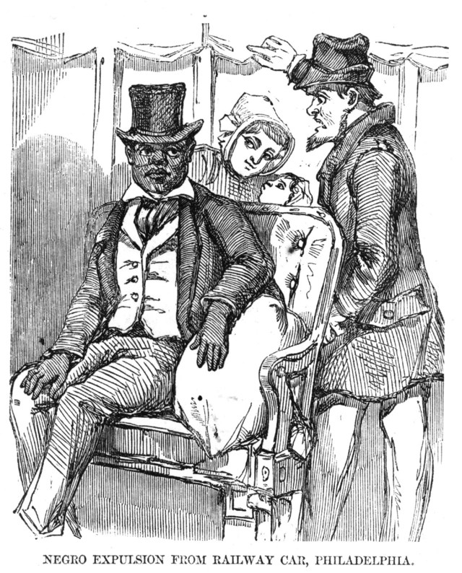
Notes: African Americans
  Plessy v. Ferguson
  The Supreme Court ruled that “separate but equal” did not violate the 14th (equal rights) Amendment.
  Upholds the Jim Crow laws
  Separate is Equal

Slide 21
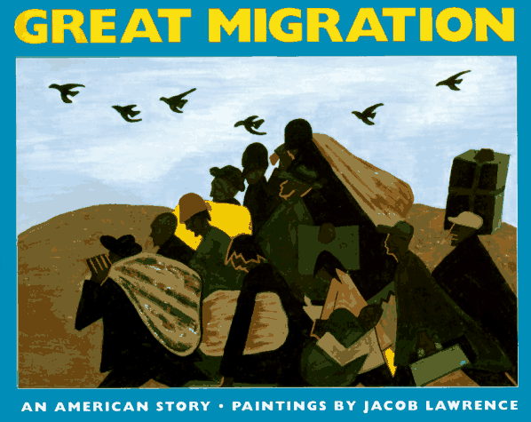
Notes: African Americans
  Great Migration
    Period during the late 19th and early 20th Centuries in which Southern African Americans began to move to Northern cities in search of jobs and to escape poverty and discrimination in the South
Problem:
Life wasn’t always better
in the North

Slide 22
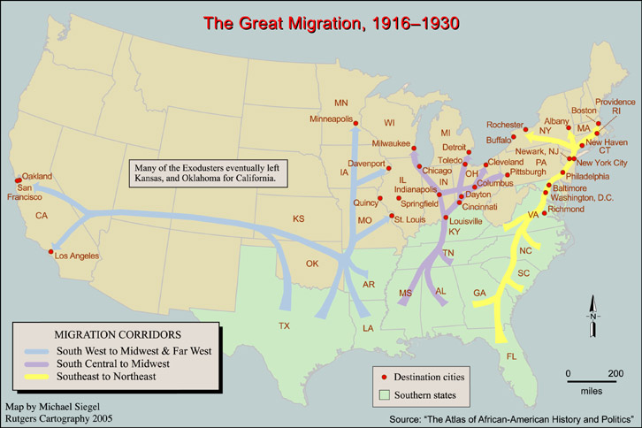
The Great Migration

Slide 23
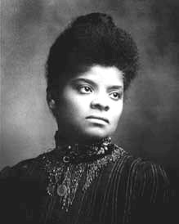
Notes: African Americans
Ida B. Wells
  Led an Anti-Lynching crusade calling on the federal government to take action
  “I’d a be well if you didn’t hang me”

Slide 24
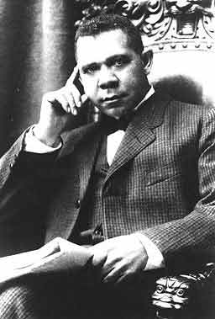
Notes: African Americans
Booker T. Washington
  Believed the way to equality was through vocational education and economic success
  He accepted Social Segregation

Slide 25
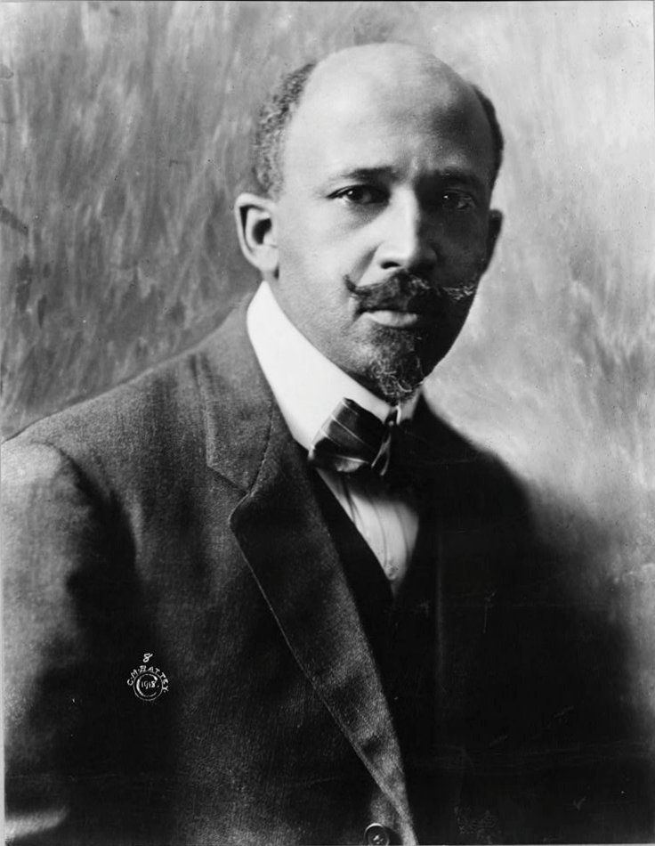
Notes: African Americans
W.E.B. DuBois
  Believed that education was meaningless without equality
  Helped form the National Association for the Advancement of Colored People (NAACP) which continues to strive for African American equality

Slide 26
Women’s Suffrage
Review…
Suffrage means…

Slide 27
Women’s Suffrage
Review…
Suffrage means the right to vote
1848 Women Suffragettes met at _________ ______________ to demand women be granted the same rights as men and the right to vote

Slide 28
Women’s Suffrage
Review…
Suffrage means the right to vote
1848 Women Suffragettes met Seneca Falls, NY to demand women be granted the same rights as men and the right to vote

Slide 29
Women’s Suffrage
Review…
Suffrage means the right to vote
1848 Women Suffragettes met Seneca Falls, NY to demand women be granted the same rights as men and the right to vote
Wyoming is the 1st state to give women the right to vote to attract women to move west

Slide 30
Women’s Suffrage
Review…
Suffrage means the right to vote
1848 Women Suffragettes met Seneca Falls, NY to demand women be granted the same rights as men and the right to vote
Wyoming is the 1st state to give women the right to vote to attract women to move west
Early activists in the women’s suffrage movement included…

Slide 31
Women’s Suffrage
Review…
Suffrage means the right to vote
1848 Women Suffragettes met Seneca Falls, NY to demand women be granted the same rights as men and the right to vote
Early activists in the women’s suffrage movement include Susan B. Anthony, Elizabeth Cady Stanton and Lucretia Mott
http://www.history.com/shows/the-people-speak/videos#the-people-speak-3

Slide 32
Women’s Suffrage Movement
Contributing factors for success
    Women were working/earning their own money
    Influence of the Progressive Movements
      Labor Reform, Government Reform, Big Business regulation
Was a forerunner of modern protest movements
    Organized, picketing, demonstrations, political lobbying

Slide 33
Women’s Suffrage Movement
Benefitted from Strong New Leadership with fresh ideas and more daring tactics
    Alice Paul and Carrie Chapman Catt
    http://www.youtube.com/watch?v=pO70ZjZ0wrw
Encouraged Women to enter the labor force during WWI
In 1919 the 19th Amendment was passed guaranteeing women the right to vote

Slide 34
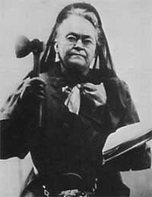
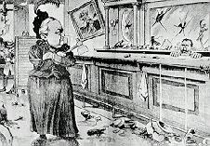
Women’s Suffrage
Middle Class women involved in the reforms (Prohibition).
18th Amendment – Prohibited the making and selling of alcohol
Carrie Nation

Slide 35
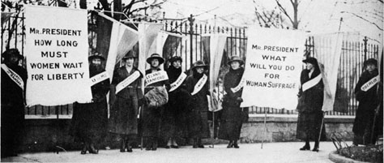
Pressure put on Wilson to support women’s suffrage.

Slide 36
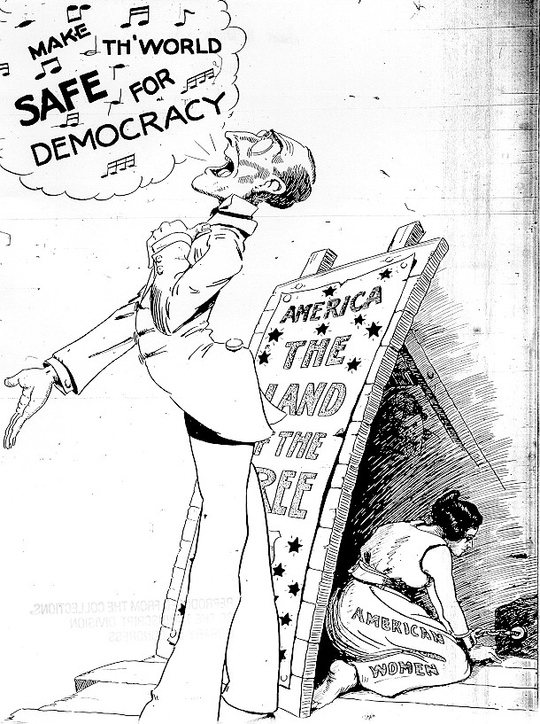
What is the
message?

Slide 37
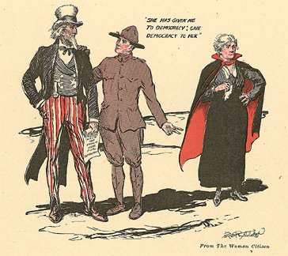

Slide 38
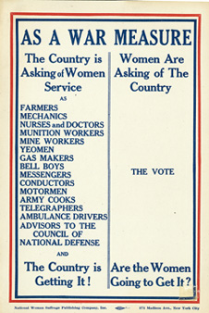
What role in the campaign
for women’s suffrage
can you attribute
to WWI?

Slide 39
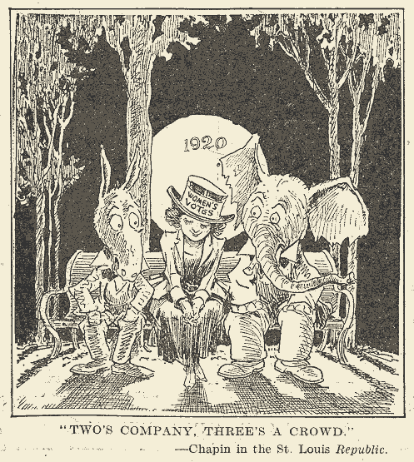
(1920) 19th Amendment ratified, granting women right to vote

