Slide 1
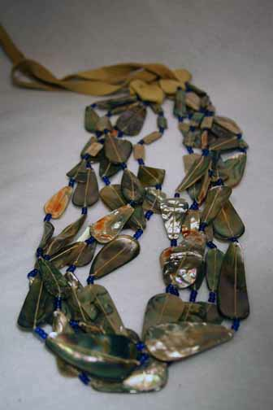
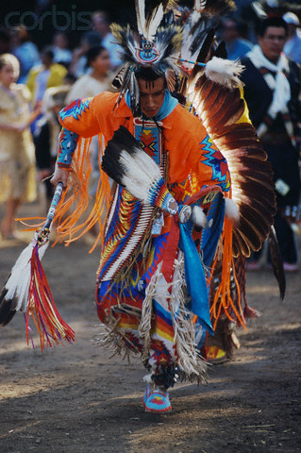
Chumash Clothes
This is a man wearing traditional Chumash Clothes
By,
Ellie
This is a piece of traditional Chumash jewelry.

Slide 2
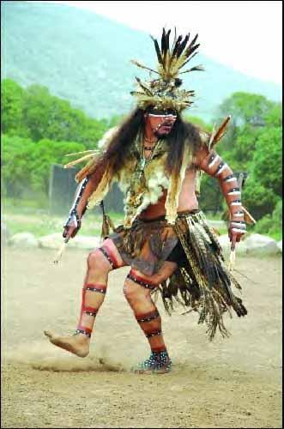
CHUMASH TRADITIONS
THIS CHUMASH INDIAN IS DANCING TO A TRADITION OF THE GODS
BY, TANNER

Slide 3
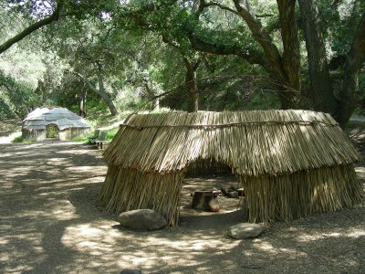
Chumash Homes
BY, MEGAN
THIS IS A CHUMASH HOMES WERE MADE OF WEEDS.

Slide 4
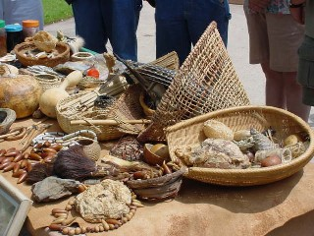
CHUMASH FOODS
http://www.campinternet.net/~lausd/chumash_artifacts_2.jpg
THIS IS CHUMASH FOOD LIKE ACORNS AND SQUASH. BY, DLYAN

Slide 5
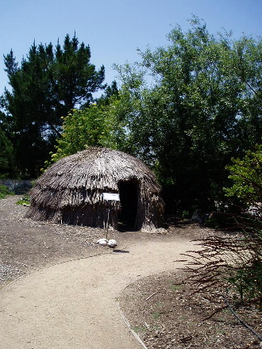
CHUMASH HOMES
THE CHUMASH HOMES WERE DOME SHAPED . BY, MEGAN

Slide 6
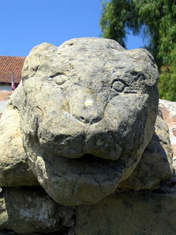
ACTIVITIES
BY, HAYDEN
THE CHUMASH MADE SCULPTURES TO HONOR THE GODS

Slide 7

ACTIVITIES
The baskets had many different kinds of weeds which made different designs.
BY, HAYDEN
THE CHUMASH MADE BASKETS TO CARRY FOOD AND WATER

Slide 8
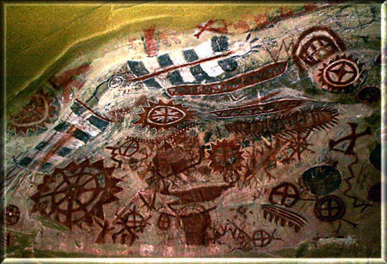
ACTIVITIES
THE CHUMASH MADE CAVE PANTINGS TO TELL STORIES OF THE PAST
BY, HAYDEN

Slide 9
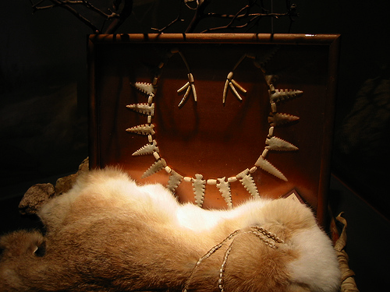
ACTIVITIES
THE CHUMASH MADE JEWELRY TO WEAR TO CEREMONIES
BY, HAYDEN

Slide 10
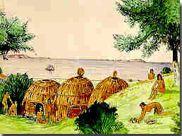
Chumash Homes
This Chumash village is home to many people. They lived by the Pacific Ocean.

Slide 11
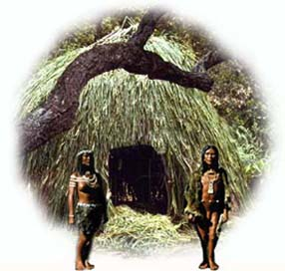
Chumash Homes
    This is two people guarding their home
    By,Megan

Slide 12
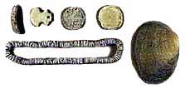
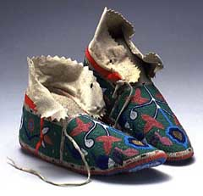
More Traditional Chumash Clothes And Jewelry
This is some jewelry that the Chumash wore in traditional times.
These are some traditional Chumash moccasins.

