Slide 1
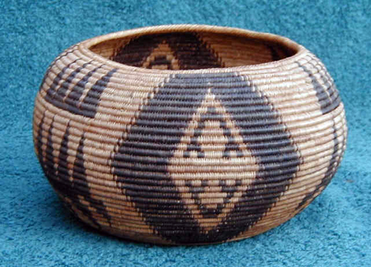
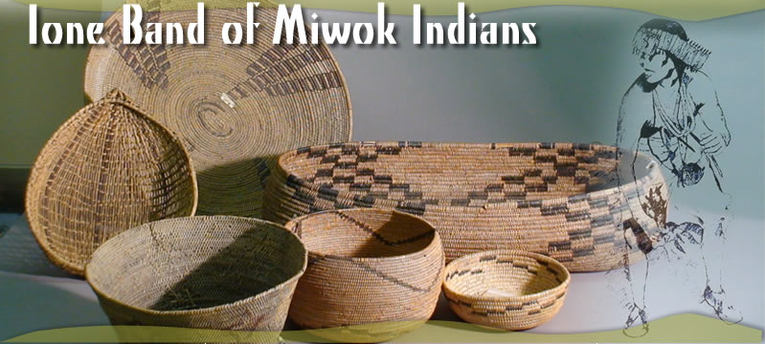
Activities
One of the Miwok Indians activities were making bowls.

Slide 2
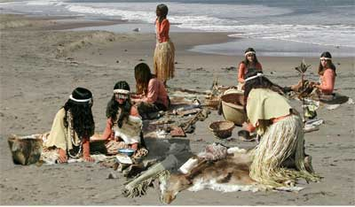
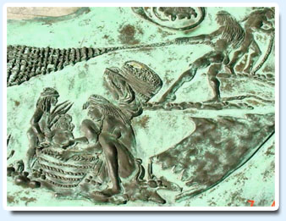
Activities
The Miwok Indians did a lot of cool activities like wall writing and making the clothes they wore. By :Alysa Panks

Slide 3
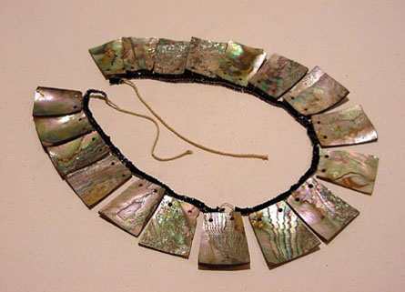
Clothes and Jewelry

Slide 4
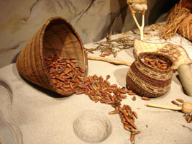
Food
Miwok Indians liked to eat acorns. They made flour pancakes.

Slide 5
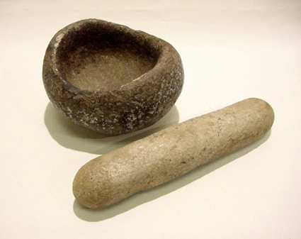
What Miwoks Use
Miwok Indians use pestle and mortars that often look like this. They use them to crush acorns.

Slide 6
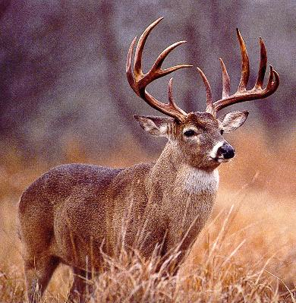
Miwok Indians like to eat meat
Sometimes Miwok Indians eat deer, fish, and other small game.

Slide 7
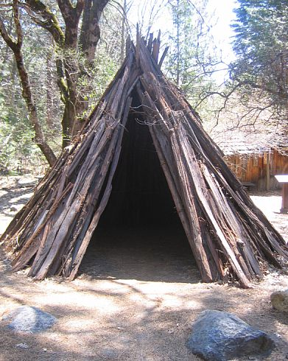
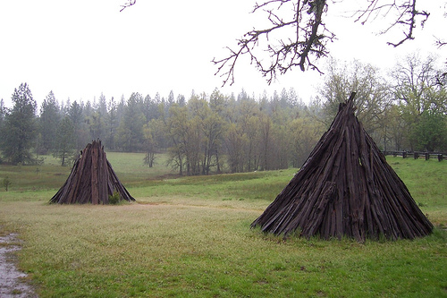
MIWOK HOMES
Miwok tribes lived in the mountains, so they had to have warm houses. BY ALEX PAPESH

Slide 8
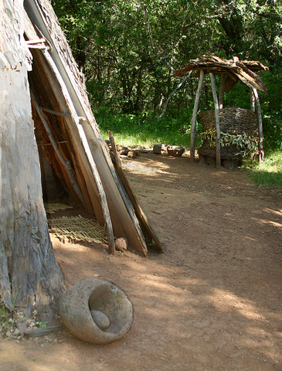

HOMES AND REGIONS
Miwoks lived in the mountains, so they had to have houses that will keep them warm all year round.

Slide 9
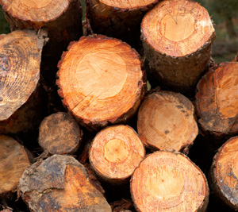
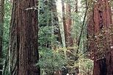
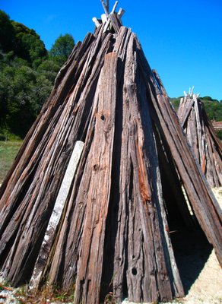
MIWOKS HOUSES ARE MADE OF …….
Miwoks built their homes out of thin pieces of wood or bark.
-this to that-

Slide 10
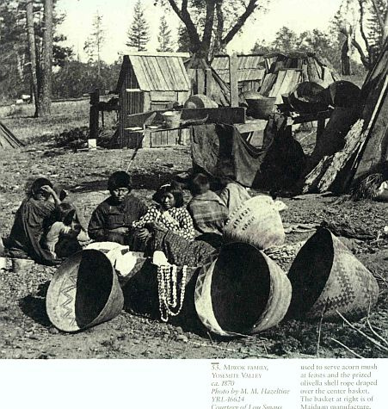
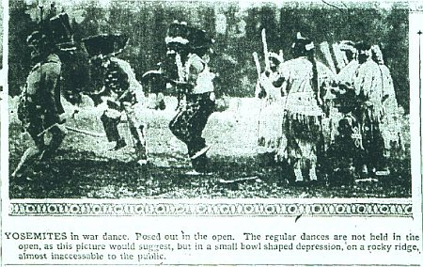
Traditions
One of the Miwok traditions is dancing . In the right corner is a picture of real Miwok Indians dancing.

