Slide 1
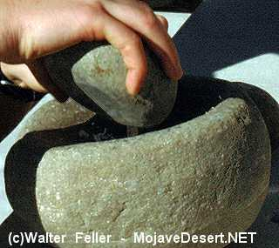
Mojave Foods
This is a Mojave Indian grinding up grains.
By Raven Cooper

Slide 2
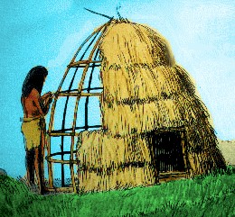
Mojave Homes
The Mojave Indians used shade roofs named Ramadas.
By Wyatt

Slide 3
Mojave activities
The Mojave Indians did

